Slide 1
RRR measurement setup at CERN
Konrad Eiler

Slide 2
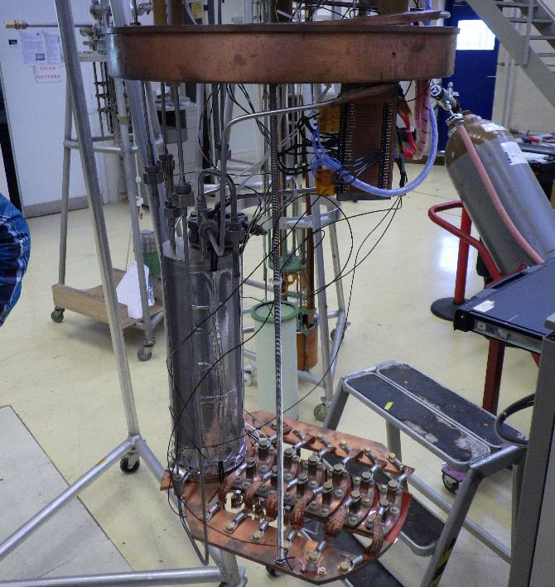
Overview
Samples are in vacuum, cooled by through LHe and copper plate
LHe supply
Cold mass
(Cu plate)
as sample holder

Slide 3
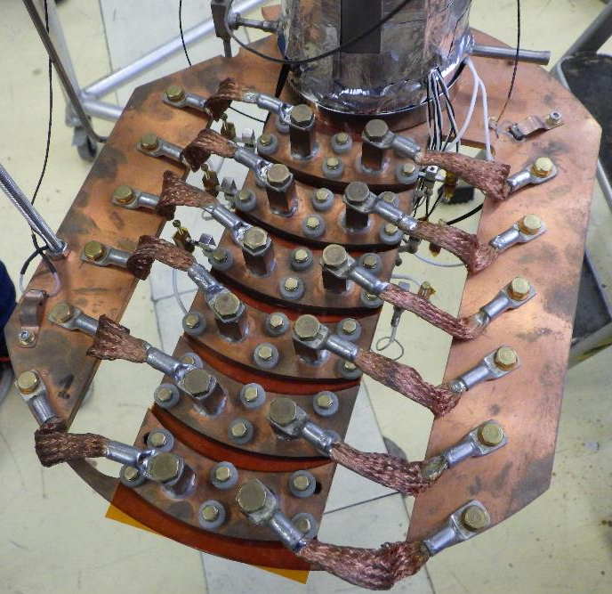
Top view
This setup allows us to measure both straight
as well as bent samples
(e.g. cut from cavities)

Slide 4
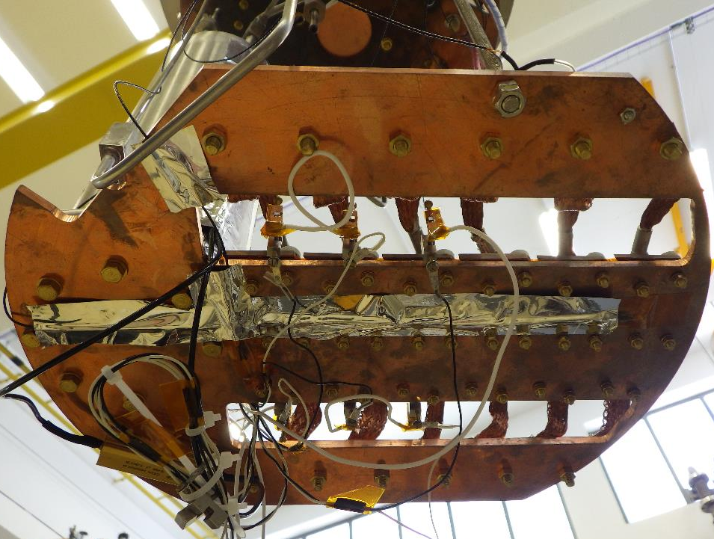






Bottom view
$$T_{2}$$
$$T_{1}$$
$$U_{2}$$
$$U_{3}$$
$$U_{1}$$
$$I$$

Slide 5
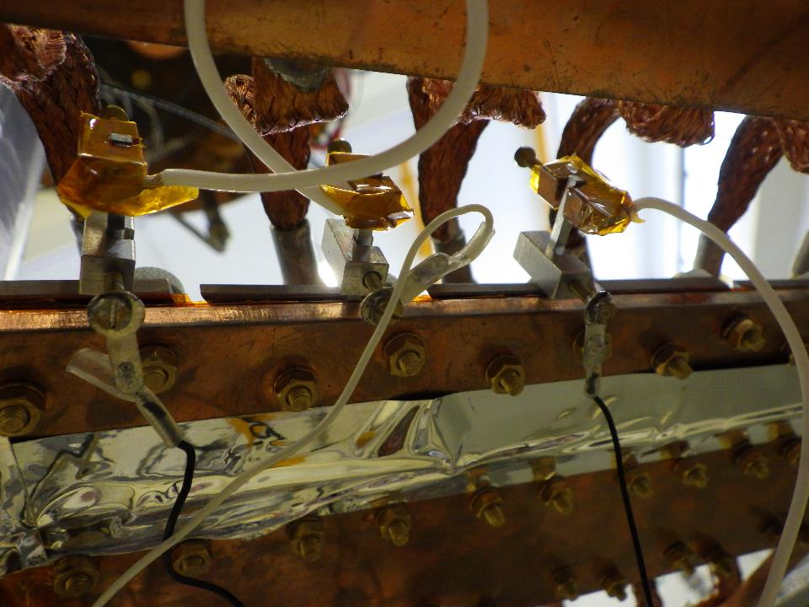

Slide 6
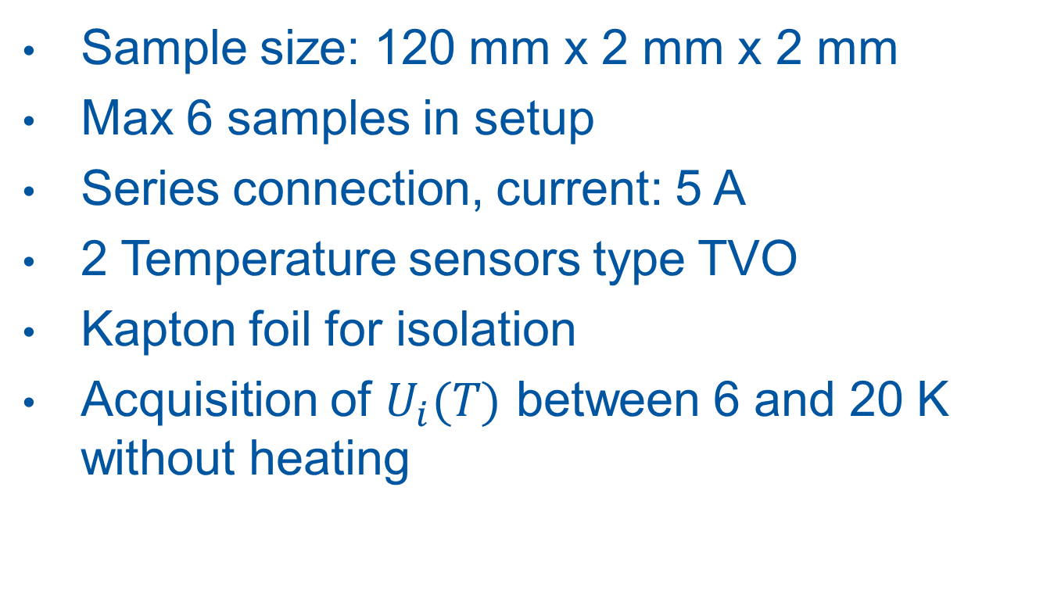
Setup data
Sample size: 120 mm x 2 mm x 2 mm
Max 6 samples in setup
Series connection, current: 5 A
2 Temperature sensors type TVO
Kapton foil for isolation
Acquisition of $U_{i}(T)$ between 6 and 20 K without heating

Slide 7
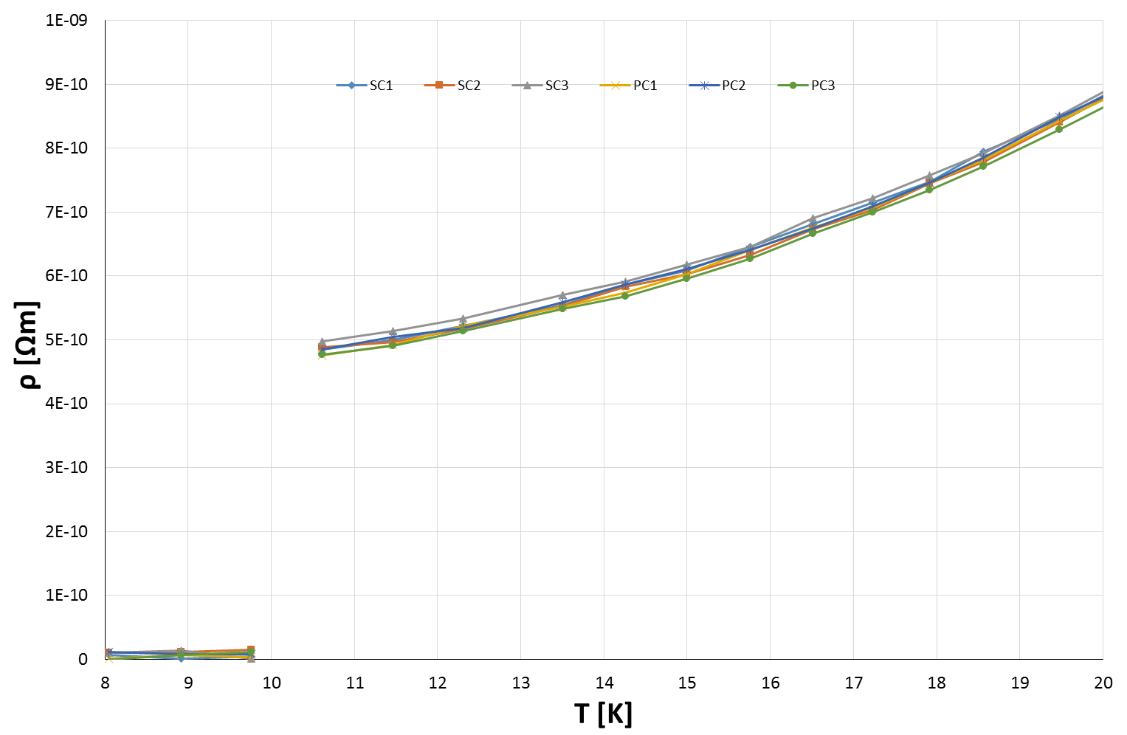
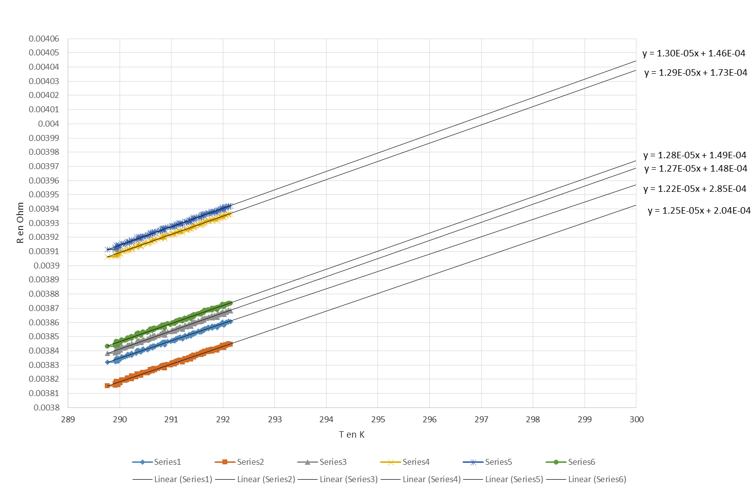


Results
$$RRR=\frac{ρ(300 K)}{ρ(4.2 K)}$$
$ρ(T)$ at cold
exponential fit
$ρ(T)$ at 300 K

