Slide 1
Grid Software Quality Process
GridKa School 2009
Andres Abad Rodriguez
CERN
Karlsruhe, 2 September 2009

Slide 2
Contents
  Setting the context
  Distributed Development
  Building Methodologies
  Distributed Computing
  Testing methodologies
  Software Quality Attributes
  Release Process
  Conclusions

Slide 3
Setting the Context
What is a distributed environment?
  “Distributed development is a form of R&D where the project members are geographically distributed across different business worksites or locations. The collaboration is done leveraging internet technologies.”
  “A non-centralized network consisting of numerous computers that can communicate with one another and that appear to users as parts of a single, large, accessible "storehouse" of shared hardware, software, and data”
The main goal of this talk is to present some of the factors to take into account when building, testing and releasing grid systems

Slide 4

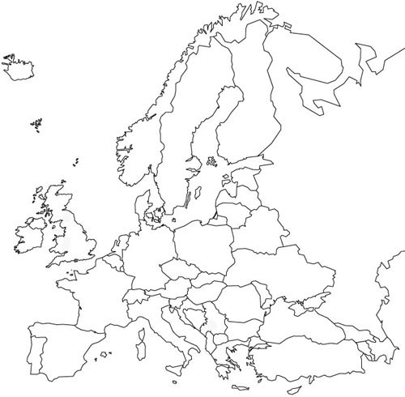
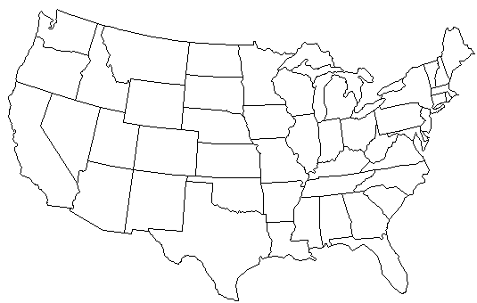














Distributed Development
LCG-DM
BDII
Integration
Certification
BO: VOMS, WMS
PD: CREAM-CE
RM: WMS-UI
CT: MS Porting
MULTIPLATFORM
PORTING
RGMA
Integration
YAIM with CERN
VDT
SECURITY
LB

Slide 5
Challenges
  Lack of communication and coordination
  Possible conflicts of responsibilities
  Need of a Process with Policies and Conventions
  Clear definition of software parts and their relations
  Need of a central information system for technology transfer and information exchange
  Need of a repository of build artefacts

Slide 6
Building Methodologies
Configuration
Build procedures
Versions
Dependency Management
Integration
Modules
Releases
Packaging
Reproducibility
Repository
Binaries
Logs
Metrics
Package Management
Build-time testing

Slide 7
Software Configuration Management
  SCM is the task of tracking and controlling changes in the software
  Configuration management practices include revision control and the establishment of baselines
  Not only VCS, also building and packaging
  Must be done per platform
  SCM concerns itself with answering the question "Somebody did something, how can one reproduce it?"

Slide 8
Dependency Management
  Coupling or dependency is the degree to which each program module relies on each one of the other modules
  Dependency hell is a colloquial term for the frustration of some software users who have installed software packages which have dependencies on specific versions of other software packages
  Full dependency tracking and controlled build environment

Slide 9
Integration
  Assigning VCS baselines to module versions
  Combining module versions of the software to create a release
  Deployment tests (possibly automatically on continuous integration)
  Packaging is needed per platform according to the platform conventions
  Special focus on reproducibility

Slide 10
Artefact Repository
  All binaries must be uniquely identifiable and always available
  Logs and Report of the build process must be always available and easily reachable from the binaries
  Metrics generated during the process must be stored together with the reports
  Support for platform specific package management system may be added to ease the software installation

Slide 11
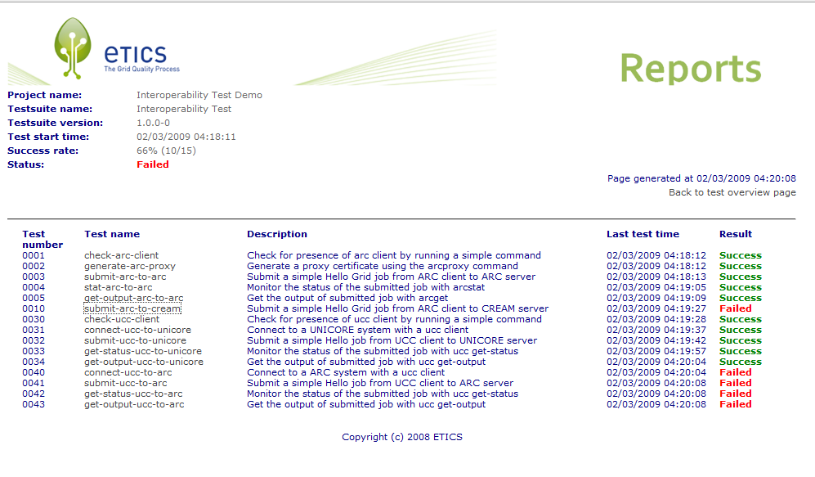
Example

Slide 12
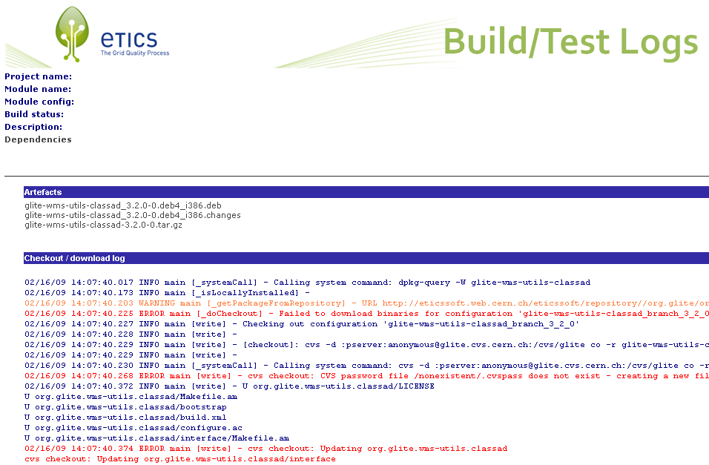
Example

Slide 13
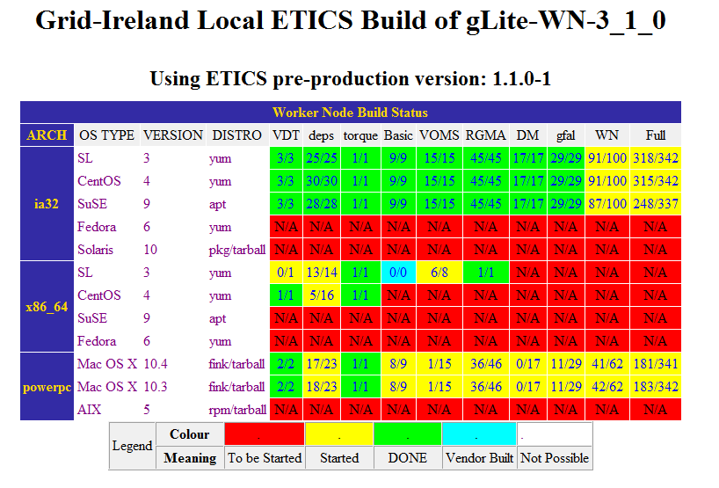
Example

Slide 14






A “Typical” Grid Environment
JSDL
UNICORE
Condor
PBS
LSF
Condor
DGAS
DPM
dCache
SRM 2.1
SRM 2.0
Castor

Slide 15
Challenges
  Non-determinism, time-outs
  Infrastructure dependencies
  Distributed heterogeneous services
  Lack of mature standards (interoperability)
  Multiple heterogeneous platforms
  Difficulty to deploy and test a distributed environment
  LOTS of TESTING!!
  Multi-node, multi-platform, multi-environment, etc.

Slide 16
Testing Methodologies
Static
Coding Conventions
Quality of Code
Dynamic
Unit
Coverage
Non Functional
Performance
Usability
Standard compliance
Deployment
Integration
Interoperability
System
Stress
Multi-node

Slide 17
Static testing
Naming conventions, class and method length, dependencies, complexity, presence and correctness of comments (according to some standard, e.g. JavaDoc)
Coding antipatterns: empty try/catch/switch blocks, unused variables, empty if/while statements, overcomplicated expression, high cyclomatic complexity
Bug patterns: single-threaded correctness, thread/synchronization correctness, performance issues, security and vulnerability to malicious or untrusted code
Compliance with standards (e.g. IPv6 incompatible calls)

Slide 18
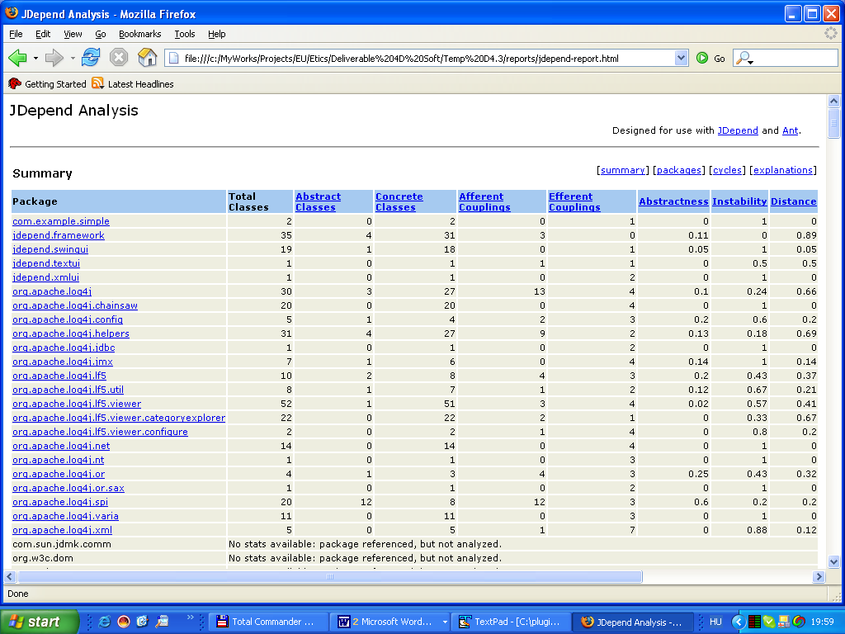
Examples

Slide 19
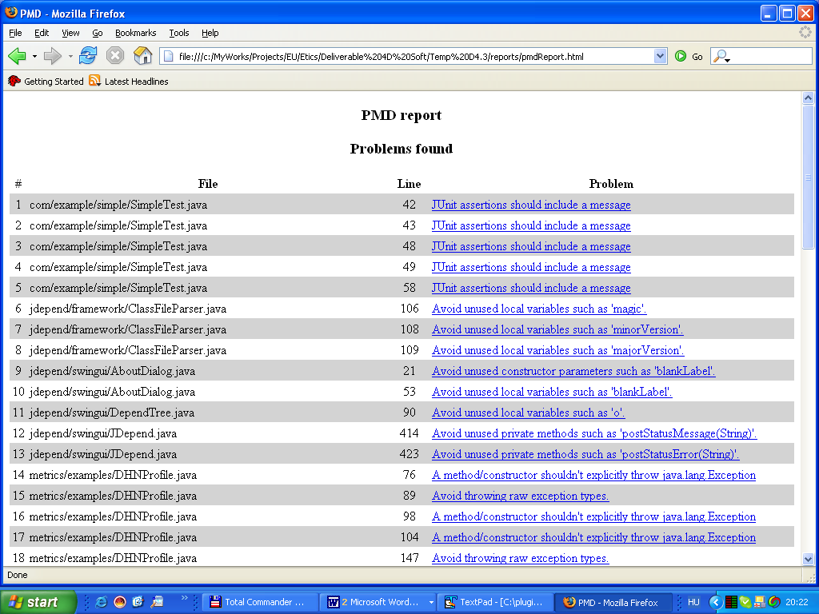
Examples

Slide 20
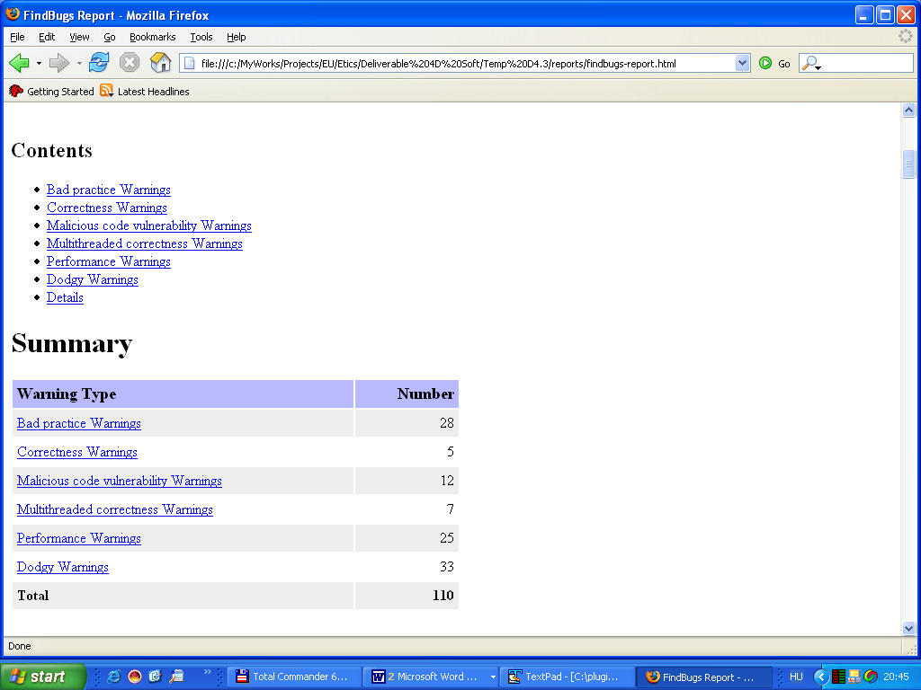
Examples

Slide 21
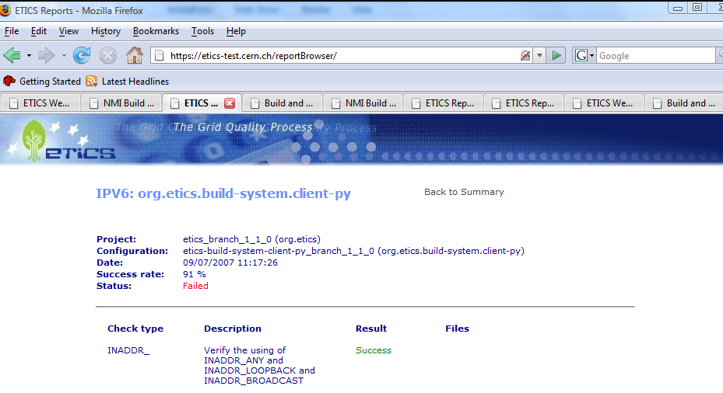
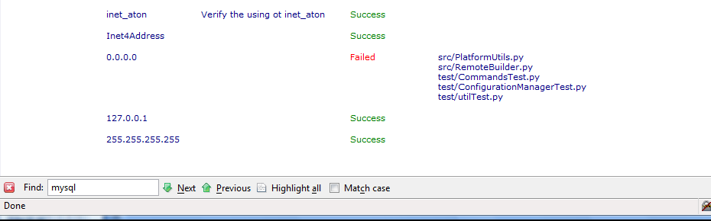
Examples

Slide 22
Unit Testing
Normally during the build
Independent from the environment and the test sequence
Not used to test system-wide functionality, but the formal behaviour of functions and methods
A consistent fraction of coding bugs can be found by doing proper unit tests as part of a continuous integration process
It is also proven that they are the first thing that is skipped as soon as a project is late (which happens very often)
The most used technology to implement Unit Tests is referred to as xUnit, where x stands for a programming language (cpp, py, j, etc)

Slide 23
Mock Objects
Used in conjunctions with unit test to provide stubs (mock objects) of classes/applications required by the code under tests
Mock objects exist for many widely used applications (service containers, databases, etc)
Tools are also available to generate mock objects/classes from existing code
Dependency Injection allows to replace real dependencies with mock objects during tests.

Slide 24
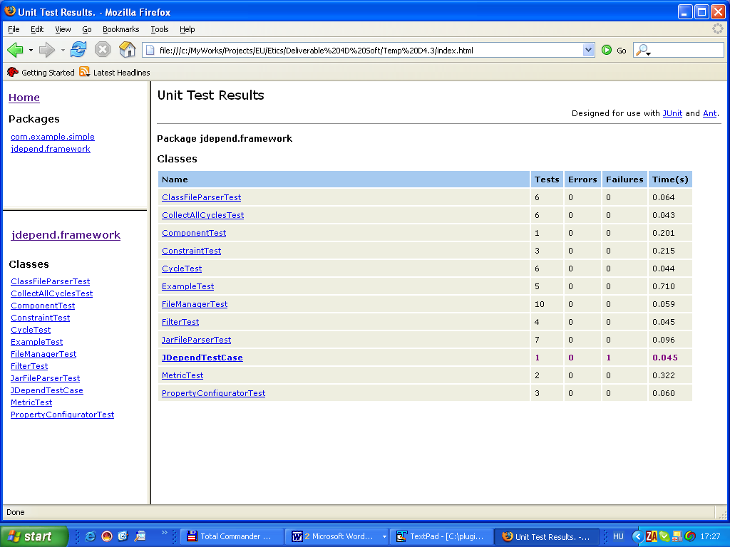
Example

Slide 25
Coverage
Used in conjunction with unit tests to calculate how much of the code is actually tested
Can be done at four levels:
  Line coverage
  Basic block coverage
  Method coverage
  Class coverage
All previous method are ‘line coverage’ methods
A more difficult problem is to provide ‘path coverage’, that is a calculation of how many different execution paths have been unit tested

Slide 26
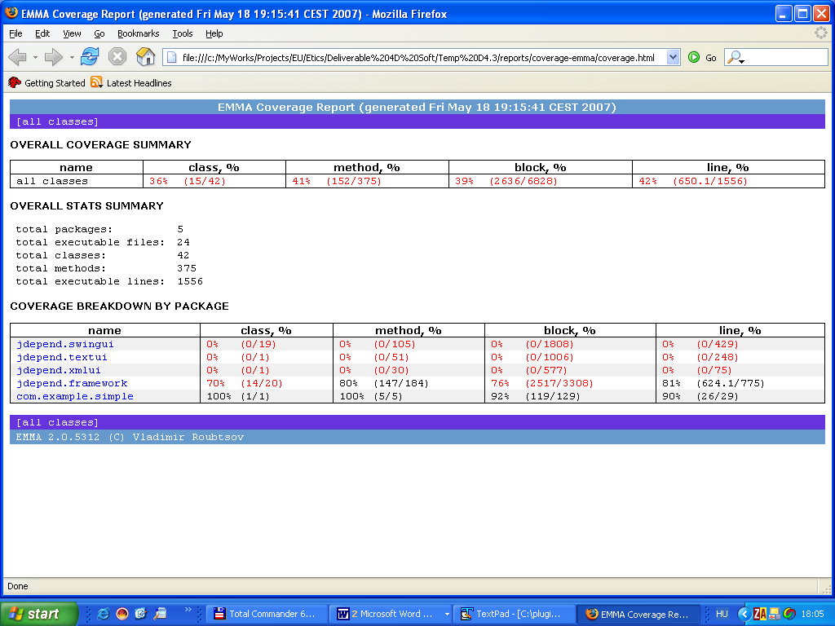
Example

Slide 27
Installation, Configuration and Integration Tests
Installation and configuration of the services are the first thing users will try and the place where most of the bugs are initially found
Use automated systems for installing and configuring the services (system management tools, APT, YUM, quattor, etc). Manual installations are not easily reproducible
Upgrade scenarios from one version of a service to another must also be tested
Many integration, interoperability and compatibility issues are immediately discovered when installing and starting services

Slide 28
Functional and Non-Functional System Tests
At this point you can fire the full complement of:
  Regression tests (verify that old bugs have not resuscitated)
  Functional tests (black and white box testing)
  Coverage (in terms of requirements, more difficult that unit test coverage)
  Performance tests
  Stress tests
  End-to-end tests (response times, auditing, accounting)
Of course this should be done:
  for all services and their combinations
  on as many platforms as possible
  with full security in place
  using meaningful tests configurations and topologies

Slide 29
Software Process Quality Attributes
Software Modularity
Explicit Dependency Definition
Clear Responsibilities / Information Exchange
Software Process with Policies and Conventions
Quality Metrics produced, stored and monitored
Multi-platform
Reproducibility of each single operation
Common Repositories of Artefacts

Slide 30
Software Engineering Tools
Development
IDE
Debugger
SCM
Configuration Manager
Version Manager
Testing
Unit
VCS
Dependency Manager
Bug Tracker
Static
Task Manager
System
Execution Engine
Deployment
Release
Builder
Packager
Integration Manager
Execution Engine
Maintenance / Archive
Binary Repository
Log Repository
Metrics Repository
Package Manager Repositories
Compiler
Builder
Interoperability
Doc

Slide 31
Software Engineering Tools
Development
IDE
Debugger
SCM
Configuration Manager
Version Manager
Testing
Unit
VCS
Dependency Manager
Bug Tracker
Static
Task Manager
System
Execution Engine
Deployment
Release
Builder
Packager
Integration Manager
Execution Engine
Maintenance / Archive
Binary Repository
Log Repository
Metrics Repository
Package Manager Repositories
Compiler
Builder
Interoperability
Doc

Slide 32
Conclusions
Distributed Development:
Cannot rely on personal abilities of developers
Coordination and Collaboration is difficult
Need of a common information system
Distributed Computing:
Designing and testing for the grid and with the grid is a difficult task
Need of a large controlled environment to simulate production
A Software Engineering Process is required in case of distributed development and/or distributed computing.
The Software Engineering Tool must be tailored for this environment to support each activity.

Slide 33

Thanks!
http://www.eticsproject.eu

