Slide 1
Racks in BA6
SPS test stand Integration 5 October 2017

Slide 2
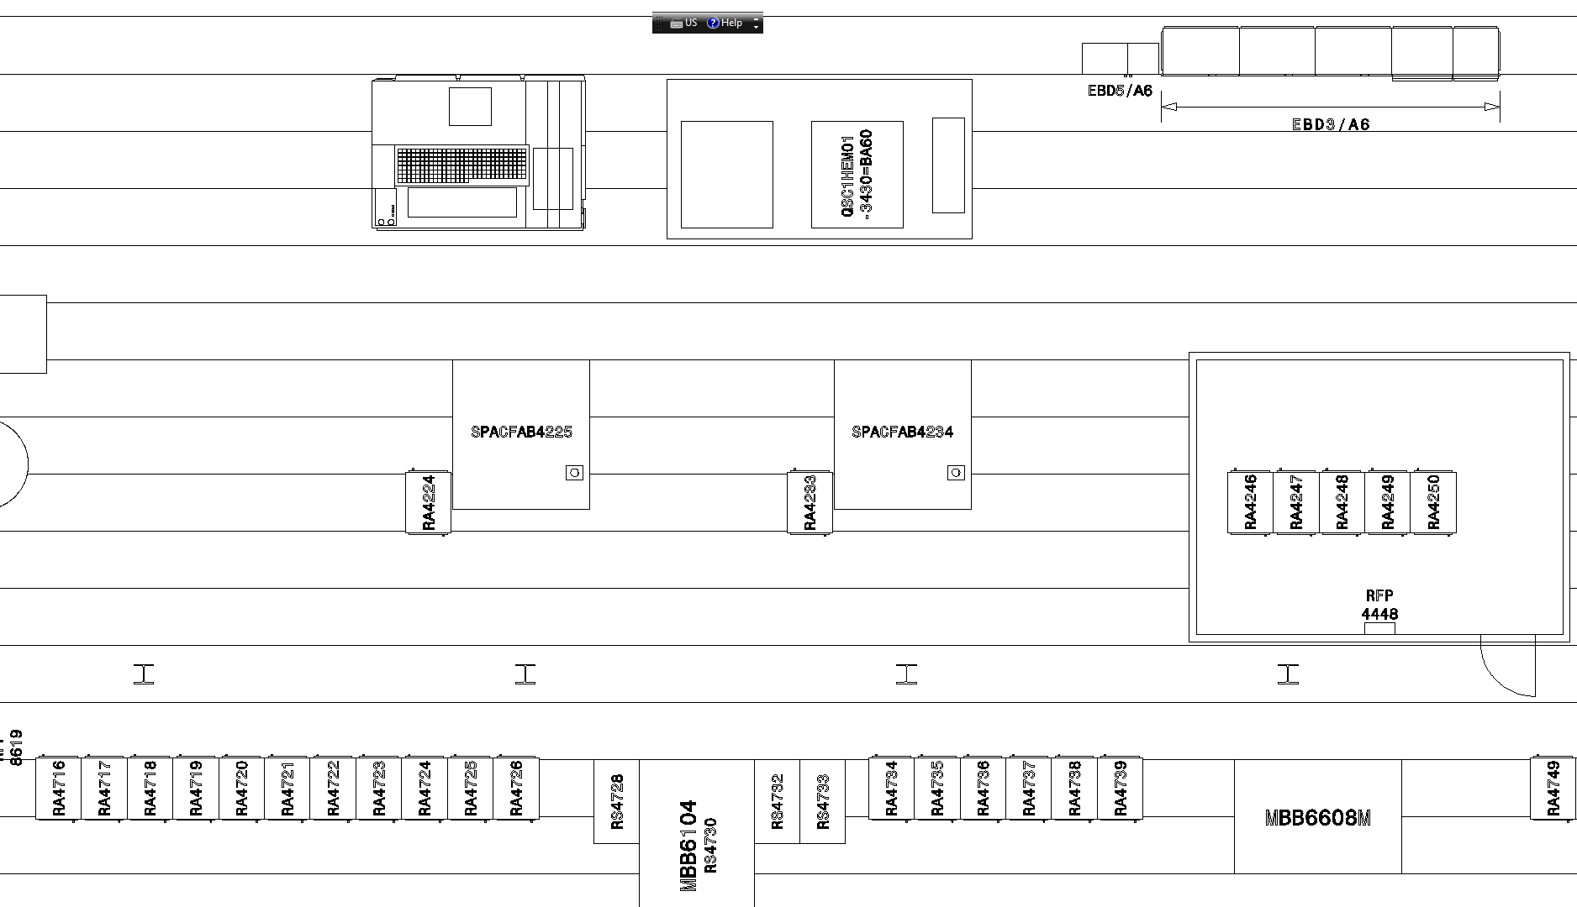
SPSEY___6001 Rack’s layout
LLRF racks
IOT racks
IOT racks
Crab-cavity services racks

Slide 3
Racks in BA6 – not Faraday cage
Rack name | Type | Assignment | Contact | Supply | Action
BA6 RA 4224 | SPS green (80cm) | BE/RF/PM | F.Killing | CERN | install from green rack’s row
BA6 RA 4233 | SPS green (80cm) | BE/RF/PM | F.Killing | CERN | cut false floor, reinforce
BA 6 RA 4716 | standard (90cm) | BE/ICS/AS | N.Broca | EXT | displace the present ones to IOTS
BA 6 RA 4717 | standard (90cm) | BE/ICS/AS | N.Broca | EXT | cut false floor, reinforce
BA 6 RA 4718 | standard (90cm) | (BE/ICS/AS Fire Safety) | M.Dole | EXT | cut false floor, reinforce
BA 6 RA 4719 | standard (90cm) | (BE/ICS/AS Fire Safety) | M.Dole | EXT | cut false floor, reinforce
BA 6 RA 4720 | standard (90cm) | (BE/ICS/AS Fire Safety) | M.Dole | EXT | cut false floor, reinforce
BA 6 RA 4721 | SPS green (80cm) | TE/CRG | C.Fluder | CERN | OK
BA 6 RA 4722 | SPS green (80cm) | TE/CRG | C.Fluder | CERN | OK
BA 6 RA 4723 | SPS green (80cm) | TE/CRG | C.Fluder | CERN | OK
BA 6 RA 4724 | SPS green (80cm) | TE/CRG | C.Fluder | CERN | OK
BA 6 RA 4725 | SPS green (80cm) | EN/ACE/SU | M.Sosin/T.Dijoud | CERN | OK
BA 6 RA 4726 | SPS green (80cm) | Transfer table | K.Artoos | CERN | OK
Racks in Faraday cage
Rack label |  | Assignment | Contact | Supply | Action
BA6 RA 4246 | standard (90cm) | LLRF | P.Baudrenghien | CERN | DIR/ Installation
BA6 RA 4247 | standard (90cm) | LLRF | “ | CERN | DIR/ Installation
BA6 RA 4248 | standard (90cm) | Fiber | “ | CERN | DIR/ Installation
BA6 RA 4249 | standard (90cm) | Oasis | “ | CERN | DIR/ Installation
BA6 RA 4250 | standard (90cm) | Oasis | “ | CERN | DIR/ Installation

Slide 4
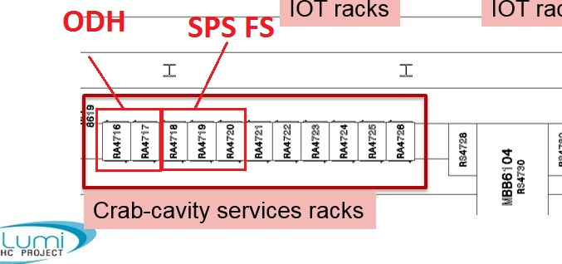
Racks in BA6 – not Faraday cage
Rack name | Type | Assignment | Contact | Supply | Action
BA6 RA 4224 | SPS green (80cm) | BE/RF/PM | F.Killing | CERN | install from green rack’s row
BA6 RA 4233 | SPS green (80cm) | BE/RF/PM | F.Killing | CERN | cut false floor, reinforce
BA 6 RA 4716 | standard (90cm) | BE/ICS/AS | N.Broca | EXT | displace the present ones to IOTS
BA 6 RA 4717 | standard (90cm) | BE/ICS/AS | N.Broca | EXT | cut false floor, reinforce
BA 6 RA 4718 | standard (90cm) | (BE/ICS/AS Fire Safety) | M.Dole | EXT | cut false floor, reinforce
BA 6 RA 4719 | standard (90cm) | (BE/ICS/AS Fire Safety) | M.Dole | EXT | cut false floor, reinforce
BA 6 RA 4720 | standard (90cm) | (BE/ICS/AS Fire Safety) | M.Dole | EXT | cut false floor, reinforce
BA 6 RA 4721 | SPS green (80cm) | TE/CRG | C.Fluder | CERN | OK
BA 6 RA 4722 | SPS green (80cm) | TE/CRG | C.Fluder | CERN | OK
BA 6 RA 4723 | SPS green (80cm) | TE/CRG | C.Fluder | CERN | OK
BA 6 RA 4724 | SPS green (80cm) | TE/CRG | C.Fluder | CERN | OK
BA 6 RA 4725 | SPS green (80cm) | EN/ACE/SU | M.Sosin/T.Dijoud | CERN | OK
BA 6 RA 4726 | SPS green (80cm) | Transfer table | K.Artoos | CERN | OK
Racks in Faraday cage
Rack label |  | Assignment | Contact | Supply | Action
BA6 RA 4246 | standard (90cm) | LLRF | P.Baudrenghien | CERN | DIR/ Installation
BA6 RA 4247 | standard (90cm) | LLRF | “ | CERN | DIR/ Installation
BA6 RA 4248 | standard (90cm) | Fiber | “ | CERN | DIR/ Installation
BA6 RA 4249 | standard (90cm) | Oasis | “ | CERN | DIR/ Installation
BA6 RA 4250 | standard (90cm) | Oasis | “ | CERN | DIR/ Installation

Slide 5
Integration issues
Corrections needed to SPSEY___6001
Racks IOT: front face aligned with the front face of the IOTs and not displaced as on the drawing.
Racks for BE/ICS are longer by 10cm (standard length).
Change of assignment
Some work to do
Racks BE/ICS (SPS Fire Safety and ODH): bar for earth to pass underneath the rack such that they can be installed or moved during a run later on.
The 2 racks to be displaced to the IOTs will need to be freed from the earth bar.
For 5 new standard racks, we need to cut the false floor plates, then reinforce to support the remaining shorter plates.
Work will be seen on site with EN/EL, SMB/SE

