Slide 1
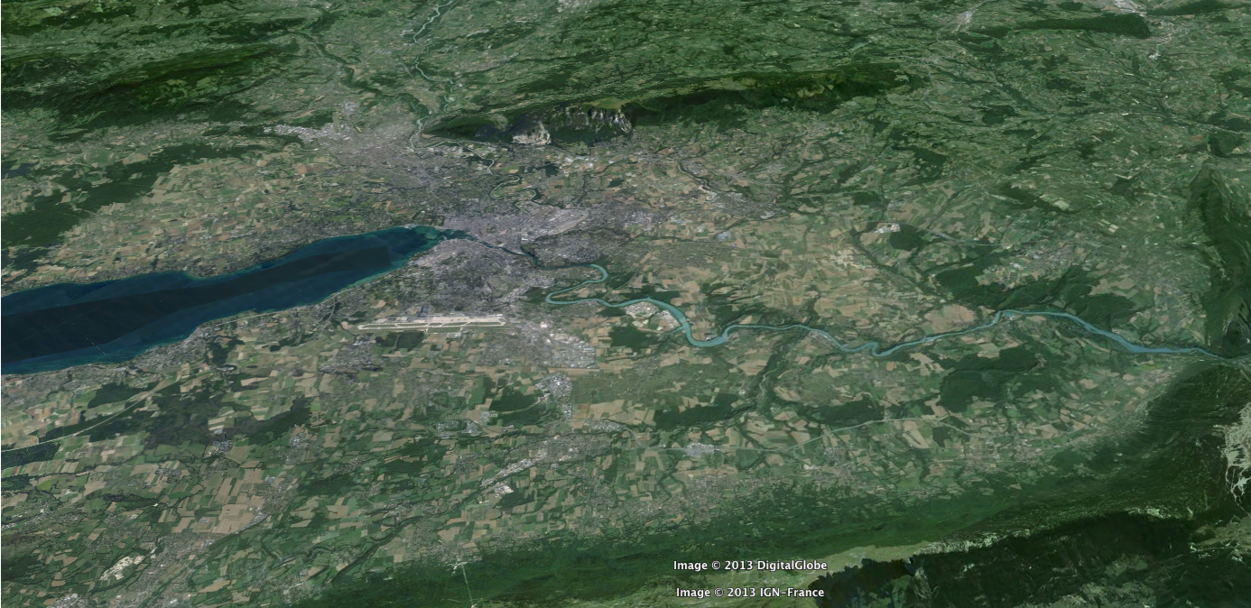
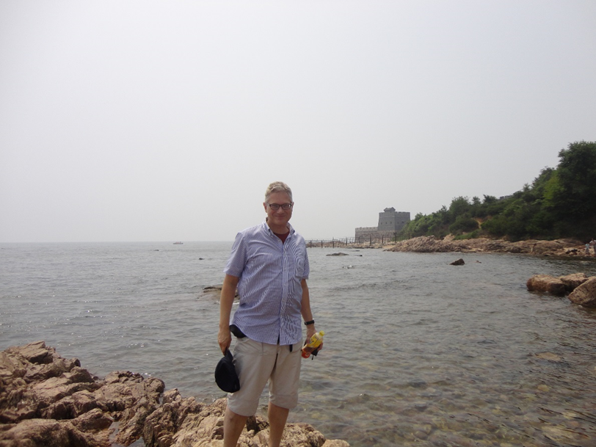


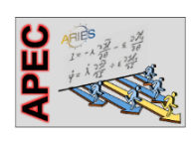
Machine Aspects of Future pp Colliders
Frank Zimmermann
CERN, Pisa School on Future Colliders
Work supported by the European Commission under the HORIZON 2020 project ARIES, grant agreement 730871

Slide 2

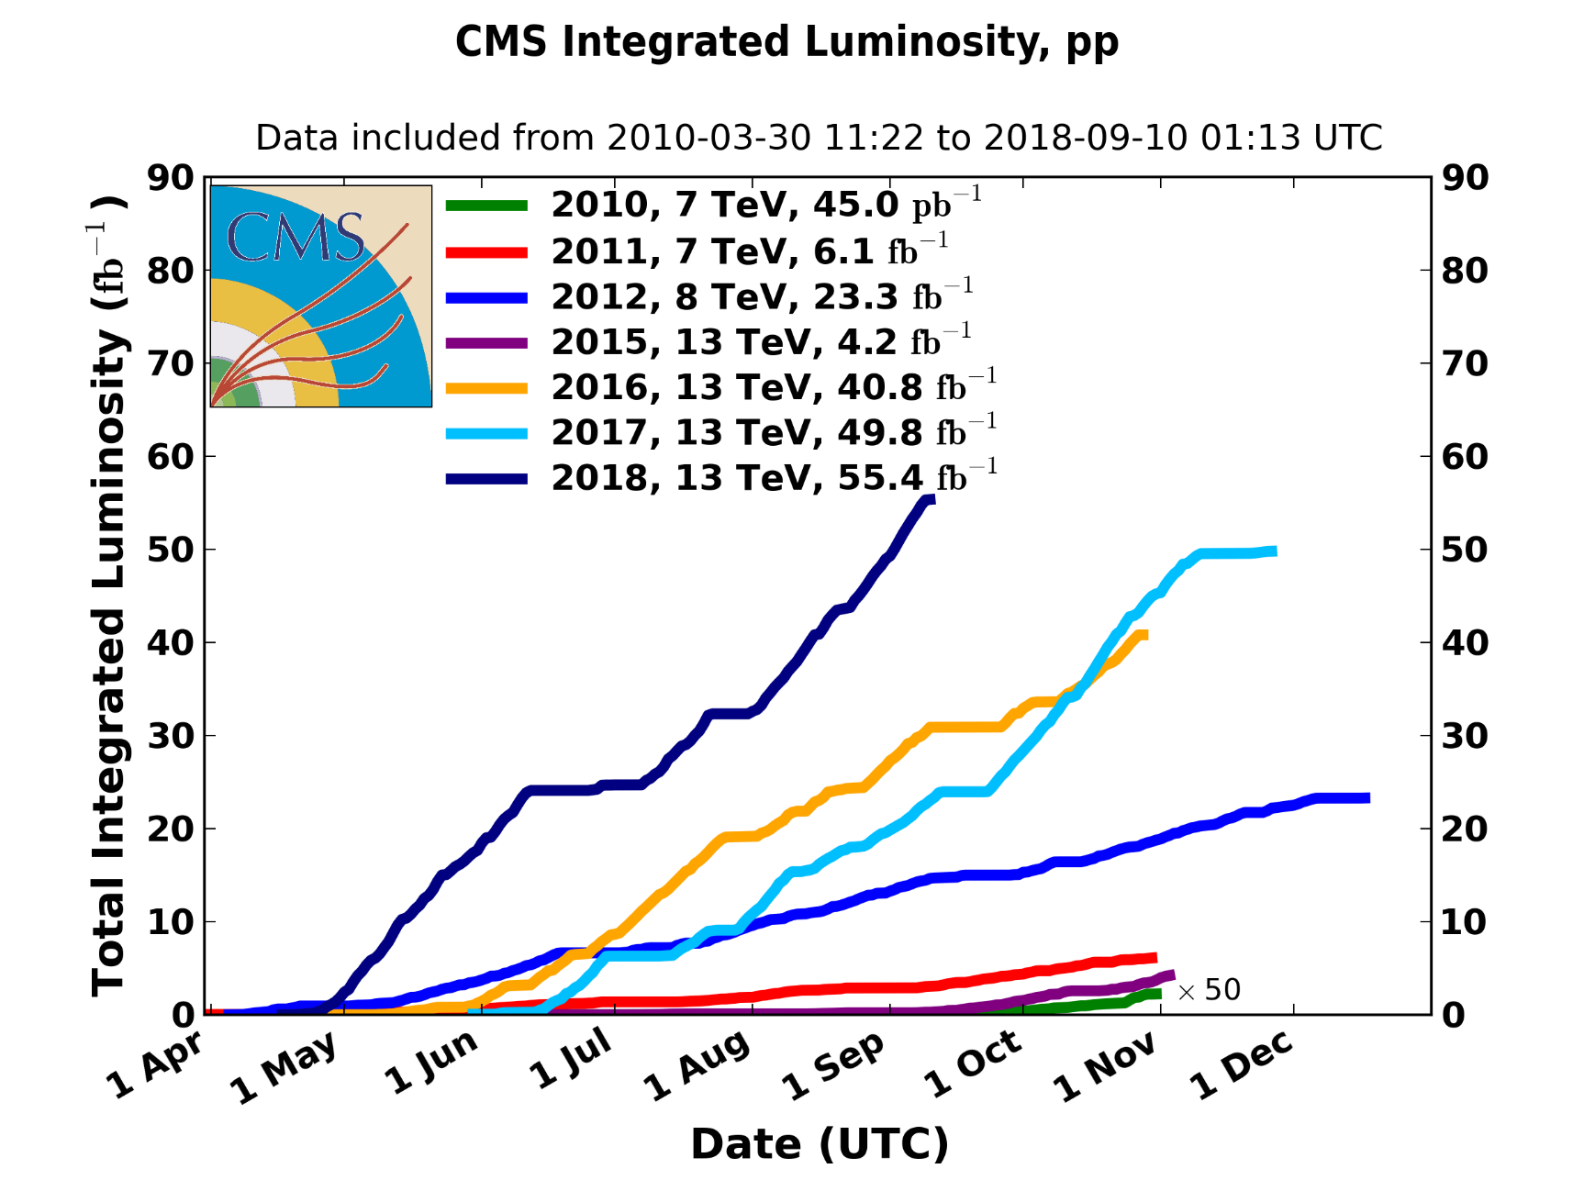
LHC: today’s frontier collider
excellent performance at E_{cms}=13 TeV

Slide 3

energy frontier in ~25 years
very large circular hadron collider - only feasible approach to reach 100 TeV c.m. collision energy in coming decades
access to new particles (direct production) in few-TeV to 30 TeV mass range, far beyond LHC reach
much-increased rates for phenomena in sub-TeV mass range → much increased precision w.r.t. LHC
M. Mangano
circular hadron collider energy reach
cf. LHC: factor ~4 in radius, factor ~2 in field → O(10) in E_{cms}
$$E∝B_{dipole}{×ρ}_{bending}$$

Slide 4
why not build a linear hadron collider?

Slide 5
ILC real-estate gradient:
250 GeV/11 km ~23 MeV/m
length of a 100 TeV linear collider
based on ILC technology:
100 TeV/(23 MeV/m) > 4000 km !
for me it is clear, we need a circular tunnel

Slide 6
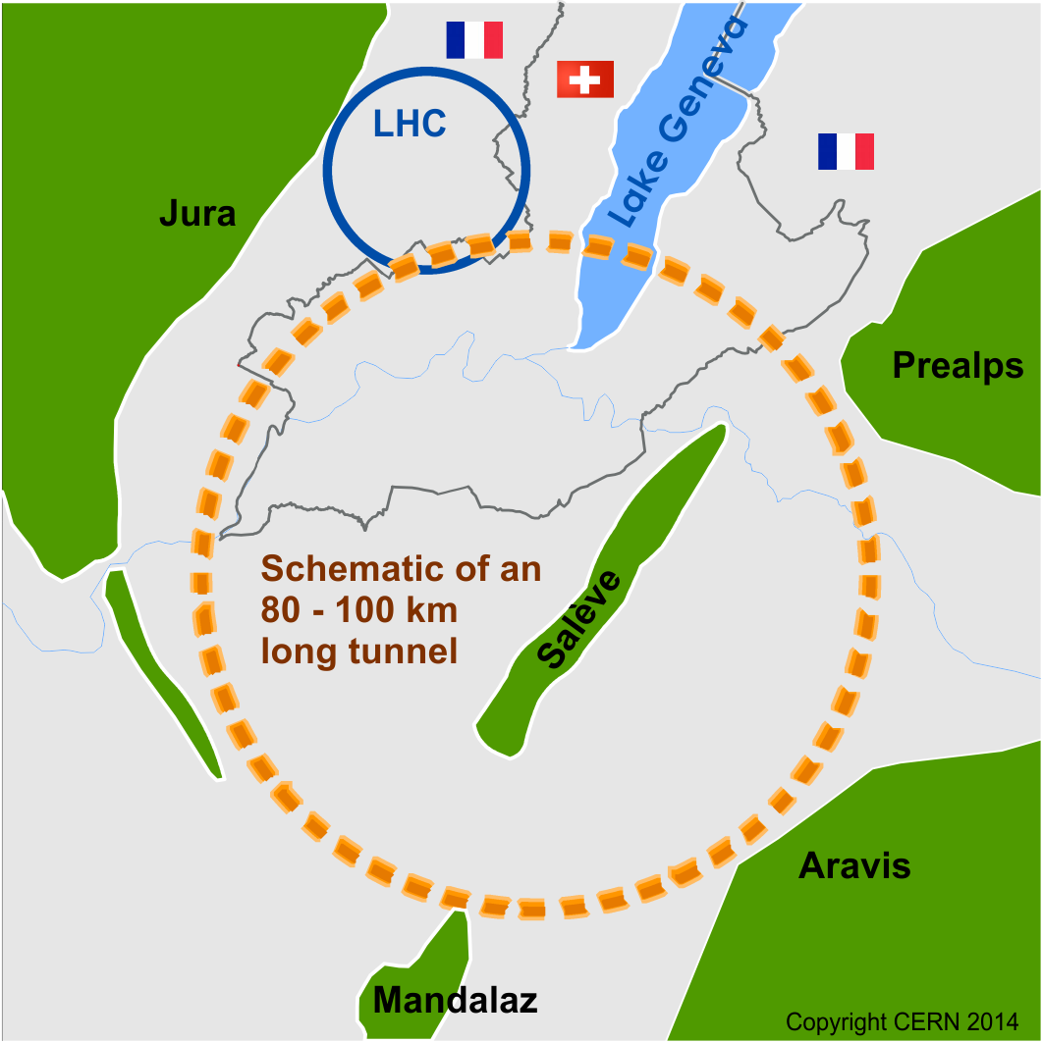
Future Circular Collider Study
Goal: CDR for European Strategy Update 2019/20
international FCC collaboration (CERN as host lab) to design:
pp-collider (FCC-hh) → main emphasis, defining infrastructure requirements
80-100 km tunnel infrastructure in Geneva area, site specific
e⁺e⁻ collider (FCC-ee), as a possible first step
p-e (FCC-he) option, one IP, FCC-hh & ERL
HE-LHC w FCC-hh technology
HE-LHC
~16 T ⇒ 100 TeV pp in 100 km
suggested
in 2010

Slide 7
CERN Circular Colliders & FCC
1980
1985
1990
1995
2000
2005
2010
2015
2020
2025
2030
2035
2040
Constr.
Physics
LEP
Design
Proto
Construction
Physics
LHC – in operation
HL-LHC - ongoing project
Design
Construction
Physics
~20 years
FCC – design study
Design
Proto
Construction
Physics
must advance fast now to be ready for the period 2035 – 2040
milestone: CDR by end 2018 for next update of European Strategy

Slide 8
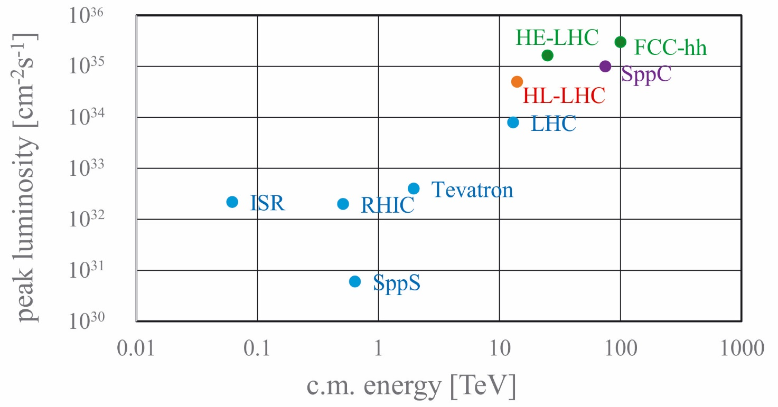
past, present & proposed hadron colliders

Slide 9
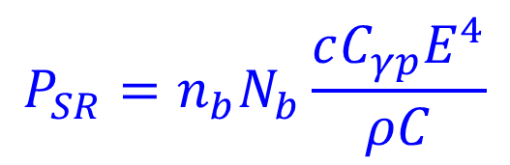
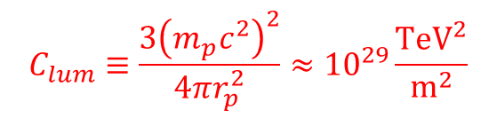


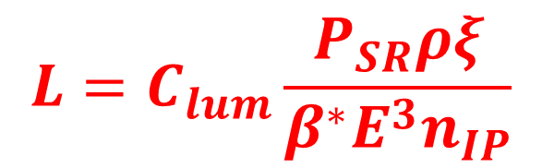

peak luminosity limited by SR power & beam-beam
synchrotron radiation power / beam:
$$P_{SR}=n_{b}N_{b}\frac{cC_{γp}E^{4}}{ρC}$$
$$ξ=\frac{{n_{IP}r}_{p}N_{b}}{4πε_{N}}$$
limited
total beam-beam
tune shift
maximum
acceptable
$$C_{γp}≡\frac{4π}{3}\frac{r_{p}}{{\left(m_{p}c^{2}\right)}^{3}}$$
ρ: bending radius
C: circumference
n_{b}: #bunches/beam
N_{b}: #p/bunch
E: beam energy
r_{p}: class. proton radius
$$L=\frac{c}{C}\frac{γn_{b}N_{b}^{2}}{4πβ^{∗}ε_{N}}$$
luminosity
luminosity formula for SR-power and
tune-shift limited hadron collider
$$L=C_{lum}\frac{P_{SR}ρξ}{β^{∗}E^{3}n_{IP}}$$
with
$$C_{lum}≡\frac{3{\left(m_{p}c^{2}\right)}^{2}}{4πr_{p}^{2}}≈{10}^{29}\frac{{\text{TeV}}^{2}}{{\text{m}}^{2}}$$

Slide 10



peak luminosity limited by pile up
event
pile up / Xing
$$μ=σ_{\text{inel}}\frac{γN_{b}^{2}}{4πβ^{∗}ε_{N}}$$
maximum
acceptable
σ_{tot} [mbarn] ≈ 42.1s ^{-0.467}-32.19 s^{-0.540} +35.83 +0.315 ln²(s/34); s in units of GeV²
~112 mbarn at 14 TeV, ~156 mbarn at 100 TeV
σ_{inel} [mbarn] ≈ σ_{tot}-11.7 +1.59 ln s - 0.134 ln²s
~83 mbarn at 14 TeV, ~110 mbarn at 100 TeV
$$L=\frac{c}{C}\frac{γn_{b}N_{b}^{2}}{4πβ^{∗}ε_{N}}$$
luminosity
luminosity formula for
pile-up limited hadron collider
$$L=f_{rev}\frac{n_{b}μ}{σ_{\text{inel}}}$$
shorter bunch spacing could help?!
(e.g. 25→ 5 ns would increase n_{b} 5x!)

Slide 11

FCC-hh collider parameters
parameter | FCC-hh |  | HE-LHC | HL-LHC | LHC
collision energy cms [TeV] | 100 |  | 27 | 14 | 14
dipole field [T] | 16 |  | 16 | 8.33 | 8.33
circumference [km] | 97.75 |  | 26.7 | 26.7 | 26.7
beam current [A] | 0.5 |  | 1.1 | 1.1 | 0.58
bunch intensity [10¹¹] | 1 |  | 2.2 | 2.2 | 1.15
bunch spacing [ns] | 25 |  | 25 | 25 | 25
synchr. rad. power / ring [kW] | 2400 |  | 101 | 7.3 | 3.6
SR power / length [W/m/ap.] | 28.4 |  | 4.6 | 0.33 | 0.17
long. emit. damping time [h] | 0.54 |  | 1.8 | 12.9 | 12.9
beta* [m] | 1.1 | 0.3 | 0.45 | 0.15 (min.) | 0.55
normalized emittance [μm] | 2.2 |  | 2.5 | 2.5 | 3.75
peak luminosity [10³⁴ cm⁻²s⁻¹] | 5 | 30 | 16 | 5 (lev.) | 1
events/bunch crossing | 170 | 1000 | 460 | 132 | 27
stored energy/beam [GJ] | 8.4 |  | 1.3 | 0.7 | 0.36

Slide 12
FCC-hh layout 2017
two high-luminosity experiments (A & G)
two other experiments combined with injection (L & B)
two collimation insertions
  betatron cleaning (J)
  momentum cleaning (F)
extraction insertion (D)
clean insertion with RF (H)
compatible with LHC or SPS as injector
circumference: 97.75 km

Slide 13
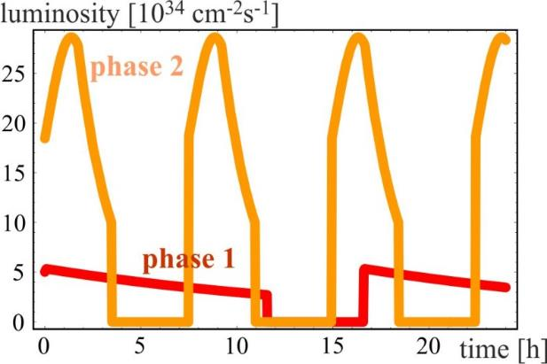
FCC-hh luminosity over 24 h
radiation damping: τ~1 h
PRST-AB 18,
101002 (2015)
  for both phases:
  beam current 0.5 A, unchanged!
  total synchrotron radiation power ~5 MW.
phase 1: β*=1.1 m, ξ_{tot}=0.01, t_{ta}=5 h, 250 fb⁻¹ / year
phase 2: β*=0.3 m, ξ_{tot}=0.03, t_{ta}=4 h, 1000 fb⁻¹ / year

Slide 14
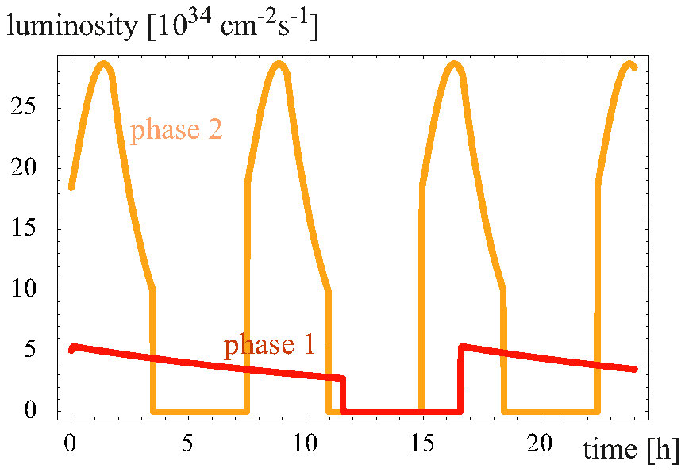
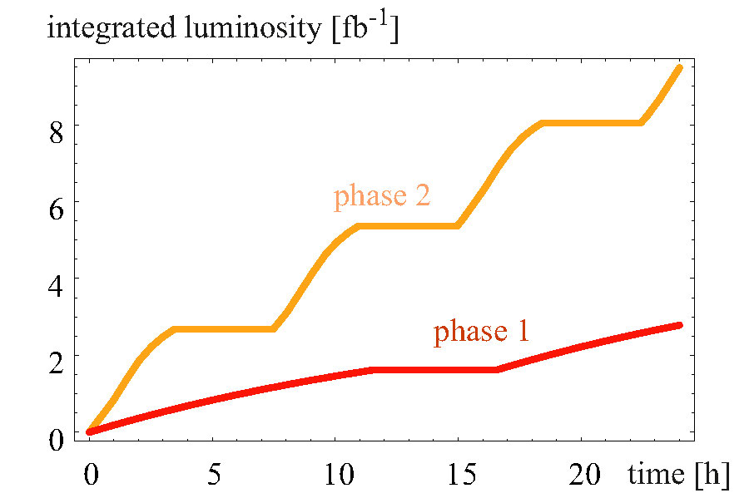
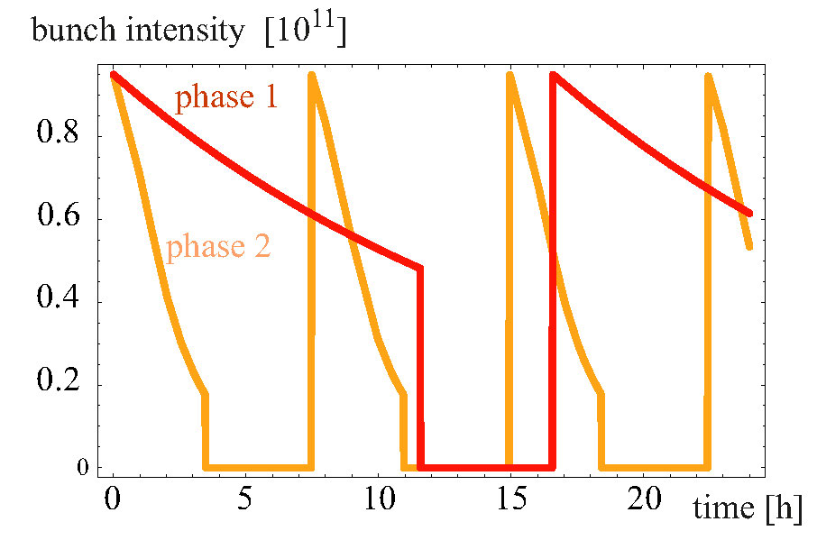
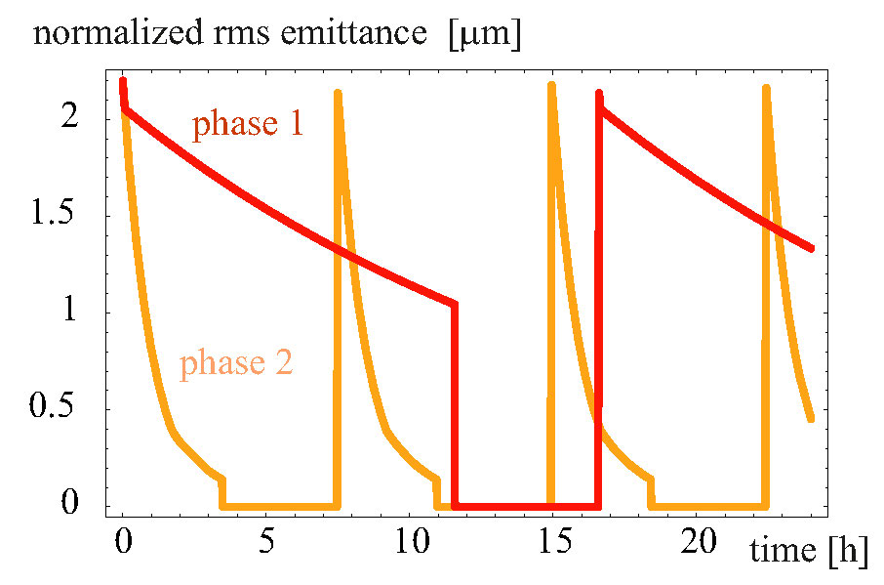
FCC-hh - 100 TeV c.m., 25 ns
burn off slower than emittance
damping → emittance control

Slide 15
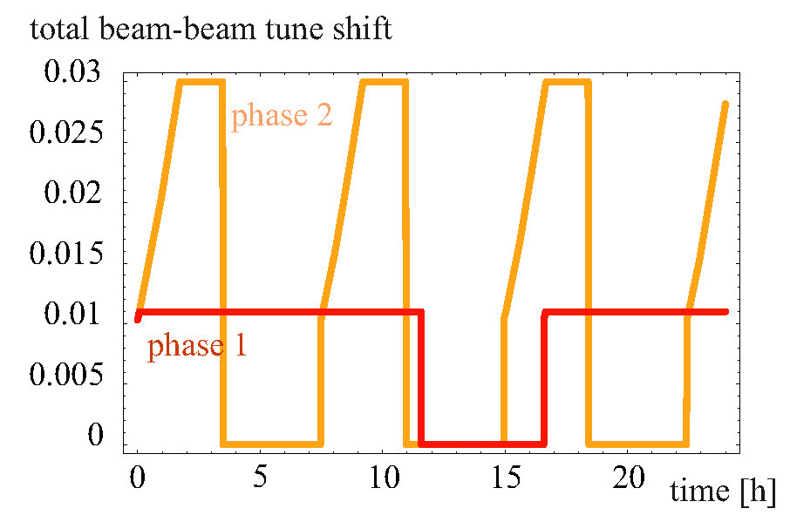
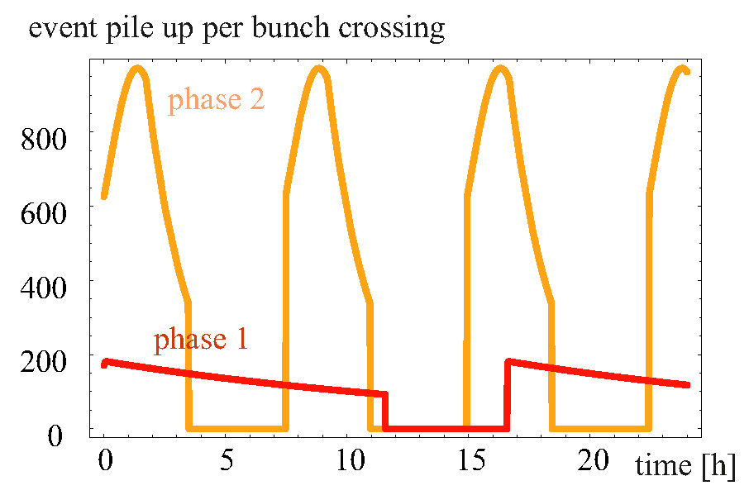
FCC-hh - 100 TeV c.m., 25 ns
in phase 2, β* 1.1→0.3 m,
without (or with less)
emittance control:
tune shift increases during fill
until reaching maximum of 0.03

Slide 16
impact of luminosity levelling
pile up mitigations: 25 ns w luminosity levelling or closer bunch spacing
luminosity levelling with 25 ns beam is an option
(green curve)
limited luminosity loss for 500 events per bunch crossing
maybe still acceptable at 330 events
lines show average luminosities
for closer bunch spacing
A. Langner, D. Schulte

Slide 17
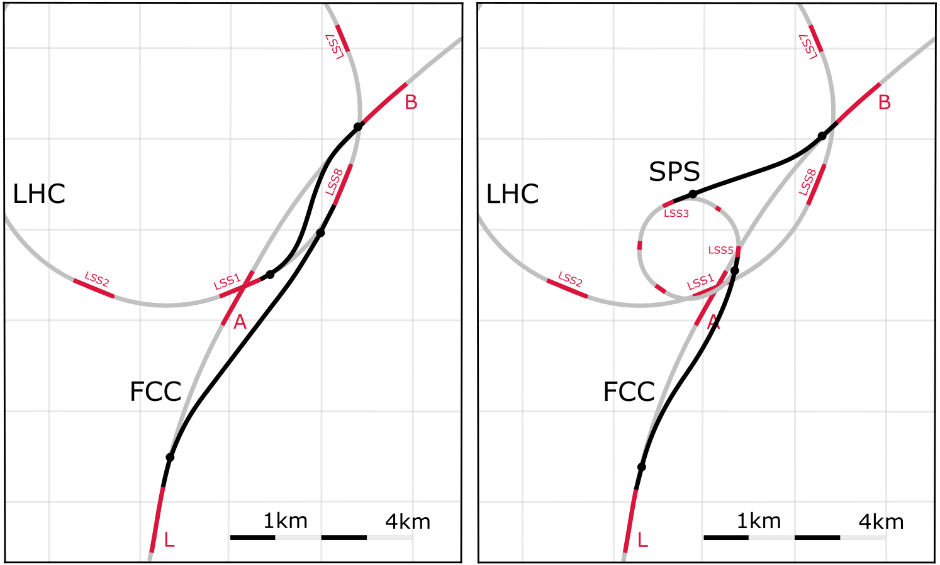
FCC-hh injector options
Baseline:
LHC @ 3.3 TeV
Alternative:
scSPS @ 1.3 TeV
Total of O(5.5 km) superconducting bends in transfer lines from LHC, at 7.2 T
O(6.5 km) normal-conducting bends from SPS, at 1.8 T
Current baseline: Injection energy 3.3 TeV LHC → Field-swing FCC-hh like LHC
Alternative options: Injection from SPS_{upgrade} around 1.3 TeV
SPS_{upgrade} could be based on fast-cycling SC magnets, 6-7T, ~ 1T/s ramp, cf. SIS 300 design
SPS_{upgrade} would also be an ideal injector for HE LHC (as alternative to the 450 GeV SPS)

Slide 18
cost of future accelerators
1959
cost ~ E_{cms} ^{0.28}
1971
by extrapolation:
100 TeV collider
~1.8x cost of LHC?
2008
P. Lebrun, RFTech 2013

Slide 19
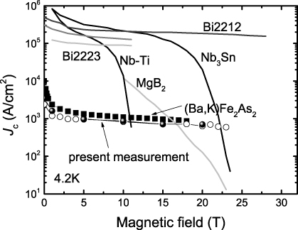
HL-LHC/FCC technology change: Nb-Ti →Nb₃Sn
O. Bruning

Slide 20
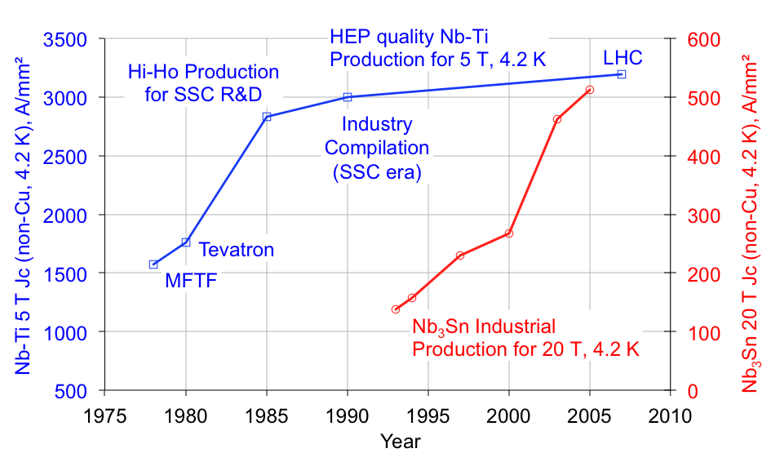
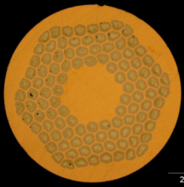
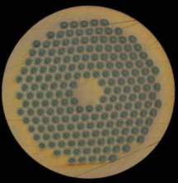
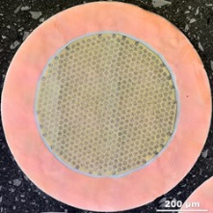
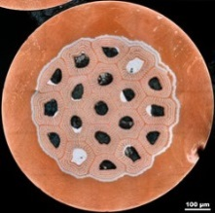
SC wire production: Nb-Ti and Nb₃Sn
US-CDP
ITER wires
HL-LHC wires
B. Strauss, data by courtesy of J. Parrell (US DOE OST)

Slide 21
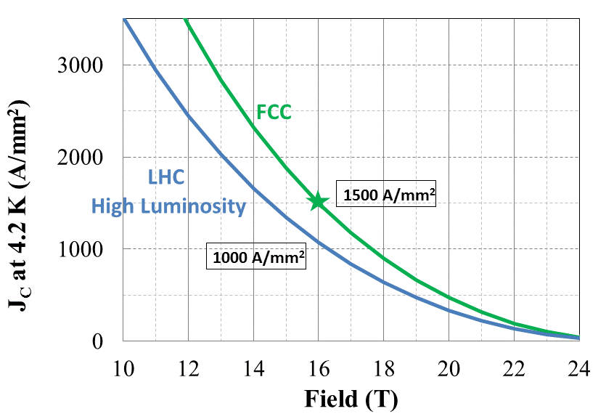
FCC Nb₃Sn conductor program
Nb₃Sn is one of the major cost & performance factors for FCC-hh and must be given highest attention
main development goals until 2020:
J_{c} increase (16T, 4.2K) > 1500 A/mm² i.e. 50% increase wrt HL-LHC wire
reference wire diameter 1 mm
potentials for large scale production and cost reduction
Notes:
New slide from Davide.
Showing that conductor development is launched at international level, Russia, Japan, (Korea and Europe in preparation)
Underline importance of that development as main cost driver for the hadron collider machine.

Slide 22
worldwide FCC Nb₃Sn program
Main development goal is wire performance increase:
J_{c} (16T, 4.2K) > 1500 A/mm² →50% increase wrt HL-LHC wire
Reduced coil & magnet cross-section
5400 mm²
3150 mm²
~1.7 times less SC
~10% margin
HL-LHC
~10% margin
FCC ultimate
Conductor activities for FCC started in 2017:
Bochvar Institute (production at TVEL), Russia
KEK (Jastec and Furukawa), Japan
KAT, Korea
Columbus, Italy
University of Geneva, Switzerland
Technical University of Vienna, Austria
SPIN, Italy
University of Freiberg, Germany
  In addition, agreements under preparation:
  Bruker, Germany
  Luvata Pori, Finland
after only one year development, prototype Nb₃Sn wires from several new industrial FCC partners (Japan, Korea, Russia) already achieve HL-LHC performance

Slide 23
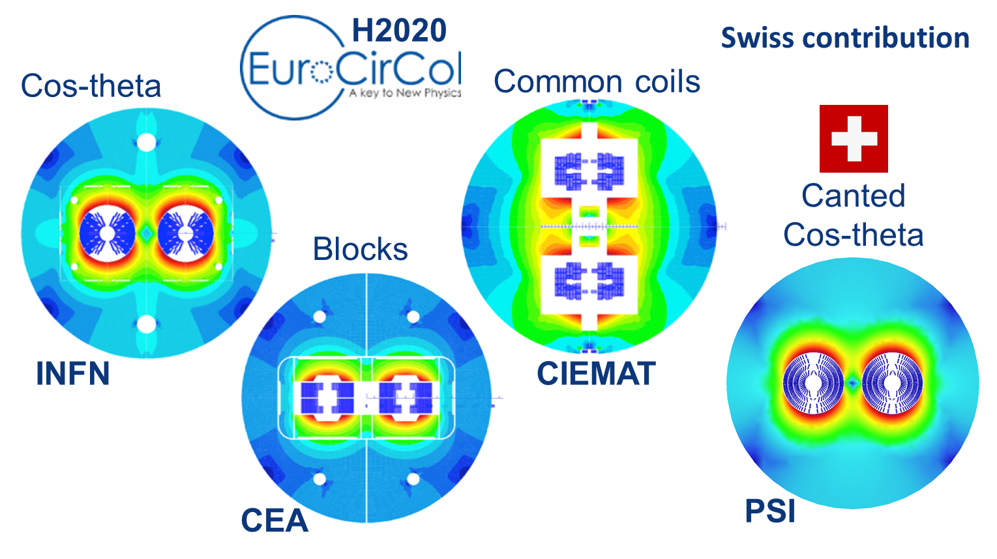
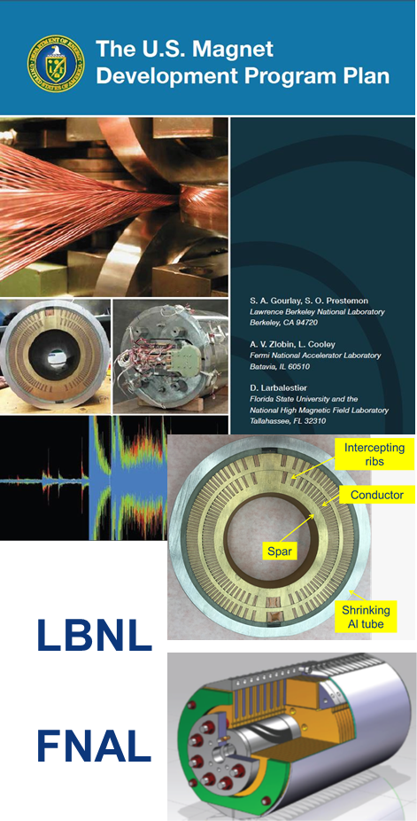
16 T dipole design activities & options
M. Benedikt
short model magnets (1.5 m lengths) built from 2018 – 2022
Russian 16 T magnet program launched by BINP recently

Slide 24
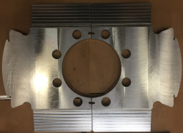
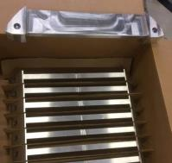
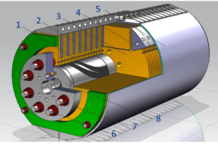
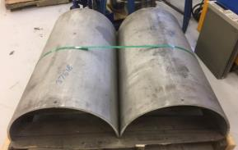
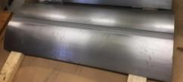
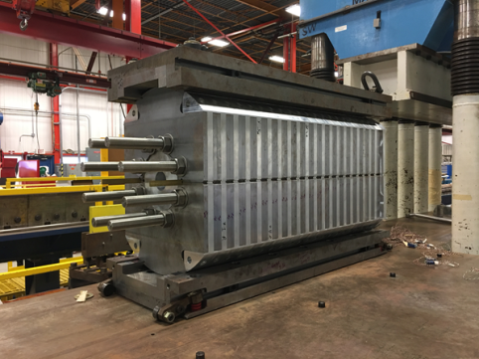
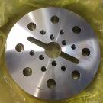
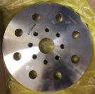
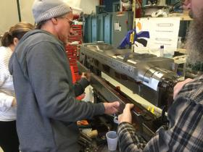
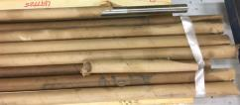
15 T dipole demonstrator (US MDP)
Iron Laminations
AL I-Clamps
StSt Skin
Fillers
End Plates
Axial Rods
All coil parts, structural components and tooling are available at FNAL
Coil fabrication and the work with mechanical structure are in progress
First magnet test in September 2018
A. Zlobin

Slide 25
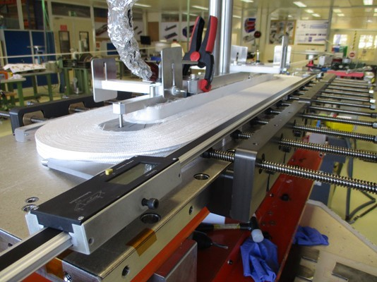
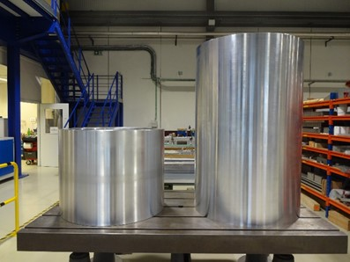
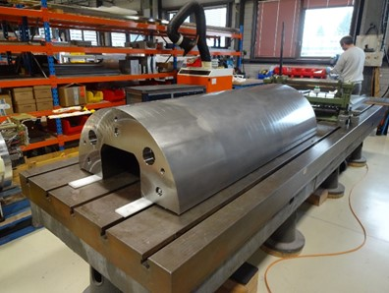
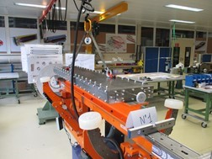
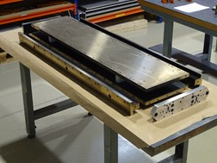
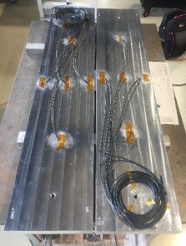
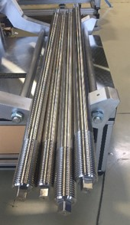
16 T ERMC construction at CERN
First ERMC coil winding
Aluminum shell
Magnet yoke
Dummy coils
Coil Reaction Tool
Coil Impregnation Tool
D. Tommasini
Axial rods
Coil fabrication
Winding of the first coil has been completed. Preparation for reaction on-going. All tooling for coil production ready
Magnet assembly
Components and tooling ready. Dummy assembly to characterize the structure behavior on-going.

Slide 26
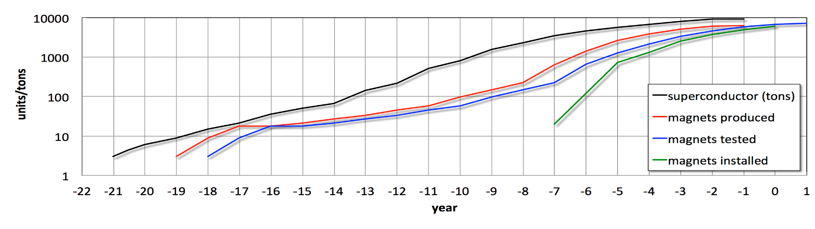
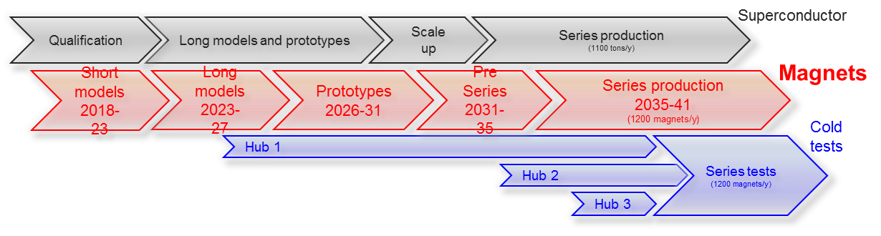
FCC 16 T magnet R&D schedule
total duration of magnet program: ~20 years
would follow HL-LHC Nb₃Sn program with long models w industry from 2023/24
M. Benedikt, L. Bottura

Slide 27
HE-LHC is not an easy machine
push for “cheap” injection from SPS at 450 GeV
poor field quality and much larger beam than for FCC-hh
less physical aperture than for LHC,
  complicating collimation and protection at injection
limited length of straight section (LEP tunnel)
cannot apply length scaling with energy used for FCC-hh design,
  complicating collimation at top energy
magnets must be bent, while FCC-hh magnets are straight
can magnets made from Nb₃Sn (brittle) be bent mechanically?
  additional complication
limited tunnel cross section
- restricted transverse size of magnet cryostats

Slide 28
field errors limit dynamic aperture
Nb₃Sn wire with 20 μm instead of 50 μm filaments
in addition must introduce artificial pinning centres
sextupole
field errors
in N_{b3}Sn dipole
as a function of
dipole field
3 injection
energies
(450, 900
and 1300
GeV) are
indicated
S. Izquierdo Bermudez

Slide 29
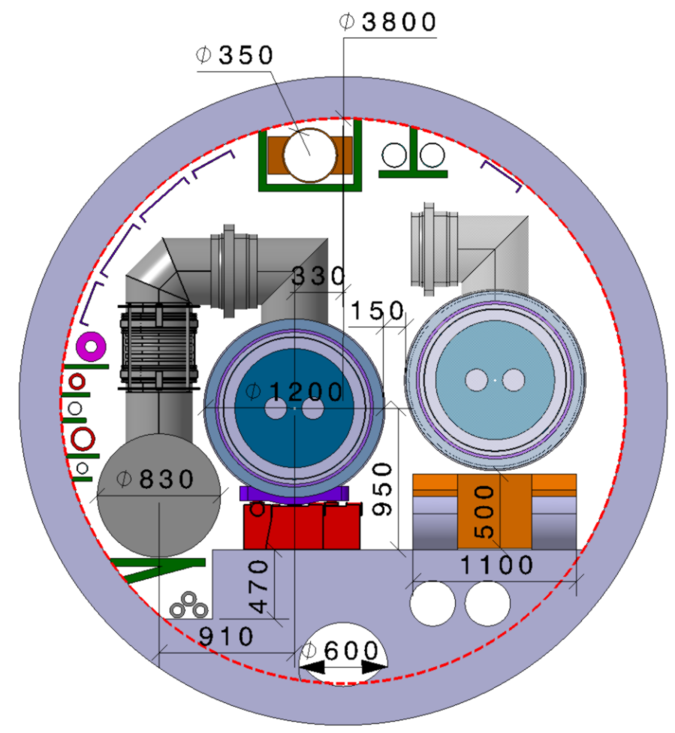
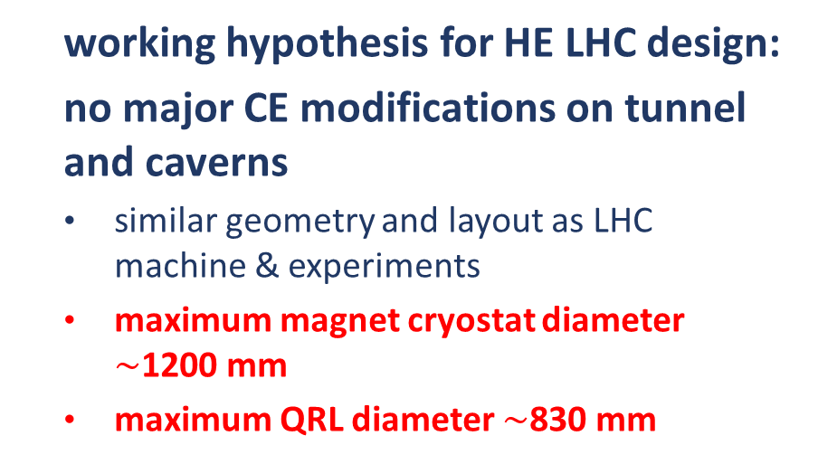
HE-LHC integration aspects
  working hypothesis for HE LHC design:
  no major CE modifications on tunnel and caverns
  similar geometry and layout as LHC machine & experiments
  maximum magnet cryostat diameter $\sim$1200 mm
  maximum QRL diameter $\sim$830 mm
  LHC tunnel diameter 3.8 m
integration and design strategy:
development of optimized 16 T magnet, compatible with HE LHC requirements
new cryogenic layout to limit QRL dimension
V. Mertens, M. Benedikt

Slide 30
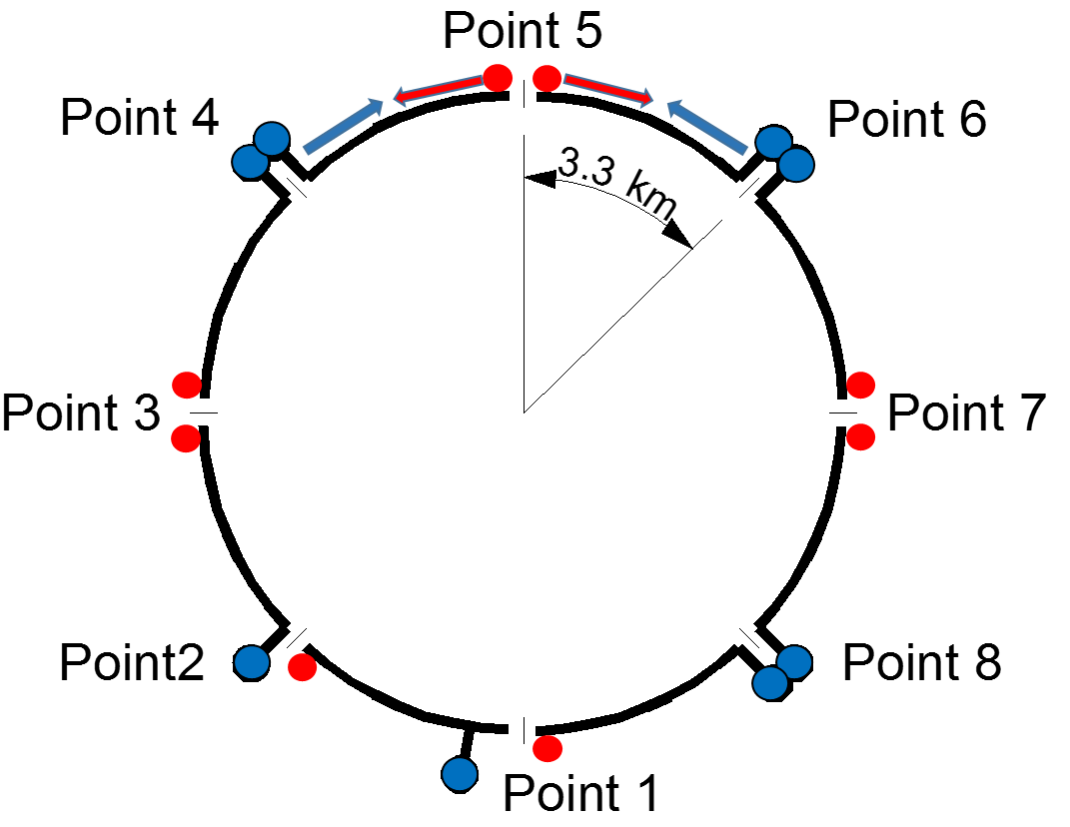
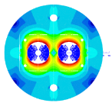



16 T dipole evolution & HE-LHC cryogenics
Coil optimization and margin 18 → 14%
Stray-field < 0.1 T at cryostat
Half-sector cooling instead of full sector (as for LHC)
to limit cross section of cryogenic distribution line
800 mm 600 mm
Cosine-theta (baseline)
Block-type coils
Common-coils
higher heat load and integration limitations:
8 additional 1.8 K refrigeration units wrt. LHC
8 new higher-power 4.5 K cryoplants
2015 2017

Slide 31

HE-LHC IR layout
triplet lengths:
LHC: 30.4 m
HL-LHC: 41. 8 m
HE-LHC: 56 m (13.5 TeV);
ca. 11 m
for crab cavities
L. van Riesen Haupt

Slide 32



HE-LHC IR optics & triplet shielding
rriplet quadrupole design with 2 cm inner tungsten shielding
for 10 ab⁻¹ integral luminosity: $\sim$40 MGy peak dose (peak at Q3 can be reduced w addt’l shielding)
J. Abelleira
General optics design work ongoing for HE LHC with focus on: injection (energy), field quality, physical & dynamic aperture, protection
l* = 23 m,
TAS 1.8 m long
(as for HL-LHC,
different radius)
  collision optics
  with β*=0.25 m
L. van Riesen Haupt

Slide 33
SPPC main parameters
Parameter | Unit | SPPC |  |  | FCC
 |  | PreCDR | “CDR” | “Ultimate”
Circumference | km | 54.4 | 100 | 100 | 100
c.m. energy | TeV | 70.6 | 75 | 125-150 | 100
dipole field | T | 20 | 12 | 20-24 | 16
injection energy | TeV | 2.1 | 2.1 | 4.2 | 3.3
#IPs |  | 2 | 2 | 2 | 2
luminosity per IP | 10³⁵ cm⁻²s⁻¹ | 1.2 | 1.0 | - | 0.5 |  | 3.0
norm. emittance | μm | 4.1 | 2.4 | ? | 2.2 (0.44)
IP beta function | m | 0.75 | 0.75 | - | 1.1 |  | 0.3
beam current | A | 1.0 | 0.7 | - | 0.5
bunch separation | ns | 25 | 25 | - | 25 (5) | 25 (5)
bunch population | 10¹¹ | 2.0 | 1.5 | - | 1.0 (0.2) | 1.0 (0.2
SR power /beam | MW | 2.1 | 1.1 | - | 2.5
SR heat load/ap | W/m | 45 | 13 | - | 30
J. Tang

Slide 34

SppC layout 2017
coexistence ee, pp, ep
two high-luminosity pp experiments
two other experiments for AA & ep
one (combined) collimation insertion
one RF insertion
extraction insertion
injection insertion
greenfield injector chain
J. Gao
circumference: 100 km
J. Gao, X. Lou, J. Tang

Slide 35

SppC injector chain
J. Gao
p-Linac: proton superconducting linac
p-RCS: proton rapid cycling synchrotron
MSS: Medium-Stage Synchrotron
SS: Super Synchrotron
ion beams: dedicated linac (I-Linac) and RCS (I-RCS)

Slide 36

SppC: wire from Fe-based HTS*
*discovered at TIT/Japan in 2008
Chinese 10-year R&D target
for SPPC collider

Slide 37

SppC: China-Domestic Collaboration on HTS
In October 2016, A consortium for High-temperature superconducting materials, industrialization and applications was formed in China, with participation of major research and production institutions on HTS.
China is actually leading the development of Fe-HTS technology in the world; world-first 100-m Fe-HTS wire was made by CAS-Institute of Electrical Engineering in the last year .
J. Gao,
J. Tang,
Q. Xu

Slide 38



SppC Design of 12-T Fe-based Dipole Magnet
C. Wang, E. Kong (USTC), Q. Xu et al.
Yoke OD
500mm
Table 1: Main parameters of the cables
Cable | Hight | Width-i | Width-o | Ns | Strand | Filament | Insulation
IRONBASED1 | 8 | 1.5 | 1.5 | 20 | IRON-BASED | FE-BASED | 0.15
IRONBASED2 | 5.6 | 1.5 | 1.5 | 14 | IRON-BASED | FE-BASED | 0.15
IRONBASED3 | 5 | 1.5 | 1.5 | 12 | IRON-BASED | FE-BASED | 0.15
Table 2: Main parameters of the strand
Strand | diam. | cu/sc | RRR | Tref | Bref | Jc@ BrTr | dJc/dB
IRON-BASED | 0.802 | 1 | 200 | 4.2 | 10 | 4000 | 111
One meter of such magnet requires iron-based HTS strand length of 6.08 km

Slide 39




FCC-hh cryogenic beam vacuum system
synchrotron radiation (~ 30 W/m/beam (@16 T field) (cf. LHC <0.2W/m) ~ 5 MW total load in arcs
absorption of synchrotron radiation at higher temperature (> 1.8 K) for cryogenic efficiency
provision of beam vacuum, suppression of photo-electrons, electron cloud effect, impedance, etc.
FCC-hh beam-screen test set-up at ANKA/Germany:
beam tests since June 2017, for prototypes,
confirming vacuum design simulations
X-ray fan
2.5 GeV ANKA/KIT storage ring
ANKA e⁻ photon spectrum
= FCC –hh spectrum

Slide 40
FCC-hh cryoplants – energy efficiency
BS temperature choice through overall optimisation:
cryoplant power consumption
vacuum system performance
impedance and beam stability
300MW
200MW
100MW
L. Tavian, P. Lebrun
optimum beam screen operation temperature 40 - 60 K
electrical power for beam screen cooling ~100 MW .

Slide 41



FCC implementation - footprint baseline
present baseline position established considering:
lowest risk for construction
fastest and cheapest construction
feasible positions for large span caverns (most challenging structures)
next step: review of surface site locations and machine layout
J. Osborne, J. Stanyard

Slide 42





CEPC Site Selections
6
1
1)
4
4
2
2)
5
1) Qinhuangdao, Hebei Province（Completed in 2014）
2) Huangling, Shanxi Province（Completed in 2017)
3) Shenshan, Guangdong Province(Completed in 2016)
4) Baoding (Xiong an), Hebei Province (Started in August 2017)
5) Huzhou, Zhejiang Province (Started in March 2018)
6) Chuangchun, Jilin Province (Started in May 2018)
3)
3
J. Gao

Slide 43


Item | Huangling | Shenshan | Funing
Project layout
Construction difficulty | Moderate | Relatively difficult | Relatively easy
Huangling (100 km)
Shenshan (100 km)
Funing (100 km)
X. Lou
Notes:
Huangling: The site is mainly on the loess plateau. The buried depth of the tunnel and the depth of the shafts are quite different. The construction access layout is relatively simple.
Shen-Shan: The site is mainly the low mountain area. The buried depth of the tunnel and the depth of the shafts are large, and the construction access layout is relatively complicated.
Funing: The site is generally the low hilly areas; underground burial depth is not big; the construction site conditions are better; the construction access layout is relatively simple.

Slide 44


FCC – tunnel integration in arcs
  FCC-ee FCC-hh
  5.5 m inner diameter
V. Mertens

Slide 45
CEPC/SppC – tunnel integration in arcs
  6.0 m width, hosting 5 rings simulatenously
J. Gao

Slide 46

CE schedule studies
Total construction duration 7 years
First sectors ready after 4.5 years
4.5yrs
6.5yrs

Slide 47

technical schedule for each of three options
schedule constrained by 16 T magnets & CE
→ earliest possible beam operation dates
FCC-ee: 2039
FCC-hh: 2043
HE-LHC: 2040 (with HL-LHC stop LS5 / 2034)

Slide 48


Global FCC Collaboration
  from Italy
  CNR-SPIN, Genoa
  CSIL, Milan
  INFN, Frascati (Roma)
  Sapienza, Rome
  UNICAL, Arcavacata di Rende
  UNIGEOA, Genova
  UNIMI, Milan
  UNIROMA3, Roma
124
Institutes
30
Companies
32
Countries
EC
H2020

Slide 49
EU H2020 Design Study EuroCirCol
European Union Horizon 2020 program
Support for FCC-hh study
3 MEURO co-funding
Started June 2015, ends in May 2019
Scope:
FCC-hh collider
Optics Design (arc and IR)
Cryogenic beam vacuum system design including beam tests at ANKA
16 T dipole design, construction folder for demonstrator magnets
Notes:
New slide from Davide.
Showing that conductor development is launched at international level, Russia, Japan, (Korea and Europe in preparation)
Underline importance of that development as main cost driver for the hadron collider machine.

Slide 50


EASITrain Marie Curie Training Network
European Advanced Superconductivity Innovation and Training Network
selected for funding by EC in May 2017, started 1 October 2017
SC wires at low temperatures for magnets (Nb₃Sn, MgB₂, HTS)
Superconducting thin films for RF and beam screen (Nb₃Sn, Tl)
Electrohydraulic forming for RF structures
Turbocompressor for Nelium refrigeration
Magnet cooling architectures
Horizon 2020 program
Funding for 15 Early Stage Researchers over 3 years & training
13 Beneficiaries
I-CUBE
12 Partners
J. Gutleber

Slide 51
FCC Planning – CDR Production
CDR Concise summary volumes 1 (PH), 2 (hh), 4 (ee), 6 (HE):
  Completion of design work, coherent and consistent; contents for concise volumes by end June 2018
  Overall final editing July – August 2018; Proof reading and approval September – October
  “Print-ready” versions by November 2018
CDR long technical volumes 3, 5, 7:
  Collection of input (from status June 2018) during July – October 2018.
  Overall volume editing November 2018 – January 2019; Proof reading and approval February – March 2019
Cost study based on CDR status (June 2018), other documents for ESU, June - November 2018
M. Benedikt

Slide 52


CEPC Accelerator from Pre-CDR to CDR
J. Gao
CEPC accelerator CDR completed in June 2018 (released on Spet. 2 2018)
  Executive Summary
  Introduction
  Machine Layout and Performance
  Operation Scenarios
  CEPC Collider
  CEPC Booster
  CEPC Linac
  Systems Common to the CEPC Linac, Booster
  and Collider
  8. Super Proton Proton Collider
  9. Conventional Facilities
  10. Environment, Health and Safety
  11. R&D Program
  12. Project Plan, Cost and Schedule
  Appendix 1: CEPC Parameter List
  Appendix 2: CEPC Technical Component List
  Appendix 3: CEPC Electric Power Requirement
  Appendix 4: Advanced Partial Double Ring
  Appendix 5: CEPC Injector Based on Plasma Wakefield Accelerator
  Appendix 6: Operation as a High Intensity γ-ray Source
  Appendix 7: Operation for e-p, e-A and Heavy Ion Collision
  Appendix 8: Opportunities for Polarization in the CEPC
  Appendix 9: International Review Report
Draft CDR for
Mini International
Review in Nov. 2017
March 2015
April 2017
CDR International Reviewed June 28-30, 2018, final CDR (accelerator) released on Sept. 2, 2018

Slide 53
a few conclusions
FCC study develops high-performance energy frontier circular colliders for post-LHC era – input to ESU’19/20
parallel effort in China (CEPC/SppC) – Chinese decision could come within 2 to 5 years
worldwide R&D programs on key technologies: Nb₃Sn superconductor, high-field magnets, highly-efficient SC RF
international FCC collaboration growing steadily, many R&D opportunities; all of the community invited to join
FCC concept supports attractive staged long-term strategy for particle physics: FCC-ee → FCC-hh → FCC-μμ
highest-luminosity collisions up to very high energies; collider program extending well into the 22nd century

Slide 54
EuroCirCol Final Meeting
& FCC Week 2019
https://indico.cern.ch/event/727555
Brussels
24-28 June, 2019

Slide 55
appendix: path to FCC-μμ

Slide 56

how to go further – beyond FCC-hh?
muon collider* is back !
3 recent new ideas :
LEMMA μ production by e⁺ annihilation
Gamma factory for e⁺ generation
full exploitation of FCC complex
*first proposed by Gersh Budker in 1969

Slide 57
from US-MAP (2015) to LEMMA scheme (2017)
key challenges
~10¹³-10¹⁴ μ / sec
tertiary particle pgπgμ:
fast cooling
(τ=2μs)
by 10⁶ (6D)
fast acceleration
mitigating μ decay
background
from μ decay
Positron Beam
e+ ring
μ⁺
LHeC-class e+ source & e+ acceleration at 45 GeV
(circular/linear options)
μ⁻
isochronous rings
100 KW target
key challenges
~10¹¹ μ / sec from e⁺e⁻gμ+μ−
M. Antonelli, M. Boscolo, P. Raimondi et al.
key
R&D
10¹⁵ e⁺/sec, 100 kW class target, NON destructive process in e+ ring

Slide 58



“Gamma Factory” based on “PSI”
Compton back scattering at LHC or FCC
high photon energies,
high cross section
W. Krasny
FCC based Gamma Factory could provide >10¹⁷ e⁺/s

Slide 59


γ factory proof-of-principle experiment in the LHC
Pb⁺⁸¹ beam lifetime $\sim$38 hours
(and first electrons in the LHC…)
“… this was a HUGE deal! One of the main scientiﬁc advances in the whole of physics this year!”
Dima Budker

Slide 60

cost & power efficiency of future lepton colliders
Cost-figure-of-merit versus power-figure-of-merit for future lepton colliders (Jean-Pierre Delahaye)

Slide 61

Combining Gamma Factory, LEMMA,
FCC-ee and FCC-hh
$$L≈f_{rev}{\dot{N}}_{μ}\frac{{\dot{N}}_{μ}}{ε_{N}}\frac{1}{3^{6}}γτ^{2}\frac{1}{4πβ^{∗}}=\frac{1}{3^{6}}\left\{{\left(\frac{eF_{dip}}{2πm_{μ}}\right)}^{3}\frac{τ_{0}^{2}}{4πc^{2}}\right\}\left[B^{3}C^{2}\right]\left[{\dot{N}}_{μ}\frac{{\dot{N}}_{μ}}{ε_{N}}\right]\frac{1}{β^{∗}}$$
100 TeV μ collider in C=100 km FCC tunnel with B=16 T → L>10³⁴ cm⁻²s⁻¹

