Slide 1

Low EMittance Muon Accelerator studies
P Raimondi
For the LEMMA Team

Slide 2
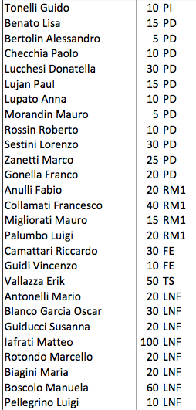
Low EMittance Muon Accelerator team
CSN1 team
Additional national
M. Ricci (Uni. Marconi, INFN-LNF) A. Stella (LNF), G. Cavoto (La Sapienza), E. Bagli (INFN-Fe), M. Prest, M. Soldani, C. Brizzolari (Uni-Insubria&INFN), A. Lorenzon, S. Vanini, S. Ventura, D. Dattola(INFN-Uni. Padova), A. Wulzer (Uni. Pd & EPFL)
Additional international
P. Raimondi, S. Liuzzo, N. Carmignani (ESRF)
R. Di Nardo, P. Sievers, M. Calviani, S. Gilardoni (CERN)
I. Chaikovska, R. Chehab (LAL-Orsay)
L. Keller, T. Markiewicz (SLAC)
ARIES WP6: improving Accelerator PErformance and new Concepts
task for muon collider
Task 6.6 Assessment of advanced muon-collider concepts without ionization cooling

Slide 3
Outline
muon case, muon sources
Introduction:
Physics Opportunities
  Very High Energy
  Multi-TeV
Low emittance muon beam production concept: e⁺ on target
  Target options
  Positron Source
  Multipass scheme
First study of multi-TeV MC parameters
First design of the e⁺ ring
  Multiturn simulations
  First considerations about target thermo-mechanical stresses
  First considerations on e+ source
Experimental tests
  45 GeV e+ beam
Conclusions

Slide 4
Giudice

Slide 5
Muon based Colliders
A μ⁺μ⁻ collider offers an ideal technology to extend lepton high energy frontier in the multi-TeV range:
  No synchrotron radiation (limit of e⁺e⁻ circular colliders)
  No beamstrahlung (limit of e⁺e⁻ linear colliders)
  but muon lifetime is 2.2 μs (at rest)
Best performances in terms of luminosity and power consumption
Great potentiality if the technology proves its feasibility:
  cooled muon source
  fast acceleration
  μ Collider
  radiation Safety (muon decay in accelerator and detector)

Slide 6
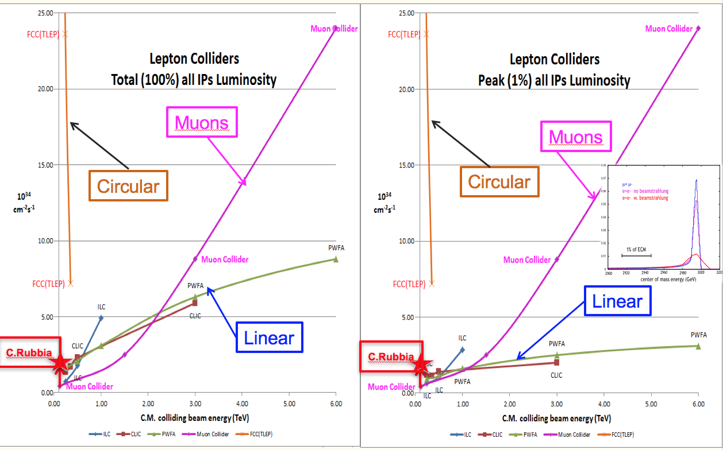
Muon Colliders potential of extending leptons high energy frontier with high performance

Slide 7
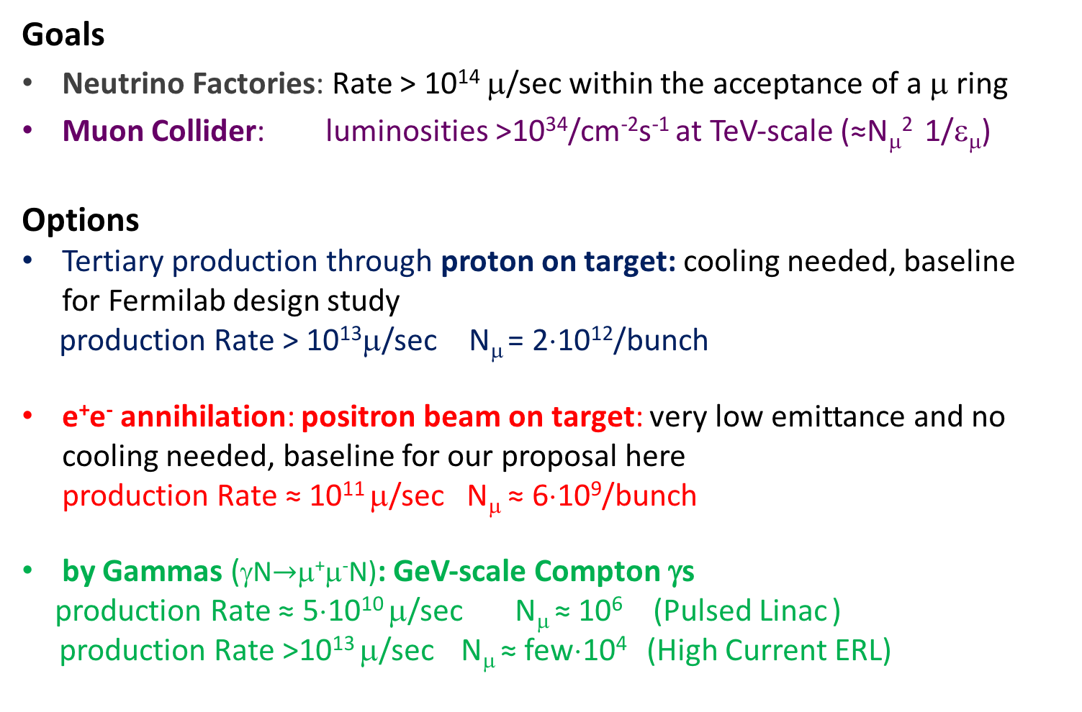
Muon Source
Goals
Neutrino Factories: Rate > 10¹⁴ μ/sec within the acceptance of a μ ring
Muon Collider: luminosities >10³⁴/cm⁻²s⁻¹ at TeV-scale (≈N_{μ}² 1/ε_{μ})
Options
Tertiary production through proton on target: cooling needed, baseline for Fermilab design study
production Rate > 10¹³μ/sec N_{μ} = 2×10¹²/bunch
e⁺e⁻ annihilation: positron beam on target: very low emittance and no cooling needed, baseline for our proposal here production Rate ≈ 10¹¹ μ/sec N_{μ} ≈ 6×10⁹/bunch
by Gammas (γN$\text{→}$μ⁺μ⁻N): GeV-scale Compton γs
production Rate ≈ 5×10¹⁰ μ/sec N_{μ} ≈ 10⁶ (Pulsed Linac )
production Rate >10¹³ μ/sec N_{μ} ≈ few×10⁴ (High Current ERL)
not discussed here
see also: W. Barletta and A. M. Sessler NIM A 350 (1994) 36-44 (e⁻N$\text{→}$μ⁺μ⁻ e⁻ N)

Slide 8

Muon source Comparison
 | Physical process | Rate μ/s | normalized emittance [μm-rad]
e+ on target | e+e-→ μ+μ- | 0.9x10¹¹ | 0.04
Protons on target | p N→ πX, kX→ μ X’ | 10¹³ | 25
Compton γ on target | γ N→ μ+μ- N | 5x10¹⁰ | 2

Slide 9
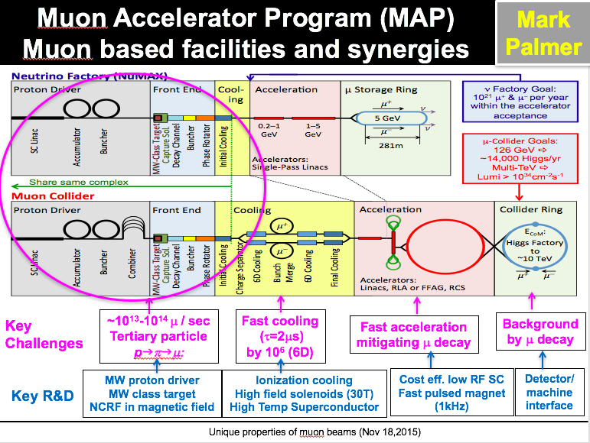

Slide 10
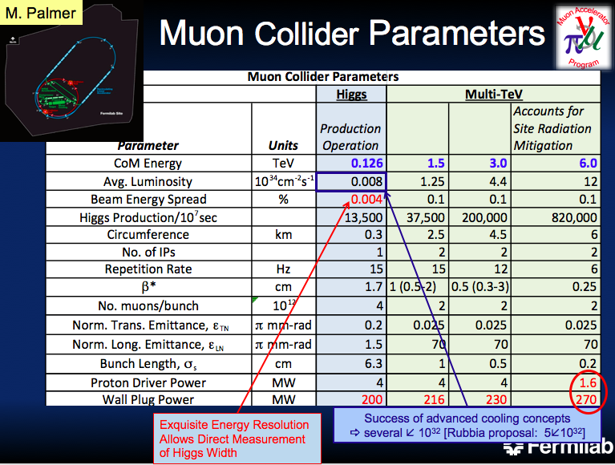

Slide 11
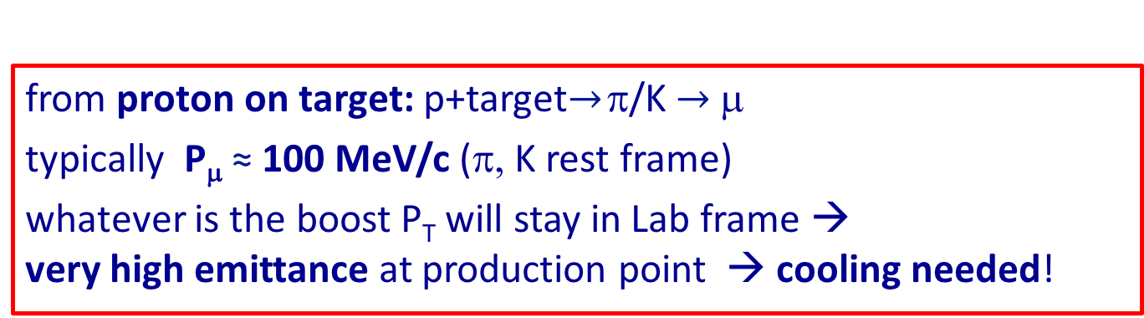
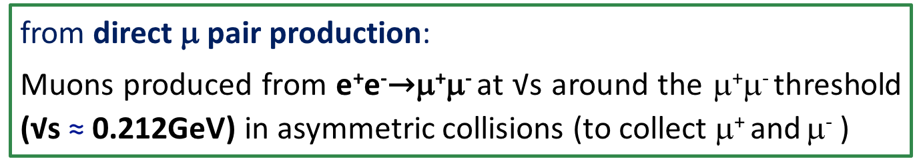
Low emittance μ beam source
from proton on target: p+target$\text{→}$ π/K $\text{→}$μ
typically P_{μ} ≈ 100 MeV/c (π, K rest frame)
whatever is the boost P_{T} will stay in Lab frame → very high emittance at production point → cooling needed!
from direct μ pair production:
Muons produced from e⁺e⁻$\text{→}$μ⁺μ⁻ at √s around the μ⁺μ⁻ threshold (√s ≈ 0.212GeV) in asymmetric collisions (to collect μ⁺ and μ⁻ )
NIM A Reviewer: “A major advantage of this proposal is the lack of cooling of the muons…. the idea presented in this paper may truly revolutionise the design of muon colliders … “

Slide 12
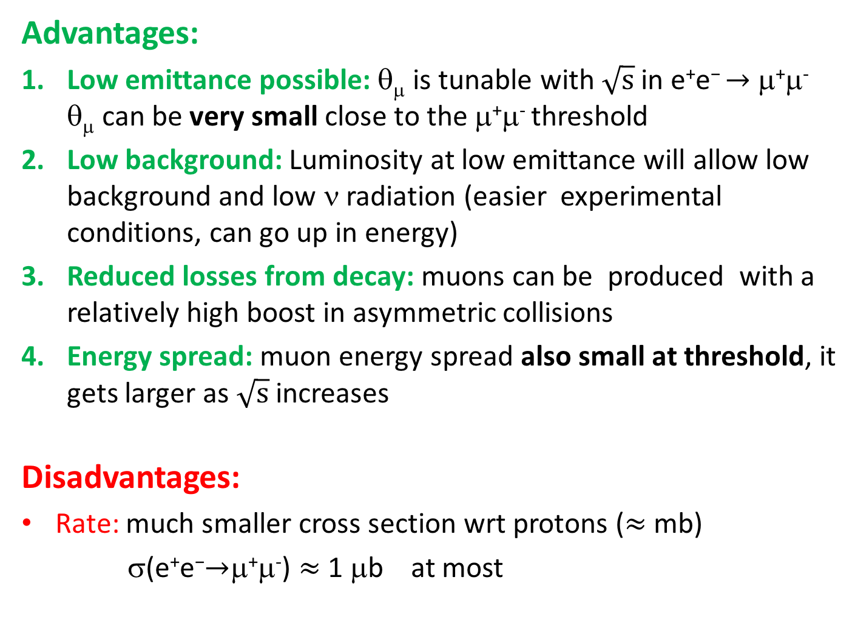
Advantages:
Low emittance possible: θ_{μ} is tunable with $\sqrt{s}$in e⁺e$\text{− }\text{→}$ μ⁺μ⁻ θ_{μ} can be very small close to the μ⁺μ⁻ threshold
Low background: Luminosity at low emittance will allow low background and low ν radiation (easier experimental conditions, can go up in energy)
Reduced losses from decay: muons can be produced with a relatively high boost in asymmetric collisions
Energy spread: muon energy spread also small at threshold, it gets larger as $\sqrt{s}$ increases
Disadvantages:
Rate: much smaller cross section wrt protons ($≈$ mb)
σ(e⁺e$\text{−}\text{→}$μ⁺μ⁻) $≈$ 1 μb at most

Slide 13
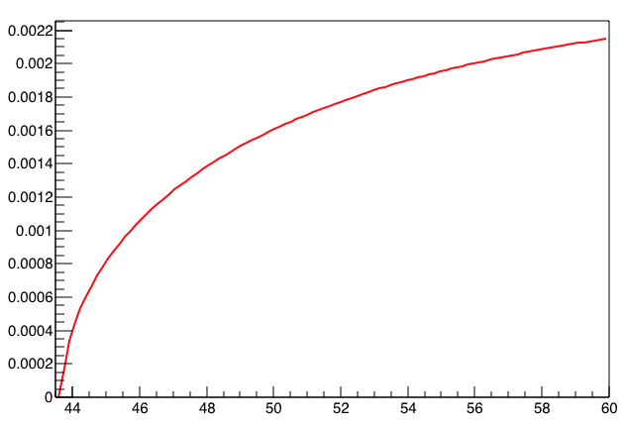
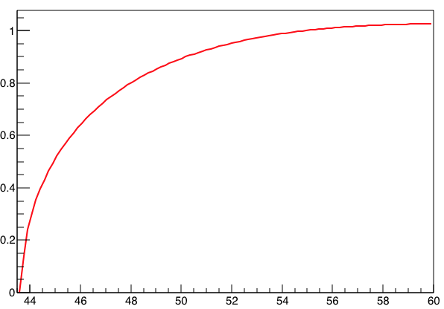
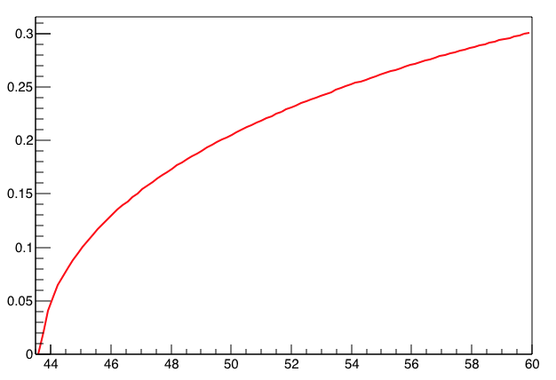
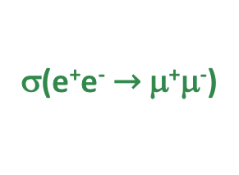
Cross-section, muons beam divergence and energy spread as a function of the e+ beam energy
mrad
2
1.6
1.2
0.8
0.4
0
θ_{μ}^{max}
σ(e⁺e⁻ $\text{→}$μ⁺μ⁻)
μb
1
0.8
0.6
0.4
0.2
0
44
46
48
50
52
54
56
58
60
E_{beam}(e⁺)
GeV
0.3
0.25
0.2
0.15
0.1
0.05
0
r.m.s.(E_{μ})/E_{μ}
44
46
48
50
52
54
56
58
60
E_{beam}(e⁺)
GeV
The value of sqrt(s) (i.e. E(e⁺) for atomic e⁻ in target)
has to maximize the muons production and minimize the beam angular divergence and energy spread
44
46
48
50
52
54
56
58
60
E_{beam}(e⁺)
GeV

Slide 14
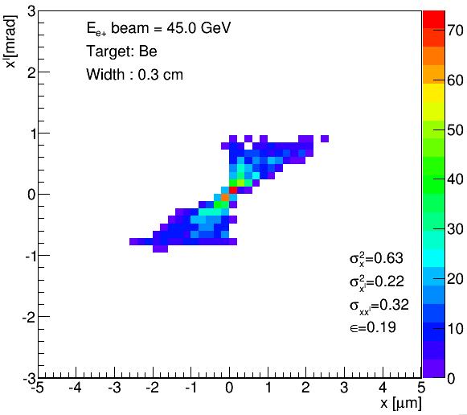


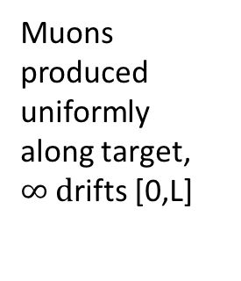
Production contribution to μ beam emittance
ideal e⁻ target
[Babayaga 3.5]
e⁺ beam
on target
e⁺
L
μ^{+/-}
$$θ_{μ}^{max}=\frac{4m_{e}}{s}\sqrt{\frac{s}{4}−m_{μ}^{2}}$$
e⁺
x’
x₁’= x₀’
1 mrad
If L was a drift
e⁺
x
x₀
x₀’
x₁ = Lx₀’
43.1
45.2
$$\sqrt{s}(GeV)$$
E(e+)
51.8
x’
Muon beam at the exit of a 3 mm Be target
ε_{μ}=0.19 nm
(45 GeV e+ beam)
Muons produced uniformly along target,
$∞ d$rifts [0,L]
x’_{max}=θ_{μ}^{max}
μ^{+/−}
x_{max}=L x’_{max}
thin light materials targets have negligible multiple scattering contribution
[Geant4]
The emittance contributions due to muon production angle: ε_{μ} = x x’_{max} /12= L (θ_{μ}^{max})²/12
→ ε_{μ} completely determined by L and s -by target thickness and c.o.m. energy
Notes:
emittance prop to target thickness (L)
emittance prop to theta^2 prop to

Slide 15
Criteria for target design
Number of μ⁺μ⁻ pairs produced per e⁺e⁻ interaction is given by
N(μ⁺μ⁻)= σ(e⁺e ⟶ μ⁺μ⁻) N(e⁺) ρ(e⁻) L
N(e⁺) number of e⁺
ρ(e⁻) target electron density
L target length
To maximise N(μ⁺μ⁻):
N(e⁺) max rate limit set by e⁺ source
ρ(e⁻)L max occurs for L or ρ values giving total e⁺ beam loss
  e⁻ dominated target: radiative Bhabha is the dominant e⁺ loss effect, giving a maximal μ⁺μ⁻ conversion efficiency
  N(μ⁺μ⁻)/N(e⁺) ≈ σ(e⁺e ⟶ μ⁺μ⁻)/σ_{rb} ≈ 10⁻⁵
  standard target: Bremsstrahlung on nuclei and multiple scattering are the dominant effects, Xo and electron density will matter N(μ⁺μ⁻)/N(e⁺) ≈ σ(e⁺e ⟶ μ⁺μ⁻)/σ_{brem}
Notes:
efficienza massima che si puo’ avere: processo che domina e’ il radiative Bhabha (e+ su e-, senza nuclei)
sigma*L*rho
radiative Coulomb scattering (brems) e’ sui nuclei
mettendoli insime il processo va come 10^-25 cm-2 *Z^2

Slide 16
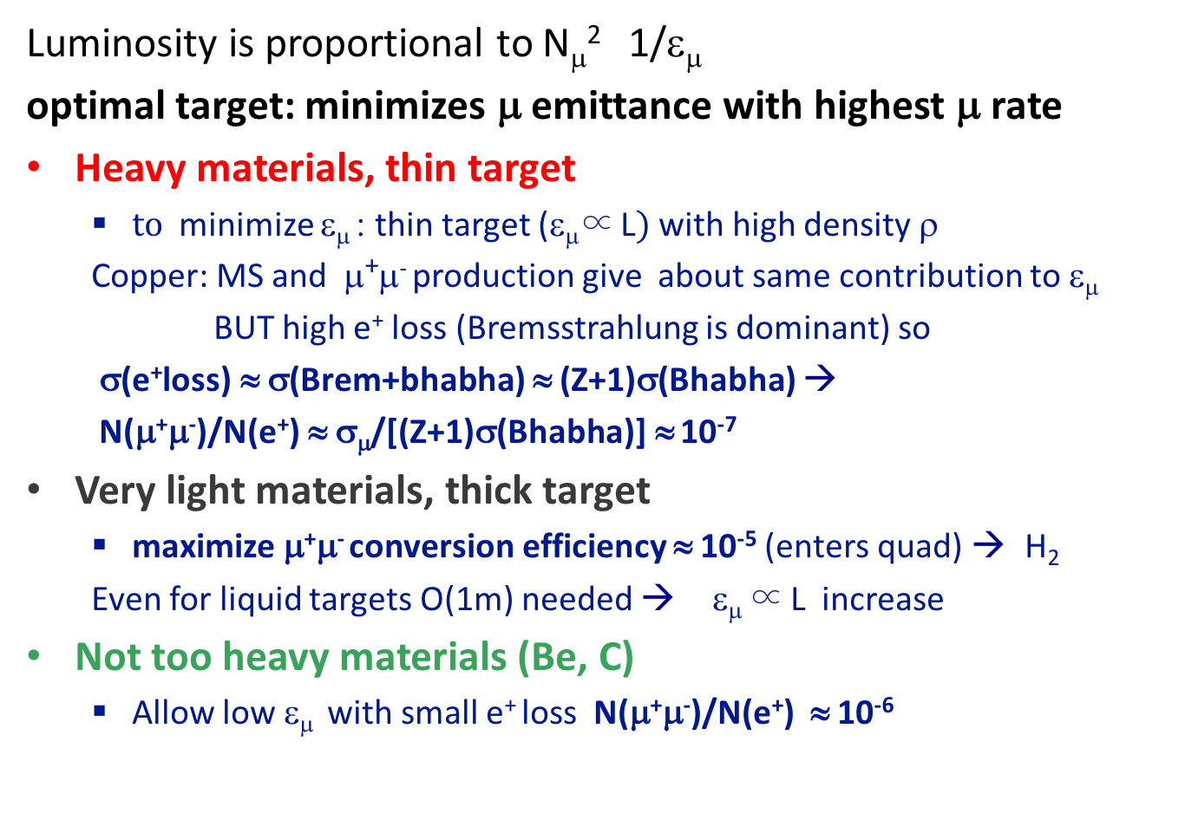
Criteria for target design
Luminosity is proportional to N_{μ}² 1/ε_{μ}
optimal target: minimizes μ emittance with highest μ rate
Heavy materials, thin target
  $to$minimize ε_{μ} : thin target (ε_{μ}∝ L$)$ with high density ρ
  Copper: MS and μ⁺μ⁻ production give about same contribution to ε_{μ}
  BUT high e⁺ loss (Bremsstrahlung is dominant) so
  σ(e⁺loss) ≈ σ(Brem+bhabha) ≈ (Z+1)σ(Bhabha) →
  N(μ⁺μ⁻)/N(e⁺) ≈ σ_{μ}/[(Z+1)σ(Bhabha)] ≈ 10⁻⁷
Very light materials, thick target
  maximize μ⁺μ⁻ conversion efficiency ≈ 10⁻⁵ (enters quad) → H₂
  Even for liquid targets O(1m) needed → ε_{μ} ∝ L increase
Not too heavy materials (Be, C)
  Allow low ε_{μ} with small e⁺ loss N(μ⁺μ⁻)/N(e⁺) ≈ 10⁻⁶
not too heavy and thin in combination with stored positron beam
to reduce requests on positron source

Slide 17
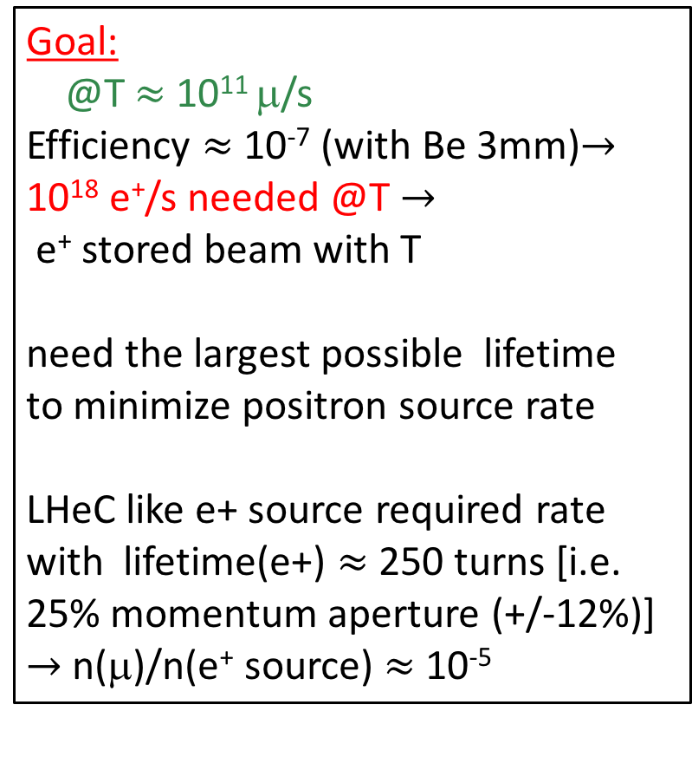
Low emittance μ beam production by positrons on target
e⁻ gun
Goal:
@T $≈$ 10¹¹ μ/s
Efficiency $≈$10⁻⁷ (with Be 3mm)$\text{→}$ 10¹⁸ e⁺/s needed @T $\text{→}$
e⁺ stored beam with T
need the largest possible lifetime
to minimize positron source rate
LHeC like e+ source required rate with lifetime(e+) $≈$ 250 turns [i.e. 25% momentum aperture (+/-12%)] $\text{→}$ n(μ)/n(e⁺ source) $≈$10⁻⁵
linac
μ⁻
AR
to fast acceleration
e⁺
AMD
TT
T
AR
μ⁺
e⁺
e⁺ Linac or Booster
(not to scale)
Notes:
mu production efficinency = N(mu)/N(e+e-)=sigma * rho * L = 0.6E-6 * N(e-)/cm-3 *L ~1.E-7
1.E-6 barn=10E-30 cm-2
L=R/sigma = 10E10/1.E-30 = 10E40 cm-2s-1
μ production efficiency ~ 10⁻⁷ $\text{→}$requirement on e+ on μ target: 1.5x10¹⁸ e⁺/sec

Slide 18
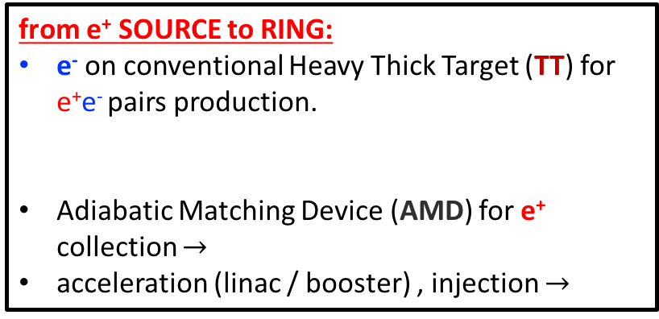
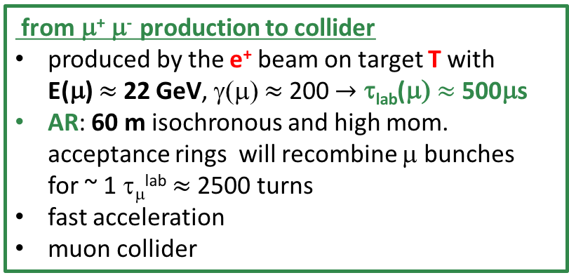
Low emittance μ beam production
by positrons on target
from e⁺ SOURCE to RING:
e⁻ on conventional Heavy Thick Target (TT) for e⁺e⁻ pairs production.
Adiabatic Matching Device (AMD) for e⁺ collection $\text{→}$
acceleration (linac / booster) , injection $\text{→}$
e⁻ gun
linac
μ⁻
AR
to fast acceleration
e⁺
AMD
TT
T
AR
μ⁺
e⁺
e⁺ Linac or Booster
e⁺ RING:
6.3 km 45 GeV storage ring with target T for muon production
from μ⁺ μ⁻ production to collider
  produced by the e⁺ beam on target T with E(μ) $≈$22 GeV, γ(μ) $≈$200 $\text{→}$ τ_{lab}(μ) $≈$500μs
AR: 60 m isochronous and high mom. acceptance rings will recombine μ bunches for ~ 1 τ_{μ}^{lab} $≈$2500 turns
fast acceleration
muon collider
(not to scale)

Slide 19
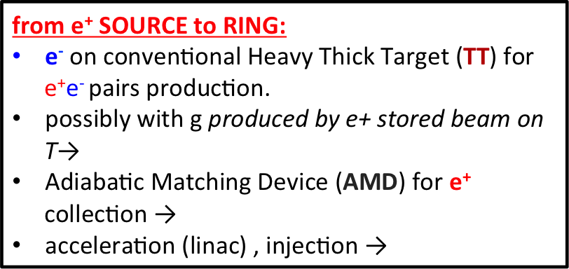
Low emittance μ beam production
by positrons on target
from e⁺ SOURCE to RING:
e⁻ on conventional Heavy Thick Target (TT) for e⁺e⁻ pairs production.
possibly with
Adiabatic Matching Device (AMD) for e⁺ collection
acceleration (linac) , injection
e⁻ gun
linac
μ⁻
AR
to fast acceleration
e⁺
AMD
TT
T
AR
μ⁺
e⁺
e⁺ Linac or Booster
e⁺ RING:
6.3 km 45 GeV storage ring with target T for muon production
The ring will work as a fast cycling booster
from μ⁺ μ⁻ production to collider
  produced by the e⁺ beam on target T with E(μ) $≈$22 GeV, γ(μ) $≈$200 $\text{→}$ τ_{lab}(μ) $≈$500μs
AR: 60 m isochronous and high mom. acceptance rings will recombine μ bunches for ~ 1 τ_{μ}^{lab} $≈$2500 turns
fast acceleration
muon collider
(not to scale)

Slide 20
Low emittance μ beam production by positrons on target
e⁻ gun
linac
μ⁻
e+ ring parameter | unit
Circumference | km | 6.3
Energy | GeV | 45
bunches | # | 100
e⁺ bunch spacing = T_{rev} (AR) | ns | 200
Beam current | mA | 240
N(e⁺)/bunch | # | 3 · 10¹¹
U₀ | GeV | 0.51
SR power | MW | 120
AR
to fast acceleration
e⁺
AMD
TT
T
AR
μ⁺
e⁺
e⁺ Linac or Booster
(not to scale)
(also 28 km is being studied as an option)

Slide 21
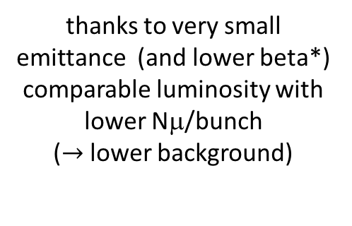
6 TeV μ collider
draft Parameters
 |  | LEMC-6TeV
Parameter | Units
LUMINOSITY/IP | cm⁻² s⁻¹ | 5.09E+34
Beam Energy | GeV | 3000
Hourglass reduction factor |  | 1.000
Muon mass | GeV | 0.10566
Lifetime @ prod | sec | 2.20E-06
Lifetime | sec | 0.06
c*tau @ prod | m | 658.00
c*tau | m | 1.87E+07
1/tau | Hz | 1.60E+01
Circumference | m | 6000
Bending Field | T | 15
Bending radius | m | 667
Magnetic rigidity | T m | 10000
Gamma Lorentz factor |  | 28392.96
N turns before decay |  | 3113.76
β_{x} @ IP | m | 0.0002
β_{y} @ IP | m | 0.0002
Beta ratio |  | 1.0
Coupling (full current) | % | 100
Normalised Emittance x | m | 4.00E-08
Emittance x | m | 1.41E-12
Emittance y | m | 1.41E-12
Emittance ratio |  | 1.0
Bunch length (zero current) | mm | 0.1
Bunch length (full current) | mm | 0.1
Beam current | mA | 0.048
Revolution frequency | Hz | 5.00E+04
Revolution period | s | 2.00E-05
Number of bunches | # | 1
N. Particle/bunch | # | 6.00E+09
Number of IP | # | 1.00
σ_{x} @ IP | micron | 1.68E-02
σ_{y} @ IP | micron | 1.68E-02
σ_{x'} @ IP | rad | 8.39E-05
σ_{y'} @ IP | rad | 8.39E-05
no lattice yet
μ⁺μ⁻ rate = 9 10¹⁰ Hz
ε_{N} = 40 nm
if: LHeC like e⁺ source
with 25% mom. accept. e⁺ ring
and ε dominated by μ production
    [ NIM A 807
    101-107 (2016)]
thanks to very small emittance (and lower beta*)
comparable luminosity with lower Nμ/bunch
($\text{→}$lower background)
Of course, a design study is needed to have a reliable estimate of performances
Notes:
head-on scheme,
β_{y}* ~σιγμα_{z}
no beam-beam

Slide 22

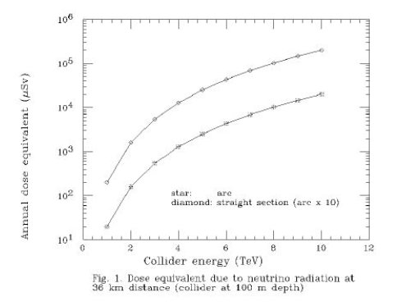
Annual dose
Straight section
p on target
arc
1 mS/year
Straight section
e⁺ on target
arc
muon rate: p on target option 3 10¹³ μ/s
e⁺ on target option 9 10¹⁰ μ/s
Notes:
This is just to show the reduction one has for radiological issues.
The annual dose equivalent on the earth surface would be decreased by two order of magnitudes, allowing muon collider at larger center-of-mass energy
(behavior due to neutrino-matter cross section)

Slide 23
Key R&D
MW proton driver
MW class target
NCRF in magnetic field
Ionization cooling
High field solenoids (30T)
High Temp Superconductor
Cost eff. low RF SC Fast pulsed magnet
(1kHz)
Detector/machine
interface
Key Challenges
~10¹³-10¹⁴ μ / sec
Tertiary particle pgπgμ:
Fast cooling
(τ=2μs) by 10⁶ (6D)
Fast acceleration
mitigating μ decay
Background
by μ decay
MAP
share the same complex
Positron Beam
e+ ring
μ⁺
LHeC-class e+ source & e+ acceleration at 45 GeV
(circular/linear options)
μ⁻
isochronous rings
100 KW target
Key Challenges
~10¹¹ μ / sec from e+e-gμ+μ−
EASIER AND CHEAPER DESIGN, IF FEASIBLE
Key
R&D
10¹⁵ e+/sec, 100 kW class target, NON distructive process in e+ ring

Slide 24
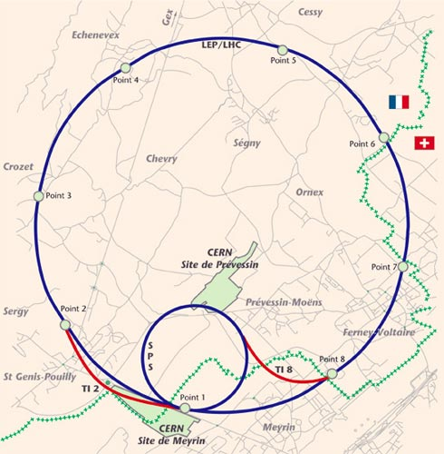
CMC
CERN
Muon
Collider
SRF
SRF
14 TeV cme
LHC tunnel
SPS tunnel and mb PS
~7GeV SRF
Cost ~LHC
SRF
SRF

Slide 25
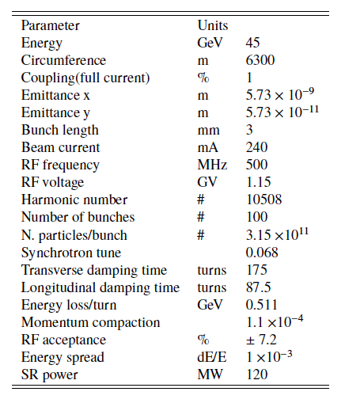
Low emittance 45 GeV positron ring
cell
circumference 6.3 km: 197 m x 32 cells
(no injection section yet)
Table e+ ring parameters
P. Raimondi
momentum acceptance
Physical aperture=5 cm constant
no errors
Good agreement between MADX PTC / Accelerator Toolbox, both used for particle tracking in our studies
Notes:
Lattice includes radiation and RF

Slide 26
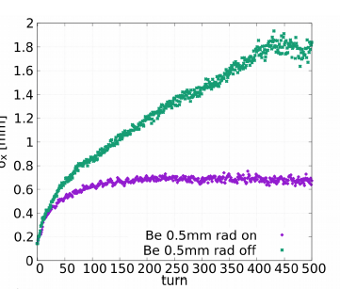
Multi-turn simulations
  Initial 6D distribution from the equilibrium emittances
  6D e⁺ distribution tracking up to the target (AT and MAD-X PTC)
  tracking through the target (with Geant4beamline and FLUKA and GEANT4)
  back to tracking code
At each pass through the muon target the e+ beam
gets an angular kick due to the multiple Coulomb scattering, so at each pass changes e⁺ beam divergence and size, resulting in an emittance increase.
undergoes bremsstrahlung energy loss: to minimize the beam degradation due to this effect, D_{x}=0 at target
in addition there is natural radiation damping
(it prevents an indefinite beam growth)
no damping
with damping
σ_{x}(mm)

Slide 27
e+ lifetime with Be target
3mm Be Target
(0.8% Xo)
determined by bremsstrahlung and momentum acceptance
Lifetime with ~ 40 turns
2-3% e+ losses happen in the first turn
Lifetime ∝ 1/thickness as expected

Slide 28

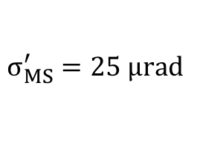
Evolution of e+ beam size and divergence
3mm Be Target (0.8% Xo) at center of IR
bremsstrahlung and
multiple scattering
artificially separated by
considering alternatively
effects in longitudinal
(dominated by bremsstrahlung)
and transverse (dominated by multiple scattering) phase space due to target;
in blue the combination of both effects (realistic target)
Some bremsstrahlung contribution due to residual dispersion at target
multiple scattering contribution in line with expectation:
one pass contribution due to the target:
$$σ_{MS}=\frac{1}{2} \sqrt{n_{D} }σ_{MS}^{′} β$$
$$σ_{MS}^{′}=25 μrad$$
n_{D} number of damping turns

Slide 29
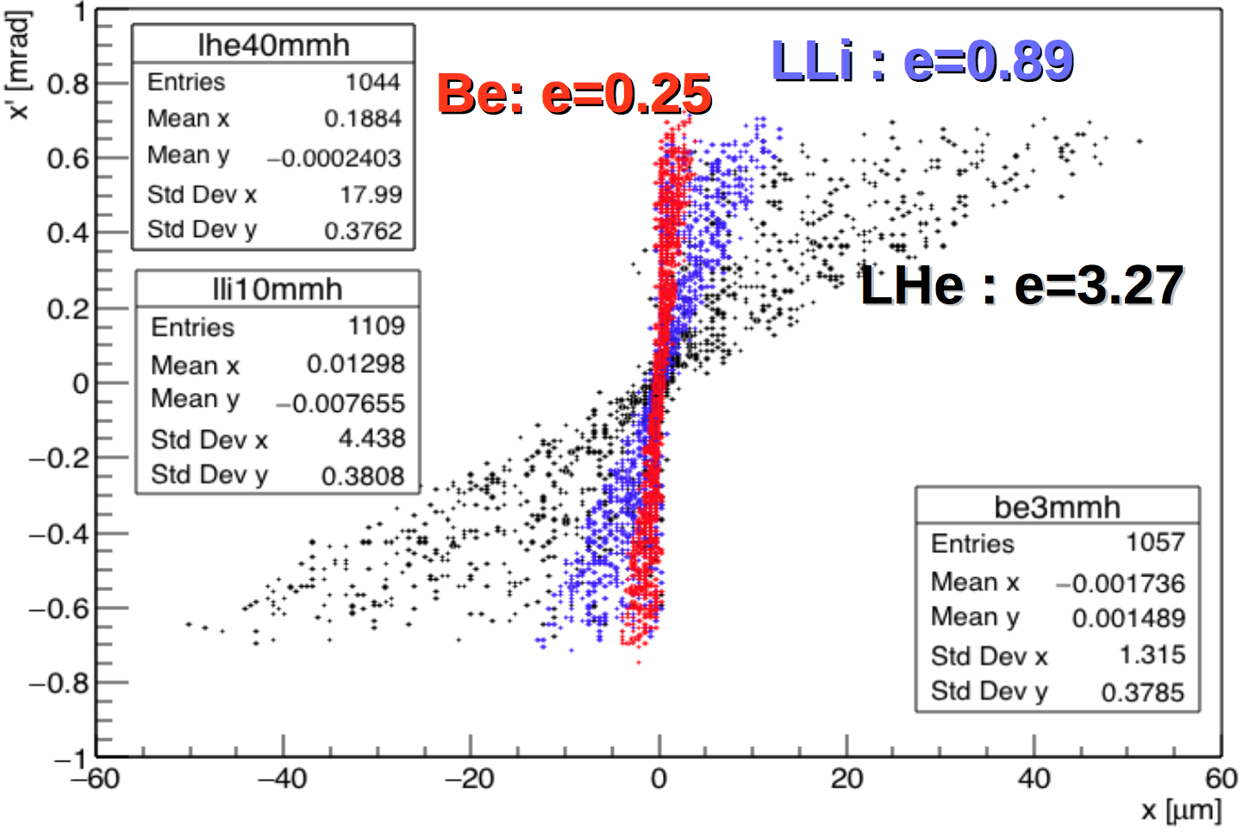
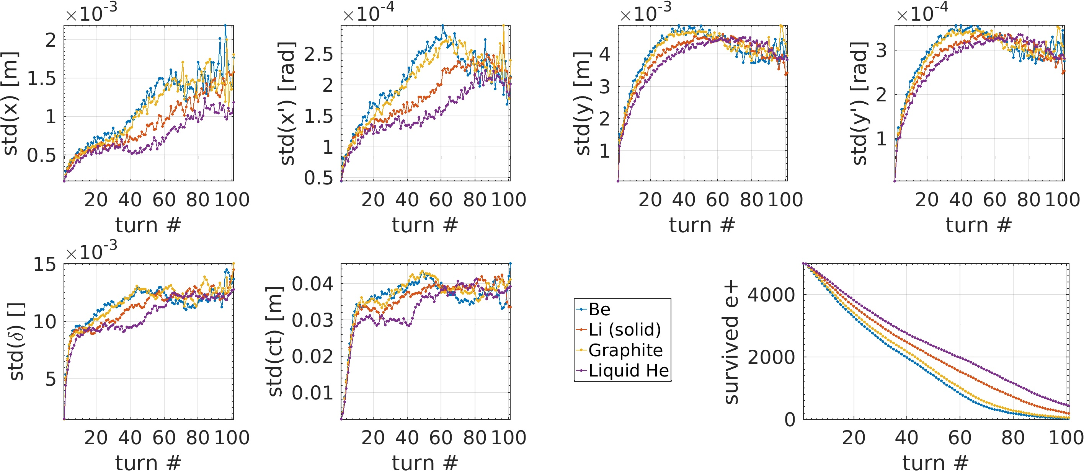
Going to lighter targets for μ production
Be Beryllium
LLi Liquid Lithium, might be a good option (Proposed/tested for targets for n production)
LHe Liquid Helium
thickness according
constant muons production
e = muon emittance at production [10⁻⁹m-rad]
E(e⁺)=45 GeV
Look to light liquid targets to reduce problems of thermo-mechanical stresses

Slide 30
Target: thermo-mechanical stresses considerations
Beam size as small as possible (matching various emittance contribution), but
constraints for power removal (200 kW) and temperature rise
to contrast the temperature rise
  move target (for free with liquid jet) and
e⁺ beam bump every 1 bunch muon accumulation
Solid target: simpler and better wrt temperature rise
  Be, C
  Be target: @HIRadMat safe operation with extracted beam from SPS, beam size 300 μm, N=1.7x10¹¹ p/bunch, up to 288 bunches in one shot
Liquid target: better wrt power removal
  Li, difficult to handle lighter materials, like H, He
    LLi jets examples from neutron production, Tokamak divertor
(200 kW beam power removal seems feasible) , minimum beam size to be understood
[Kavin Ammigan 6th High Power Targetry Workshop]
Notes:
Just few words about the target. As I said, we would like to have the matching from various contributions, but we have the constraints for power removal and temp. rise.
Of course, we have to move the target, which is easier for liquid jets, and we foresee the move the beam spot @T every muon bunch accumulation.
Solid target: much simpler from the practical point of view and they sustain smaller beam spot sizes
liquid Lithium jets target would likely sustain 200kW

Slide 31
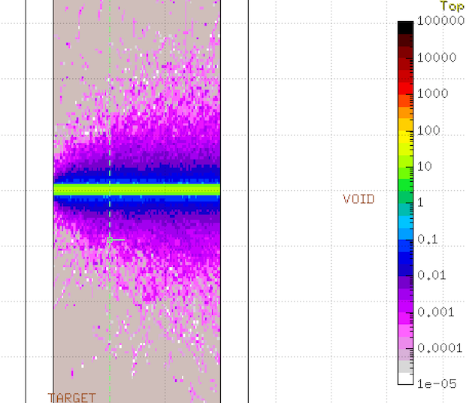
Conventional options for μ target
Aim at bunch (3x10¹¹ e⁺) transverse size on the 10 μm scale: rescaled from test at HiRadMat (5x10¹³p on 100μm) with Be-based targets and C-based (HL-LHC)
No bunch pileup Fast rotating wheel (20000 rpm)
Power removal by radiation cooling (see for instance PSI muon beam upgrade project HiMB)
Need detailed simulation of thermo-mechanical stresses dynamics
  Start using FLUKA + Ansys Autodyn (collaboration with CERN EN-STI)
Experimental tests:
  FACET-II available from 2019
  10¹¹ e-/bunch, 10 μm spot size, 100 Hz
  DAFNE available from 2020, see later
[F. Maciariello et al., IPAC2016]
[A. Knecht, NuFact17]]
Notes:
Just few words about the target. As I said, we would like to have the matching from various contributions, but we have the constraints for power removal and temp. rise.
Of course, we have to move the target, which is easier for liquid jets, and we foresee the move the beam spot @T every muon bunch accumulation.
Solid target: much simpler from the practical point of view and they sustain smaller beam spot sizes
liquid Lithium jets target would likely sustain 200kW

Slide 32
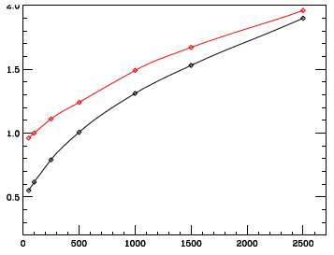
μ Accumulator Rings considerations
isochronous optics with high momentum acceptance (δ ≳ 10%)
optics to be designed
3 mm Be Target
Multiple Scattering effect
using one-turn matrix
e+ energy = 50 GeV
beam divergence:
a factor 3-2 increase at 45-50 GeV w.r.t. muon production angle contribution
beam size:
depends on optics need low-β to suppress size increase
this contribution can be strongly reduced with crystals in channeling
e+ energy = 45 GeV
σ’(mrad)
Accumulator turns
muon
production
angle
muon
production
angle + MS
contribution
better performances at 50 GeV provided >15% momentum acceptance
Notes:
the AR has still be designed, it has to be isoc. with high mom. accept.
independently on the optics there will be a contribution due the beam divergence due to the MS that increases with the number of turns in the accumulator up to a factor 3 wrt to the contribution of the muon production at 45 GeV.
Running at 50 GeV will mitigate this increase, giving also a larger muon rate (because of the muon production cross-section)

Slide 33
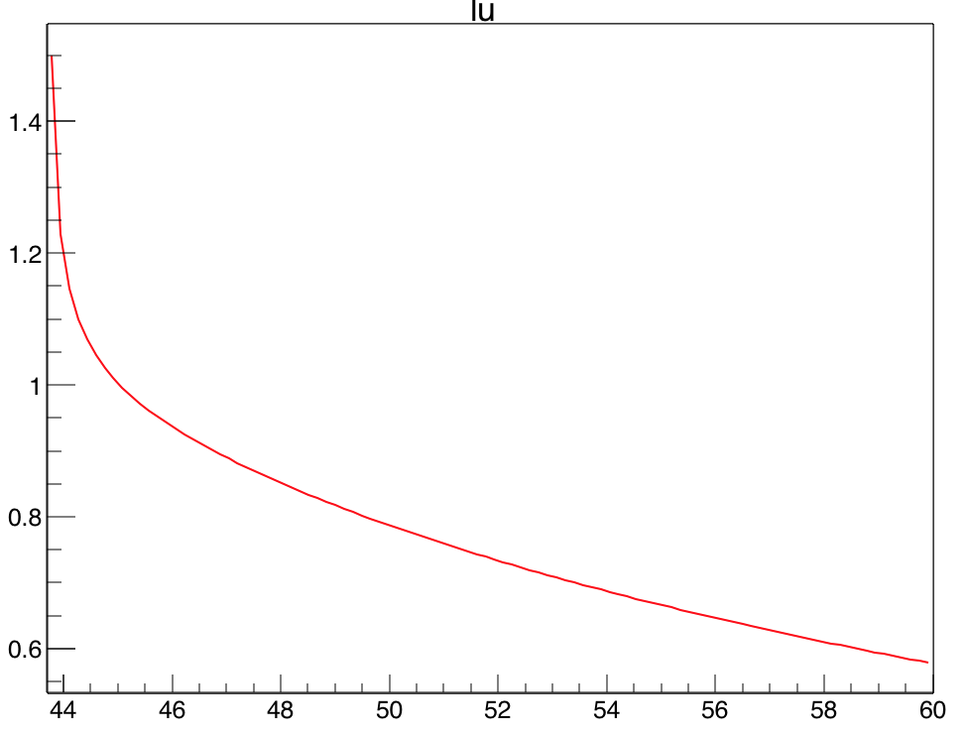
Luminosity of μ⁺μ⁻ Collider vs e⁺ beam energy
Optimal working point for ε(e⁺) ≅ ε(MS) ≅ ε(rad) ≅ ε(prod) ≅ ε(AR)
and sustainable beam spot on target
ε(prod) and μ intensity ∝ positron beam energy:
1.2 3.0 4.2 5.0 5.2 6.0 produced muon beam spot (μm)
L
@3mm target
1.4
1.2
1
0.8
0.6
a.u.
0.3
0.25
0.2
0.15
0.1
0.05
0
Valid for θ_{μ}^{max}
dominated emittance [ε(prod)]
r.m.s.(E_{μ})/E_{μ}
44 46 48 50 52 54 56 58 60
44
46
48
50
52
54
56
58
60
E_{beam}(e⁺)
GeV
E_{beam}(e⁺)
GeV
mrad
μb
2
1.6
1.2
0.8
0.4
0
1
0.8
0.6
0.4
0.2
0
σ(e⁺e⁻→μ⁺μ⁻)
θ_{μ}^{max}
44
46
48
50
52
54
56
58
60
44
46
48
50
52
54
56
58
60
E_{beam}(e⁺)
GeV
E_{beam}(e⁺)
GeV

Slide 34
Test @CERN
Experiments in H4:
45 GeV e⁺ on target, beam spot 2 cm, mrad divergence
High intensity (up to 5 x 10⁶ e+/spill) with 6 cm Be target (spill ~15s)
goal: measure muon production rate and muons kinematic properties
Low intensity
measure beam degradation (emittance energy spectrum)
measure produced photons flux and spectrum
1 week assigned out of 2 requested in 2017
Priority to High intensity (had 2 days at ≈ 10⁶ e⁺ /spill)
1-(2) weeks in 2018 for:
  Complete original program of the 2017 experiment (need 2 weeks for high and low intensity runs)
  Attempt muon production on crystals

Slide 35
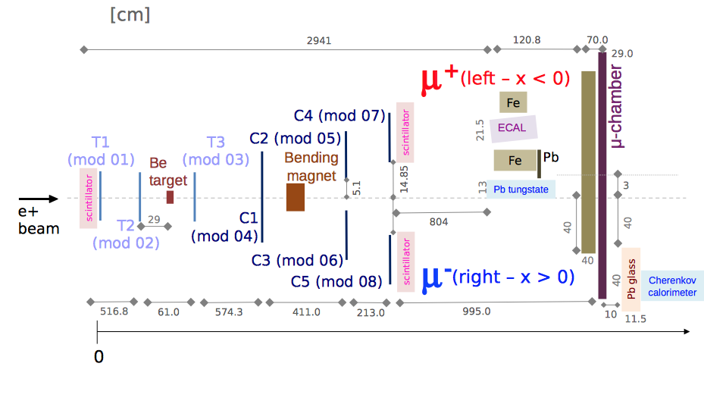
Experimental set-up
T = Si Telescope
C = Si chambers
ECAL = sampling EMC
Pb tungstanate = CMS like EMC
Pb glass = lead glass EMC

Slide 36
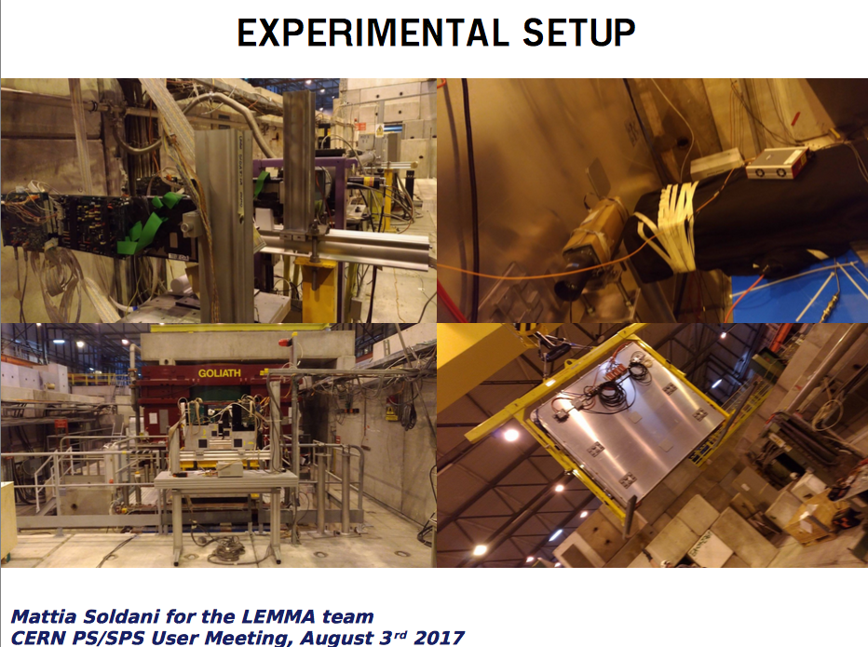

Slide 37
Candidates events in the μ chambers
μ⁺
μ⁻

Slide 38
Conclusion
The production of muons starting from e⁺ beam on target is a very attractive possibility for a muon collider
Key challenges:
  Low emittance and high momentum acceptance 45 GeV e⁺ ring
  O(100 kW) class target in the e⁺ ring for μ⁺ μ⁻ production
  High rate positron source
  High momentum acceptance muon accumulator rings
First design of low emittance e⁺ ring with preliminary studies of beam dynamics
Many issues are being addressed:
  target material & characteristics
  e⁺ accelerator complex
  muon accumulator rings design
  luminosity parameters optimization
We will continue to optimize all the parameters, lattices, targets, etc. in order to assess the ultimate performances of a muon collider based on this concept

Slide 39
Exploring the potential for a
Low Emittance Muon Collider
some References:
    M. Boscolo et al., “Studies of a scheme for low emittance muon beam production from positrons on target”, IPAC17 (2017)
    M.Antonelli, “Very Low Emittance Muon Beam using Positron Beam on Target”, ICHEP (2016)
    M.Antonelli et al. , “Very Low Emittance Muon Beam using Positron Beam on Target”, IPAC (2016)
    M. Antonelli, “Performance estimate of a FCC-ee-based muon collider”, FCC-WEEK 2016
    M. Antonelli, “Low-emittance muon collider from positrons on target”, FCC-WEEK 2016
    M. Antonelli, M. Boscolo, R. Di Nardo, P. Raimondi, “Novel proposal for a low emittance muon beam using positron beam on target”, NIM A 807 101-107 (2016)
    P. Raimondi, “Exploring the potential for a Low Emittance Muon Collider”, in Discussion of the scientific potential of muon beams workshop, CERN, Nov. 18th 2015
    M. Antonelli, Presentation Snowmass 2013, Minneapolis (USA) July 2013, [M. Antonelli and P. Raimondi, Snowmass Report (2013) also INFN-13-22/LNF Note
    Also investigated by SLAC team:
  L. Keller, J. P. Delahaye, T. Markiewicz, U. Wienands:
    “Luminosity Estimate in a Multi-TeV Muon Collider using e⁺e⁻→ μ⁺μ⁻ as the Muon Source”, MAP 2014 Spring workshop, Fermilab (USA) May ’14
    Advanced Accelerator Concepts Workshop, San Jose (USA), July ‘14

Slide 40
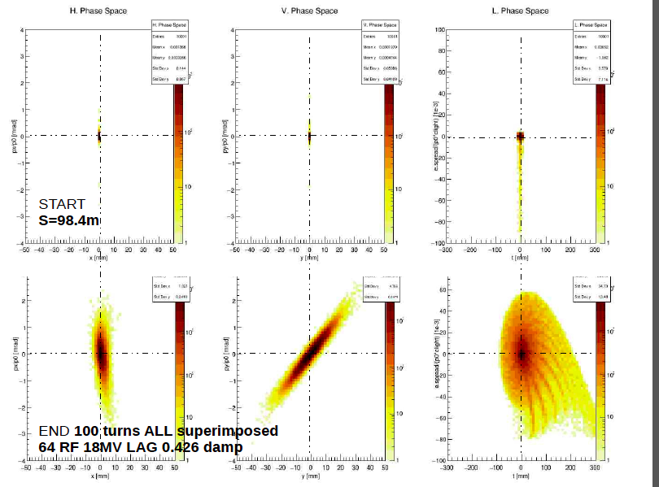
e+ ring with target: beam evolution in the 6D phase space
x-p_{x}
y-p_{y}
t-E
before target,
starting point
after 40 turns
MAD-X PTC & GEANT4 6-D tracking simulation of
e+ beam with 3 mm Be target along the ring (not at IR center in this example)

