Slide 1
SPS CC: Final plan for interlocking of crab cavities in SPS
G.Vandoni
MPP 29th September 2017

Slide 2
Outline
SPS crab-cavity test stand architecture
Interlocks Functional specification
Safety
Machine protection
Equipment protection
Actions
Conclusion
Rationale
Implementation

Slide 3
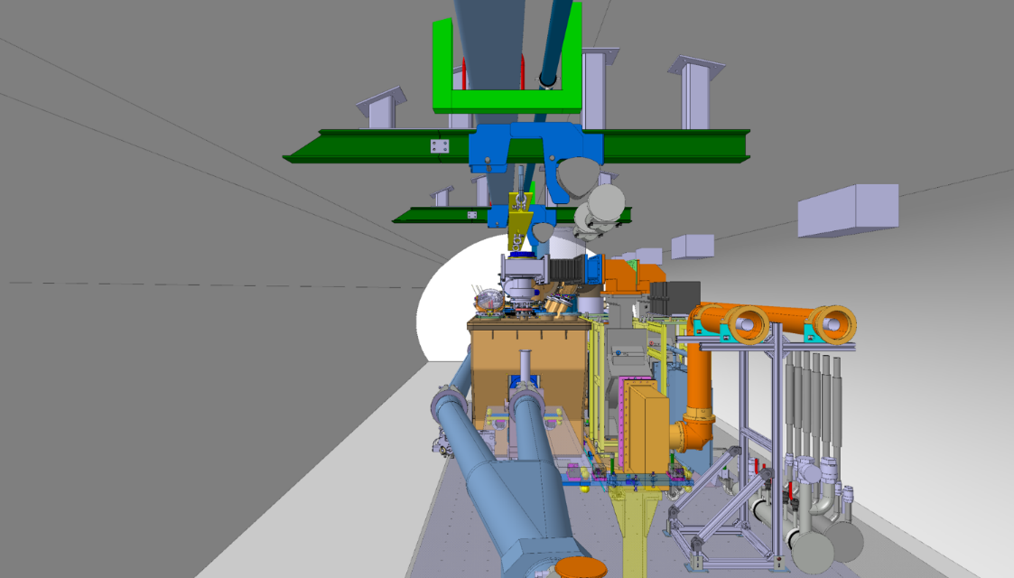
Test stand architecture – tunnel
TEST STAND ARCHITECTURE | INTERLOCKS FUNCTIONAL SPECIFICATION | ACTIONS | CONCLUSIONS
Cryogenic distribution line
Cryogenic distribution line
New handling rails
RF power waveguides
RF power waveguides
Crab-cavity cryomodule
Y-chamber
Moving Transfer table

Slide 4
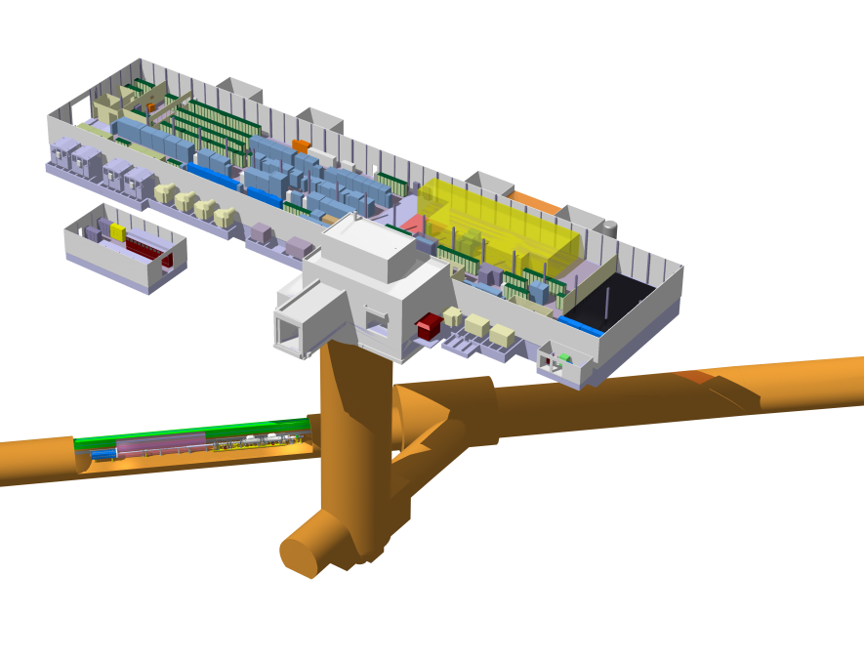
Test stand architecture – tunnel and surface
TEST STAND ARCHITECTURE | INTERLOCKS FUNCTIONAL SPECIFICATION | ACTIONS | CONCLUSIONS
Cryogenic distribution line
Cryogenic distribution line
BA6 – surface area
RF power amplifiers IOT & Controls
New handling rails
He
LLRF Faraday cage
New handling rails
Cryogenic compressor
RF power waveguides
N2
RF power waveguides
Cryo distribution line
CC SPS test stand
TA6 - alcove
COLD-BOX
Cryo distribution system

Slide 5
Interlock types
TEST STAND ARCHITECTURE | INTERLOCKS FUNCTIONAL SPECIFICATION | ACTIONS | CONCLUSIONS
type | why | what
Personnel safety | Radiation (X-rays) ODH and cryo hazard mechanical hazard | Access versus RF Power to cavities Table movement
Machine protection | Aperture | Beam & extraction versus Table position/ movement Vacuum sector valves
Equipment protection |  | RF Power versus Vacuum, cryogenics,… Beam versus HOM power
Cryogenic distribution line
Test program & scope imply an increase in energy + intensity and includes study of failure scenarios: flexible interlocking as we learn to know the system.

Slide 6

Personnel Safety
TEST STAND ARCHITECTURE | INTERLOCKS FUNCTIONAL SPECIFICATION | ACTIONS | CONCLUSIONS
Safe Access VETO to RF Power
Safe Access
VETO to Table movement
Valves closed
when table is remotely piloted
LHe level >0
VETO to Table movement
Valves closed
when table is locally piloted

Slide 7
New EIS-machine
TEST STAND ARCHITECTURE | INTERLOCKS FUNCTIONAL SPECIFICATION | ACTIONS | CONCLUSIONS
IOT1
IOT2
LLRF

Slide 8
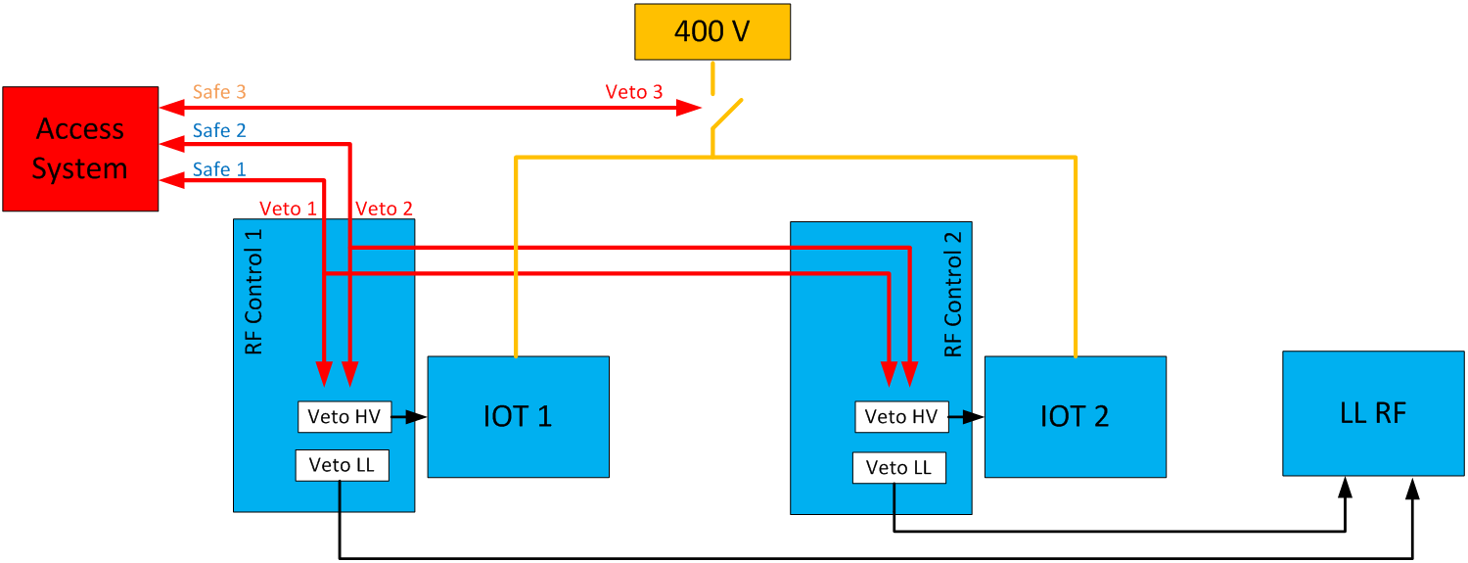
New EIS-machine
TEST STAND ARCHITECTURE | INTERLOCKS FUNCTIONAL SPECIFICATION | ACTIONS | CONCLUSIONS
Responsability issue being sorted out
LLRF

Slide 9
Machine protection - rationale
TEST STAND ARCHITECTURE | INTERLOCKS FUNCTIONAL SPECIFICATION | ACTIONS | CONCLUSIONS
LHC beam extraction in LSS6
NA slow extraction in LSS6
CCCM aperture
CCCM
  Fast extraction to LHC
  Crab-cavity in beam does not yield enough aperture for extracted beam
  Slow extraction of fixed target beam
  at 400GeV, incl. extraction bump
    purple : raw beam envelope
    red: beam envelope + tolerance
    Crab cavity in beam gives sufficient aperture for slow extraction to NA
    No bumper dipole interlock (opp. to Coldex)
H.Bartosik @
SPS Test Day, I
https://indico.cern.ch/event/463435/

Slide 10
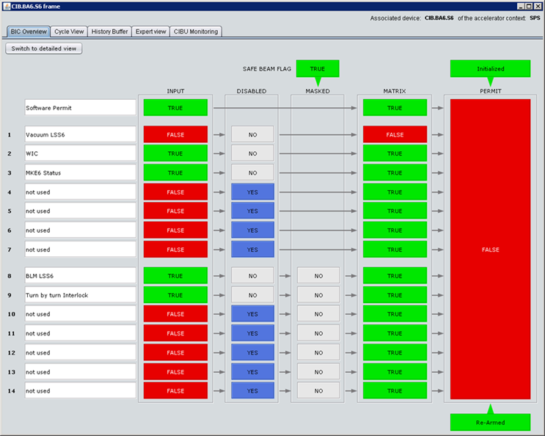
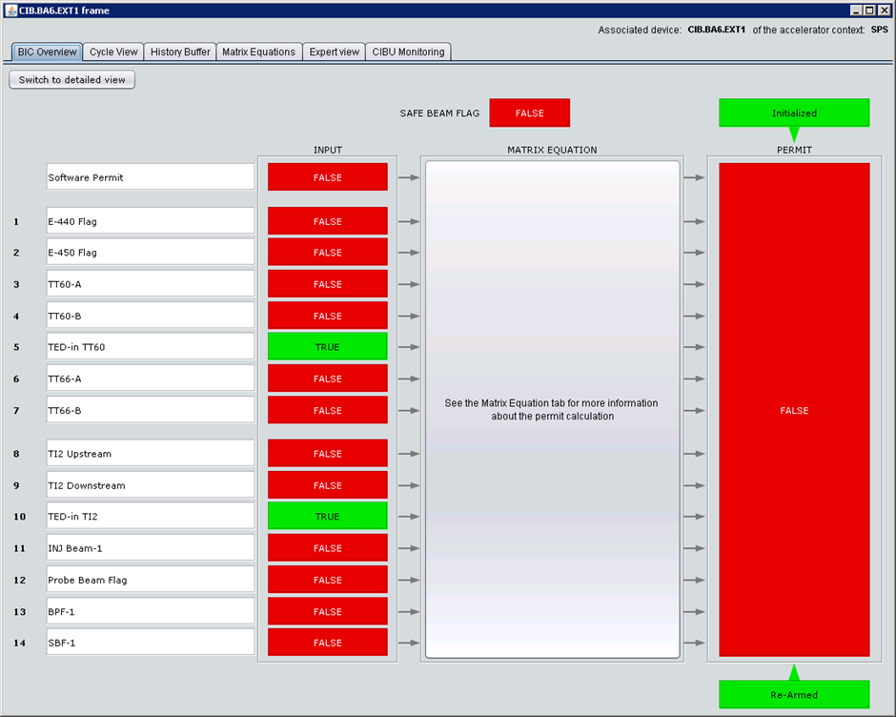
Machine protection - BIS board entries
TEST STAND ARCHITECTURE | INTERLOCKS FUNCTIONAL SPECIFICATION | ACTIONS | CONCLUSIONS
Cryogenic distribution line
BIS SPS RING – BA6
BIS EXTR1 – BA6
Software Permit
VVS CIBU
SPS RING
CC CIBU
U
SPS EXTR1
CC CIBU
BLM CIBU
M
1 new entry, unmaskable, from CC
VVS exception for V1/V3
Software permit for OP interlock
CC BLM individual threshold setting
1 new entry, unmaskable, from CC

Slide 11
Controls layout Transfer Table
TEST STAND ARCHITECTURE | INTERLOCKS FUNCTIONAL SPECIFICATION | ACTIONS | CONCLUSIONS
ACCESS
?

Slide 12
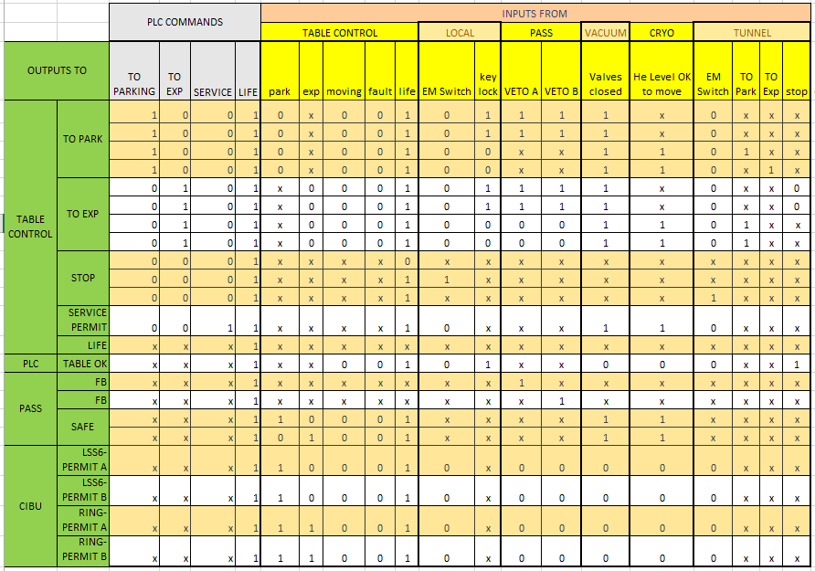
Truth Table for Transfer Table
TEST STAND ARCHITECTURE | INTERLOCKS FUNCTIONAL SPECIFICATION | ACTIONS | CONCLUSIONS
ACCESS

Slide 13
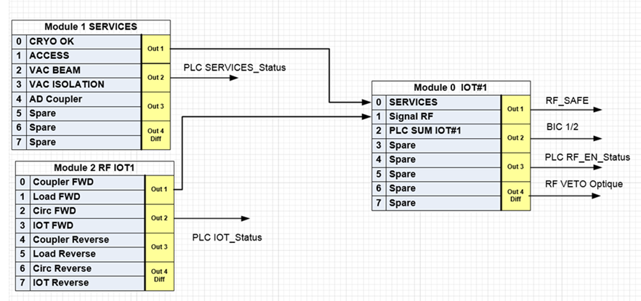
IOT Interlock modules
TEST STAND ARCHITECTURE | INTERLOCKS FUNCTIONAL SPECIFICATION | ACTIONS | CONCLUSIONS
When CM in-beam, the RF PLC status, HOM power threshold, set of RF signals interlock beam
When CM out-of-beam, only the table status interlocks beam
Internal, equipment protection interlocks
INPUT
HOM Power threshold*
INPUT
*HOM Power threshold 200W implemented to protect LHC-type HOM coupler feedthroughs after failure of high power new design HOM FT’s during dressed cavity tests
RF status

Slide 14
Documents
TEST STAND ARCHITECTURE | INTERLOCKS FUNCTIONAL SPECIFICATION | ACTIONS | CONCLUSIONS
 | STATUS | STEPS
ECR Access system | in work | intl check | expert check | approval by project, BE-ICS, DSO…
Interlocks Funct Specification EDMS 1843638 | intl check |  | expert check | approval by project, OP, MPP
Procedure for EIS lock-out | as per EIS regulation
Settle the issue with EIS-machine on IOT direct power interlocking
Hardware and PLC logics under construction
Operation due to start March 2018
Cooldown & beam permit February 2018 (interlock tests)

Slide 15
Conclusions
TEST STAND ARCHITECTURE | INTERLOCKS FUNCTIONAL SPECIFICATION | ACTIONS | CONCLUSIONS
Cryogenic distribution line
Robust, flexible interlocking based on CERN standards
Safety dictates interlock of Access Safe to RF and table movement (EIS on IOT)
Machine protection ensured via BIS interlocked with transfer table position
Equipment protection and protection against hardware failure in beam implemented
Software interlock for flexible, evolving action
Thresholds implemented to allow for changes as our knowledge progresses with MDs

Slide 16
Thank you for your attention
L.Arnaudon, R.Calaga, V.Kain, J.Uythoven, S.Gabourin, D.Glenat, T.Ladzinski, D.Vaxelaire

