Slide 1
Oxidation behavior of graphite in air at high temperature
153rd MPP meeting
A. Perillo-Marcone, M. Calviani (EN-STI-TCD)
In collaboration with EN/MME

Slide 2
Oxidation of graphite at high temperature over milliseconds
Performed at CERN by EN/MME

Slide 3
Methodology
Impacting samples with laser beam in air
Temperature reached ~900-1300 °C
Exposition time ~10 ms
Materials
      Sigrafine (high density graphite in TDE)
      Sigraflex (low density graphite in TDE)
Examine changes in:
      Microstructure
      Chemical composition
      Phase

Slide 4
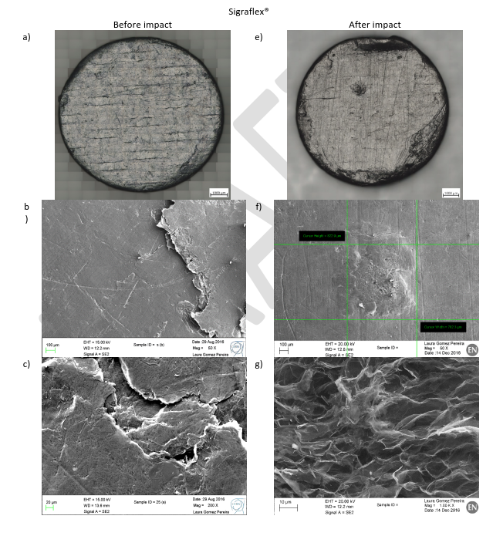
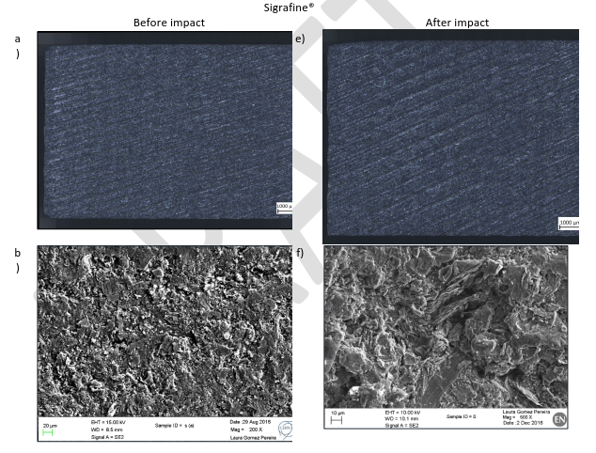
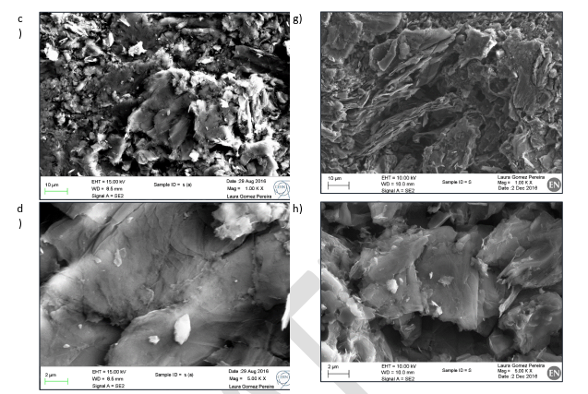
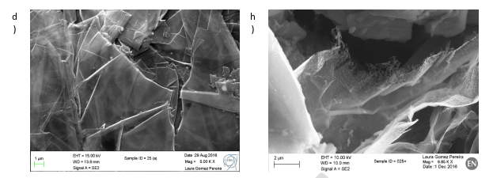
Results

Slide 5
Laser Impact – Conclusions
No clear indication of oxidation
Observed damage generated by thermo-mechanical stresses (not representative of stresses from proton beams)
Highly pessimistic conditions in comparison to TDE:
    Exposition times ~10ms (instead of us for TDE)
    Atmosphere 100% air

Slide 6
Oxidation in air furnace
Performed at CERN by EN/MME

Slide 7
Scope
Remove thermomechanical stresses
Overly conservative exposition time
Exposition to 100% air atmosphere

Slide 8
Methodology
Preheating air furnace to >1100 °C
Insertion of samples in furnace (temperature drop to ~850 °C)
Samples maintained in furnace during 100s
Microscopy and chemical analysis of samples

Slide 9
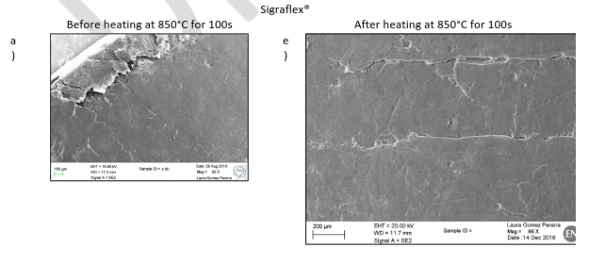
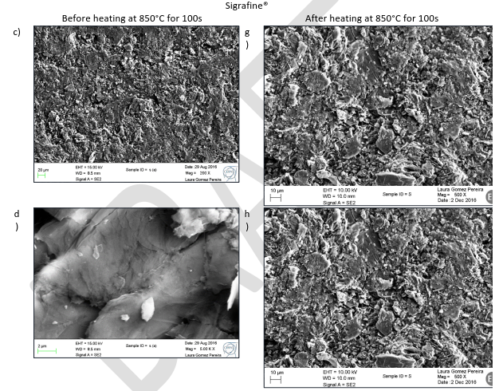
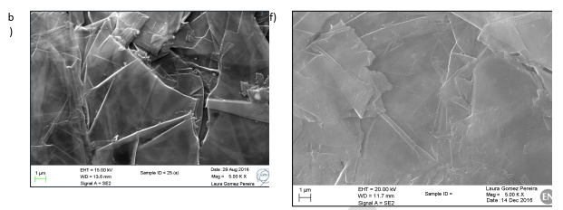
Results
No apparent change in microstructure
Amount of O and Si keep constant before and after the study
Material does not seem to be affected by oxidation
Further test in oven at 1100°C under way

Slide 10
Oxidation at 2500 °C – 10s
Performed by SGL

Slide 11
Methodology
Five samples of Sigrafine and Sigrafoil tested separately
Heating up in argon to 2500 °C
Injection of air in furnace
Exposition time ~10s

Slide 12
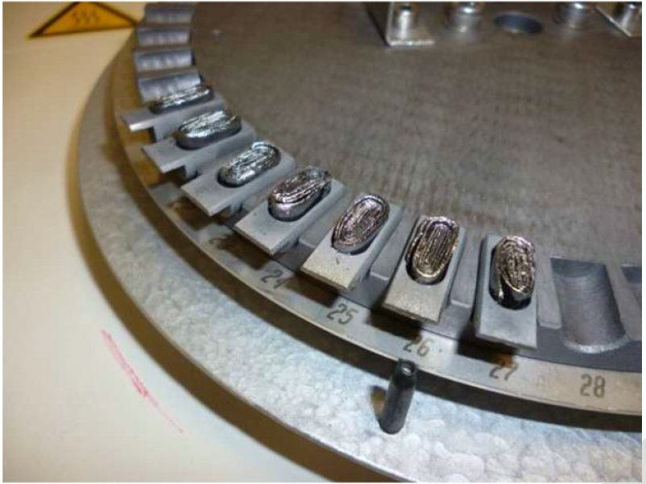
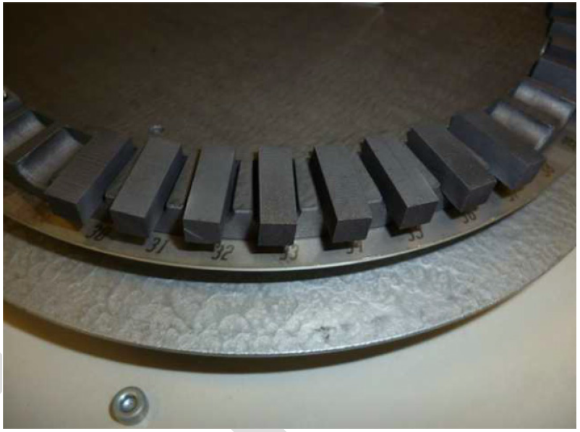
Tested samples
Sigraflex
Sigrafine

Slide 13
Results
After exposition to air at 2500 °C in air during 10s, there is a mass loss of:
    0.66% in Sigrafine
    0.99% in Sigraflex
Sigrafine
Sigraflex

Slide 14
Conclusions
Attack limited to surface
  Thermal energy too high for O₂ to penetrate/diffuse in the bulk
Findings in line with previous studies found in literature, limited to 1500 °C
Low temperature oxidation not located on surface → voids would appear in the bulk (longer times required for this)

Slide 15
Oxidation at 1200 °C – 100s, 1000s
Performed by SGL

Slide 16
Methodology
Only samples of Sigrafine investigated so far
Furnace heated up to 1200 °C, in argon atmosphere
Switch to air during 100/1000 s
Switch back to argon
Cool-down in argon
Micro scale to measure weight
Physical and mechanical properties measured before/after test

Slide 17
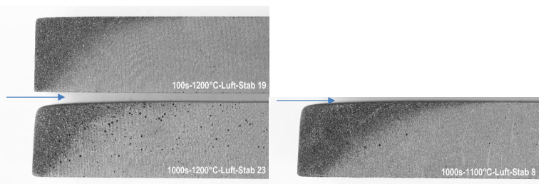
Results
Air flow indicated by the arrows
Strong reaction observed after the air meets the graphite surface
In all three cases, a pattern of the air flow around the sample observed
After 1000s, holes observed on the surface
Mass loss remains limited: ~1% for 100s, ~4% for 1000s
No changes in density, electrical resistivity or dynamic modulus

Slide 18
General conclusions
As well known, graphite is sensitive to oxidation at high temperature
Oxidation highly dependent on temperature and exposition time
At significantly high T (>1500°C) oxidation limited to surface, for exposition times of 10s
Greater mass loss observed for longer exposition times, but still attack limited to surface
All tests several times more pessimistic that actual conditions in TDE
These studies allow to exclude the possibility of graphite igniting at high temperature in the presence of air in the TDE scenarios
Comprehensive report including all these studies being written. Expected to be released by end of 2017/beginning 2018

Slide 19
Back-up slides

Slide 20
Laser heating – CERN/EN-MME

Slide 21
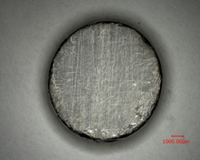
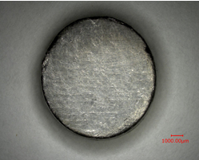
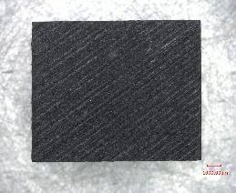
Samples
  Sigraflex I (SI)
  Sigraflex II (SII)
  Sigrafine
L20010
Anisotropic
Ø 10 mm x 2 mm
L25012
Anisotropic
Ø 10 mm x 2.5 mm
R7300 P500
Isotropic
10 mm x 10 mm x 12 mm
Material supplied by SGL

Slide 22
Laser Parameters
Laser ≠ Proton Beam
Less Energy density in order to minimize the thermomechanical stress on the sample
Best parameters after several trials…
Sigraflex
Energy | Frequency | Power | Wavelength | Height
1 J | 1 Hz | 1 W | 1064 mm | Defocused beam Z – 3.5mm
400 µm
Laser source
Sigrafine
Focused beam
3.5 mm
Energy | Frequency | Power | Wavelength | Height
4 J | 1 Hz | 4 W | 1064 mm | Defocused beam Z – 3.5mm
Sample

Slide 23
Inspection procedure
  Microscopy observation (OM* and SEM*) → surface aspect
Digital microscope KEYENCE VHX 1000
OM “ZEISS Axio Imager” with “ZenCore” software
SEM, field emission gun FEG Sigma (ZEISS)
  Chemical Analysis → chemical composition
50 mm2 X Max Energy dispersive X-ray spectroscopy EDS detector (Oxford), INCA software
  Phase Analysis → change in the crystalline phases after the laser impact
X-ray diffraction (XRD), θ/2θ or grazing angle
  On sample as received and after impact
*OM: Optical Microscope
*SEM: Scanning Electron Microscope

Slide 24
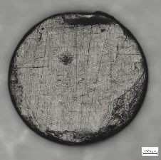
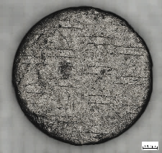
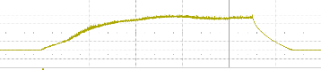
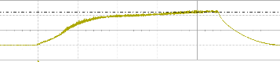
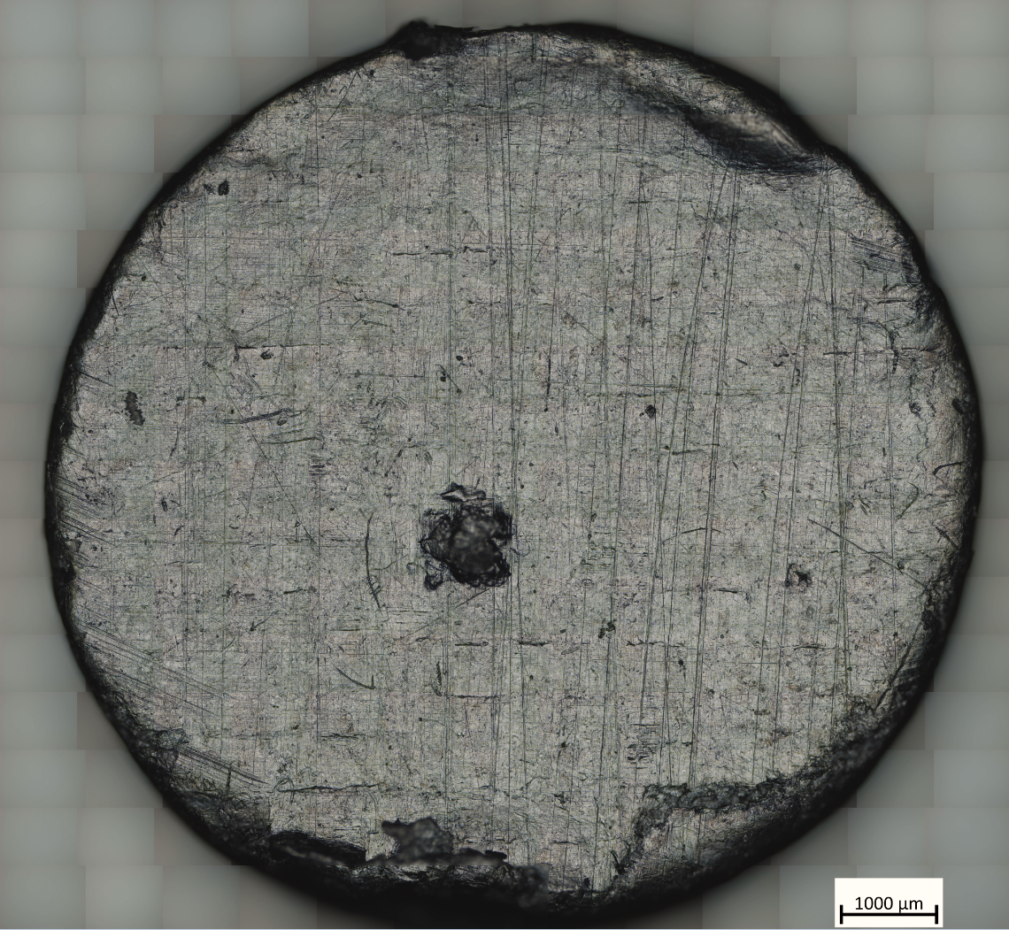
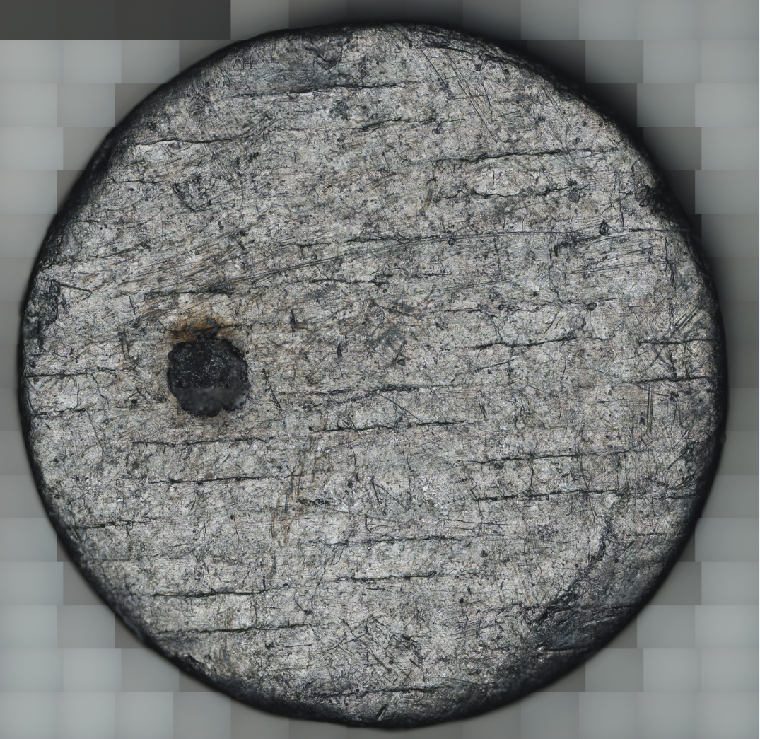
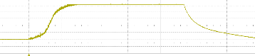
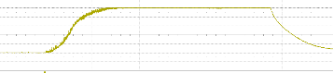
OM and SEM – Sigraflex
1.105 °C
9 ms (2 ms/div)
LVD*
1.266 °C
9 ms (2 ms/div)
1.354 °C
10 ms (2 ms/div)
MVD*
1.393 °C
10 ms (2 ms/div)
LVD = Least Visual damage
MVD = Most Visual damage

Slide 25
OM and SEM – Sigraflex
LVD*
Discontinuities
1 mm²
0.8 mm²
Decohesion
Flake like morphology
Swelling
MVD*
Embossed Surface
0.4 mm²
0.65 mm²

Slide 26

EDS – Sigraflex as received
Presence and quatification of O cannot be 100% ensured
Peak of C, O, Si
Similar Chemical Analysis
Examples:
Ʃ peak | E (keV) | El.
C + C | 0.54 | O
C x 3 | 0.81 | -
C + Si | 2.02 | P
One chosen as reference

Slide 27
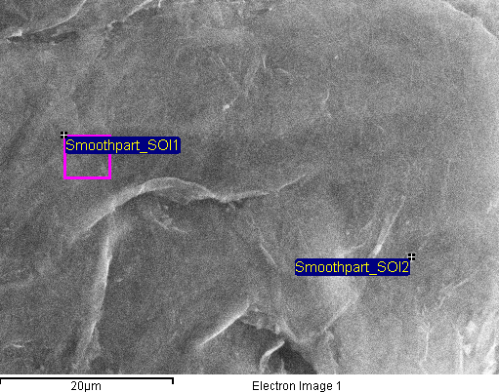
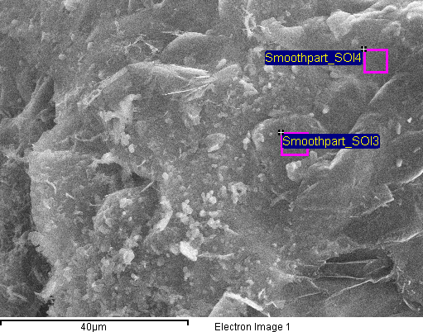
EDS – Sigraflex after impact
Reference
Reference
Higher amount of O and Si
Common features in all Sigraflex samples

Slide 28
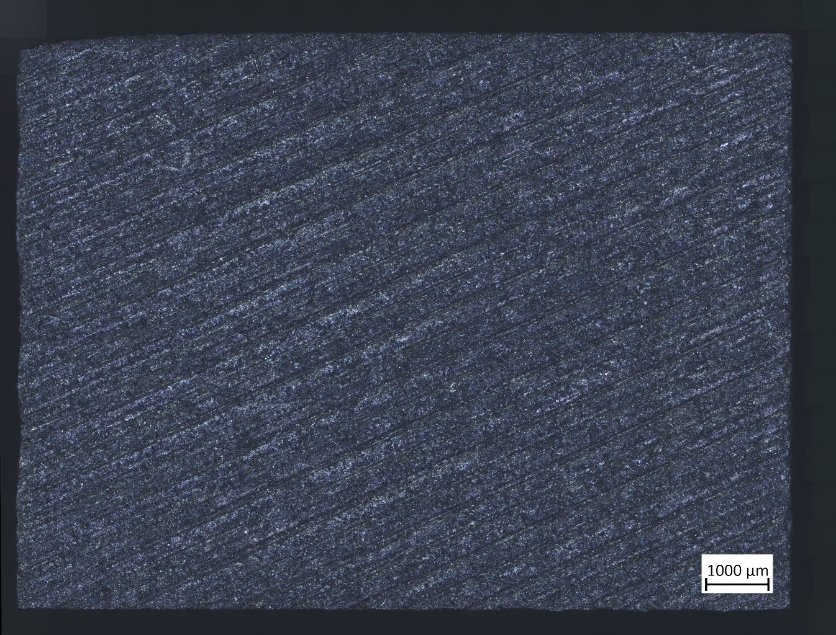
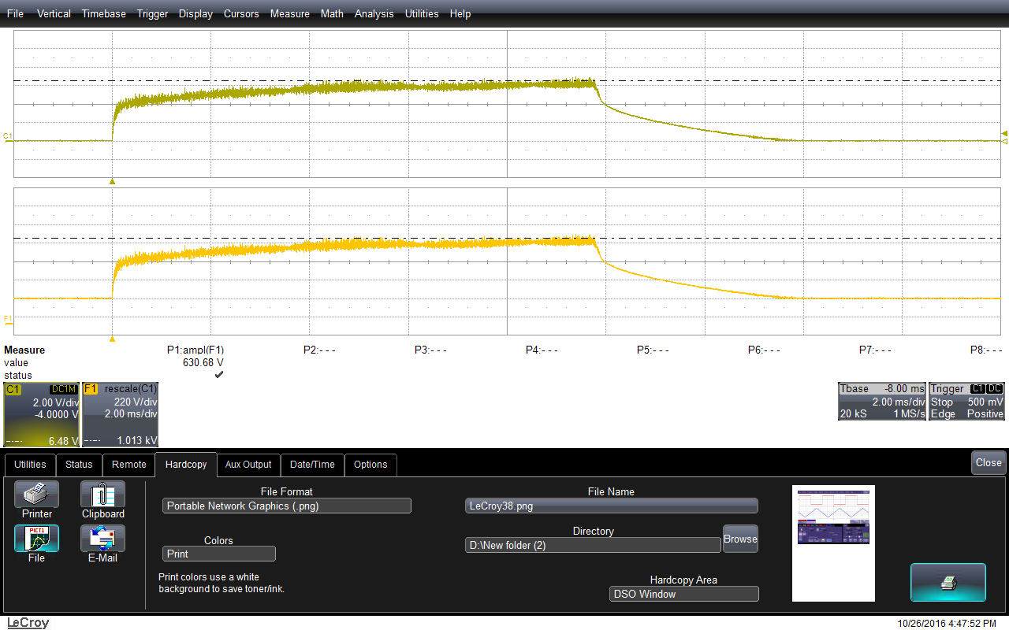
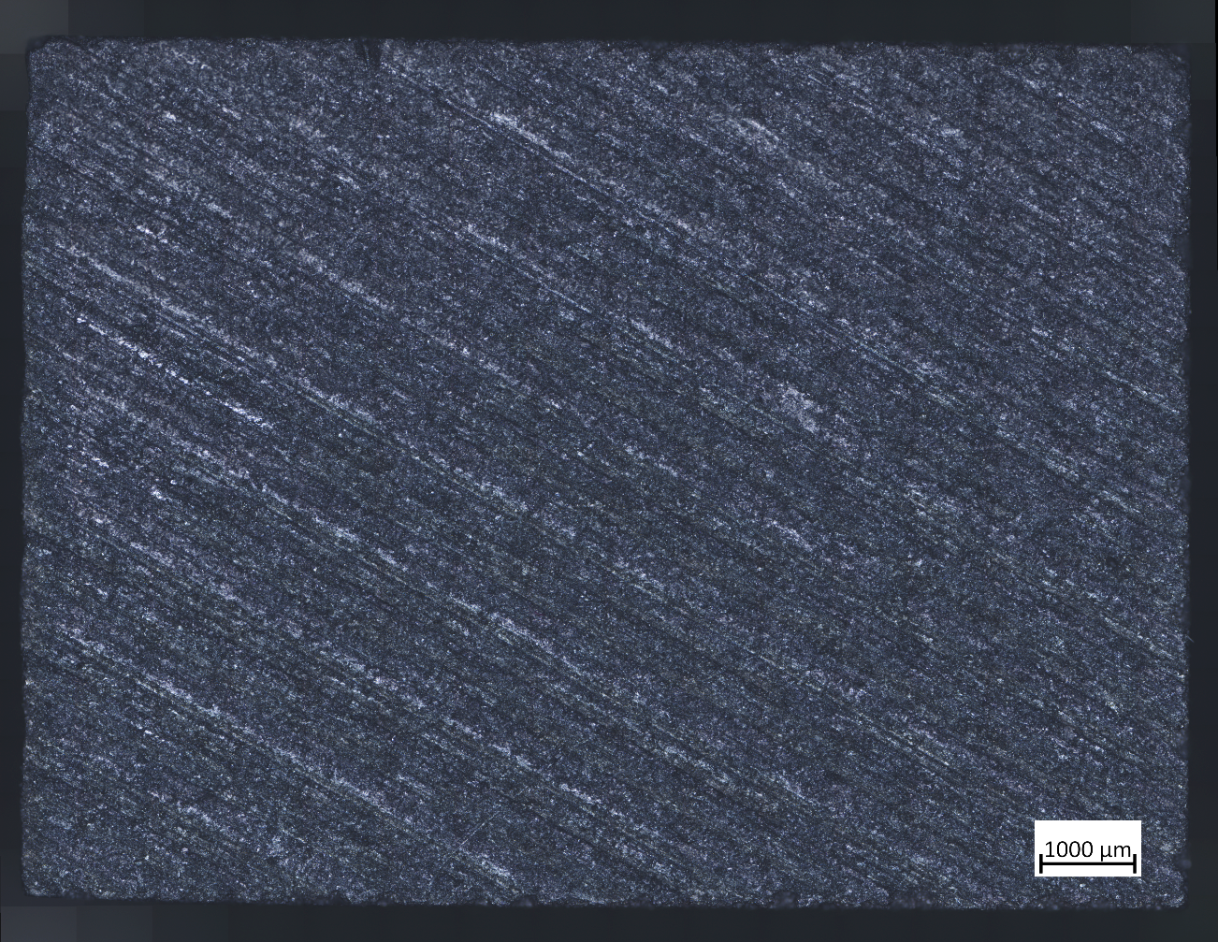

OM – Sigrafine after impact
1.013 °C
10 ms (2 ms/div)
953 °C
9 ms (2 ms/div)
No laser impact visible with OM

Slide 29
SEM – Sigrafine after impact
Presence of a macro-voids
No changes of Microstructure

Slide 30
Furnace heating – CERN/EN-MME

Slide 31
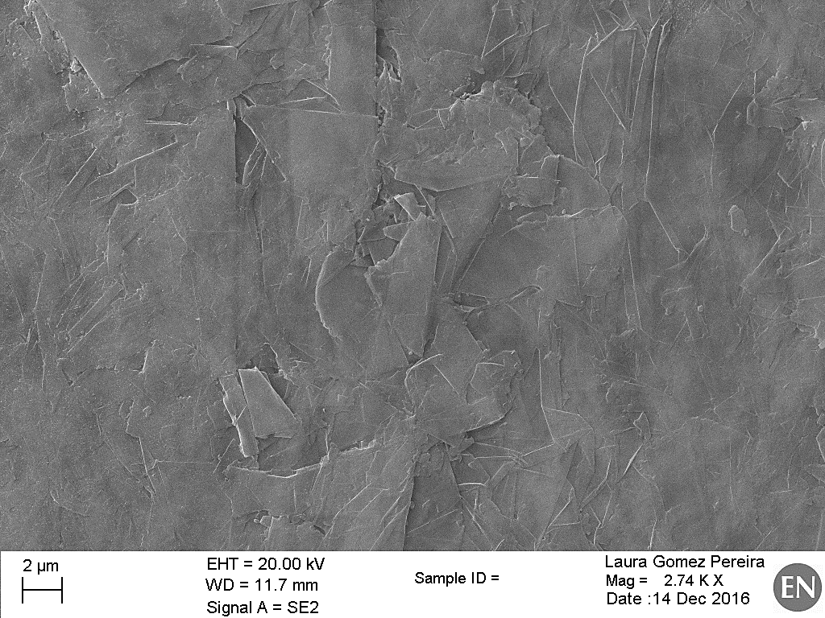
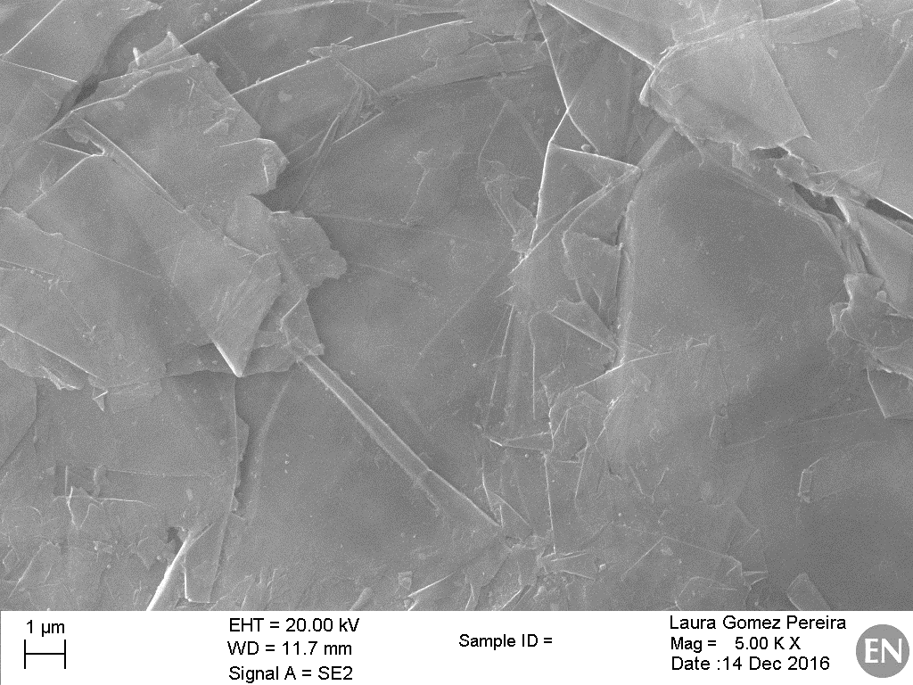
SEM – Sigraflex
Discontinuities
Decohesion
Flake like morphology
No apparent change in Microstructure

Slide 32
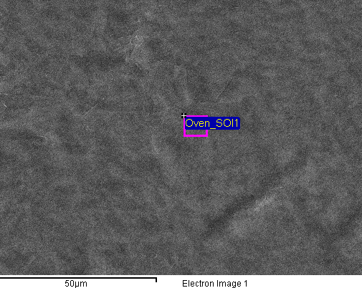
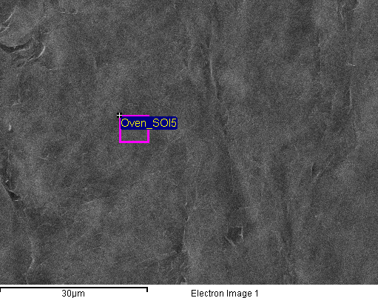
EDS – Sigraflex
Reference
Reference
No changes in Si and O content
Pollution: Al, Si, P

Slide 33
SEM – Sigrafine
Production marks
Roughness
Irregular
No apparent change in Microstructure

Slide 34
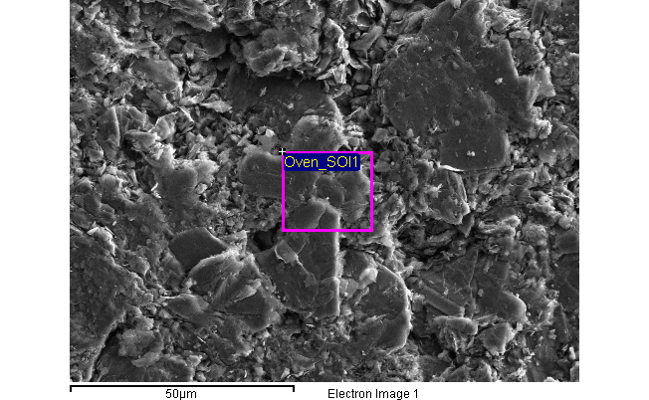
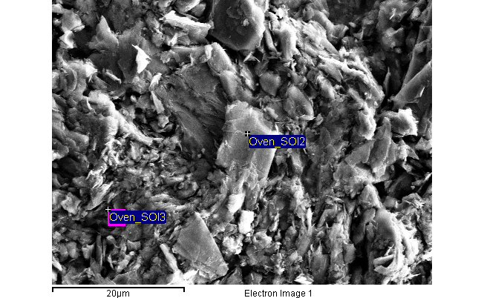
EDS – Sigrafine
Reference
Same amount of O

Slide 35
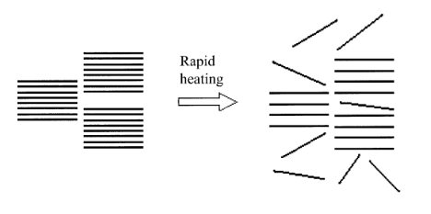
Summary of observations
Laser Impact
Oven Studies
Microstructure:
Embossed surface and Expansion of graphite → Swelling
Degradation of material → Evaporation of material
Microstrucure:
No apparent change in microstructure
Chemical Analysis:
Amount of O and Si keeps constant before and after the study
Chemical Analysis:
Higher amount of O and Si
Presence of pollution → probably due to manipulation
The graphite does not seem to be affected thermally
Phase Analysis: no apparent change
Further study on-going in oven at 1100°C

