Slide 1
Depolarization (hardware)
J. Wenninger
With input from the BE RF colleagues
W. Hoefle, D. Valuch, L. Arnaudon

Slide 2
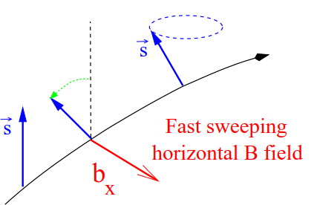
Depolarization process
The depolarization process itself was never studied in detail at LEP.
Some ‘magic’ depolarization settings were established and kept for the entire LEP life-cycle.
It is not unrealistic to assume that as a starting point one can consider similar depolarization settings for FCC-ee and LEP.
  Scale the time scales for the ~4 times longer revolution period.
  More issues with decoherence of the spin vectors during depolarization process at FCC-ee ?!?

Slide 3
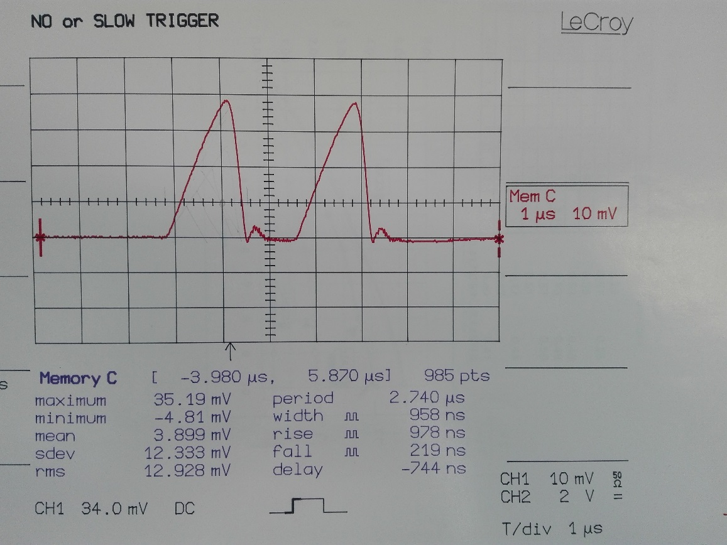
LEP kicker
Magnetic kicker with max field of ~ 0.4x10⁻³ Tm.
Kicker pulse: ~1 μs FWMH. One pulse per revolution.
Standard field strength for depolarization ~ 0.2x10⁻³ Tm.
  orbit kick of 1.2 μrad, spin rotation of 140 μrad.
~ 1 μs
L. Arnaudon, S. Myers and R. Olsen, Commissioning of the LEP transverse feedback system, Proc. IEEE Particle accelerator Conf. EPAC90 (Nice, 1990 )

Slide 4
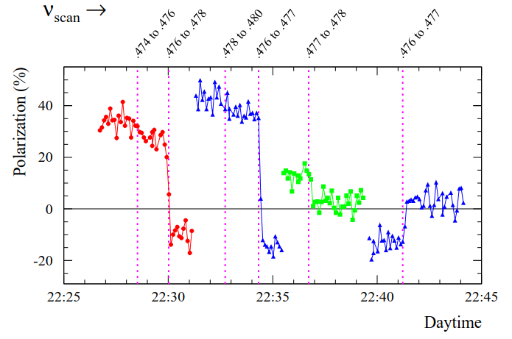
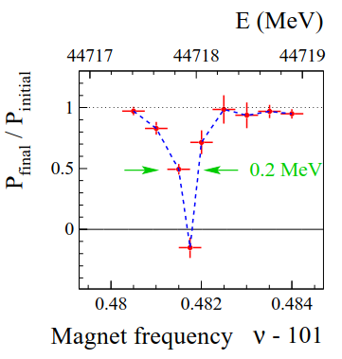
LEP depolarization
Depolarization sweeps were typically 22 Hz wide to provide an energy within ±0.44 MeV.
  More precise frequency determinations were possible, usually not used because the standard accuracy was adequate and more accurate scans could be time consuming.
In the first set of measurements Q_{s} was modified to confirm that the depolarization did not happen on a Q_{s} sideband, and the energy was varied using the RF frequency to determine if the depolarization scan corresponded to ν_{s} or 1-ν_{s}.
  From them on it was usually possible to track the energy.

Slide 5
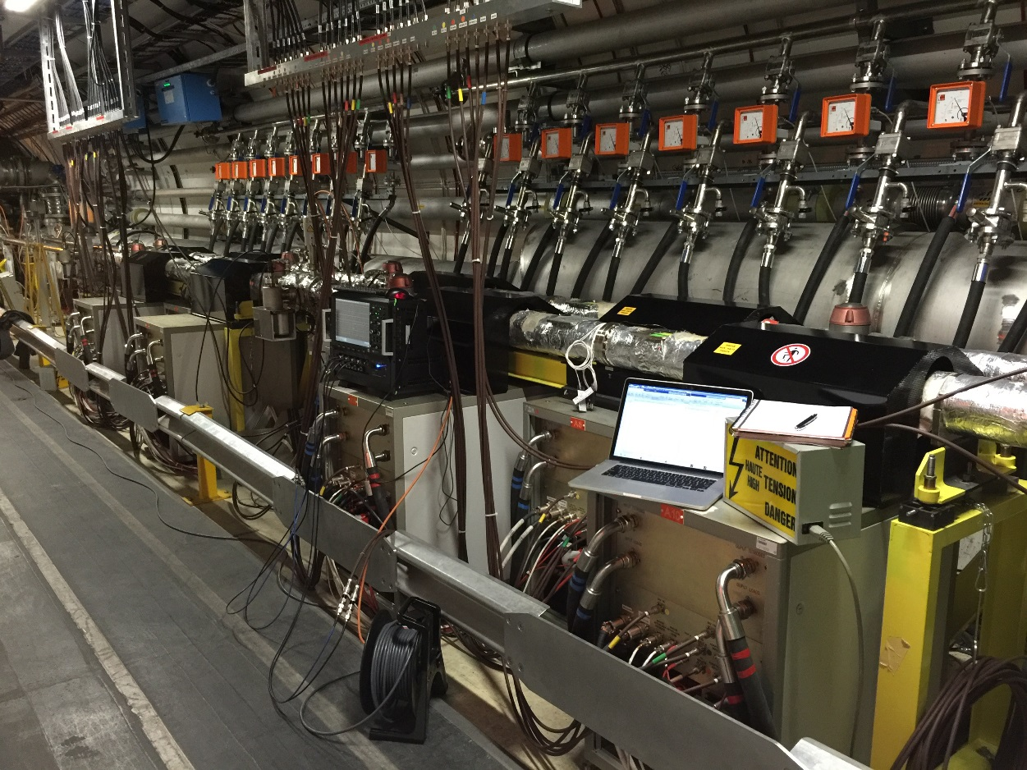
LHC transverse feedback system
Four kickers per beam, per plane, located in RF zone (UX451) at point 4
  Electrostatic kicker, length 1.5 m.
  Providing a kick of ~2 μrad @ 450 GeV (all 4 units combined).
  Useful bandwidth ~1 kHz – 20 MHz.
ADT kickers and power amplifiers at point 4

Slide 6
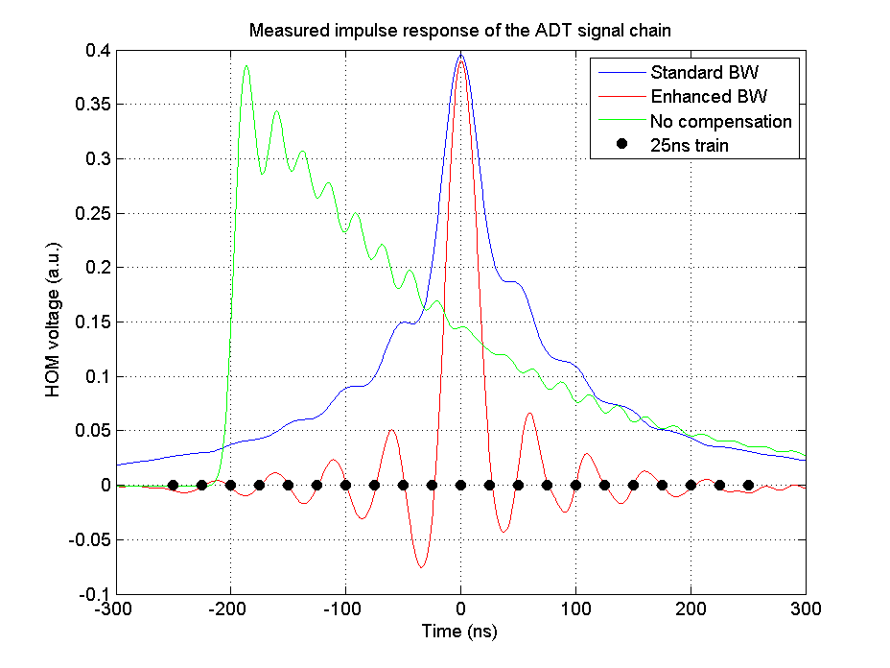
LHC TF digital processing
Impulse response of “standard bandwidth” and “enhanced bandwidth” operation of the LHC TF.
Almost bunch-by-bunch kicker for LHC 25 ns bunch spacing.
  More or less what would be nice to have for FCC-ee depolarization.

Slide 7
LHC ->FCC-ee
The LHC TF system would provide a transverse kick of up to ~20 μrad at the Z peak with ~10 MHz bandwidth. This is 10x more than what we may need → OK !
For a LEP like kick of ~1 μrad there is a factor 4-5 margin wrt DA. AM arrangement of 2 kickers with adequate phase advance to enhance the deflection may be used to overcome DA issues.

