Slide 1
Beam Energy Spread Measurement @ FCC-ee
Thank you !
  Mogens
  Patrizia
  Mike
  Jorg
    For challenging me and asking me questions about the beam energy spread measurement in the past months / years
  There would have been no talk possible today without this pre-existing thinking and coding
    I realize that I was expected to present something only two days ago, while browsing the agenda !
Piece of advice:
  To all workshop organizers
    Invite speakers one by one (as opposed to bulk mailing)
      With a personal e-mail indicating the desired content of the presentation
      Well ahead of time (several months), to allow for original and substantial work
      Several times until you get a personal reply

Slide 2
Initial requirements w/o energy spread
Targets set in the TLEP paper
  Precision on the Z width : 100 keV
  Precision on the Z mass : 100 keV
  Precision on the peak cross section : 10⁻⁴
We will run at least with three beam energies around the Z pole
  E_{beam} = 45.6 GeV , i.e., the Z pole
    σ_{peak} ~ 30 nb , L_{peak} ~ 100 ab⁻¹, N_{peak} ~ 3×10¹² events
  E_{beam} = 43.95 GeV and 47.15 GeV, for the α_{QED}(m_{Z}) measurement
    σ_{peak±3} ~ 6 nb; L_{peak±3} ~ 25 ab⁻¹, N_{peak±3} ~1.5×10¹¹ events
  Statistics large enough to be limited by systematic uncertainties for m_{Z}, Γ_{Z} and σ₀
To reach the aforementioned targets w/o energy spread, we need
  A measurement of the beam energy (e⁺ and e⁻) with a precision of 50 keV
  A point-to-point relative integrated luminosity measurement precision of 5×10⁻⁵
  An absolute integrated luminosity measurement precision of 10⁻⁴
    Result of a 3-parameter fit: σ(m_{Z}) = 96 keV, σ(Γ_{Z}) = 104 keV, σ(σ₀)/σ₀= 10⁻⁴

Slide 3
Side remark : what beam energies ?
With the same precision on the beam energy and luminosity, no spread
  Result of the fit with Peak±2 instead of Peak±3
    σ(m_{Z}) = 86 keV, σ(Γ_{Z}) = 140 keV, σ(σ₀)/σ₀= 10⁻⁴
  Result of the fit with Peak±1 instead of Peak±3
    σ(m_{Z}) = 84 keV, σ(Γ_{Z}) = 263 keV, σ(σ₀)/σ₀= 10⁻⁴
  Target not reached for the Z width
    Almost no difference for the mass and the peak cross section
      Let’s stick to Peak±3 for the time being

Slide 4
What happens with energy spread ?
Let’s take the current beam energy spread with beamstrahlung
  E_{spread} = 0.132% E_{beam} (~60 MeV) for each beam – Spread assumed to be Gaussian (??)
    Cross section differs by -0.4% to +0.3% , i.e., much larger than uncertainties
  Dominant effect on the width measurement: reduction of the peak cross section
    With a three parameter fit and three energies: Γ_{Z} → [Γ_{Z}² + 8E_{spread}²]^{1/2}
      ΔΓ_{Z} > 8Γ_{Z}(E_{spread}/Γ_{Z})² × ΔE_{spread}/E_{spread} (= 12 MeV × ΔE_{spread}/E_{spread} for E_{spread} = 60 MeV)
        1% uncertainty of E_{spread} leads to > 120 keV uncertainty on Γ_{Z} !
  Need to find a way to determine the energy spread to a few per mil
    And fit the cross section to the convolution of a Breit Wigner with a Gaussian
      That’s a four parameter fit (m_{Z}, Γ_{Z}, σ₀, E_{spread})
σ (nb)
Δσ/σ (%)
E_{b} (GeV)
E_{b} (GeV)

Slide 5
Four-parameter fit with three energies
We need an external measurement of the beam energy spread
  The precisions on m_{Z}, Γ_{Z}, and σ₀ depend on the precision of this measurement
    Relative precision of 0.2% required !
      Challenging beam instrumentation
      See next talk ?
  Can we help with collision data ?
0.2%
10 %
0.5 %

Slide 6
Add two energy points ?
The optimal choice is to add Peak±1
  Energy spread determined with ~1% relative precision … not quite enough
    Still need external measurement for Γ_{Z}
      Precision 200 keV otherwise
        (160 MeV with 1% external)
  Good to have, but...
    Reduction in total Z statistics
    Assumes a constant Gaussian spread
      Other (better) ideas required
0.2%

Slide 7
Make use of e⁺e⁻ → μ⁺μ⁻ events
How are the events modified with energy spread ?
μ⁺
No energy spread
e⁺ (E_{b}, E_{b}−δE₊)
Δθ = π
e⁻ (E_{b}, E_{b}+δE₋)
Δθ < π
With energy spread
μ⁻

Slide 8
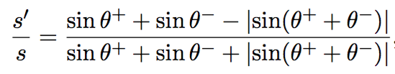
Make use of e⁺e⁻ → μ⁺μ⁻ events
Competes with initial state radiation (that you cannot get rid of)
  Angles often used to determine effective √s’
μ⁺
No ISR
e⁺ (E_{b}, E_{b}−δE)
Δθ = π
e⁻ (E_{b}, E_{b})
γ (δE)
Δθ < π
With ISR
μ⁻
Plots that follow show √s’ distributions

Slide 9
Make use of e⁺e⁻ → μ⁺μ⁻ events
Also competes with muon angular resolution …
  Need to have good ISR prediction (S. Jadach)
  Need to master muon angular resolution
    Over the whole tracker accpetance
μ⁺
Perfect resolution
e⁺ (E_{b}, E_{b})
Δθ_{ideal} = π
e⁻ (E_{b}, E_{b})
Δθ_{meas} < π
Finite resolution
μ⁻

Slide 10
The competition
Distributions of √s’ with 10⁶ e⁺e⁻ → μ⁺μ⁻ events at √s = 91.2 GeV
  With ISR only

Slide 11
The competition
Distributions of √s’ with 10⁶ e⁺e⁻ → μ⁺μ⁻ events at √s = 91.2 GeV
  With ISR and 0.1 mrad angular resolution (typical of CLIC and IDEA)

Slide 12
The competition
Distributions of √s’ with 10⁶ e⁺e⁻ → μ⁺μ⁻ events at √s = 91.2 GeV
  With ISR and 0.132% of beam energy spread
Energy spread wins the competition

Slide 13
The competition
Distributions of √s’ with 10⁶ e⁺e⁻ → μ⁺μ⁻ events at √s = 91.2 GeV
  With ISR + beam energy spread + angular resolution
Energy spread wins the competition

Slide 14
The competition
Distributions of √s’ with 10⁶ e⁺e⁻ → μ⁺μ⁻ events at √s = 91.2 GeV
  Same as before but with an angular resolution of 1 mrad
Energy spread no longer wins the competition
σ_{θ,φ} ~ 0.1 mrad is a requirement

Slide 15
Energy spread determination: Sensitivity
With precise prediction of ISR and knowledge of angular resolution
  The √s’ distribution is sensitive to the energy spread
    Sensitivity to ΔE_{spread}/E_{spread} ~ 0.15%, every 10⁶ e⁺e⁻ → μ⁺μ⁻ events !
      Independently of the actual angular resolution (0.0 or 0.1 mrad shown)
Needed anyway for all other
FCC-ee measurements
Diff. between 0.132% and 0.1333%
Slope determined with 15% precision

Slide 16
Energy spread determination: Sensitivity
Still the angular resolution must be known with a certain accuracy
  The √s’ distribution is sensitive to σ_{θ,φ} (although the dependence with E_{spread} is not)
    Effect of a 20% knowledge of σ_{θ,φ} equivalent to ΔE_{spread}/E_{spread} ~ 0.1%
      Need to determine σ_{θ,φ} to ± 0.01 mrad or better (as a function of θ and φ)
Diff. between σ_{θ,φ} = 0.1 and σ_{θ,φ} = 0.11 mrad

Slide 17
A permanent monitoring
At the Z pole, σ(e⁺e⁻ → μ⁺μ⁻) ~ 1.5 nb
  With 2.3⋅10³⁶ cm⁻² s⁻¹ collect 3.5 kHz of e⁺e⁻ → μ⁺μ⁻ events / detector
    Enjoy one million events every 5 minutes
    Monitor the beam energy spread to 0.2% precision every 3 minutes.
At Peak ± 3 GeV, the cross section is reduced to o.3 nb
  Monitor the beam energy spread to 0.2% every 15 minutes
    Probably can afford a worse precision at these points
      Due to smaller sensitivity of the cross section to E_{spread} than at the peak
Bonus: we have to such independent monitorings (two detectors)
Technical details
  The energy spread might not be Gaussian
    Need to evaluate the sensitivity to the exact shape (e.g., rectangular w/ same RMS)
  The angular resolution unfolding require full simulation, precisely tuned to the data
    Need to measure this resolution with data in every direction
  The extraction of the Z resonance parameters requires a multi-parameter fit
    If E_{spread} varies rapidly, one parameter per period of 3 minutes …

Slide 18
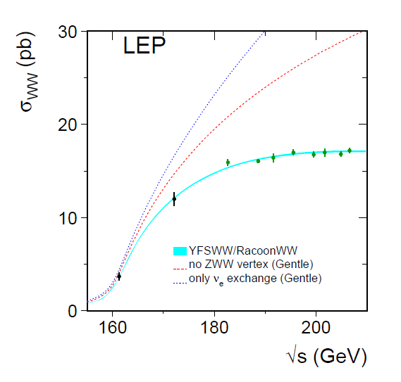
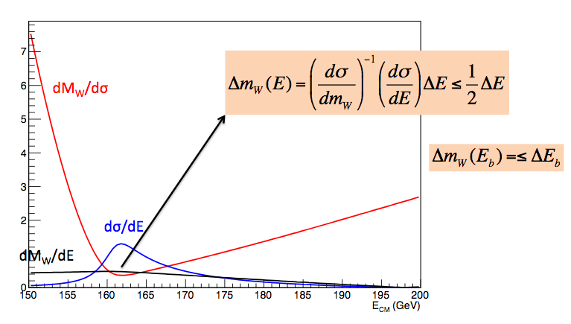
Other energies
The W mass target precision is 500 keV
  It is measured at threshold (as opposed to “at the peak”)
    A place where the effect of the energy spread is much smaller
      From Paolo Azzurri (yesterday):
    Convolution of cross section with a Gaussian (E_{spread} = 0.153%):
      No effect on σ_{WW} and m_{W} at 1st order, no effect at 2nd order, at √s = 162.3 GeV
        (integral of an odd function at 1st order, and 2nd derivative is zero)
Around 162.3 GeV

Slide 19
Other energies, cont’d
The corresponding statistical precision on Γ_{W} (2.1 GeV) will be 1.5 MeV
  With an additional run at 157.3 GeV (40% of the luminosity)
  E_{spread} is 124 MeV, adds in quadrature to Γ_{W} → (Γ_{W}²+E_{spread}² )^{1/2}
    ΔΓ_{W} = Γ_{W} (E_{spread}/Γ_{W})² × ΔE_{spread}/E_{spread} (= 7 MeV × ΔE_{spread}/E_{spread})
      A measurement of E_{spread} with a 5% precision is more than enough
        Increases uncertainty on the width to 1.55 MeV
      About 900 e⁺e⁻ → μ⁺μ⁻ events suffice !
At the WW thresh0ld, σ(e⁺e⁻ → μ⁺μ⁻) ~ 4 pb
  With 3.2⋅10³⁵ cm⁻² s⁻¹ collect 1.3 Hz of e⁺e⁻ → μ⁺μ⁻ events / detector
    Enjoy 900 events and monitor E_{spread} to 5% precision every 12 minutes
Note: This is only a back-of-the-envelope estimate
  Gives the right ball park – but needs to be cross checked
    By Paolo for the impact of energy spread on the W width precision
    By me for the precision on E_{spread} with dimuon events at the WW threshold

Slide 20
Other energies, cont’d
The statistical precision on Γ_{top} (2 GeV) will be 25 MeV
  With a scan of the top threshold : 0.2 ab⁻¹ around √s = 346 GeV
  E_{spread} is 346 MeV, adds in quadrature to Γ_{top} → (Γ_{top}²+E_{spread}² )^{1/2}
    Corresponding uncertainty: Γ_{top} (E_{spread}/Γ_{top})² × ΔE_{spread}/E_{spread} (= 60 MeV × ΔE_{spread}/E_{spread})
      A measurement of E_{spread} with a 10% precision is more than enough
        Increases uncertainty on the width to 25.7 MeV
      About 200 e⁺e⁻ → μ⁺μ⁻ events suffice !
At the top thresh0ld, σ(e⁺e⁻ → μ⁺μ⁻) ~ 1 pb
  With 1.8⋅10³⁴ cm⁻² s⁻¹ collect 18 mHz of e⁺e⁻ → μ⁺μ⁻ events / detector
    Enjoy 200 events and monitor E_{spread} to 10% precision every 3 hours
Note: This is only a back-of-the-envelope estimate
  Gives the right ball park – but needs to be cross checked
    By Frank Simon for the impact of energy spread on the top width precision
    By me for the precision on E_{spread} with dimuon events at the top threshold
I don’t see why we would need a precise E_{spread} measurement at 240 or 365 GeV
  But we’ll have it anyway !

Slide 21
Questions / remarks
Is the beam energy profile expected to be Gaussian ?
  In particular, is the beamstrahlung-induced spread expected to be Gaussian ?
  Need to check with another shape (e.g., triangular, rectangular, same RMS)
Is the beam energy profile at least expected to be symmetric ?
  In particular, is the beamstrahlung-induced spread expected to be symmetric ?
  If it is not symmetric, the effect on the masses will be larger
    Need to check how much larger
      And also predict the effect of such an asymmetry on the energy calibration
    Need to check whether we can determine the actual shape with dimuon events
      Require unfolding of ISR and angular resolution from √s’
    Need some insights from beam instrumentation
Is the beam energy profile expected to be the same at the two IPs ?
  If not, can the difference be predicted from beam instrumentation ?
Check if electrons (and maybe taus) can be used too
  More difficult : electron bremstrahlung and tau decays affect the directions
Investigate methods to map the θ and φ resolutions in the tracker
  E.g., with other resonances decaying to μ⁺μ⁻ (φ, J/Ψ) or with μ⁺μ⁻γ events ?

