Slide 1
Parton Showers and Resummation
Mike Seymour – University of Manchester / CERN TH
12th MCnet Summer School on Monte Carlo Event Generators for the Large Hadron Collider
Monash University Prato Centre, Prato, Italy, July 22nd – 27th 2018

Slide 2
Parton Showers and Resummation 1. Resummation
Mike Seymour – University of Manchester / CERN TH
12th MCnet Summer School on Monte Carlo Event Generators for the Large Hadron Collider
Monash University Prato Centre, Prato, Italy, July 22nd – 27th 2018

Slide 4
Resummation
“A procedure to obtain a finite result from a divergent sum (series) of functions” – Wiktionary
In QCD:
a procedure to sum to all orders in the perturbative expansion a subset of the terms at each order
usually what we believe to be the leading subset
usually logarithms

Slide 5
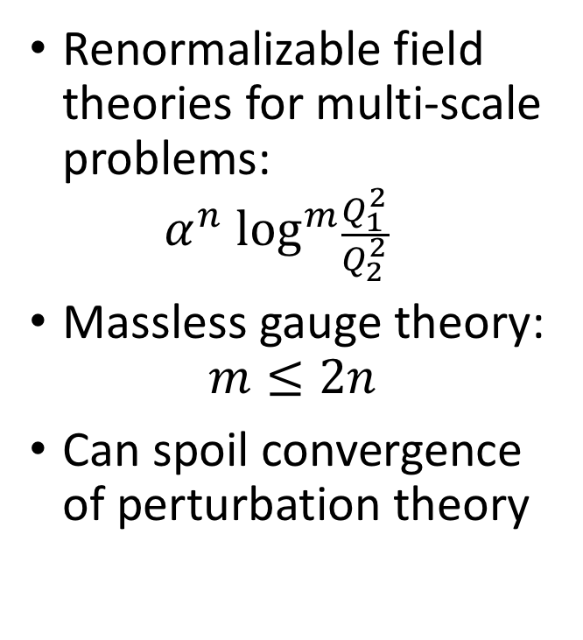
Large logs
Renormalizable field theories for multi-scale problems: $α^{n} \log^{m}\frac{Q_{1}^{2}}{Q_{2}^{2}}$
Massless gauge theory: $m≤2n$
Can spoil convergence of perturbation theory
(image courtesy of Lorenzo Magnea / California State Library)

Slide 6
Introductory example (courtesy of Gavin Salam)

Slide 7
Introductory example (courtesy of Gavin Salam)

Slide 8
Introductory example (courtesy of Gavin Salam)

Slide 9
Introductory example (courtesy of Gavin Salam)

Slide 10
Introductory example (courtesy of Gavin Salam)
Resummation probes high-order structure of perturbation theory: leads to non-perturbative structure

Slide 11
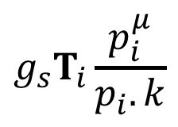
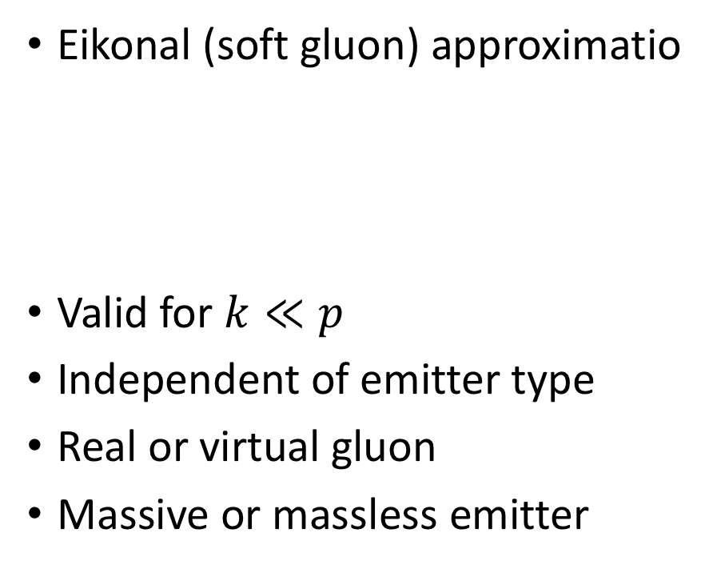

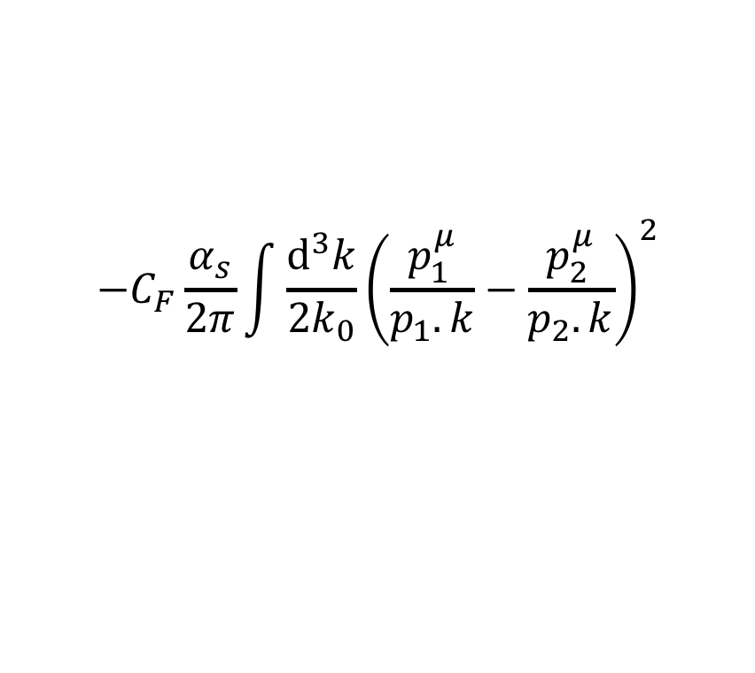


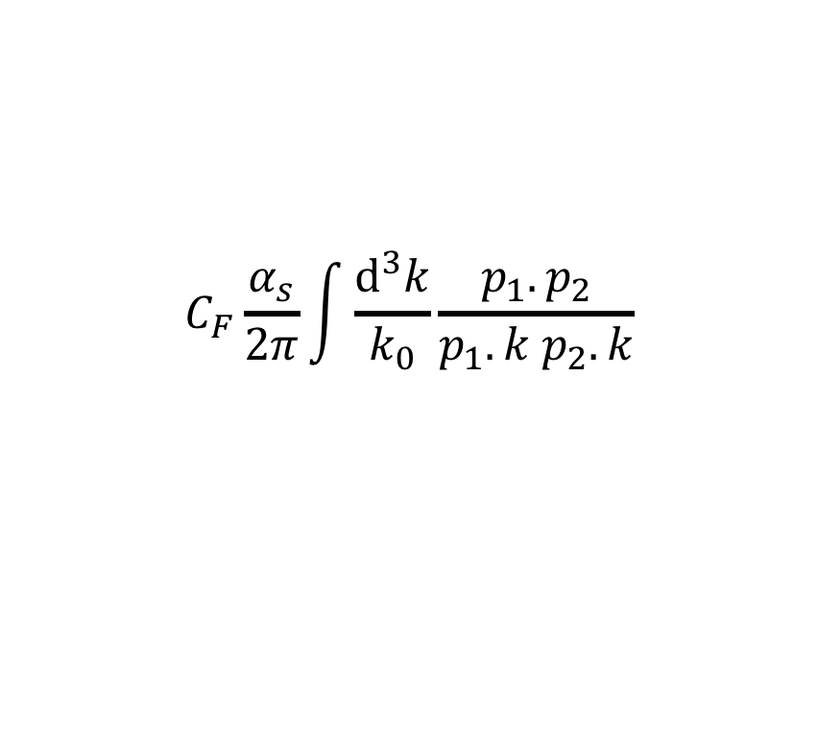

Universality of soft or collinear radiation
Eikonal (soft gluon) approximatio
Valid for $k≪p$
Independent of emitter type
Real or virtual gluon
Massive or massless emitter
n
Real emission cross section
$$i$$
$$p_{i}$$
$$g_{s}T_{i}\frac{p_{i}^{μ}}{p_{i}.k}$$
$$k$$
$$+$$
$$C_{F}\frac{α_{s}}{2π}\int{\frac{d^{3}k}{k_{0}}}\frac{p_{1}.p_{2}}{p_{1}.k p_{2}.k}$$
$$−C_{F}\frac{α_{s}}{2π}\int{\frac{d^{3}k}{2k_{0}}}{\left(\frac{p_{1}^{μ}}{p_{1}.k}−\frac{p_{2}^{μ}}{p_{2}.k}\right)}^{2}$$

Slide 12

Universality of soft or collinear radiation
Eikonal (soft gluon) approximatio
Valid for $k≪p$
Independent of emitter type
Real or virtual gluon
Massive or massless emitter
n
Virtual emission loop correction
$$i$$
$$p_{i}$$
$$g_{s}T_{i}\frac{p_{i}^{μ}}{p_{i}.k}$$
$$k$$
$${−C}_{F}\frac{α_{s}}{2π}\int{d^{4}k}\frac{p_{1}.p_{2}}{(−p_{1}.k+i0)(−p_{2}.k+i0)} \frac{i}{k^{2}+i0}$$

Slide 13
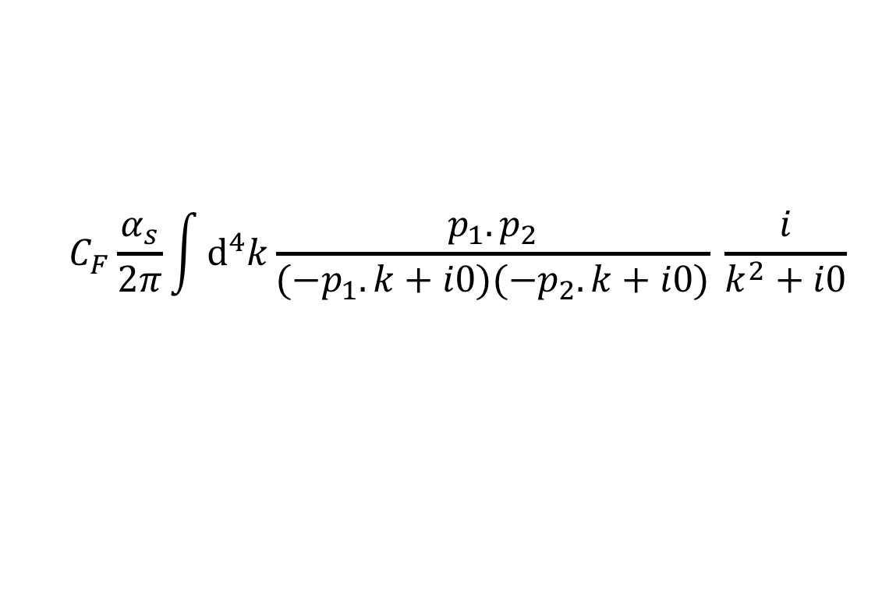
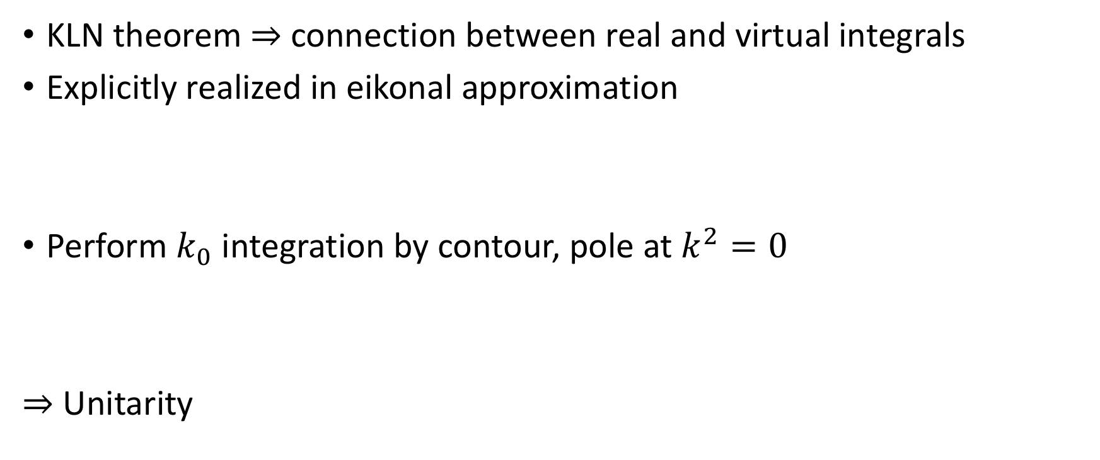
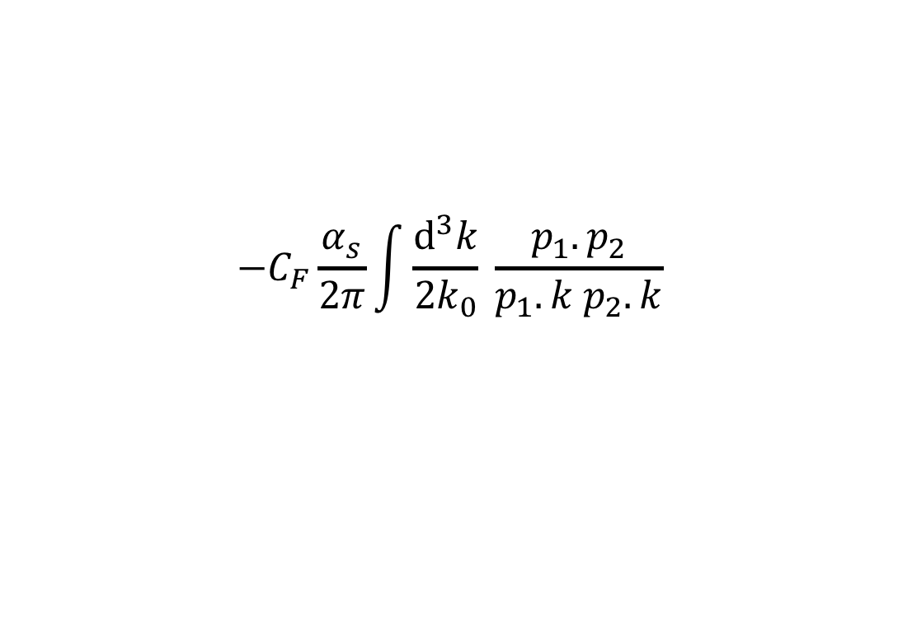
Universality of soft or collinear radiation
KLN theorem ⇒ connection between real and virtual integrals
Explicitly realized in eikonal approximation
Perform $k_{0}$ integration by contour, pole at $k^{2}=0$
⇒ Unitarity
$$C_{F}\frac{α_{s}}{2π}\int{d^{4}k}\frac{p_{1}.p_{2}}{(−p_{1}.k+i0)(−p_{2}.k+i0)} \frac{i}{k^{2}+i0}$$
$${−C}_{F}\frac{α_{s}}{2π}\int{\frac{d^{3}k}{2k_{0}}} \frac{p_{1}.p_{2}}{p_{1}.k p_{2}.k}$$

Slide 14


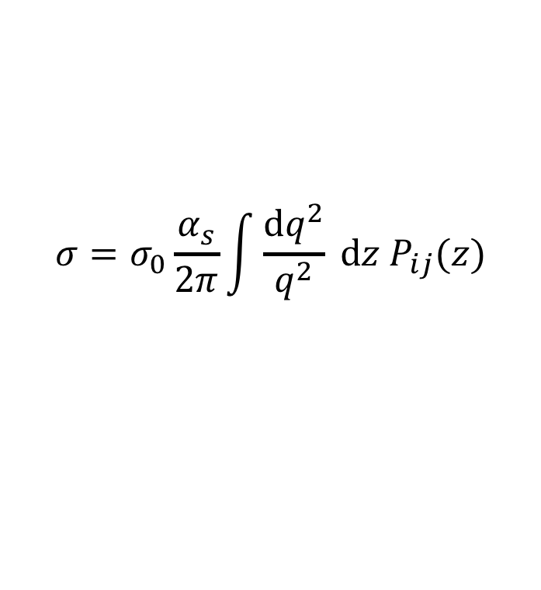
Universality of soft or collinear radiation
Collinear factorization of cross sections ($k_{⊥}≪Q$)
Can be extended to massive partons (quasi-collinear) ($k_{⊥}\sim m≪Q$)
$$i$$
$$σ=σ_{0}\frac{α_{s}}{2π}\int{\frac{dq^{2}}{q^{2}} dz P_{ij}(z)}$$
$$j$$

Slide 15
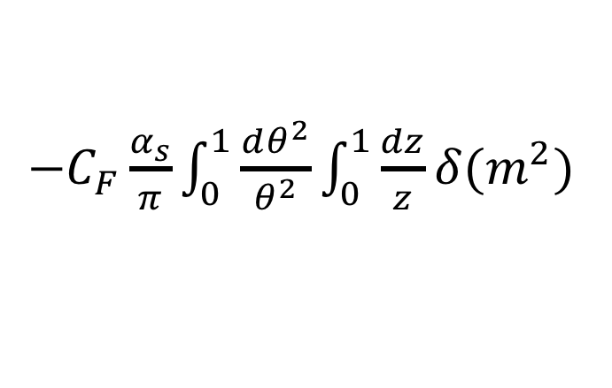
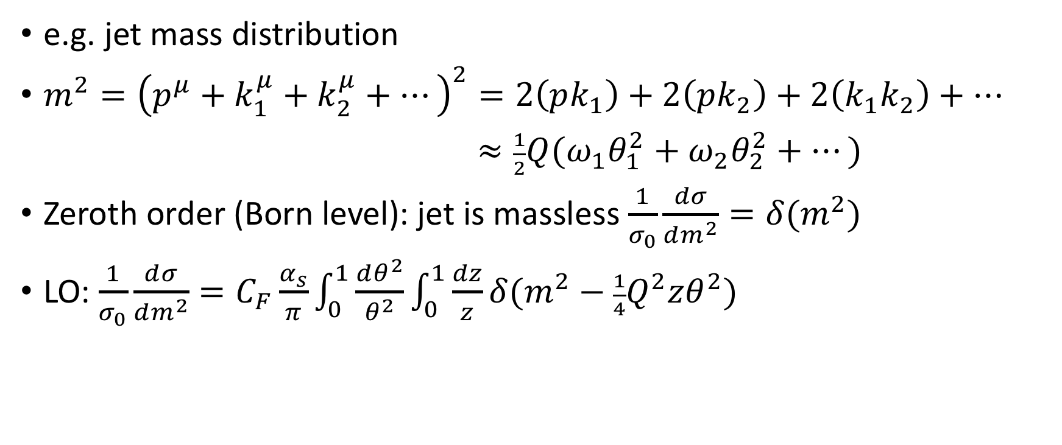
Sudakov resummation
e.g. jet mass distribution
$m^{2}={\left(p^{μ}+k_{1}^{μ}+k_{2}^{μ}+…\right)}^{2}=2\left(pk_{1}\right)+2\left(pk_{2}\right)+2\left(k_{1}k_{2}\right)+…$
$≈\frac{1}{2}Q(ω_{1}θ_{1}^{2}+ω_{2}θ_{2}^{2}+…)$
Zeroth order (Born level): jet is massless $\frac{1}{σ_{0}}\frac{dσ}{dm^{2}}=δ(m^{2})$
LO: $\frac{1}{σ_{0}}\frac{dσ}{dm^{2}}=C_{F}\frac{α_{s}}{π}\int_{0}^{1}{\frac{dθ^{2}}{θ^{2}}}\int_{0}^{1}{\frac{dz}{z}}δ(m^{2}−\frac{1}{4}Q^{2}zθ^{2})$
$−C_{F}\frac{α_{s}}{π}\int_{0}^{1}{\frac{dθ^{2}}{θ^{2}}}\int_{0}^{1}{\frac{dz}{z}}δ(m^{2})$
Real emission (affects mass)
Virtual exchange (zero mass)

Slide 16
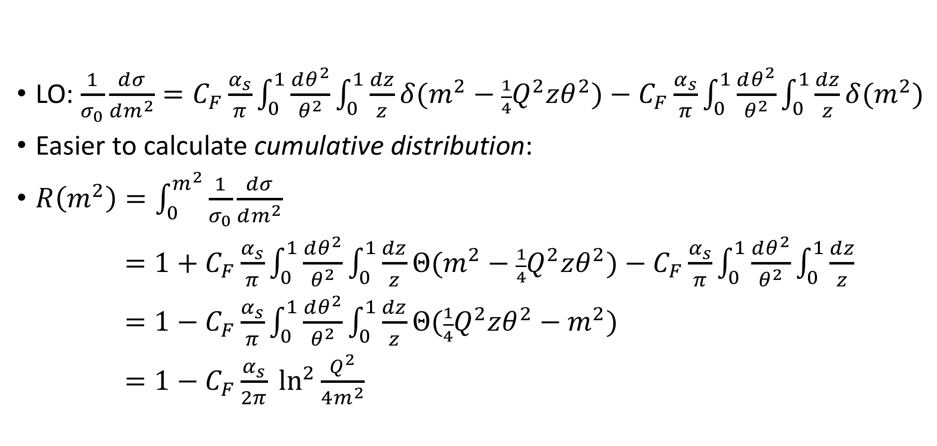
Sudakov resummation
LO: $\frac{1}{σ_{0}}\frac{dσ}{dm^{2}}=C_{F}\frac{α_{s}}{π}\int_{0}^{1}{\frac{dθ^{2}}{θ^{2}}}\int_{0}^{1}{\frac{dz}{z}}δ(m^{2}−\frac{1}{4}Q^{2}zθ^{2})−C_{F}\frac{α_{s}}{π}\int_{0}^{1}{\frac{dθ^{2}}{θ^{2}}}\int_{0}^{1}{\frac{dz}{z}}δ(m^{2})$
Easier to calculate cumulative distribution:
$R\left(m^{2}\right)=\int_{0}^{m^{2}}{\frac{1}{σ_{0}}\frac{dσ}{dm^{2}}}$
$=1+C_{F}\frac{α_{s}}{π}\int_{0}^{1}{\frac{dθ^{2}}{θ^{2}}}\int_{0}^{1}{\frac{dz}{z}}Θ(m^{2}−\frac{1}{4}Q^{2}zθ^{2})−C_{F}\frac{α_{s}}{π}\int_{0}^{1}{\frac{dθ^{2}}{θ^{2}}}\int_{0}^{1}{\frac{dz}{z}}$
$=1−C_{F}\frac{α_{s}}{π}\int_{0}^{1}{\frac{dθ^{2}}{θ^{2}}}\int_{0}^{1}{\frac{dz}{z}}Θ(\frac{1}{4}Q^{2}zθ^{2}−m^{2})$
$=1−C_{F}\frac{α_{s}}{2π} \ln^{2}\frac{Q^{2}}{4m^{2}}$
Leading (double-log) approximation
Virtual exchange
Integrated over “vetoed” region

Slide 17
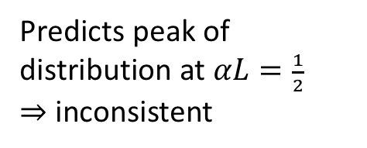
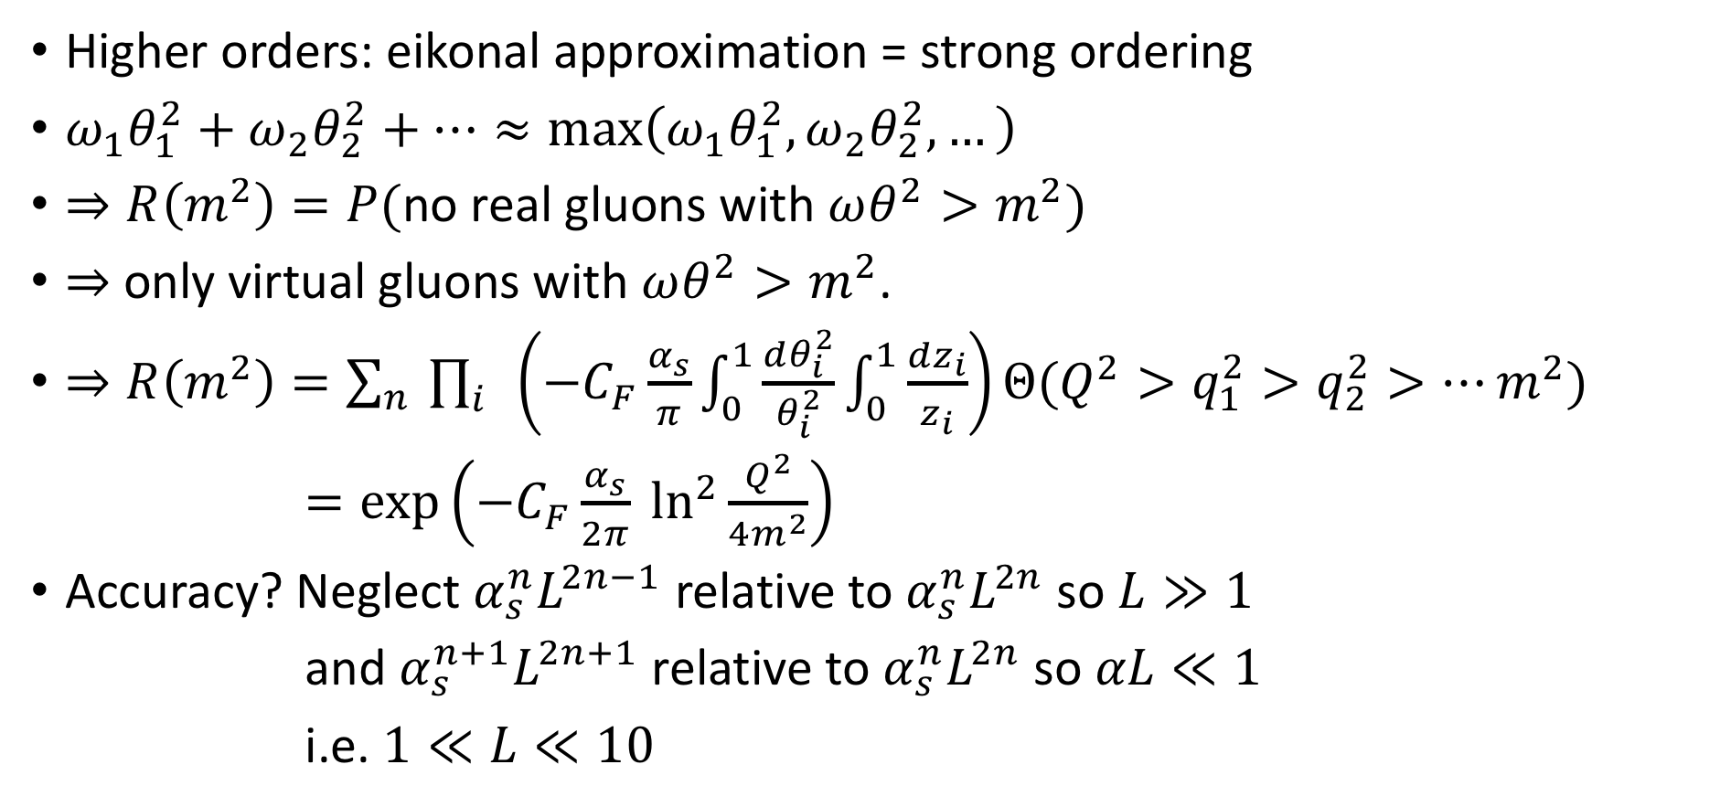
Sudakov resummation
Higher orders: eikonal approximation = strong ordering
$ω_{1}θ_{1}^{2}+ω_{2}θ_{2}^{2}+…≈max\left(ω_{1}θ_{1}^{2},ω_{2}θ_{2}^{2},…\right)$
$⇒R\left(m^{2}\right)=P($no real gluons with $ωθ^{2}>m^{2})$
⇒ only virtual gluons with $ωθ^{2}>m^{2}$.
$⇒R\left(m^{2}\right)=\sum_{n}{\prod_{i}{\left(−C_{F}\frac{α_{s}}{π}\int_{0}^{1}{\frac{dθ_{i}^{2}}{θ_{i}^{2}}}\int_{0}^{1}{\frac{dz_{i}}{z_{i}}}\right)Θ(Q^{2}>q_{1}^{2}>q_{2}^{2}>…m^{2})}}$
$=exp\left(−C_{F}\frac{α_{s}}{2π} \ln^{2}\frac{Q^{2}}{4m^{2}}\right)$
Accuracy? Neglect $α_{s}^{n}L^{2n−1}$ relative to $α_{s}^{n}L^{2n}$ so $L≫1$
and $α_{s}^{n+1}L^{2n+1}$ relative to $α_{s}^{n}L^{2n}$ so $αL≪1$
i.e. $1≪L≪10$
Predicts peak of distribution at $αL=\frac{1}{2}$ ⇒ inconsistent

Slide 18
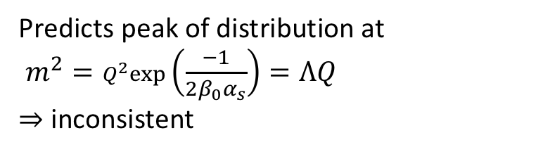
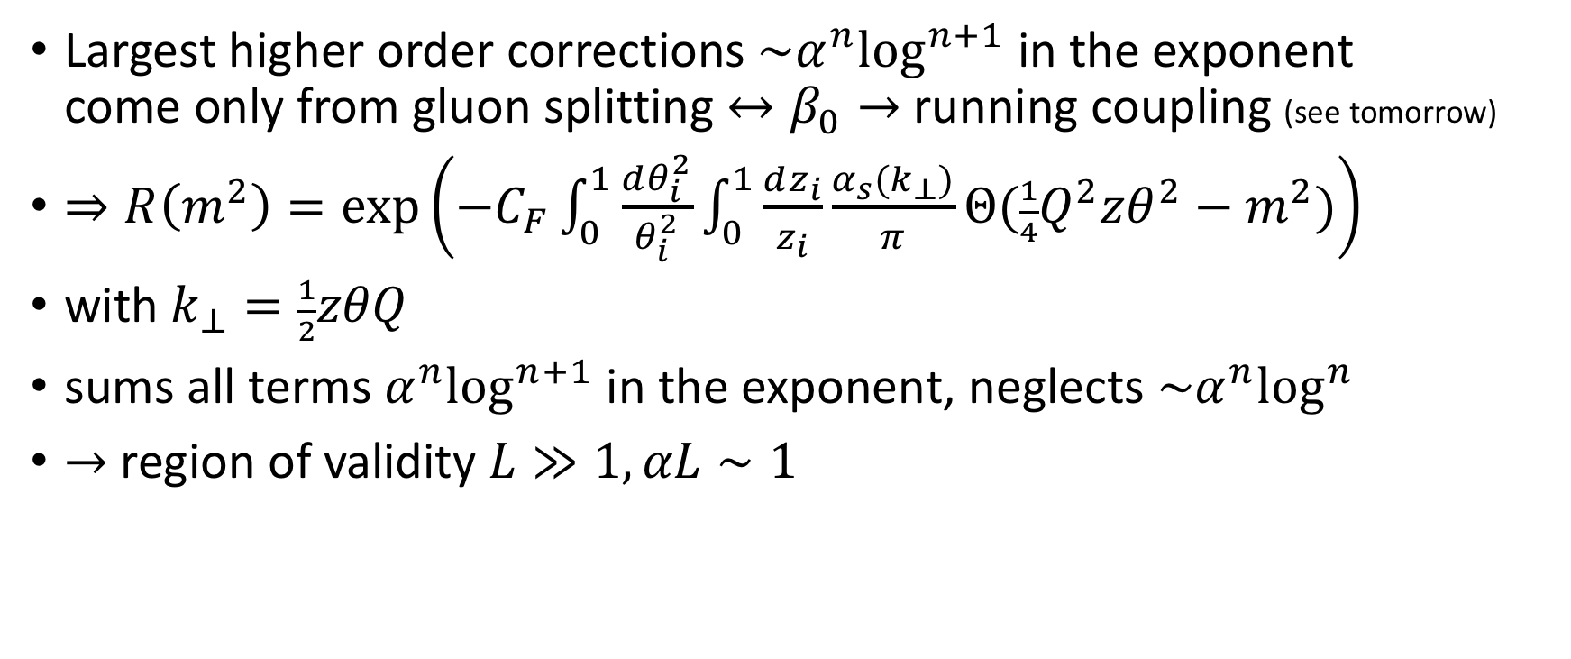
Sudakov resummation – Leading Log Approx
Largest higher order corrections $\sim α^{n}\log^{n+1}$ in the exponent come only from gluon splitting $↔β_{0}→$ running coupling (see tomorrow)
$⇒R\left(m^{2}\right)=exp\left(−C_{F}\int_{0}^{1}{\frac{dθ_{i}^{2}}{θ_{i}^{2}}}\int_{0}^{1}{\frac{dz_{i}}{z_{i}}}\frac{α_{s}(k_{⊥})}{π}Θ(\frac{1}{4}Q^{2}zθ^{2}−m^{2})\right)$
with $k_{⊥}=\frac{1}{2}zθQ$
sums all terms $α^{n}\log^{n+1}$ in the exponent, neglects $\sim α^{n}\log^{n}$
$→$ region of validity $L≫1, αL∼1$
Predicts peak of distribution at $m^{2}=Q^{2}exp\left(\frac{−1}{2β_{0}α_{s}}\right)=ΛQ$ ⇒ inconsistent
Catani, Trentadue, Turnock, Webber, 1993

Slide 19


Aside: useful formulae for $α_{s}$
$α_{s}\left(k_{⊥}\right)=\frac{α_{s}(μ)}{1+β_{0}α_{s}\left(μ\right)log\frac{k_{⊥}^{2}}{μ^{2}}}=\frac{1}{β_{0}log\frac{k_{⊥}^{2}}{Λ^{2}}}=α_{s}\left(μ\right)−β_{0}α_{s}^{2}\left(μ\right)log\frac{k_{⊥}^{2}}{μ^{2}}+α_{s}^{n}L^{n−1}$
$β_{0}=\frac{33−2N_{f}}{12π}$

Slide 20

Sudakov resummation – NLLA
NLLA corrections come from:
Hard collinear emission
Two-loop running coupling
Energy-momentum correlations (“recoil”)
$⇒R\left(m^{2}\right)=exp\left[−Lg_{1}\left(α_{s}L\right)+g_{2}\left(α_{s}L\right)\right]$

Slide 21
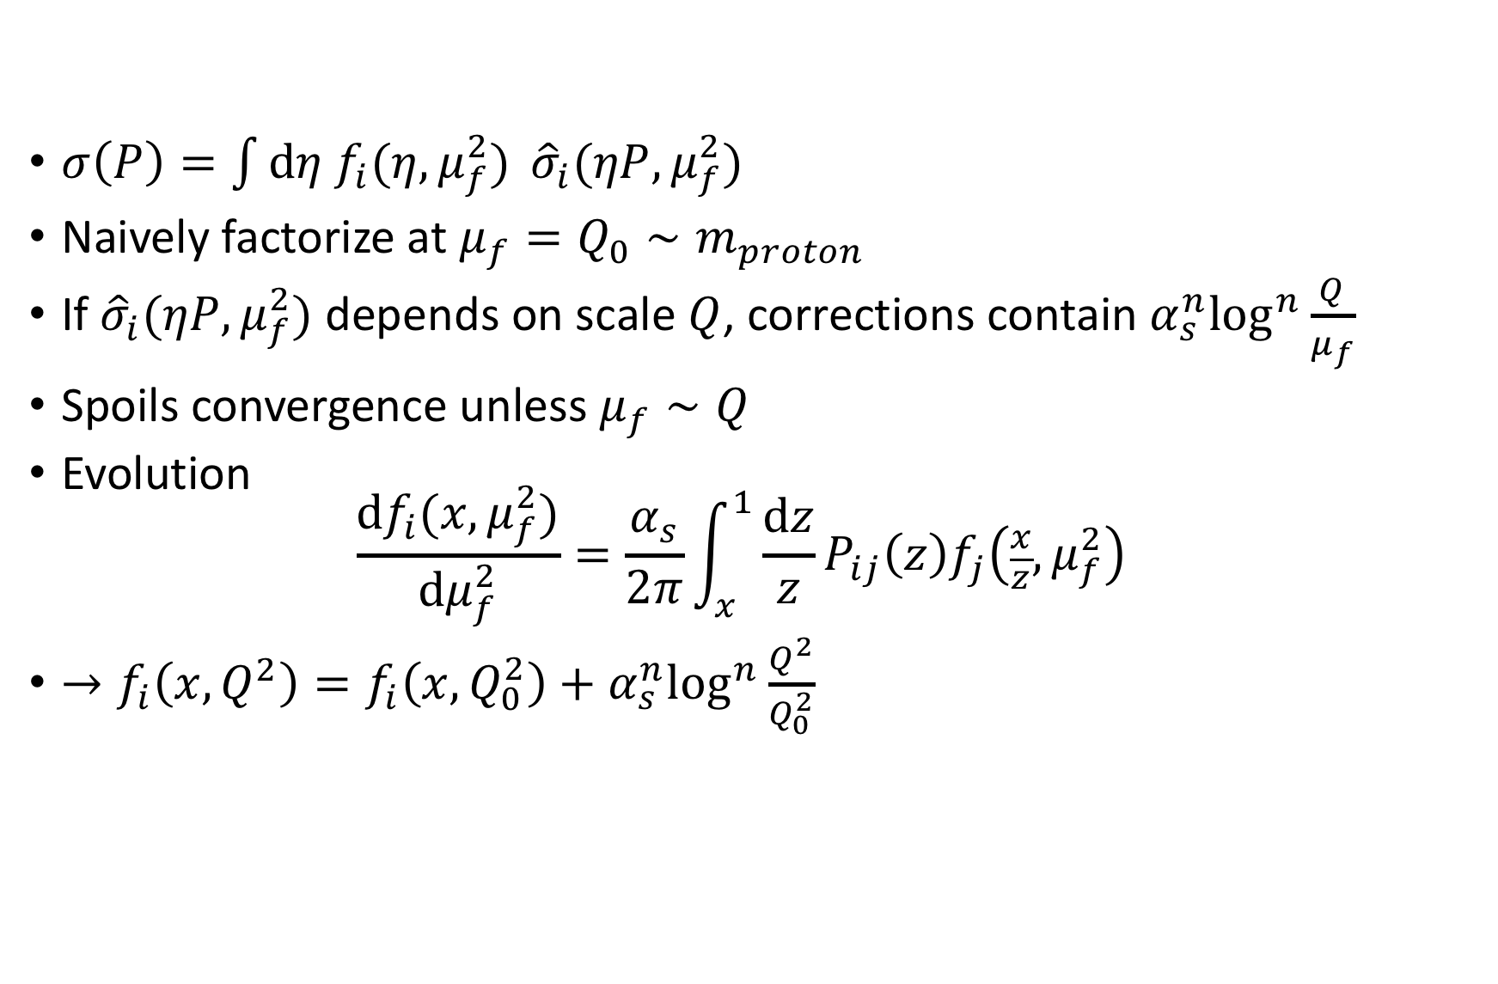
PDF evolution as resummation
$σ\left(P\right)=\int{dη f_{i}(η,μ_{f}^{2})} {\hat{σ}}_{i}(ηP,μ_{f}^{2})$
Naively factorize at $μ_{f}=Q_{0}∼m_{proton}$
If ${\hat{σ}}_{i}(ηP,μ_{f}^{2})$ depends on scale $Q$, corrections contain $α_{s}^{n}\log^{n}\frac{Q}{μ_{f}}$
Spoils convergence unless $μ_{f}∼Q$
Evolution $\frac{df_{i}(x,μ_{f}^{2})}{dμ_{f}^{2}}=\frac{α_{s}}{2π}\int_{x}^{1}{\frac{dz}{z}}P_{ij}\left(z\right)f_{j}\left(\frac{x}{z},μ_{f}^{2}\right)$
$→f_{i}\left(x,Q^{2}\right)=f_{i}\left(x,Q_{0}^{2}\right)+α_{s}^{n}\log^{n}\frac{Q^{2}}{Q_{0}^{2}}$

Slide 22
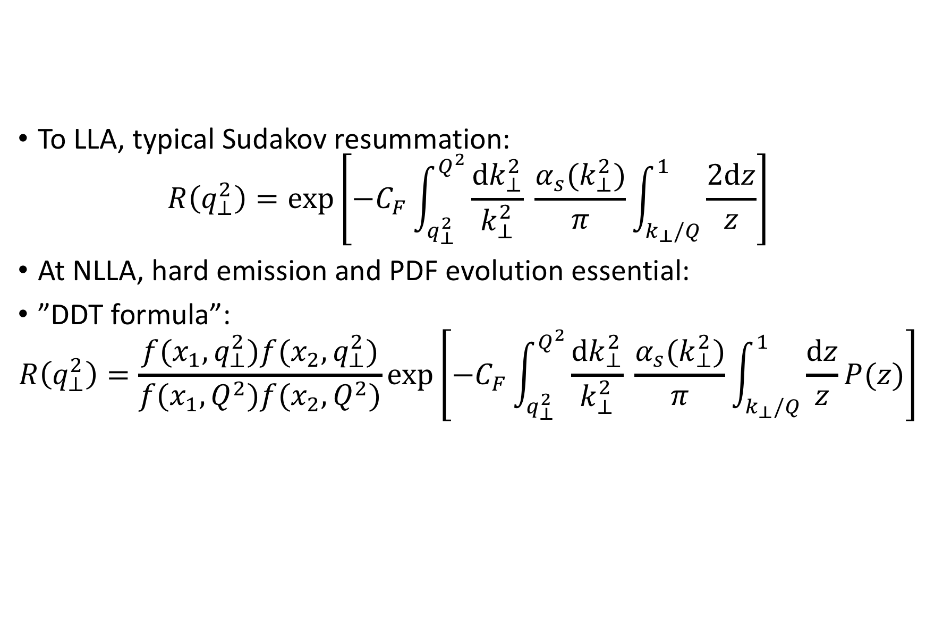
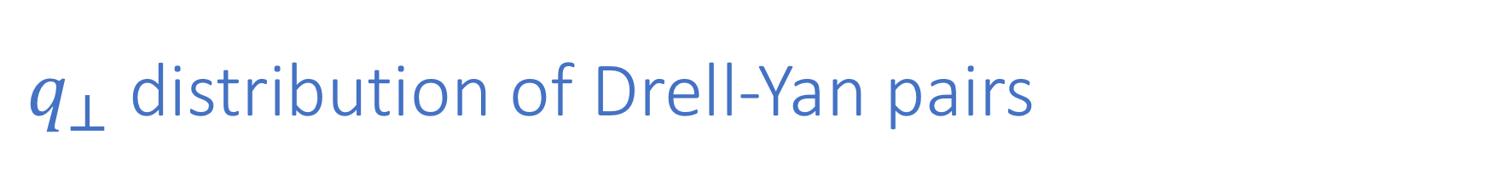
$q_{⊥}$ distribution of Drell-Yan pairs
To LLA, typical Sudakov resummation:
$$R\left(q_{⊥}^{2}\right)=exp\left[−C_{F}\int_{q_{⊥}^{2}}^{Q^{2}}{\frac{dk_{⊥}^{2}}{k_{⊥}^{2}} \frac{α_{s}(k_{⊥}^{2})}{π}\int_{k_{⊥}/Q}^{1}{\frac{2dz}{z}}}\right]$$
At NLLA, hard emission and PDF evolution essential:
”DDT formula”:
$$R\left(q_{⊥}^{2}\right)=\frac{f(x_{1},q_{⊥}^{2})f(x_{2},q_{⊥}^{2})}{f(x_{1},Q^{2})f(x_{2},Q^{2})}exp\left[−C_{F}\int_{q_{⊥}^{2}}^{Q^{2}}{\frac{dk_{⊥}^{2}}{k_{⊥}^{2}} \frac{α_{s}(k_{⊥}^{2})}{π}\int_{k_{⊥}/Q}^{1}{\frac{dz}{z}P(z)}}\right]$$
Dokshitzer, Dyakonov, Troyan, 1980

Slide 23
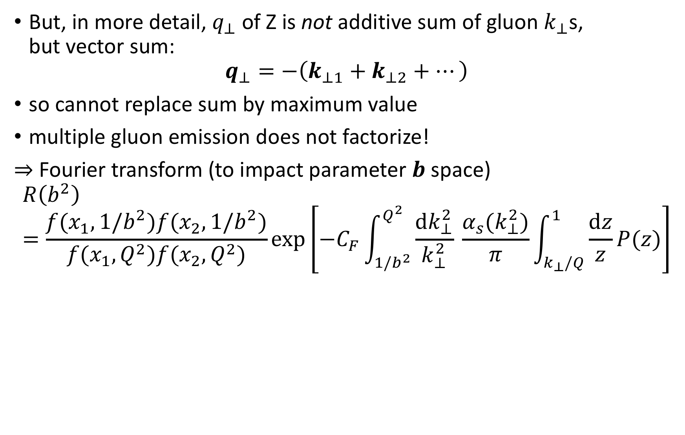
$q_{⊥}$ distribution of Drell-Yan pairs
But, in more detail, $q_{⊥}$ of Z is not additive sum of gluon $k_{⊥}$s, but vector sum:
$$q_{⊥}=−\left(k_{⊥1}+k_{⊥2}+…\right)$$
so cannot replace sum by maximum value
multiple gluon emission does not factorize!
⇒ Fourier transform (to impact parameter $b$ space)
$$R\left(b^{2}\right)=\frac{f(x_{1},1/b^{2})f(x_{2},1/b^{2})}{f(x_{1},Q^{2})f(x_{2},Q^{2})}exp\left[−C_{F}\int_{{1/b}^{2}}^{Q^{2}}{\frac{dk_{⊥}^{2}}{k_{⊥}^{2}} \frac{α_{s}(k_{⊥}^{2})}{π}\int_{k_{⊥}/Q}^{1}{\frac{dz}{z}P(z)}}\right]$$
Collins, Soper, Sterman, 1985

Slide 24
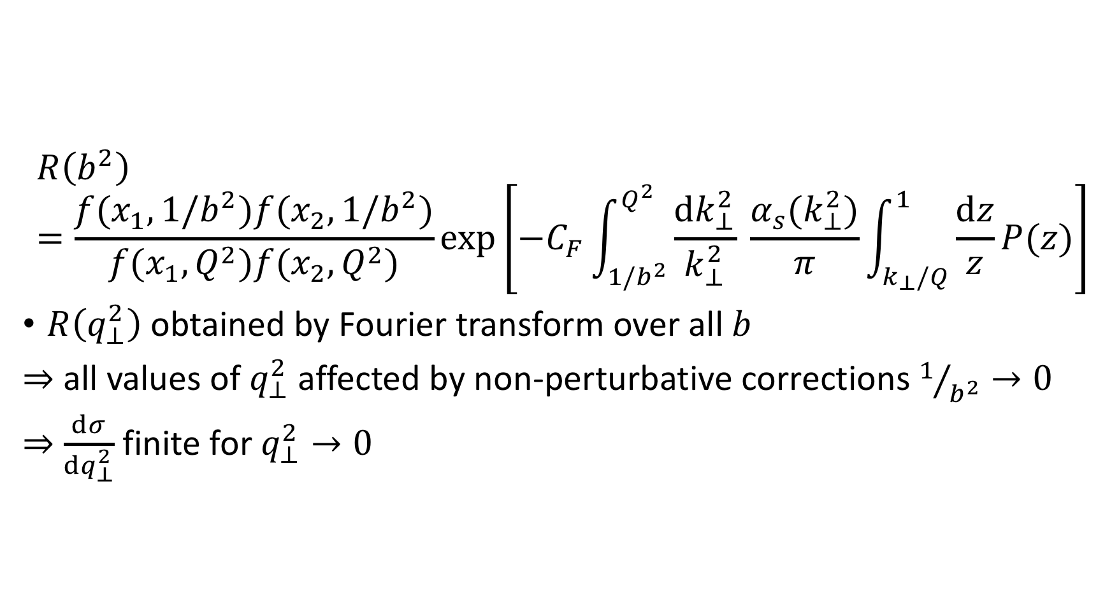
$q_{⊥}$ distribution of Drell-Yan pairs
$$R\left(b^{2}\right)=\frac{f(x_{1},1/b^{2})f(x_{2},1/b^{2})}{f(x_{1},Q^{2})f(x_{2},Q^{2})}exp\left[−C_{F}\int_{{1/b}^{2}}^{Q^{2}}{\frac{dk_{⊥}^{2}}{k_{⊥}^{2}} \frac{α_{s}(k_{⊥}^{2})}{π}\int_{k_{⊥}/Q}^{1}{\frac{dz}{z}P(z)}}\right]$$
$R\left(q_{⊥}^{2}\right)$ obtained by Fourier transform over all $b$
⇒ all values of $q_{⊥}^{2}$ affected by non-perturbative corrections $1/{b^{2}}→0$
⇒ $\frac{dσ}{dq_{⊥}^{2}}$ finite for $q_{⊥}^{2}→0$
Parisi & Petronzio, 1979

Slide 25
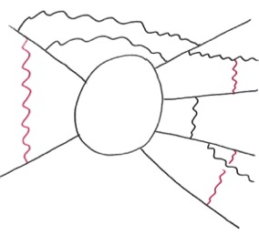
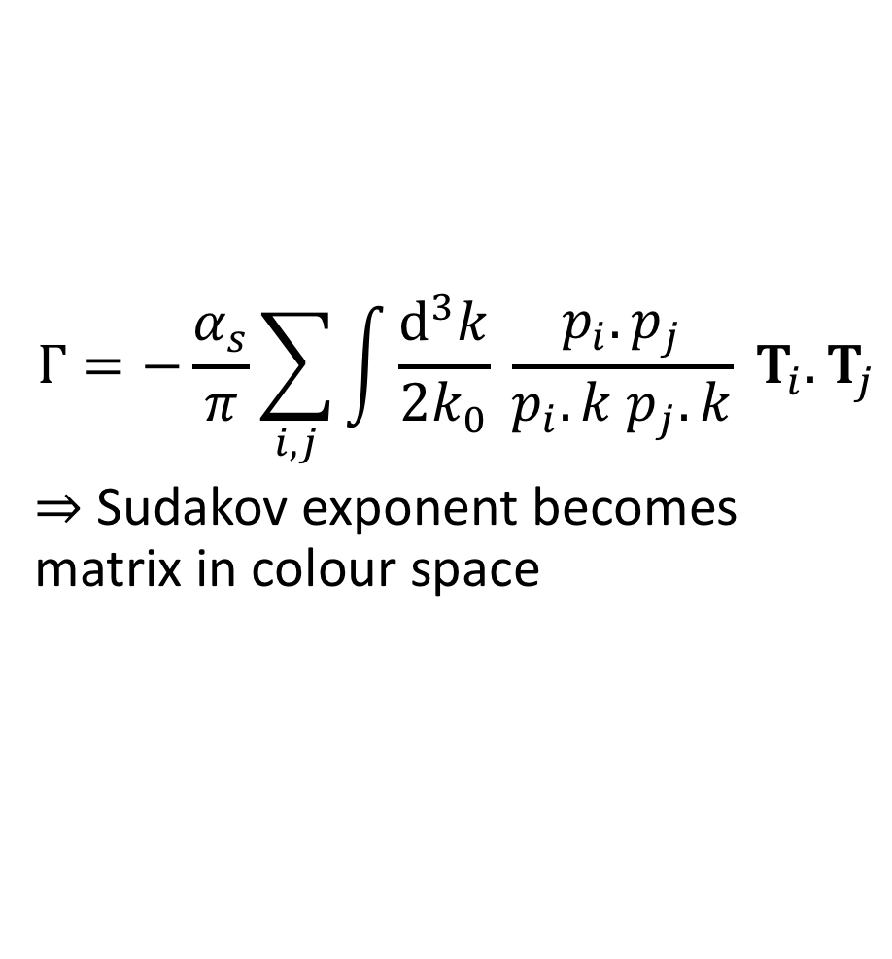
Colour evolution
$$Γ=−\frac{α_{s}}{π}\sum_{i,j}{\int{\frac{d^{3}k}{2k_{0}} \frac{p_{i}.p_{j}}{p_{i}.k p_{j}.k}}} T_{i}.T_{j}$$
⇒ Sudakov exponent becomes matrix in colour space

Slide 26
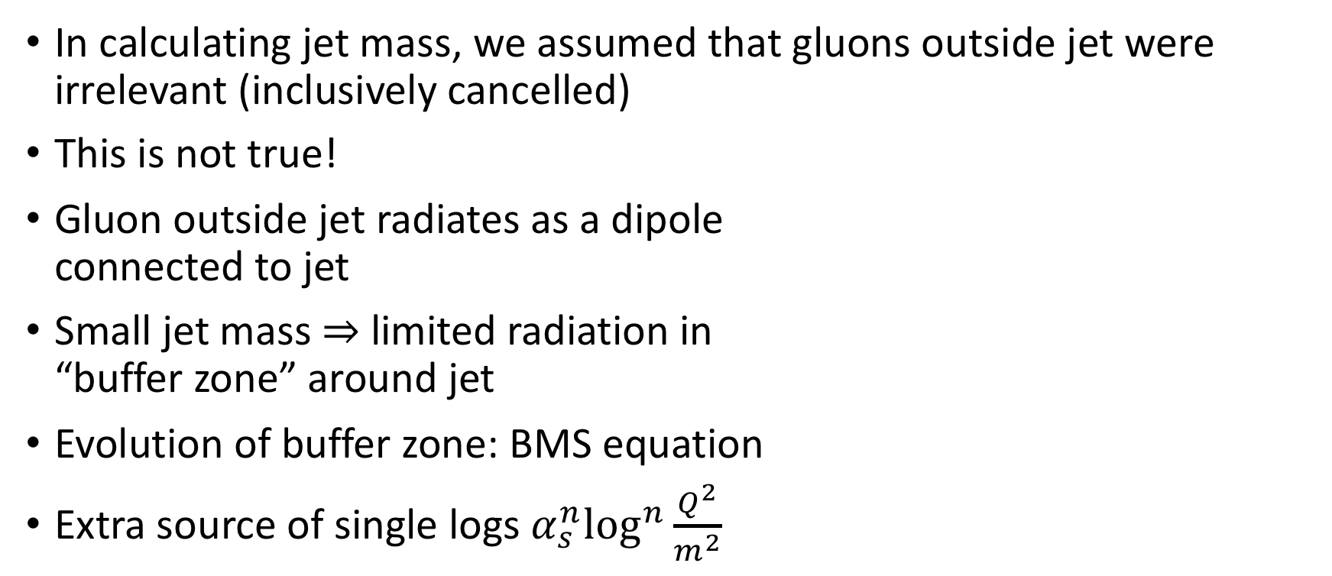
A surprise … non-global logarithms
In calculating jet mass, we assumed that gluons outside jet were irrelevant (inclusively cancelled)
This is not true!
Gluon outside jet radiates as a dipole connected to jet
Small jet mass ⇒ limited radiation in “buffer zone” around jet
Evolution of buffer zone: BMS equation
Extra source of single logs $α_{s}^{n}\log^{n}\frac{Q^{2}}{m^{2}}$
Dasgupta & Salam, 2002
Banfi, Marchesini, Smye, 2002

Slide 27
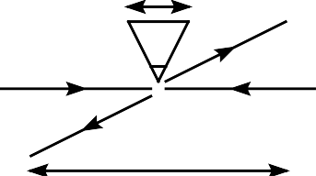
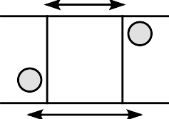


Gaps Between Jets
Event definition excludes collinear region
Non-global logs are leading $α_{s}^{n}\log^{n}\frac{Q^{2}}{Q_{0}^{2}}$
Υ
Q
Υ
Q₀
Δy
Δy

Slide 28
Other resummations
Multiplicity distributions & LPHD
BFKL / HEJ
Coulomb gluons at quark threshold

