Slide 1
Feasibility and implication of installation of the string test in SM18 with a slope
M. Bajko WP16

Slide 2

Open technical issues under discussions
Integartion
With SLOPE or not ( no request from CRG nor from magnets and Vac)
Tooling : for Sc link and DFX installation
Which set up point 1 or 5? Paolo Integration? The most complex one
String should validate installation and dismounting procedures
Cryogenics:
Need of a quench buffer, 10 g/s recovery line at warm, operational pressure 20 bars
Which cooling ( point 1 or point 5)
Do we have spare DFX or we use a standard one?
VHe in a cold mass = 25 l/ m? Herve?
Magnets
Machine cycles…see with ABP
Training till Inom? Iultimate?
Provoked quenches with QHs to check propagation, QH delays
Tracking test ( measurements during ramp?)
Thermal cycle?
Alignment
Monitoring also during operation the position of the magnets (installation, cool down, warm up)
Vacuum
Beam screen? With dedicated instrumentation? Chaufrettes?
De we have counted in the budget the beam screens? 700 kCHF extra cost?WP12?we would need for Q1 proto ( 166mm) and D1( 6mm dipole) proto , we have for the series but we need to instrument at least one ( 6 mm quad).

Slide 3
Integration slide1
Integartion
With SLOPE or not ( no request from CRG nor from magnets and Vac)
Tooling : for Sc link and DFX installation
Which set up point 1 or 5? Paolo Integration? The most complex one
String should validate installation and dismounting procedures
We have to choose between:
P1 or P5
Where P1L = P5R, and P1R= P5L
QRX
Using the argument of the SM18 set-up the choice is: P5L or P1L
Using the argument of complexity is : P5L
DFX
D1
P5
CP
Q3
Q2b
Q2a
Q1
Q1
Q2a
Q2b
Q3
Proximity of existing cryogenic installations
Position of the cryo line between the wall and magnets
CP
D1
DFX
P5L is the most complicated and coherent set up with the Sm18 installations and the tunnel is the smallest .
We plan to reproduce the space allowed in that place of the tunnel for the interventions

Slide 4
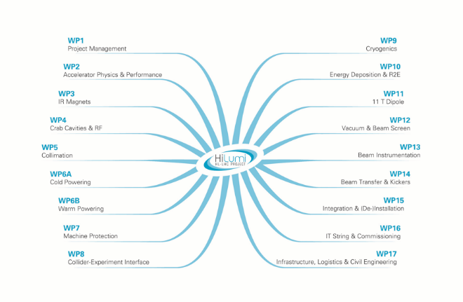
Integration slide 2
Integartion
With SLOPE or not ( no request from CRG nor from magnets and Vac)
Tooling : for Sc link and DFX installation
Which set up point 1 or 5? Paolo Integration? The most complex one
String should validate installation and dismounting procedures
P5L is the most complicated and coherent set up with the Sm18 installations and the tunnel is the smallest .
We plan to reproduce the space allowed in that place of the tunnel for the interventions
QRX
P5
DFX
D1
CP
Q3
Q2b
Q2a
Q1
Consultation results
OK
Not relevant
There is no clear show stopper in SM18 to simulate the SLOPE but we did not get till today REQUEST for doing it.
OK
Not relevant
Not relevant
OK
Not relevant
OK
OK
Not relevant
Not relevant
OK
OK
OK
OK
TODAY we do not consider to implement a SLOP for the IT STRING.

Slide 5
Integration slide 3
Integartion
With SLOPE or not ( no request from CRG nor from magnets and Vac)
Tooling : for Sc link and DFX installation
Which set up point 1 or 5? Paolo Integration? The most complex one
String should validate installation and dismounting procedures
Magnets ordered by arrival option 1
  Q2a prototype 1st-3rd Q 2019
  Q2b series 2nd Q 2020
  Q1 prototype 2nd Q 2020
  CP series 2nd Q 2020
  D1 prototype 1st Q 2021
  Q3 series 2nd Q 2021
P5
QRX
DFX
D1
CP
Q3
Q2b
Q2a
Q1
In principle more difficult the installation and have more interest for the WP15 and for Vac as allows instrumenting the Beam screen of Q1 ( the tick version)
CP
Q1
Q3
Q2a
Q2b
D1
HL LHC IT STRING
3rd Q 2019
2020
2021
3rd Q 2021

Slide 6
Integration slide 4
Integartion
With SLOPE or not ( no request from CRG nor from magnets and Vac)
Tooling : for Sc link and DFX installation
Which set up point 1 or 5? Paolo Integration? The most complex one
String should validate installation and dismounting procedures
Magnets ordered by arrival option 2
  Q2a prototype 1st-3rd Q 2019
  Q2b series 2nd Q 2020
  Q3 prototype 2nd Q 2020
  CP series 2nd Q 2020
  D1 prototype 1st Q 2021
  Q1 series 2nd Q 2021
P5
QRX
DFX
D1
CP
Q3
Q2b
Q2a
Q1
CP
Q3
Q1
Q2a
Q2b
D1
HL LHC IT STRING
3rd Q 2019
2020
2021
3rd Q 2021

Slide 7
Cryogenics
Cryogenics:
Need of a quench buffer, 10 g/s recovery line at warm, operational pressure 20 bars
Which cooling ( point 1 or point 5)
Do we have spare DFX or we use a standard one?
VHe in a cold mass = 25 l/ m? Herve?
P5L is the most complicated and coherent set up with the Sm18 installations and the tunnel is the smallest .
We plan to reproduce the space allowed in that place of the tunnel for the interventions
Antonio Perin is working on the cryogenics. Together with MSC-TF and P. Gayet we are evaluating the pumping capacity for SM18 . The last conclusion made by L. Serio ( with SM18 UPG) was that no need of additional pumping.

Slide 8
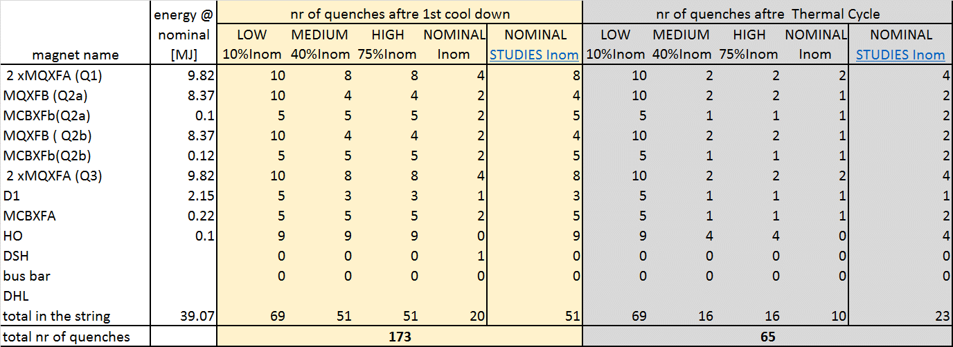
Magnets
I_{nom} is what we have considered thill now.
In the phase of HWC of the STRING 120 quenches were estimated to be done till I nom. An other 50 quenches are planned to do with the goal of “special test” not done in the shadow of the HWC.
Magnets
Machine cycles…see with ABP
Training till Inom? Iultimate?
Provoked quenches with QHs to check propagation, QH delays
Tracking test ( measurements during ramp?)
Thermal cycle?
Hardware Commissioning
Special Tests
Hardware Commissioning
Special Tests
The Current level has a non-negligible consequence on the energy deposition into the cold mass + extraction and so on the pumping capacity affecting finally also the planning
1 TC is planned

Slide 9
Vacuum
Vacuum
Beam screen? With dedicated instrumentation? Chaufrettes?
De we have counted in the budget the beam screens? 700 kCHF extra cost?WP12?we would need for Q1 proto ( 166mm) and D1( 6mm dipole) proto , we have for the series but we need to instrument at least one ( 6 mm quad).
Beam Screens will be installed
Following the magnets availability and the needs in testing all type of beam screens we have:
3 instrumented: Q1 proto, D1 proto and Q2a or Q2b proto

Slide 10
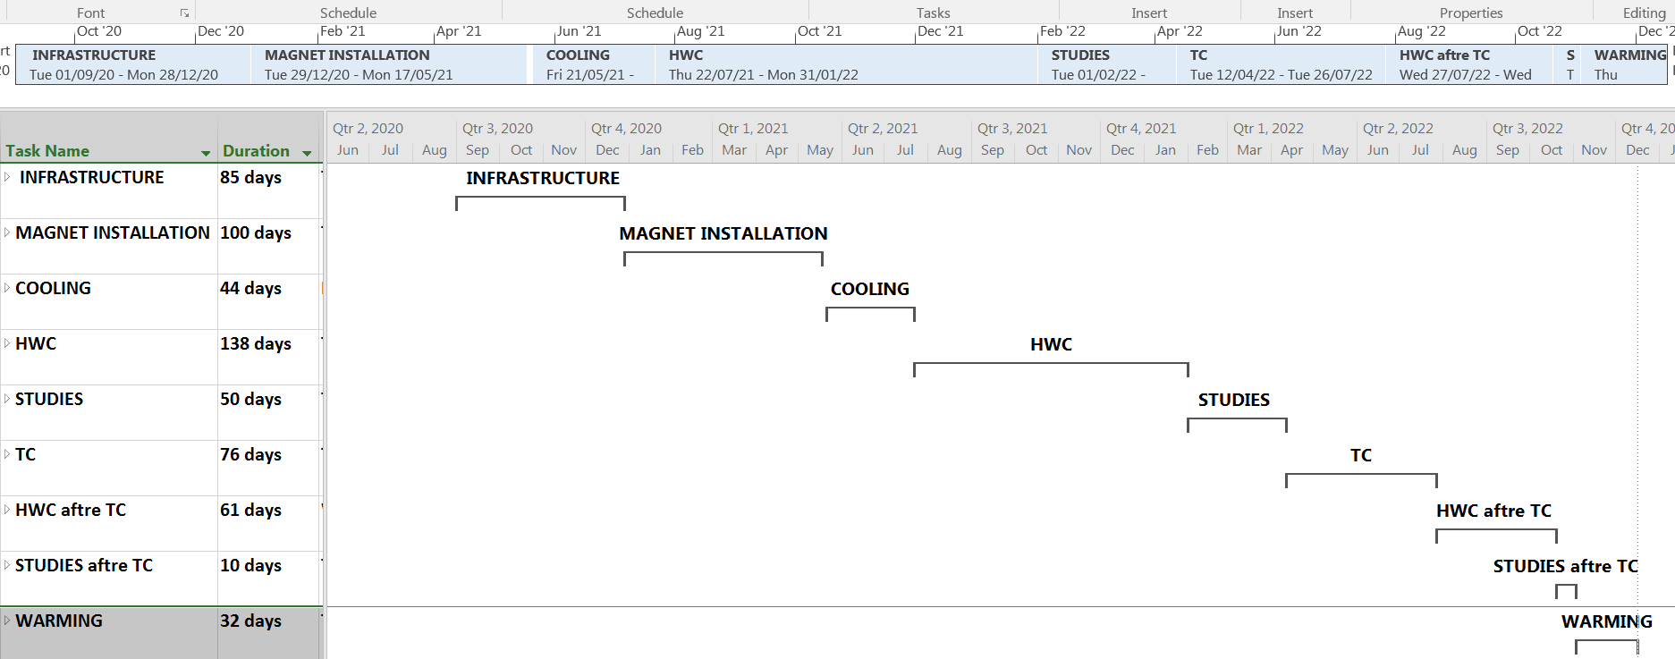
Planning ( Draft version)

Slide 11
Summary
Today we do NOT consider to implement a SLOP for the IT STRING.
P5L
is the most complicated and coherent set up with the Sm18 installations
We plan to make 1 TC and approximately 200 quenches up to a
maximum of I _{nominal}

