Slide 1
Beam coupling impedance reduction techniques
Mario Beck - HSC section meeting - 2 October 2017
Thanks to: The Impedance Working Group, Bruno Balhan, Mike Barnes, Giovanni Rumolo, Carlo Zannini

Slide 2
Introduction I
Beam coupling impedance describes the interaction of the beam with its surrounding in frequency domain (wake in time domain)
It is mainly associated to: - Changes in the beam’s surrounding aperture (step transitions, cavity like structures) - Non-PEC EM properties of the surrounding materials
Notes:
High impedances can lead to multiple problems in modern particle accelerators (beam instabilities and heating)
Impedances are produced due to changes in its surrounding aperture or EM properties of the surrounding materials as those prevent the image currents induced by the beam from following the beam

Slide 3
Introduction II
Strong beam coupling impedance can lead to multiple problems in modern particle accelerators (beam instabilities and heating)
To minimize the beam coupling impedance, the beam should see as little change in surrounding diameter as possible (no undesired cavities, step transitions)
Materials with low losses also lead to a lower beam coupling impedance

Slide 4
Introduction III
But components besides the beam pipe needed (e.g. for acceleration, extraction, injection)
Different methods exist to reduce the beam coupling impedance
The principle is to give the image current, induced into the machine by the beam, a high(er) conductivity path to follow the beam
Notes:
To avoid impedance, the beam should see as little change in surrounding diameter or in material as possible
But components besides the beam pipe needed (e.g. for acceleration, extraction, injection)
Different methods exist to damp the creation of wakes and thus reduce the impedance

Slide 5
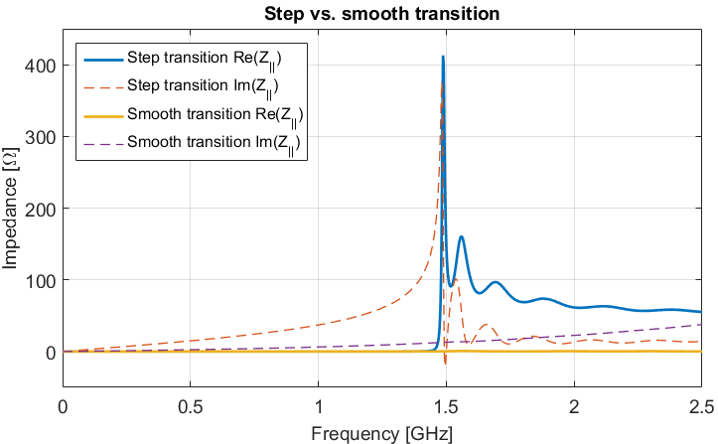
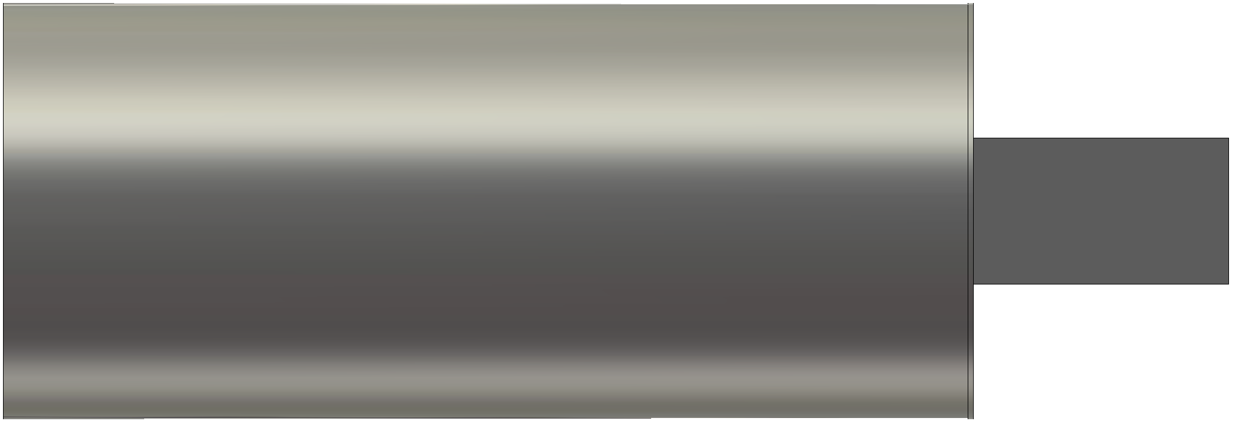
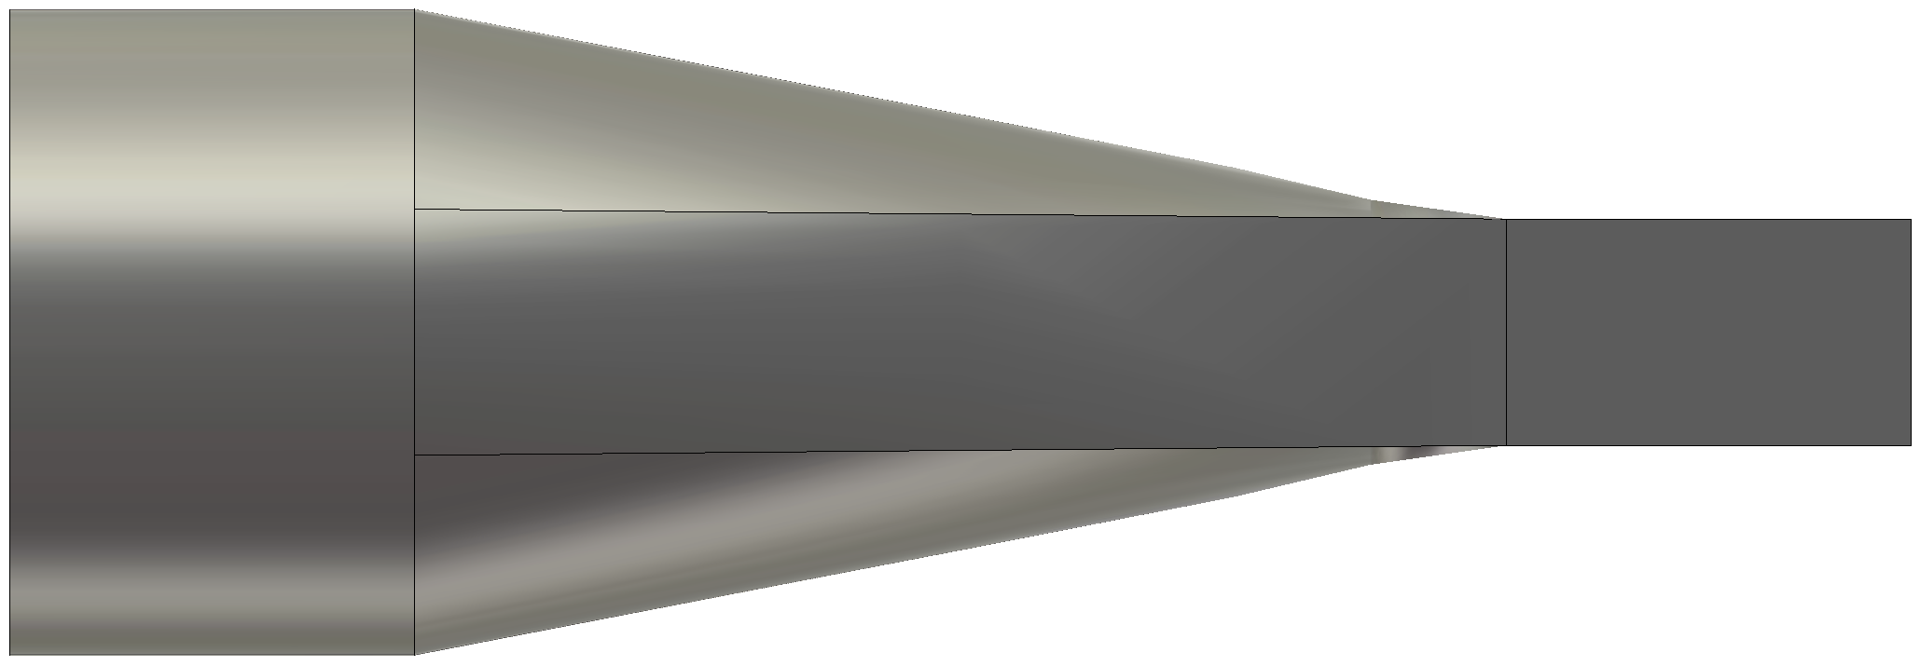
Smooth transition
The creation of wakes can be strongly reduced by smoothening transitions between beam pipe geometries
The contributions of multiple step transitions in an accelerator can add up and lead to high impedances
-vs-
Notes:
The creation of wakes can be strongly reduced by smoothening transitions between beam pipe geometries
The contributions of multiple step transitions in an accelerator can add up and lead to high impedances

Slide 6
Shielding of unwanted cavities
Unwanted cavities can be introduced for example by beam instrumentation tools, tanks housing beam steering devices or vacuum pumping ports
Shielding these undesirable cavities can reduce the impedance quite significantly
Notes:
Unwanted cavities can be introduced for example by beam instrumentation tools and tanks housing beam steering devices and vacuum pumping ports.
Shielding these undesirable cavities can reduce the impedance quite significantly.

Slide 7
Example: SPS extraction septum
The extraction septum (ZS) consists out of 5 tanks connected by beam pipes housing beam instrumentation tools
The ZS is up for a general reconditioning and the equipment owner asked the IWG for proposals to reduce the beam coupling impedance
Notes:
The septum consists out of 5 tanks connected by beam pipes housing beam instrumentation tools.
The shielding of all the cavities and tanks from the beam reduces the impedance in the order of several magnitudes.

Slide 8
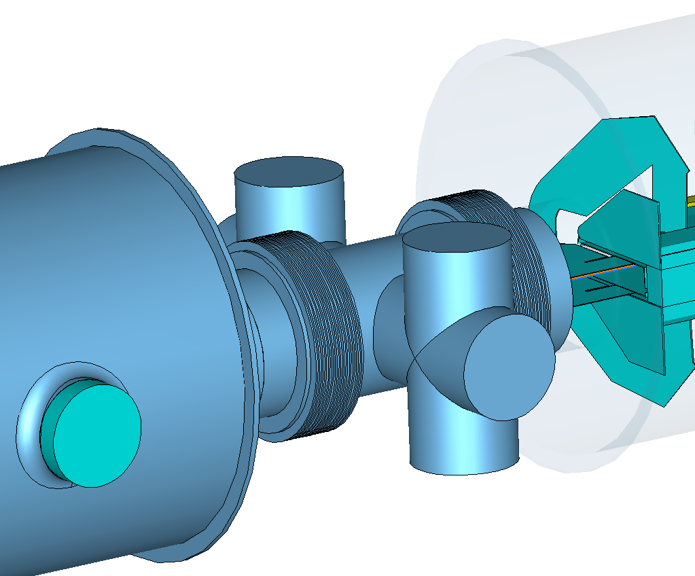
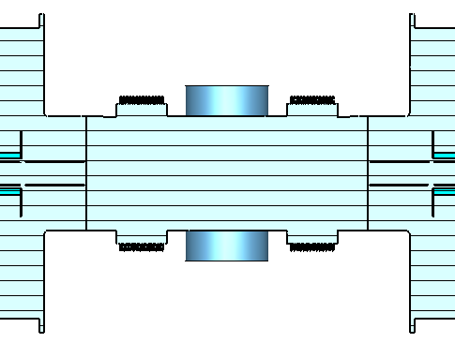
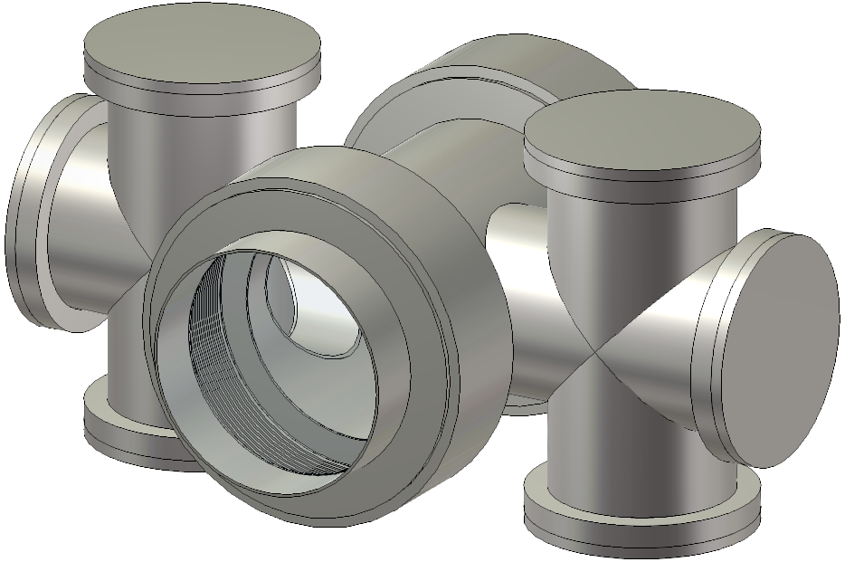
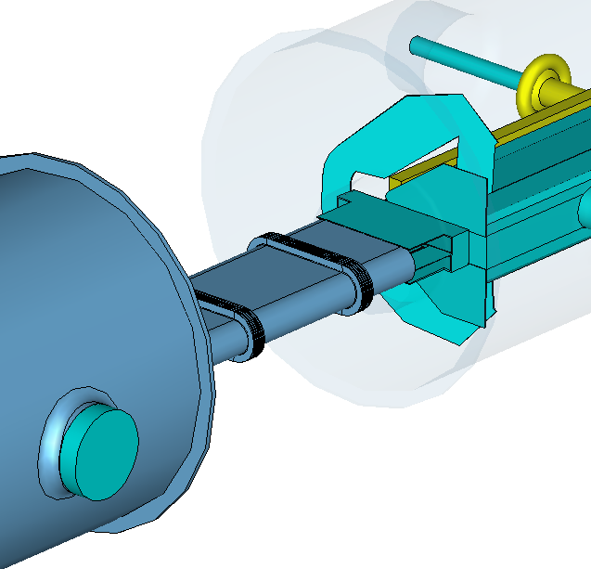
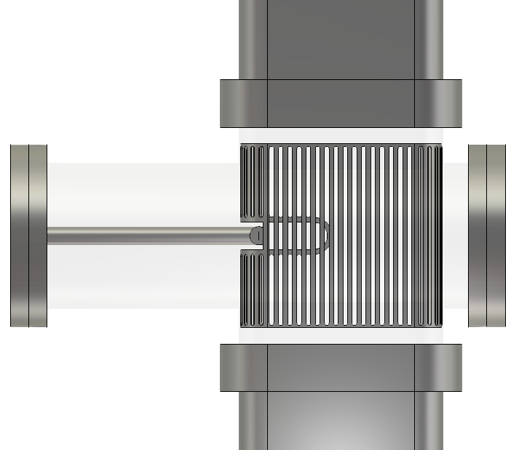
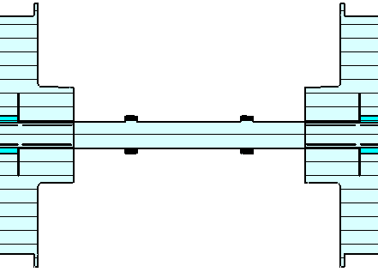
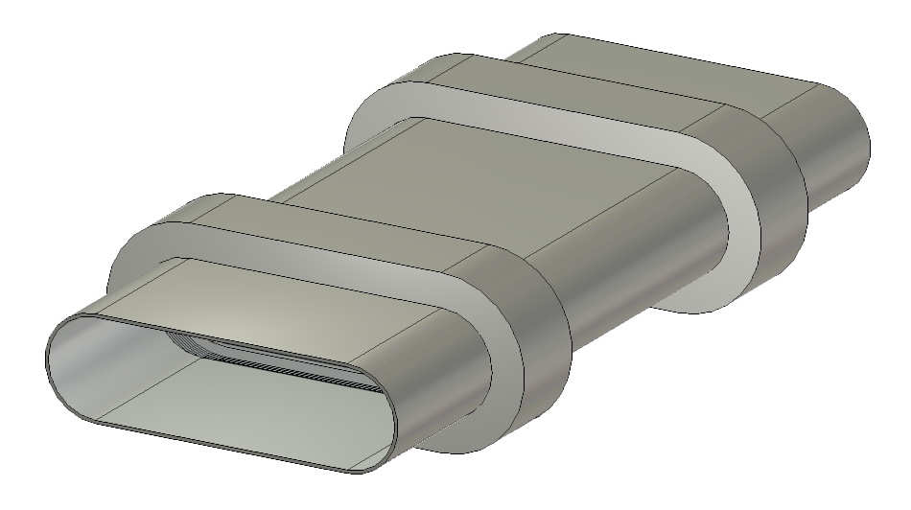
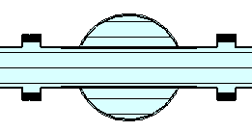
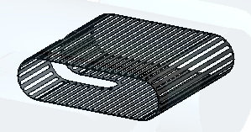
Example: Modifications to the ZS
old connector
cleaning
electrode
no shields
beam
larger beam pipe
before modifications ↑
↓ after modifications
new connector
tank
shield
beam
tank
shield
cavity
shield
cavity
shield

Slide 9
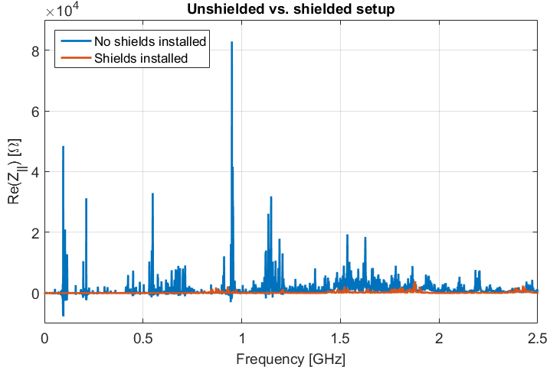
Example: Effects of modifications
The shielding of all the cavities and tanks from the beam reduces the impedance in the order of several magnitudes

Slide 10
Coating
Some components in the accelerator use materials with a high inherent impedance (e.g. collimators, protection devices).
To reduce the impedance of those elements coating with a high conductivity material can be applied provided:
The correct functionality of the device is preserved
The vacuum requirements are fulfilled
The coating does not facilitate the creation of unwanted electron clouds
Notes:
Some components in the accelerator use materials with a high inherent impedance (e.g. collimators, protection devices).
To reduce the impedance of those elements coting with a high conductivity material can be applied provided:
The correct functionality of the device
Fulfilled vacuum requirements
The coating does not create unwanted electron cloud

Slide 11
Serigraphy – Problem
Some kickers use ferrites to deflect the beam. Some ferrites begin to heat up when exposed to high intensity beam EM fields
The heated ferrite may lead to: - Intolerable outgassing (unacceptable vacuum degradation) - The loss of its magnetic properties (if the ferrite is heated above its Curie temperature)
Notes:
Some kickers use ferrites to deflect the beam. Some ferrites begin to heat up when exposed to high intensity beam EM fields
The heated ferrite can start to outgas and in the worst case loses its magnetic properties
A coating would impact the magnetic field the kicker produces and thus impair its performance

Slide 12
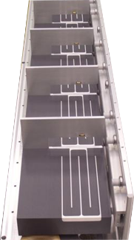
Serigraphy - Concept
A coating would impact the magnetic field the kicker produces and thus impair its performance
A coupling structure (serigraphy) is printed on the ferrite
This allows the kicker to function still within the specifications, but provides the image current an easier path to follow the beam
Example of serigraphy on the MKE

Slide 13
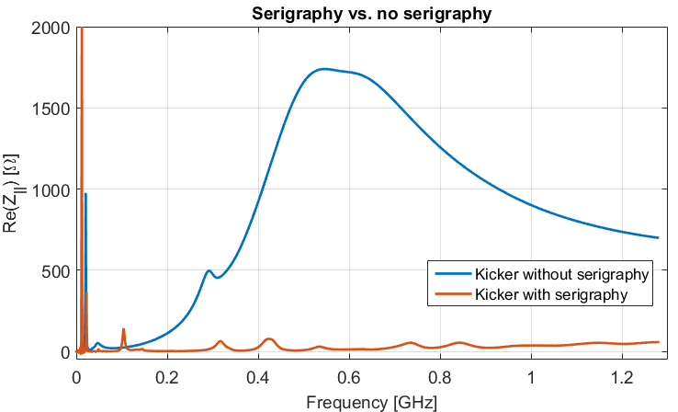

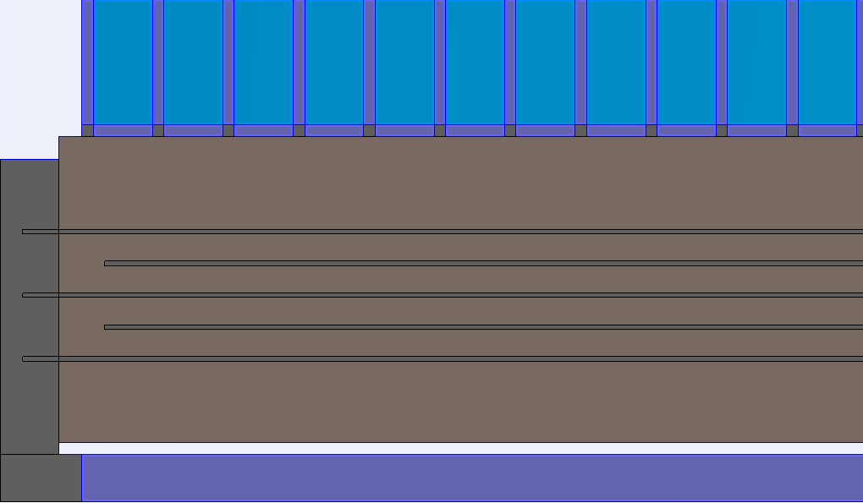
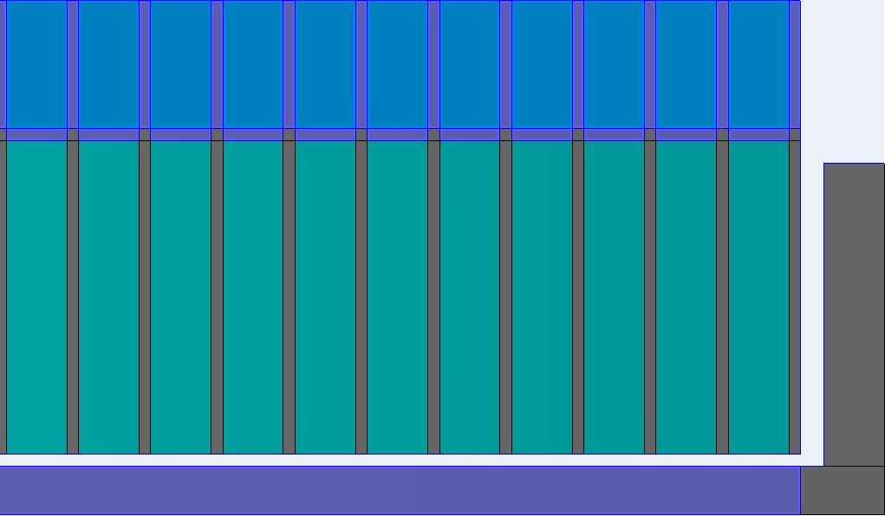
Serigraphy - MKP
Compared to the MKE (extraction kicker) the MKP (injection kicker) has shorter ferrite cells due to different requirements
To achieve sufficient coupling, the serigraphy has to expand over the whole kicker => isolation needed
view
cut
serigraphy
ferrite
-vs-
isolation plate
Notes:
A coupling structure is printed on the ferrite
This allows the kicker to function still within the specifications, but provides the image current an easier path to follow the beam
Less wake is created in the ferrite

Slide 14
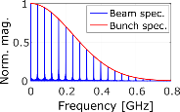

Serigraphy - Heating
The heating of the ferrite is proportional to the power deposited in it. The power loss is highly dependent on the impedance of an object:
Thermal steady state simulations for the shown kicker versions for HL-LHC type beam show a reduction of the maximum ferrite temperature of factor 7.5.
$$∆W={\left(f_{0}eN_{Beam}\right)}^{2}∙\sum_{p=−∞}^{p=∞}{\left({\left|Λ\left(pω_{0}\right)\right|}^{2}∙Re[Z_{||}(pω_{0})]\right)}$$
Notes:
The heating of the ferrite is proportional to the power deposited in it. The power loss is highly dependent on the impedance of an object:
Thermal steady state simulations for the shown kicker versions for HL-LHC type beam show a reduction of the maximum ferrite temperature of factor 7.5.

Slide 15
Impedance model
To see the effect of the updated beam coupling impedance on the beam dynamic, PyHEADTAIL simulations are needed
Reviewing / improving the SPS impedance model; taking into account recent changes in the machine (changed MKE serigraphy length) and studying the case of the new Q22 optics
Create a LIU-SPS impedance model
Notes:
To see the effect of the impedance on the beam dynamic simulations are needed
All the impedance (wake) simulations results are used to create an impedance / wake model of the SPS
The wake model than is the input for beam dynamic simulations with PyHEADTAIL

Slide 16
Conclusion
It is of high importance to include impedance considerations at the design or upgrade phase of an accelerator
Methods relatively simple to implement can minimize the impedance compatible with other requirements
The results of the simulations can be used for the impedance model and thus lead to a better under standing of the machine
Notes:
It is of high importance to include impedance considerations at the design or upgrade phase of an accelerator
Methods relatively simple to implement can minimize the impedance compatible with other requirements
The results of the simulations can be used for the impedance model

