Slide 1

Large Genomic Data Sets in Autism Research:
SFARI DOMA Practices
Natalia Volfovsky
November 16, 2017

Slide 2

Mission: improve the understanding, diagnosis and treatment of autism spectrum disorders (ASD) by funding innovative research of the highest quality and relevance
https://www.sfari.org
Identify risk factors whether genetic, environmental or epidemiological.
Use non-human organisms to understand how these risk factors alter brain function and animal behavior.
Promote preclinical and clinical investigations to improve autism diagnosis & therapy.
Notes:
SFARI 2017 budget: $78.5 million
SFARI currently supports over 270 investigators
Since its launch in 2003, SFARI has committed more than $480 million in external research support to more than 400 investigators in the U.S. and abroad
119 SFARI-funded research publications & 15 reviews published in 2016
Strategy 12015-20120
Create a research-/clinical trial-ready cohort of 50,000+ ASD individuals/families.
Identify additional high-risk ASD genes/CNVs &, through GWAS, identify common risk genes.
Identify non-genetic risk factors and mechanisms through which they interact with genetic risk.
Identify neural circuits/pathways that are impaired in significant groups of ASD individuals.
Identify quantitative, reproducible & scalable ASD biomarkers useful for assessing treatment effectiveness.
Support discovery of one or more effective treatments that benefit individuals with autism.

Slide 3
Autism spectrum disorder(ASD) is extremely heterogeneous
Pam Feliciano, 2017
Notes:
As many of you know, autism spectrum disorder is an extremely heterogeneous condition. There is a very wide spectrum of behaviors that fall under

Slide 4
Autism risk is complex
Huguet, Benabou, and Bourgeron, 2016
Notes:
In addition to having many symptoms, there are many risk factors for autism. We know that much of the risk for autism is genetic. with the remaining risk explained by environmental factors. One of the most important findings in the past decade has been the recognition of the role that de novo mutations play in this condition. Through exome sequencing of several thousand ASD trios, the field has identifeid approximately 100 genes that harbor heterozygous, de novo LGD (likely gene disrupting) mutations in ASD.
Relative contribution of the genetics and environment in ASD. Based on twin and familial studies, it is estimated that the genetic and environmental contributions to ASD are approximately 50/50 %. Most of the heritable part seems to be due to common variants observed in the general population, with a small contribution of rare variants. Importantly, the de novo mutations are genetic causes of ASD but do not contribute to the heritability since there are only present in the patient. These de novo events are therefore considered to be “environmental causes” of ASD, but acting on the DNA molecule (Adapted from Huguet and Bourgeron 2016)

Slide 5
De Novo Mutations
Genotype is present in neither parent, but usually heterozygous in the child
Spontaneous genetic mutations

Slide 6
The history of the genetics of autism
gene.sfari.org
Huguet, Benabou, and Bourgeron, 2016
Notes:
The history of the genetics of autism from 1975 to 2015. The increase in the identified genes associated with ASD (SFARI—March 2015) is represented together with the prevalence of ASD (data taken from the Center for Disease Control and Prevention), the different versions of the Diagnostic Statistical Manual (from DSM II to DSM 5.0) and the advance in genetics technology
In the last 30 years, twin studies have indicated a strong genetic contribution to Autism Spectrum Disorders (ASD). The heritability of ASD is estimated to be 50 %, mostly captured by still unknown common variants. In approximately 10 % of patients with ASD, especially those with intellectual disability, de novo copy number or single nucleotide variants affecting clinically relevant genes for ASD can be identified.

Slide 7
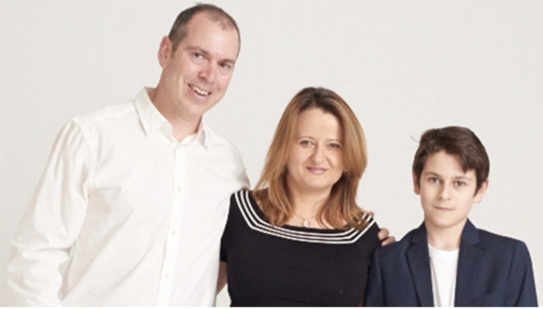
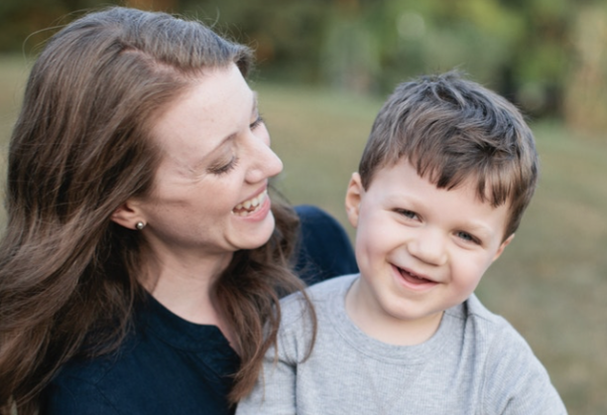



SFARI Research Cohorts
https://www.sfari.org
Simons Simplex Collection
(SSC)
~10,000 individuals
~ 1,500 individuals
Notes:
Our data:

Slide 8
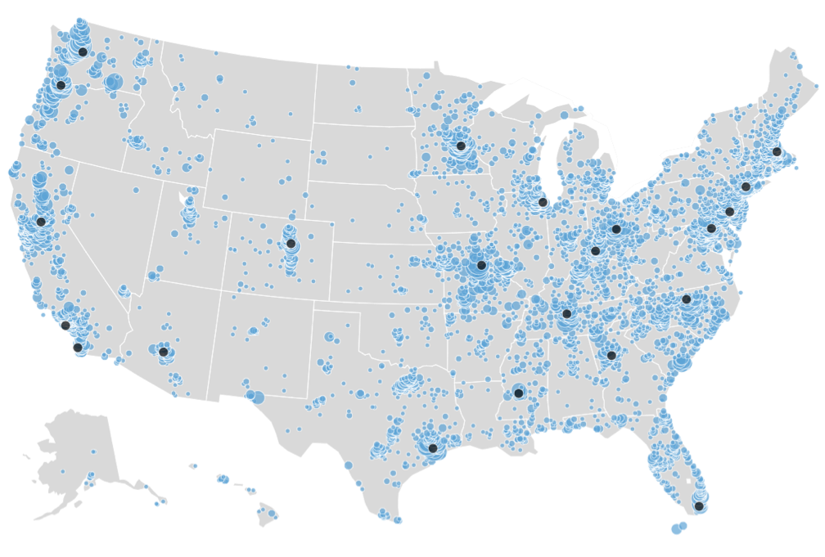
Simons Foundation Powering Autism Research through Knowledge
https://sparkforautism.org
Individuals with autism
  n= 28,501
Family members
  n= 52,070
Usable saliva samples
  n= 29,374
Complete trios + DNA
n = 4,294 trios
Unaffected sibs + DNA n= 2,086
Recruit, engage, and retain 50,000 individuals with ASD
and their biological family
members to:
identify causes of ASD
enable genotype-driven research
find better treatments to improve lives
Pam Feliciano, October 2017
Notes:
To date, we have recruited x people with ASD. This map shows the density of participants in every state in the US with the black dots representing the clinical sites in the network.

Slide 9





Danish Neonatal Screening Biobank
The DNSB houses blood spots from all individuals born in Denmark
Since 1981 (more than 2 million individuals). These samples can be
linked to first-degree and other relatives, and there are now at least
15,000 diagnosed cases of autism in the biobank, as well as 15,000
cases of ADHD and 25,000 cohort-matched controls.
Exome sequencing of blood spot-derived DNA:
collaboration between Mark Daly (Broad Institute) and Preben
Mortensen (Aarhus University, Denmark).
Notes:
Our data:

Slide 10
Data Sharing Policy
SFARI aims to support reproducible scientific research of the highest quality. This can be greatly facilitated by making all raw data, analysis methods, and, when applicable, computer code, available to the research community as quickly and transparently as possible.
Data generated from collections is considered “community resources” and, as such, all these data, including, but not limited to, alignment files and variant calls, will be made available to the entire research community, pre-publication, in real-time, as they are produced.
Besides being subject to any limitations by consent and IRB protocol, a publication embargo will also be enforced for 6 months after the defined project is complete while foundation-sponsored analyses are underway.
Notes:
SFARI 2017 budget: $78.5 million
SFARI currently supports over 270 investigators
Since its launch in 2003, SFARI has committed more than $480 million in external research support to more than 400 investigators in the U.S. and abroad
119 SFARI-funded research publications & 15 reviews published in 2016
Strategy 12015-20120
Create a research-/clinical trial-ready cohort of 50,000+ ASD individuals/families.
Identify additional high-risk ASD genes/CNVs &, through GWAS, identify common risk genes.
Identify non-genetic risk factors and mechanisms through which they interact with genetic risk.
Identify neural circuits/pathways that are impaired in significant groups of ASD individuals.
Identify quantitative, reproducible & scalable ASD biomarkers useful for assessing treatment effectiveness.
Support discovery of one or more effective treatments that benefit individuals with autism.

Slide 11
SFARI Data Overview
Sequencing and preprocessing
S
Sequencing Center
Sequencing Center
Sequencing Center
Storage and secondary analysis
Flatiron Institute
AWS
Tape Archive at Fermi Lab
Data sharing and collaboration
Data portal
Data portal
Globus
Data portal
Data portal

Slide 12
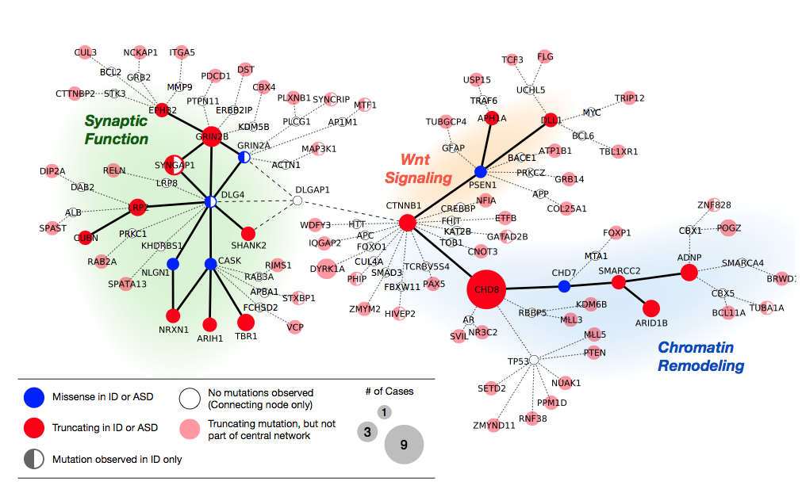
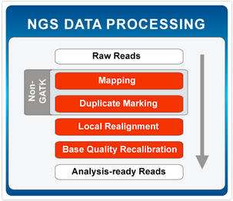
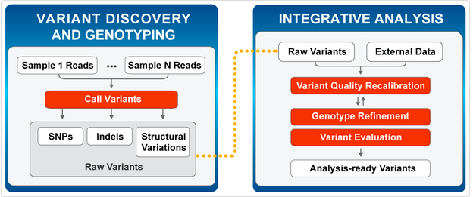
Data Analysis
Interpretation of Genomic Results
Genomic Analysis Workflows

Slide 13
SFARI Data Requests
SFARI genomic data requests through SFARIBase @ sfari.org
Notes:
Researchers: 288
- Institutions: 180
- Projects: 300
- Requests: 951

Slide 14
Challenges of Data Sharing
Data management
Collaboration utilities
Users’ ability to deploy their own analysis tools
Ability to harmonize data from different projects
Ability to harmonize data from different archives of the same project
- AWS, Google, local servers
Price, speed
- storage, data transfers, computin
Support of international collaborations and ability to deal with data governance across countries, including local restrictions

Slide 15
Human Cell Atlas (HCA) Data Coordination Portal

Slide 16
Global Alliance for Genomics and Health (GA4GH): Data Biosphere
Notes:
Figure 1. The diagram illustrates a proposed architecture for a Data Biosphere, consisting of (from the bottom up): (i) Data Assets, such as large datasets of genome sequences or images, stored on Clouds that provide low-level services, such as storage, databases, and access control (grey); (ii) Data Access Services, which control access to data services and expose them via standardized APIs to multiple different services created by many groups (blue); (iii) Indexing and Search capabilities to make it easy for researchers to find data and build cohorts (pink); (iv) Workspaces, which are analytical sandboxes where researchers can perform analyses on cuts of data and share them with collaborators (red); (v) Analytical engines, which allow users to deploy workflows and perform exploratory analyses (green); (vi) Repositories for sharing workflows and notebooks (orange); and (vii) Specialized Portals and user interfaces to support ad-hoc use cases and leverage the underlying services (yellow and peach).

Slide 17
Genomics data portals
Support
  collaboration
  data sharing and
  reproducibility in scientific research
Technology
  API access
  docker containers and
  standardized workflow description languages
Leverage experiences of scientific data management communities
Invest in the implementations of science specific standards

Slide 18
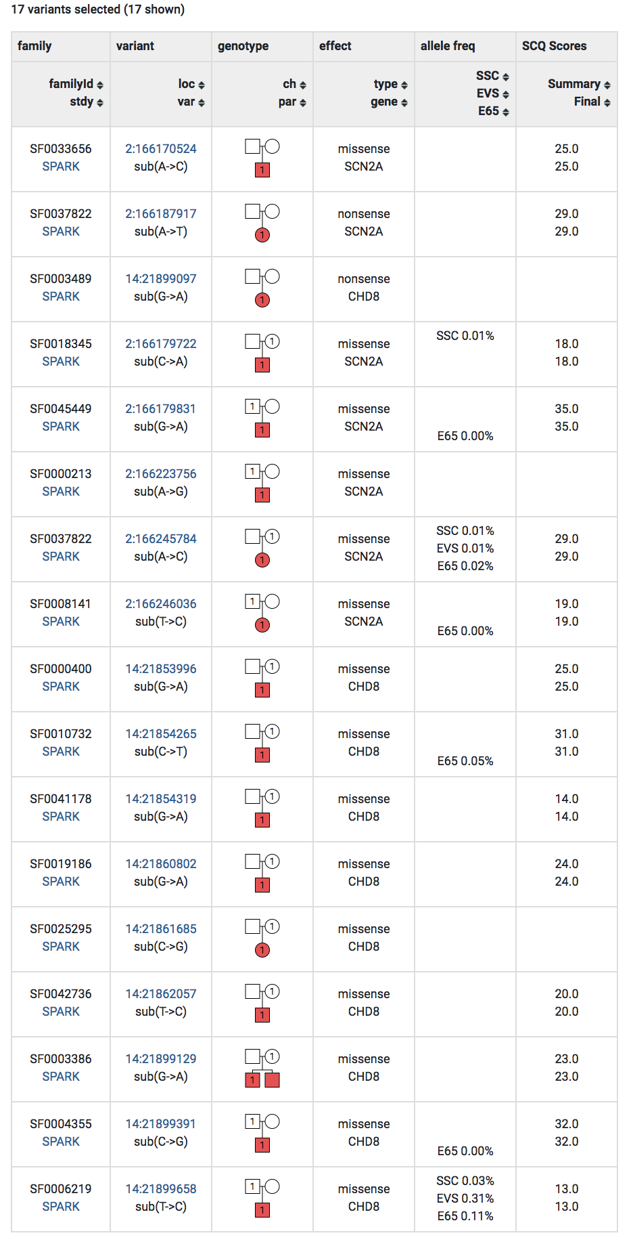
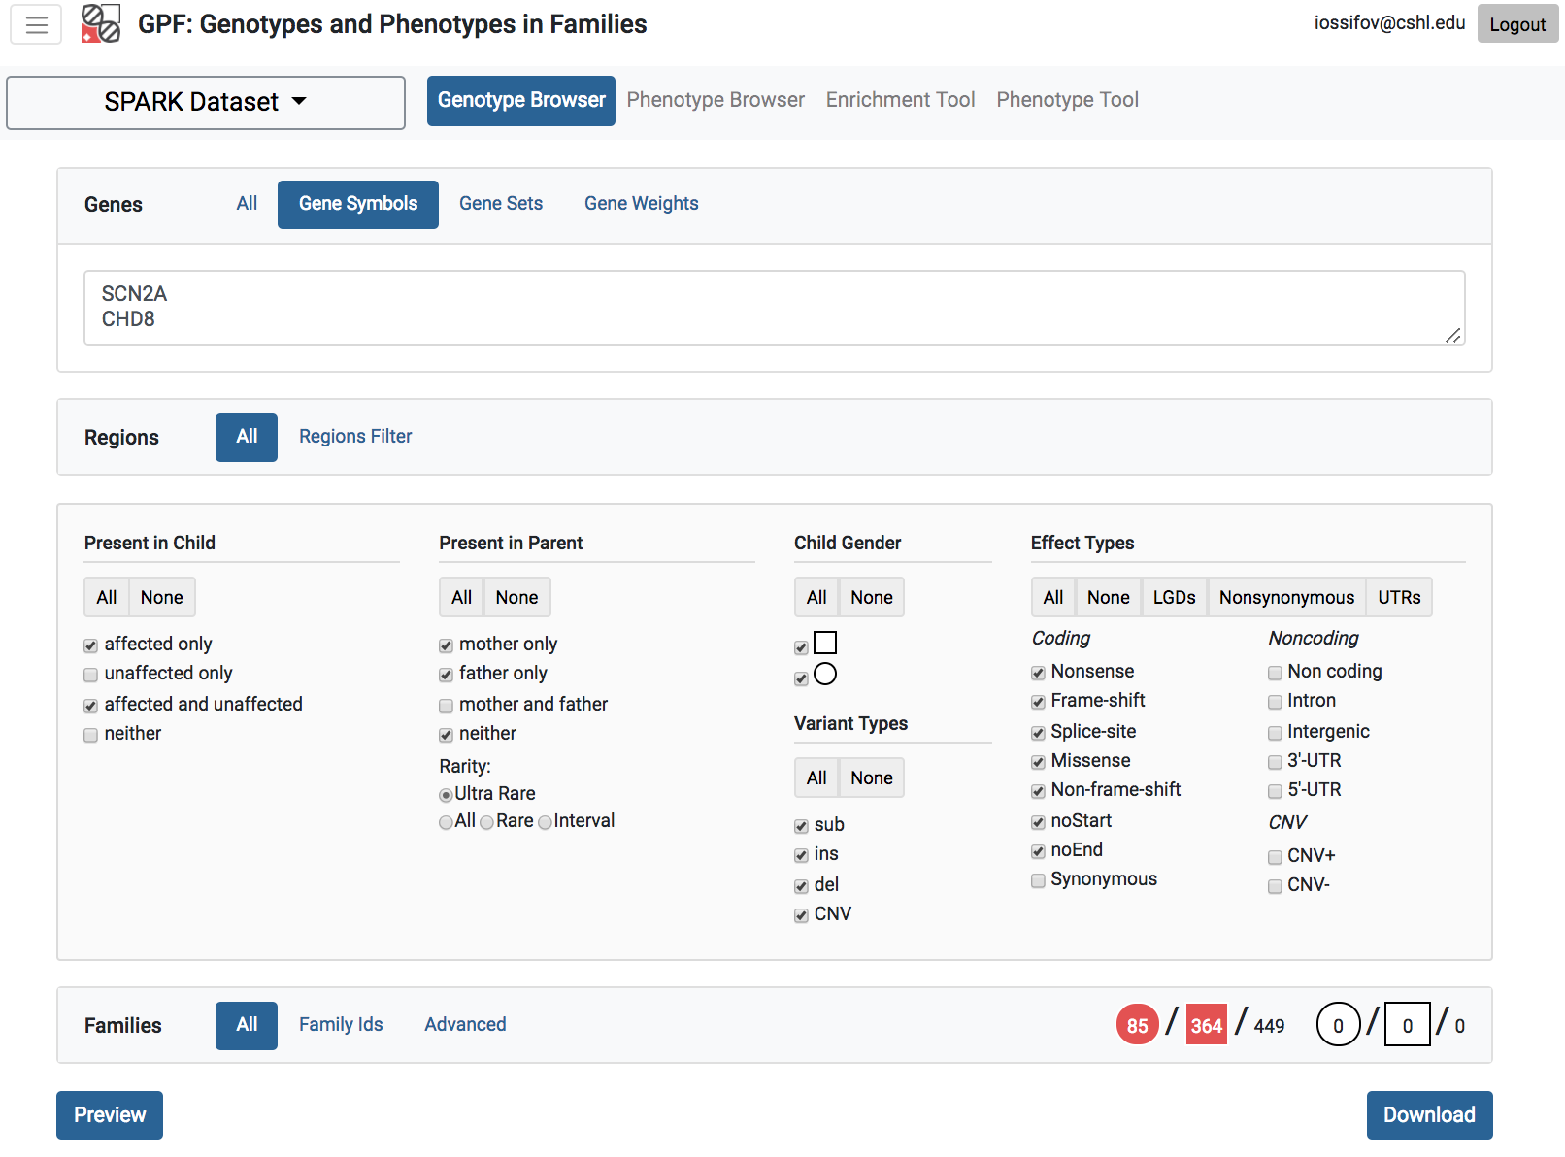
  Genome and Phenotype Tool (GPF)
https://gpf.sfari.org/
Query
Features:
SPARK Content:
  De novo variants
  Rare and common transmitted variants
  Phenotypic data
Integration:
  SSC exome and whole-genome
  VIP
Query: Interface
  By gene
  By set of genes (i.e. by pathway)
  By predicted variant effect (i.e. LGDs)
  By variant frequency
  By transmission pattern (i.e. de novo or transmitted from mother)
  By phenotypic properties (i.e. affected children with SCQ score larger than 20)
Analysis tools:
  Enrichment of de novo variant in a given gene set.

Slide 19
SFARI-IOBIO Data Federation Project
Notes:
SFARI supports the development of computational infrastructure to support reproducible, collaborative research and data sharing. The individual platforms that comprise this infrastructure are designed to address major challenges in the analysis of phenotypic and genotypic data that are collected from multiple, large, family-based cohorts: data access, harmonization and federation. We have recently begun two pilot analysis portals that take different approaches which we hope will inform the future development of this infrastructure:
The Genome and Phenotype in Families (GPF) portal is a system for the visualization of pre-computed, comprehensively annotated variant calls in multiplex pedigrees. The system is designed to be portable (i.e., installed locally or within a public/private cloud) and accept standard genomics data formats.
The IOBIO-SFARI data portal, in contrast, will initially focus on building an entirely federated approach to data access and analysis. Different data repositories (e.g., VCF and BAM files stored in multiple Internet-accessible buckets) will be accessed and then streamed to a cloud-based pipeline that will perform fully integrated analyses. Analyses in the pilot phase will initially be limited to QC data and variant calls for the autism research community, but, if successful, the array of analyses will be expanded in the near future.

Slide 20
Acknowledgements
SF Informatics Team
SCC Flatiron Institute
SFARI Science Team
SPARK Team
New York Genome Center(NYGC), Baylor College of Medicine Sequencing Center
Iossifov Lab at NYGC/CSHL
Marth Lab at University of Utah and IOBIO –Frameshift team
Notes:
Similar to Google Maps, we need to align and integrate diverse, often unstructured, data sets into a comprehensive knowledge network if we are to understand the complexities of human health and disease.

Slide 21
Thank you!
Notes:
Similar to Google Maps, we need to align and integrate diverse, often unstructured, data sets into a comprehensive knowledge network if we are to understand the complexities of human health and disease.

Slide 22
Autism risk is complex
Inherited variants ~50%?
De novo LGD & missense variants
~10-30%?
Somatic variants
1%?
Environment
17 %
Pam Feliciano, 2017
Notes:
In addition to having many symptoms, there are many risk factors for autism. We know that much of the risk for autism is genetic. with the remaining risk explained by environmental factors. One of the most important findings in the past decade has been the recognition of the role that de novo mutations play in this condition. Through exome sequencing of several thousand ASD trios, the field has identifeid approximately 100 genes that harbor heterozygous, de novo LGD (likely gene disrupting) mutations in ASD.

Slide 23
Distribution of genetic risk in autism
Gauglet at al, 2014

