Slide 1
Top-Quark Mass in ATLAS
Young-Kee Kim
The University of Chicago
on behalf of ATLAS Collaboration
Top Quark Physics at the Precision Frontier
January 16-18, 2018
Fermilab

Slide 2
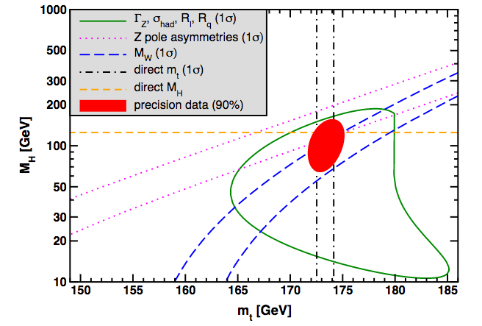
Electroweak and constraints on new physics
Particle Data Group (December 1, 2017)
Z pole asymmetries
Γ_{Z}, σ_{had}, R_{l}, R_{q}
Provides crucial info. for global fits of EW interactions, assessing the internal consistency of the SM and probing its extensions
Affects the stability of the SM Higgs potential, which has cosmological implications

Slide 3
Electroweak and constraints on new physics
Particle Data Group (December 1, 2017)
Top
mass
Higgs mass
W mass
Provides crucial info. for global fits of EW interactions, assessing the internal consistency of the SM and probing its extensions
Affects the stability of the SM Higgs potential, which has cosmological implications

Slide 4
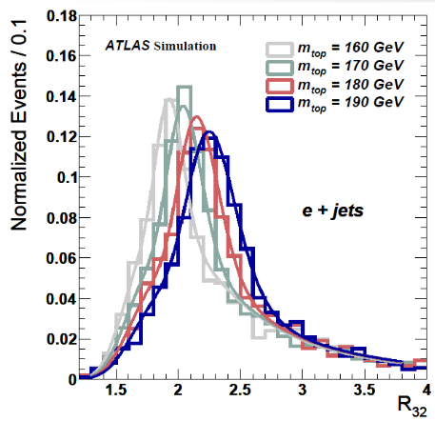
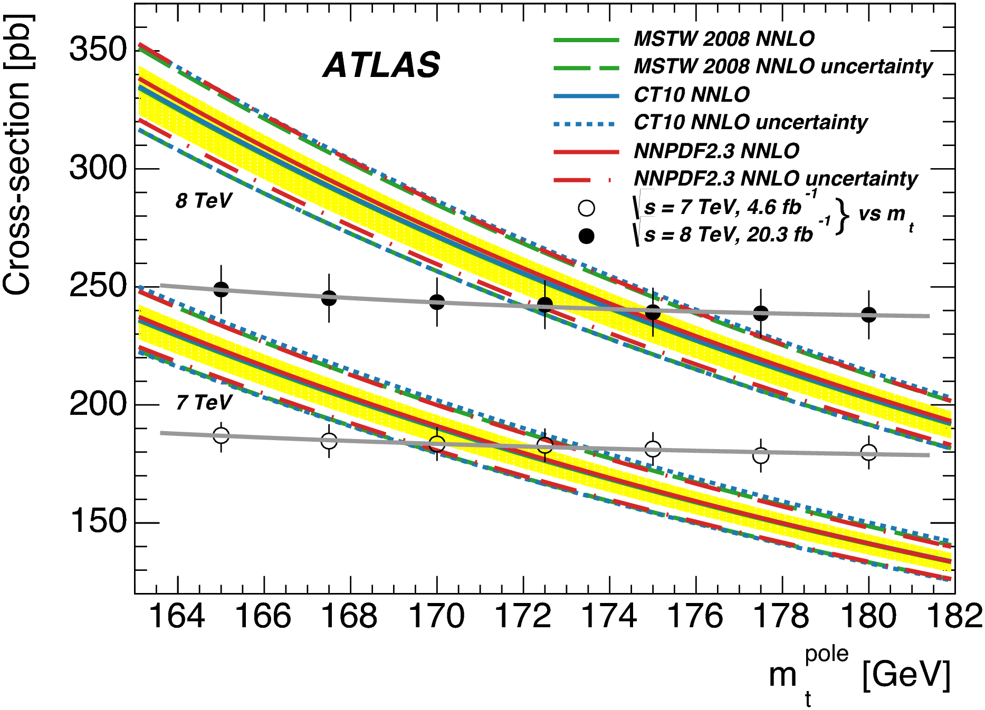
Definition of top mass; Measurement methods
“Top mass” = Top MC mass
  Standard
    Reconstruct top-pair system
    Reconstruct “top mass” distribution
    MC samples w/ various m_{top} values
    m_{top} that gives the best fit to data
  Alternative
    Use variables sensitive on m_{top}
    Different systematic uncertainties
Top-quark pole mass
  σ_{tt} depends on top “pole” mass
  Δσ_{tt} / σ_{tt} ~ 5% → Δm_{top} / m_{top} ~ 1%
130 140 150 160 170 180 m_{top}^{reco}

Slide 5
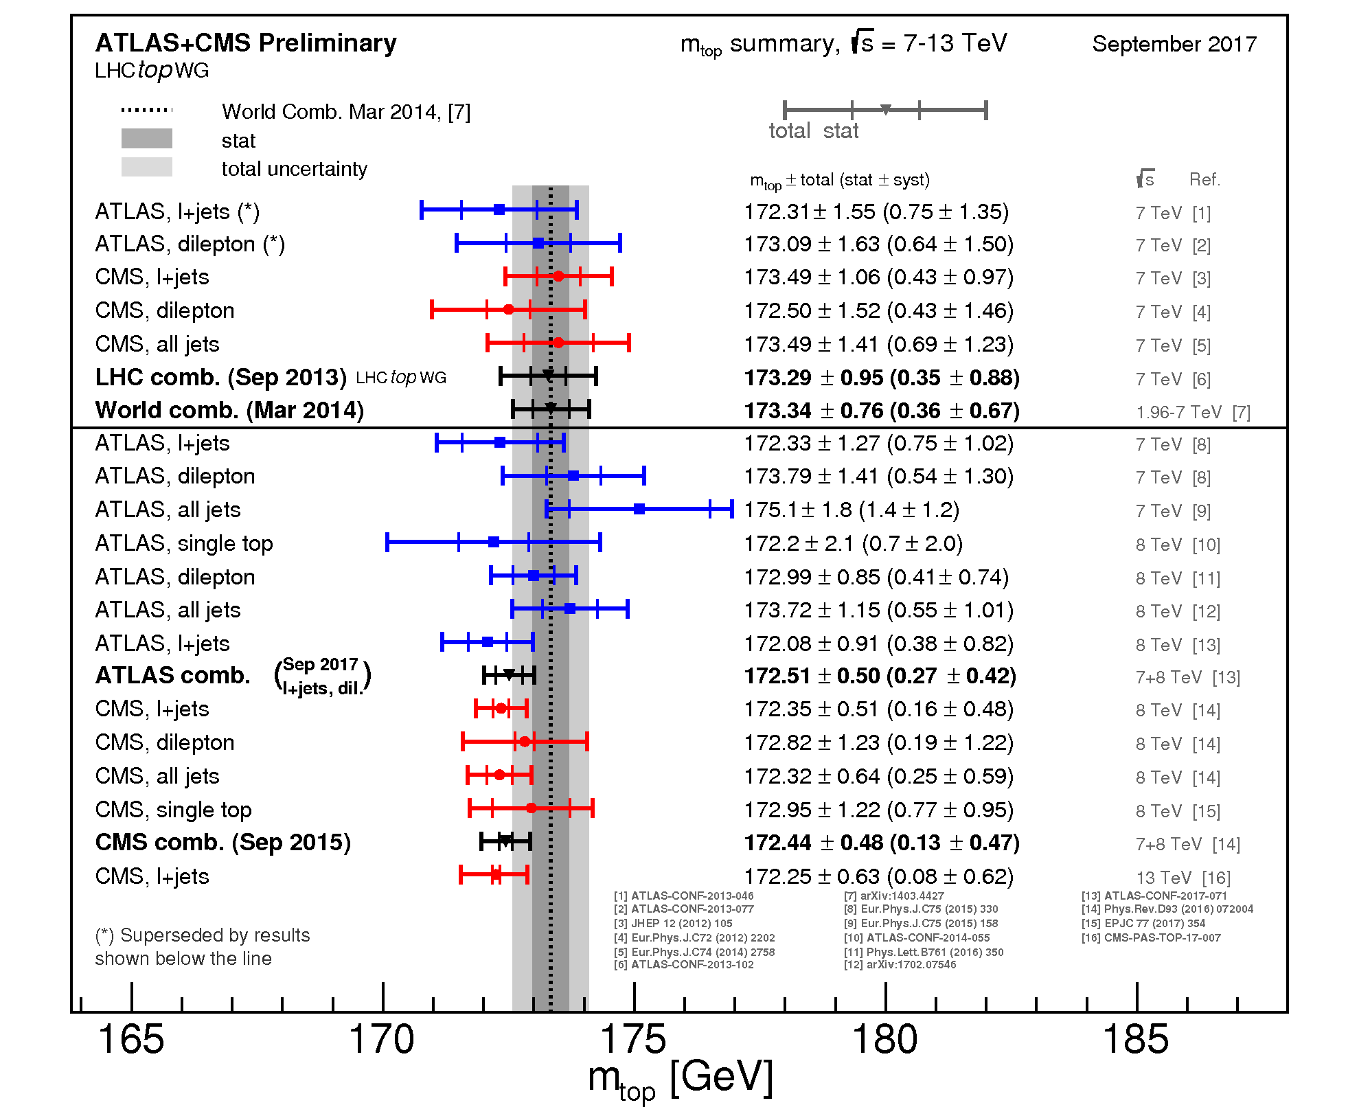
ATLAS + CMS: top-MC mass measurements
ATLAS
7 TeV
ATLAS
7 TeV
Dominated by systematic uncertainties → influenced strategies for 8 TeV analysis

Slide 6
ATLAS + CMS: top-MC mass measurements
ATLAS
7 TeV
ATLAS
7 TeV
ATLAS
8 TeV
~0.5 GeV uncertainty → needs a better understanding of MC and pole mass relations

Slide 7
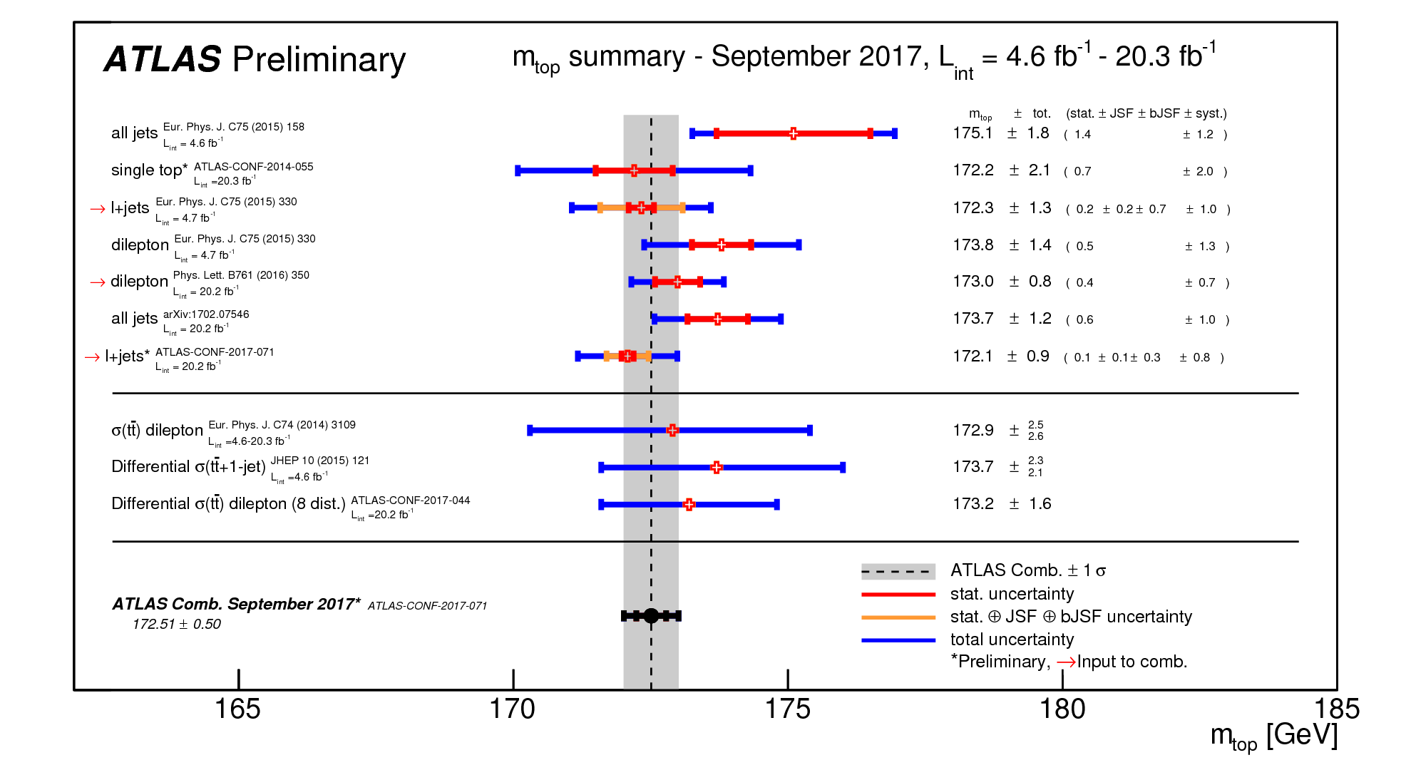
ATLAS: top mass measurements
8 TeV
8 TeV
Eur. Phys. J. C77 (2017) 804
L_{int} = 20.2 fb⁻¹
8 TeV

Slide 8
Top mass: 7 TeV → 8 TeV
Better knowledge
jet energy scale and b-jet energy scale
Optimization procedure to reduce the systematic uncertainty
(jet energy scale and theory modeling)
trading between statistical and systematic uncertainty

Slide 9
Direct Top Mass (top pair)
(lepton = e, μ)
 | All jets WWbb → qqqqbb | Lepton + jets WWbb → lνqqbb | Di-lepton WWbb → llννbb
Branching Ratio | 46% (multi-jet bgrnd) | 30% | 4% (clean)
Triggers | 5 jets (p_{T} > 55 GeV) | e, μ (p_{T} > 24 GeV)
Pre-selection (all central objects) | 0 lepton (e, μ) E_{T} < 60 GeV 5 jets (p_{T} > 60 GeV) others (p_{T} > 25 GeV) 2 b-tagged jets | 1 lepton (e, μ) p_{T}^{e,μ} > 25 GeV E_{T} > 30(e),20(μ) GeV 4 jets (p_{T} > 25 GeV) 1 or 2 b-tagged jets | 2 leptons (e, μ) p_{T}^{e,μ} > 25 GeV E_{T} > 25 GeV 2 jets (p_{T} > 25 GeV) 1 or 2 b-tagged jets
b-tagging | ε_{b} = 59% (tight) Rejection:~13(c),~330(u/d/s) | ε_{b} = 70% Rejection: ~5 (c), ~140 (u/d/s)
/
/
/

Slide 10
Direct Top Mass (top pair)
(lepton = e, μ)
 | All jets WWbb → qqqqbb | Lepton + jets WWbb → lνqqbb | Di-lepton WWbb → llννbb
Top pair event reconstruction (jet to parton matching) | b-tagged jets → b quarks un-tagged jets → light (b) quarks m_{qq} = m_{W}, m_{top1} = m_{top2} |  | b-tagged jets → b quarks
 | χ² | event-likelihood | min(<m_{lb}>)
Final selection Reduce background Correct jet-parton matching Better resolution Lower syst. uncertainty | Δφ(b₁,b₂) > 1.5 <Δφ(b,W)> < 2 | Boosted decision tree (BDT) > -0.05 2 b-tagged jets | p_{T,lb} > 120 GeV
# of events | 12,900 | 38,054 | 9,426
Signal events | See next slides | Top pair: 97.6% Single top: 2.4% | Top pair: 94.6% Single top: 3.6%
Background events |  | Total: 1.0% W + jets: 0.8% (data driven) | Total: 0.6% Fake lepton:0.3% (data driven)

Slide 11
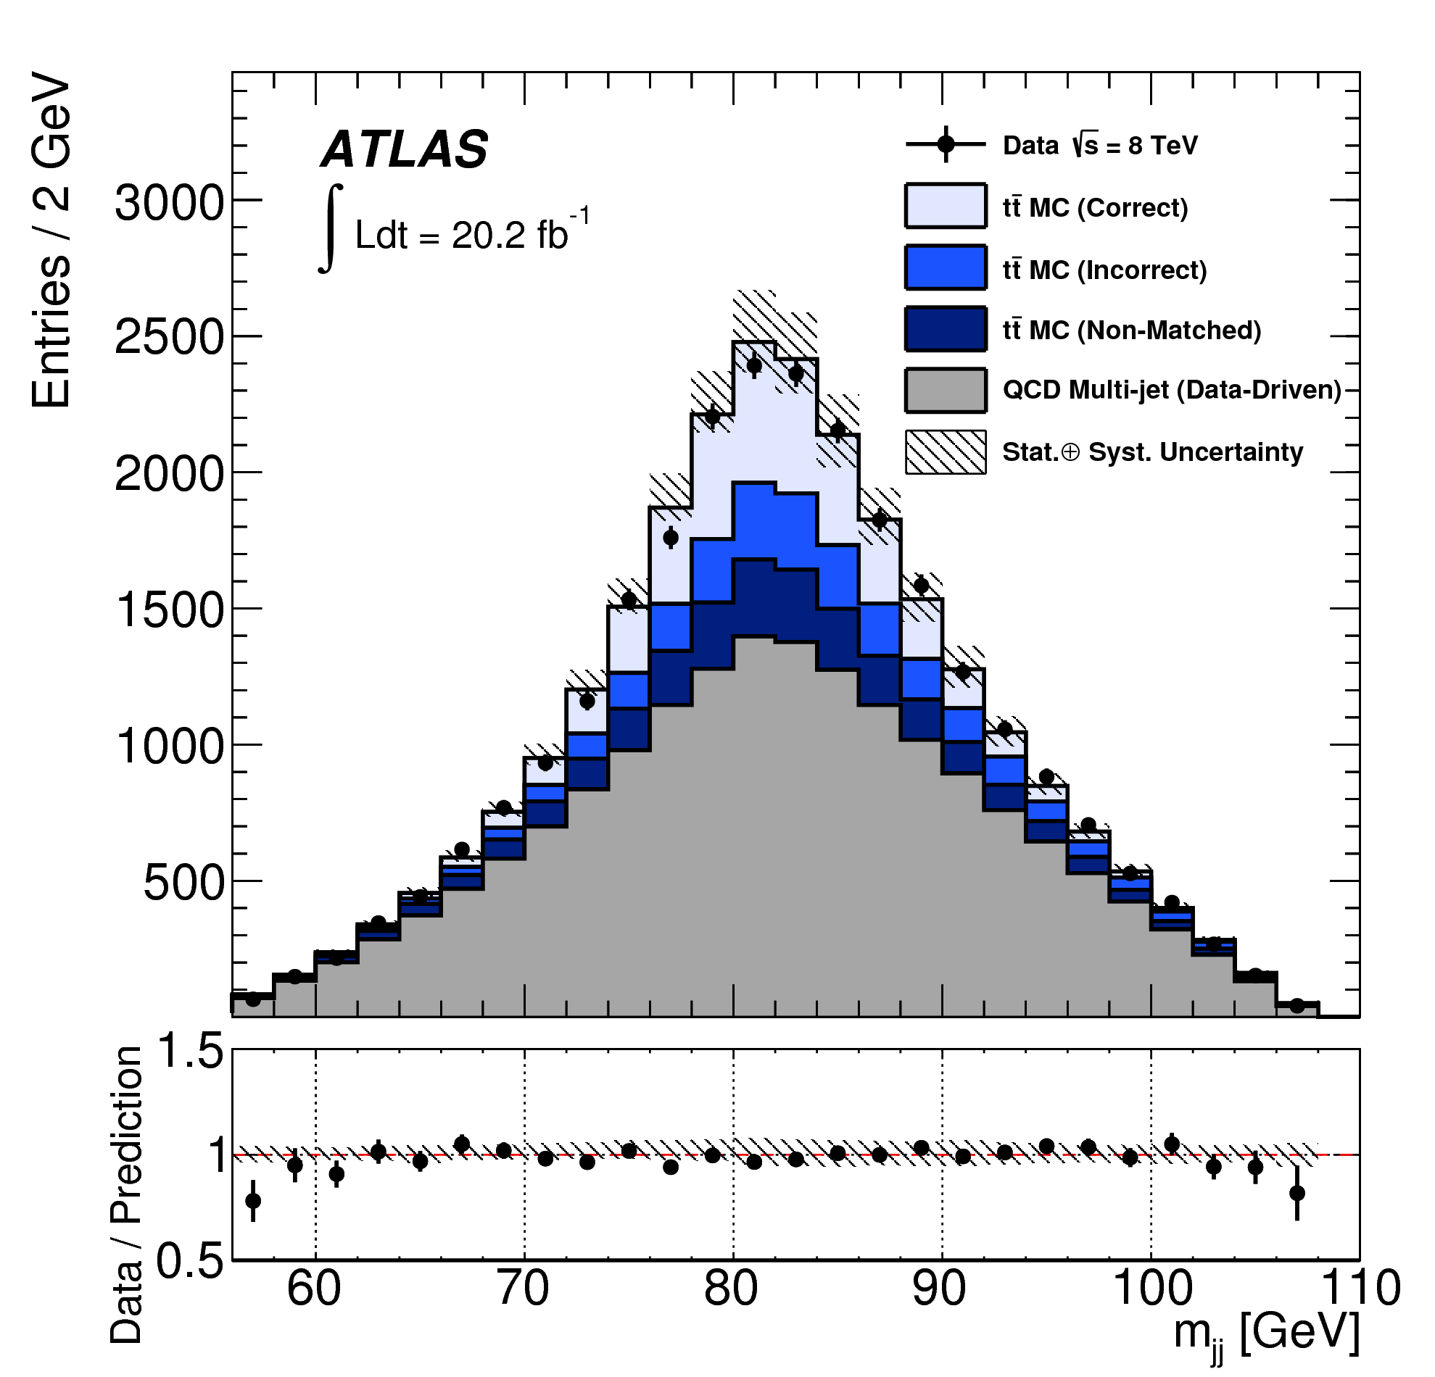
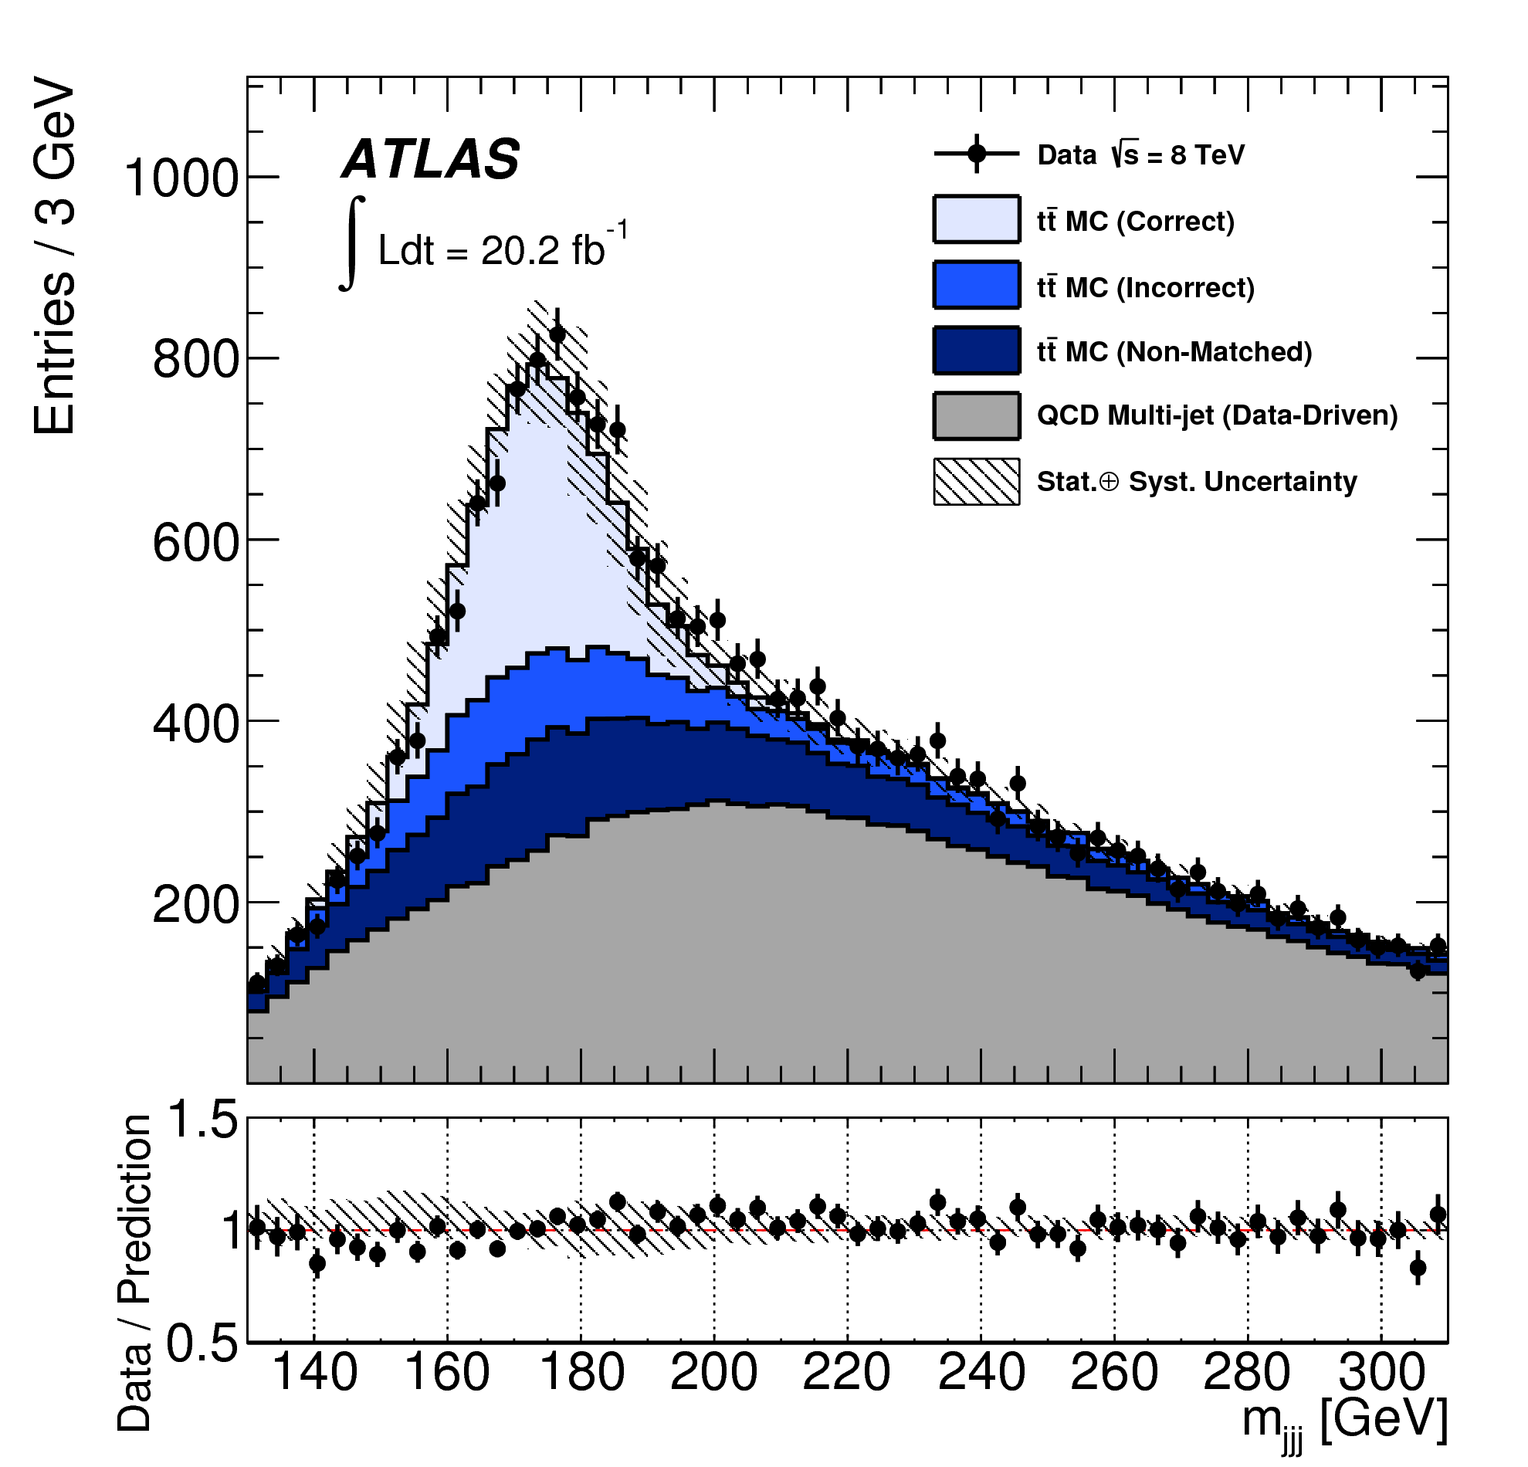
All-jets top mass at 8 TeV
JHEP 09 (2017) 118
Challenge: multi-jets bgrnd
  Estimate (data driven)
  Control regions for normalization and shape
<Δφ(b,W)>
Control region | Control region
Control region | Signal region
multi-jet bgrnd
N_{b-tag}
Signal: Jet-parton assignment
Correctly matched
Incorrectly matched
Not matched
multi-jet bgrnd

Slide 12
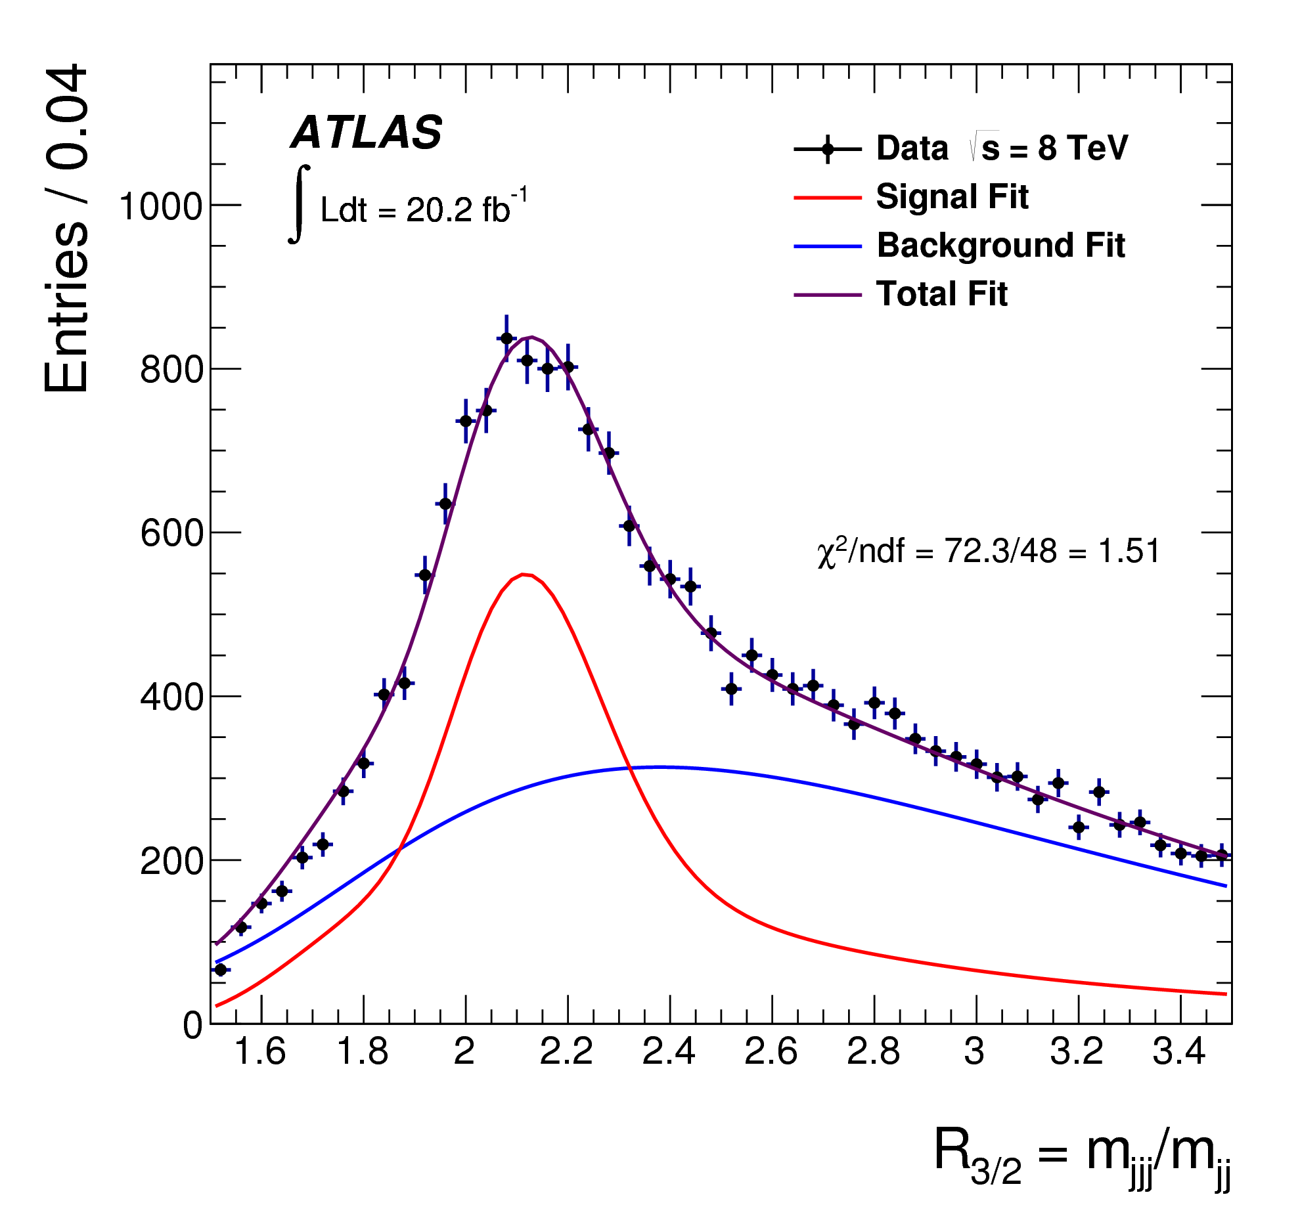
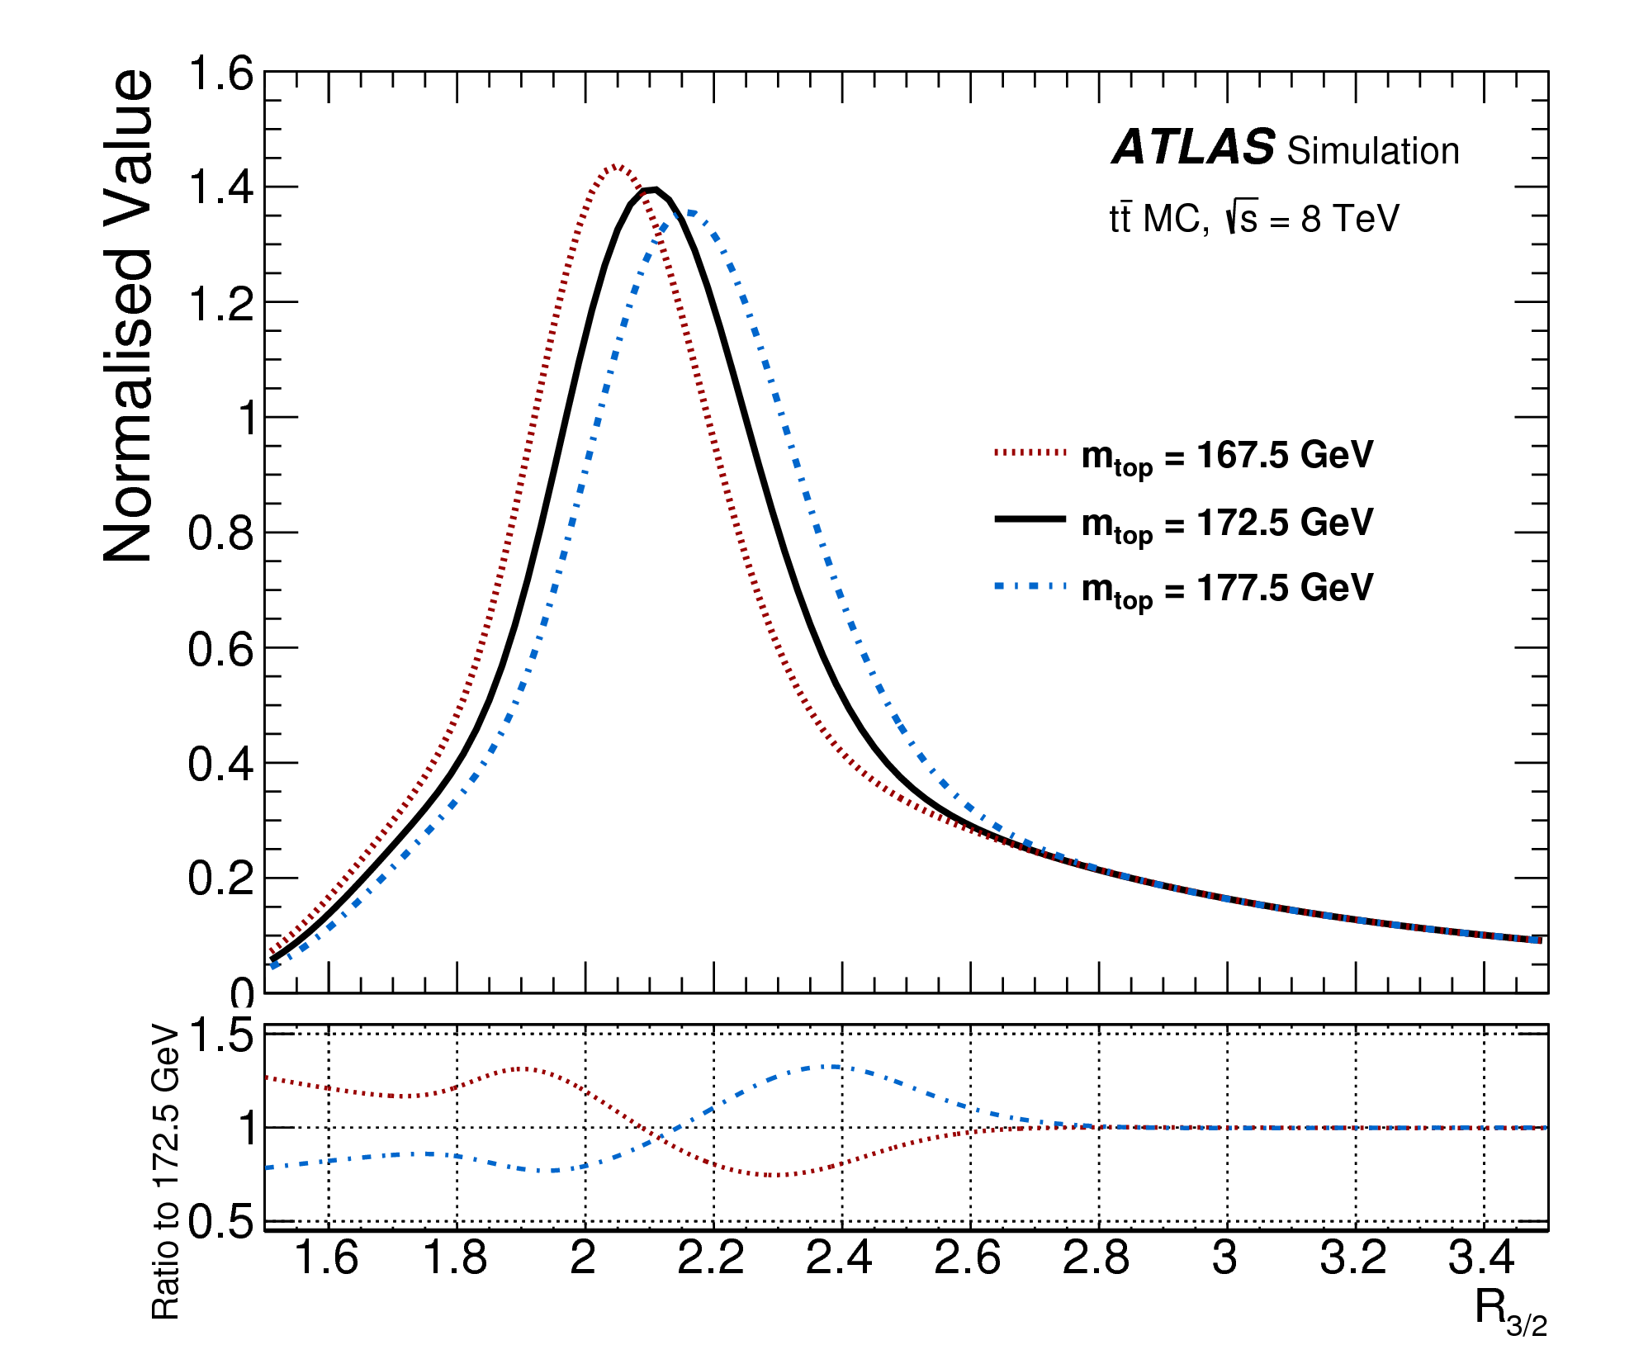
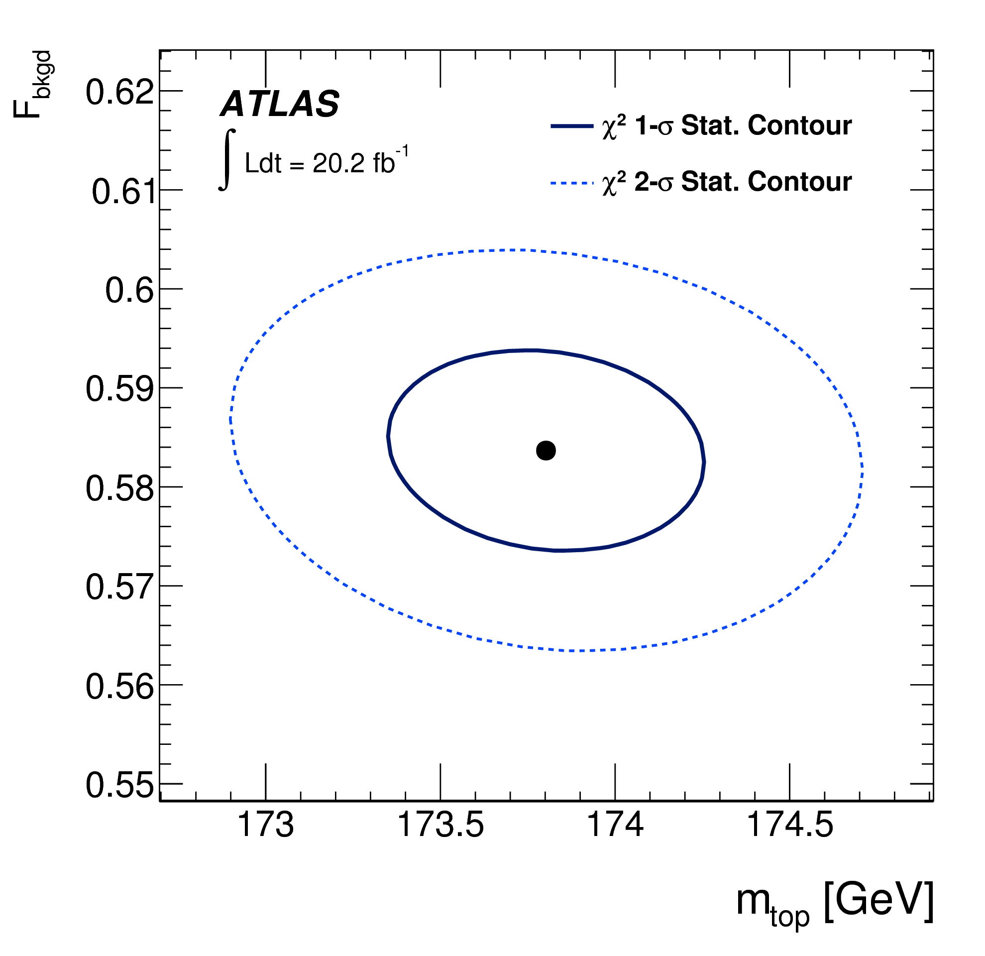
All-jets top mass at 8 TeV
JHEP 09 (2017) 118
Template fit
  R_{3/2} = m_{qqb} / m_{qq}
  Partially cancel syst. effects common to m_{top} and m_{W}
Binned min. χ² approach
Dominant syst. uncertainties
  Jet energy scale (JES)
  Hadronization modeling
  Relative b-to-light-jet E scale (bJES)

Slide 13
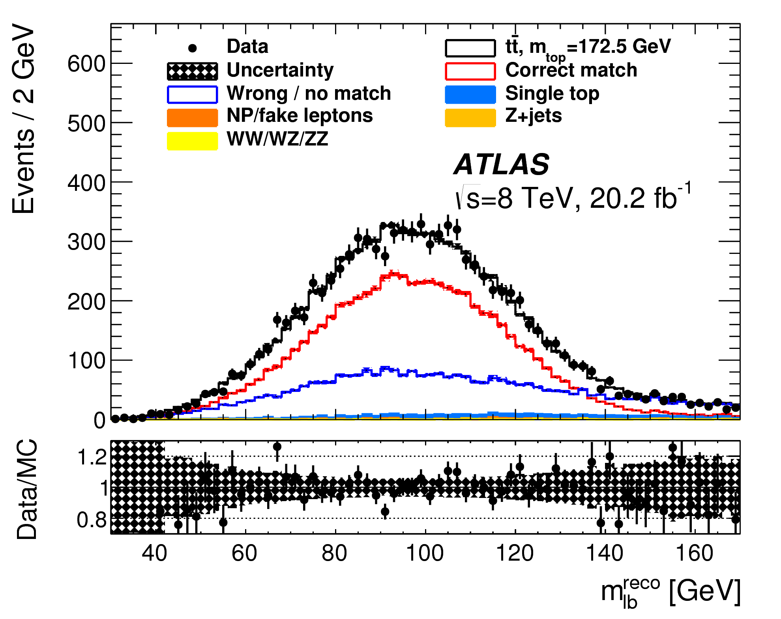
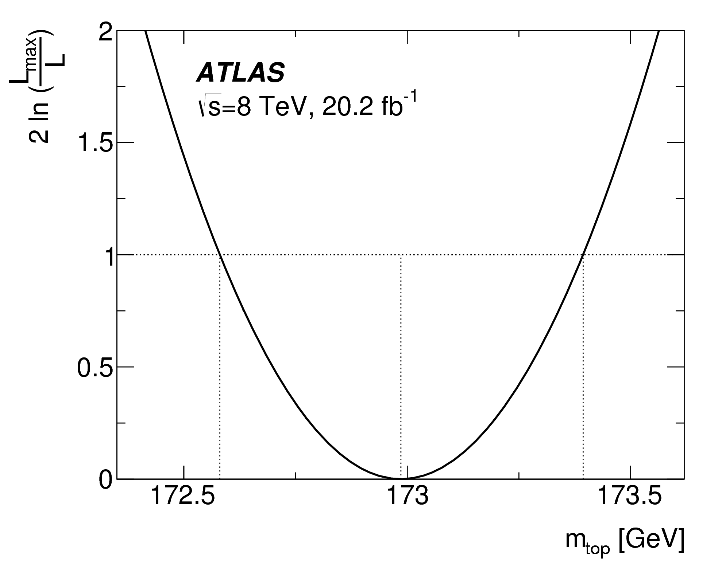
Di-lepton top mass at 8 TeV
Phys. Lett. B 761 (2016) 350
Optimize to minimize the total uncertainty in m_{top}
  Trading between stat. vs syst.
  p_{T,lb} = p_{T}(lepton, b-jet) > 120 GeV
Template fit
  m_{lb}^{reco}
Unbinned maximum-likelihood fit to data
Dominant syst. uncertainties
  Jet energy scale (JES)
  Relative b-to-light-jet energy scale (bJES)
correct match
wrong / no match

Slide 14
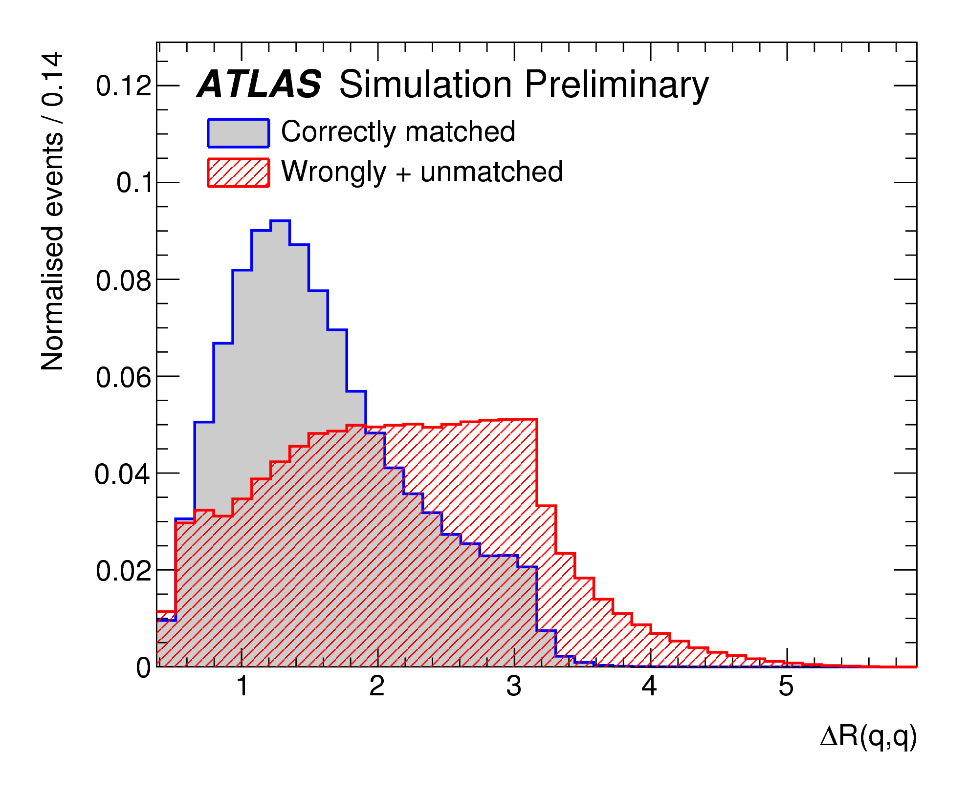
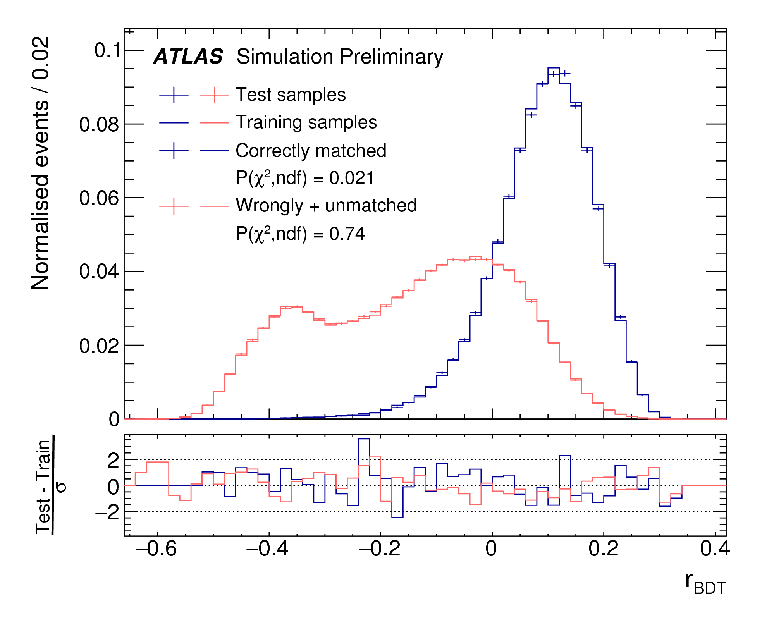
Lepton+jets top mass at 8 TeV
ATLAS-CONF-2017-071
BDT to minimize the total uncertainty in m_{top}
  Distinguishes events with a correct jet-to-parton matching
  12 input variables
    ΔR(q₁,q₂): untag.-jets to W
    p_{T}(W_{had}), p_{T}(top_{had})…
  BDT > -0.05
    Remove 60% signal (wrongly matched or unmatched)
    Remove 90% of W+jets
correctly matched
wrongly matched
+ unmatched
correctly matched
wrongly matched
+ unmatched

Slide 15
Lepton+jets top mass at 8 TeV
ATLAS-CONF-2017-071
Template fit
Simultaneous measurement of m_{top}, JES and bJES
  M_{top}^{reco}
  m_{W(q1,q2)}
  R_{bq}^{reco} = (p_{T}^{b1}+p_{T}^{b2}) / (p_{T}^{q1}+p_{T}^{q2})
Reduces the sizeable JES and bJES induced uncertainties
Unbinned likelihood fit
Dominant syst. uncertainty
  JES
  b-tagging
60 70 80 90 100 110
m_{top}^{reco} (GeV)
0.5 1 1.5 2 2.5 3
R_{bq}^{reco} (GeV)

Slide 16
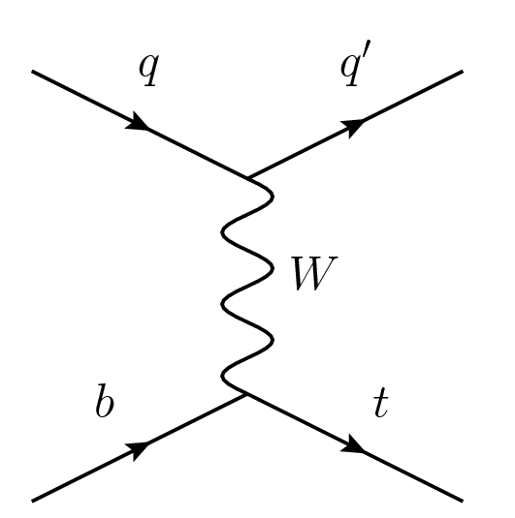
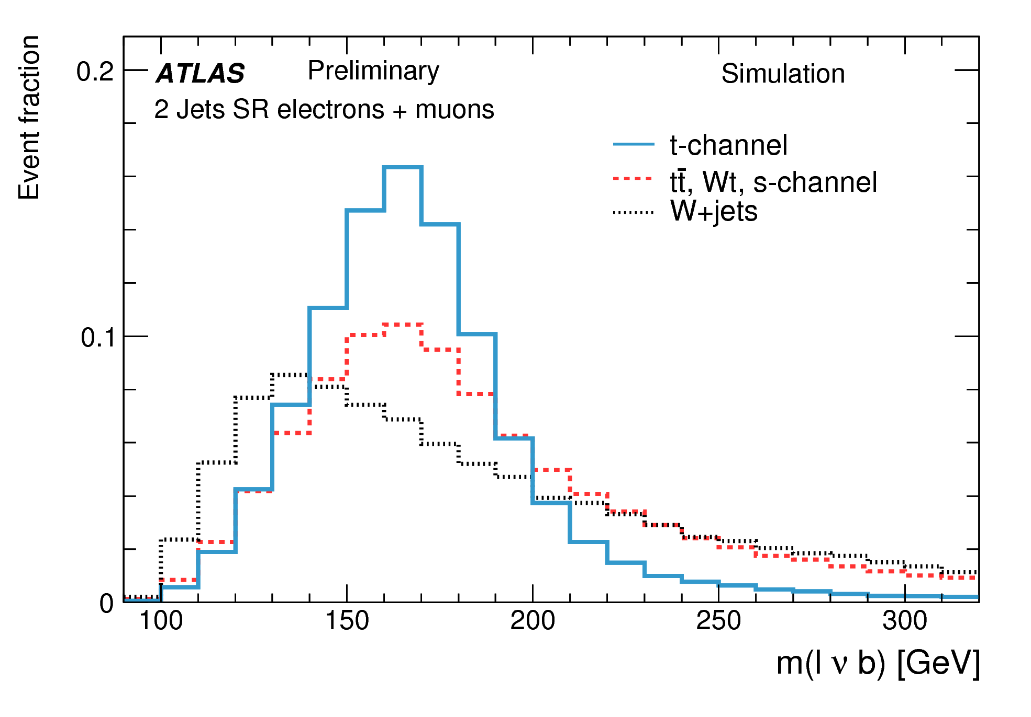
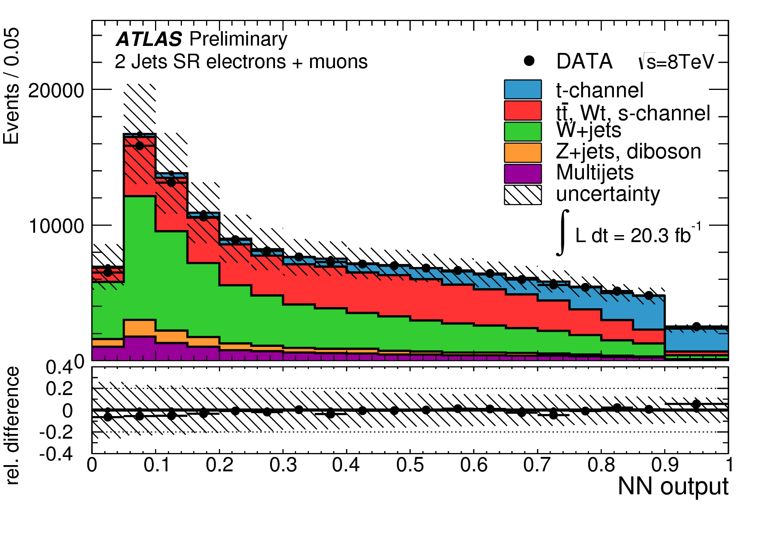
Top mass with single top events
ATLAS-CONF-2014-055
t-channel dominant
  1 lepton (e, μ)
  1 neutrino
  1 b quark
  1 light quark
Compared to top-pair
  Weak int.s → different color flow
  Lower Q²
  Less jet-parton ambiguities
  Less jet multiplicity → large bgrnd
  Different systematics
Neutral network
  Multivariate analysis technique
  12 variables including m_{lνb}, m_{jb}, …
  NN_{output} > 0.75

Slide 17
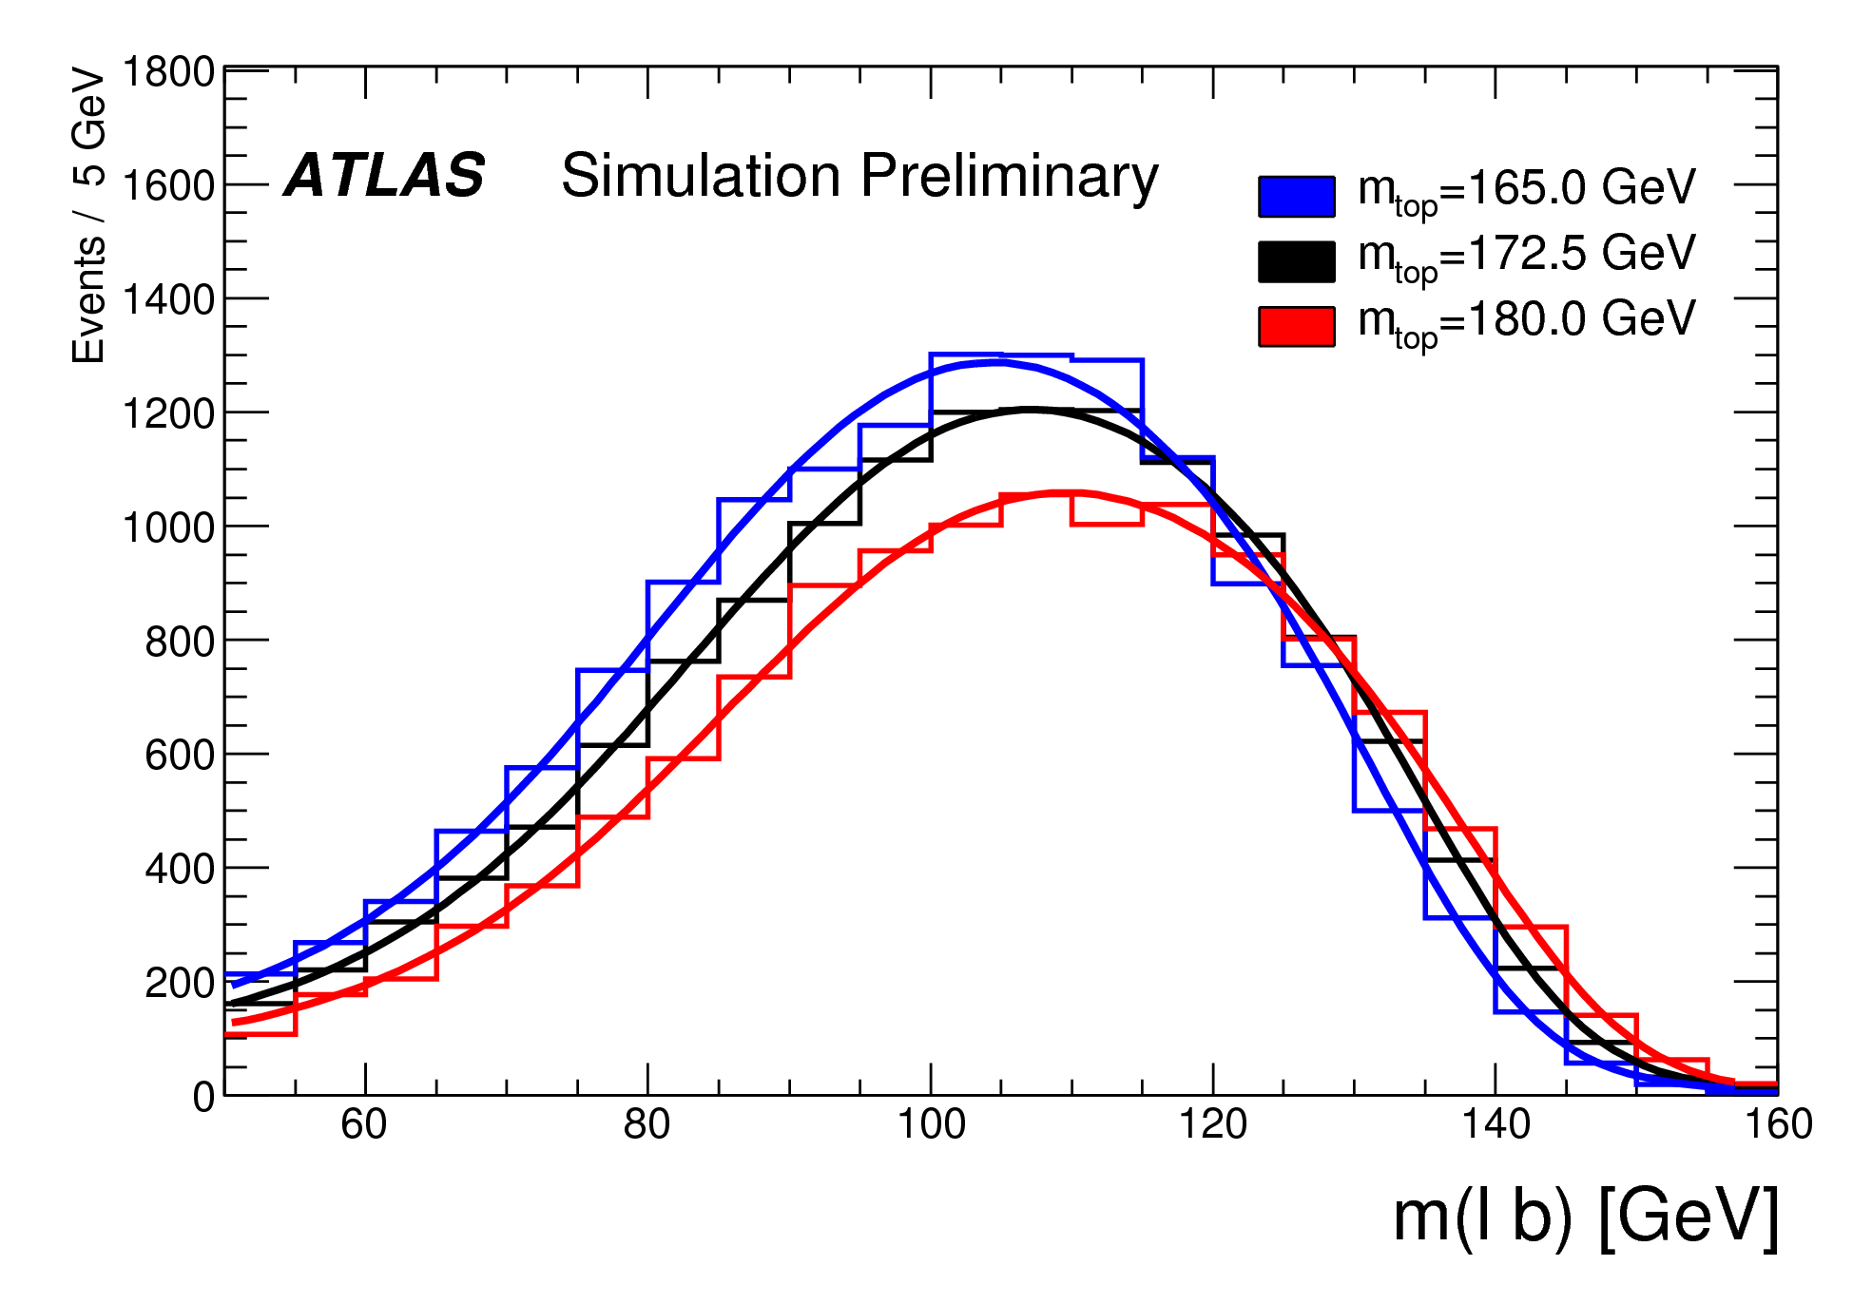
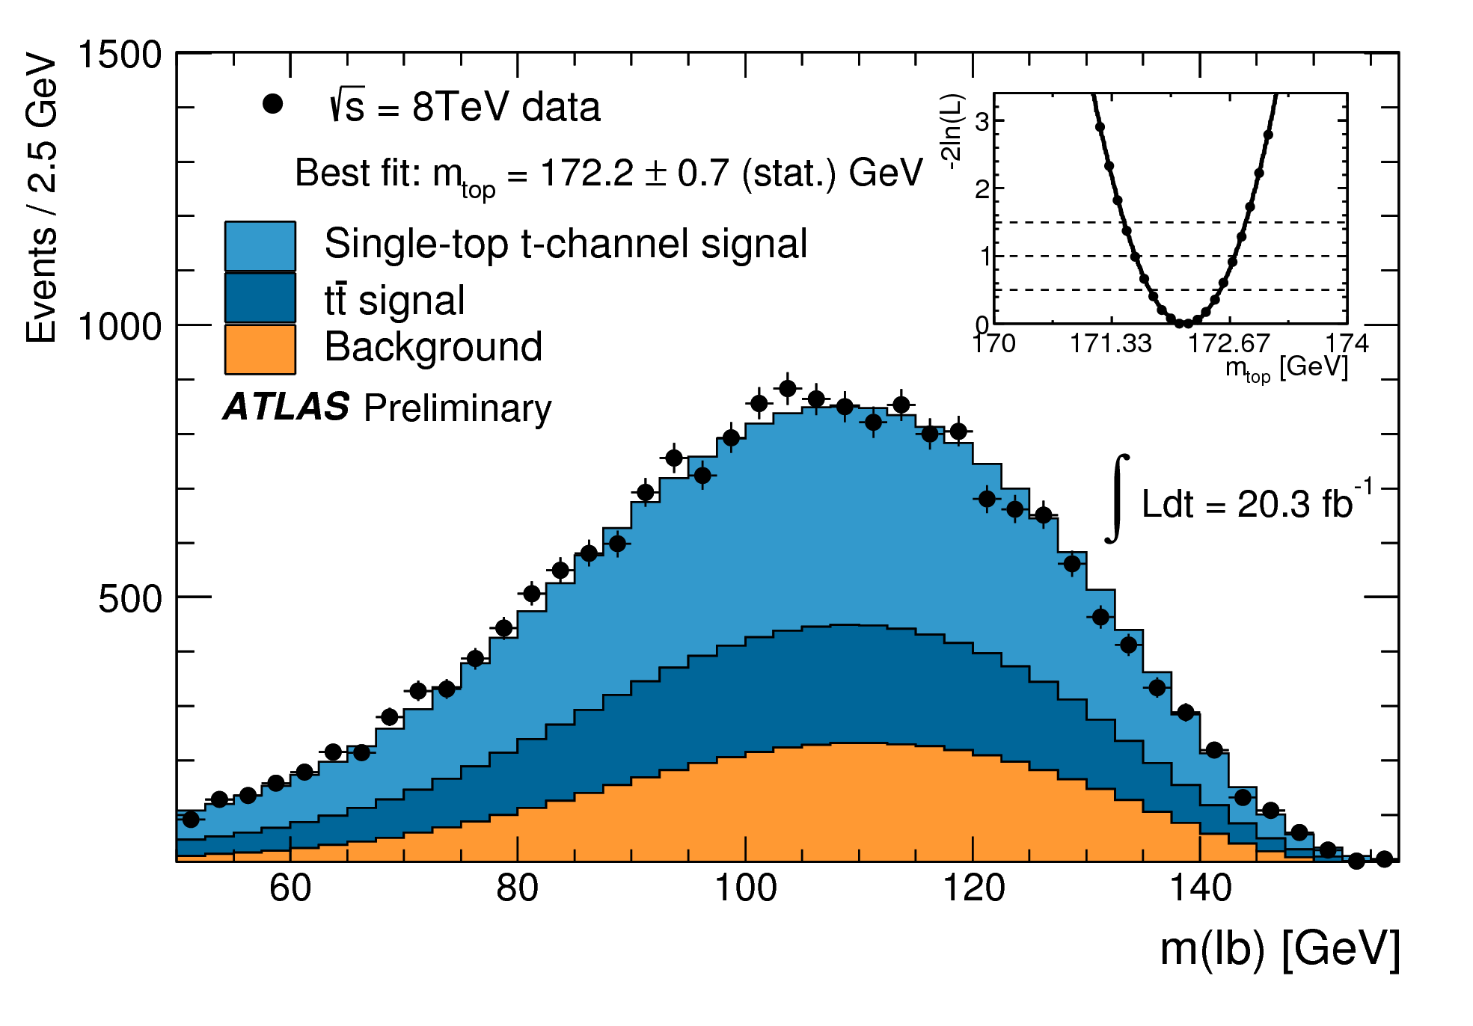
Top mass with single top events
ATLAS-CONF-2014-055
t-channel dominant
  1 lepton (e, μ)
  1 neutrino
  1 b quark
  1 light quark
Selected events
  Data: 19,833 events
  Signal + background
    Top pair: 26%
    Background: 28%
Template fit to m_{lb}
Binned maximum likelihood
Dominant syst. uncertainty
  JES
t-channel
Single-top
Top pair
Background

Slide 18
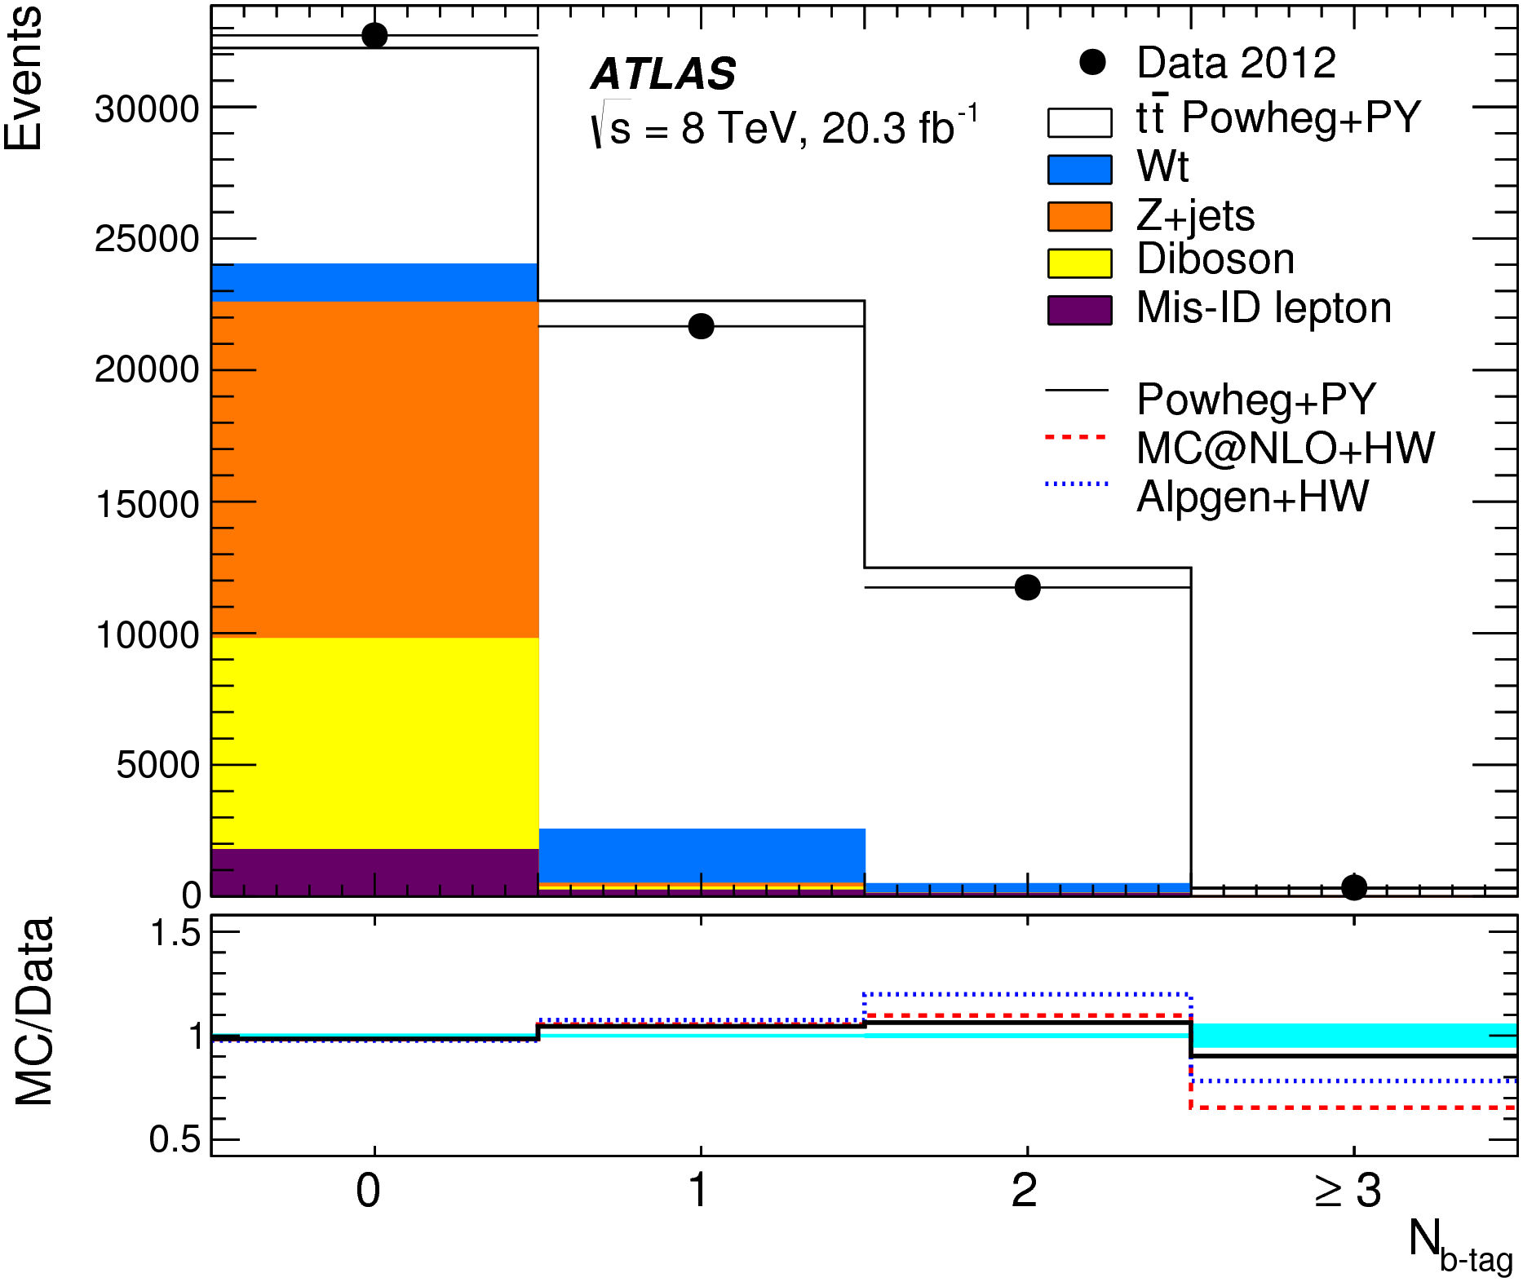
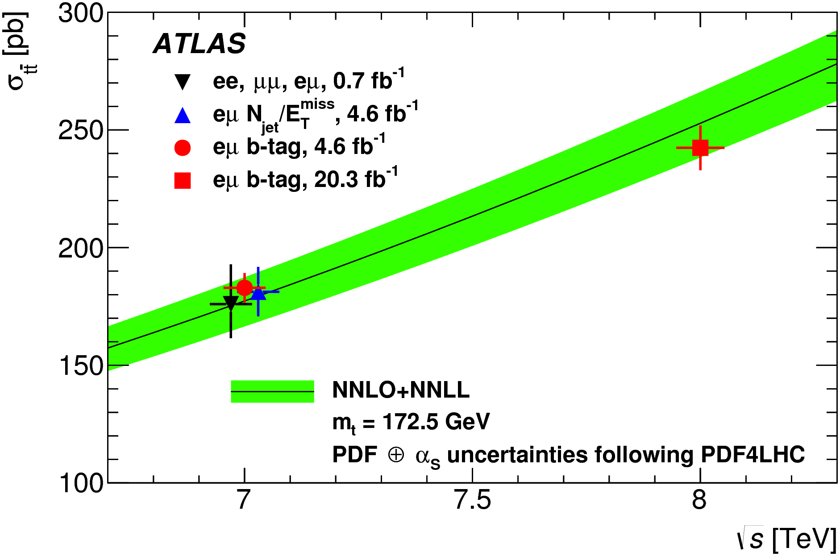
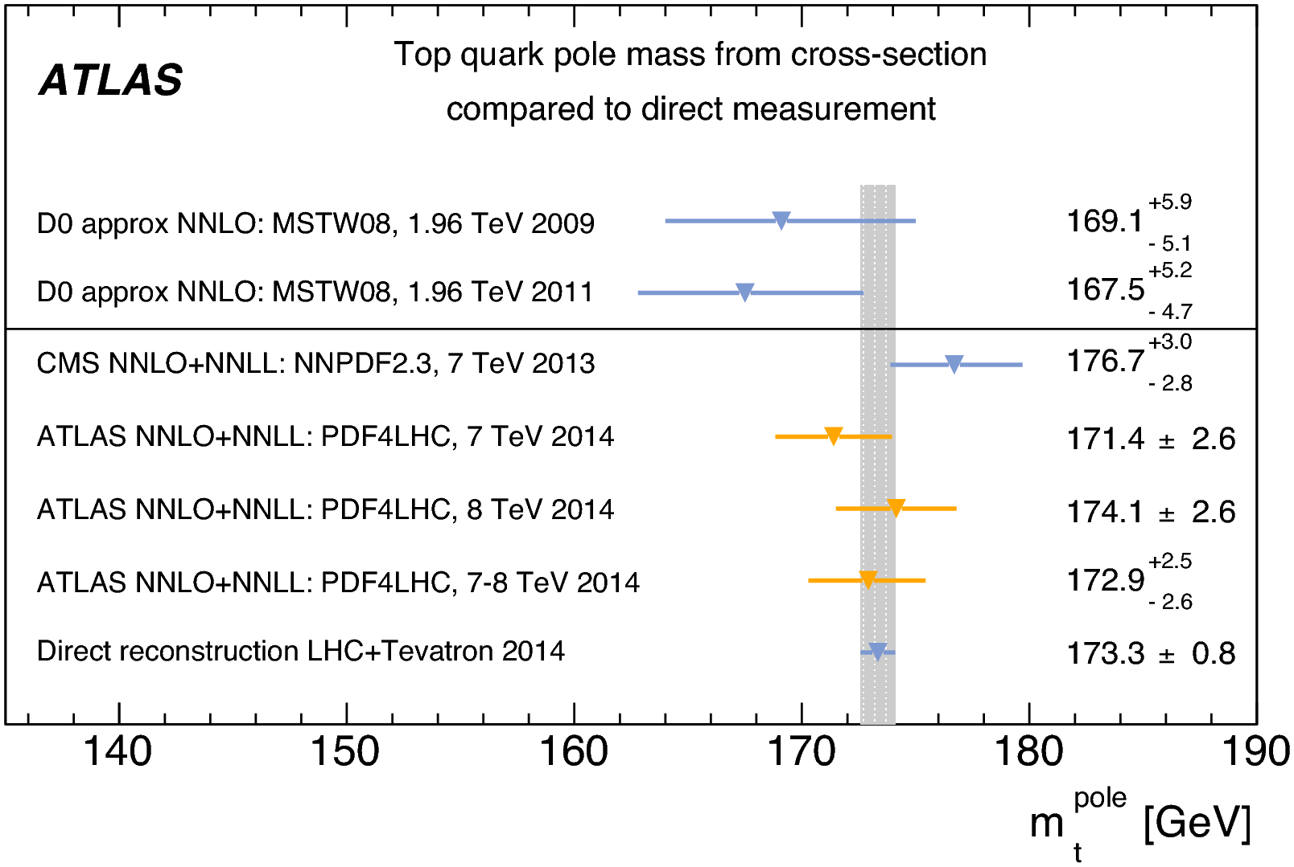
Top-pole mass
Eur. Phys. J. C74 (2014) 3109
Top pair cross sec.: sensitive to
  Gluon PDFs,
  Top mass
  Physics beyond the SM
Di-lepton channel
  e + μ + 1 or 2 b-jets
  Main background: Wt
Extracted top-pole mass from σ_{tt}

Slide 19
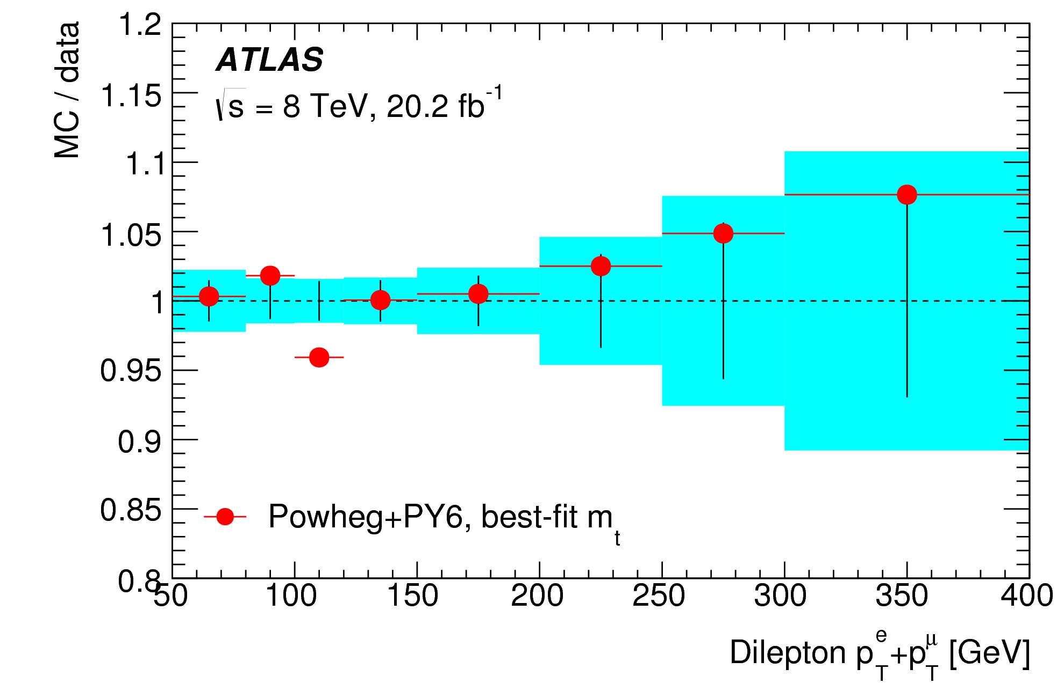
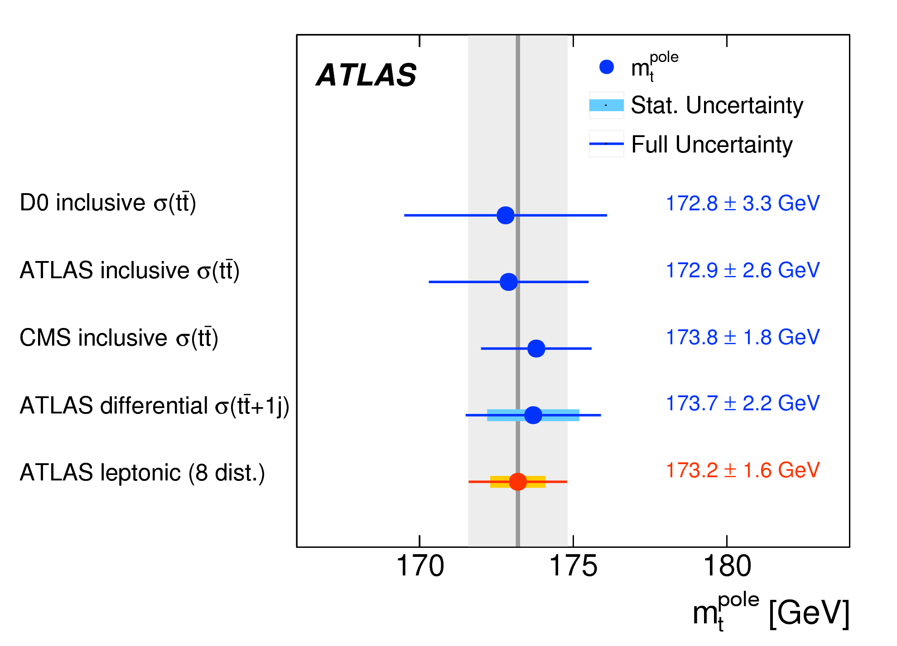
Top-pole mass
Eur. Phys. J. C77 (2017) 804
Differential cross sections
  1 lepton or 2-lepton system
  Less sensitive to hadronic part
m_{top}: p_{T}^{l}, p_{T}^{eμ}, m^{eμ}, p_{T}^{e}+p_{T}^{μ}, E^{e}+E^{μ}
  PDF/QCD scales:|η^{l}|, |y^{eμ}|, Δφ^{eμ}
Fit to fixed order QCD predictions (NLO) from the MCFM program
  Missing
  NNLO corr.s absorbed
  in scale uncert. (constrained in fit)
  δm_{top}^{pole} = ± 0.9 (stat)
  ± 0.8 (syst)
  ± 1.2 (theo)
  Dominant: QCD scales

Slide 20
Top mass measurements in ATLAS at 8 TeV
(GeV)
 | Dilepton | L+jets | All-jets | Single top | dσ_{tt}/dx
Top mass | MC mass |  |  |  | pole mass
 | 172.99 | 172.08 | 173.72 | 172.2 | 173.2
Statistical uncertainty | 0.41 | 0.39 | 0.55 | 0.7 | 0.9
Dominant syst. uncertainty | JES:0.54 bJES:0.30 | JES:0.54 b-tagging:0.38 | JES:0.60 Hadronization:0.64 | JES:1.5 Hadronization:0.7 | QCD scale: 1.0
Total sys. uncertainty | 0.74 | 0.82 | 1.01 | 2.0 | 1.4
Total uncertainty | 0.84 | 0.91 | 1.15 | 2.1 | 1.6

Slide 21
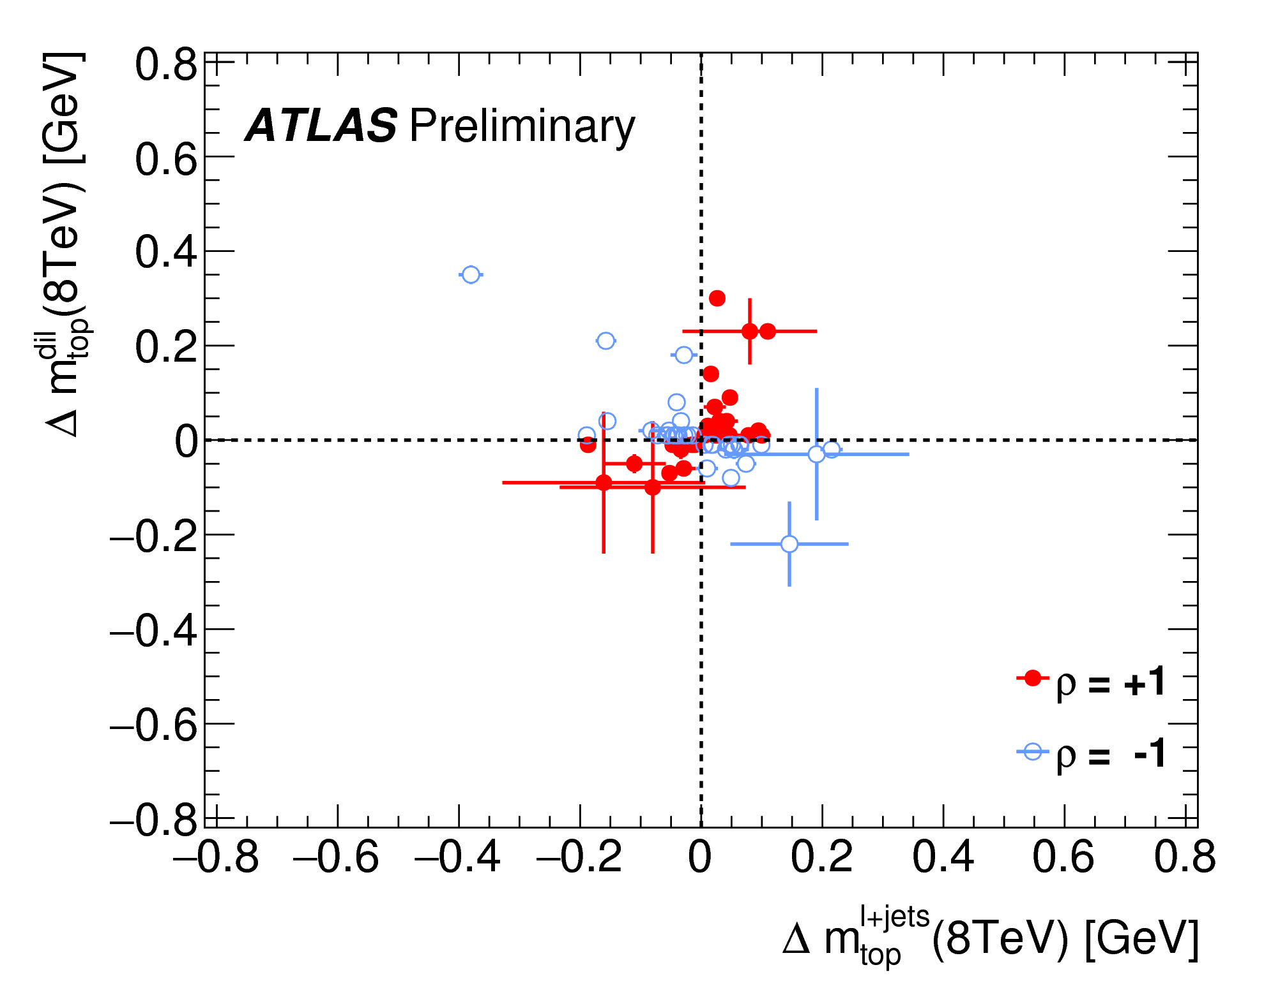
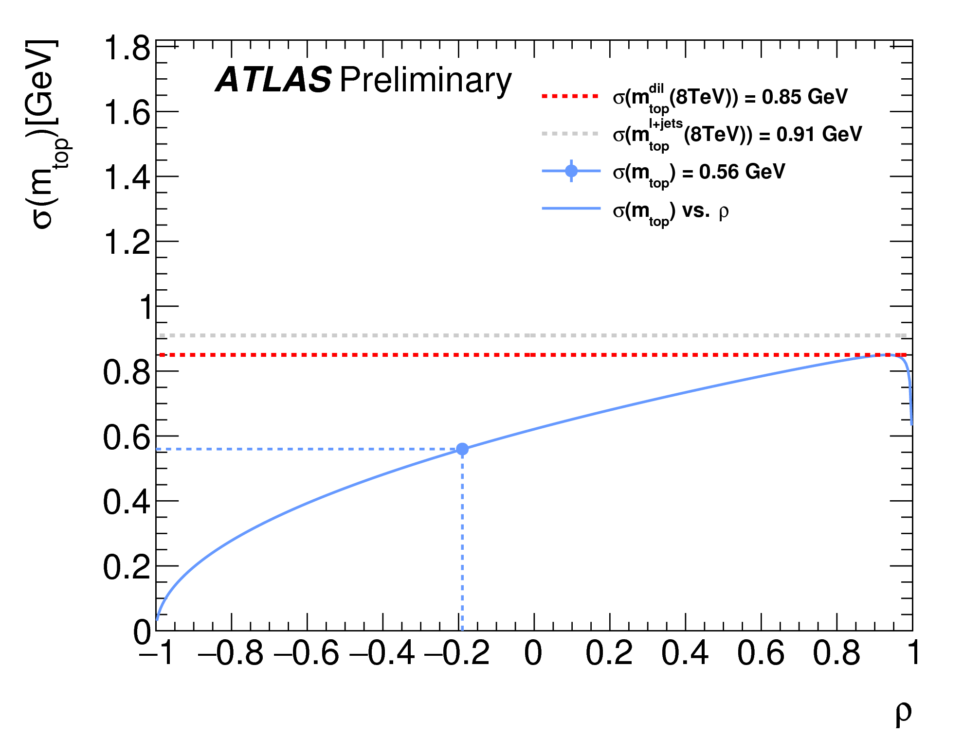
ATLAS top mass combination
Performed using the best linear unbiased estimate (BLUE) method:
Central values
Uncertainties
Correlations ρ of the estimators for each uncertainty

Slide 22
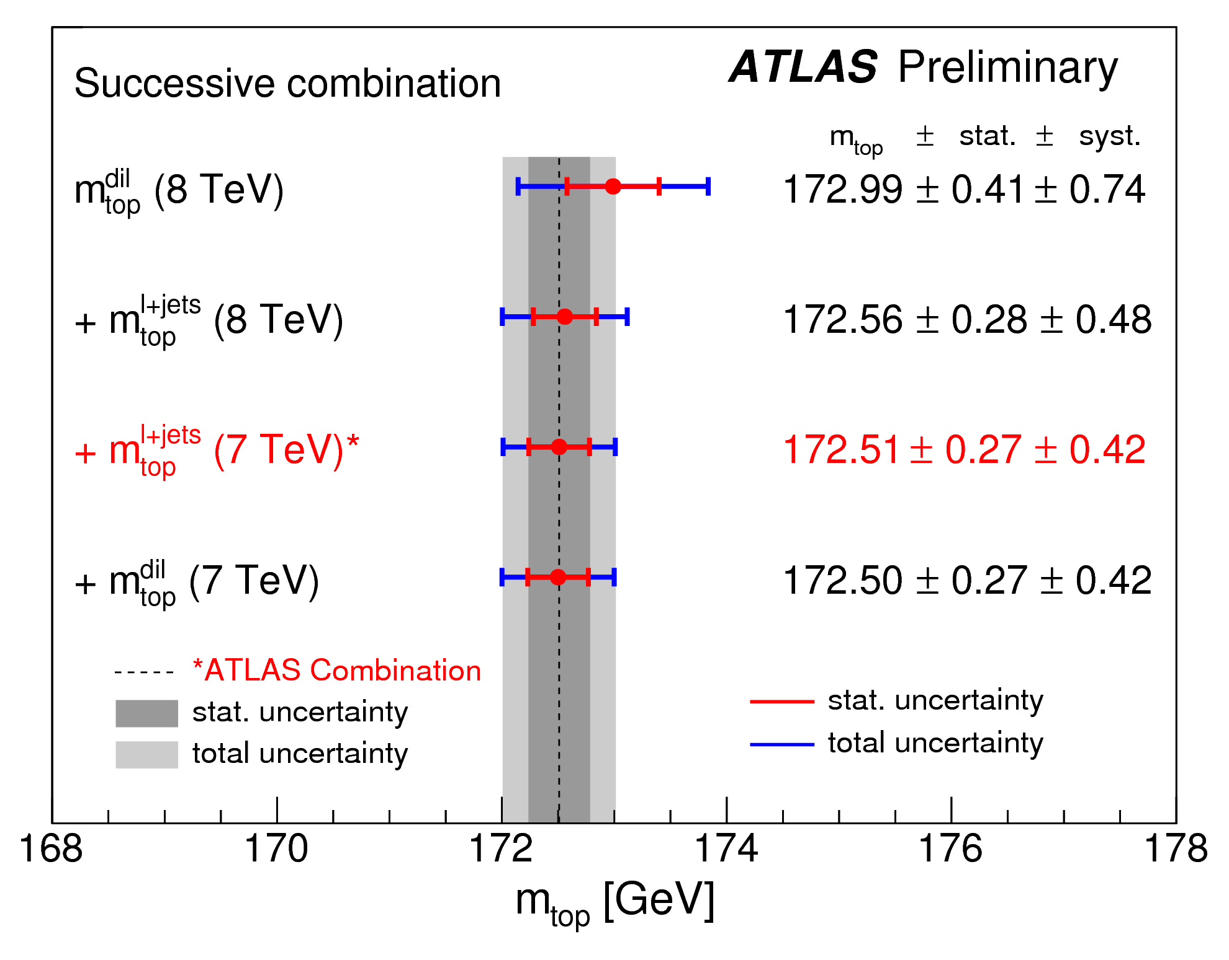
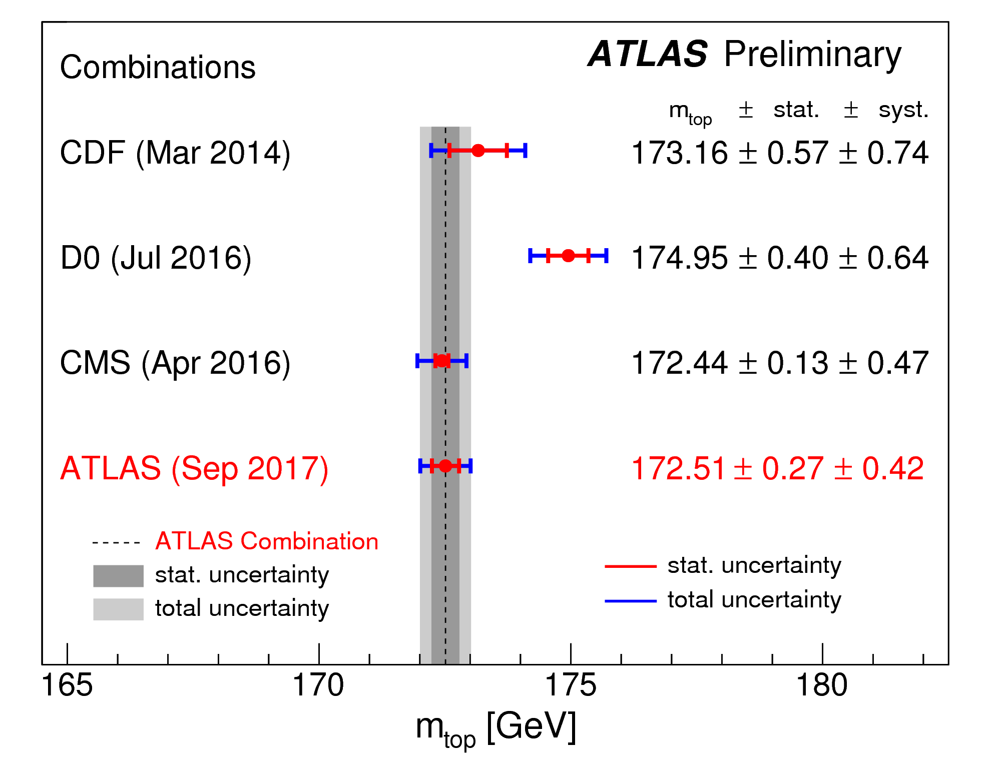
ATLAS top mass combination
Combined result when successively adding results to the most precise one
Combined result per experiment

Slide 23
Conclusions
ATLAS has made a number of measurements of the top quark mass at 7 and 8 TeV
Top-MC mass (Standard & Alternative)
  Best individual measurements
    Reduced the total uncertainty by trading stat. for syst. precision
    Di-lepton channel: 0.84 GeV at 8 TeV
    Lepton+jets channel: 0.91 GeV at 8 TeV
  ATLAS combination
    Care was taken to minimize & properly evaluate the correlations between individual measurements
    m_{top} = 172.51 ± 0.50 GeV
Top-pole mass via differential cross sections of top pair
  m_{top}^{pole} = 173.2 ± 1.6 GeV: consistent with m_{top} measurements

