Slide 1
Intel Code Modernisation GeantV Project Highlights
Andrei Gheata for the GeantV team
Openlab Technical Workshop
CERN, January 11-12, 2018

Slide 2
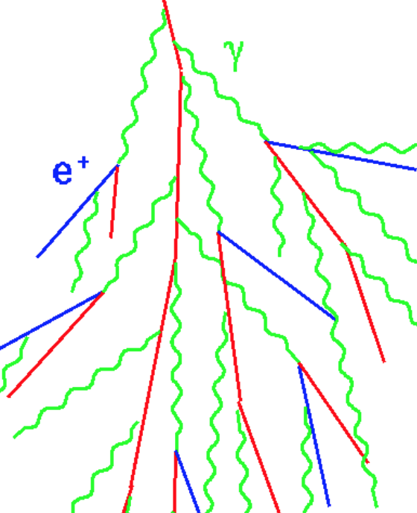
GeantV becoming a framework
2a. next boundary
dist = f(pos, dir, geom)
3. propagate with selected step
Runge-Kutta(pos, mom, B, step)
1. Proposed:
phys_step = f(total_xsec)
4a. Repeat 2,3 until reaching boundary, then restart from 1
4b. Repeat 2,3 until reaching proposed step
2b. Step is safe?
Do stages 1 to 6 for every track step – not very efficient….
5. continuous processes
Eloss, MSC -> pos’, P’
Instead, accumulate particles and execute a stage when having a full “basket”
Do this for every stage in a concurrent environment -> framework
6. discrete process sampling
daughters = f(process, …)

Slide 3
A generic vector flow approach
NUMA #0
Support bots scalar/vector implementations
GeantPropagator
Handler 1
scalar
virtual
DoIt(Track*)
NUMA #1
GeantPropagator
SimulationStage
Select(track)
SimulationStage
virtual DoIt(std::vector<Track*>)
worker threads
SimulationStage
Handler “i”
vector
SimulationStage
Basketizer “I”
threads of the same propagator collaborate
Stage buffer
GeantTaskData
Stage buffer
Stage buffer
Stage buffer
GeantTrack *
serving tracks for ALL threads
gen_{N}
gen₁
gen₀
Event server
Priority filter
…
policy to consume showers first
secondaries…
primaries

Slide 4
Features: integrating with experiment frameworks
digiA
Prod
evtGen
Producer
GeantV
Producer
digiB
Prod
output
Filter
digiC
Prod
Tested with ToyCMS (simplification of CMSSW)
  GeantV behaving as a “callable”, threads controlled by external framework
  Preserving the basketizing features in a MT environment
  Example will be provided in the alpha tag
  Next: integration with Gaudi
GeantV
RunManager (user entry point)
CMSApplication
  CMS detector construction
  CMS primary generator
Book a task (task data object)
RunSimulationTask(evset, task_data)

Slide 5
Features: Topology awareness
GeantV
run manager
NUMA discovery service
(libhwloc)
Propagator
Propagator
(…)
Scheduler
Scheduler
node
socket
socket
socket
~9% gain
CPU
CPU
Basketizer
Basketizer
memory
Hardware is topology organized (node->socket->CPU->caches->memory
Binding together resources which are nearby can bring important benefits
  Take into account Non-Uniform Memory Access

Slide 6

Features: Vectorization using VecCore
distance( double &);
distance( vector_type &);
Type-based explicit vectorization
  There are few libraries providing this: Vc, UME::SIMD
Geometry code & magnetic field RK propagator written in this way
  EM physics models coming next
Can profit also expressing internal vectorization when loop auto-vectorization is not possible
Scalar interface
Vector interface
template<typename Real_v>
void DistanceImplementation( const Real_v &input, Real_v & distance)
{
Distance computation algorithm here in terms of VecCore
// Real_v is an arbitrary scalar/SIMD type. VecCore library wraps
// math/vector operations expressed for different vector backends (Vc,
// UME::SIMD)
}
template <typename T = Real_s>
class ScalarT {
public:
using Real_v = T;
using Float_v = Float_s;
using Double_v = Double_s;
// Functions operating with scalar types
template <typename T = Real_s>
class VcVectorT {
public:
using Real_v = Vc::Vector<T>;
using Float_v = Vc::Vector<Float_s>;
using Double_v = Vc::Vector<Double_s>;
// Functions operating with vector types
https://github.com/root-project/veccore

Slide 7
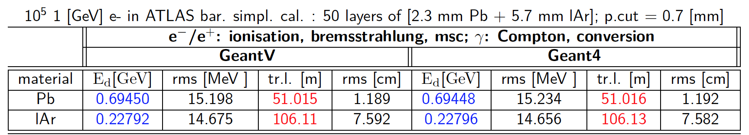
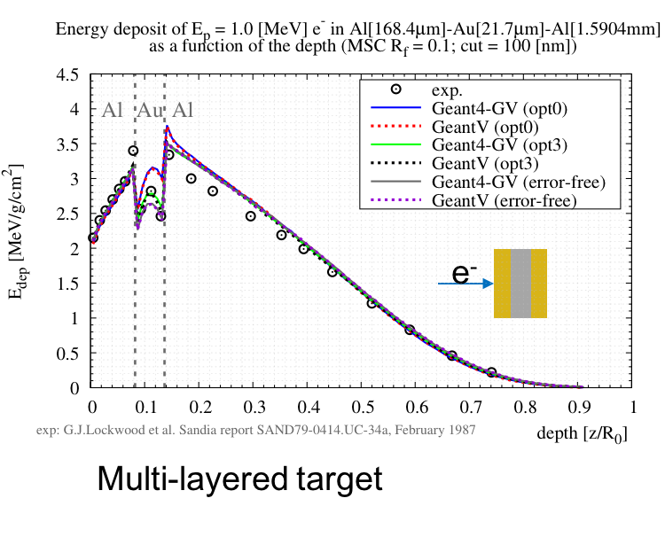
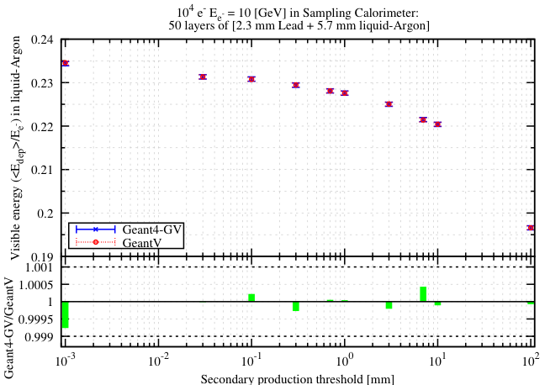
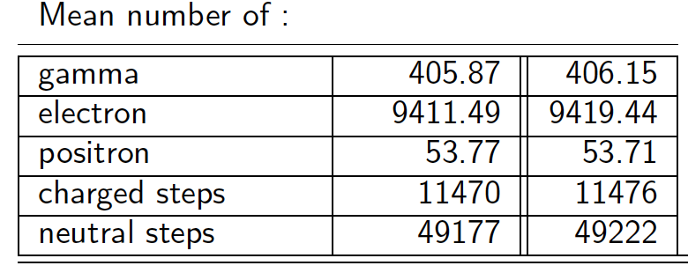
Features: Revisited EM Physics models
ATLAS simplified sampling calorimeter
Scalar EM models revisited in a vectorization friendly way (e.g. vectorizable sampling) and validated against Geant4 version. Vectorization work planned for 2018 for the full EM shower simulation.

Slide 8
Plans 2018
The alpha “functionality” tag is imminent
  Finalizing few remaining items, including library cleanup and restructuring
  Aiming to demonstrating GeantV functionality based on examples and exposing the library to experiments
The beta “performance” tag planned for December 2018
  Target: full EM shower transport vectorized, with close to design performance
  Examples including MC truth processing and I/O
  R&D and integration with new fast simulation approaches (e.g. ML-based inference)

Slide 9
Conclusion
GeantV Intel code modernization IPCC ended
  The library is available: gitlab.cern.ch/GeantV/geant.git
  Valuable components already delivered to the community via Geant4/ROOT: VecGeom/VecCore, improved EM physics models
  GeantV R&D continues, focused on physics vectorization and fast simulation
    Using ML for fast simulation supported by an IPCC
A huge THANKS to INTEL for the support provided these years

