Slide 1
2018 CERN openlab Technical Workshop
CERN, 11th and 12th January 2018
Maria Girone – CERN openlab CTO

Slide 2
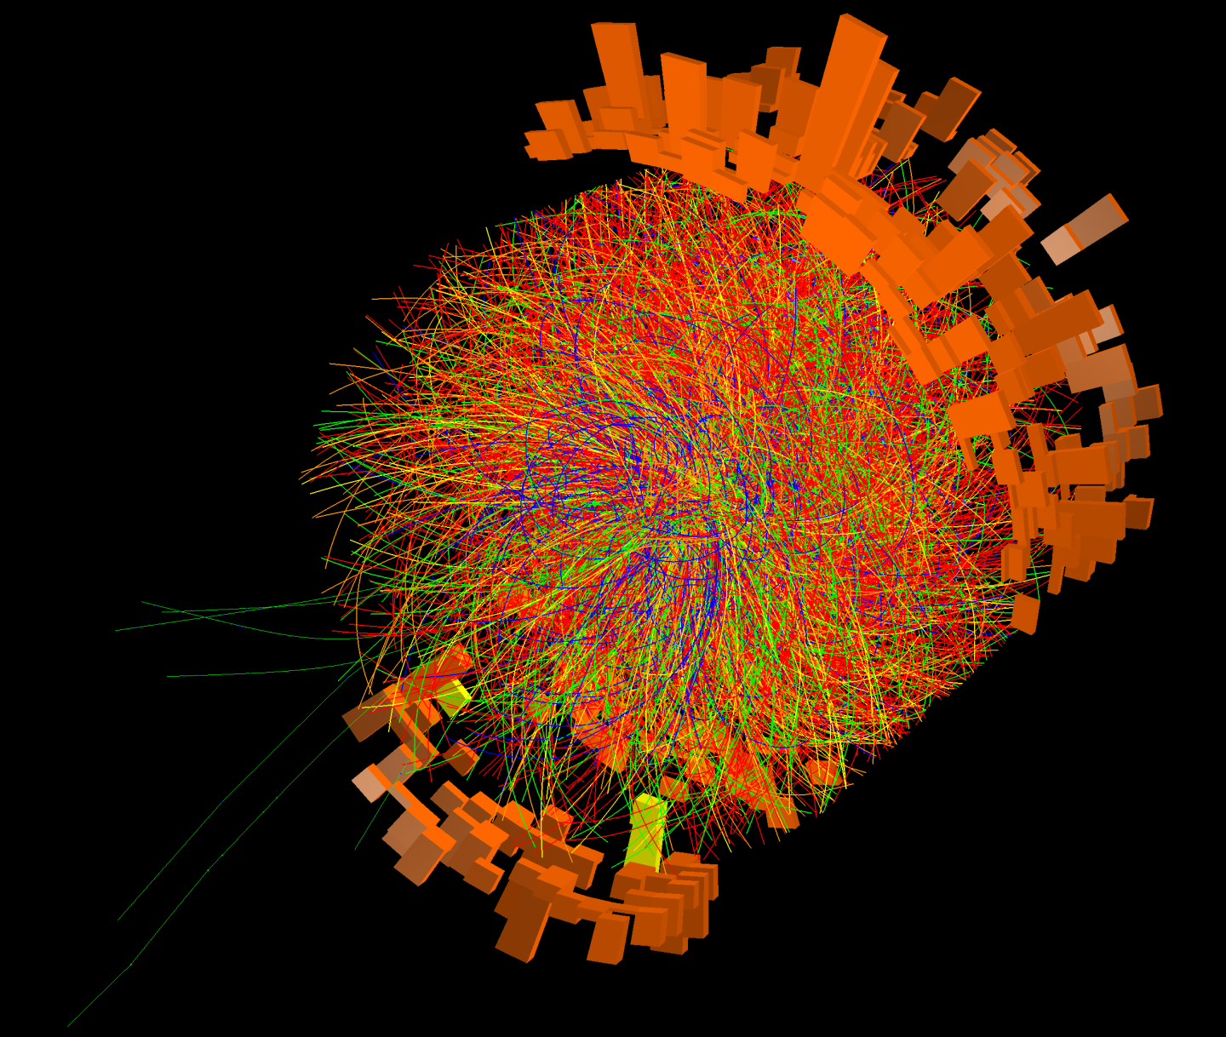
HAPPY 2018!!

Slide 3
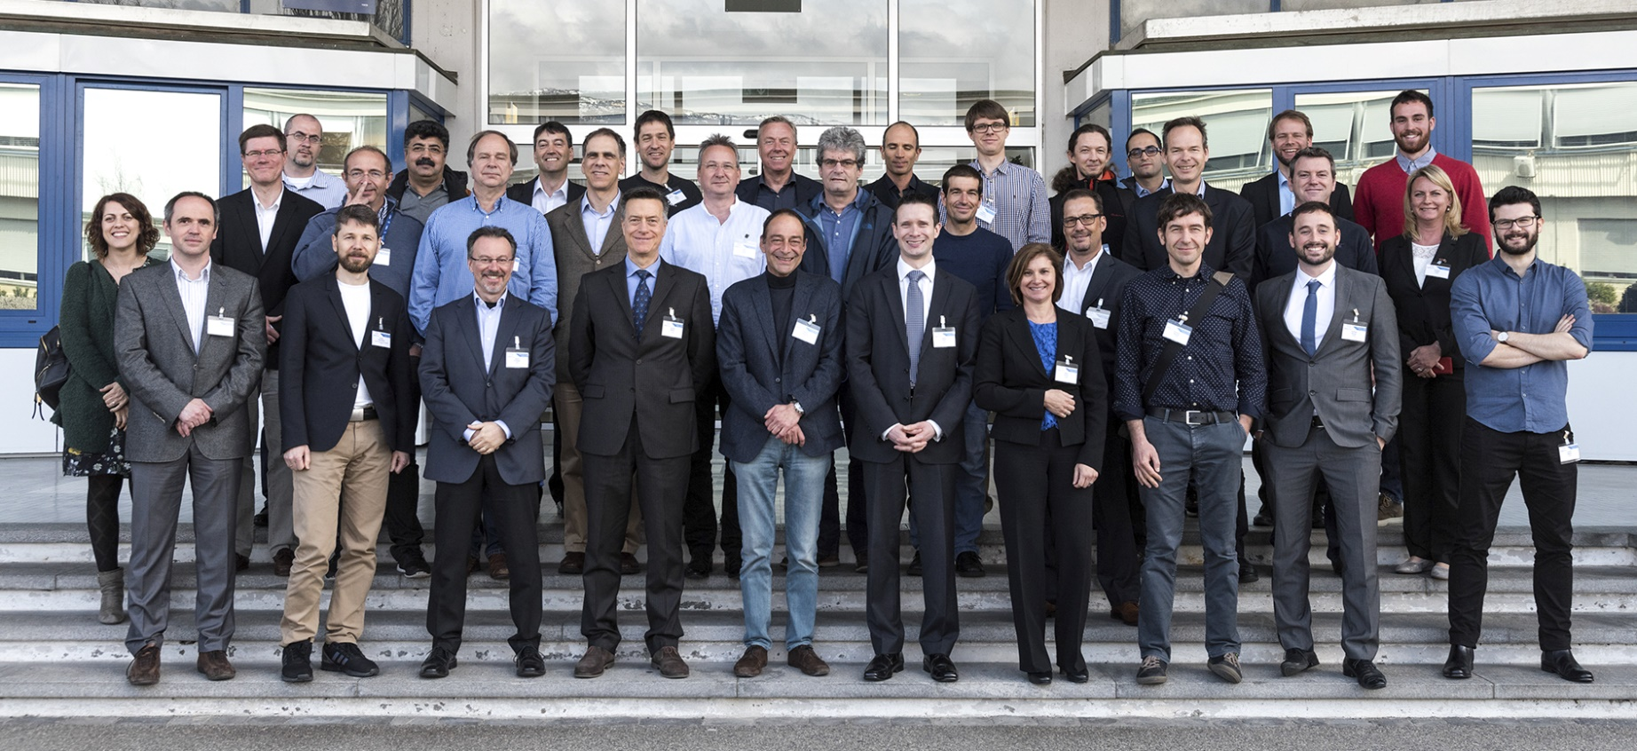
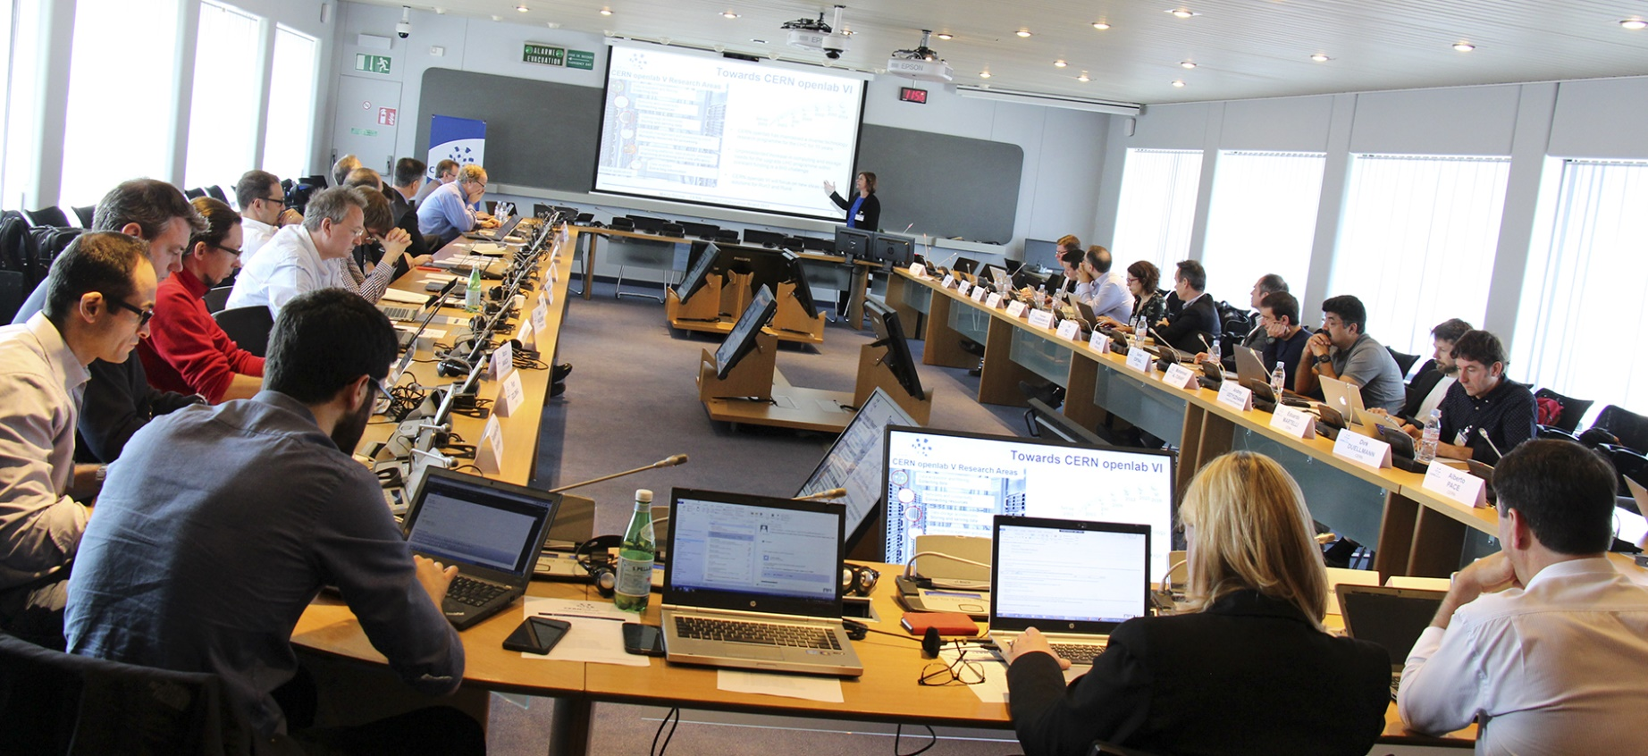
ENTERING OUR SIXTH THREE-YEAR PHASE
CERN openlab Collaboration Board 2017

Slide 4

WORKSHOP GOALS
Review the CERN openlab projects carried out in our CERN openlab PHASE V (2015-2017)
  Talks & Poster Sessions
Look forward to our future collaboration in CERN openlab PHASE VI (2018-2020) with talks from our community and industry
  Data Centre Technologies and Infrastructure R&D
  Computing Performance and Software
  Machine Learning and Data Analytics
  Applications in Other Sciences
Networking opportunities at coffee breaks, this evening’s cocktail and tomorrow’s lunch
cern.ch/go/NlQ8

Slide 5
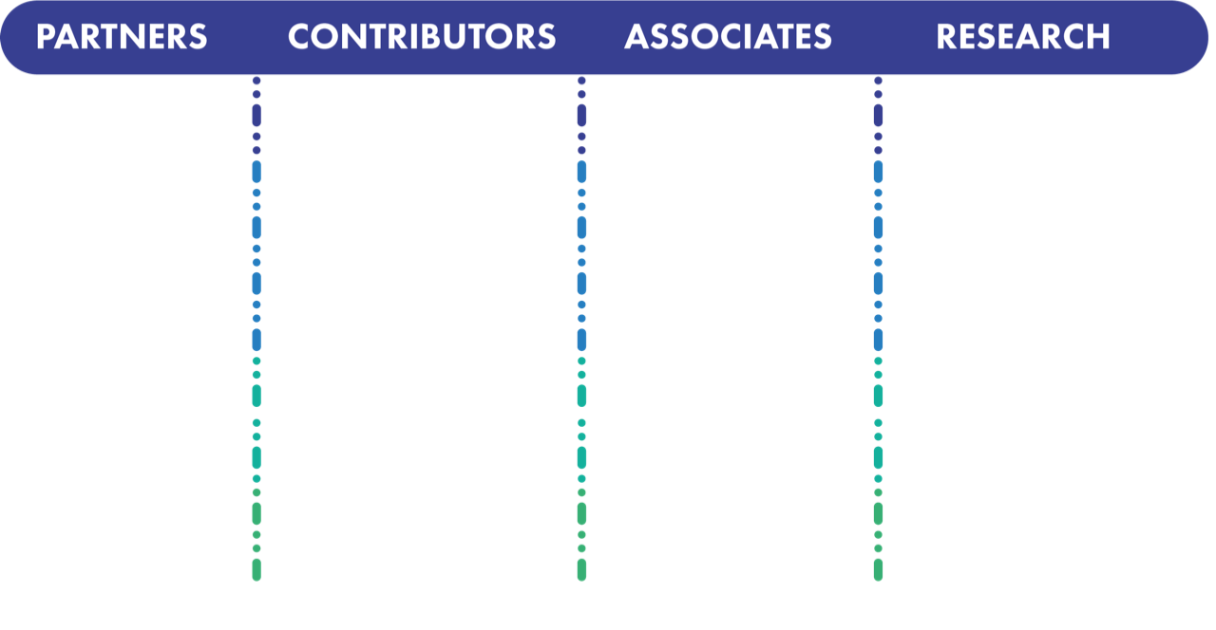



















Collaboration members

Slide 6
WORKSHOP AGENDA (PART 1)
WRAP-UP OF PHASE V
Thursday 11th 14:15 – 15:45
POSTER SESSION @ coffee break s and networking cocktail
(includes voting for best posters!)
Thursday 11th 15:45 – 65:15 & 17:20 – 18:20
Friday 12th 11:10 – 11:40

Slide 7





PHASE V R&D Projects
High-bandwidth fabrics, accelerated platforms
Data Acquisition (LHCb, IT-CF)
Code modernization (EP-SFT, IT-CF)
Cloud infra (IT-CM)
Data Storage (IT-ST, IT-DB)
Data Analytics, Machine Learning (many)
Networks (IT-CS)
Control Systems
(BE-ICS)
Data quality monitoring, anomaly detection, physics data reduction, benchmarking/scalability, systems biology and large-scale multi-disciplinary platforms
Simulation, HPC on the Cloud,
benchmarking
Predictive/proactive maintenance and operations
Cloud federations, containers, scalability
Software Defined Networks, Security
Storage architectures, scalability, monitoring

Slide 8
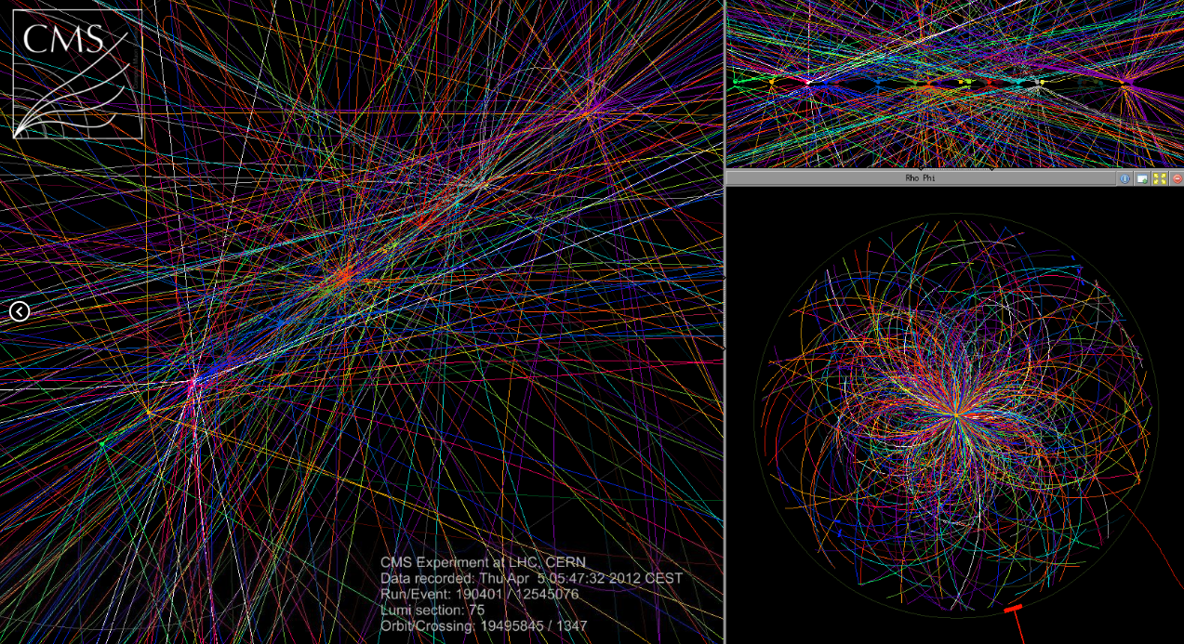
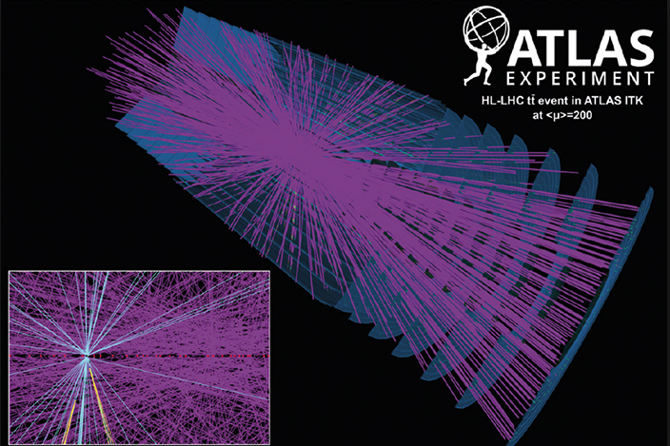
Phase VI
A concern addressed in Phase VI white paper is the resource gap associated with the needs of the HL-LHC
Roughly a factor of 10 is needed over technology improvements in both processing and storage on the time scale of the start
Relying on innovation through our CERN openlab industry partnerships to help close this gap
Many incremental improvements will be needed

Slide 9
WORKSHOP AGENDA – PART 2
PHASE VI R&D Topics
cern.ch/go/NlQ8
APPLICATIONS IN OTHER SCIENCES R&D
Thursday 11th 16:15 – 17:20
MACHINE LEARNING & DATA ANALYTICS R&D
Friday 12th 9:00 – 11:10
COMPUTING PERFORMANCE & SOFTWARE R&D
Friday 12th 11:40 – 12:40
DATA CENTRE & INFRASTRUCTURE R&D
Friday 12th 13:40 – 16:30

Slide 10

CONTACTS
ALBERTO DI MEGLIO
CERN openlab Head
alberto.di.meglio@cern.ch
ANDREW PURCELL
CERN openlab Communications Officer
andrew.purcell@cern.ch
MARIA GIRONE
CERN openlab CTO
maria.girone@cern.ch
FONS RADEMAKERS
CERN openlab CRO
fons.rademakers@cern.ch
KRISTINA GUNNE
CERN openlab Administration/Finance Officer
kristina.gunne@cern.ch
www.cern.ch/openlab

Slide 11
Thanks!
Maria.Girone@cern.ch

