Slide 1
W-MON
CERN distributed network of sensors for
real-time remote control of radioactivity and radiation
D. Celeste, A. Curioni, L. Gallego-Manzano, F. Murtas,
D. Perrin, S. Romano, M. Silari
CERN, 1211 Geneva 23, Switzerland
fabrizio.murtas@cern.ch

Slide 2
The Internet-of-Things → Internet-of-Sensors concept
Key technology developments for IoT / radiation measurements
Affordable solid-state radiation sensors
Reliable and cheap micro-controllers and memories
New developments in wireless communication (i.e. LPWAN)
Low power microelectronics
Host of new low power devices (e.g. GPS, Bluetooth)
Efficient batteries
Relevant new trends in IoT
Machine learning / AI integrated in IoT
Big data
New emphasis on security measures applied to IoT
Notes:
IoT (source: Gartner, Inc): 8.4 billion things connected in 2017 / 30% increase from 2016 / 20 billions by 2020 / 5 million+ new things get connected every day / others (e.g. INTEL) put the figures 10 times higher
Main applications (source: INTEL): Business/manufacturing 40.2% / Health care 30.3% / Retail 8.3% / Security 7.7% / Transportation 4.1%

Slide 3
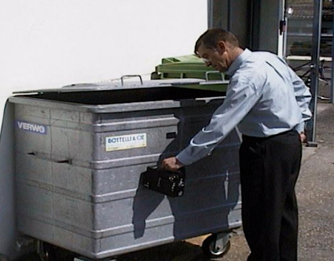
The shortcomings of manual radiation monitoring
The radioactivity level of more than 100 metallic containers for ordinary waste is routinely monitored at CERN
1. Human operator introduces variability/reliability issues
2. Exact inventory/location of containers must be known to the operator at all times
3. No automated data logging/alarm system
4. System blind between last control and emptying of the bin
5. Only just above 10% of all containers are controlled
6. Contractor’s cost + CERN supervision
Upgrade to an automated system
W-MON

Slide 4


The requirements for an automatic system
The radiation to be monitored is mainly gamma rays
Sensitivity down to background level
Robust device: resistant to adverse weather, temperature variations, mechanical shocks
Must operate unattended and with minimal maintenance
Low power consumption (battery powered)
Integrated data transmission facilities (e.g. GSM, WiFi, RF, , )
Acceptable cost
To connect to REMUS system, which provides data logging and alarm functions
Relevant information: alarm for radiation level above threshold, alarm for equipment malfunctioning (auto-diagnostic), location of the container (GPS), log of the use of the container (whether the lid has been opened)

Slide 5
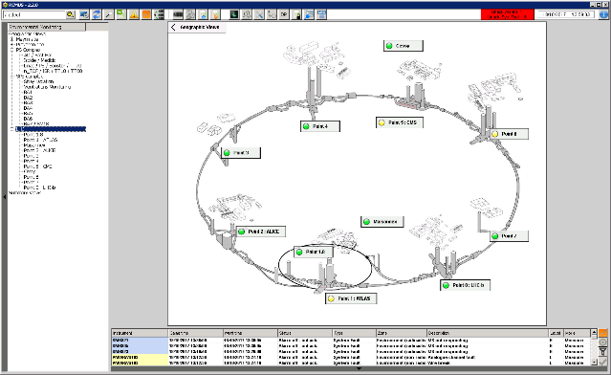
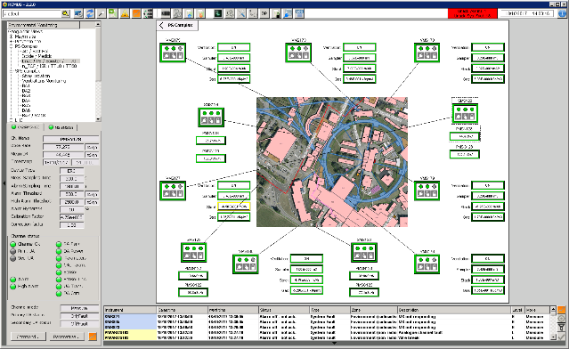
REMUS: Radiation and Environment Monitoring Unified Supervision

Slide 6
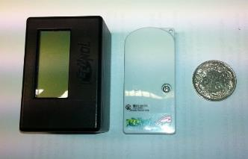
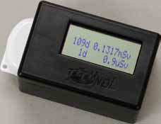
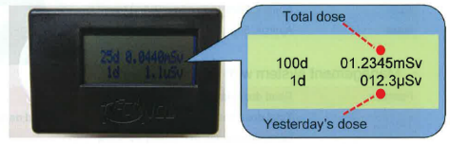
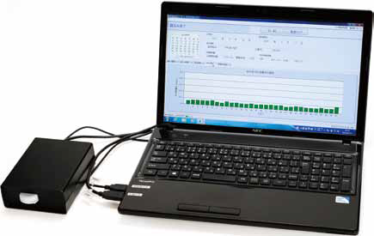
The D-shuttle personal dosimeter (Chiyoda / AIST)
Personal reader (one day, integral dose)
Hamamatsu Si PIN diode
Electronic board with microprocessor and memory storage
Communication board with optical and 2.4 GHz RF transmitters
Shock sensor
Lithium battery, lifetime 1 year
Dose reading from 0.1 µSv to 100 mSv
Size 68 mm x 32 mm x 14 mm
Weight 23 g
History reader
(400 days, every hour)

Slide 7
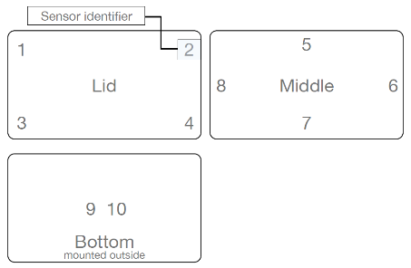
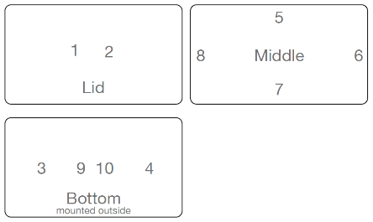
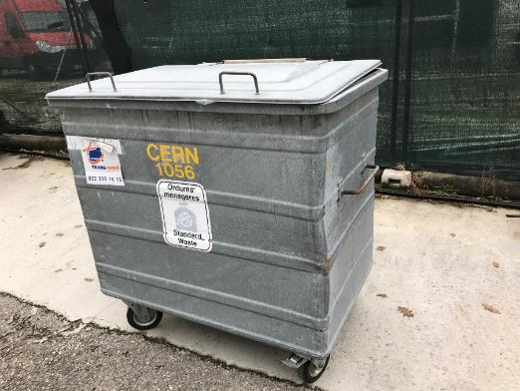
Tests in operational conditions: sensors’ coverage
Sensitivity: 10 counts per 0.1 μSv (= 10 cts/h per 0.1 μSv/h) with ¹³⁷Cs photons

Slide 8
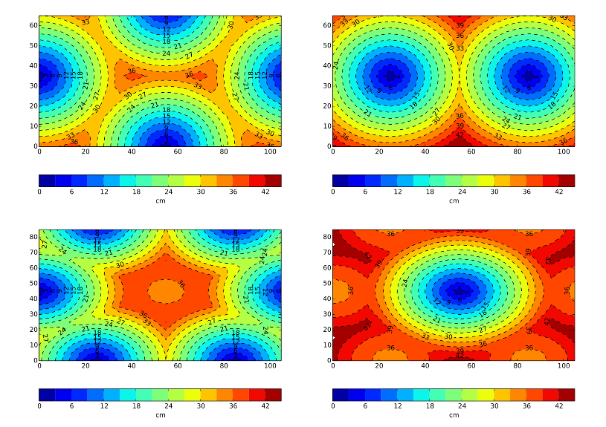
Closest sensor distance maps
Horizontal Mid-plane
Top or bottom
Vertical Mid-plane
Side
Distance map: distance of closest sensor at any given position (in cm)

Slide 9
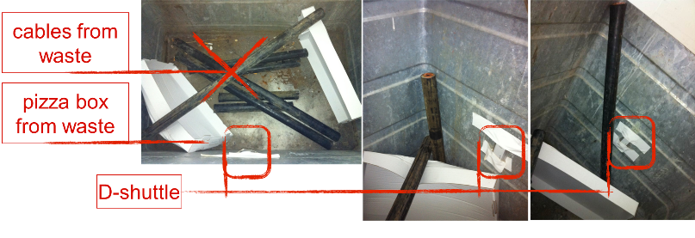
Tests in operational conditions (10 sensors on the container)
Filling the waste container from the bottom
The 2 dips are due to reading of the sensors [taken out for ~2 hours]
The lower reading after #4 went in is due to the pieces rolling toward the sides

Slide 10
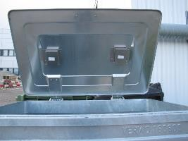
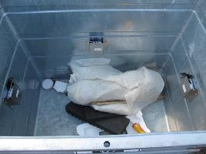
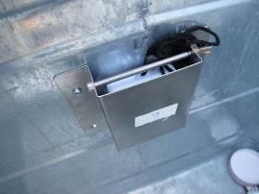
Tests in operational conditions
Operational test in realistic conditions ongoing since April 3rd
A regular waste container equipped with 8 sensors
Each sensor housed in a plastic waterproof box and protected by a light metal shield
Over 8 months the stability of the response of the sensors has been tested against:
  Temperature variations (from 5 ºC to over 40 ºC inside the container)
  Rain and high humidity
  Shaking test (in a washing machine!)
  Shaking and mechanical shock during normal use of the container (filling, emptying, etc.)

Slide 11
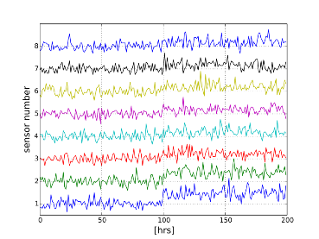
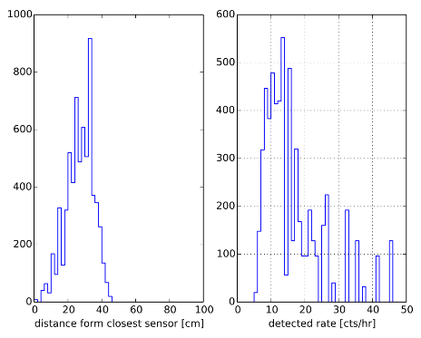
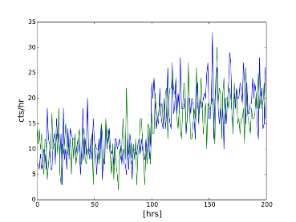
Tests in operational conditions
150 kBq ¹³⁷Cs source
in the centre of the container
Mean 25 cm
Background would be 10 cts/h
8 sensors, source on the bottom at [55,0,-45]

Slide 12
Tests in operational conditions
External cobalt source near the container
for industrial radiography
on April 11th at 21h

Slide 13
We have the sensor …
Now we need to comunicate automatically
the measurements

Slide 14
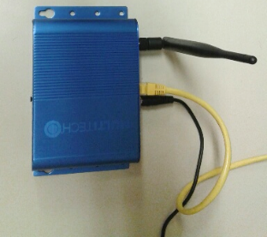
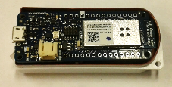
D-shuttle assemblies for wireless communication
Assembling
D-shuttle
Communication board and cable
ESP32 WiFi
LoRa
Master LoRa + Wifi + BT
Slave Wifi + BT
LoRa
ESP32 WiFi
LoRa gateway

Slide 15
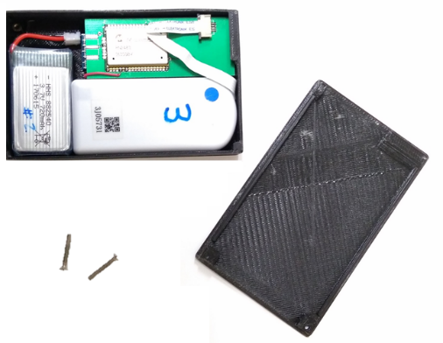
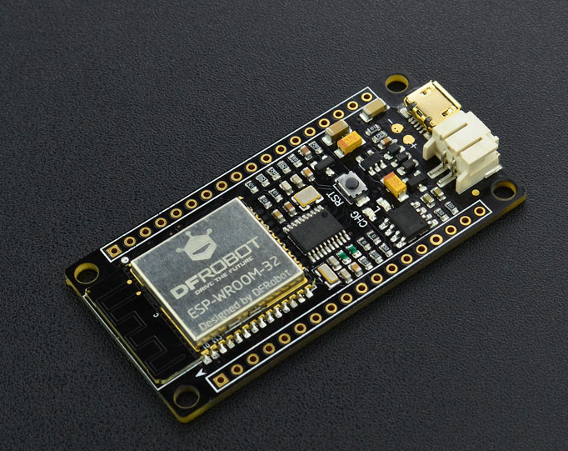
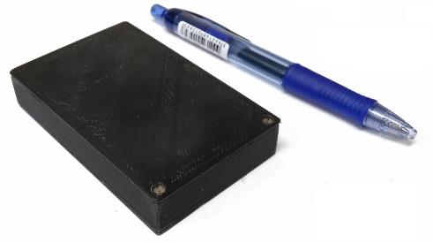
The present W-MON slave prototype
Firebeatle ESP32
USA
3.3 V
WiFi
Blotooth !!
Very low consumption
Standby 10 uA
Rechargeable
16 euro

Slide 16
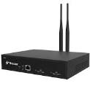


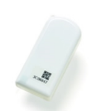



New W-MON communication
D-shuttle
Master
Gateway
Bluetooth
LoRA
LoRAWAN chip
Before:
RF data transfer
Optical data transfer
Manual trigger by an
external magnetic
field
Now:
BT transfer
Micro-controller
- trigger
- decode data packets
Master

Slide 17
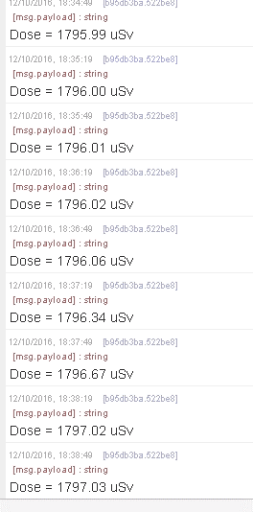
Data transmission
NOISE generated by CERN communication board (now solved)
Decoded and transmitted data from D-shuttle to remote PC through the LoRa communication protocol
No gamma source
Gamma source
Dose recorded every 30 seconds

Slide 18
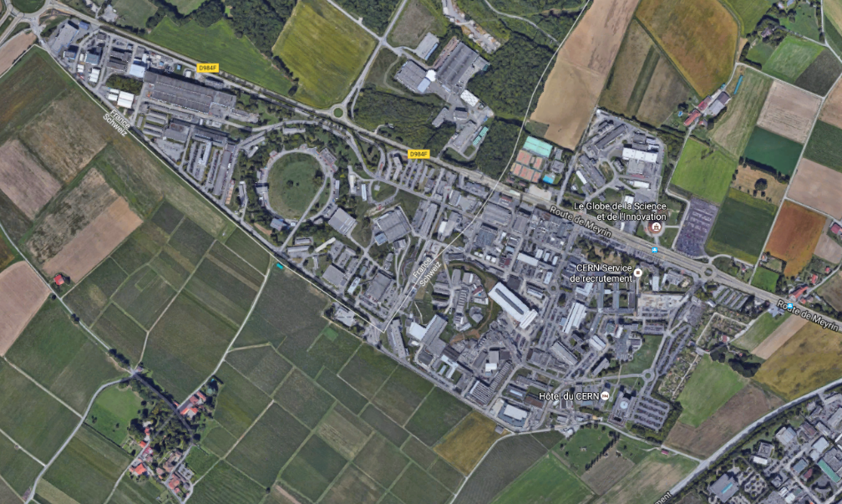
Lora range test @ CERN
Gateway placed in building 14 on 6th floor
Points received
Points not received
Gateway position
Further locations (the water tower) are being investigated to reach the entire CERN site

Slide 19


W-MON architecture
REMUS
Master with Lora and
WiFi access point
The master waits for the data from the dosimeters through WiFi
Sends all data through LoRa
Synchronizes the slaves and everybody gets back to sleep for one hour

Slide 20


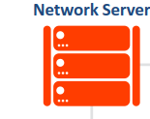






Long Range Wide Area Network - LoRaWAN
LoRA
Up to 15 km range
LoRaWAN protocol
Application Server
D-shuttle
Master
Gateway
LoRAWAN
chip
4G/3G
Ethernet
Low bit rate -> Low consumption / Frequency band 868 MHz (EU), (920-925 MHz Japan)

Slide 21
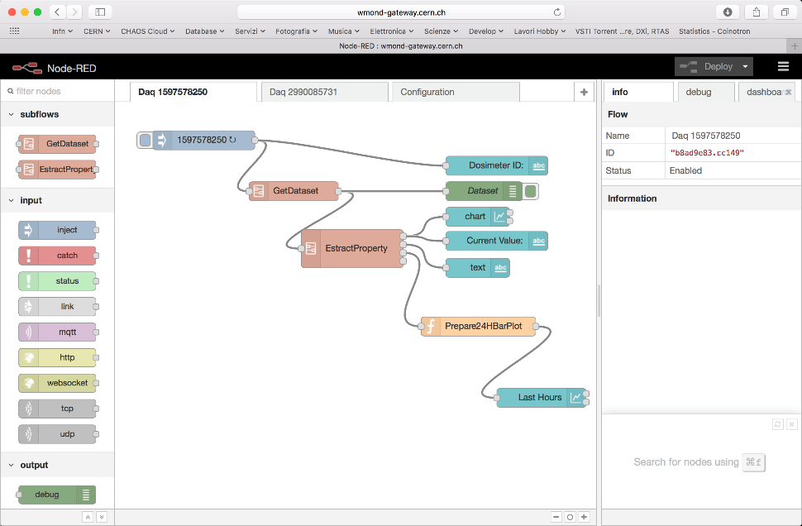
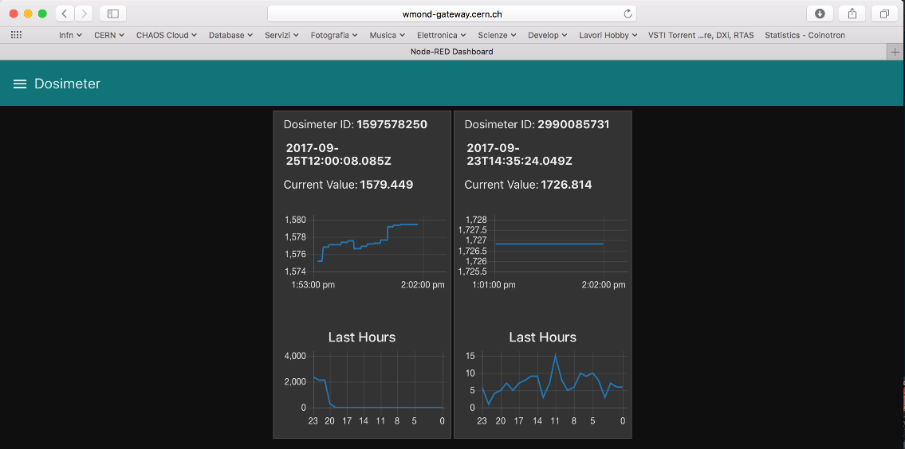
WMON dashboard
With Node-red a Web monitor page has been realized
wmond-gateway

Slide 22
The next steps
LoRa range test extended over the entire CERN sites
Compatibility tests of LoRa with existing CERN IT infrastructure – Ongoing
Set-up data transfer to REMUS – Ongoing
Optimize/reduce power consumption!
Test with one or two containers equipped with 8 to 10 D-shuttles, BT and LoRa communication, data transfer to REMUS – November 2017
Pilot phase with 10 – 20 containers – Summer 2018
Full scale project – End 2018

Slide 23
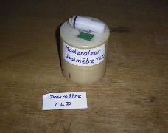
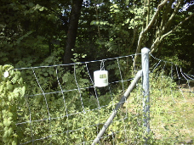
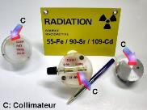
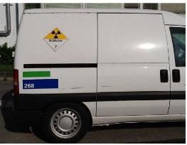
Potential perspectives @ CERN
Distributed network of sensors: environmental monitoring of large areas, providing the environmental gamma dose in real time with high granularity
Personal dosimetry: D-shuttle/DIS/DMS comparison
Automatic tracking of radioactive sources
Tracking of transport of radioactive materials

Slide 24
Thank you !
fabrizio.murtas@cern.ch

