Slide 1


Security considerations for IoT
Pascal Oser
Work sponsored by the Wolfgang Gentner Programme
of the Federal Ministry of Education and Research: http://cern.ch/gentner

Slide 2
Introduction
Failures in developing secure IoT
How you can improve IoT security
How we improve IoT security
Summing-up

Slide 3
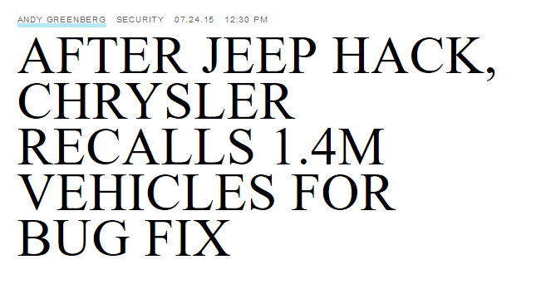

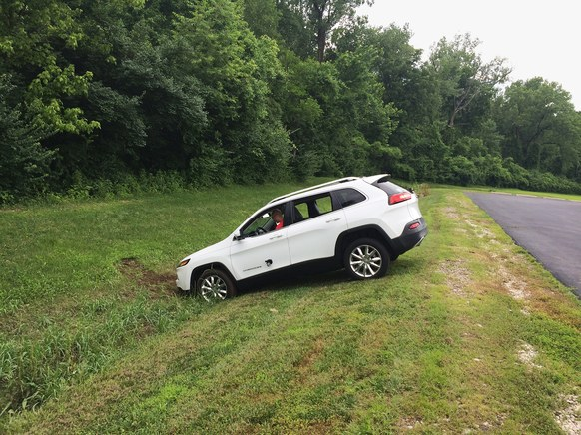
Failures in developing secure IoT

Slide 4

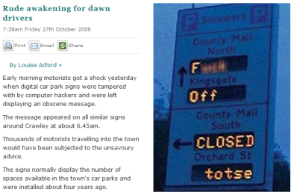

Failures in developing secure IoT

Slide 5
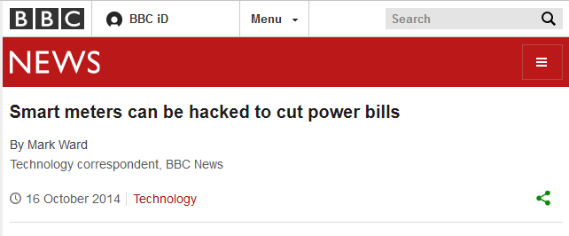
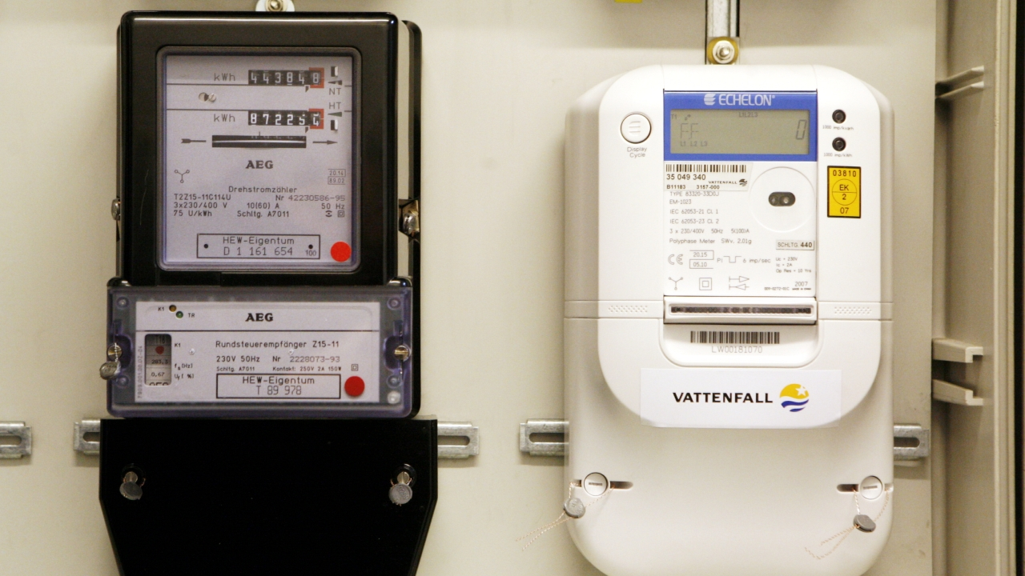
Encryption keys generated by
device name (6 characters long)
No authentication for pairing
Guessable hardcoded administrator credentials
Long network communication crashes the device
Failures in developing secure IoT

Slide 6
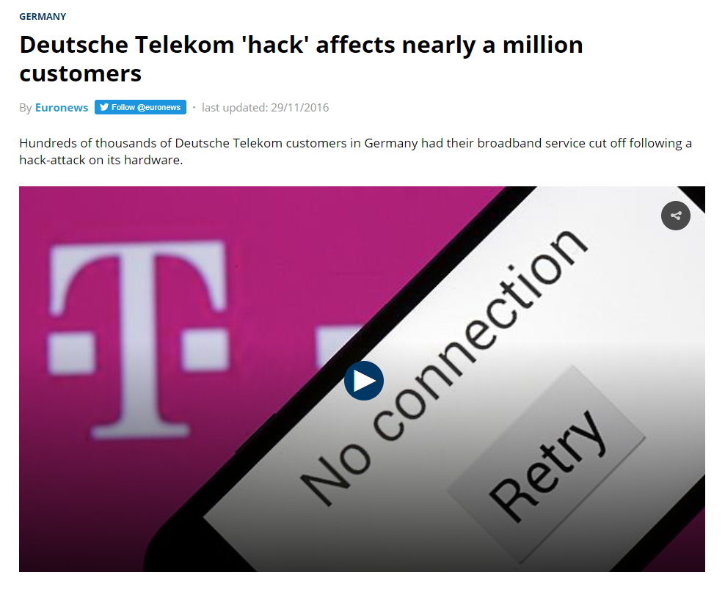

Failures in developing secure IoT

Slide 7
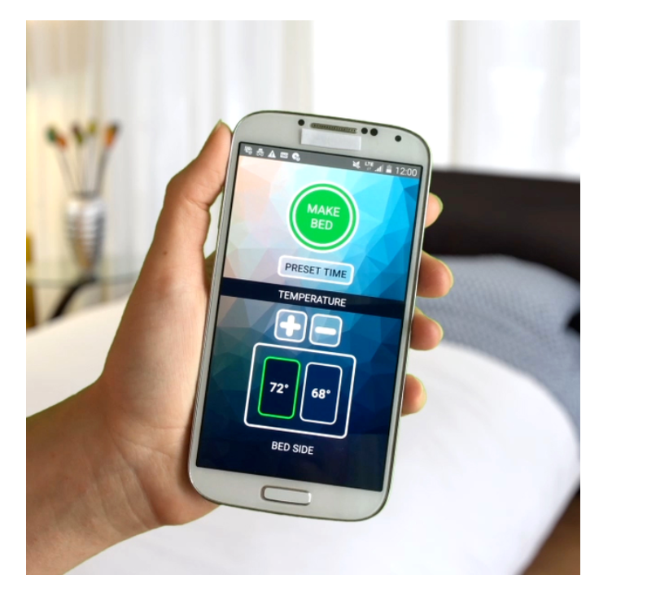

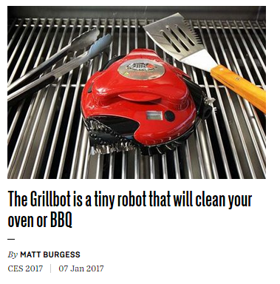
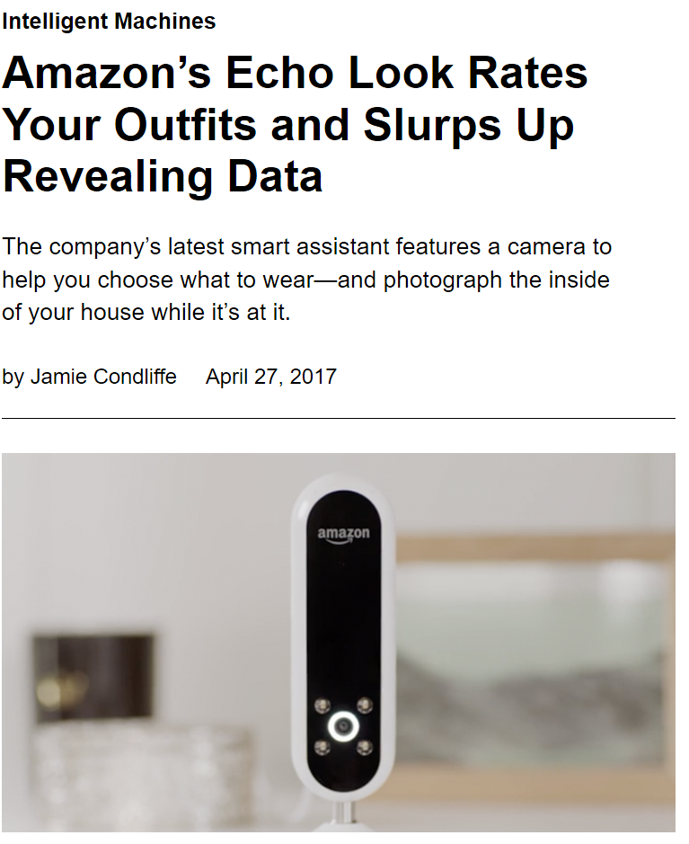

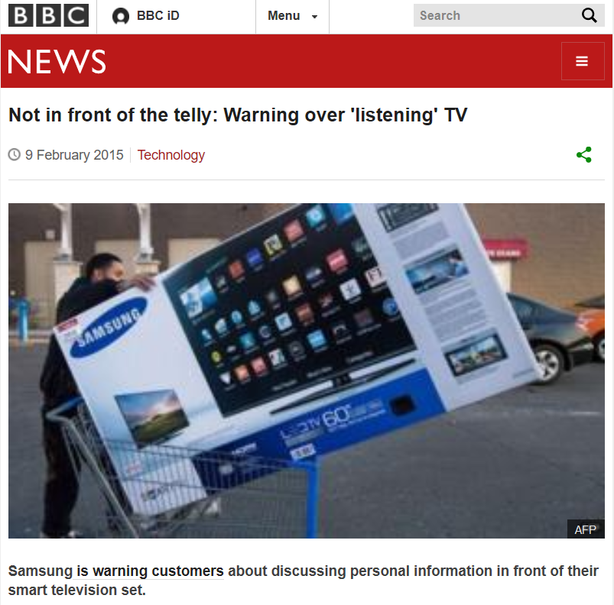

IoT is everywhere
Failures in developing secure IoT

Slide 8
How you can improve IoT security

Slide 9
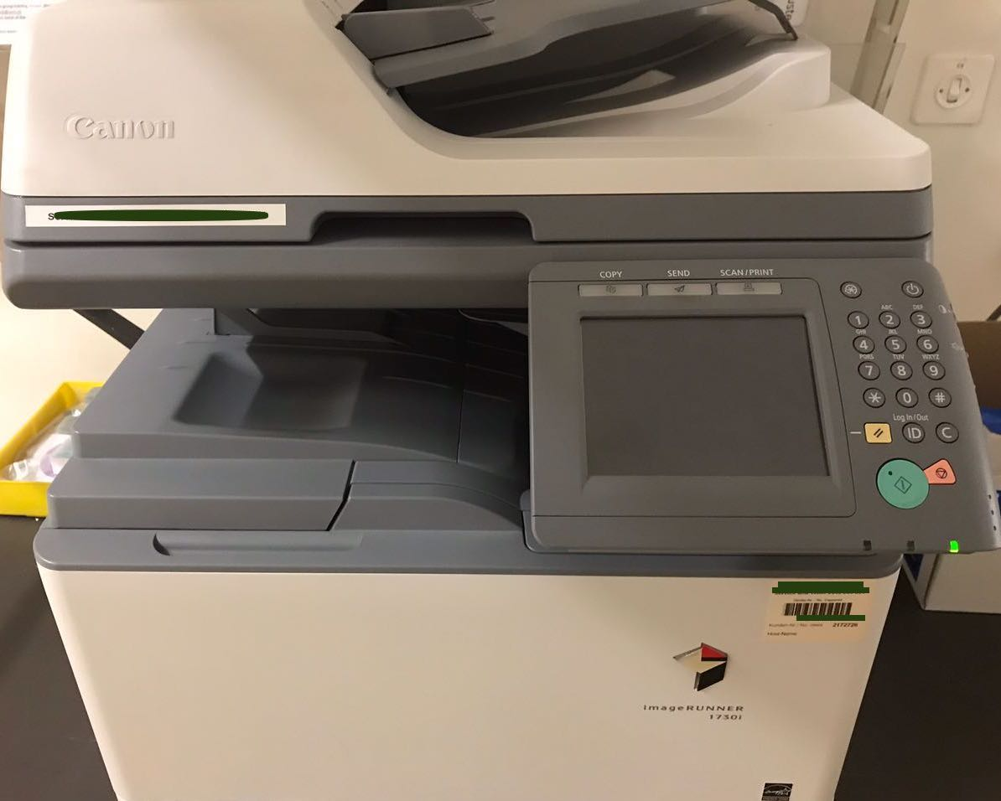
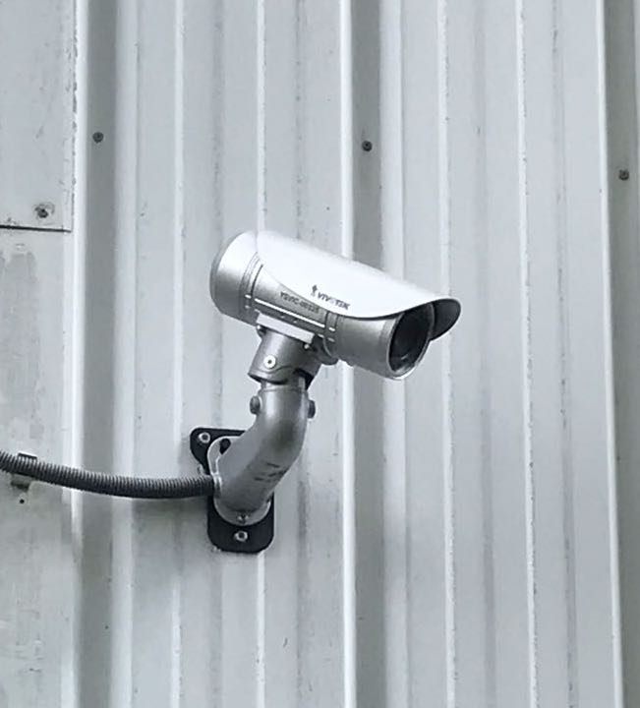
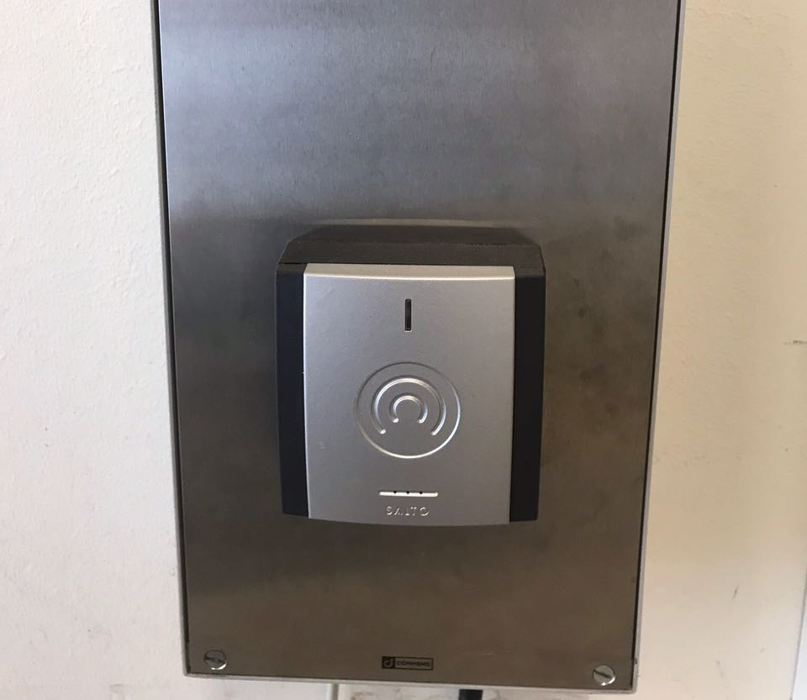
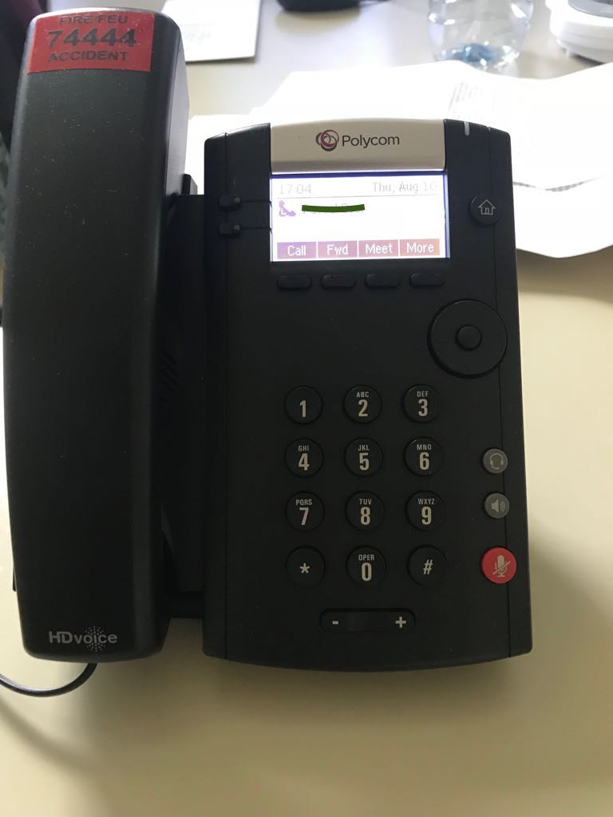

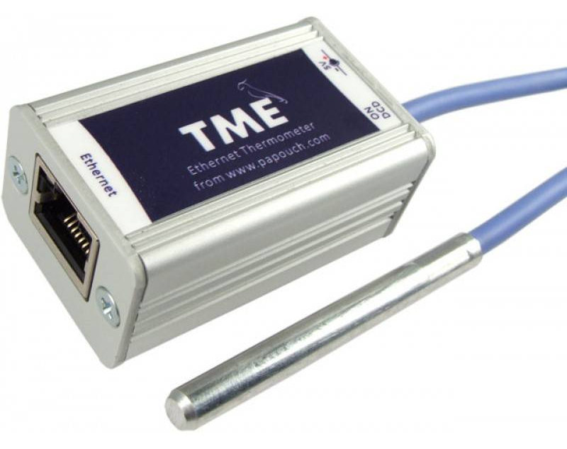
Small selection of IoT at CERN
How you can improve IoT security

Slide 10
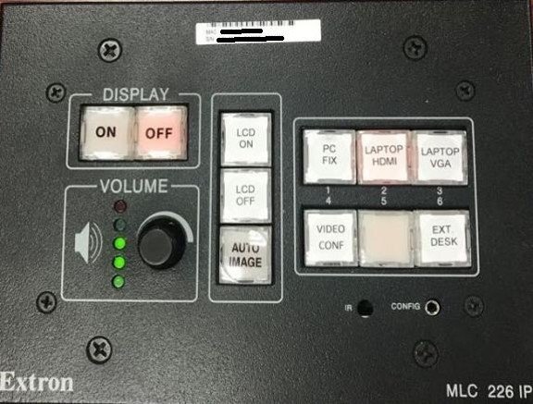
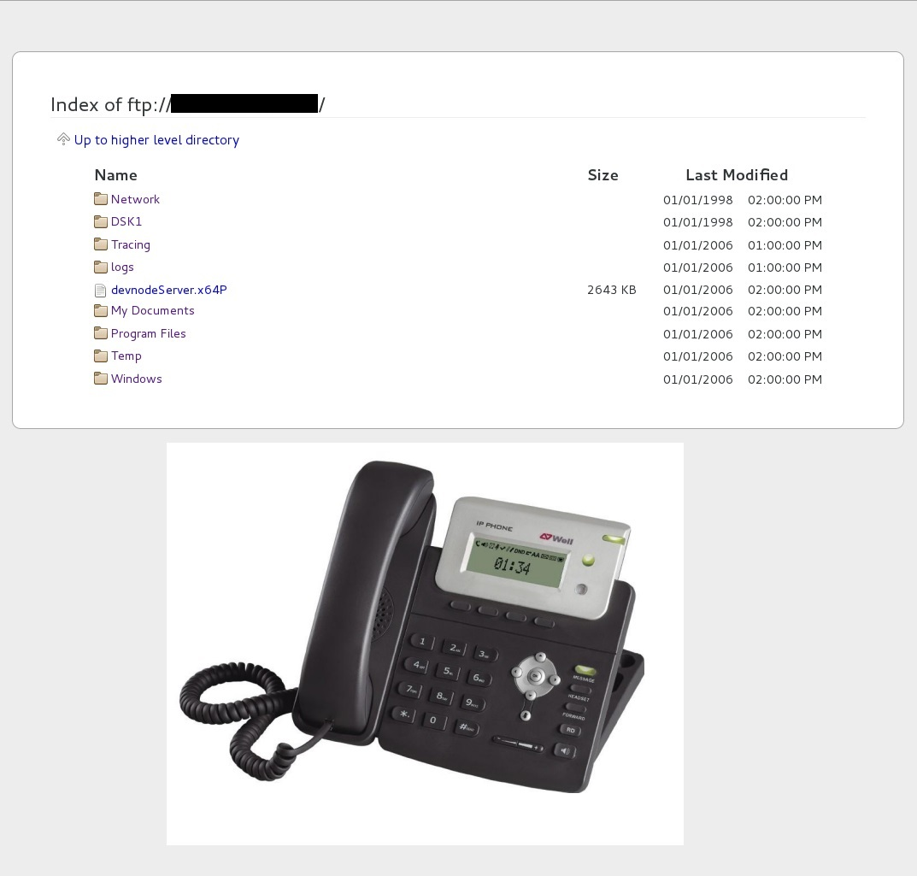
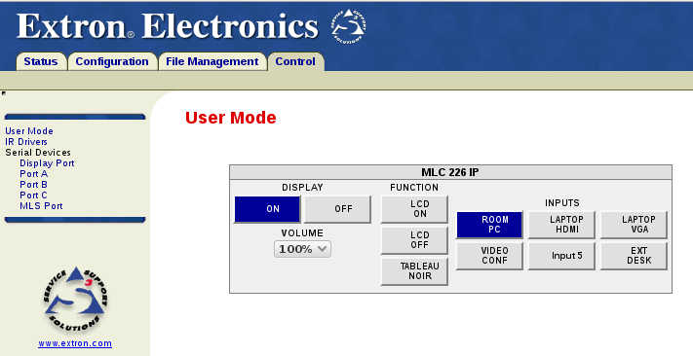
Disable not needed services
How you can improve IoT security

Slide 11
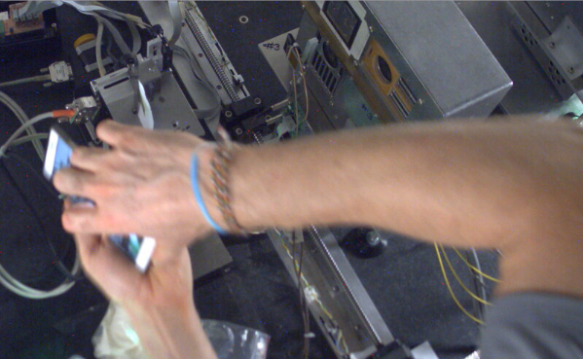
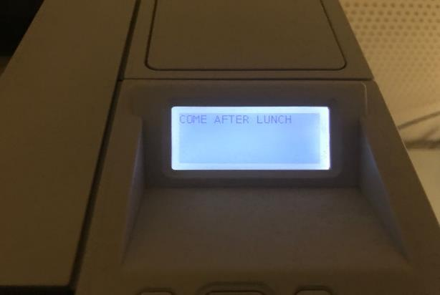
Be aware of authentication bypass
How you can improve IoT security

Slide 12
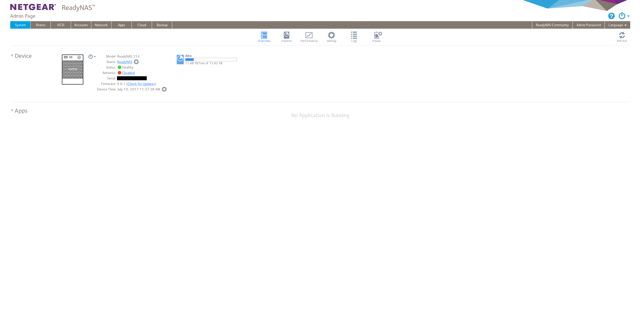
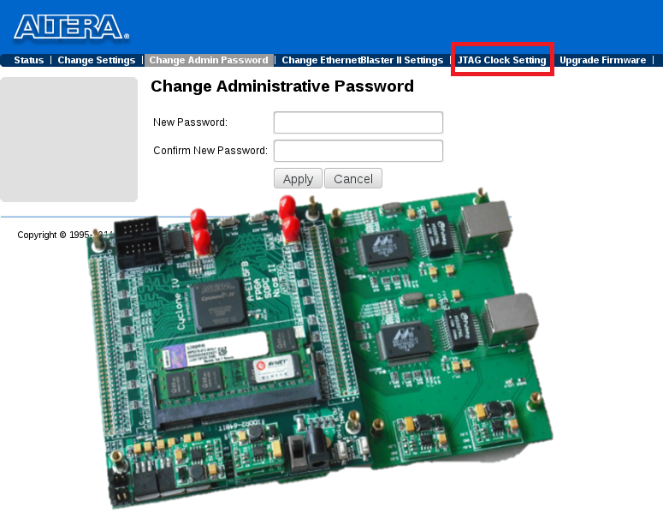
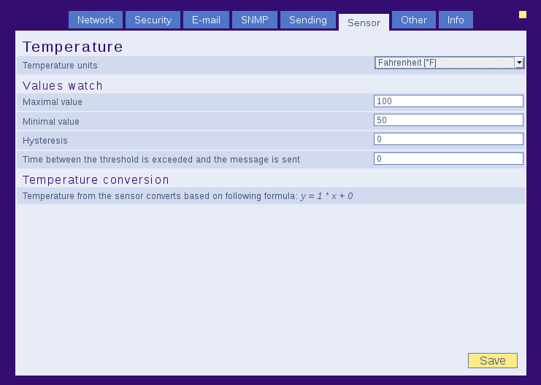
Don’t use guessable passwords
How you can improve IoT security

Slide 13
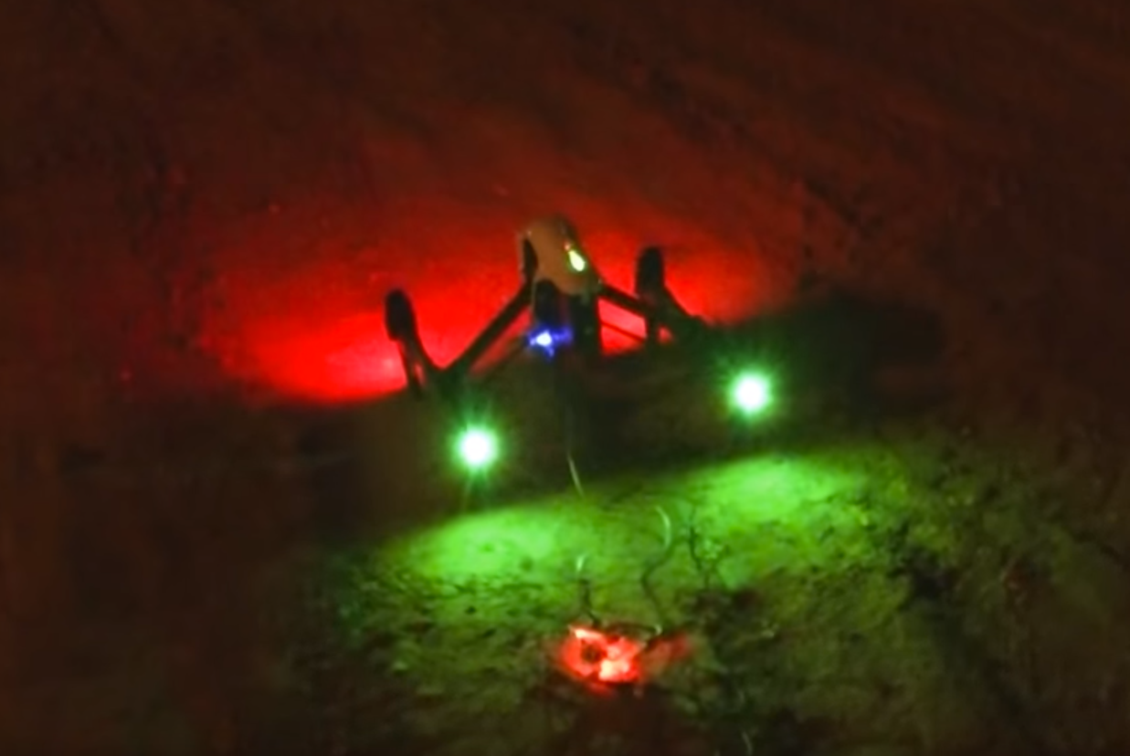
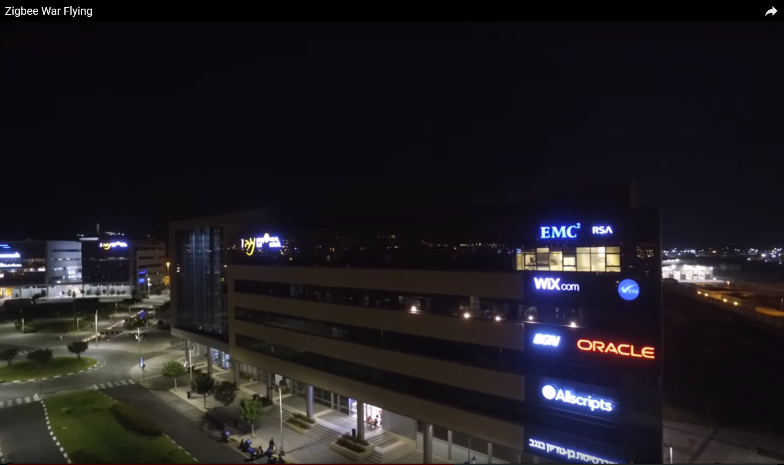
Keep your Firmware up-to-date
How you can improve IoT security

Slide 14
How we do improve IoT security

Slide 15
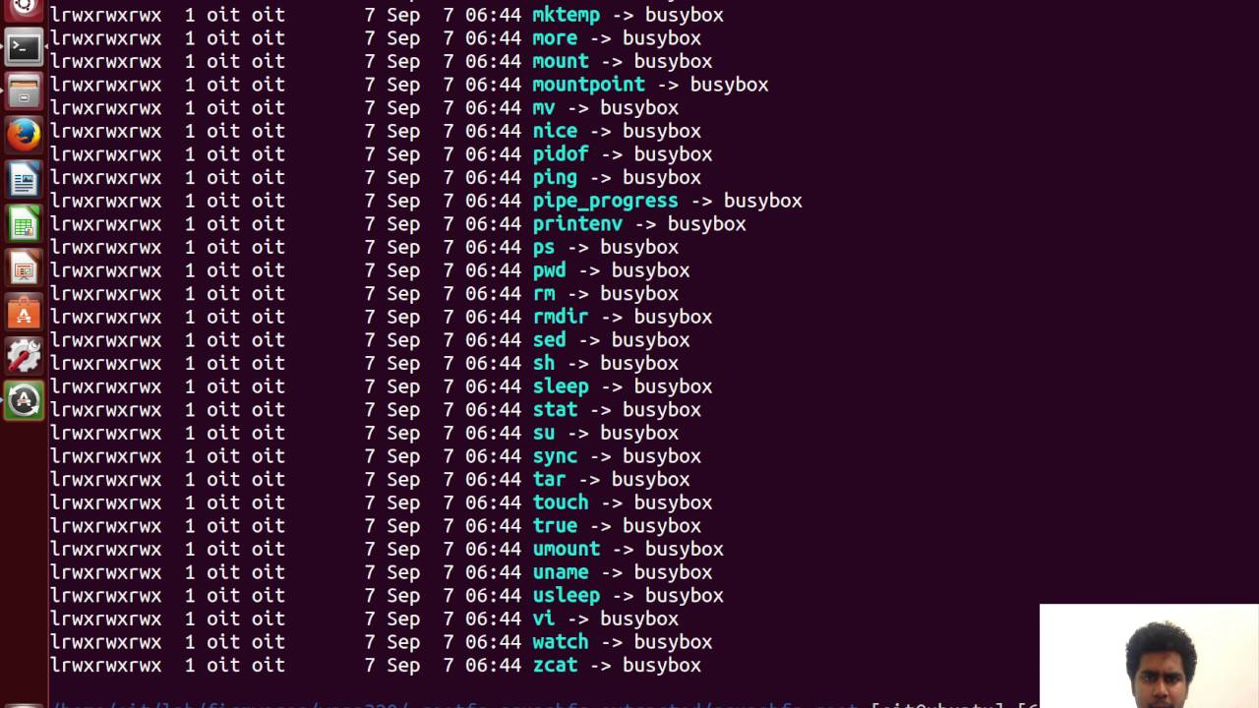

Which IoT is “secure“?
Estimating the security level of the IoT devices you run
You see the vulnerable IoT devices in your network
Remotely detecting IoT devices
  Clock skew
    Remote measuring the internal Quartz
Estimating the security level of IoT devices
  Firmware analysis
    Certificates, web server, libraries,
    code patterns, strings …
How we do improve IoT security

Slide 16
Summing-up

Slide 17
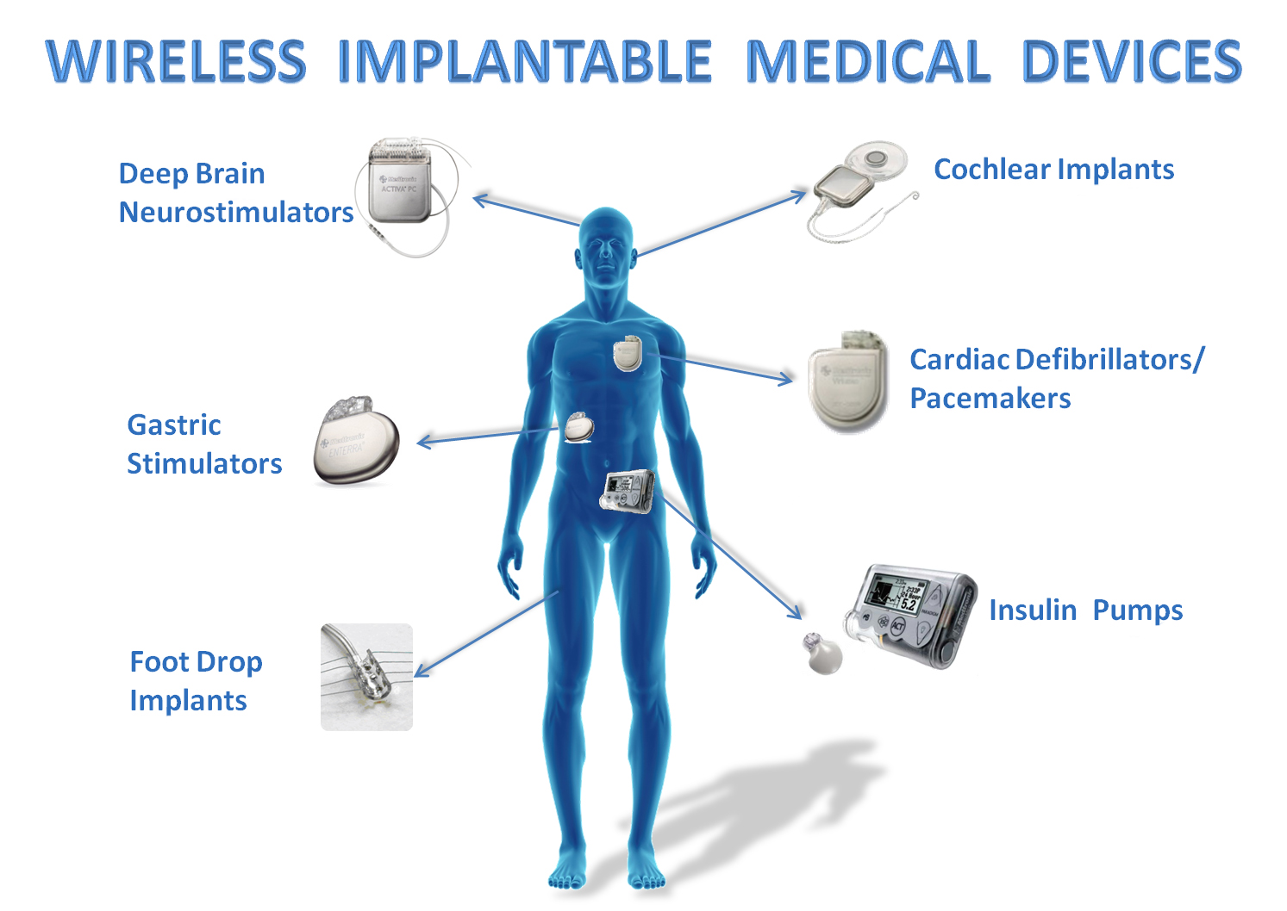
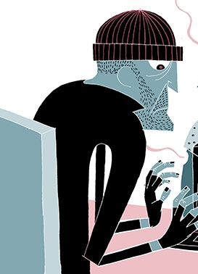
Internet of insecure Things
Care about a secure product
Configure your devices properly
Choose strong credentials
Don’t forget to update them
Limit the access
And be aware…
IoT don’t look always like IoT
Summing-up

Slide 18
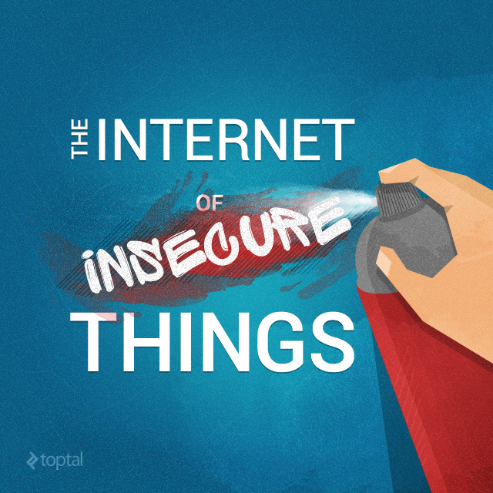
Questions?
p.oser@cern.ch

Slide 19
Backup
Pascal Oser

Slide 20
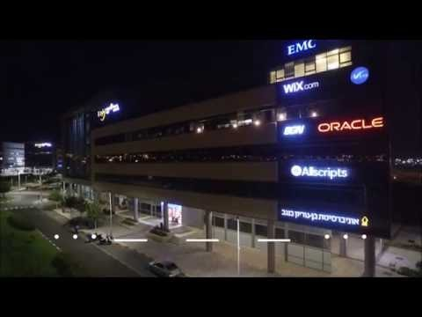
IoT war flying
Pascal Oser

Slide 21
Resources
Oscilloscope: http://www.conrad.com/medias/global/ce/2000_2999/2700/2780/2786/123467_BB_01_FB.EPS_1000.jpg
Mirai: https://4.bp.blogspot.com/-p8D76bMmh38/WXcXv6OMDII/AAAAAAAAtw8/jJiK0rQiWIED4UqW6cCu2WW6mEaPGrqOwCLcBGAs/s1600/Mirai-Botnet-ddos-attack.png
Jeep: https://www.wired.com/2015/07/jeep-hack-chrysler-recalls-1-4m-vehicles-bug-fix
Smart meter: https://images.futurezone.at/smart-meter-neu-1.jpg/24.490.046
Smart meter: http://www.bbc.com/news/technology-29643276
Unsecure things: https://static1.squarespace.com/static/52b489ede4b01176ccb429a3/t/570fa14e07eaa02ef84be726/1460642254897/
Medical: ww2.kqed.org/futureofyou/wp-content/uploads/sites/13/2015/07/Implantable-medical-devices_graphic_WHITE.jpg
Busybox: https://i.ytimg.com/vi/GuXcdopoJlI/maxresdefault.jpg
Clock: https://www.microsemi.com/images/gallery/Chip%20Scale%20Atomic%20Clock-CSAC-300dpi.jpg
Thermometer: https://static.webshopapp.com/shops/097528/files/044833734/papouch-tme-ethernet-thermometer.jpg
SmartDuvet: https://www.smartduvet.com/
Hair coach: https://health.nokia.com/us/en/hair-coach?btmsg&
BBQ: http://www.wired.co.uk/topic/ces-2017
Barbie: https://www.nytimes.com/2015/09/20/magazine/barbie-wants-to-get-to-know-your-child.html?_r=0
Smart TV: http://www.bbc.com/news/technology-31296188
Alexa: https://www.technologyreview.com/s/604284/amazons-echo-look-rates-your-outfits-and-slurps-up-revealing-data/#
War flying: https://www.youtube.com/watch?v=Ed1OjAuRARU
Pascal Oser

