Slide 1
LIU–PLI report
LIU PSB meeting

Slide 2
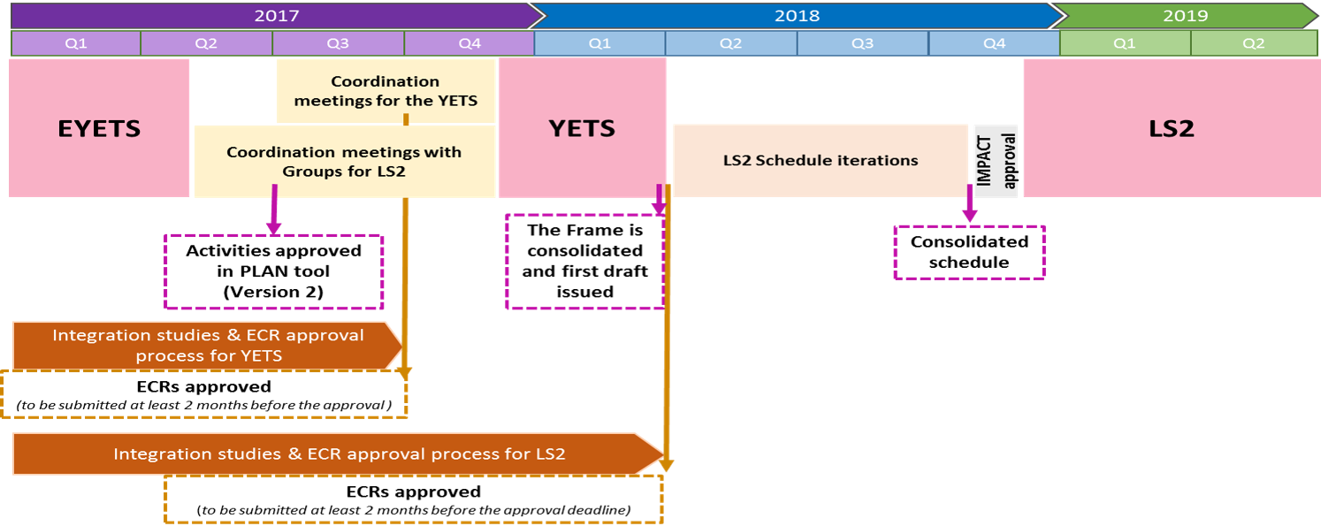
Roadmap towards LS2
Presentation LHC Performance Workshop January 2017 (Chamonix 2017)

Slide 3
ECR for the YETS 2017-2018 and LS2
Facility | Scope | Location | Period | Description | Responsible | Group | SRR | ECR
PS Complex | PBU-LN4 - LIU Linac4 | LBE line (PS Switch Yard) | LS2 | New LBE line | LALLEMENT JEAN-BAPTISTE 73578 169658 | BE-ABP |  | CPS-LJ-EC-0005 v.0.1 [Under Approval]
LINAC2 | PBU-LN4 - LIU Linac4 | LT (LTP), LTS (LTL) and LTE lines | LS2 | Partial dismantling of Linac2 |  | BE-ABP |  | CPS-LJ-EC-0003 v.0.2 [Under Approval]
LINAC4 | PBU-LN4 - LIU Linac4 | LBE line (PS Switch Yard) | LS2 | Temporary installation for the LBE beam test during LS2 | LOMBARDI ALESSANDRA 73607 160103 | BE-ABP |  | Engineering Spec.
LINAC4 | PBU-LN4 - LIU Linac4 | L4T and LT lines | LS2 | Connection of Linac4 to BHZ20 |  | BE-ABP |  | CPS-LJ-EC-0002 v.0.2 [Under Approval]
Facility | Scope | Location | Period | Description | Responsible | Group | SRR | ECR
PS Booster | PBU-PRJ - LIU-Booster | Period 3 L1 (4 rings) | 17/18 YETS | Installation of 4 new Tune pick-ups | GASIOR MAREK 72530 163104 | BE-BI |  | PSB-BPMTA-EC-0001 v.1.0 [Released]
PS Booster | PBU-PRJ - LIU-Booster | Period 4 L1 (ring 3) | 17/18 YETS | New SEMGrid (x1) in the PSB 4L1 | VENESS RAYMOND 73009 160753 | BE-BI | PSB-LJ-EC-0004 v.1.0 [Released] | Yes
PS Booster | PBU-PRJ - LIU-Booster | BI line | LS2 | Relocation of BI.BTV30 | BURGER STEPHANE 71933 164941 | BE-BI |  | PSB-LJ-EC-0006 v.1.1 [Released]
PS Booster | PBU-PRJ - LIU-Booster | LT, LTB and BI lines | LS2 | New BLMs Installation in the LT, LTB and BI Lines for H- exchange monitoring | ZAMANTZAS CHRISTOS 73409 162170 | BE-BI |  | Yes
PS Booster | PBU-PRJ - LIU-Booster | BT line | LS2 | Relocation of BT2.BTV10 and BT3.BTV10 in the PS Booster | BURGER STEPHANE 71933 164941 | BE-BI |  | PSB-LJ-EC-0002 v.1.0 [Released]
PS Booster | PBU-PRJ - LIU-Booster | BT, BTP lines (PS Booster and PS Switch Yard) | LS2 | Installation of new BLMs on PS Booster extraction lines | ZAMANTZAS CHRISTOS 73409 162170 | BE-BI |  | Yes
PS Booster | PBU-PRJ - LIU-Booster | BTP Line (PS Switch Yard) | LS2 | Modification of the beam instrumentations on the BTP line | BARTMANN WOLFGANG 76806 169198 | BE-BI |  | Yes
PS Booster | PBU-PRJ - LIU-Booster | 4L1 11L1 | LS2 | Wire Scanners (x8) in the PSB 4L1 and 11L1 | VENESS RAYMOND 73009 160753 | BE-BI | PSB-LJ-EC-0004 v.1.0 [Released] | Yes
PS Booster | PBU-PRJ - LIU-Booster | BI line | LS2 | Add new BPMs on the BI line | TAN JOCELYN 63580 163812 | BE-BI |  | Yes
PS Booster | PBU-PRJ - LIU-Booster | BTP line (PS Switch Yard) | LS2 | Add BPMs on the BTP line | TAN JOCELYN 63580 163812 | BE-BI |  | Yes
Facility | Scope | Location | Period | Description | Responsible | Group | SRR | ECR
PS Booster | PBU-PRJ - LIU-Booster |  | LS2 | INSULATION AND GROUNDING OF BSW VACUUM CHAMBERS (RF bypasses) | BLAS ALFRED 74412 163586 | BE-RF |  | Yes
PS Booster | PBU-PRJ - LIU-Booster | 7L1 (C02), 13L1 (C04), 5L1 (C16) | LS2 | The New PS Booster RF System (Finemet Cavities) | PAOLUZZI MAURO 73462 163587 | BE-RF | PSB-LJ-EC-0009 v.1.0 [Released] | PSB-ACWFB-EC-0001 v.0.1 [Approval Closed]
Facility | Scope | Location | Period | Description | Responsible | Group | SRR | ECR
PS Complex | PBU-LN4 - LIU Linac4 | 363 | LS2 | New ERD1*7A switchboard | DEVINE JAMES DILWYN 75610 168824 | EN-EL |  | Yes

Slide 4
ECR for the YETS 2017-2018 and LS2
Facility | Scope | Location | Period | Description | Responsible | Group | SRR | ECR
PS Booster | PBU-LN4 - LIU Linac4 | BI line (PS Switch Yard) | LS2 | Removal of 2 beam stoppers (BI.STPFA and BI.STPSW) on the BI line | NUIRY FRANCOIS-XAVIER 63294 169640 | EN-STI |  | PSB-LJ-EC-0012 v.0.1 [In Work]
PS Booster | PBU-PRJ - LIU-Booster | BTP line | LS2 | Upgrade of beam stopper BTP.STP10 | NUIRY FRANCOIS-XAVIER 63294 169640 | EN-STI |  | Yes
PS Booster | PBU-PRJ - LIU-Booster | Period 8 | LS2 | New PS Booster Absorber in Period 8 | NUIRY FRANCOIS-XAVIER 63294 169640 | EN-STI | PSB-LJ-EC-0007 v.1.0 [Released] | Yes
Facility | Scope | Location | Period | Description | Responsible | Group | SRR | ECR
PS Booster | PBU-PRJ - LIU-Booster | BI line | LS2 | New Septum BI.SMV10 and relocation of BI.BTV30 | HOURICAN MICHAEL 78241 163073 | TE-ABT |  | PSB-MSMIB-EC-0001 v.1.1 [Released] PSB-LJ-EC-0006 v.1.1 [Released]
PS Booster | PBU-PRJ - LIU-Booster | Period 1L1 | LS2 | New injection region in the Booster | WETERINGS WILHELMUS 74897 163804 | TE-ABT |  | PSB-L-EC-0001 v.1.1 [Released]
PS Booster | PBU-PRJ - LIU-Booster | BI line | LS2 | New distributor BI.DIS10 | WETERINGS WILHELMUS 74897 163804 | TE-ABT |  | PSB-MSMIA-EC-0001 v.1.0 [Released]
PS Booster | PBU-PRJ - LIU-Booster | BT line | LS2 | Installation of Upgraded PSB Recombination Septa BT.SMV10 (BT1 and BT4) | HOURICAN MICHAEL 78241 163073 | TE-ABT |  | PSB-MSMIC-EC-0001 v.1.0 [Released]
PS Booster | PBU-PRJ - LIU-Booster | Period 1, 2, 16 | LS2 | Exchange KSW magnet in 16L4, 1L4 and 2L1 | CORALEJO FELICIANO LUIS MIGUEL 62013 169742 | TE-ABT |  | PSB-MKKSW-EC-0001 v.1.0 [Released]
PS Booster | PBU-PRJ - LIU-Booster | BT line | LS2 | Installation of Upgraded PSB Recombination Septum BT.SMV20 | HOURICAN MICHAEL 78241 163073 | TE-ABT |  | PSB-MSMID-EC-0001 v.1.0 [Released]
Facility | Scope | Location | Period | Description | Responsible | Group | SRR | ECR
PS Booster | PBU-PRJ - LIU-Booster | 361 (BHP) | LS2 | Installation of new Power Converters for PSB injection BI.BVT | PITTET SERGE 72279 165205 | TE-EPC |  | Yes
PS Booster | PBU-PRJ - LIU-Booster | 361 (BCER) | LS2 | Installation of new Power Converters for PSB injection Qstrip, Correctors, Quad. | PITTET SERGE 72279 165205 | TE-EPC |  | Yes
PS Booster | PBU-PRJ - LIU-Booster | 361 (BCER) | LS2 | New power converters for PSB BDL - Sirius-S type | PITTET SERGE 72279 165205 | TE-EPC |  | Yes
PS Booster | PBU-PRJ - LIU-Booster | 361 (BHP) | LS2 | Supply upgraded converters for Booster BE.SMH15 & New BT1&4.SMV10 & BT2.SMV20 Se | PITTET SERGE 72279 165205 | TE-EPC |  | Yes
PS Booster | PBU-PRJ - LIU-Booster | 361 (BHP) | LS2 | New converters for Booster Ejection Transfer Bending Magnets | PITTET SERGE 72279 165205 | TE-EPC |  | Yes
PS Booster | PBU-PRJ - LIU-Booster | 245 | LS2 | New MPS for LIU Booster (POPS-B) | BOATTINI FULVIO 78542 161264 | TE-EPC |  | PSB-LJ-EC-0008 v.1.0 [Released]

Slide 5
ECR for the YETS 2017-2018 and LS2
Facility | Scope | Location | Period | Description | Responsible | Group | SRR | ECR
PS Complex | PBU-LN4 - LIU Linac4 | LT, LTB, LBE, LBS, BI Lines | LS2 | New interlock system for the connection of Linac4 | MOMPO RICHARD 71032 164157 | TE-MPE |  | Yes
PS Booster | PBU-PRJ - LIU-Booster |  | LS2 | WIC - Deployment of the Magnet Interlock system in the transfer lines PSB to PS | MOMPO RICHARD 71032 164157 | TE-MPE |  | Yes
Facility | Scope | Location | Period | Description | Responsible | Group | SRR | ECR
PS Booster | PBU-PRJ - LIU-Booster | BI line | LS2 | Change of BVT magnets (10 units) and New Corrector Magnets in the BI Line | NEWBOROUGH ANTONY 77731 160429 | TE-MSC |  | PSB-LJ-EC-0001 v.1.0 [Released]
PS Booster | PBU-PRJ - LIU-Booster | PS Booster Rings | LS2 | Damping Resistors on PSB Bending and Quad Magnets | NEWBOROUGH ANTONY 77731 160429 | TE-MSC |  | PSB-M-EC-0001 v.0.1 [Under Approval]
PS Booster | PBU-PRJ - LIU-Booster | BT line | LS2 | New BT.BHZ10 | NEWBOROUGH ANTONY 77731 160429 | TE-MSC | PSB-LJ-EC-0010 v.0.2 [Under Approval] | Yes
PS Booster | PBU-PRJ - LIU-Booster | BT line | LS2 | New BT.BVT10 and BT.BVT20 magnets | NEWBOROUGH ANTONY 77731 160429 | TE-MSC |  | Yes
PS Booster | PBU-PRJ - LIU-Booster | BT, BTP, BTM lines (PS Booster and PS Switch Yard) | LS2 | New BT/BTP Quadrupoles for PS BOOSTER | NEWBOROUGH ANTONY 77731 160429 | TE-MSC |  | Yes
PS Booster | PBU-PRJ - LIU-Booster | BTM line | LS2 | Replace BTM.BHZ10 by larger magnet | NEWBOROUGH ANTONY 77731 160429 | TE-MSC | PSB-LJ-EC-0011 v.0.2 [Under Approval] | Yes

