Slide 1

Status of the correction schemes in the arcs
  Reminder from Berlin
  Errors definition and correction schemes
  Evaluation of the results
  Conclusions and perspectives
David Boutin, Antoine Chance, Barbara Dalena
09 OCTOBER 2017

Slide 2
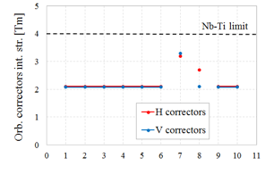
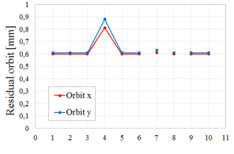
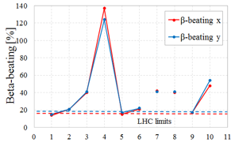
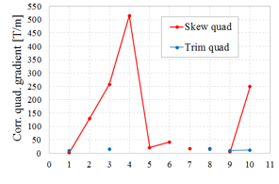
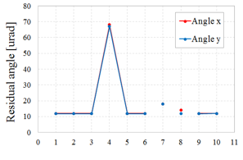
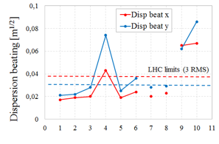


Main Results discussed at FCC WEEK 2017
  Improved correction schemes of the linear coupling and the ring tunes were implemented
  Skew quadrupoles corrector strengths were too high if a2(u) > 0.55
  Increased tolerances on the quadrupole alignment error and the dipole b1 error gave reasonable strengths for the orbit correctors
  Collision optics had higher beta and dispersion beating than injection (orbit optimization bug)
D. BOUTIN, 09 OCTOBER 2017

Slide 3
Errors Definition
  Errors defined for main dipoles, main quadrupoles and for BPMs used in arcs and DIS sections
  Errors are Gaussian distributed, truncated at 3-σ values, with a different seed for each run
  No errors defined in the straight sections (insertions) unless specified
  Study of the variation of dipole a2 and quadrupole alignment tolerances, with 100 machines simulated for each case of study
Element | Error | Error desc. | Units | FCC | LHC | Comments
Dipôle | σ(x),σ(y) |  | mm | 0.5 | 0.5 | no effect on observables
 | σ(ψ) | roll angle | mrad | 0.5 | n/a | effect in vertical plane
 | σ(δB/B) | random b1 | % | 0.1 | 0.08 | LHC value includes σ(ψ)
 | σ(δB/B) | random a2 | 10-4 units | 1.1 | 1.6
 | σ(δB/B) | uncert. a2 | 10-4 units | 1.1 | 0.5
Quad | σ(x),σ(y) |  | mm | 0.36 | 0.36
 | σ(ψ) | roll angle | mrad | 1 | 0.5
 | σ(δB/B) | random b2 | % | 0.1 | 0.3
BPM | σ(x),σ(y) |  | mm | 0.3 | 0.24 | value relative to quad
 | σ(read) |  | mm | 0.2 | 0.5 | accuracy
Reference values of the LHC design taken from LHC Project Report 501/370
D. BOUTIN, 09 OCTOBER 2017

Slide 4
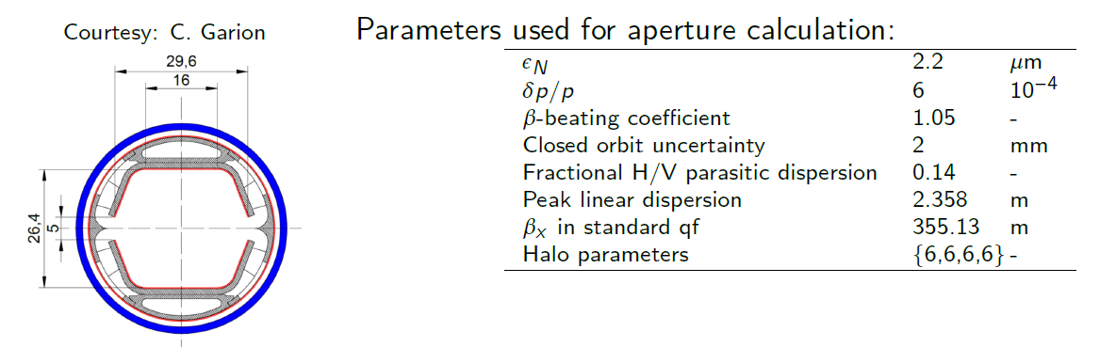
Impact of the Errors on the beam screen
  The synchrotron radiation is evacuated through an aperture in the horizontal plane of the arc dipole chamber (total gap 5 mm as presented in FCC Week)
  The maximum drift a photon can travel in the arc sections before hitting the chamber walls is estimated to 11 m
  Position and angle misalignment of the beam can affect the evacuation efficiency, leading to heating, desorption and performances losses
D. BOUTIN, 09 OCTOBER 2017

Slide 5
Correction Schemes of the arc sections
  Optics studied at injection (3.3 TeV, β* = 4.6 m), another optics at collision (50 TeV, β* = 0.3 m) gives similar results
  All main quadrupoles units of the arc sections and DIS have a BPM and an orbit corrector included next to the quadrupole. Quadrupoles correctors (‘skew’ or ’trim’) can also be inserted before the quadrupole unit.
SKEW
or
TRIM
SKEW
ou
TRIM
BPM
COR
  The correction is performed with the MADX code, following an iterative procedure:
  1/ analytic correction of the linear coupling
  2/ orbit correction
  3/ tune correction
  The errors are evaluated in the following only for the arc sections and any insertion added to the global correction scheme
  Most of the quadrupolar correctors in the short arc sections are reserved for the spurious dispersion correction
QUAD
SX
D. BOUTIN, 09 OCTOBER 2017

Slide 6
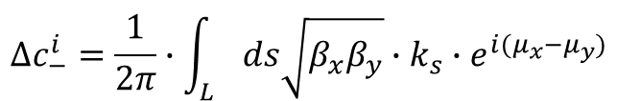
CORRECTION of the linear coupling
  Analytic calculation of the contribution of each magnet of the arc sections to the coupling:
  The main contribution is the a2 multipolar coefficient of the dipoles
$$∆c_{−}^{i}=\frac{1}{2π}∙\int_{L}{ds\sqrt{β_{x}β_{y}}}∙k_{s}∙e^{i(μ_{x}−μ_{y})}$$
extract of LHC Project Report 399
Mid long arc
180°
Q53
Q57
Q61
Q65
Q69
Q73
Q77
Q81
Q81
Q77
Q73
Q69
Q65
Q61
Q57
Q53
BPM
COR
SKEW
QUAD
SX
Correction applied to groups of 8 skew quadrupoles (L = 0.32 m, estimated gradient about 200 T/m) around the middle of each long arc
D. BOUTIN, 09 OCTOBER 2017

Slide 7
ORBIT Correction
  Performed with dipolar correctors, L = 1 m, max integrated strength = 4 Tm, Nb-Ti technology
  Global correction of the residual orbit measured by BPMs (horizontal or vertical plane)
  Same number of BPMs (parameters) and orbit correctors (variables) in each plane
  In the global correction scheme, each orbit corrector is correlated with the BPM located on the 2nd next quadrupole (phase advance of 90°)
SKEW
ou
TRIM
BPM
COR
QUAD
SX
D. BOUTIN, 09 OCTOBER 2017

Slide 8
Tune CORRECTION
  Performed with quadrupolar correctors (L = 0.32 m, maximum gradient 200 T/m, Nb-Ti technology) or with main quadrupoles (L = 6 m, maximum gradient 400 T/m, Nb-Ti technology)
  Correction of the horizontal (Q1) et vertical (Q2) tunes
  The quadrupolar correctors present at the beginning and end of long arc sections are employed
  Since the results are similar with both methods of correction, the main quadrupoles are used in the following
BPM
COR
TRIM
QUAD
SX
D. BOUTIN, 09 OCTOBER 2017

Slide 9
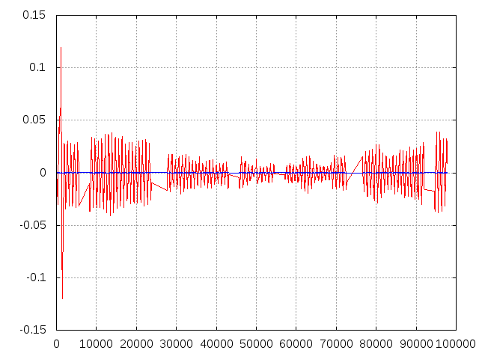
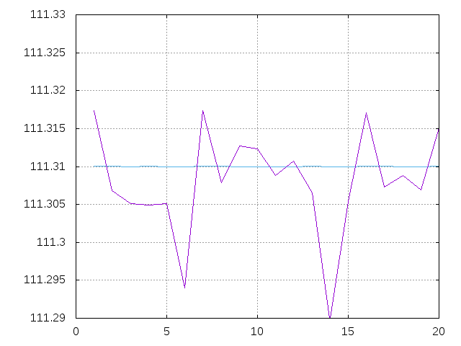
Evaluation of the results
  For each machine, calculation of the mean, RMS and maximum values of the following observables for each relevant magnet of the arc sections:
      Corrector strengths
      Residual orbit and angle
      Beta-beating Δβ/β_{ref}
      Parasitic dispersion or dispersion beating ΔD/√β_{ref}
  → see LHC Project Report 501 for more details
  From the maximum values distribution the 90-percentile (value for which 90% of the values of a given distribution are included) is calculated over all machines
Uncorrected
Corrected
Horizontal tune Q1
Corrected
Horizontal residual orbit [m]
Uncorrected
Distance [m]
Machine number
D. BOUTIN, 09 OCTOBER 2017

Slide 10
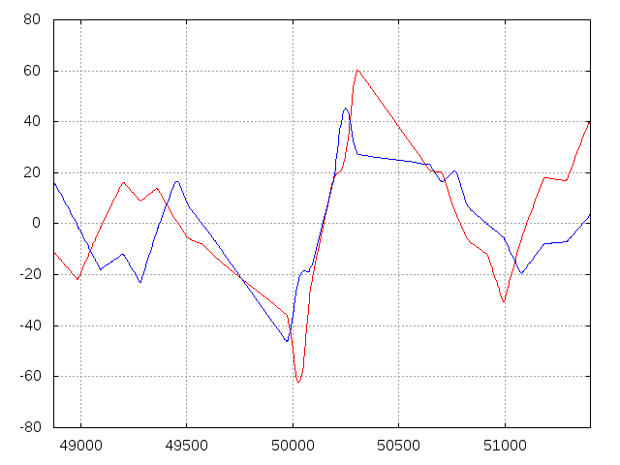
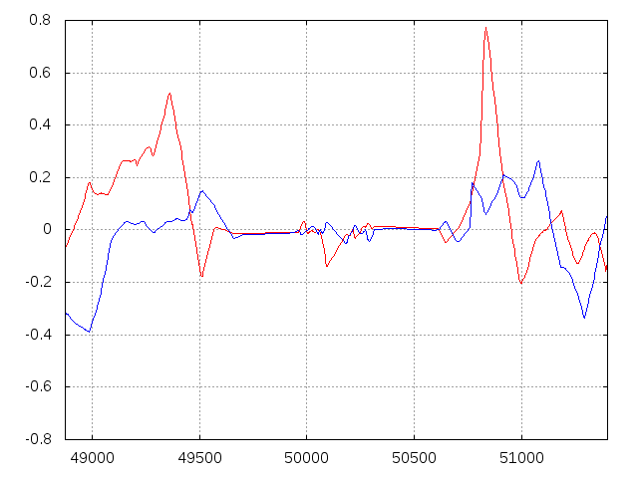
Implementation of the interaction region
  The latest IR optics V7 are included
  Correction scheme taken from IR orbit correction (E. Cruz)
  Errors implemented for the IR elements are the quadrupole alignment errors (0.5 mm) and the dipole roll angle (2 mrad)
IPG
IPG
Horizontal
Horizontal
Vertical
Vertical
Residual orbit [mm]
Residual orbit [mm]
DIS
DIS
DIS
DIS
Distance [m]
Distance [m]
D. BOUTIN, 09 OCTOBER 2017

Slide 11
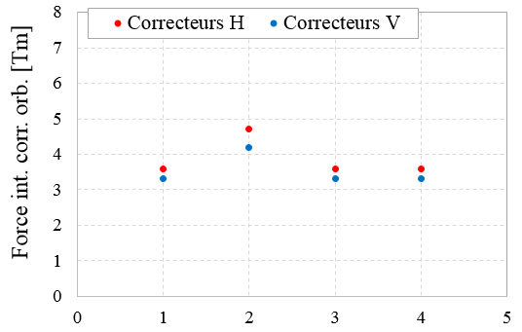
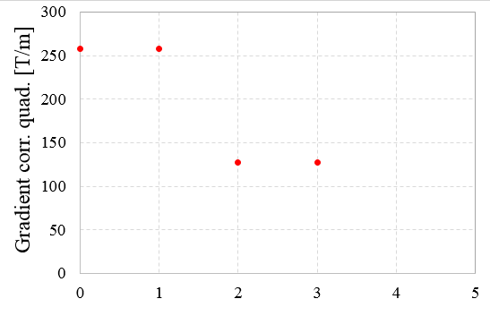
Corrector Strengths
Nb-Ti limit
The strengths are normalized to collision rigidity
Cases of study
1/ reference errors (p.3)
2/ σ(x/y) = 0.36 → 0.50 mm for quadrupoles
3/ dip a2(u) = 1.1 → 0.55
4/ dip a2(u) = 1.1 → 0.55, a2(r) = 1.1 → 2.2
σ(x/y) = 0.50 mm not compatible with Nb-Ti technology for orbit correctors
One can estimate the tolerance limit to around 0.4 mm
The IR orbit correctors are not included in the analysis
Skew quadrupoles are above 200 T/m in cases 1 and 2 (table V0/V2 values)
The tolerance on a2(u) should not be increased further (table V1 value)
D. BOUTIN, 09 OCTOBER 2017

Slide 12
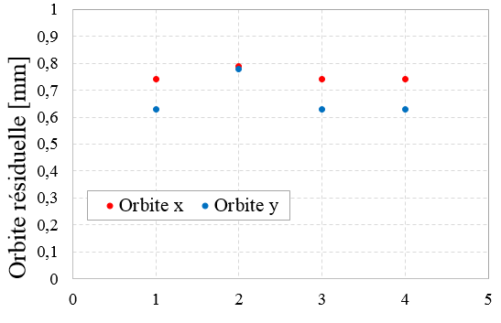
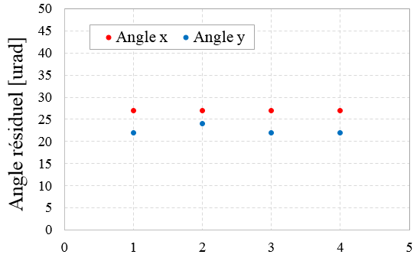
Residual ORBIT and ANGLE
Cases of study
1/ reference errors (p.3)
2/ σ(x/y) = 0.36 → 0.50 mm for quadrupoles
3/ dip a2(u) = 1.1 → 0.55
4/ dip a2(u) = 1.1 → 0.55, a2(r) = 1.1 → 2.2
All cases have a residual orbit < 1 mm, compatible with the geometry of the dipole chamber (5 mm aperture)
Residual orbit values driven by IRs, below 0.7 mm in the arcs sections
The combined contributions of a vertical residual angle of 25 µrad and of the emission cone of photons (19 µrad) contribute to a total vertical offset of +/- 1 mm after a drift of 11 m for case 2
D. BOUTIN, 09 OCTOBER 2017

Slide 13
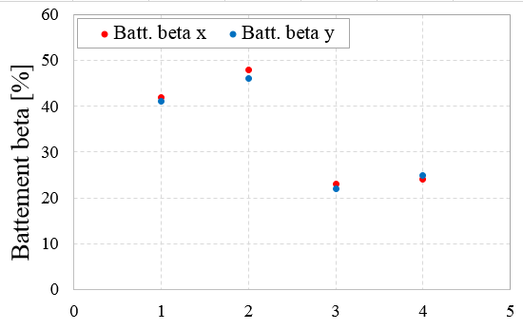
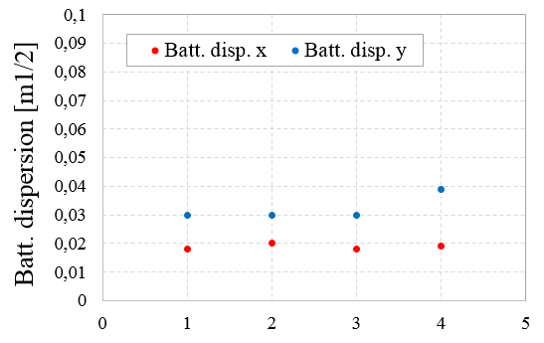
Beta and Dispersion beating
LHC limits (3 RMS)
LHC limits
Cases of study
1/ reference errors (p.3)
2/ σ(x/y) = 0.36 → 0.50 mm for quadrupoles
3/ dip a2(u) = 1.1 → 0.55
4/ dip a2(u) = 1.1 → 0.55, a2(r) = 1.1 → 2.2
Beta-beating way too strong with a2(u) = 1.1 (cases 1 and 2)
Reducing a2(u) leads to values close to LHC limits
Beta-beating values driven by long arc sections
Dispersion beating too strong for case 4
D. BOUTIN, 09 OCTOBER 2017

Slide 14
Conclusions and perspectives
  A global correction scheme of the residual orbit, the linear coupling and the ring tunes for the arc section of FCC-hh has been updated with the newest optics
  The residual orbit and angle are compatible with the aperture considered for the synchrotron radiation evacuation
  Beta-beating is too high with the a2(u) value given in tables V0/V2
  At this stage of study trim quadrupoles are not used
  The reference tolerances on quadrupole alignment and on dipole b1 give reasonable orbit correctors strengths, a quadrupole misalignment of 0.5 mm can be excluded
  The IRs contribute to the residual orbit only
  Perspectives:
      Continue the integration of the insertion regions (collimation, etc)
      Add other systematic errors (dipole b2, alignment)
      Discussions are ongoing to finalize the dimensioning of correctors and their occupation
D. BOUTIN, 09 OCTOBER 2017

Slide 15
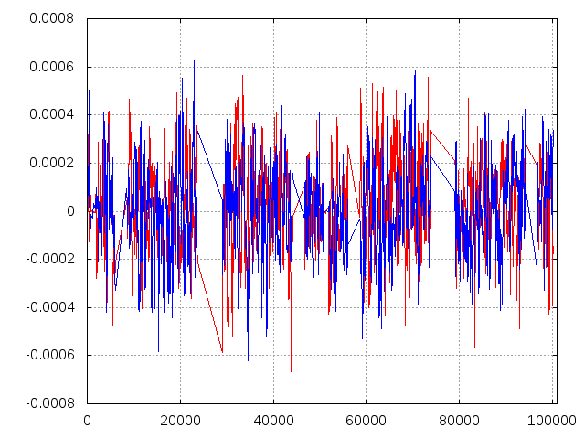
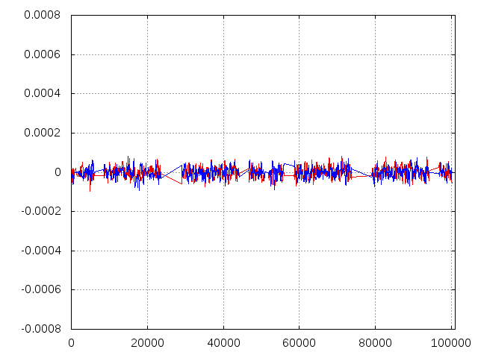
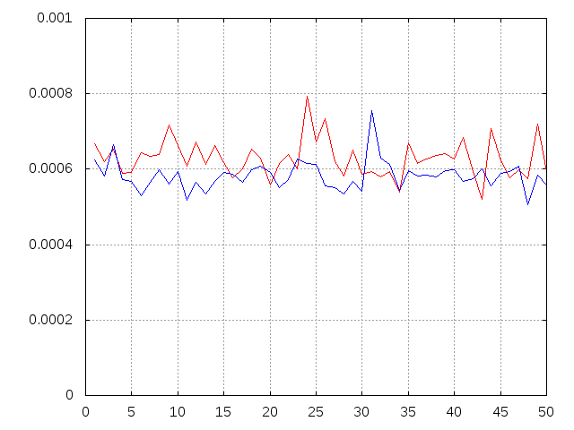
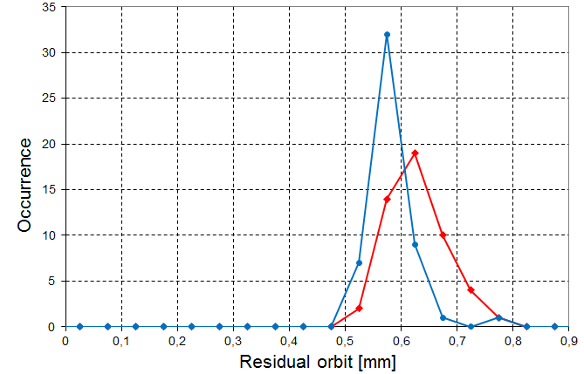
ANALYSE des résultats
Orbite résiduelle dans chaque élément de l’anneau pour 1 machine
Valeur moyenne de l’orbite résiduelle sur 100 machines
Orbite horizontale
Orbite verticale
Orbite horizontale
Orbite verticale
Orbite résiduelle [m]
Orbite résiduelle [m]
* 100 machines =>
Distance [m]
Distance [m]
Valeur maximum de l’orbite résiduelle pour 50 machines
Distribution de la valeur maximum de l’orbite résiduelle
Orbite horizontale
Orbite verticale
Orbite horizontale
Orbite verticale
niveau 90%
Histogramme =>
Taille du bin 0.05 mm
Orbite résiduelle [m]
Numéro de run
D. BOUTIN, 09 OCTOBER 2017

Slide 16
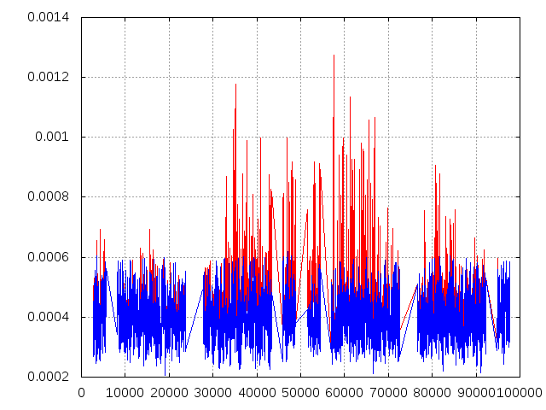
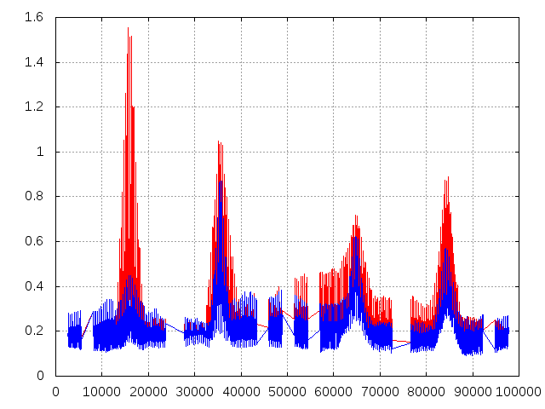
Evaluation of the results
  For each run, calculation of the mean, RMS and maximum values for the following observables for all elements of the arc (see LHC Project Report 501 for more details):
      Corrector strengths
      Residual orbit and angle
      Beta-beating Δβ/β_{ref}
      Parasitic dispersion or dispersion beating ΔD/√β_{re}
  From the distribution of the maximum values the 90-percentile (value for which 90% of the distribution is included) is calculated over all runs
  Several runs did not have a convergence for the ring tunes and were excluded from further analysis, the errors correlation is under investigation
Unfiltered
Unfiltered
Filtered
Filtered
Relative horizontal beta-beating [part.]
Horizontal residual orbit [m]
Path length [m]
Path length [m]
D. BOUTIN, 09 OCTOBER 2017

