Slide 1

FCC – hh Injection and Extraction
M. Atanasov, W. Bartmann, F. Burkart, R. Bruce, M. Hofer, B. Goddard, T. Kramer, A. Lechner, E. Renner, L. Stoel, A. Sanz Ull, P. Van Trappen

Slide 2
Outline
Injection baseline
Extraction baseline
Strategies in case of erratic extraction kickers
  retrigger strategies
  alternative kicker layouts with reduced segmentation
  alternative switch technologies
For a complete summary of the current baseline design please refer to:
Injection and extraction insertions and dump lines (F. Burkart, FCC Week 2017)
scSPS as 1.3 TEV HEB (F. Burkart, FCC Week 2017)
Beam transfer technology challenges, including dump and dilution system design (W. Bartmann, FCC Week 2017)
LHC at 3.3 HEB (W. Bartmann, FCC Week 2017)

Slide 3
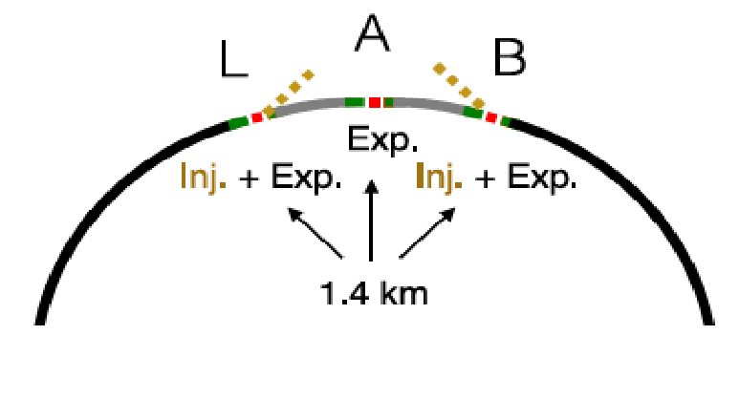
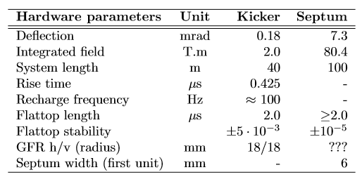
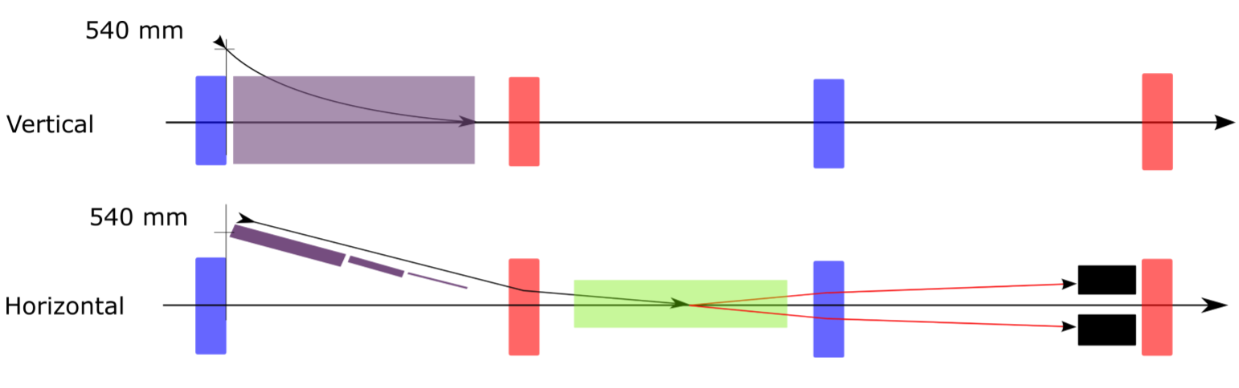
Injection – Status
same baseline as FCC Week 2017
injector options: LHC at 3.3 TeV and scSPS at ~1.3 TeV
injection into side-experiments
W. Bartmann, F. Burkart

Slide 4
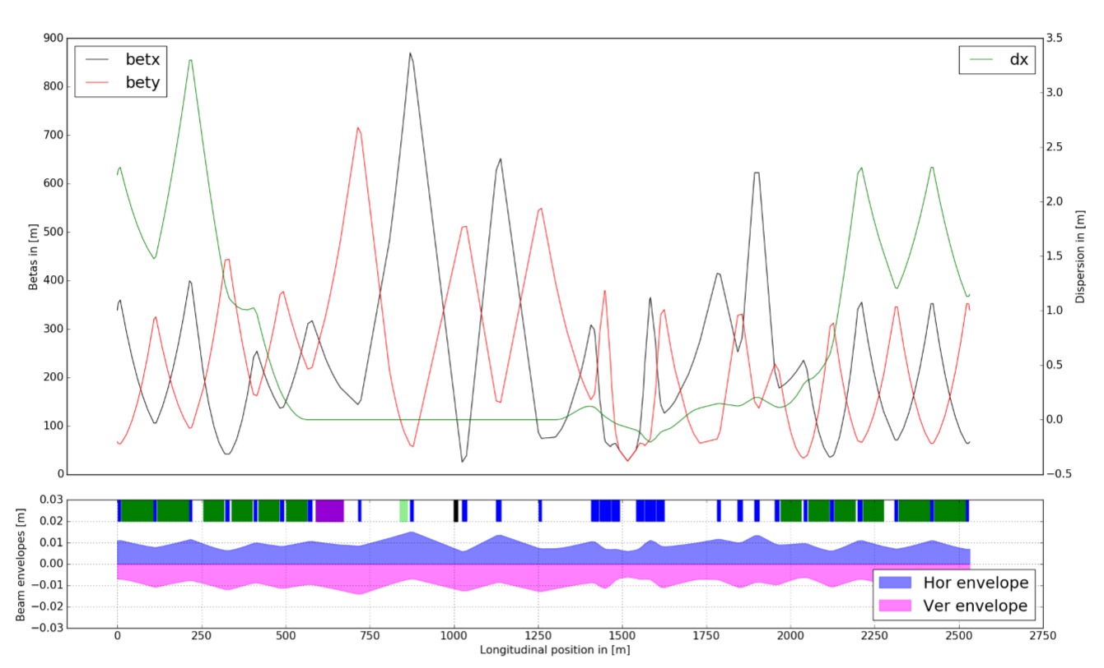

Injection – Status
Current progress + outlook:
transferline design; drift straight left in transfer line for injection protection collimation scheme
injection protection design
tracking studies for injection failures (pycollimate)
higher beta function on injection protection absorber (TDI) might be needed
MSI
MKI
TDI
M. Hofer
$$Δ μ\sim 90deg$$

Slide 5
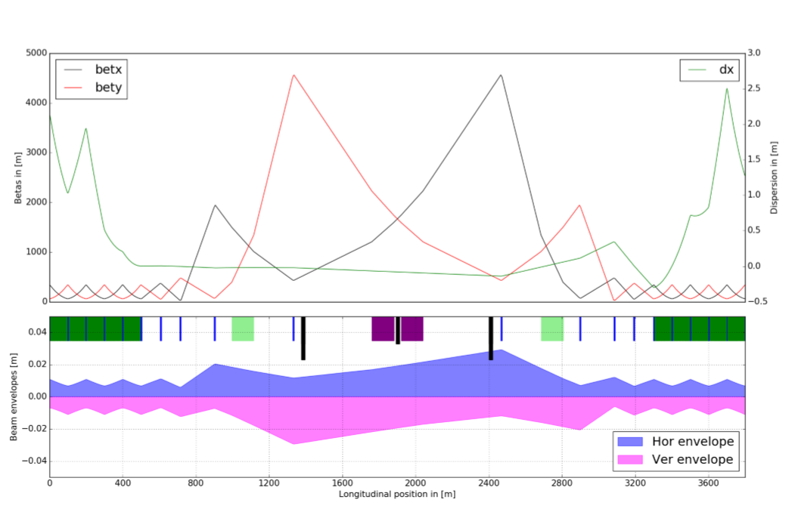
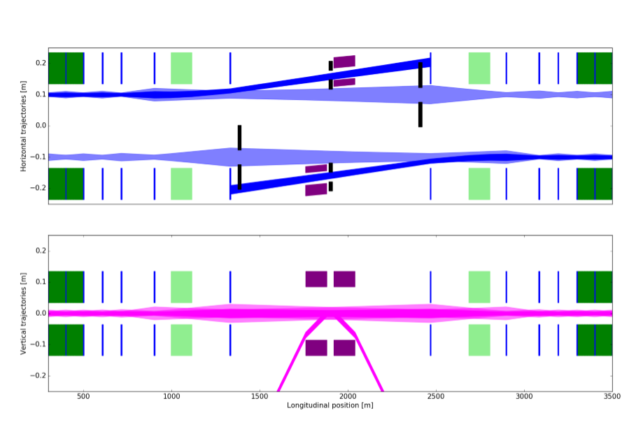
Extraction – Status FCC Week 2017
MKD
MSD + TCDS
QD
TCDQ
MKD
QD
MSD + TCDS
TCDQ
W. Bartmann, F. Burkart
same baseline as FCC Week 2017
optimized to 2.8 km (overlapping septum protection)
high beta functions at extraction absorbers

Slide 6
Extraction Design Requirements – Safety and Availability
  Safely extracting the beam (8.5 GJ stored beam energy)
  Surviving asynch. beam dump
  Avoiding an asynch. beam bump (main cause: erratic kicker)
    reduce risk of spontaneous triggering → minimize failure rate, relaxed hardware parameters (current baseline design: 300 kicker segments with relaxed hardware requirements), reduced number of modules
    avoid asynchronous beam dump in case of spontaneous triggering
    reduce impact of spontaneous triggering

Slide 7
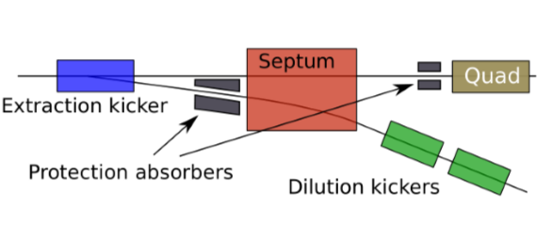
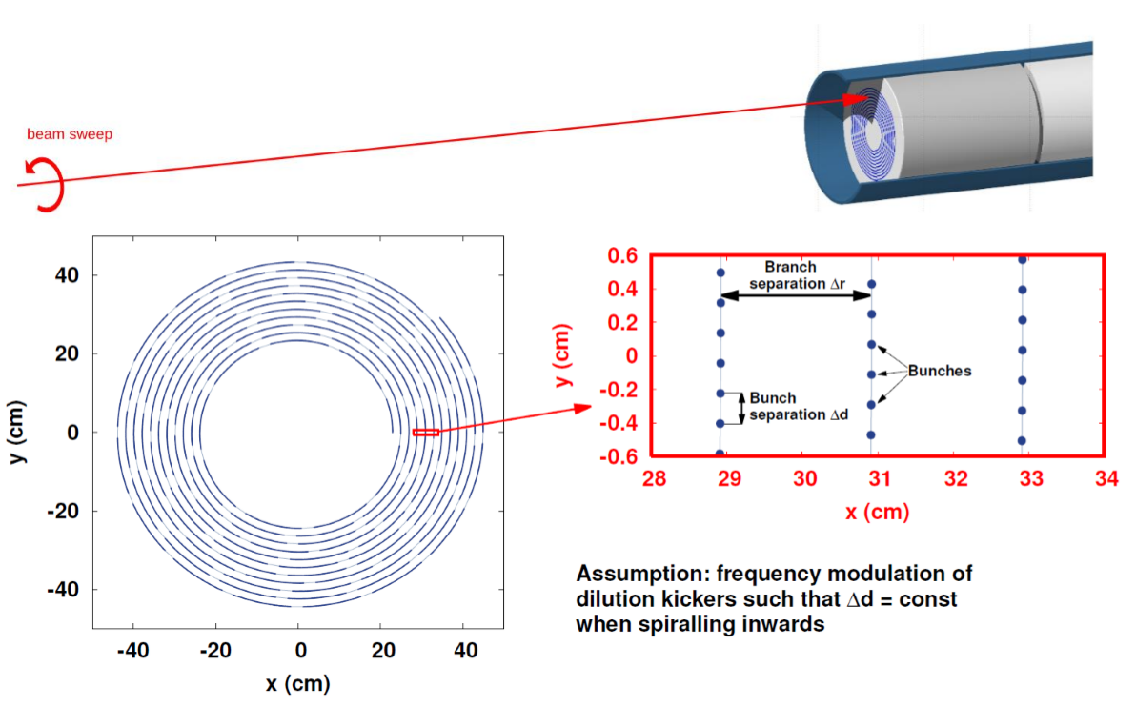
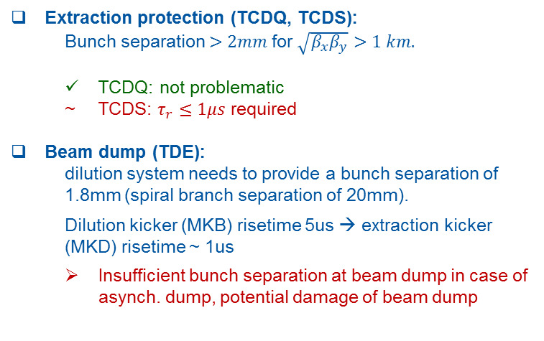
Requirements to Survive an Asynch. Beam Dump
Extraction protection (TCDQ, TCDS):
  Bunch separation $>2mm$for $\sqrt{β_{x}β_{y}}>1 km.$
  TCDQ: not problematic
  TCDS: $τ_{r}≤1μs$ required
Beam dump (TDE):
  dilution system needs to provide a bunch separation of 1.8mm (spiral branch separation of 20mm).
  Dilution kicker (MKB) risetime 5us → extraction kicker (MKD) risetime ~ 1us
  Insufficient bunch separation at beam dump in case of asynch. dump, potential damage of beam dump
Aim: Reduce probability of asynch. dump
  F. Burkart, A. Lechner, D. Barna
  Further information: Design Studies for the FCC-hh beam dump, A. Lechner, FCCW 17)

Slide 8
Extraction Design Requirements – Safety and Availability
  Safely extract beam (8.5 GJ stored beam energy)
  Surviving asynch. beam dump
  Avoiding an asynch. beam bump (main cause: erratic kicker)
    reduce risk of spontaneous triggering → minimize failure rate, relaxed hardware parameters (current baseline design: 300 kicker segments with relaxed hardware requirements), reduced number of modules
    avoid asynchronous beam dump in case of spontaneous triggering
    reduce impact of spontaneous triggering

Slide 9
Avoiding an Asynch. Beam Dump in Case of Erratic Triggering
Different strategies to respond to an erratic extraction kicker
Retrigger instantaneously
(as in LHC, delay 0.7 – 0.8 us)
Retrigger with a delay
(2) Wait 5 us (risetime dilution system)
= delayed asynch. dump
(3) Retrigger with next abort gap
= semisynchronus dump
(1) Immediate asynch. dump

Slide 10
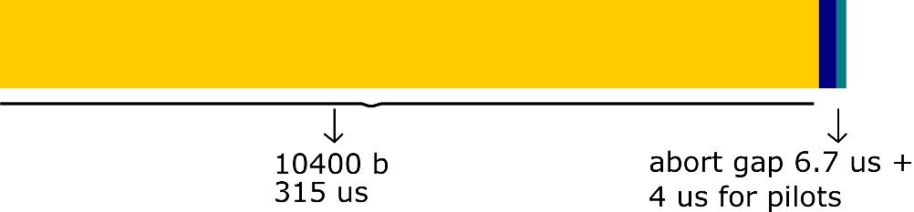
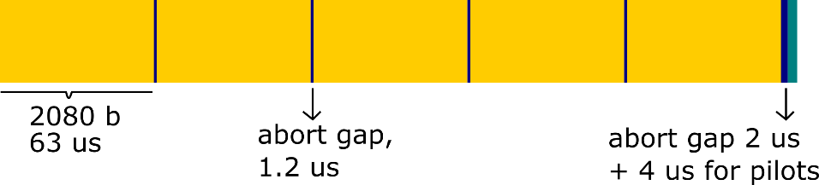
Semisynchronous Dump
= wait for the next abort gap to retrigger remaining kicker modules
Evaluate impact on the machine due to oscillating beam in the collider (losses, beam-beam effects, impact on extraction after one turn, impact on sweep pattern)
Impact can be relaxed by introducing multiple abort gaps:
  1 abort gap: 10400 bunches
  5 abort gaps: 2080 bunches
Consider RF synchronization

Slide 11
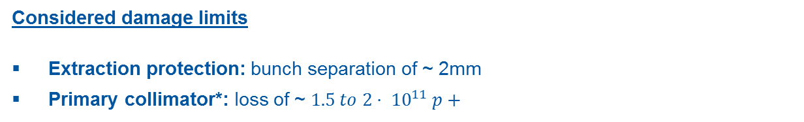
Impact of Alternative Retrigger Strategies
Assessing the feasibility of a semisynchronous dump for the baseline design (300 kicker modules, each with a kick of 0.15 urad)
How far can the modularity be reduced to still stay below the damage limits in case of different failure scenarios?
Considered damage limits
Extraction protection: bunch separation of ~ 2mm
Primary collimator*: loss of ~ $1.5 to 2⋅ {10}^{11} p+$
*Remark: only estimations of damage limit for primary collimators are considered (1-2 FCC bunches) → FLUKA studies for damage limits are started by collimation, FLUKA team and EN/MME

Slide 12
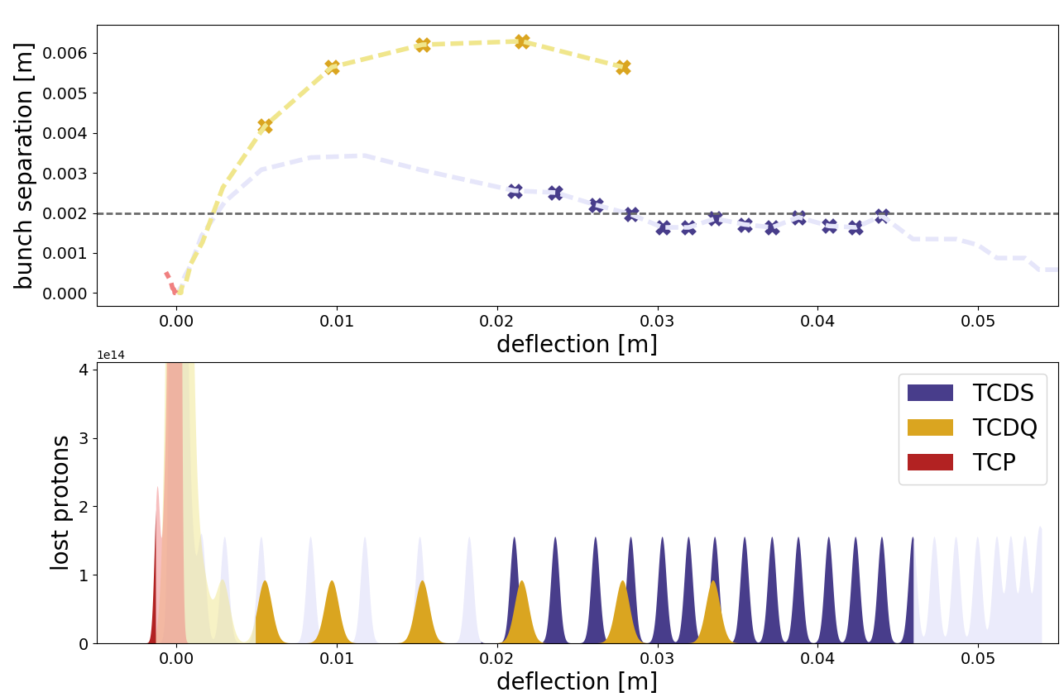

Extraction Kicker Baseline (A) – Semisynchronous Dump
 | A: 300 kicker modules
l [m] | 0.3
U [kV] | 1.2
I [kA] | 2.1
Z [Ohm] | 0.33
L [uH] | 0.38
tau [us] | 1
Single erratic kicker module (MKD) | semisynch. dump (0.9 sigma osc.) * Absorber/collimator/Dump: OK
Common cause failure | <5 erratic modules: semisynch. (5 ag)* ≥5 erratic modules: asynch. dump
Asynch. dump: | Absorber/collimator: OK Dump: ?
Load on and bunch separation at extraction absorber and primary collimator for 1 us risetime (shaded areas: by absorbers not intercepted p+)
*) Taking a loss of $1.5 to 2 {10}^{11}$ p+ at the primary collimator as a limit

Slide 13
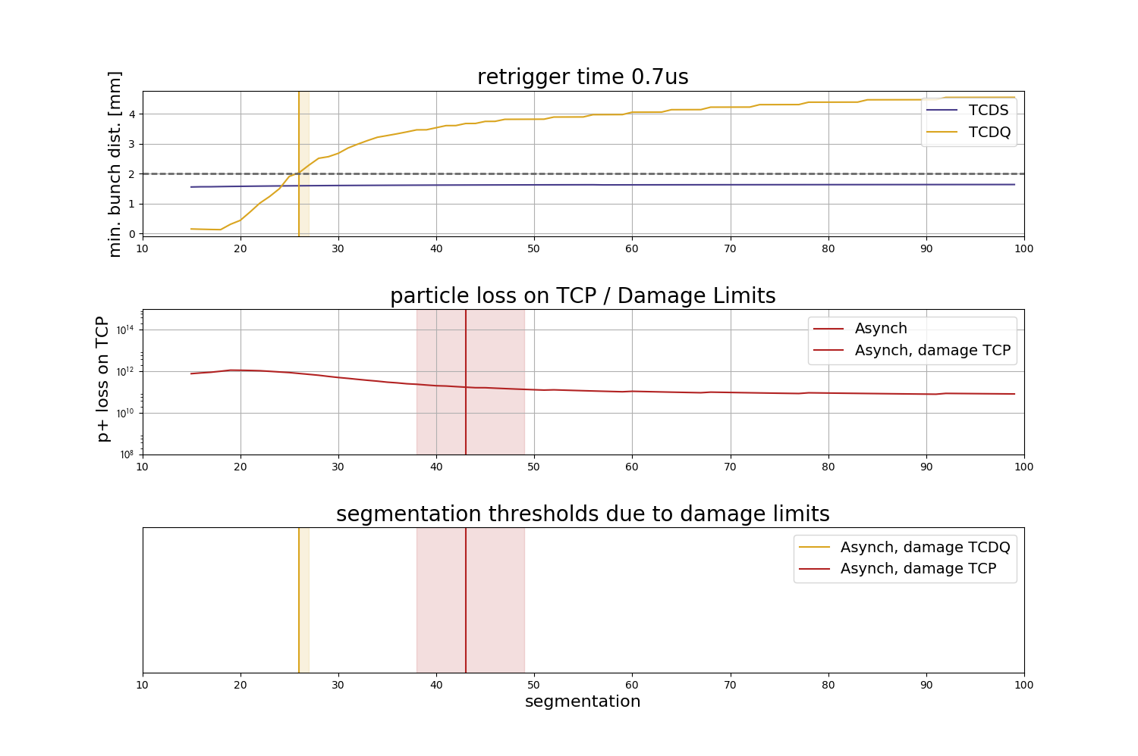
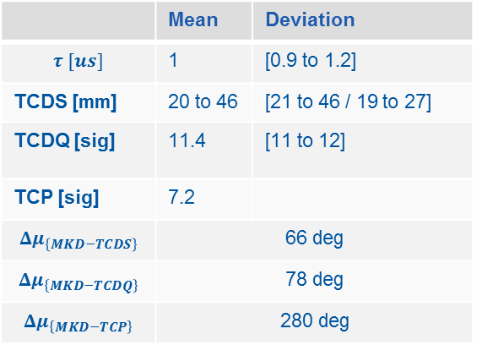
Extraction – Limits for Reduction of Kicker Segmentation
Ad 1) Asynch. dump
 | Mean | Deviation
$$τ [us]$$ | 1 | [0.9 to 1.2]
TCDS [mm] | 20 to 46 | [21 to 46 / 19 to 27]
TCDQ [sig] | 11.4 | [11 to 12]
TCP [sig] | 7.2
$$Δμ_{\left\{MKD−TCDS\right\}}$$ | 66 deg
$$Δμ_{\left\{MKD−TCDQ\right\}}$$ | 78 deg
$$Δμ_{\left\{MKD−TCP\right\}}$$ | 280 deg
Load on quadrupole protection limits to ~28 segments
Load on primary collimator limits to ~45 segments

Slide 14
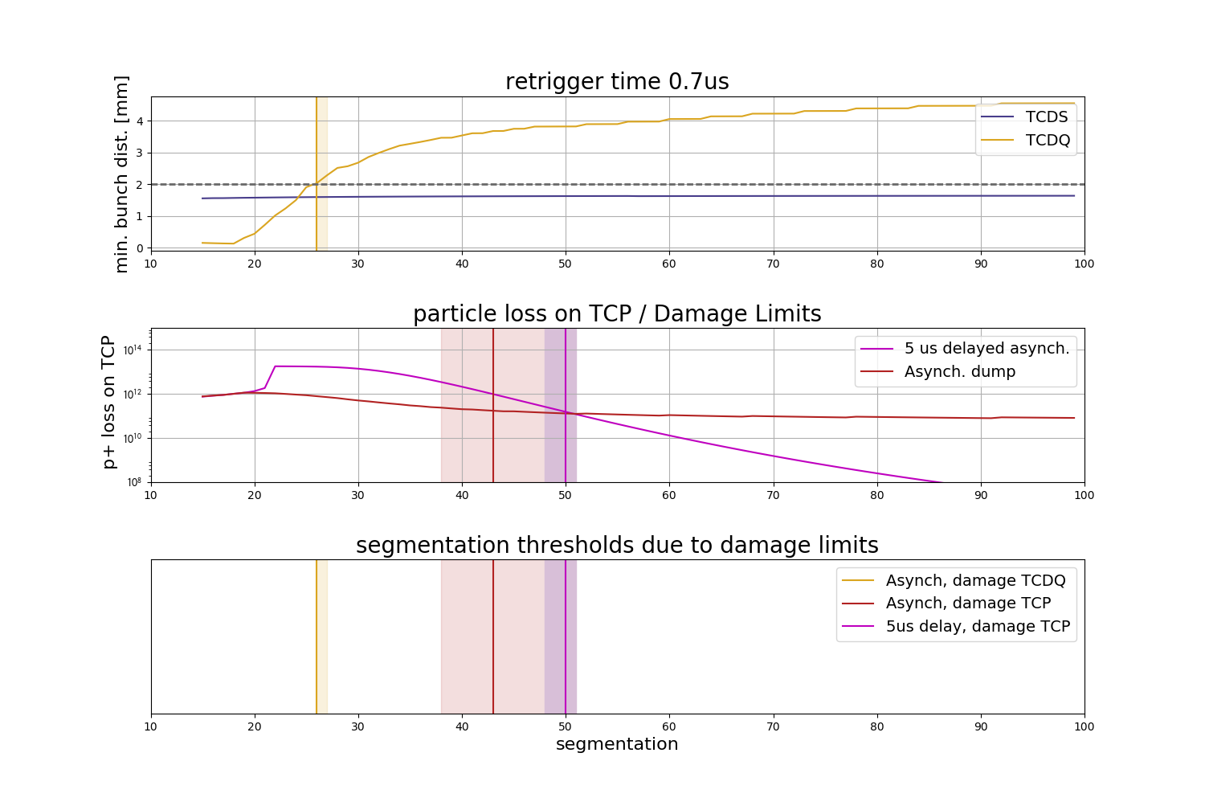
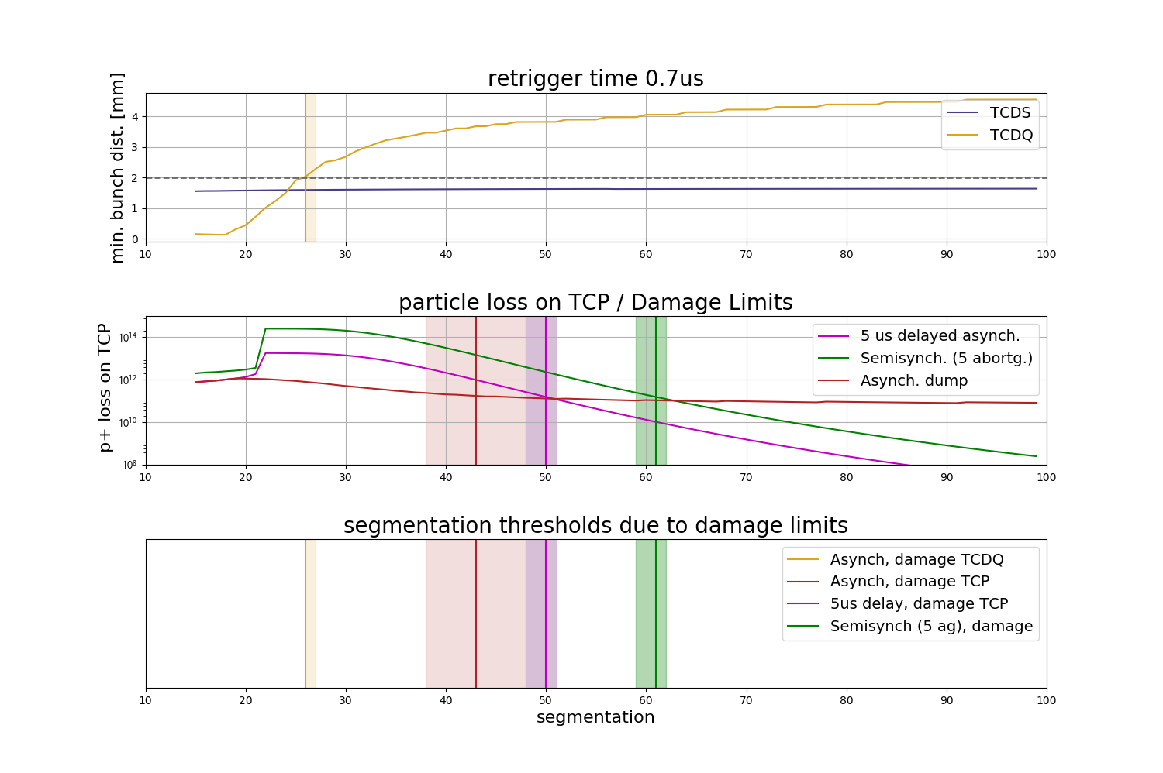
Extraction – Limits for Reduction of Kicker Segmentation
Ad 2) 5 us retrigger time (dilution system rise time)
OK down to ~50 segments for damage limit of primary collimator
Ad 3) Semisynchonous dump (5 abort gaps – 2080 bunches)
OK down to ~60 segments for damage limit of primary collimator

Slide 15
Extraction – Alternative Kicker Design (B)
 | B: ~70 kicker modules
l [m] | 1.6
U [kV] | 6.75
I [kA] | 1.7
Z [Ohm] | 2
L [uH] | 2.03
tau [us] | 1
Single erratic kicker module | semisynch. dump (3.9 σ osc.). Absorber/collimator/Dump: OK
Common cause failure | > 1 erratic modules: asynch. dump
Asynch. dump: | Absorber/collimator: OK Dump: ?

Slide 16
Extraction Design Requirements – Safety and Availability
  Safely extract beam (8.5 GJ stored beam energy)
  Surviving asynch. beam dump
  Avoiding an asynch. beam bump (main cause: erratic kicker)
    reduce risk of spontaneous triggering → minimize failure rate, relaxed hardware parameters (current baseline design: 300 kicker segments with relaxed hardware requirements), reduced number of modules
    avoid asynchronous beam dump in case of spontaneous triggering
    reduce impact of spontaneous triggering
alternative switch architecture to inhibit the current over the magnet in case of an erratic

Slide 17
Alternative Switch Topologies
Alternative switch topologies can limit the current in the kicker magnet in case of an erratic with the aim to reduce or eradicate the impact of an erratic trigger on the beam
Two alternative generator topologies:
  Series connection of two switches to inhibit current over magnet in case of single self-trigger (simulation: reduction of pulse strength to ~1%)
  Shorting crowbar switches
Concept to prove
  Above: PSpice Model for Series Switch Architecture, P. Van Trappen: Further information: New design concepts for suppressing erratic triggering of solid state switch stacks (P. Van Trappen et al, FCCWeek 2017)

Slide 18
Extraction – Alternative Kicker Design (C)
 | C: ~30 kicker modules
with 2 switch stacks in series (Concept to prove)
l [m] | 1.6
U [kV] | 4.6
I [kA] | 3.9
Z [Ohm] | 0.33
L [uH] | 2.03
tau [us] | 6.1
Single erratic kicker module | series blocking switch → semisynch. dump
Common cause failure | series blocking switch → semisynch. dump
Asynch. dump: | absorber/collimator: sacrificial dump: OK minimized probability
~ 30 modules: number limited by hardware requirements
IGBT switch should be operated at low blocking voltage, to limit transient amplitude if one switch has an erratic
Long risetime (6 us) to lower required voltage
risetime: 6 us > 5 us:
  Beam dump survives asynch. dump
  Extraction protection / primary would be damaged → sacrificial absorbers
  Probability of and asynch. dump (due to both switches failing) should be minimized

Slide 19
 | A: 300 kicker modules | B: ~70 kicker modules | C: ~30 modules (Concept to prove)
Length [m] | 0.3 | 1.6 | 1.6
U [kV] | 1.2 | 6.75 | 4.6
I [kA] | 2.1 | 1.7 | 3.9
Z [Ohm] | 0.33 | 2 | 0.33
L [uH] | 0.38 | 2.03 | 2.03
risetime [us] | 1 | 1 | 6.1
Switch topo. | Single IGBT | Stacked IGBT (2-4) | 2 stacks in series (each 2-3)
 | 1
Single erratic kicker module | semisynch. dump Abs./Coll/Dump: OK | semisynch. dump (3.85 sigma osc.) → 8 a.g.! | Series blocking switch → semisynch. dump
Common cause failure | <5 erratics.: semisynch. ≥5 erratics: → asynch. Probability to minimize | ≥1 erratic module → asynch. dump Probability to minimize | Series blocking switch → semisynch. dump
Asynch. dump | Absorber/collimator: OK Dump: ? Minimzed probability* | Absorber/collimator: OK Dump: ? Minimzed probability* | Absorber/coll.: sacrificial Dump: OK Minimzed probability*
*) Asynch dump only in case of RF synchronization loss, multiple erratic kickers (common cause), abort gap population,..
* As only for multiple erratics and other failures

Slide 20
Conclusion and Outlook
Injection:
  Injector options and injection optics are completed
  Ongoing: Studies on transfer line design, injection protection and failures ongoing
Extraction:
  Extraction straight and dump line optics are completed
  Extraction design driven by failure case of asynchronous dump, due to impact on extraction protection and dump.
      Therefore: Study on impact of alternative extraction kicker design on RAMS is ongoing.
        Baseline design with 300 extraction kicker modules: Possibility to avoid asynchronous dump in case of an erratic kicker module by waiting for the next abort gap (semi synchronous dump).
        Ongoing: Compare baseline to alternative designs (~70 kicker modules or ~30 kicker modules with 2 switches in series to mitigate impact of erratic kicker [Concept to prove]) regarding failure impact and probability
  Studies starting in cooperation with the collimation team for injection and extraction failures

Slide 21
Thank you!
Injection and extraction insertions and dump lines (F. Burkart, FCC Week 2017)
scSPS as 1.3 TEV HEB (F. Burkart, FCC Week 2017)
Beam transfer technology challenges, including dump and dilution system design (W. Bartmann, FCC Week 2017)
LHC at 3.3 HEB (W. Bartmann, FCC Week 2017)
Surviving an Asynchronous Dump? (B. Goddard, FCC Week, Rome 2016)
Dump system concepts for the Future Circular Collider (W. Bartmann, et al, Physical Review Accelerators and Beams, 2017)
Dependability analysis of a safety critical system : the LHC beam dumping system at CERN (R. Filipini, CERN-Thesis 2007)
New design concepts for suppressing erratic triggering of solid state switch stacks (P. Van Trappen et al, FCCWeek 2017)
Design Studies for the FCC-hh beam dump (A. Lechner, FCCW 17)

Slide 22
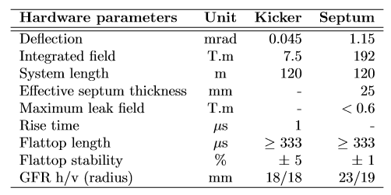
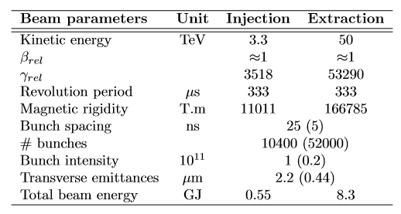
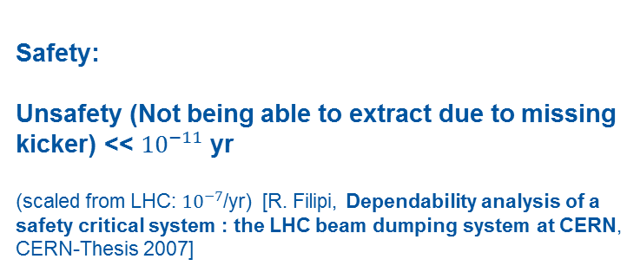
Extraction
Safety:
Unsafety (Not being able to extract due to missing kicker) << ${10}^{−11}$yr
(scaled from LHC: ${10}^{−7}$/yr) [R. Filipi, Dependability analysis of a safety critical system : the LHC beam dumping system at CERN, CERN-Thesis 2007]

Slide 23
Series Connected Switches

Slide 24
Crowbar Connected Switches

