Slide 1
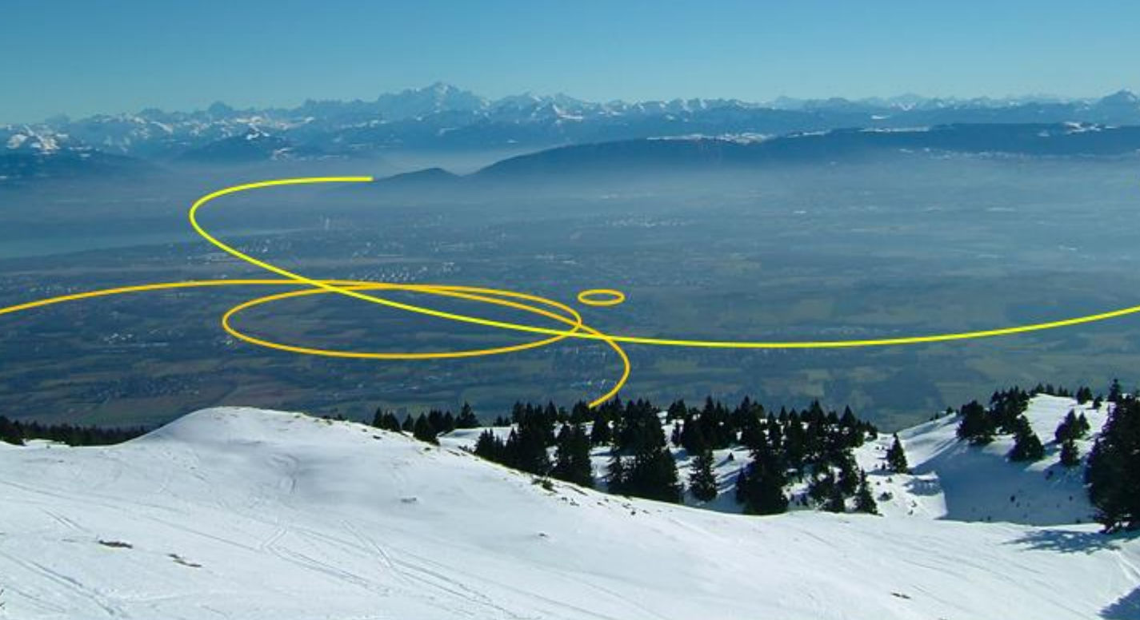


FCC-hh impedances and instabilities
O. Boine-Frankenheim (for EuroCirCol Task 2.4)
S. Arsenyev, L. Mether, B. Salvant, D. Schulte (CERN)
D. Astapovych, U. Niedermayer (TU Darmstadt)
V. Kornilov (GSI)
B. Riemann (TU Dortmund)

Slide 2
Task 2.4 Single Beam Stability
beam pipe
Wakefields and impedances:
e⁻
2D and 3D simulation codes
Bunch
Image current
Beam-beam interaction:
Not part of this work package
(but, electron lenses for LD are)
Electron clouds:
created by residual gas or wall emission.
Compare with LHC observations
and simulations as much as possible.
-> Scaling with beam energy,…
Instabilty thesholds (Landau damping):
Dispersion relations and tracking studies

Slide 3
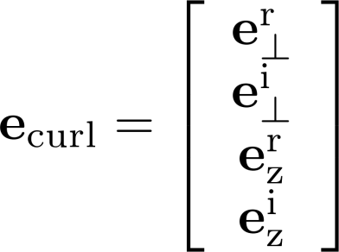












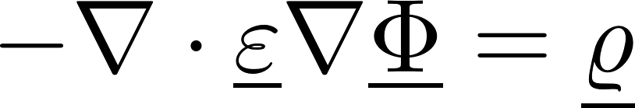




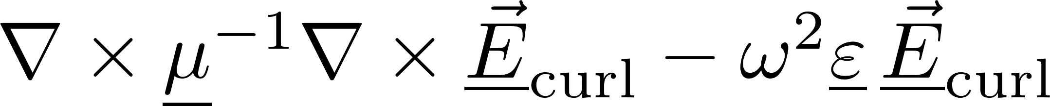
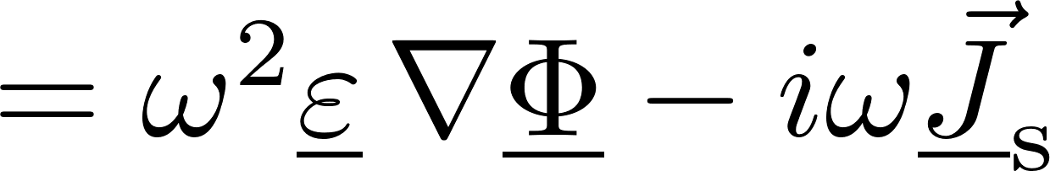
2D impedance code in frequency space
Open source package FEniCS
(A. Logg, K. Mardal, G. Wells et al.)
Mesh from GMSH
(C. Geuzaine, J. Remacle)
Nodal functions
Nedelec edge functions
U. Niedermayer et al., Space charge and resistive wall impedance computation in the frequency domain using the finite element method, Phys. Rev. ST-AB 18, 032001, 2015
BeamImpedance2D (PYTHON): https://bitbucket.org/uniederm/beamimpedance2d.git

Slide 4
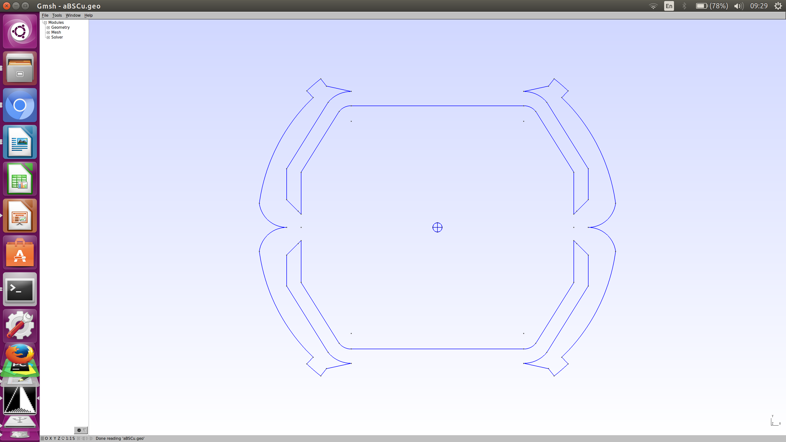
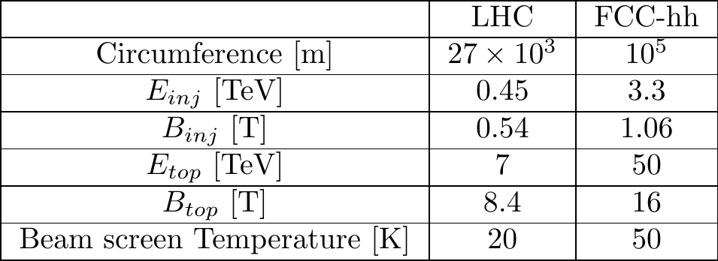
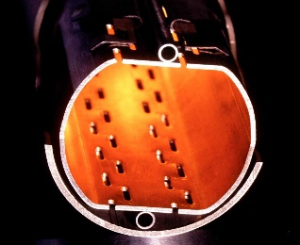
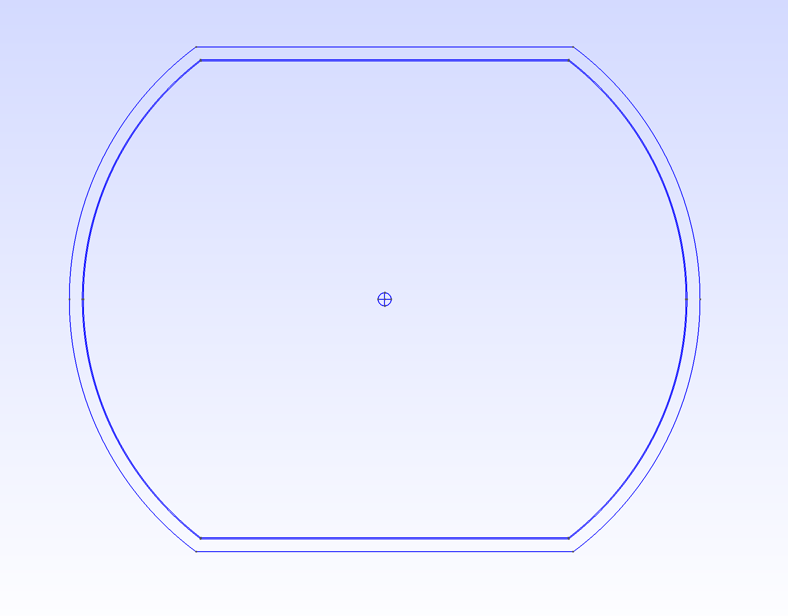
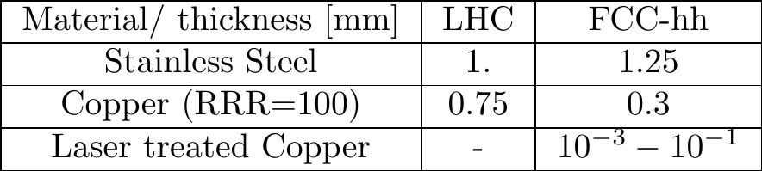
Impedance of the FCC-hh beam screen
FCC
Boundaries and parameters for impedance calculations with BeamImpedance2D
“frog”-shape
LHC

Slide 5
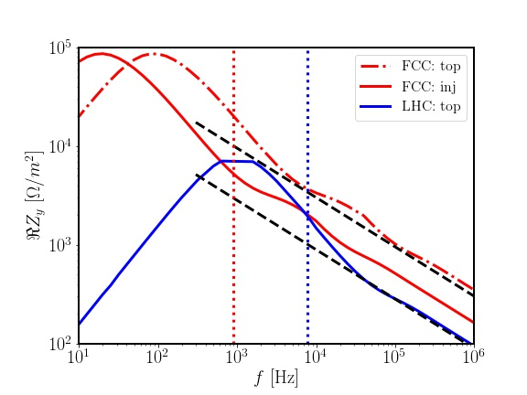

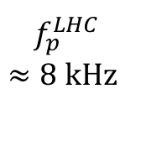
Coupled bunch instability: FCC vs. LHC
FCC
Growth rate:
(Sacherer 1974)
Transverse impedances (only real part)
growth time at 3.3 TeV:
approx. 200 turns
at 50 TeV:
approx. 1000 turns
(LHC at 7 TeV: 2000 turns)
b=0.02 m
LHC
b=0.014 m
$$f_{p}^{FCC}$$
$$≈1 \text{kHz}$$
$$f_{p}^{LHC}$$
$$≈8 \text{kHz}$$
(Thick) resistive wall impedance

Slide 6
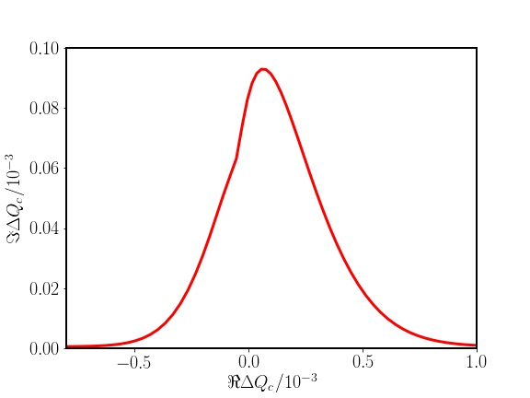
Dispersion relation and Landau damping
see V. Kornilov
(coherent tune shift)
(action)
(octupoles)
Example stability plot for LHC (7 TeV)
(incoherent tune spread)
(for stability)
LHC (7 TeV) vs FCC-hh (50 TeV):
Undesired effects: Reduction of dynamic aperture,…
Possible strategy: Active dampers for k=0, octupoles for k>0.

Slide 7
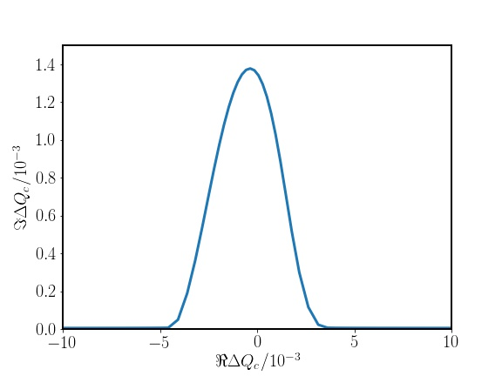



Landau damping: Possible alternative schemes
FCC-hh: Active feedback for k=0 modes, Landau damping for k>1.
Still, additional Landau damping concepts are helpful !
LHC: 10 x larger stability area then with octupoles
Radio-Frequency
Quadrupole (RFQ)
Shiltsev et al
PRL 2017
$$ΔQ^{max}=0.01$$
Electron lenses
$$l_{e}=2 \text{m}$$
Grudiev PRAB 2014
Schenk et al, IPAC17
Shiltsev et al PRL (2017)
$$I_{e}=0.8 \text{A}$$
Tune spread induced by a
counter-propagating electron beam:
(longitudinal action)
No local spread (in z) !
Dispersion relation and Landau damping ?
Detailed particle tracking studies are ongoing (see also V. Kornilov).

Slide 8
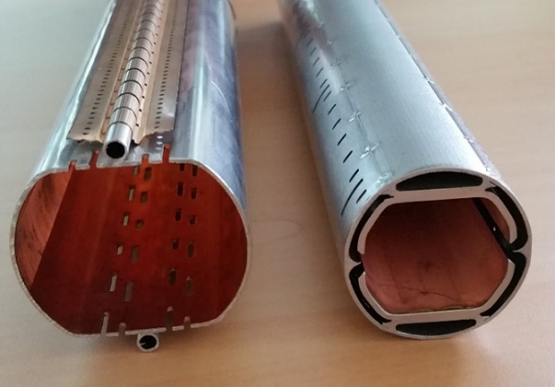
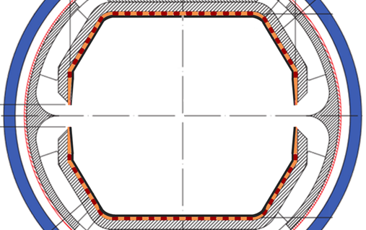
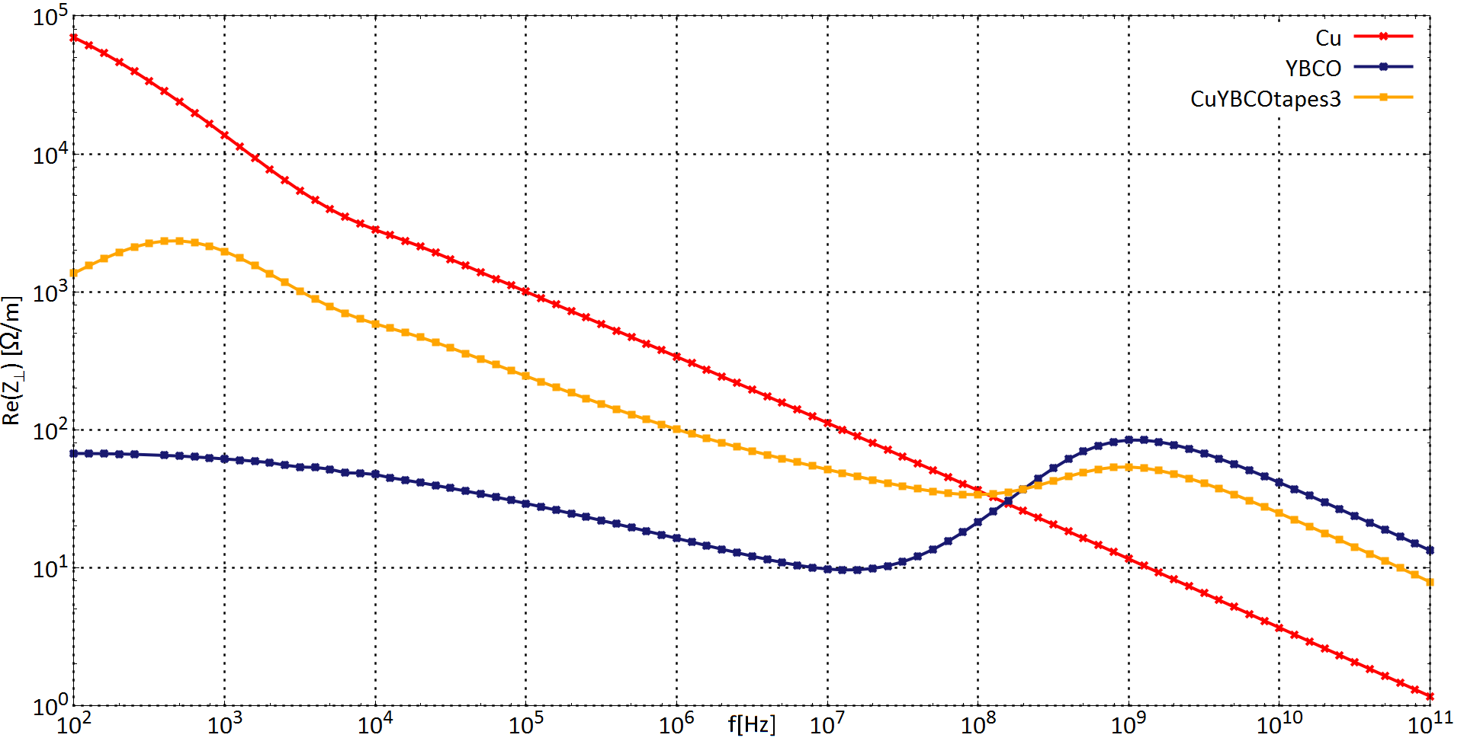

Option: HTS coated screen
Hybrid coating (HTS stripes):
Possible reduction of the resistive wall instability growth rates by factor 5-6.
Possible reduced TMCI thresholds.
Hybrid coating
B=16T
“depinning frequency“
$$f_{p}$$
P. Krkotic,
U. Niedermayer

Slide 9
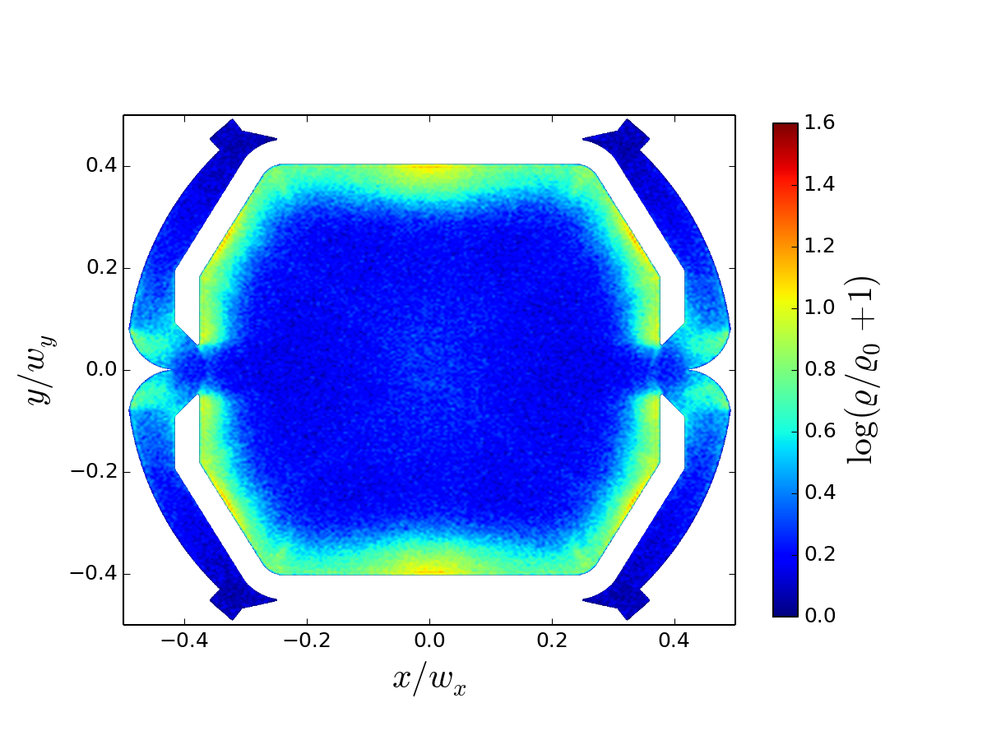
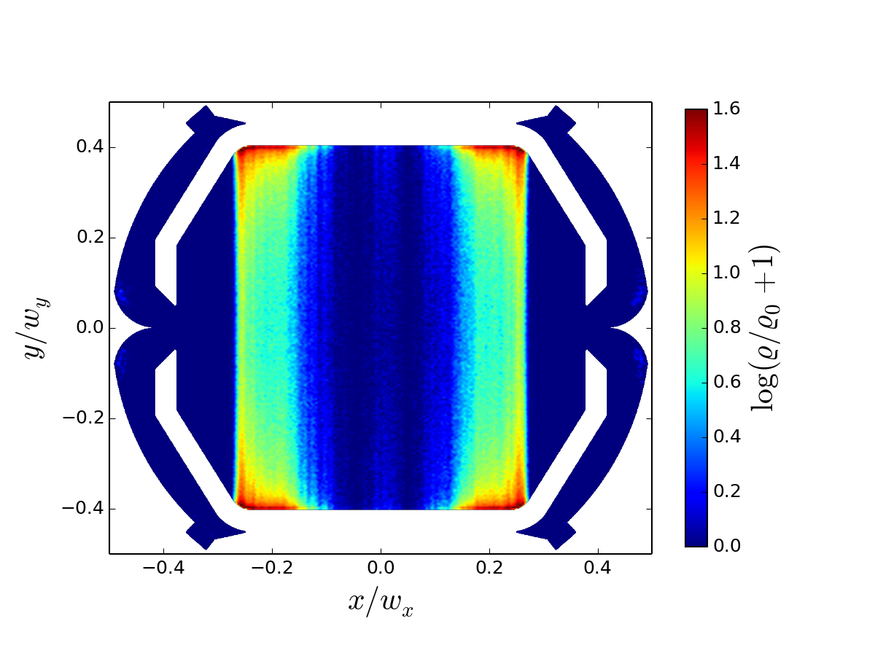
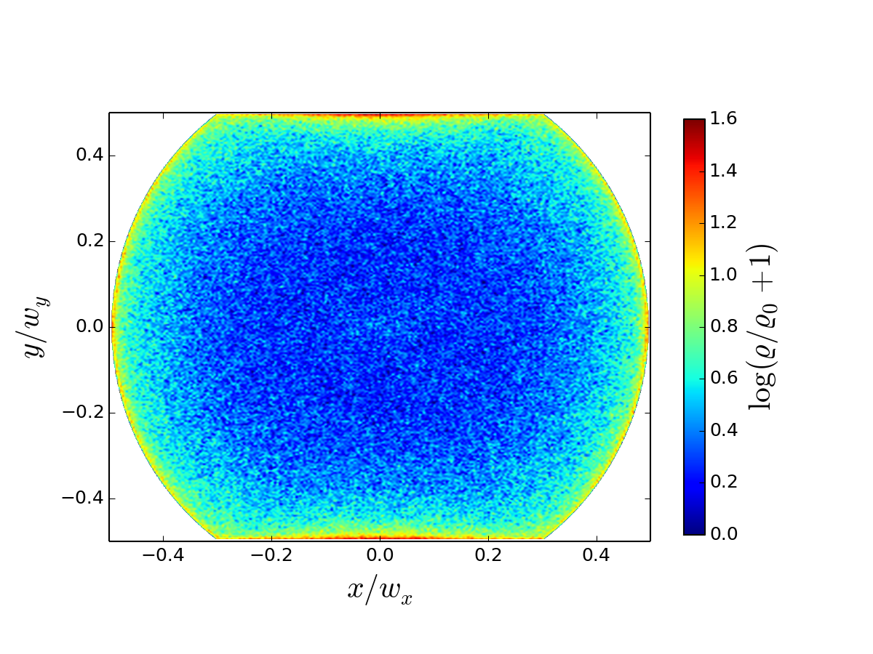
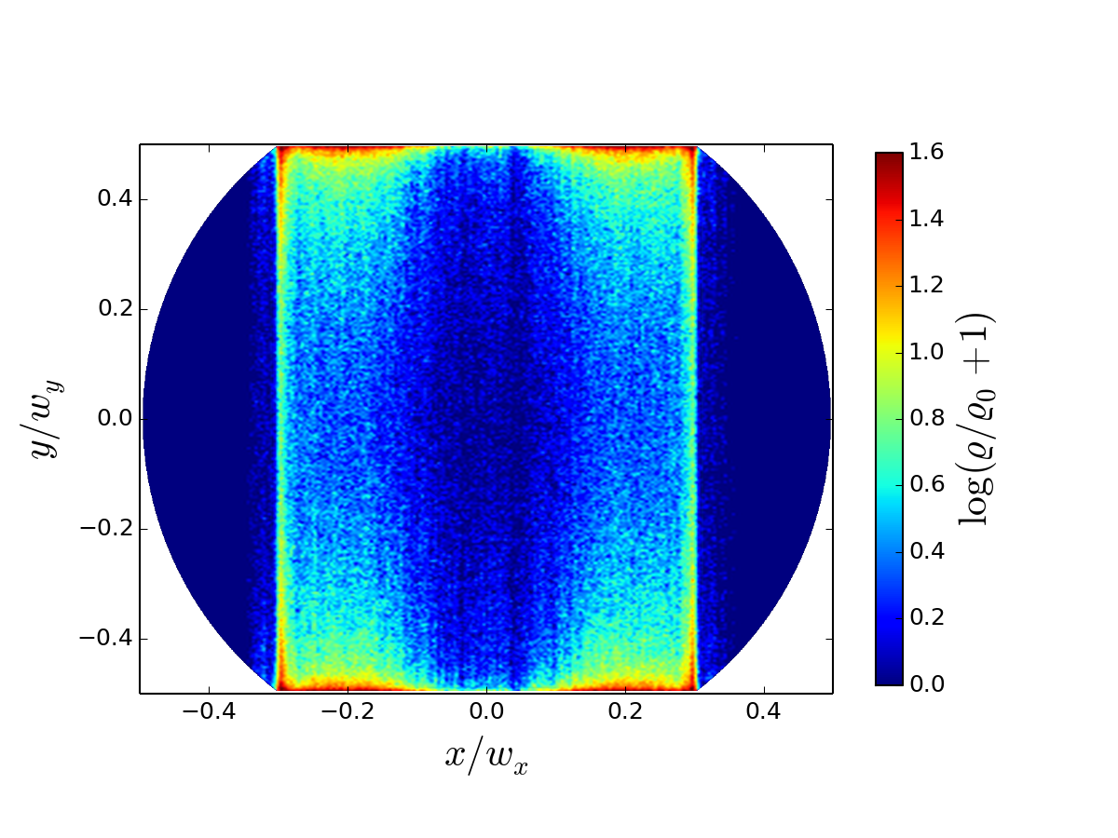

Electron cloud studies
openEcloud : https://github.com/openecloud
e.g. F. Petrov, O. Boine-Frankenheim, O. Haas, PRAB (2014)
Fast 2D Poisson solver, PIC solver, SEY model, interfaces to PATRIC/pyORBIT (to do)
B=0
B=1 T
FCC
$$N_{b}={10}^{11}$$
25 ns bunch
spacing
LHC
D. Astapovych

Slide 10
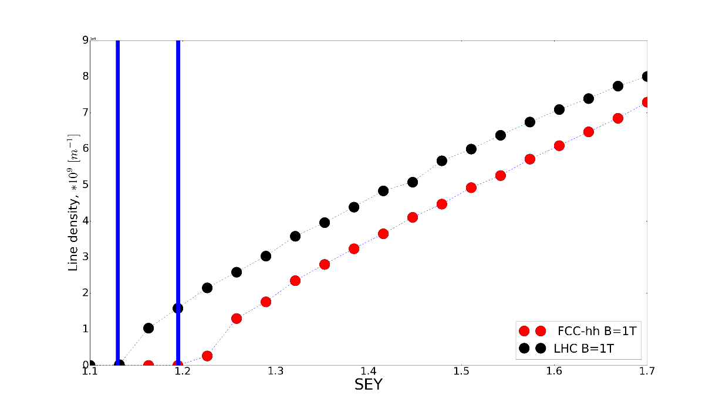
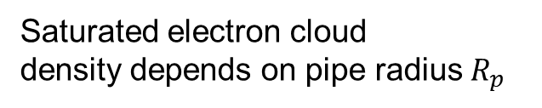
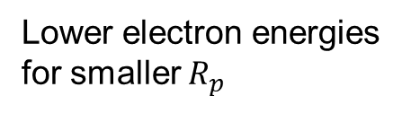



Electron cloud studies: Buildup
See also L. Mether
Photoelectrons without mitigation would dominate the buildup (L. Mether, 2016)
FCC beam pipe design: Photoelectrons stay in antechamber (first approximation)
Saturated electron cloud
density depends on pipe radius $R_{p}$
Lower electron energies
for smaller $R_{p}$
$$\text{SEY}≈1.1$$
$$\text{SEY}≈1.2$$
SEY threshold for buildup
Differences between different
simulation models and codes:
SEY model
Pipe geometry and mesh
Particle pusher and field solver
…..
Next step: (residual) photoelectrons
$$N_{b}={10}^{11}$$
25 ns bunch spacing
LHC: B=1 T
FCC: B=1 T
D. Astapovych
SEY

Slide 11
Electron cloud: instability thresholds
Rumolo et al. PRL (2008): Electron cloud induced instability
stronger at higher energies because of smaller beams.
(focusing strength for electrons
in the bunch potential)
Electron cloud density thresholds
(K. Ohmi et al, IPAC2015)
3 TeV: n_{e,th} = 4.4 x 10¹⁰ m⁻³
50 TeV: n_{e,th} = 5.7 x 10¹¹ m⁻³
-> Next step: Detailed simulations
to determine instability threshold densities
(and required SEY for FCC) !
If the the FCC screen will be a-C coated
(with SEY lower/equal 1) and the chosen
screen design avoids photoelectron entering
in the pipe, electron could induced instabilities
should be absent in the FCC.
Simulation for LHC (drifts), B-F., Petrov (PRAB 2012/2015)

Slide 12
Status and Plans (EuroCirCol WP 2.4)
Impedances studies:
Screen and coatings (HTS and laser): HTS for impedance, Laser for SEY
Warm parts (see B. Riemann)
Collimators: Important at top energy
Impedance library (see S. Arsenyev)
Impedance budgets -> from instability thresholds (!) or tolerable head loads.
Screen/Collimators: Coupled bunch damped by Octupoles (k>=0) and Feedback
TMCI (might be an issue with laser coating and collimators)
Other Landau damping mechanisms and combinations (see V. Kornilov)
Ecloud buildup and instability thresholds:
Estimates for buildup (see L. Mether)
Required SEY for instability supression.

Slide 13
Backup

Slide 14
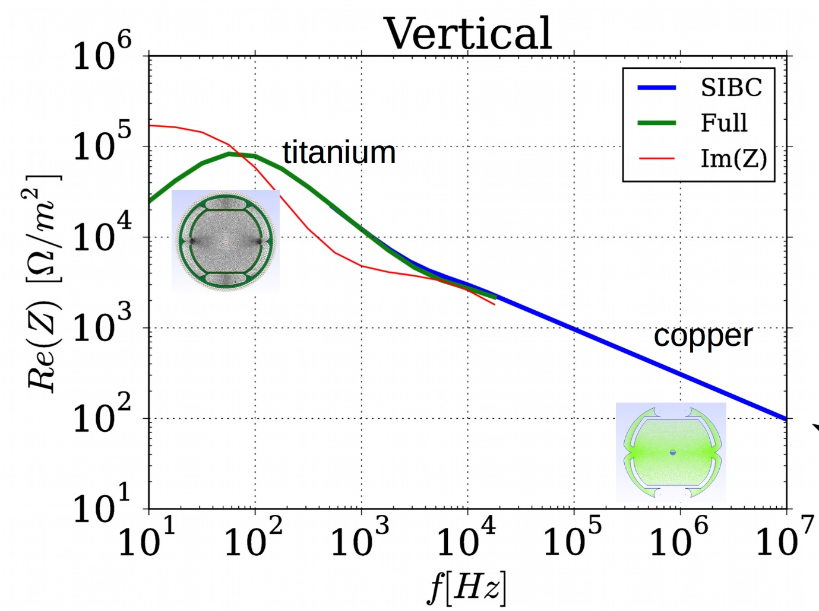
FCC beam screen and impedance
Betatron side-bands
are at 1-2 kHz
Beam pipe
Material | Cu, SS
Cu thickness [μm] | 300
Laser/a-C coating [μm] | 1-10
Resistive wall instability:
High-frequency parts and coatings treated separately.

