Slide 1


Electron cloud studies intermediate results for WP4
L. Mether, G. Rumolo
Acknowledgements: I. Bellafont, E. Belli, G. Iadarola,
R. Kersevan, D. Schulte

Slide 2
Outline
Introduction
Where is beam screen coating needed?
Constraints on photoelectron (photon) flux
Summary

Slide 3
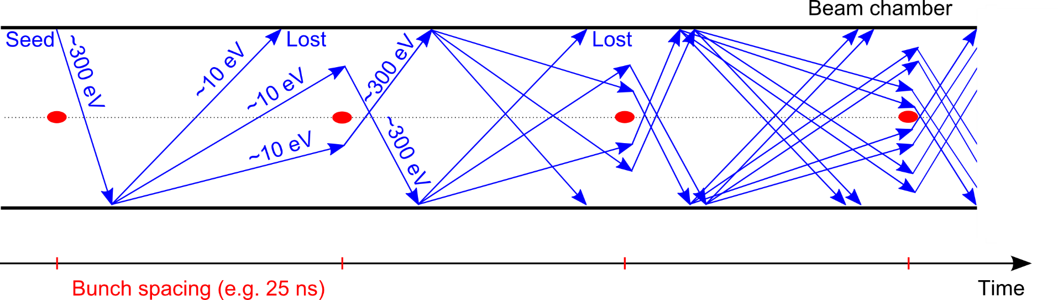
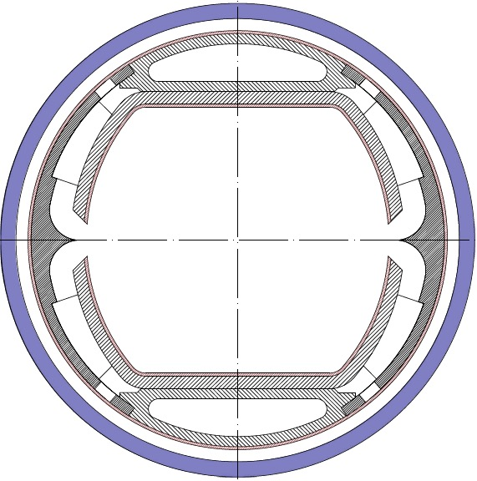
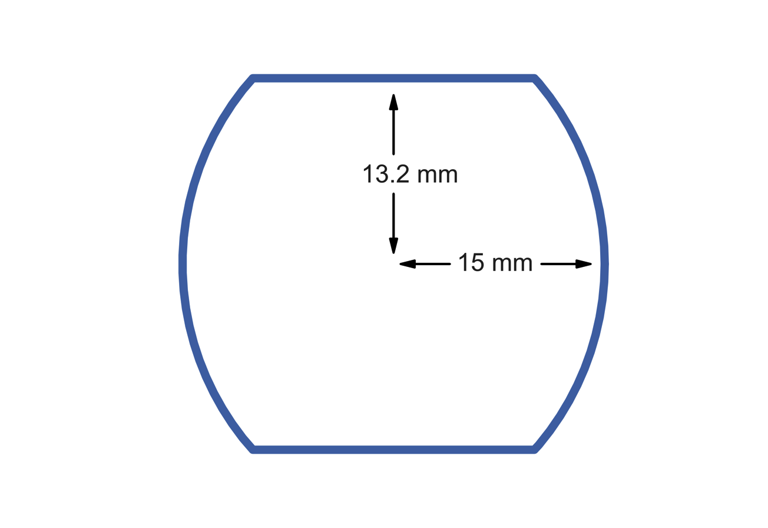
Introduction
Secondary Electron Emission can drive an avalanche multiplication effect, filling the beam chamber with an electron cloud
Main concerns of electron cloud
Transverse instabilities due to interaction between beam and electron cloud
Emittance growth, tune shift and spread, beam losses
Heat load and vacuum degradation due to electron flux on chamber wall
Constraints for beam screen
and vacuum design?
Simulation studies
Main chamber of beam screen (2015 version), Cu surface
Electron cloud build-up for 25 ns, 12.5 ns and 5 ns beam
Arc dipoles, quadrupoles and drifts
Effect of photoelectrons

Slide 4
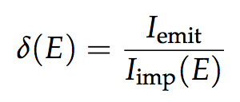
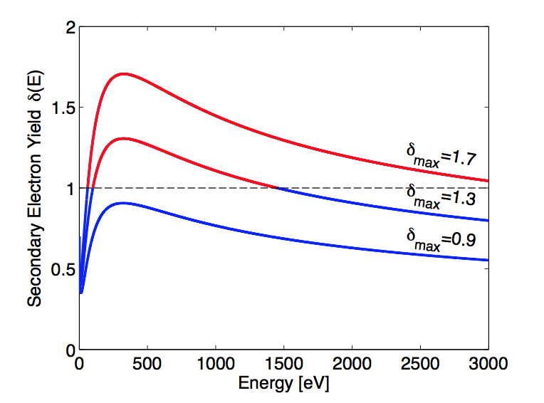
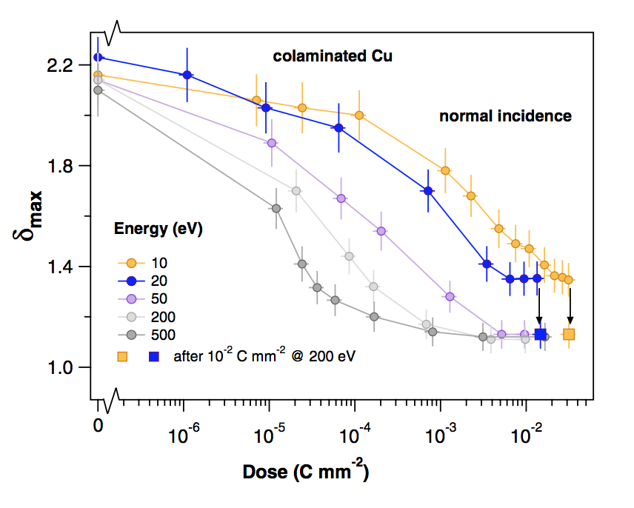
Secondary electron yield
E-cloud build-up depends crucially on the Secondary Electron Yield (SEY) :
It depends on surface properties and can be modified by surface treatments
Also the history of the surface, in particular the accumulated electron dose
  To a certain extent the e-cloud cures itself → beam induced scrubbing
Ratio between emitted and impacting electron current as a function of the energy of the impinging electrons
R. Cimino et al. Phys. Rev. Lett. 109, 064801 – 2012

Slide 5
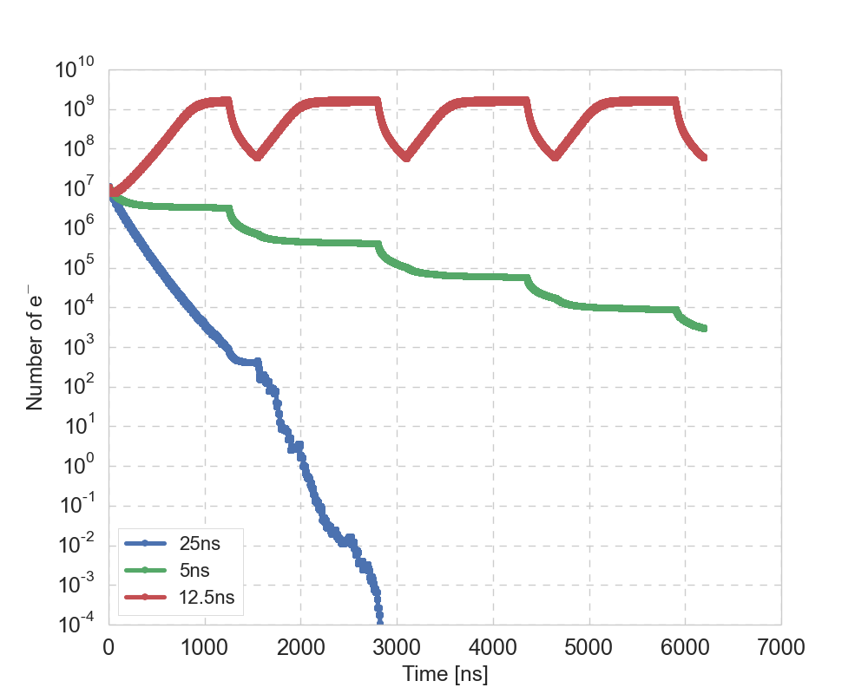
Multipacting threshold
Multipacting threshold – threshold SEY for exponential electron multiplication
  Depends on chamber geometry,
  Magnetic fields,
  Beam energy and intensity,
  Bunch spacing, train pattern
  Surface SEY …
  E-cloud build-up starting from uniform e-density for FCC-hh beams
  Multipacting thresholds from build-up simulation
  (defined as highest SEY without build-up)
 | 25 ns |  | 12.5 ns |  | 5 ns
E [TeV] | 3.3 | 50 | 3.3 | 50 | 3.3 | 50
Dipole | 1.6 | 1.6 | 1.2 | 1.2 | 1.5 | 1.4
Quadrupole | 1.2 | 1.3 | 1.0 | 1.1 | 1.1 | 1.1
Drift | 1.8 | 1.8 | 1.2 | 1.2 | 1.5 | 1.4
Dipole
SEY = 1.3

Slide 6
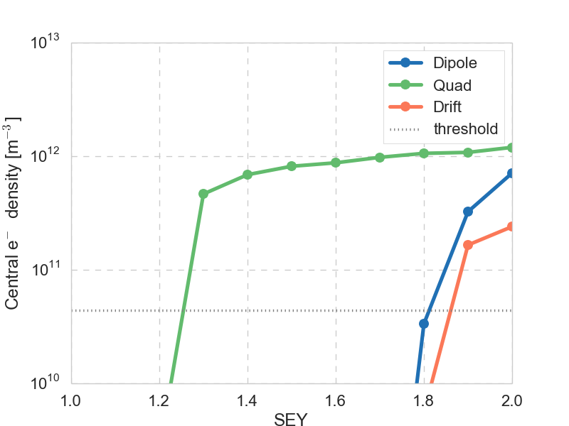
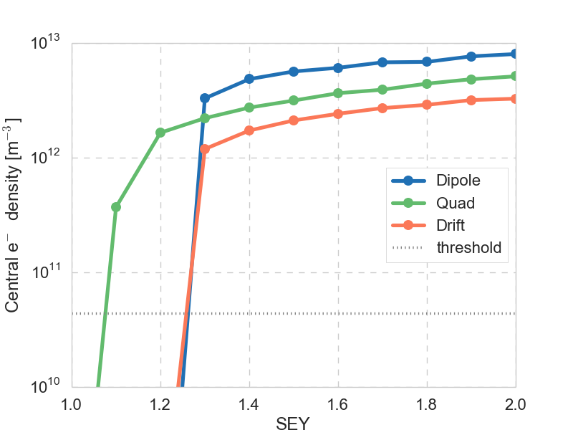
Threshold for e-cloud instability
Analytical estimate of threshold electron density for instability
  Thresholds: 6 x 10¹⁰ m⁻³ at 3.3 TeV, 3.6 x 10¹¹ m⁻³ at 50 TeV
with ,
Above the multipacting threshold, central electron densities are above the instability threshold in virtually all cases → need to stay below threshold
25 ns, 3.3 TeV
12.5 ns, 3.3 TeV
Central electron densities scaled to device length in half-cell

Slide 7
Outline
Introduction
Where is beam screen coating needed?
Constraints on photoelectron (photon) flux
Summary

Slide 8
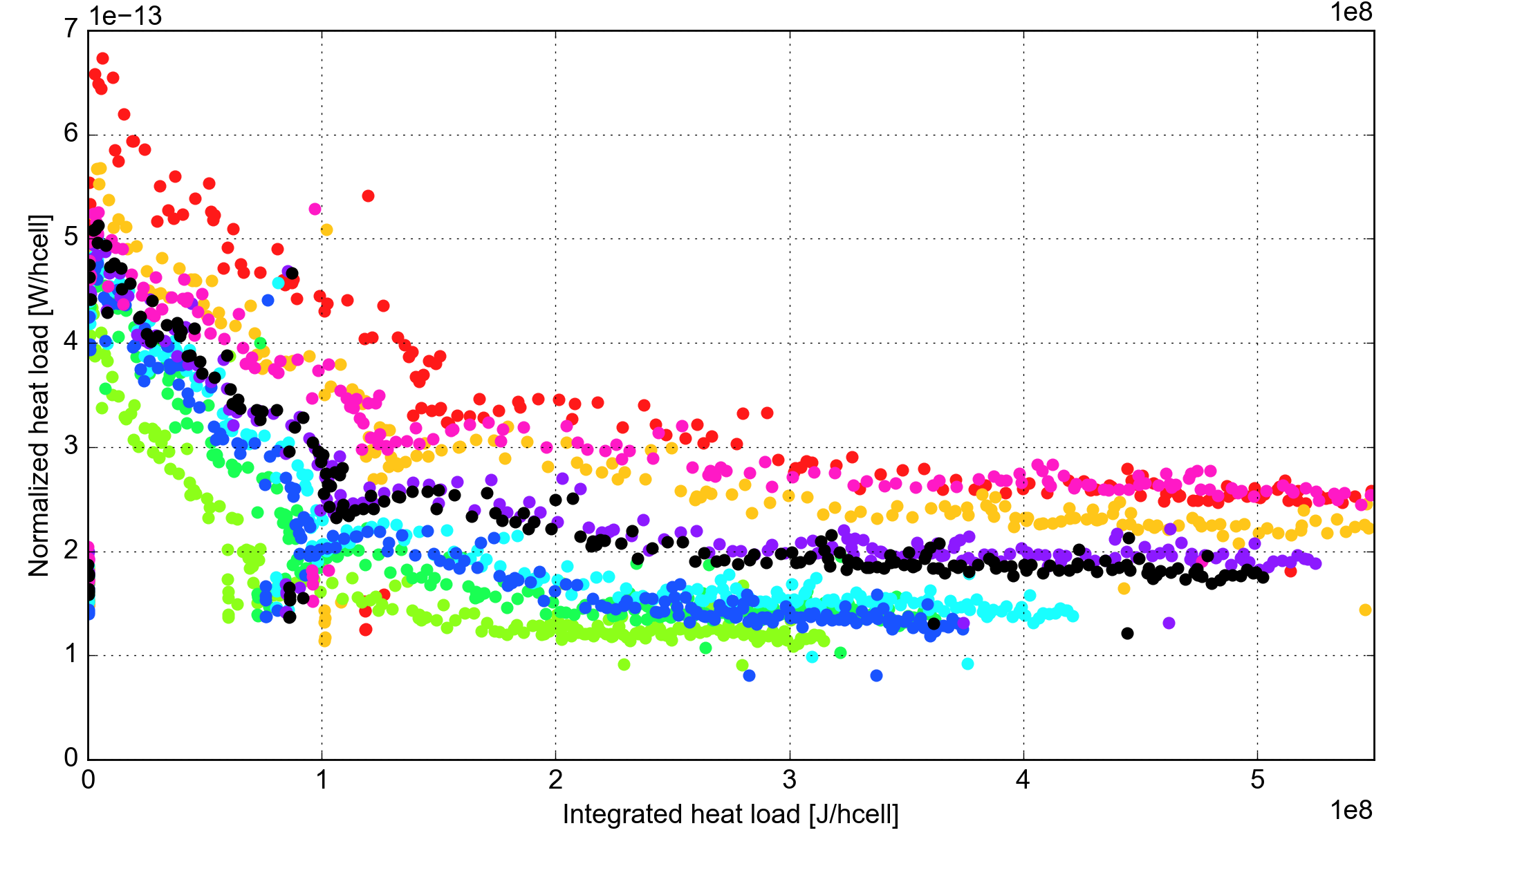
Which SEY can we assume?
In the lab SEY decreases with e-dose down to values around 1.1 – 1.2
Spending ~ 1 year of operation on lowering the SEY, can we reach SEY ~ 1.1?
  Scrubbing becomes slower for lower SEY…
  LHC relies on this assumption → doesn’t fully work!
  Current understanding indicates that some beam screens have reached ~1.1
  But others remain at 1.3 – 1.4 (after LS1), and are no longer improving
We don’t know why
Measured scrubbing curve for LHC arcs

Slide 9
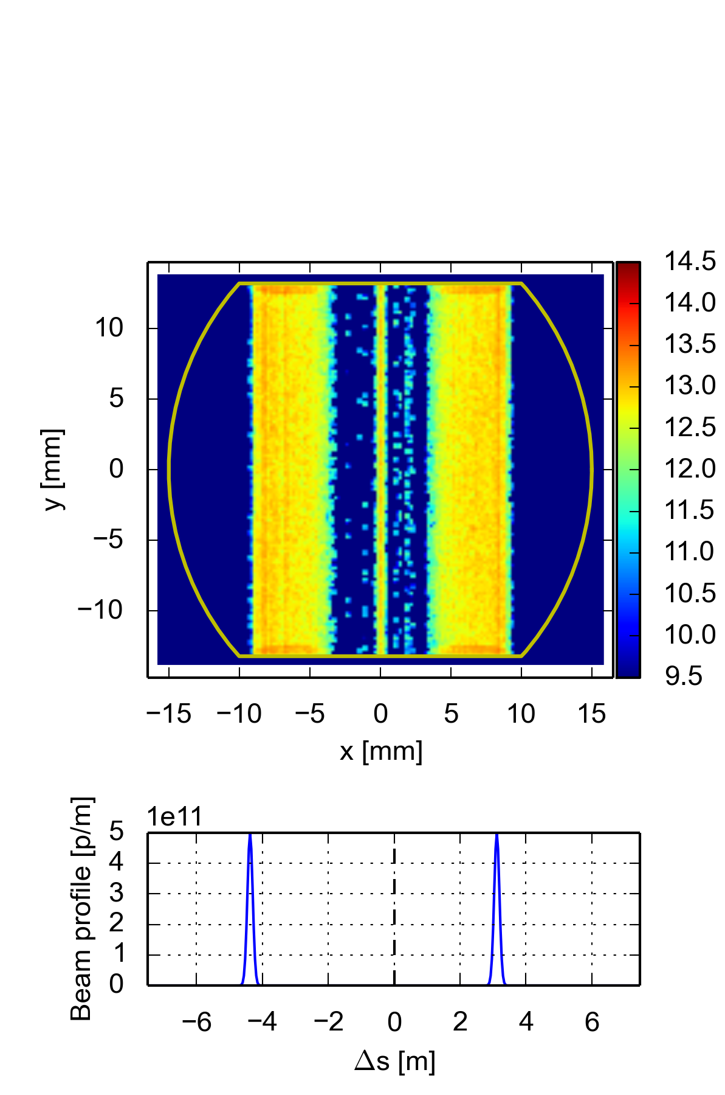
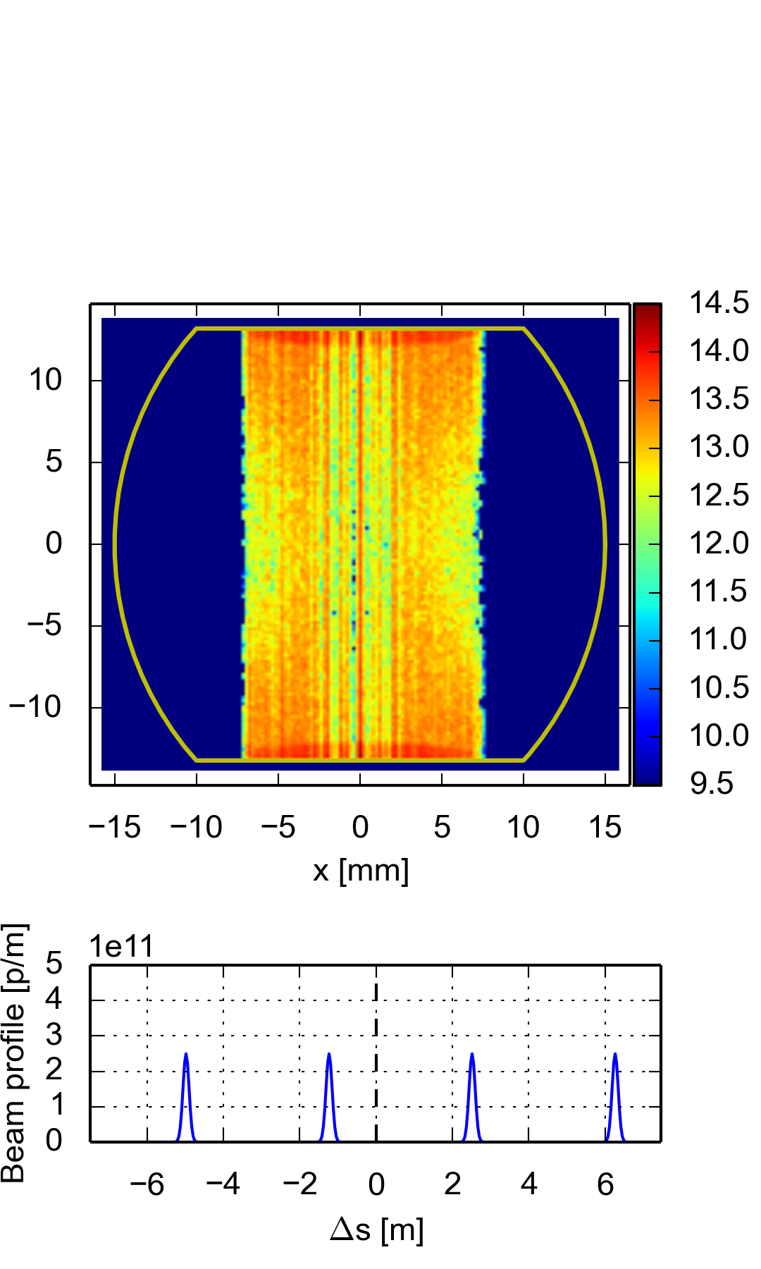
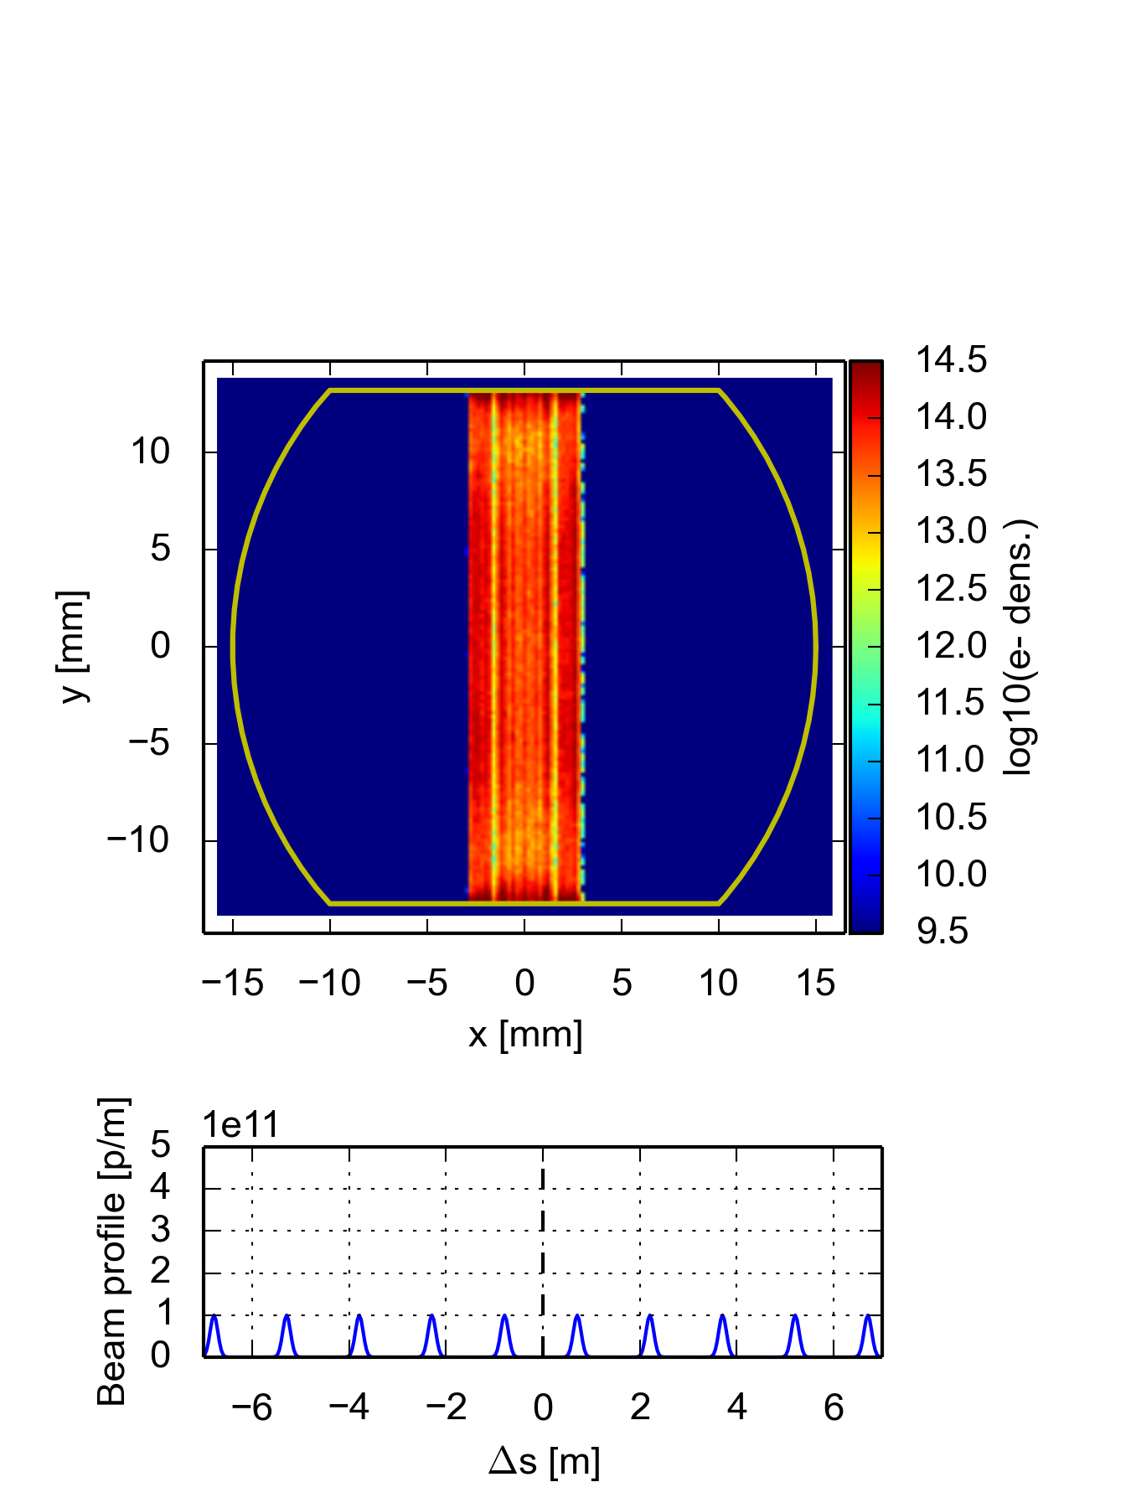
Dipoles
SEY = 1.4 should be enough for both 25 ns and 5 ns beams, 1.2 for 12.5 ns
A coating to avoid build-up for all beams should cover full top and bottom
 | 25 ns |  | 12.5 ns |  | 5 ns
E [TeV] | 3.3 | 50 | 3.3 | 50 | 3.3 | 50
SEY threshold | 1.6 | 1.6 | 1.2 | 1.2 | 1.5 | 1.4

Slide 10
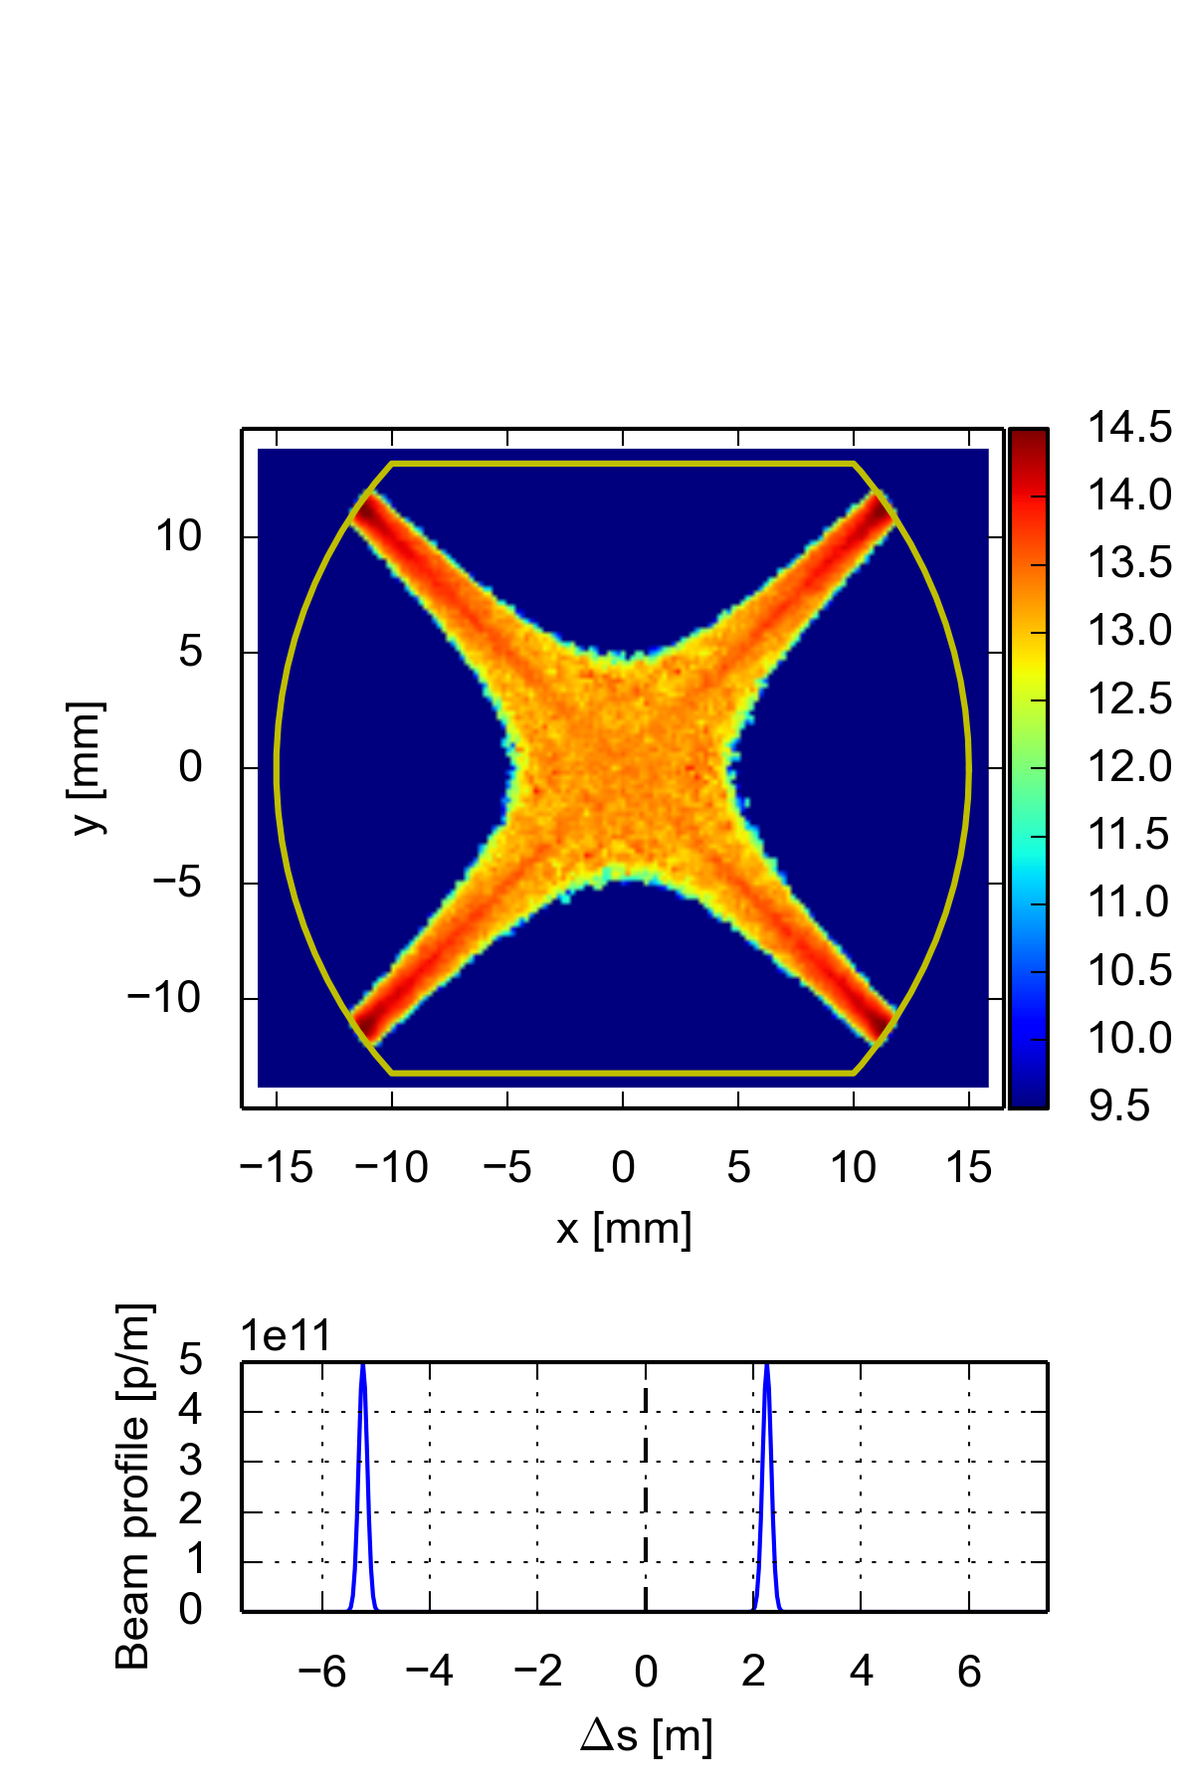
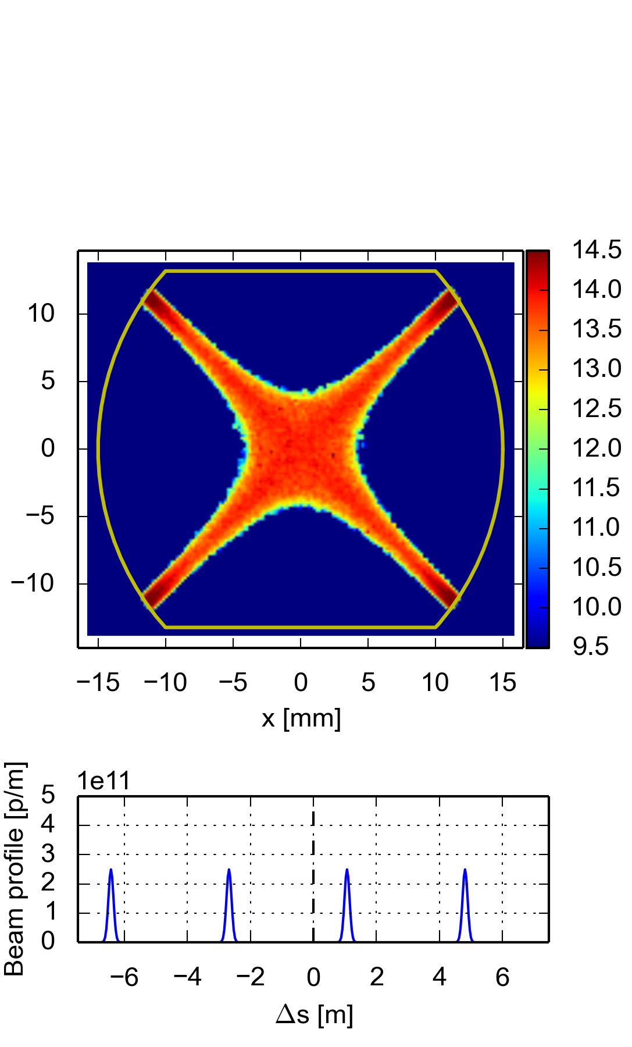
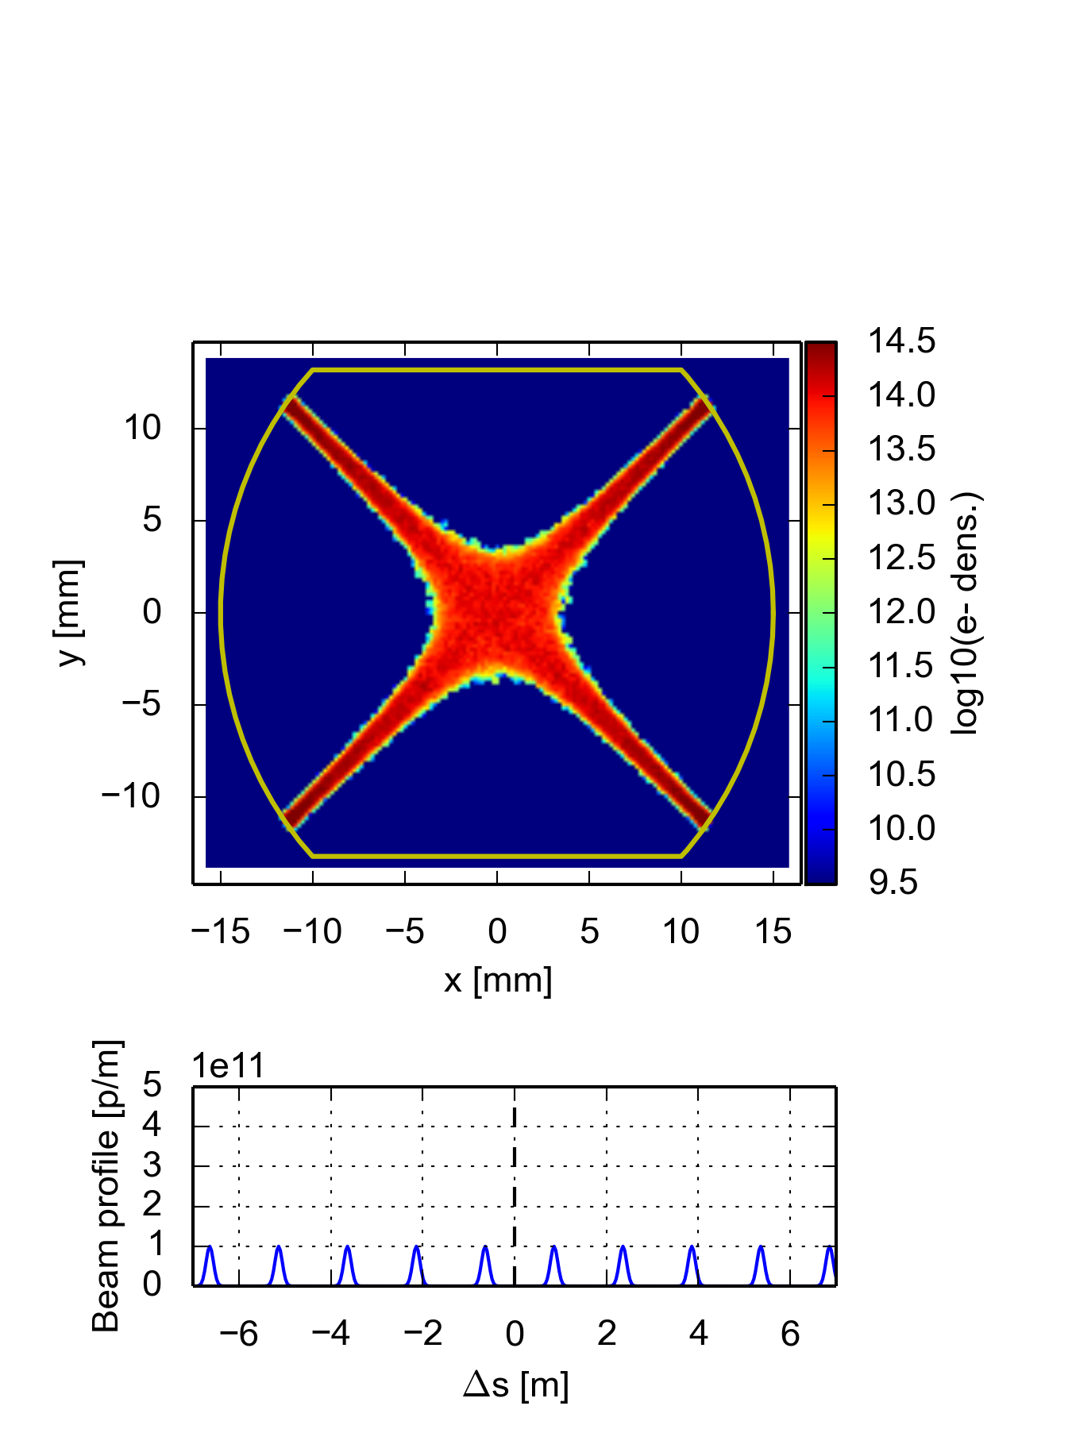
Quadrupole
For both 25 ns and 5 ns beams SEY = 1.1 OK, 12.5 ns beam requires SEY < 1.1
Coating to avoid build-up would be needed on the sides (at 45°)
 | 25 ns |  | 12.5 ns |  | 5 ns
E [TeV] | 3.3 | 50 | 3.3 | 50 | 3.3 | 50
SEY threshold | 1.2 | 1.3 | 1.0 | 1.1 | 1.1 | 1.1

Slide 11
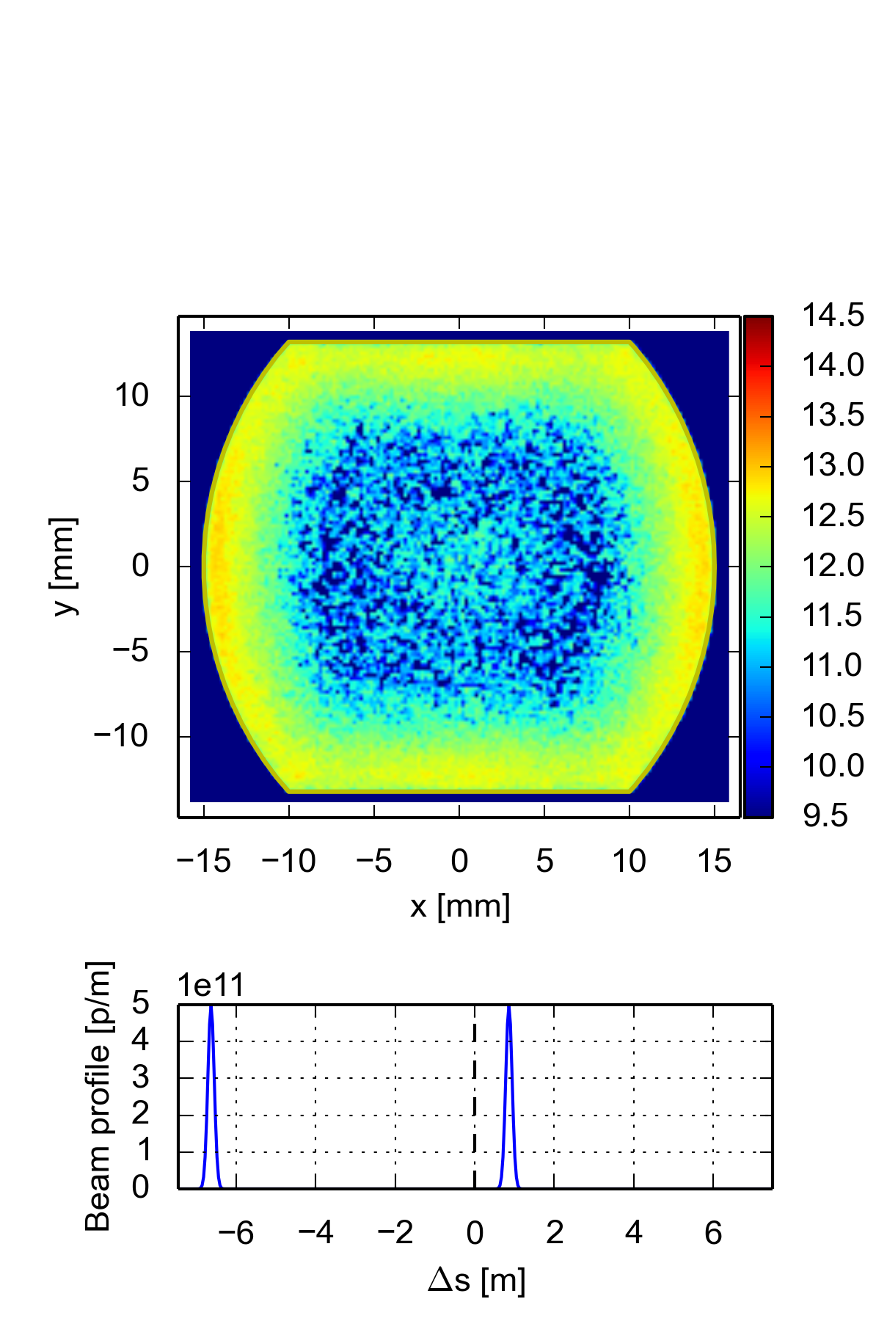
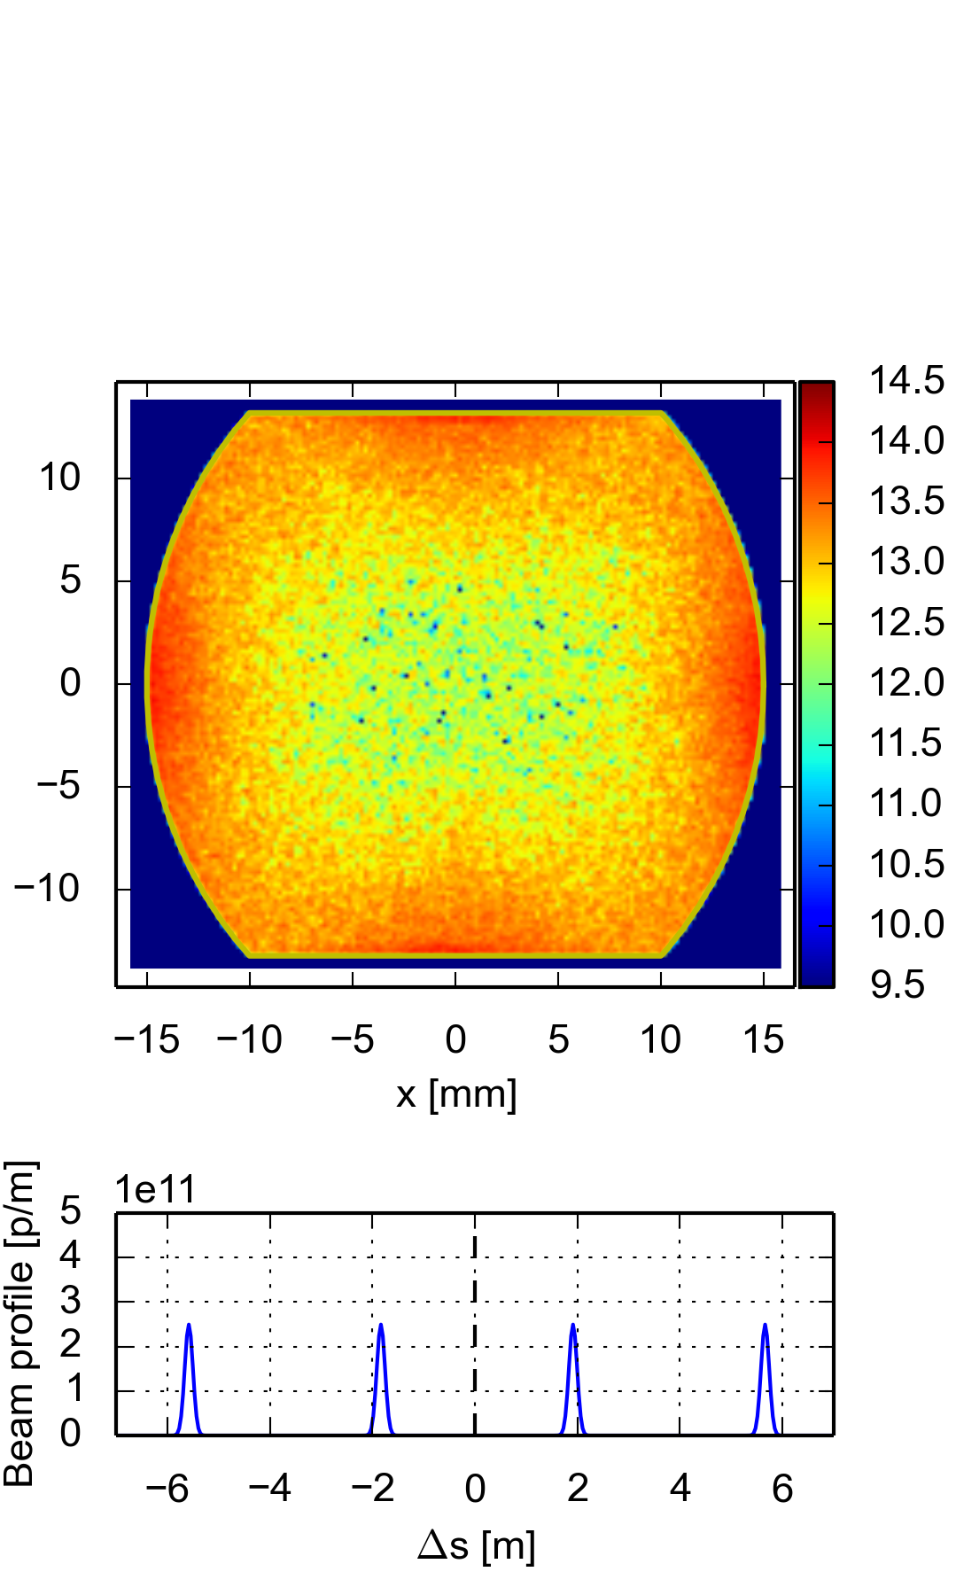
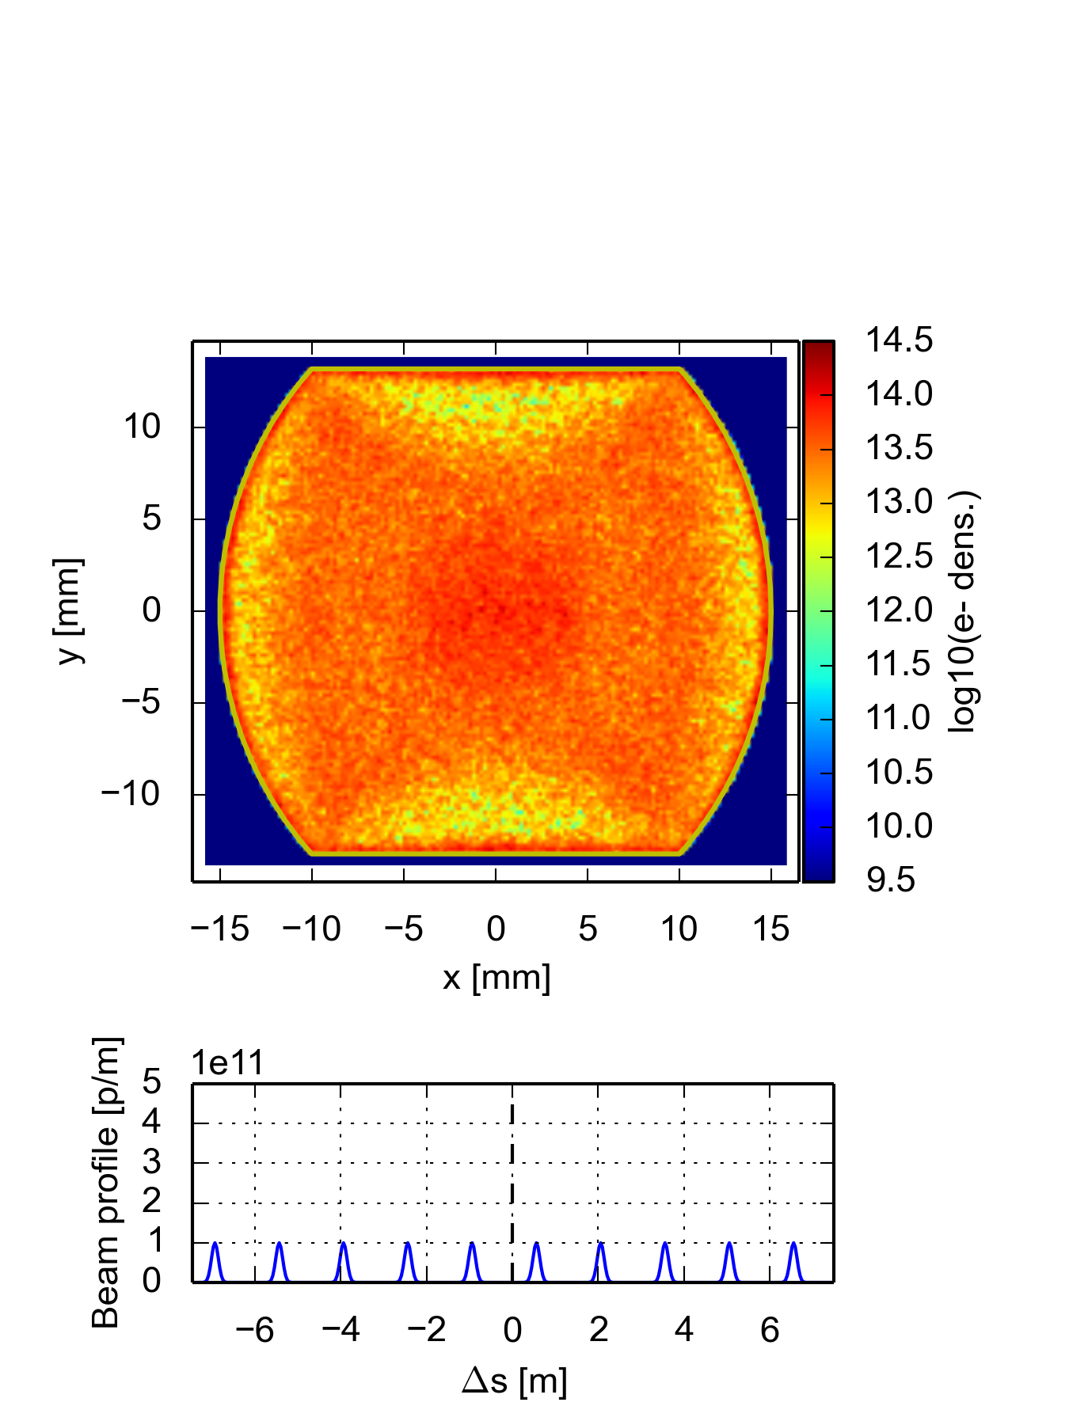
Drift
For 25 ns threshold is high → should be OK without coating (without photoelectrons)
Multipacting on all sides → studies to determine necessary fraction of coating?
 | 25 ns |  | 12.5 ns |  | 5 ns
E [TeV] | 3.3 | 50 | 3.3 | 50 | 3.3 | 50
SEY threshold | 1.8 | 1.8 | 1.2 | 1.2 | 1.5 | 1.4

Slide 12
Outline
Introduction
Where is beam screen coating needed?
Constraints on photoelectron (photon) flux
Summary

Slide 13
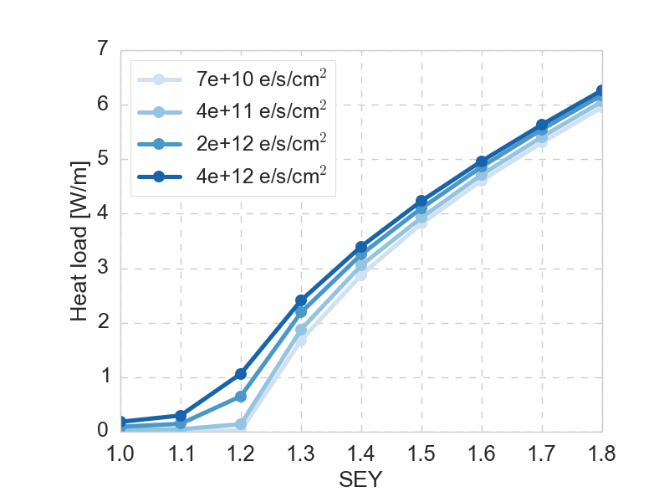
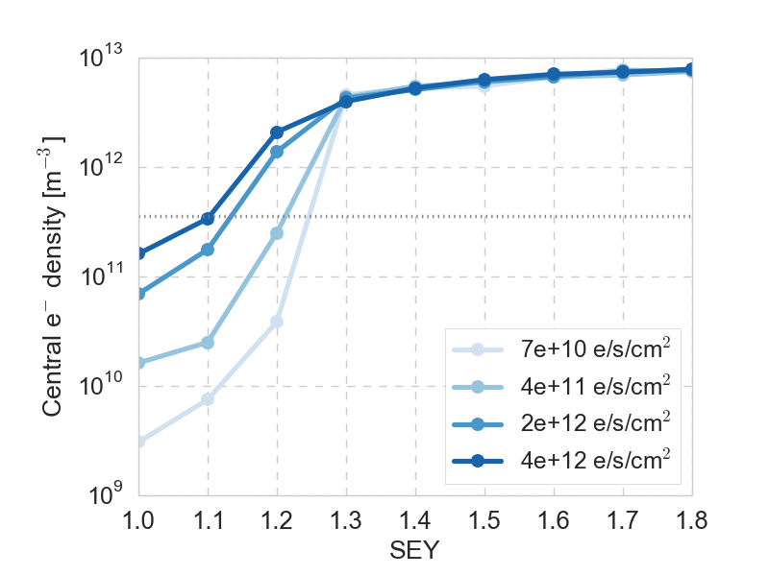
Effect of photoelectrons
The photoelectrons have a marginal effect on heat loads, but a significant effect on central densities below the multipacting threshold
  Even with low SEY, electron densities can reach instability threshold due to photoelectrons, especially for the 12.5 and 5 ns beams
N_{e} main chamber
N_{e} main chamber
12.5 ns, 50 TeV
Dipole
12.5 ns, 50 TeV
Dipole
Heat load and central electron densities scaled to device length in half-cell

Slide 14
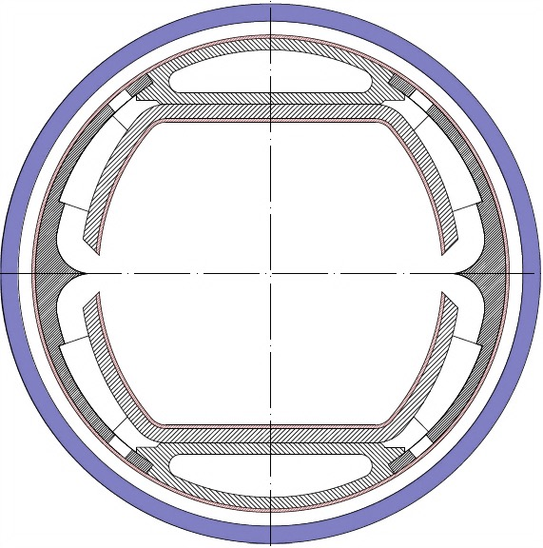
Photoelectrons in simulations
In the build-up simulations, a given number of photoelectrons are generated for every bunch
These electrons are initialized around the chamber with a cos² distribution w.r.t. the angle φ from the SR impact point
Modifications of the code to allow
for e.g. a fixed number of electrons
per chamber surface is on the list
of things to do, but not yet
implemented
φ

Slide 15
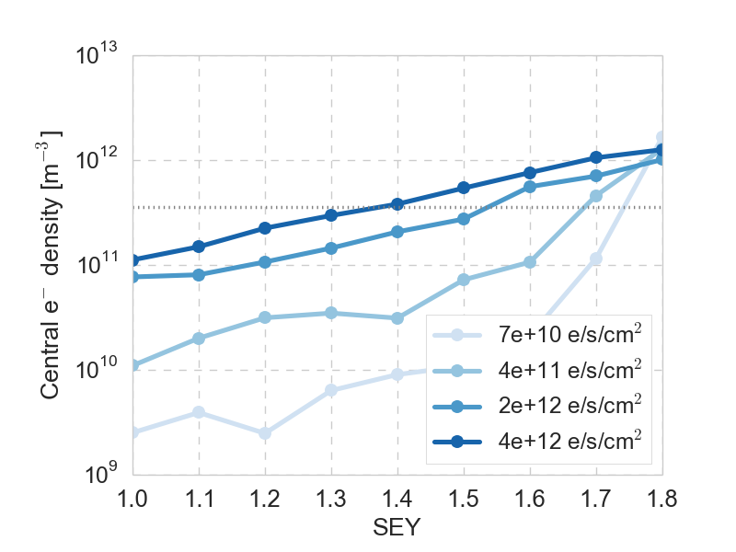
Dipoles
Effect of the number N_{pe} of initialized photoelectrons on central electron densities compared to the analytical threshold density for instability
The corresponding photon flux N_{γ} into the chamber is determined by the photoelectron yield Y:
N_{pe} = Y * N_{γ} N_{γ} = N_{pe} / Y
E.g for SEY = 1.1 and Y = 0.2 a photon flux of 2e13 p/s/cm² hits the threshold for 12.5 ns
25 ns, 50 TeV
Dipole
threshold
N_{pe} main chamber
N_{pe} main chamber
12.5 ns, 50 TeV
Dipole
Central electron densities scaled to device length in half-cell

Slide 16
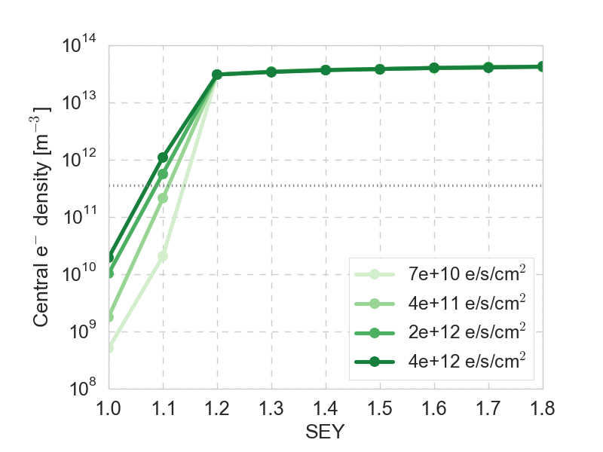
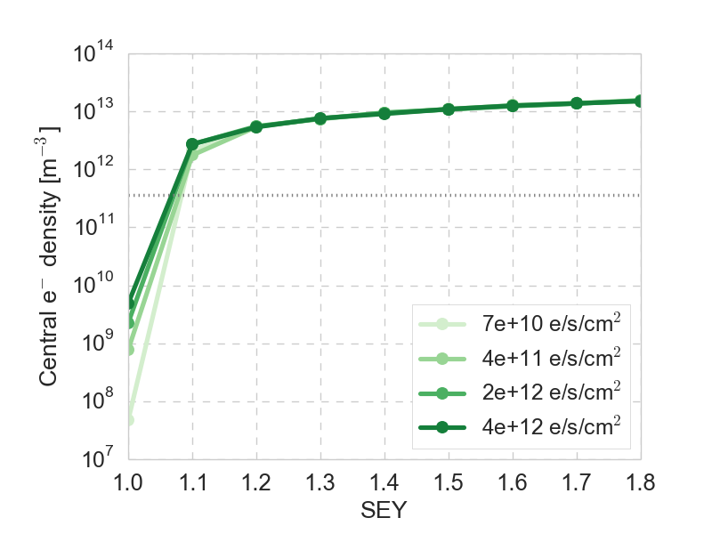
Quadrupoles
In the quadrupole the multipacting thresholds are already very low
It is mainly for the 5 ns beam that the photoelectrons could be a danger
  E.g. for SEY = 1.1 and Y = 0.2, a photon flux of 1e13 p/s/cm² is too high,
  and 2e12 p/s/cm² is very close
N_{pe} main chamber
N_{pe} main chamber
5 ns, 50 TeV
Quadrupole
12.5 ns, 50 TeV
Quadrupole
Central electron densities scaled to device length in half-cell

Slide 17
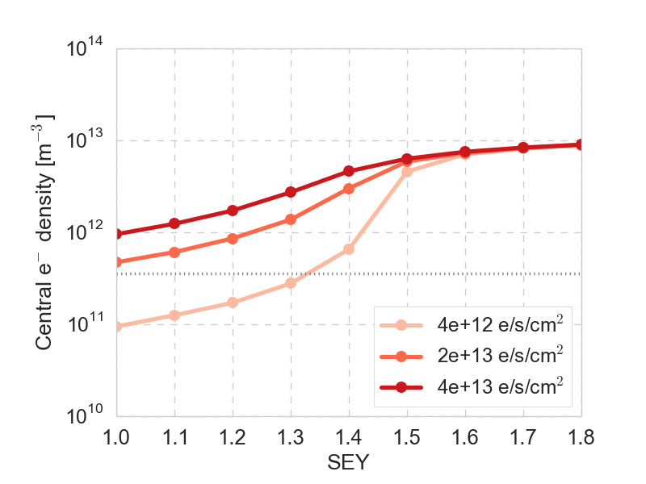
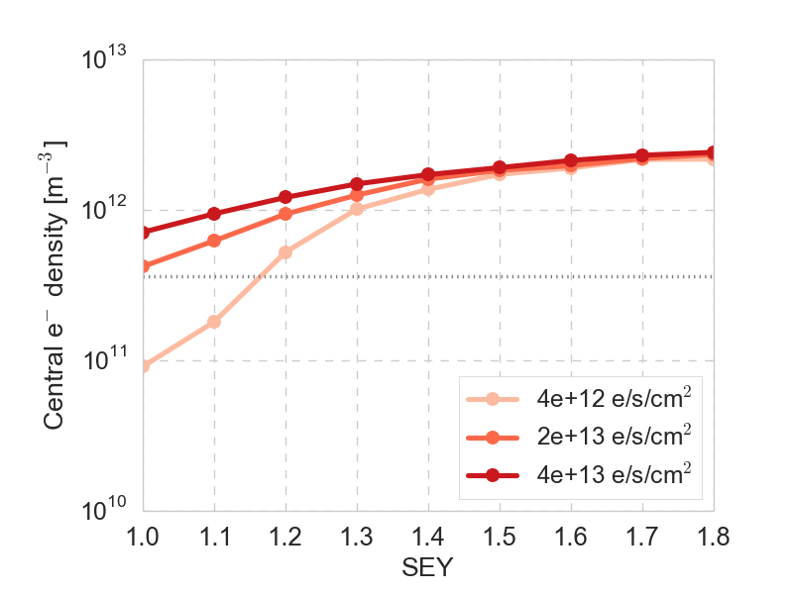
Drift
In drifts, also photoelectrons produced in ante-chamber may move into main chamber and lead to increased electron density
  Here electrons are initialized at the slit to mimic this effect (the electron numbers include these electrons)
  Eventually simulations including the slit should be done to study the effect dynamically
N_{pe}
N_{pe}
5 ns, 50 TeV
Drift
12.5 ns, 50 TeV
Drift
Central electron densities scaled to device length in half-cell

Slide 18
Summary
Which parts of the beam screen need to be coated to avoid electron cloud depends strongly on the assumptions of the SEY behavior
  In all cases, the 12.5 ns beam sets the most stringent constraints → relevant to know if this beam option is excluded
In the quadrupoles SEY <= 1.1 is required in any case (SEY < 1.1 for 12.5 ns)
  This would require a coating on the sides of the beam screen (at 45 degrees)
Constraints on photoelectrons/photons depend on the photoelectron yield
  For most cases about 1% of SR photons in the chamber should be acceptable
  The dipoles with 12.5 ns beam, and quadrupoles with 5 ns beam set the strongest constraints
  The drifts require further studies (also chamber shape etc should be known)
The results depend on many assumptions, and are not final

Slide 19
Thank you

Slide 20
Simulation overview
Beam parameters
Bunch spacing [ns] | 25 | 12.5 | 5
Bunch intensity [p⁺] | 10 x 10¹⁰ | 5 x 10¹⁰ | 2 x 10¹⁰
Norm. emittance [m] | 2.2e-6 | 1.1e-6 | 0.44e-6
Bunch length [m] | 0.08
Bunch train pattern | (50b + 12e)*4 | (100b + 24e)*4 | (250b + 60e)*4
Main chamber of FCC beam screen
(2015 version), with Cu surface
Arc elements
 | Dipole | Quad | Drift
Field | 16 T | 444 T/m | -
Length [m] | 171.6 | 12.6 | 26.6

