Slide 1
Status of FCC-hh
collimation studies
R. Bruce
On behalf of many colleagues…
Notes:
1
1

Slide 2
Collaboration
Talk based on material from, and discussions with:
CERN
  W. Bartmann, S. Arsenyev, I. Besana, F. Burkart, F. Cerutti, M. Fiascaris, B. Goddard, A. Krainer, A. Langner, A. Lechner, A. Mereghetti, D. Mirarchi, J. Molson, S. Redaelli, D. Schulte, E. Skordis, M. Varasteh, Y. Zou
IN2P3: LAL and IPNO
  LAL: A. Faus Golfe, J. Molson (until 30/09/2017)
  IPNO: L. Perrot
  possible participation of LAPP-Annecy is under negotiation and a new PhD will join the LAL team
FNAL
  Y. Alexahin, E. Gianfelice, N. Mokhov, A. Narayanan, M. Syphers
Apologies if I forgot anyone – please let me know!

Slide 3
Roles of collimation system
Provide sufficient betatron cleaning to avoid spurious dumps and quenches, and without risk of collimator damage
  Injection and top energy
  Machine aperture needs to be sufficiently far behind collimator
Provide sufficient momentum cleaning
Provide passive protection in case of failures
  Asynchronous beam dump, injection failures ….
Help in optimizing the background from the machine to the experiments
Protect machine elements from damaging radiation dose: concentration of dose in controlled areas
All while keeping impedance under control

Slide 4
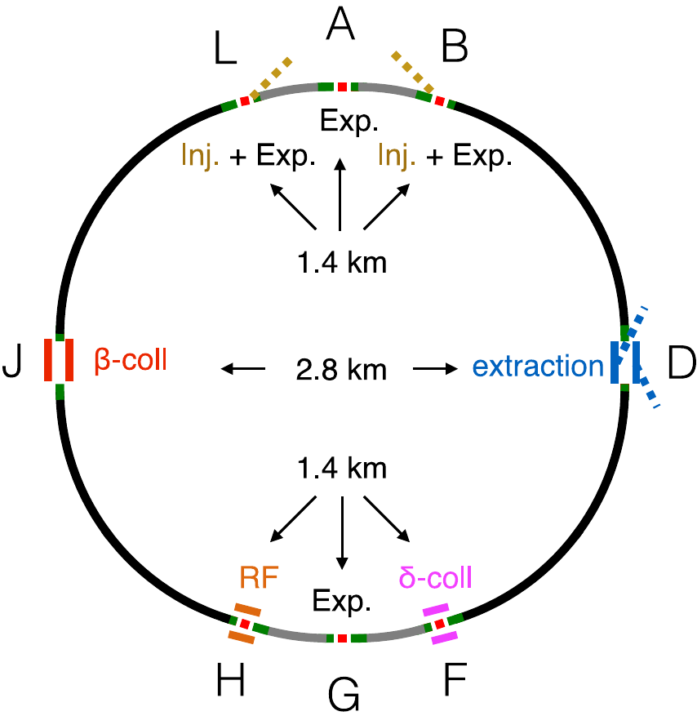
FCC collimation insertions
First design of FCC-hh collimation system is a scaled up version of the LHC system (M. Fiascaris, S. Redaelli et al.)
  Betatron collimation in IPJ
  Momentum collimation in IPF

Slide 5
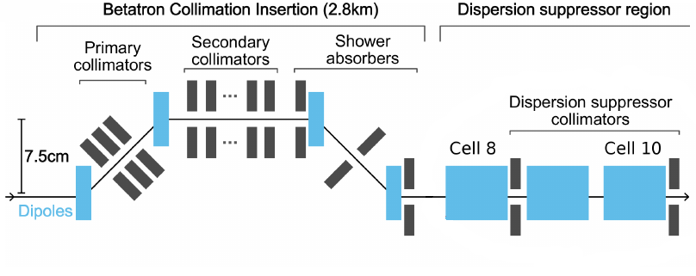
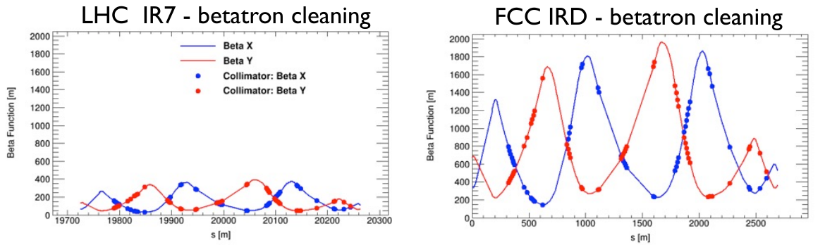
Betatron collimation design
Keep layout, design and material of LHC collimators
Scale β-functions and insertion length by factor 5 from the LHC
M. Fiascaris, R. Tomas

Slide 6
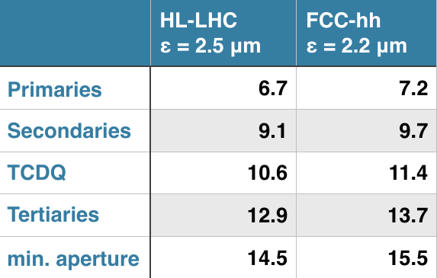
Baseline collimator settings
Present baseline for betatron collimation - scaled from HL-LHC

Slide 7
Betatron cleaning
Has been the priority so far
Most critical case for quenches: top energy
Worst case assumed: beam losses during a lifetime drop to 12 minutes, corresponding to a beam power of 11.8 MW at 50 TeV
  Very challenging for the collimation system
First step: tracking studies for loss maps
Output: losses on aperture and collimators around the ring

Slide 8
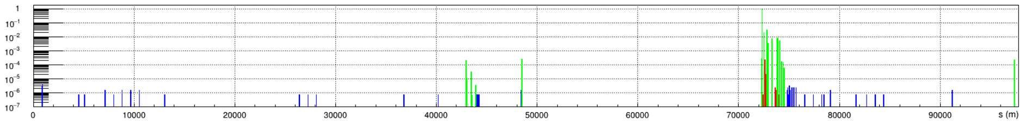
Tracking simulations for loss maps
Comparison of different scattering models - see talk J. Molson
Leakage of losses from betatron collimators in IPJ most critical in downstream dispersion suppressor
IPF
IPG
IPJ
IPA
Local cleaning inefficiency (1/m)
S(m)
J. Molson et al.
Example: betatron cleaning, on-momentum, horizontal plane, lattice as of May 2017,
FLUKA scattering

Slide 9
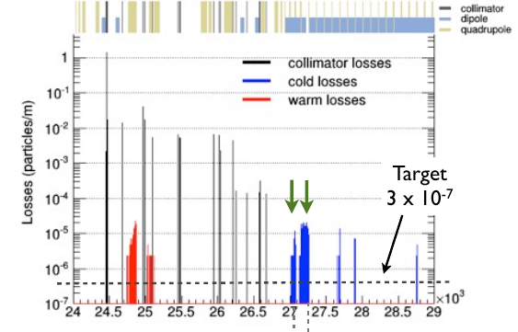
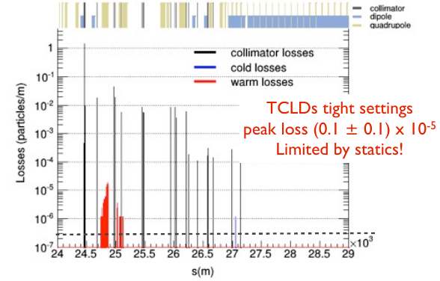
Protection of the DS
Most critical location for losses: DS of IPJ
As for HL-LHC, introduce additional collimators (TCLDs) in the DS to catch these losses
No TCLDs
With TCLDs
Example: horizontal betatron cleaning
M. Fiascaris et al., Rome 2016

Slide 10
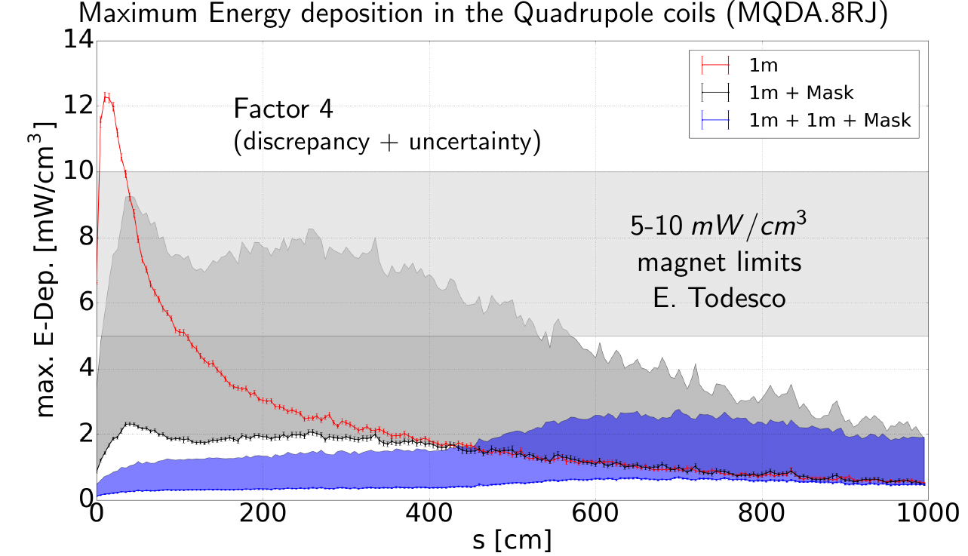
Energy deposition in the DS (cold magnets)
FLUKA studies of energy deposition needed to assess quenches – more details in talk A. Krainer
IPJ DS (and all other cold elements) sufficiently protected by present collimation system
Betatron cleaning
A. Krainer et al.

Slide 11
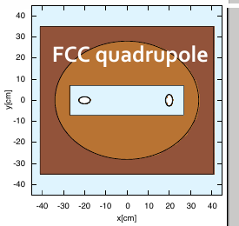
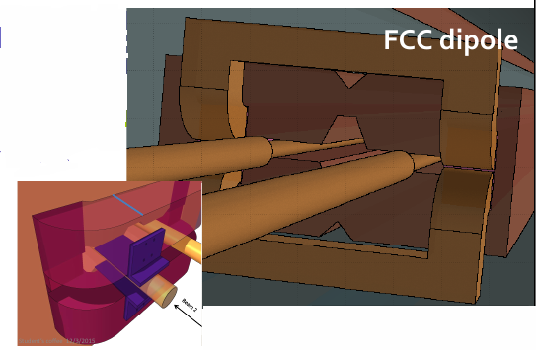
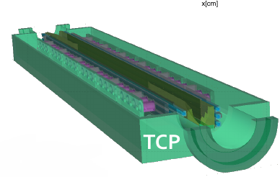
FLUKA studies of warm insertion
Can the collimation system and warm elements absorb the large power load?
FLUKA geometry of warm insertion region implemented
FLUKA studies performed of energy deposition in the warm insertion (I. Besana et al.) using tracking as starting conditions
I. Besana et al

Slide 12
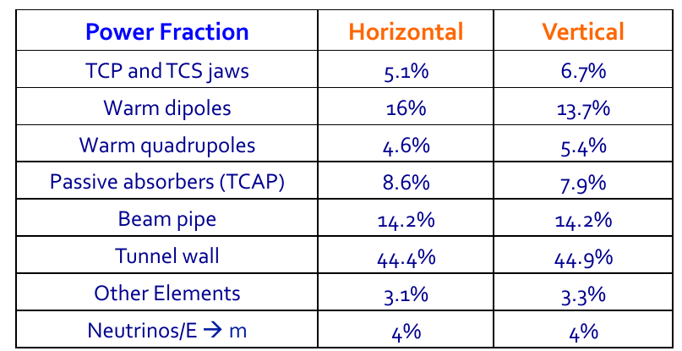
Energy deposition in collimation insertion
Sharing of power: betatron losses
As in LHC, only a small amount of total power is deposited in the collimators
I. Besana et al.

Slide 13
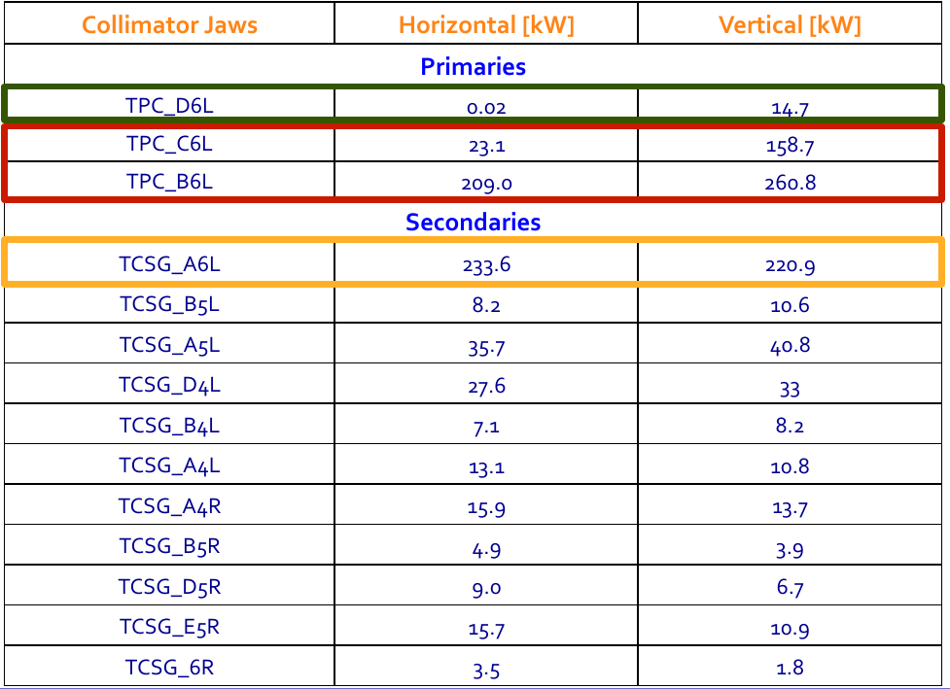
Power on collimators
Only primary collimators and the first secondary seem very critical
I. Besana et al.

Slide 14
Potentially critical elements under study
Primary collimators: shortening the length could improve the load
Warm dipoles: Can add shielding exchange at front face. Cooling / radiation damage to be studied
Passive absorbers: Needs more detailed studies on design / cooling
Tunnel wall absorbs almost half of energy deposited
  Should study activation and dose
First secondary collimator: thicker jaws decrease power load

Slide 15
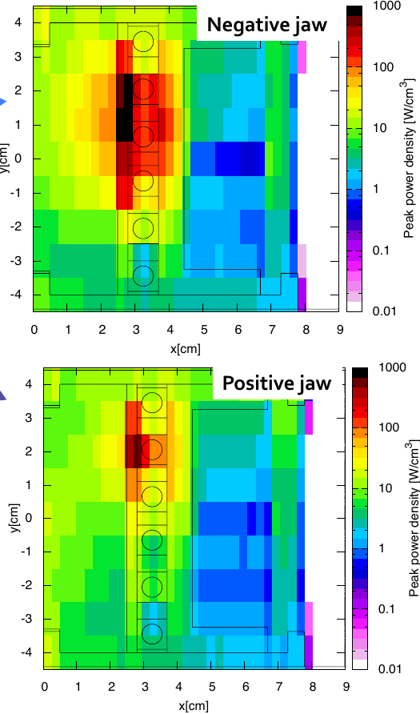
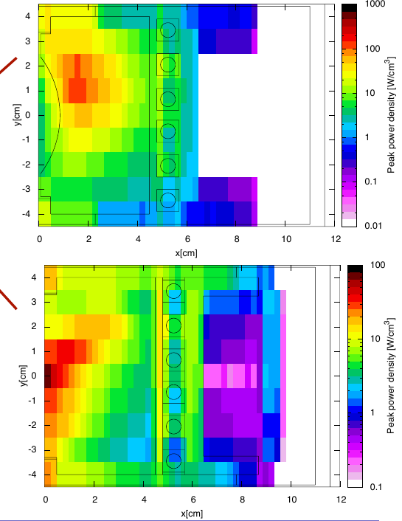
Secondary collimator: try thicker jaws
Energy deposition peak is not in active part of the jaw but in metallic plate
  Try to make the jaw thicker to distribute energy more in low-Z active part
Thicker jaws
I. Besana et al.

Slide 16
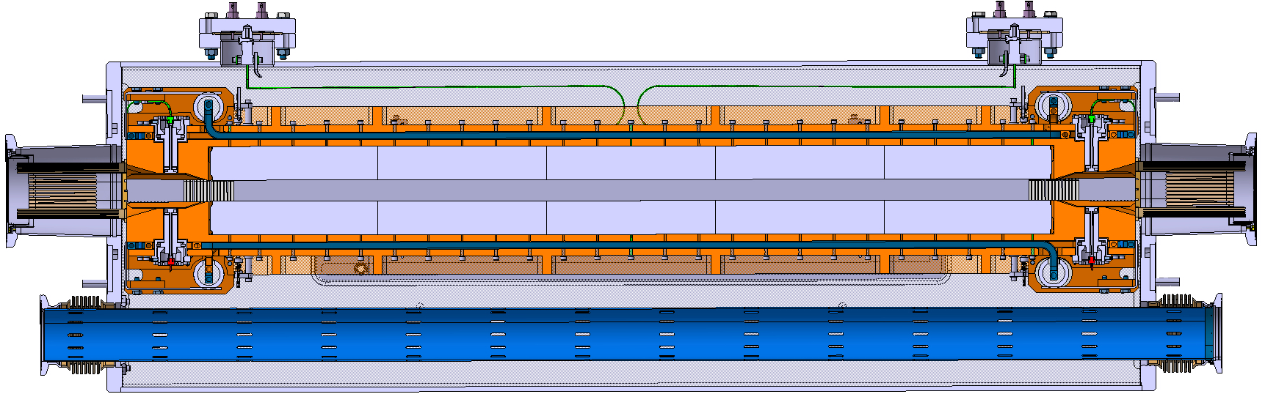
Design of thicker jaws for HL-LHC
Collimator design with thicker jaws feasible - anyway developed for HL-LHC (TCLX)
  171
  ±5
Bellow
Chamber support
New BPM
RF contact
L. Gentini et al.

Slide 17
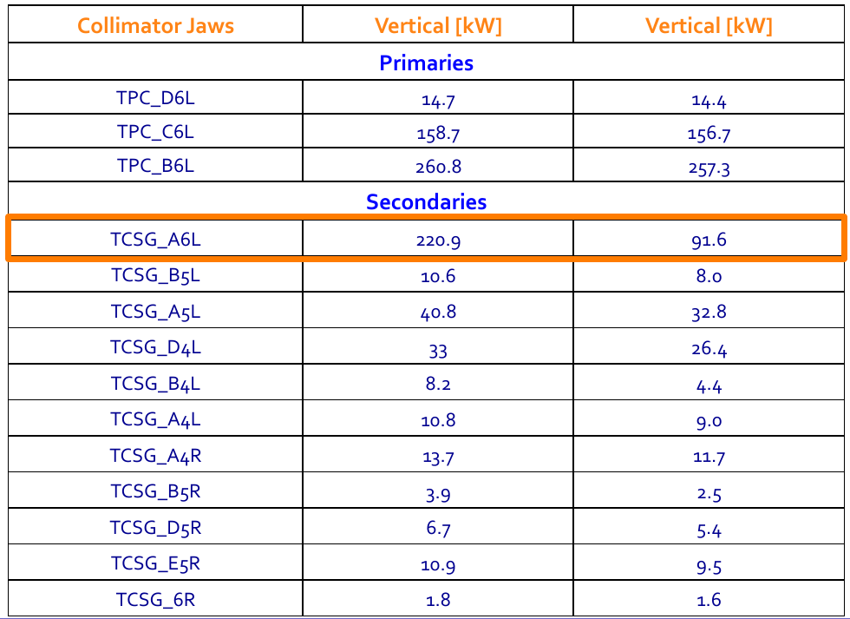
Power on collimators, thicker TCSG
Total load on worst TCSG reduce by more than factor 2
LHC jaws
Thicker jaws
I. Besana et al.

Slide 18
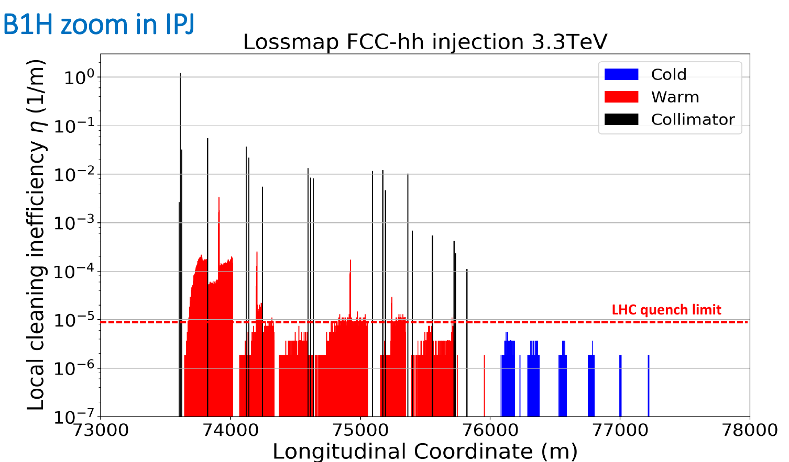
Betatron cleaning at injection
Obviously less critical than at top energy
Does not seem too problematic even without DS collimators
Y. Zou
Lattice version 8
On-momentum

Slide 19
Aperture at injection
Geometrical aperture more critical than at top energy due to larger emittance
  Studies A. Langner: using 15.5 sigma criterion for allowed aperture from HL-LHC, we are not within spec (13.2 sigma for the arc, and 11.4 sigma for the DS)
Needs to be fixed! Possibilities:
  Study stricter tolerances on optics, orbit, alignment than for HL-LHC.
  Calculations of realistic losses for FCC, comparing with FCC quench limit, to refine criterion of allowed aperture - ongoing
  Tighten cleaning hierarchy to allow smaller aperture.
  Work on the beam screen design of the elements

Slide 20
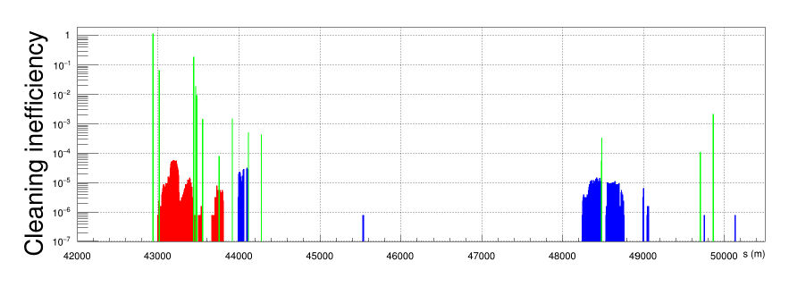
Momentum cleaning
Tracking studies at top energy show significant losses upstream of experiments – possible need for re-optimization of system
  Requirements less stringent for momentum cleaning at top energy
Possibly most critical case: losses at start of ramp.
  Proposed specification: Tolerate 1% beam loss over 10 s
  Studies at injection ongoing
Ongoing effort at Fermilab to improve energy collimation. See talk Y. Alexahin
J. Molson et al.
Lattice v8, Dp/p = 1E-3, 50 TeV

Slide 21
Failure cases
Studies starting in collaboration with the injection and dump team (F. Burkart, B. Goddard, E. Renner, W. Bartmann et al.)
Asynchronous beam dump at top energy could potentially be very critical
  Miskicked protons escaping the dump protection collimators risk to damage machine elements
  Has been a main limitation for the LHC performance reach
Planned to soon start detailed tracking studies
Injection failure: to be discussed with injection team
Other failure modes?

Slide 22
Summary
Betatron cleaning at top energy
  Cleaning efficiency and energy deposition in cold magnets under control
  Energy deposition on collimators and warm magnets: some open points but good hope to solve them in next iterations
  Aperture at injection is not sufficient– several ideas being investigated, good hope to find a solution
Momentum collimation:
  Studies ongoing. Optimization of layout/optics might be needed, but less critical than betatron cleaning
Beam failures:
  Studies now starting in collaboration with dump team
Points for future study: activation, radiation damage, design of shielding / absorbers, further optimization of optics, advanced collimation concepts (electron lens, crystals… )

