Slide 1
Energy collimation studies
Yuri Alexahin (on behalf of FNAL – NIU team)
EuroCirCol meeting
9 October 2017

Slide 2
The Team
N. Mokhov & M. Syphers (NIU) – leaders,
E. Gianfelice-Wendt – optics design
Y. Alexahin – optics & collimation arrangement design
I. Tropin – MARS simulations & collimation arrangement design
A. Narayanan (NIU PhD student) – G4beamline and MARS simulations

Slide 3
Optics Modifications
IPF @ 44.6km
- 43km
- 43km
Left: The starting optics is Collider dev/fcc hh dev.seq as found back in June 2017
Right: Eliana’s optics modification – the merit factor D_{x}²/β_{x} increased by 7 times

Slide 4
Quadrupole Strength Modification

Slide 5
Optics Functions @ Collimators
Original design
Eliana’s design

Slide 6
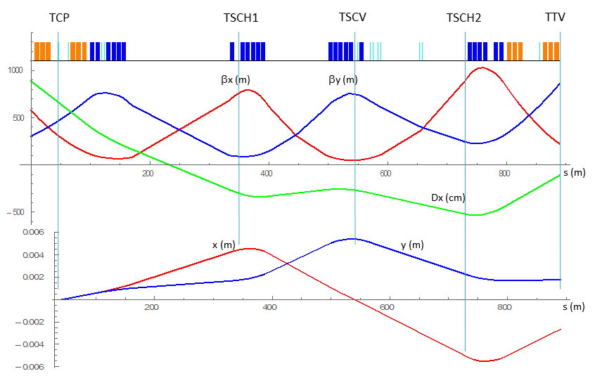
Warm Section Optics
Optics functions in warm section (from bpm.6l3.b1 to bpmwc.6r3.b1) and trajectories of particles scattered in the primary collimator by 10μrad

Slide 7
Collimators for Preliminary Study
name | collim. plane | length (m) | position from warm start (m) | jaw distance (mm) from centerline | jaw angle (μrad) w.r.t. centerline
TCP | h | 2.5 | 43.75 | 10 | -72.75
TSCH1 | h | 2.5 | 343.0 | 5 | 0
TSCV | v | 2.0 | 545.47 | 3.6 | 0
TSCH2 | h | 2.5 | 732.82 | 9 | 0
TTV | v | 1.5 | 888.65 | 2.5 | 0
Important Note:
Generally the contribution to the transverse impedance goes as β_{x,y}/gap³, so for horizontal momentum collimator Z_{x} ~ β_{x} /D_{x}³, while for the vertical Z_{y} ~ 1/β_{y}^{1/2}.
In Eliana’s design both contributions are smaller!

Slide 8
G4beamline* Simulations
The goal of the study was to see if it is possible to eliminate protons with relative momentum deviation δ_{p} larger (by absolute value) than δ_{max}=0.0015 not allowing scattered protons with transverse amplitudes larger than 12σ at 50 TeV to escape.
A G4BL input file was built that includes warm magnets and collimators as described on slides 2-3 which act on dp/p < 0 part of the halo. The gaps were calculated for δ_{max}=0.0015
Three values of dp/p were chosen: -0.0016, -0.0015 and -0.0014
For each dp/p value an ensemble of 10⁴ particles was built based on MADX values of optics functions at the warm section entrance as
where the initial phases ψ_{x,y} were randomly distributed in the interval (0, 2π), while action variables I_{x,y} were distributed according to the exponential law with the average ε⊥=4.1*10⁻¹¹m and truncation at 5σ amplitude (I_{x,y} =12.5ε⊥).
Protons that reached the end of the warm section were analysed.
*) T. Roberts, http://g4beamline.muonsinc.com

Slide 9
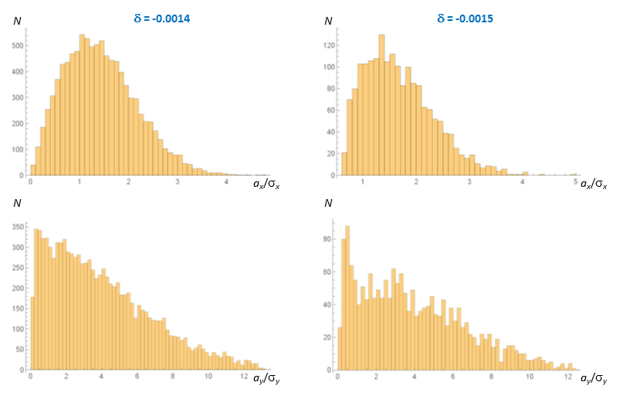
G4BL Tracking Results (30k protons total)
Distribution in the transverse amplitudes of surviving particles at the warm end, none survived of those with δ = -0.0016

Slide 10
Next steps
Limitations:
Present shape and dimensions of collimators and magnets are too simplistic.
Magnets work as “black holes”: kill all particles entering iron.
No beamline enclosure, instead some disc absorbers put to kill off particles with large amplitudes.
Only 50 TeV case considered
To-do list with G4BL
More realistic configuration of collimators (may be shorter C + metallic?)
More realistic sizes of the magnet iron yokes (w/o “kill” option)
Additional absorbes for secondaries and low energy protons
Energy deposition in collimators and magnets (“totalEnergy” command)
Injection energy case
Draft of the report
MARS model and simulations

Slide 11
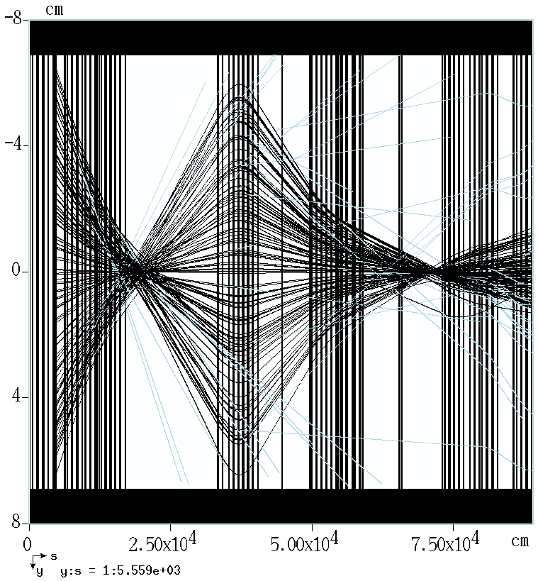
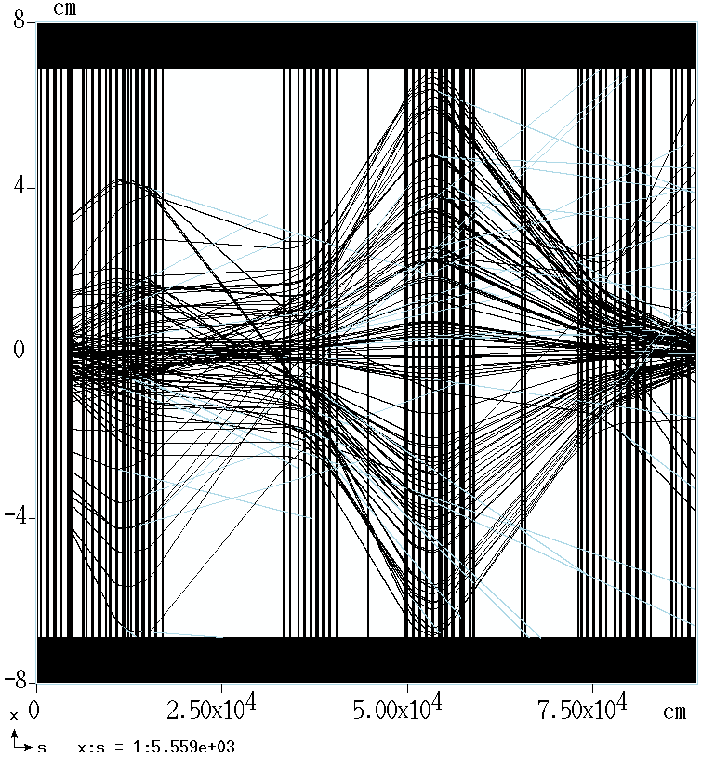
MARS Unleashed!
Lattice file for warm section was created and checked by tracking protons with original collimators (?)
Proton trajectories in horizontal (left) and vertical (right) plane. MARS notations differ from conventional x ↔ y

Slide 12
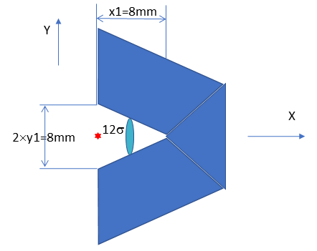
TSCV (the right half) used in G4BL simulations
Since there is no elliptic apertures in G4beamline I had to invent something that would produce smaller impedance and collimate particles with large |dp/p| tighter:
beam center
Schematic view of the cross-section of the right half of the TSCV collimator acting on protons with δ_{p} < 0. The red star shows the beam center while the teal ellipse shows the 12σ envelope for δ_{p} = ‑0.0015.

