Slide 1
New Triplet and EIR Optics
Léon van Riesen-Haupt
on behalf of the JAI FCC team

Slide 2
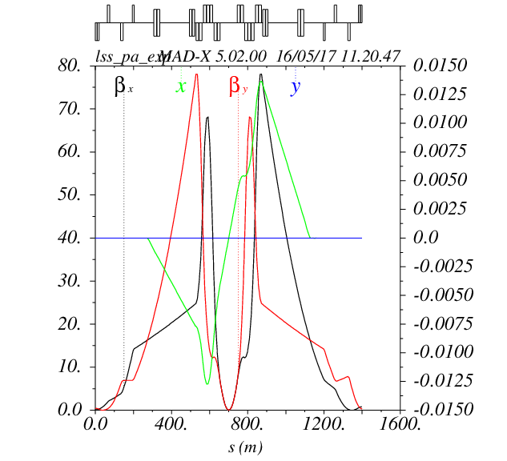
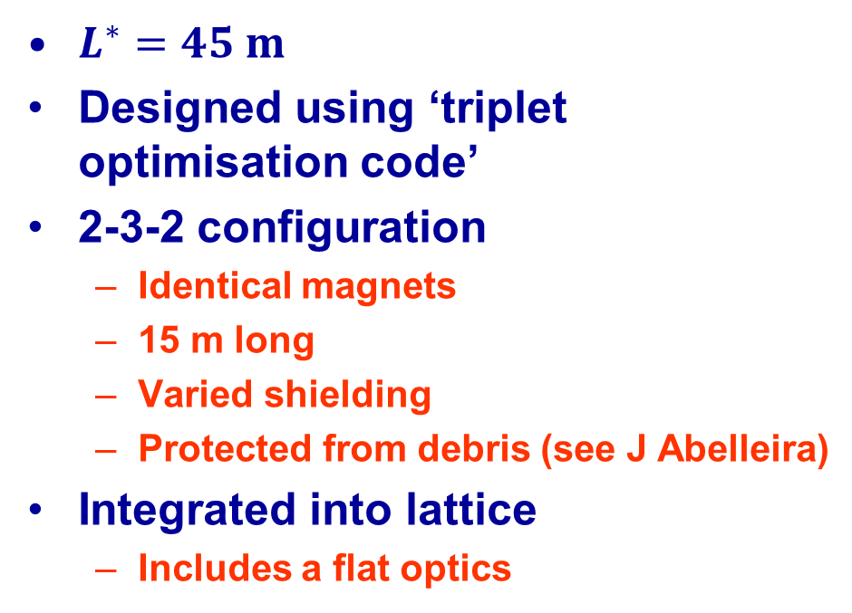


Before Berlin
Alternative Triplet before Berlin
$L^{∗}=45 m$
Designed using ‘triplet optimisation code’
2-3-2 configuration
  Identical magnets
  15 m long
  Varied shielding
  Protected from debris (see J Abelleira)
Integrated into lattice
  Includes a flat optics
$$β/km$$
$$orbit/m$$

Slide 3
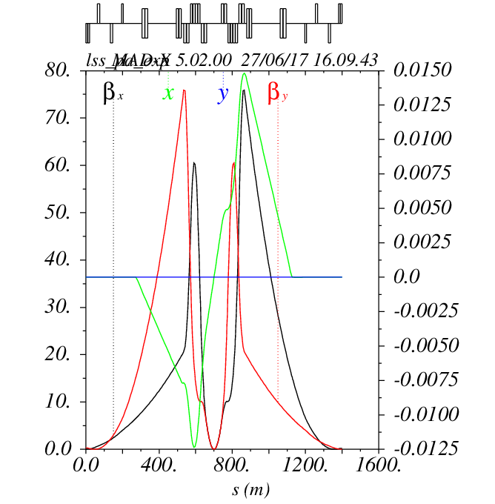
40 m$L^{∗}$
First iteration triplet design with ‘optimisation code’
  Split to maximum 15 m
  2-4-2 configuration
  Q2 magnets shorter than Q1 and Q3 magnets
  Same shielding maintained
$$β/km$$
$$orbit/m$$

Slide 4
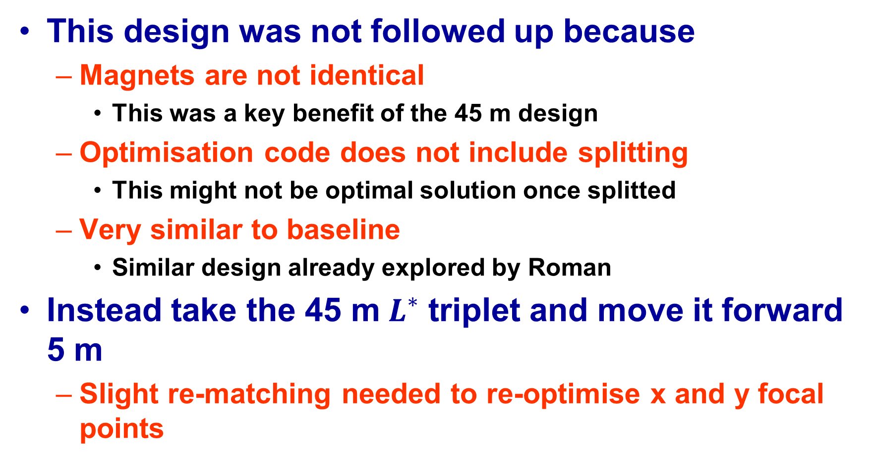
Next Iteration
This design was not followed up because
  Magnets are not identical
    This was a key benefit of the 45 m design
  Optimisation code does not include splitting
    This might not be optimal solution once splitted
  Very similar to baseline
    Similar design already explored by Roman
Instead take the 45 m$L^{∗}$ triplet and move it forward 5 m
  Slight re-matching needed to re-optimise x and y focal points

Slide 5
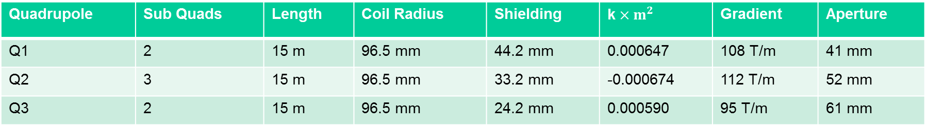
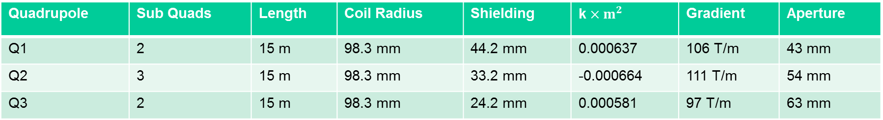


Re-Matching
$$L^{∗}=45 m$$
Quadrupole | Sub Quads | Length | Coil Radius | Shielding | k$×m^{2}$ | Gradient | Aperture
Q1 | 2 | 15 m | 98.3 mm | 44.2 mm | 0.000637 | 106 T/m | 43 mm
Q2 | 3 | 15 m | 98.3 mm | 33.2 mm | -0.000664 | 111 T/m | 54 mm
Q3 | 2 | 15 m | 98.3 mm | 24.2 mm | 0.000581 | 97 T/m | 63 mm
$$L^{∗}=40 m$$
Quadrupole | Sub Quads | Length | Coil Radius | Shielding | k$×m^{2}$ | Gradient | Aperture
Q1 | 2 | 15 m | 96.5 mm | 44.2 mm | 0.000647 | 108 T/m | 41 mm
Q2 | 3 | 15 m | 96.5 mm | 33.2 mm | -0.000674 | 112 T/m | 52 mm
Q3 | 2 | 15 m | 96.5 mm | 24.2 mm | 0.000590 | 95 T/m | 61 mm

Slide 6
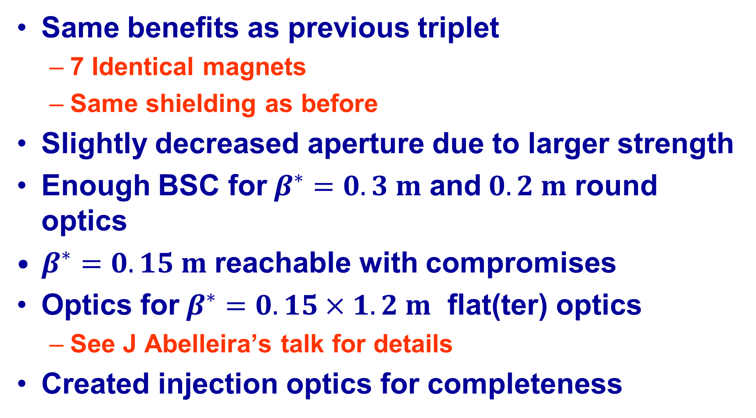
Moved Triplet
Same benefits as previous triplet
  7 Identical magnets
  Same shielding as before
Slightly decreased aperture due to larger strength
Enough BSC for$β^{∗}=0.3 m$ and$0.2 m$ round optics
$β^{∗}=0.15 m$ reachable with compromises
Optics for$β^{∗}=0.15×1.2 m$ flat(ter) optics
  See J Abelleira’s talk for details
Created injection optics for completeness

Slide 7
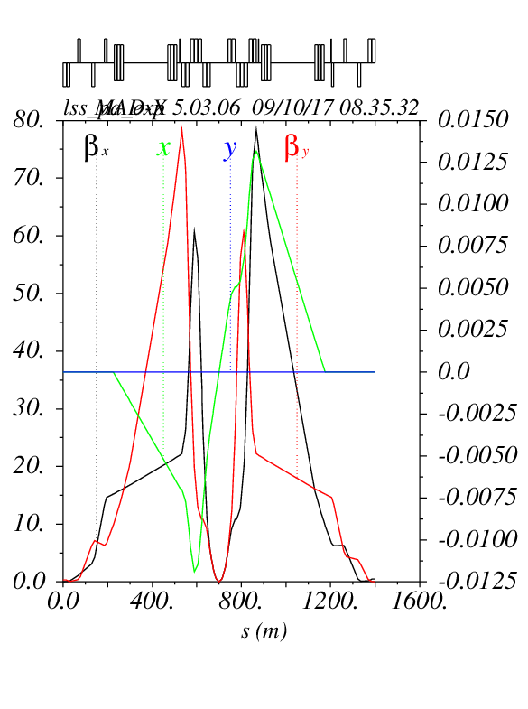
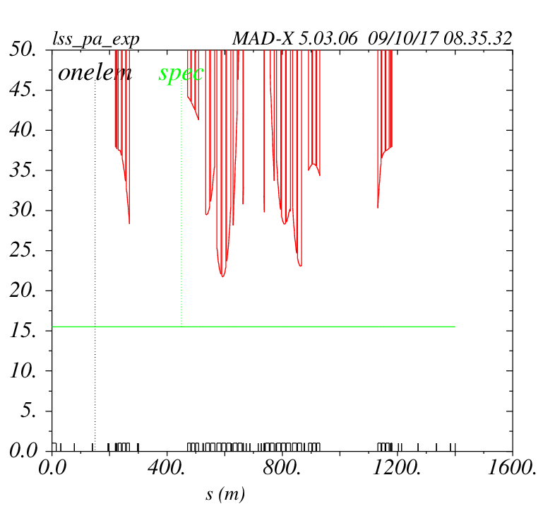




$β^{∗}=0.3 m$
$$β/km$$
$$orbit/m$$
$$21.6σ$$

Slide 8
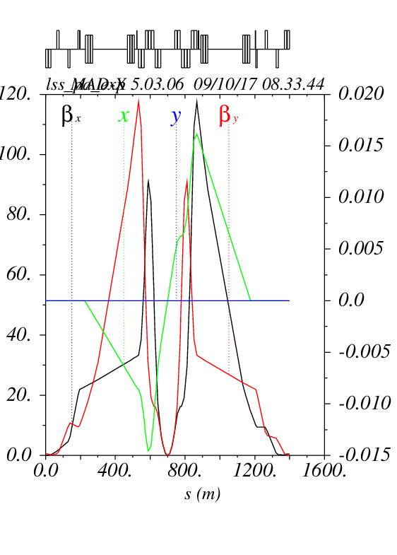
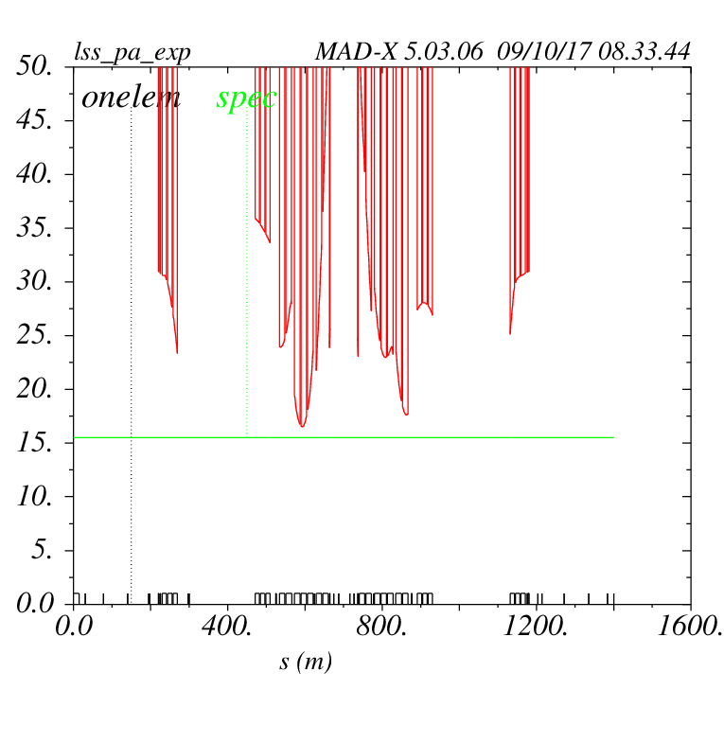




$β^{∗}=0.2 m$
$$β/km$$
$$orbit/m$$
$$16.4σ$$

Slide 9
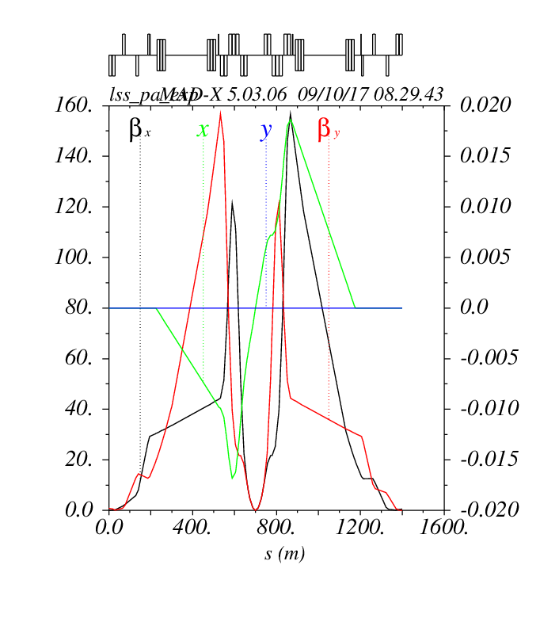
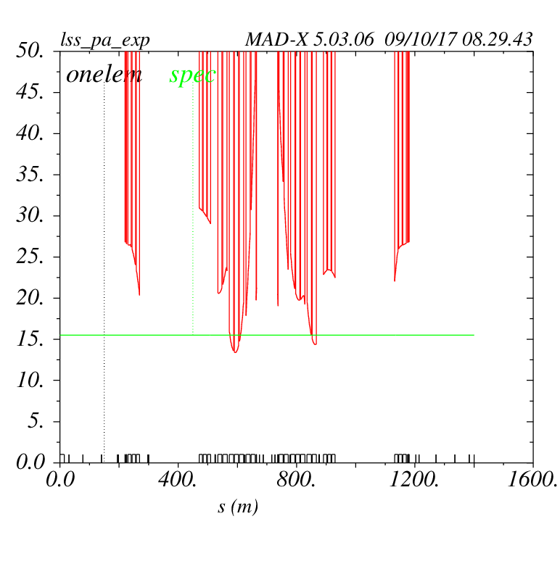




$β^{∗}=0.15 m$
$$β/km$$
$$orbit/m$$
$$13.3σ$$

Slide 10
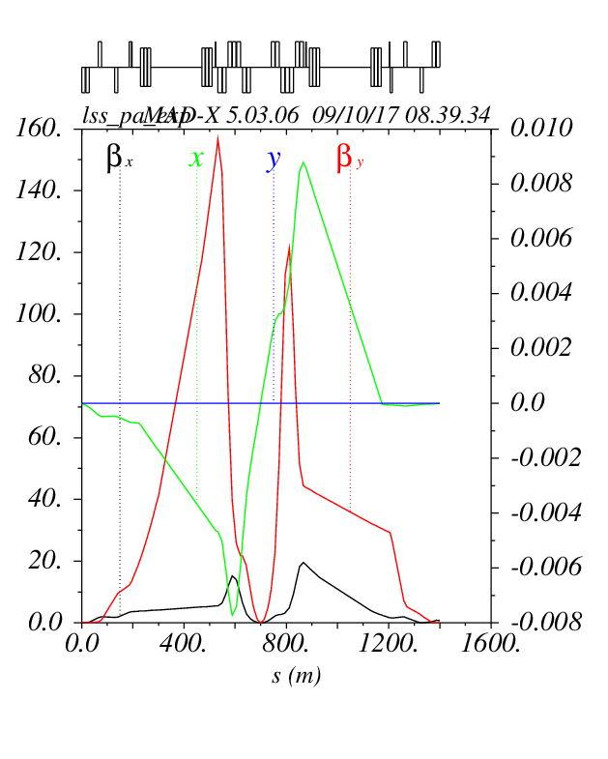
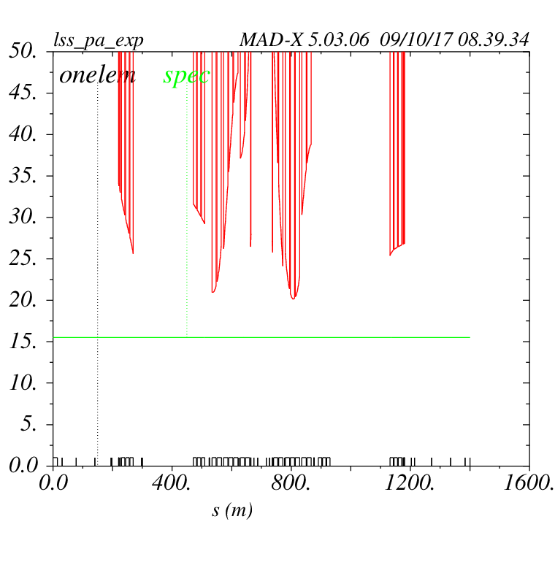



$β^{∗}=0.15×1.2 m$
$$β/km$$
$$orbit/m$$
$$20.2σ$$

Slide 11
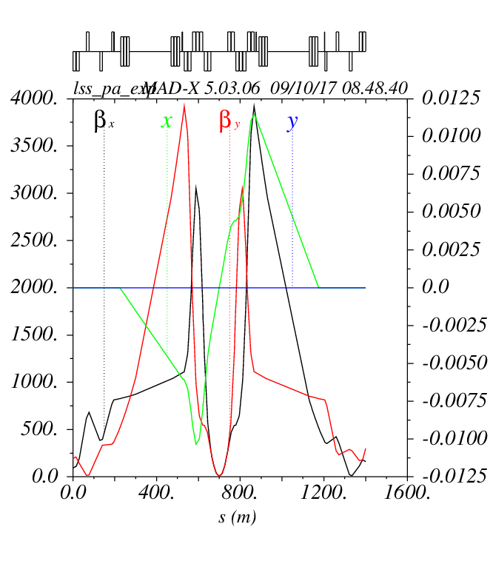
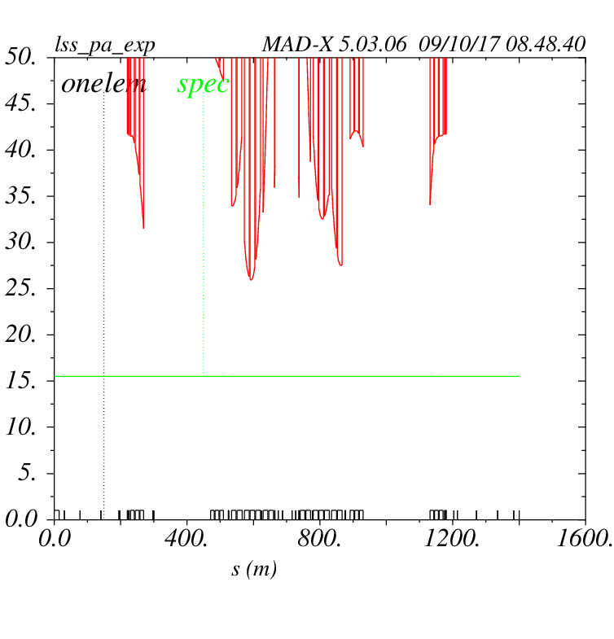


$β^{∗}=6 m$ Injection Optics @ 3.3TeV
$$β/km$$
$$orbit/m$$
$$25.9σ$$

Slide 12
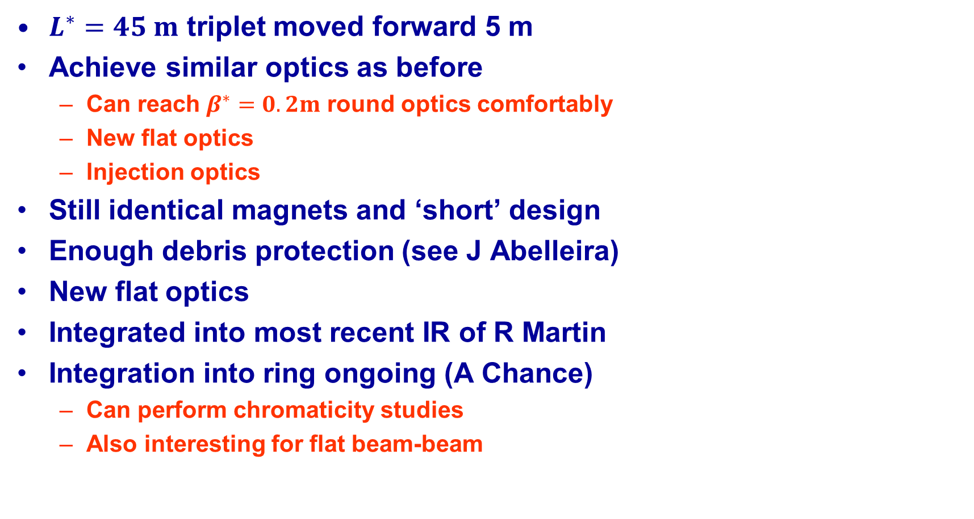
Summary and Outlook
$L^{∗}=45 m$ triplet moved forward 5 m
Achieve similar optics as before
  Can reach$β^{∗}=0.2m$ round optics comfortably
  New flat optics
  Injection optics
Still identical magnets and ‘short’ design
Enough debris protection (see J Abelleira)
New flat optics
Integrated into most recent IR of R Martin
Integration into ring ongoing (A Chance)
  Can perform chromaticity studies
  Also interesting for flat beam-beam

