Slide 1
Energy deposition studies for new triplet
Jose L. Abelleira on behalf of the JAI-FCC team
9 October 2017
Thanks to CERN FLUKA team

Slide 2
Flat beam parameter choice
Energy deposition studies for the alternative FF triplet
Energy deposition in D1/D2

Slide 3
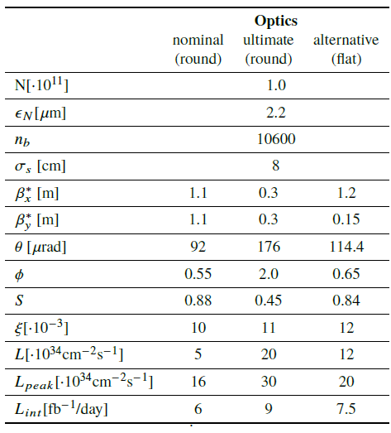
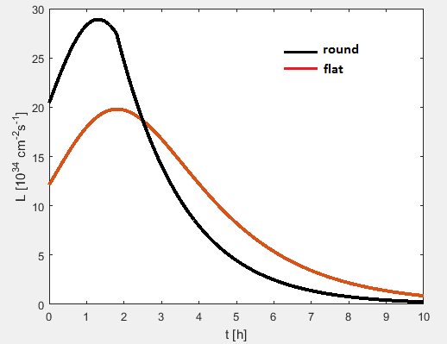
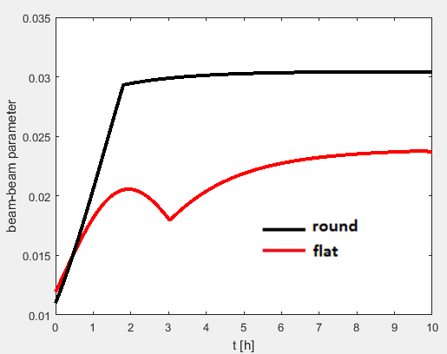
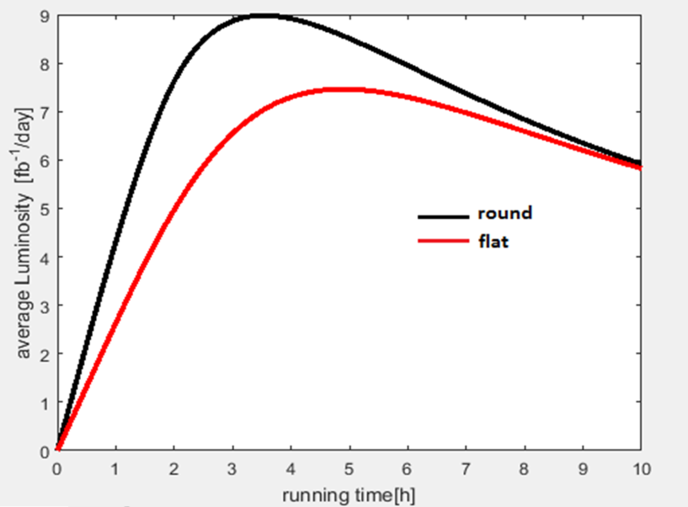
Flat beam parameter choice

Slide 4
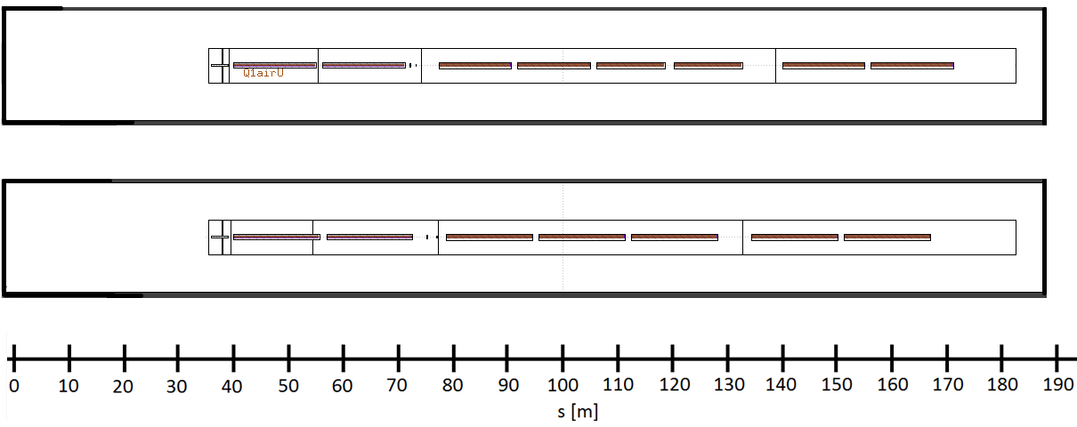
Triplet comparison
L*=40 m
Nominal
14.3 m
12.5 m
14.3 m
JAI October 2017
15 m
15 m
15 m
4 m shorter

Slide 5
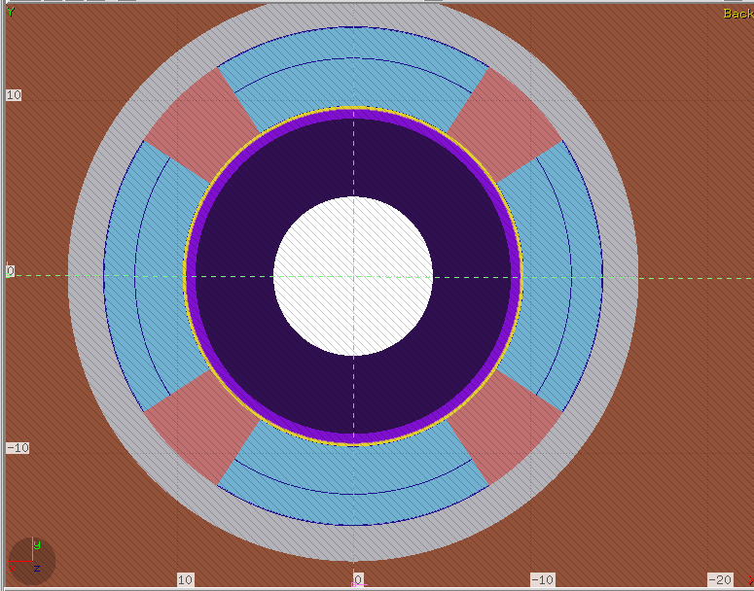
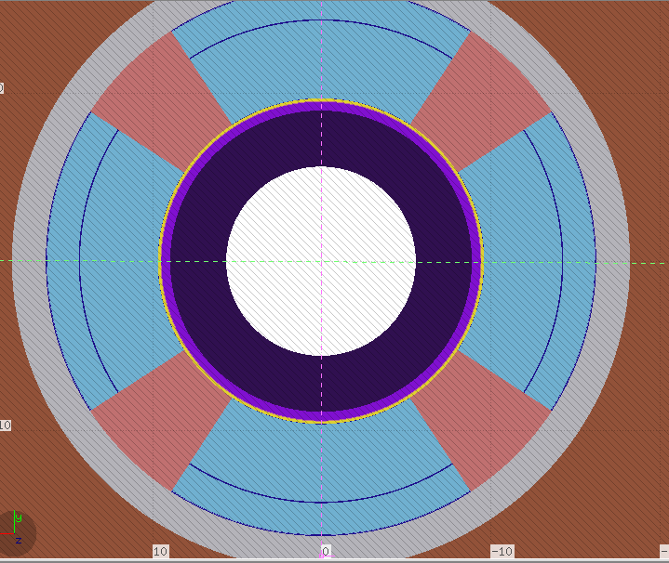
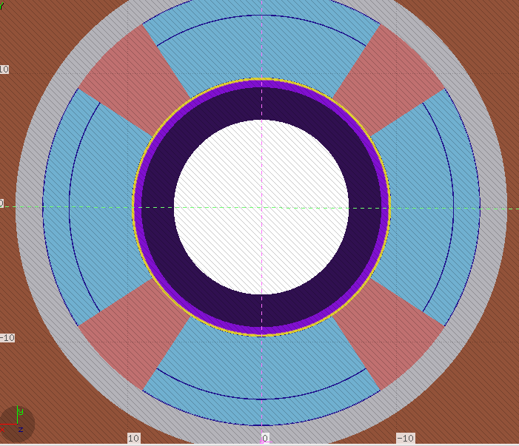
Triplet parameters
Q1
Q2
Q3
Comparison nominal triplet
 | g [T/m] | coil, r [cm] | free aper, r [cm] | Abs thickness [cm]
Q1 | 108 | 19.33 | 9.02 | 8.84
Q2 | 112 | 19.33 | 11.22 | 6.64
Q3 | 98.5 | 19.33 | 13.02 | 4.84
g [T/m]
127
102
100
Leon Van Riesen-Haupt ‘New triplet and EIR optics’

Slide 6
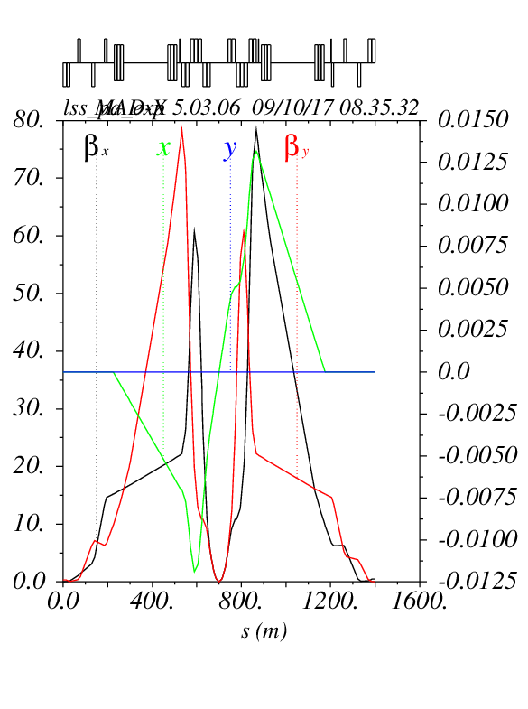
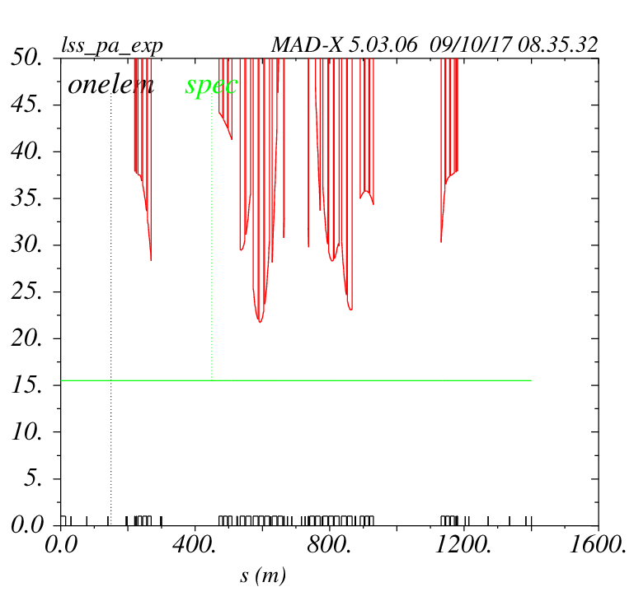

Optics for beta*=0.3 m
$$21.6σ$$
Leon Van Riesen-Haupt ‘New triplet and EIR optics’

Slide 7
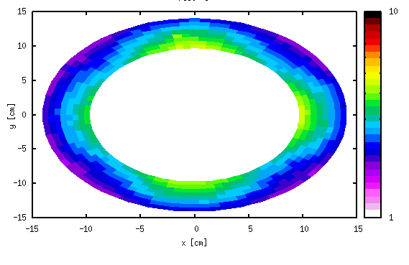
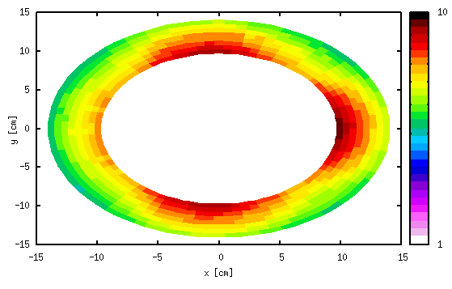
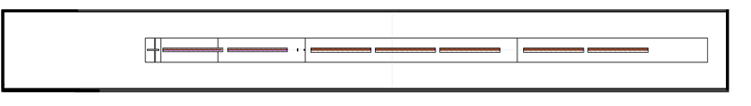
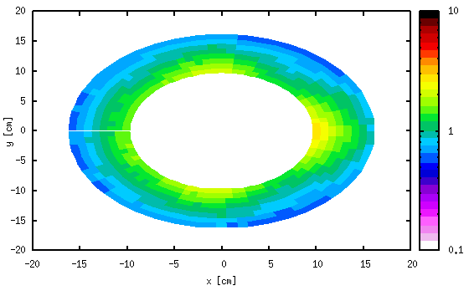
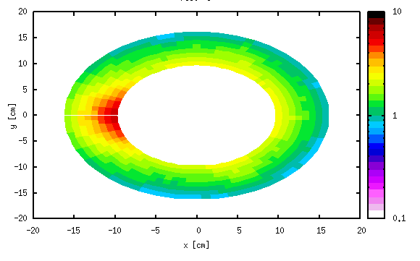
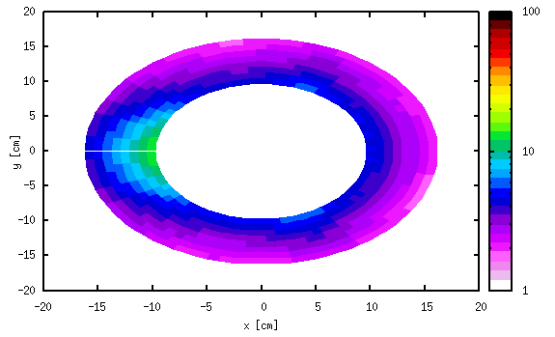
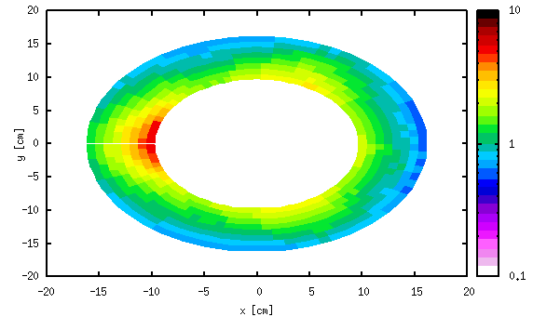
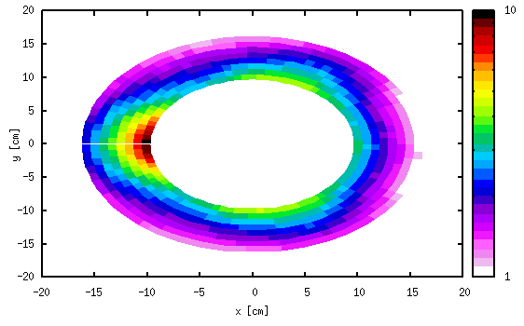
Energy deposition

Slide 8
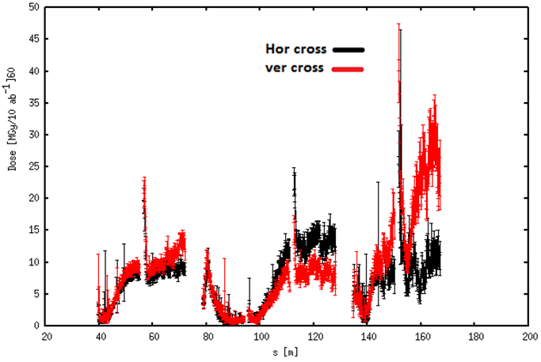
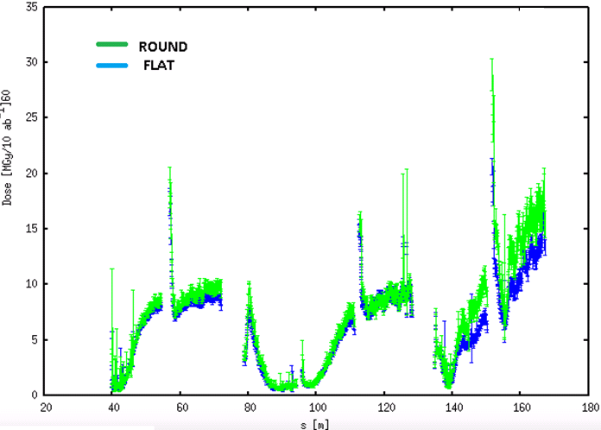
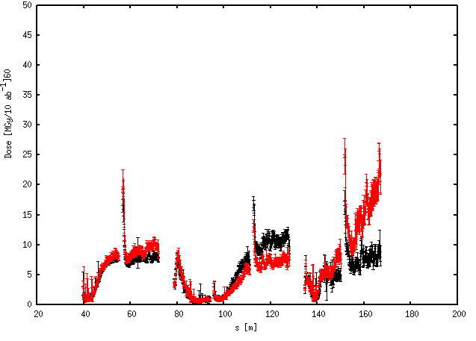
Energy deposition
ROUND
50% VERTICAL CROSSING
50 % HORIZONTAL CROSSING
FLAT

Slide 9
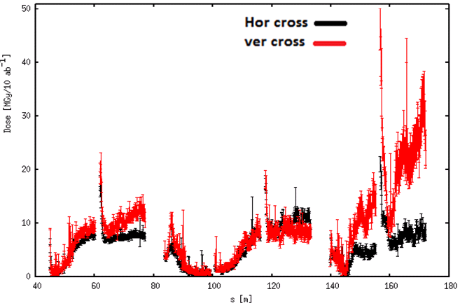
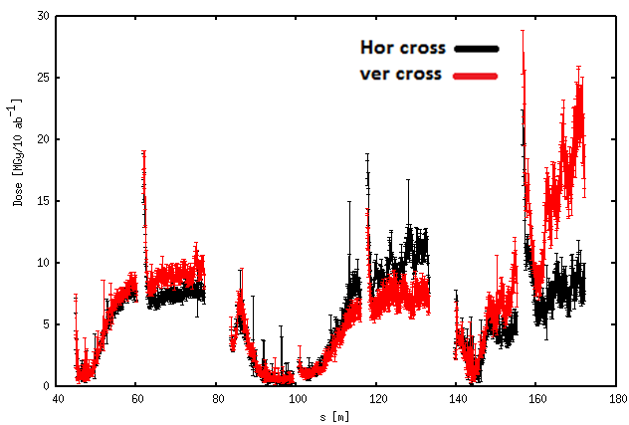
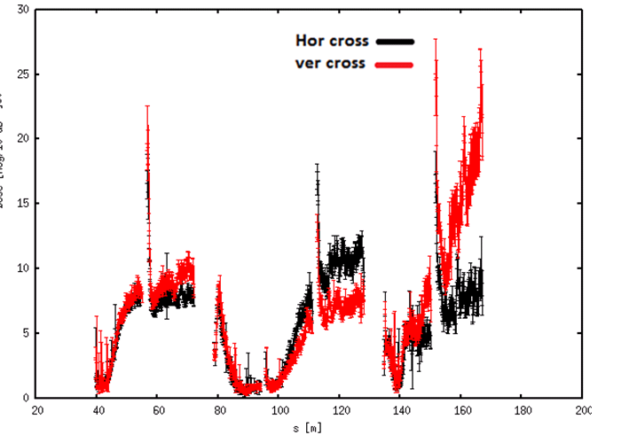
Energy deposition, L* 45m vs 40m
ROUND
FLAT
L*=45 m
ROUND
FLAT
L*=40 m

Slide 10
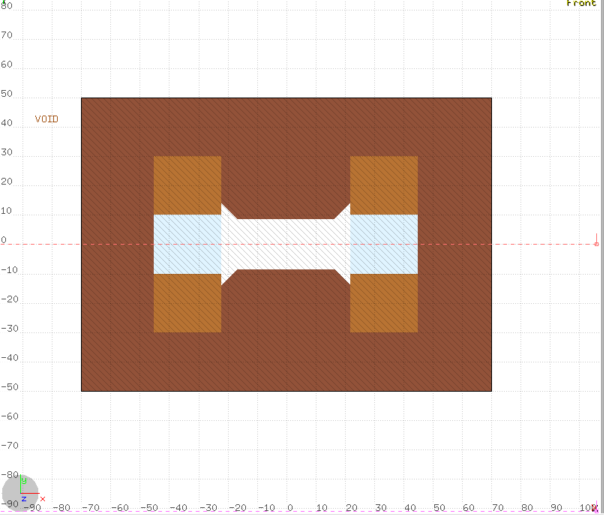
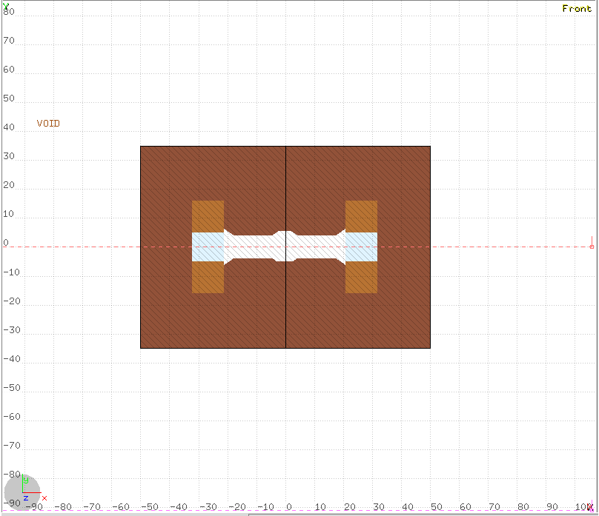
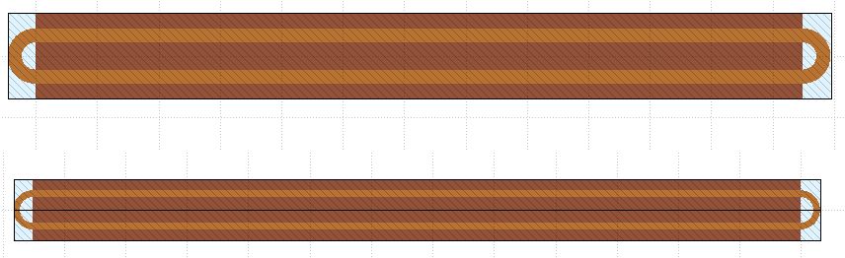
Separation magnets.
Model developed at JAI-Oxford
D1 (×3)
D2 (×3)
17 cm
8 cm
12.5 m

Slide 11
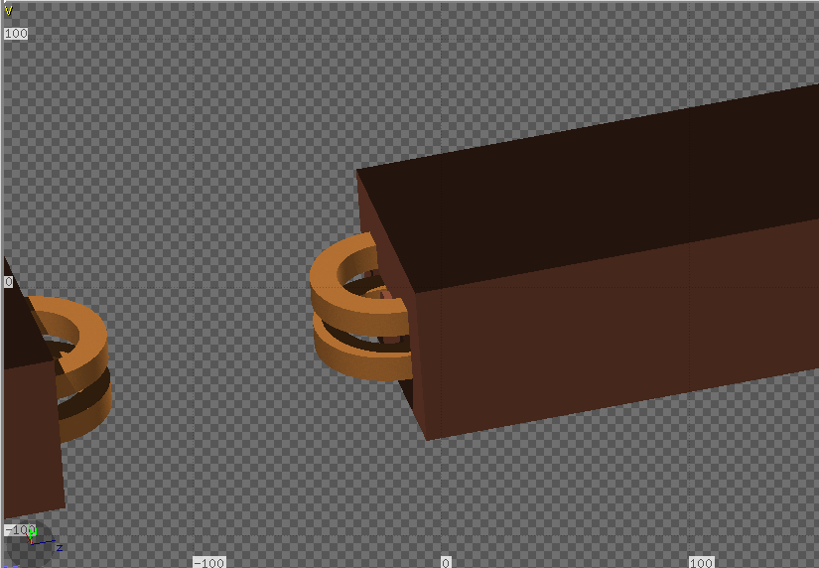
Separation magnets.
Alternative triplet
D1 (x3)
D2 (x3)

Slide 12
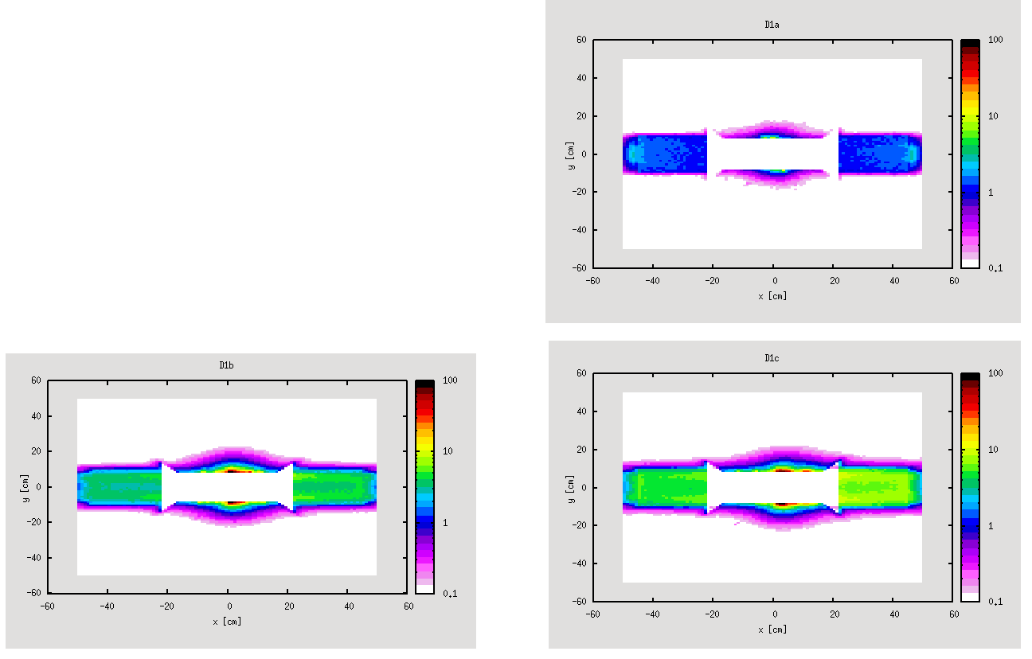
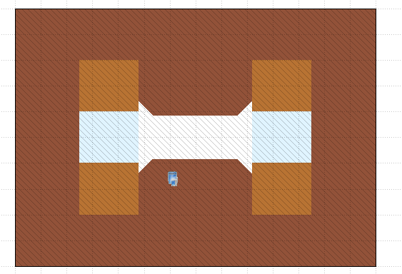
D1

Slide 13
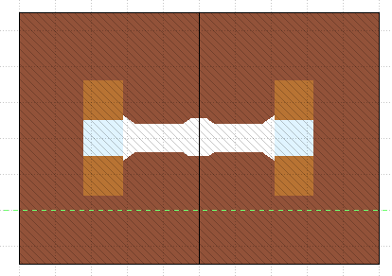
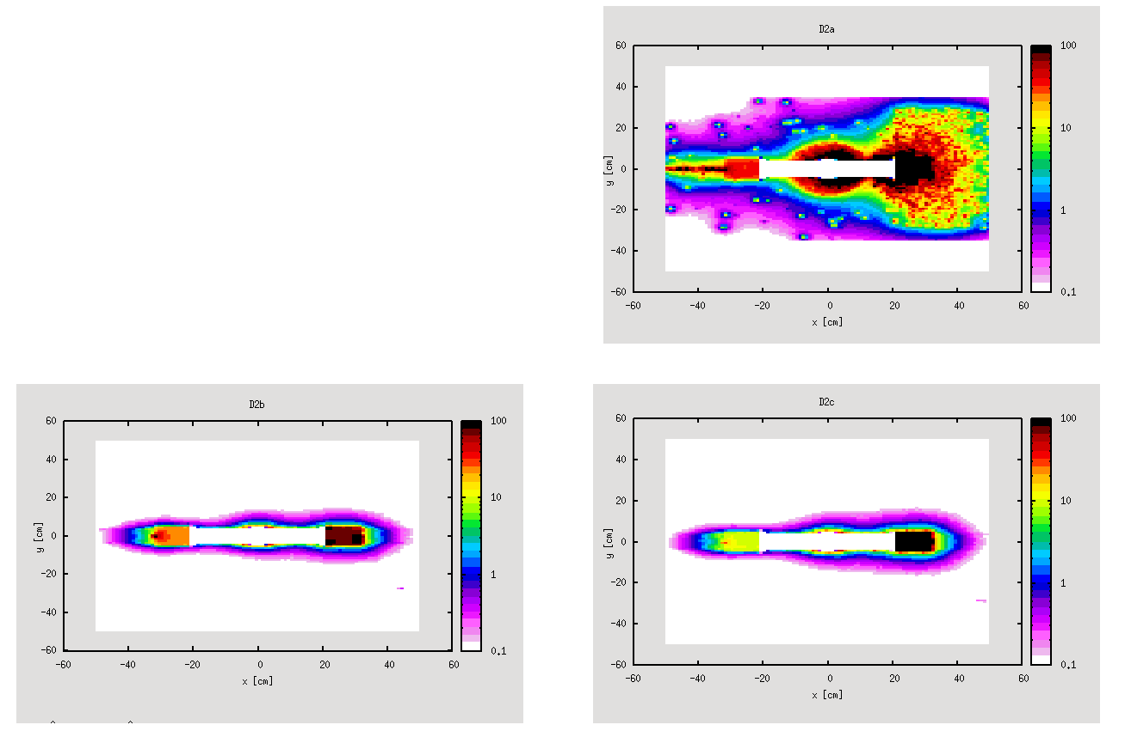
D2

Slide 14
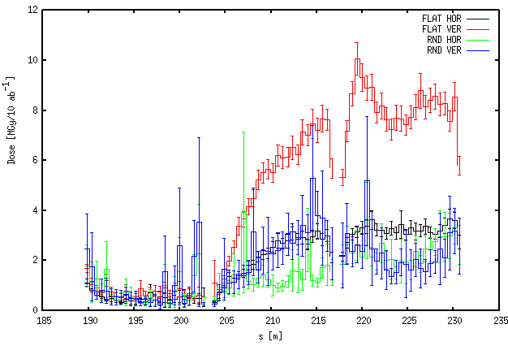
D1, Peak dose in coil

Slide 15
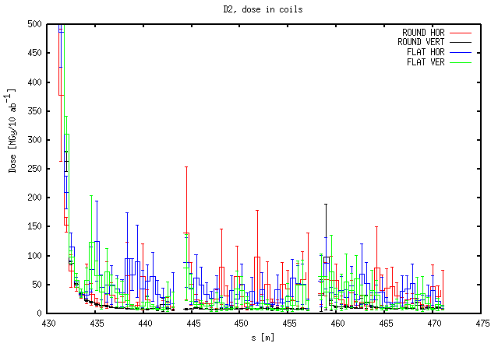
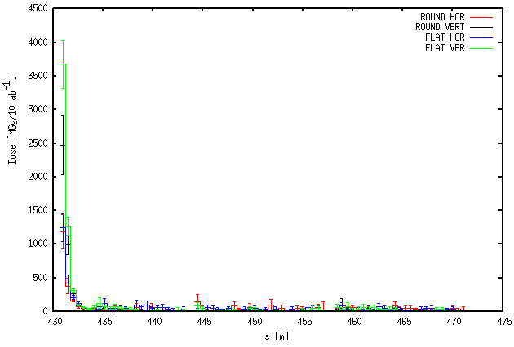
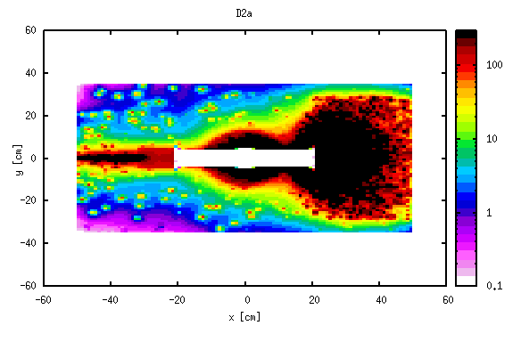
D2, peak dose in coil

Slide 16
Conclusions
A new triplet ‘JAI November 2017’ has been designed, with L*=40 m.
This triplet is more compact that the nominal one.
After some iteration with optics, one version is proposed
No energy deposition issues with L*40
A model for D1 and D2 normal conducting model is presented
First energy deposition simulations done with triplet and separation magnet.
Work will continue on the magnet model and energy deposition simulations.

