Slide 1
FCC-hh Detector Cross-Talk Update
Haroon Rafique, Rob Appleby
Cockcroft Institute / University of Manchester
Many thanks to D. Schulte, A. Langner, M. I. Besana, F. Cerutti, J. A. Fernandez, A. M. Krainer

Slide 2
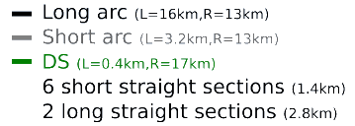
Cross-talk
The FCC-hh Experimental Interaction Region (EIR) is critical in defining FCC-hh performance
Experimental cross talk is a possible issue due to high luminosity and energy proton beams
We use IPA to IPB as a representative case
Questions:
  Do protons from collisions reach the next detector?
  What effect will this have on operation (background, emittance, losses, etc)?
  Do other collision products reach the next detector?
  Are there any areas of concern? – if so how do we address them.

Slide 3
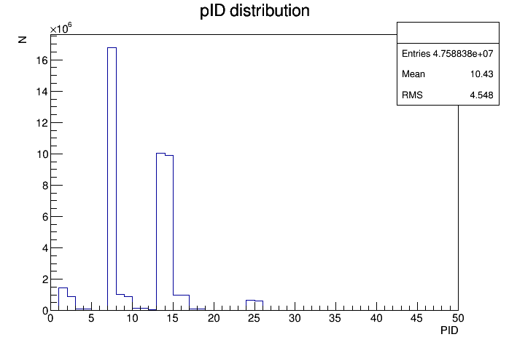
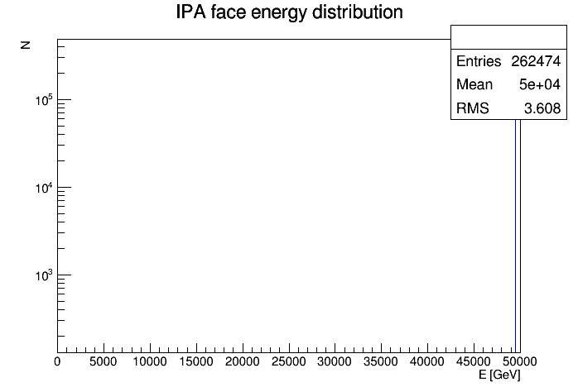
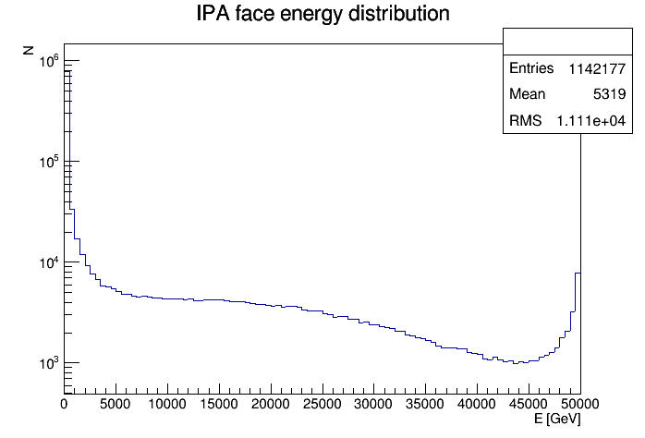
Collision Products (3 [m] post IPA)
Mean protons per primary 1.43
Mean energy of protons 13418 GeV
Mean mu- per primary 0.142
Mean energy of mu- 10.7 GeV
Mean charged hadron per primary 23.4
Mean energy of CH 396 GeV
Mean gammas per primary 19.3
Mean energy of gammas 238.9 GeV
Elastic: E > 49.95 TeV
Photons
Pions
Protons
Muons
Crossing
Charged hadrons other than protons ignored (for cross-talk) due to rigidity.
Inelastic: E < 49.95 TeV
Generated using DPMJET-III inside FLUKA
Split protons into 2 cases: Elastic and inelastic

Slide 4
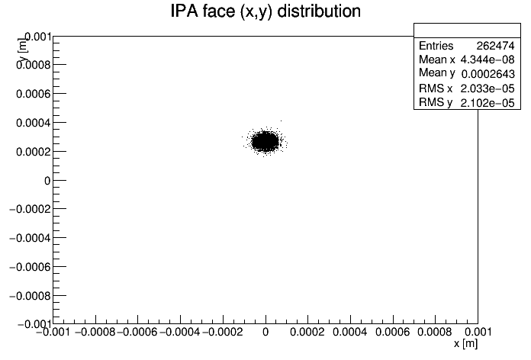
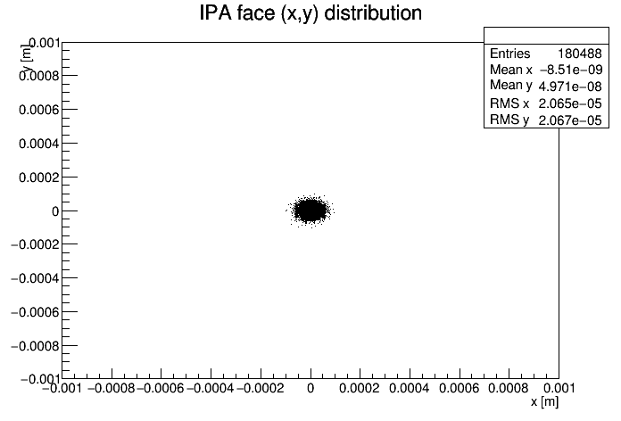
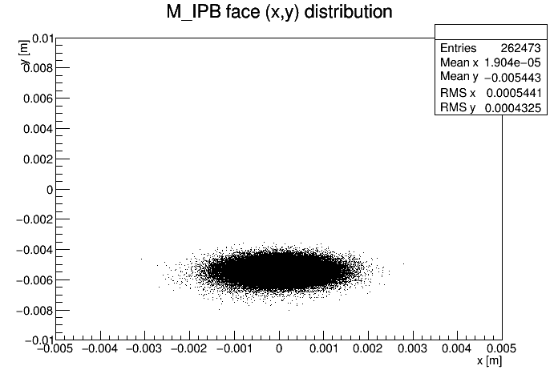
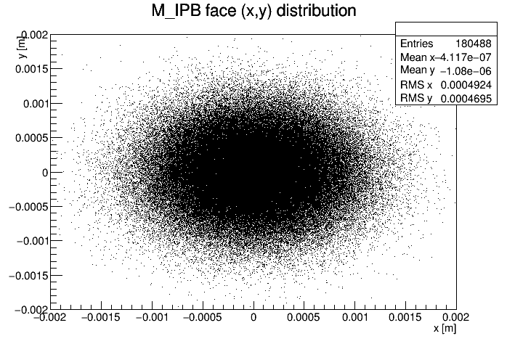
Elastic Protons
Tracking performed with PTC and MERLIN
Elastic protons all reach IPB with no losses. This will lead to emittance growth.
Not a major concern, so we concentrate on inelastic protons
Crossing
No Crossing
IPA
IPA
IPB
IPB

Slide 5
Previous Results
Elastic protons all reach IPB – emittance growth
Muon range analytically calculated – too short
Muons tracked in FLUKA – don’t reach IPB (confirmed analytical)
S = 0 corresponds to IPA

Slide 6
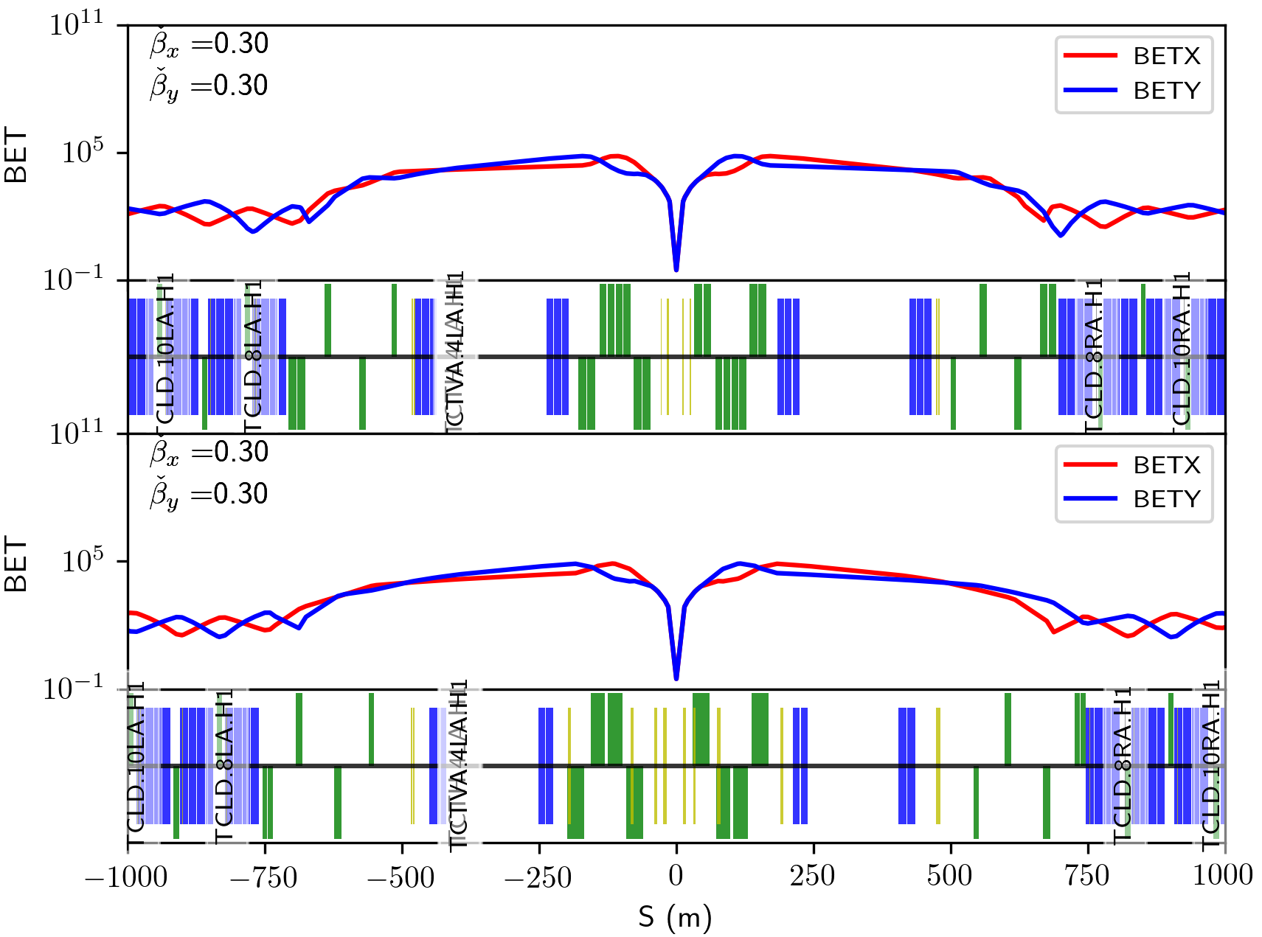
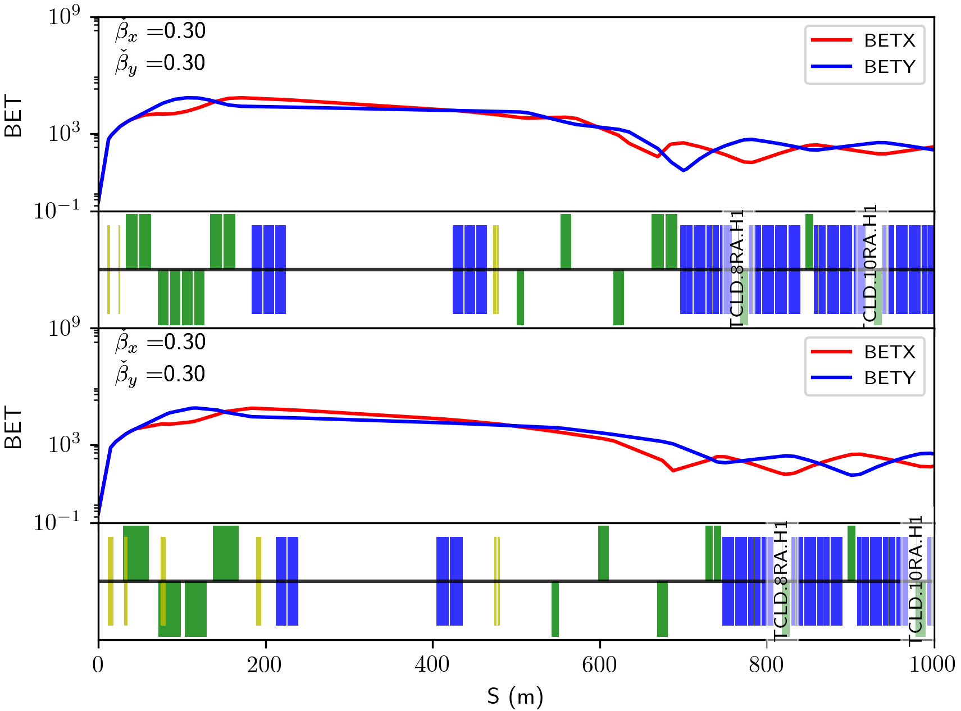
New Layout
New = FCC-hh v8
FCC-hh v8
Old = FCC-hh v7
FCC-hh v7

Slide 7
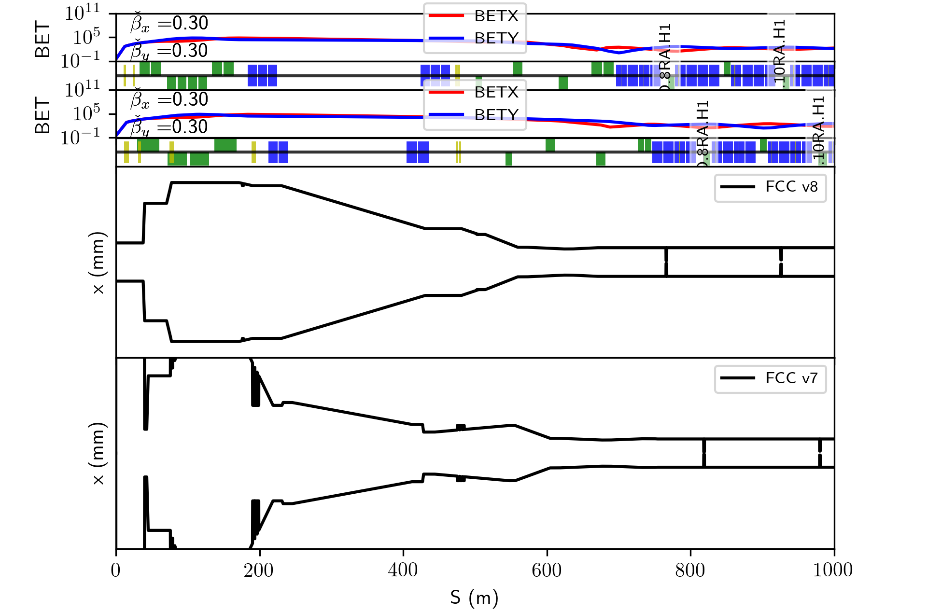
New Layout
Difference in IP apertures
Shift in Collimator positions

Slide 8
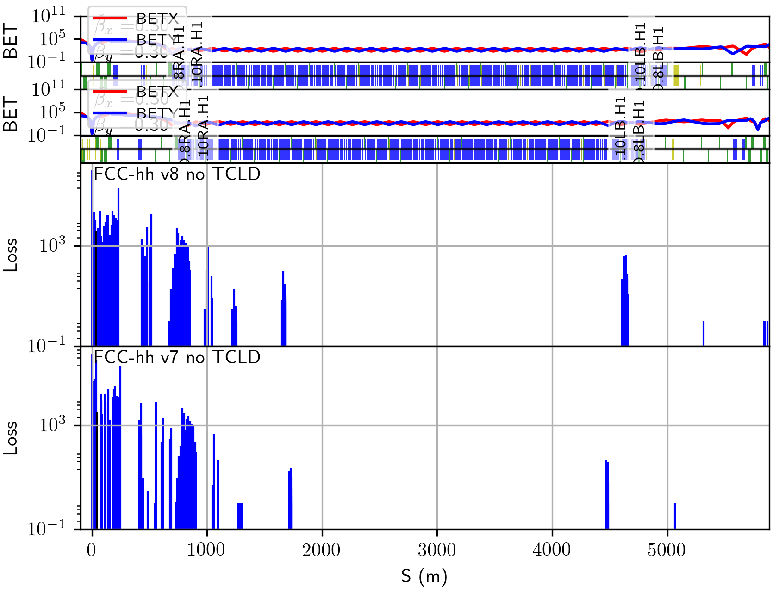
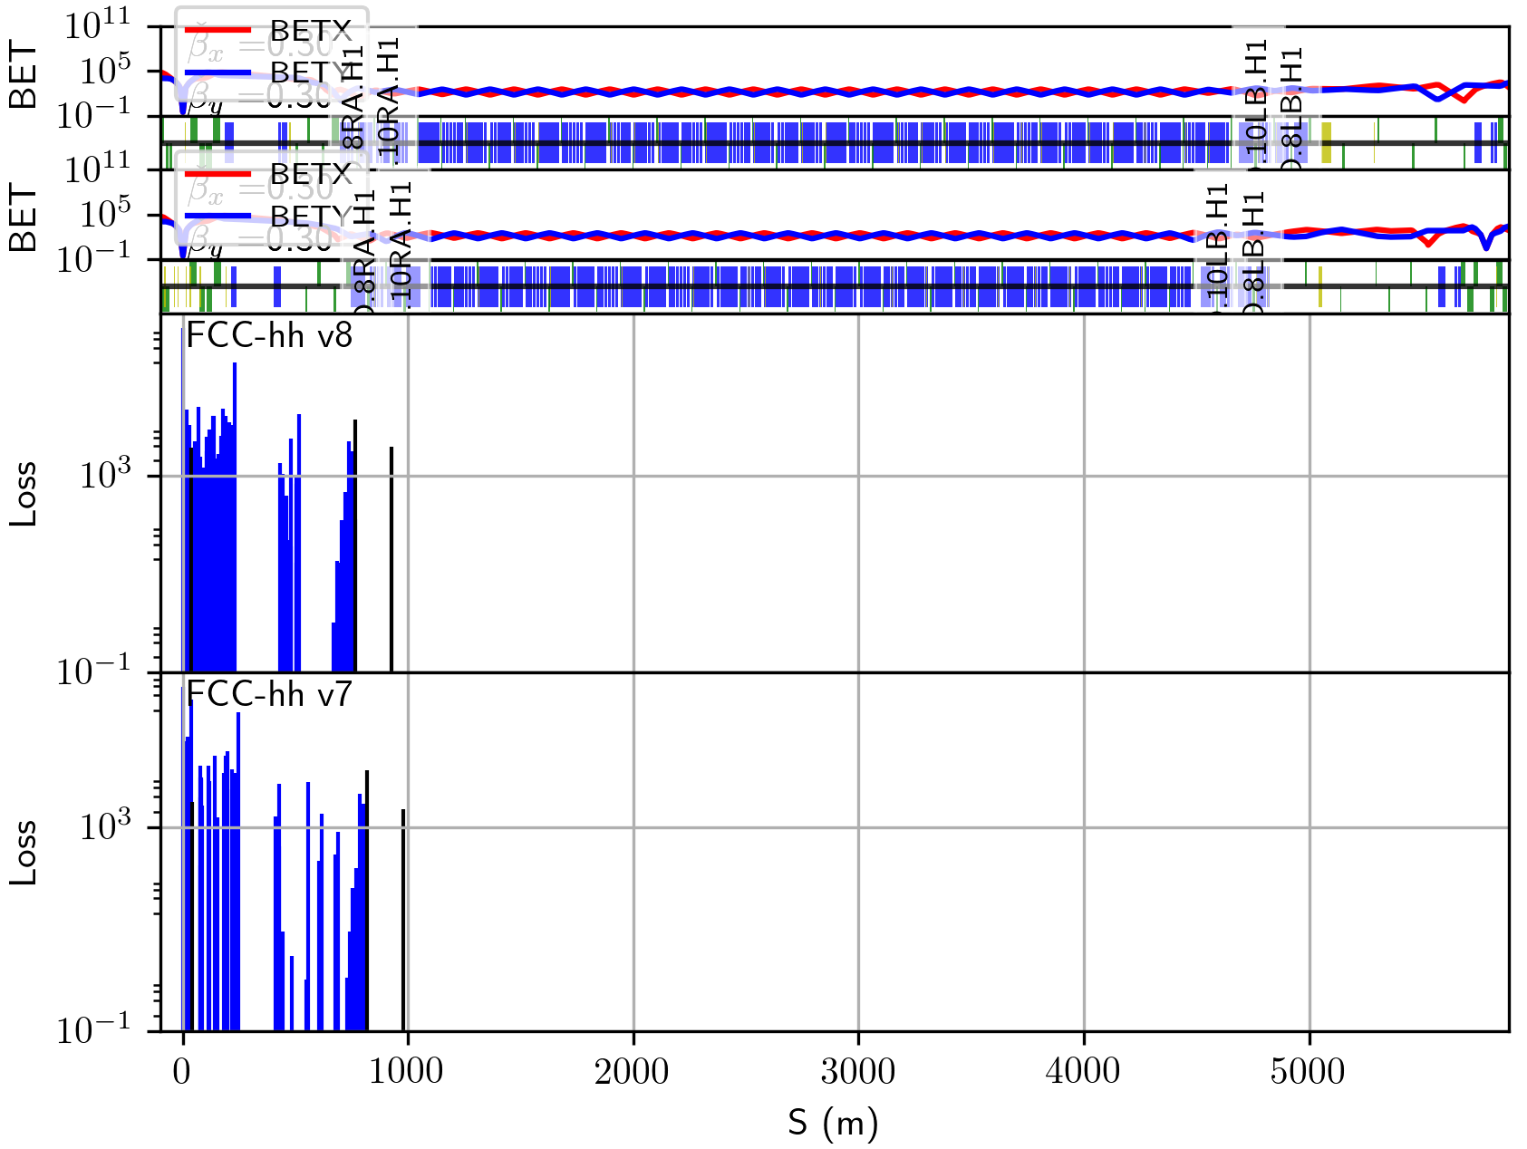
Losses with and without TCLDs
More losses in DS magnets in new lattice
Mitigated with same TCLD settings (35.14 σ)

Slide 9
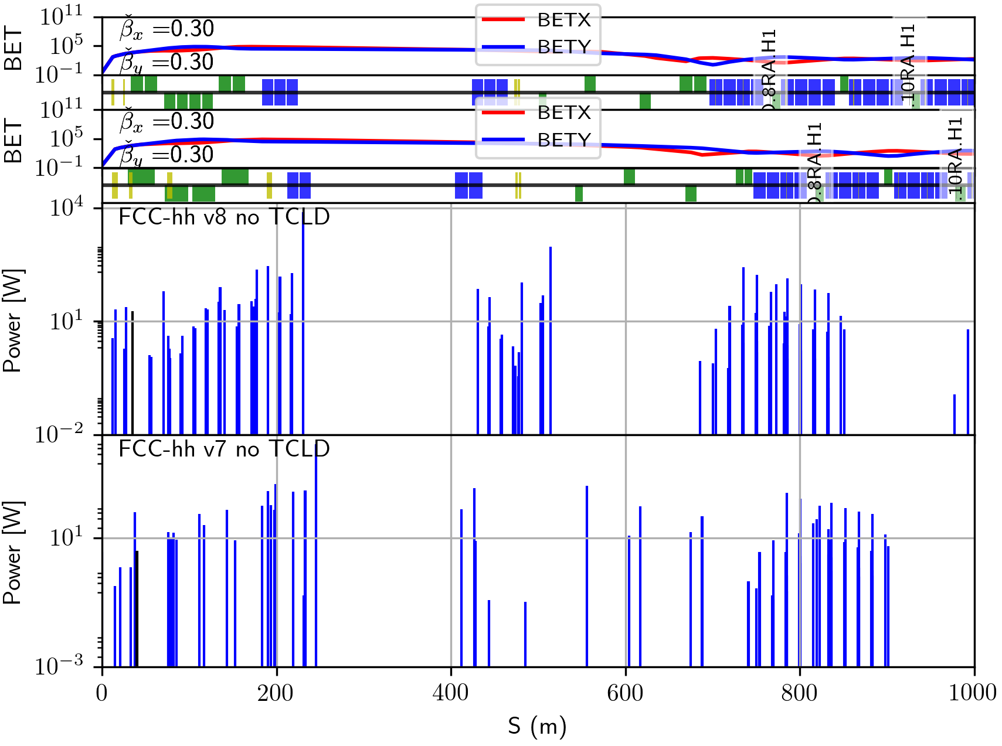
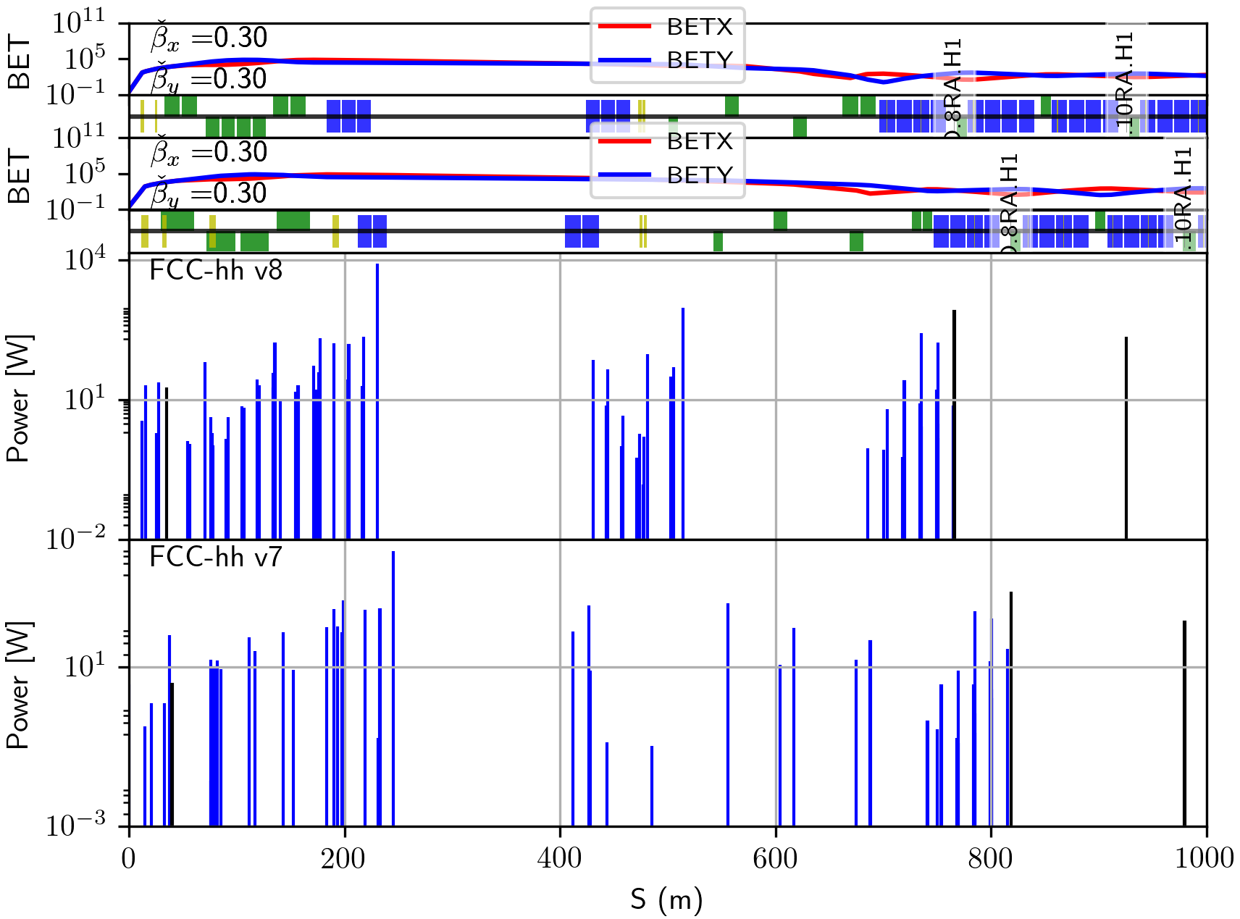
Power deposited with and without TCLDs
~8 kW in 200 m drift
~1 kW in 45 m drift
790 W in TCLD8
224 W in TCLD10

Slide 10
Cross-talk summary (including previous work)
50 TeV proton collisions modelled using DPMJET-III in FLUKA
Proton tracking performed with PTC and MERLIN
Elastic protons all reach the next IP with spot size ≈ beam
Inelastic proton cross-talk not of great concern
  1 – 10 protons per IPA bunch crossing at IPB FCC-hh v7
  Slightly reduced for FCC-hh v8
DS losses mitigated when using existing TCLD design & settings – IPAC TUPIK037
Muon tracking performed with FLUKA
Muons do not have the range to get to the next IP – IPAC TUPVA036
No major incidents due to new lattice from cross-talk perspective

Slide 11
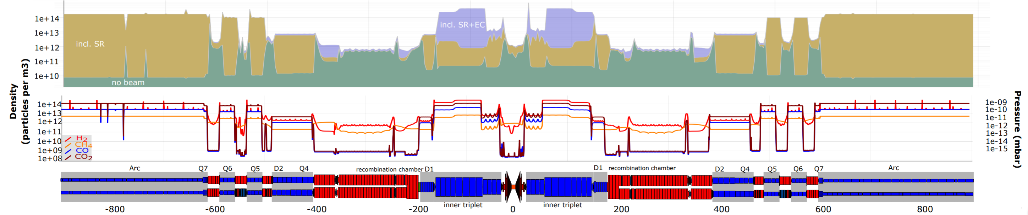
Machine Induced Background
Major contributors: beam-gas interaction, halo and collision debris losses.
Propose a study using FLUKA
  Sources of machine-induced background in the ATLAS and CMS detectors at the CERN Large Hadron Collider – R. Bruce et al. (NIM 13’)
Gas density profile required from vacuum team
  Pressure Profile in the experimental area of FCC-hh and FCC-ee calculated by an analytical code – I. Aichinger (FCC Week 17’)
Interface required from detector team
Model development with the FLUKA team
Use of linebuilder?
  The FLUKA Linebuilder and Element Database: Tools for Building Complex Models of Accelerator Beam Lines – A. Mereghetti (IPAC 12’)
Collimator hits from the collimation team

Slide 12
Thank You

Slide 13
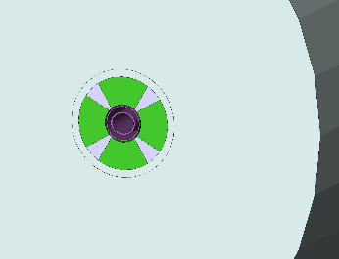
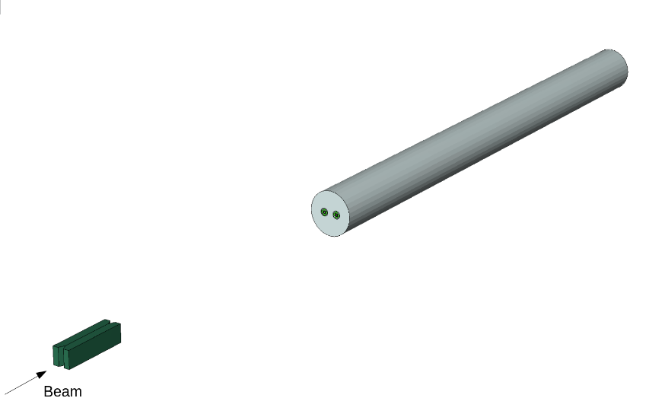
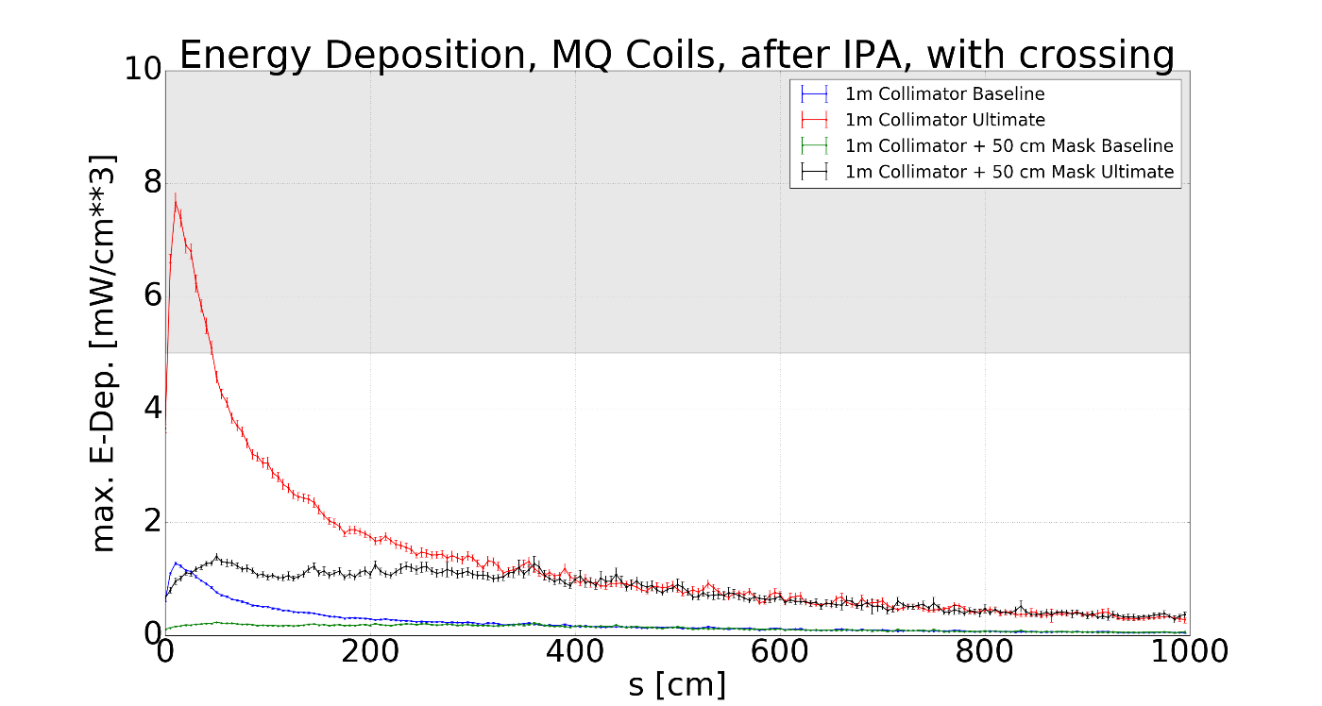
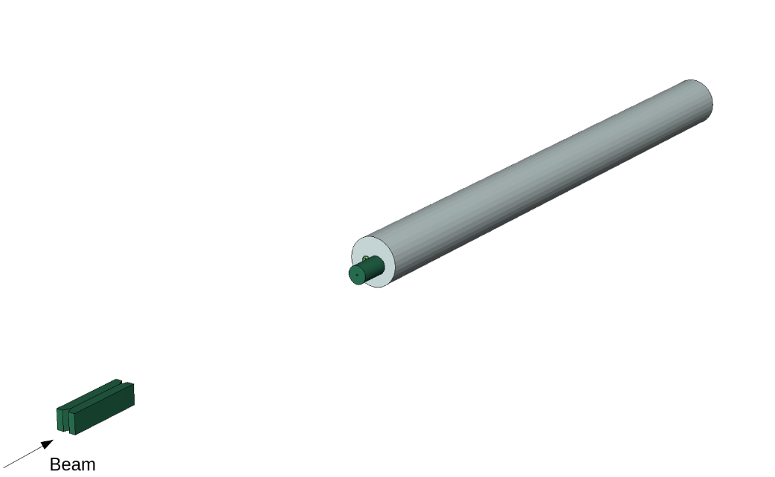
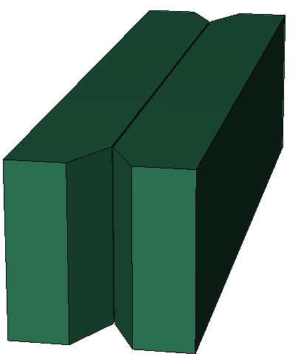
TCLD Design (A. Krainer, CERN)
MQ
MQ
5-10 mW / cm **3 limit (E. Todesco)
TCLD
50 cm Inermet180 Mask
Showers to first quadrupole after TCLD in cell 8, using FLUKA
TCLD
Inermet180 TCLD
Proton Cross-Talk and Losses in the Dispersion Suppressor Regions at the FCC-hh, IPAC17’, TUPIK037
H. Rafique, R. Appleby, A. M. Krainer, A. S. Langner, J. L. Abelleira

Slide 14
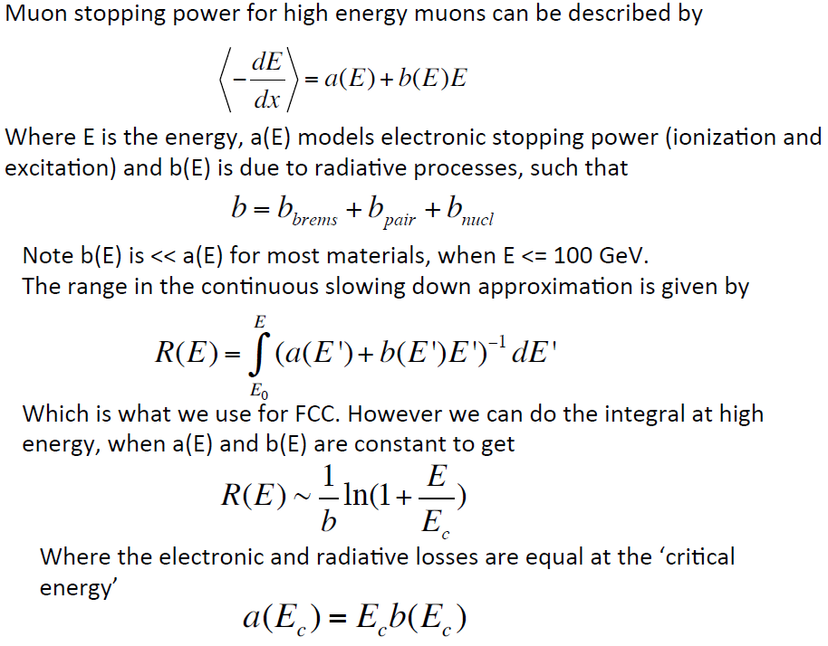
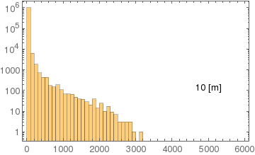
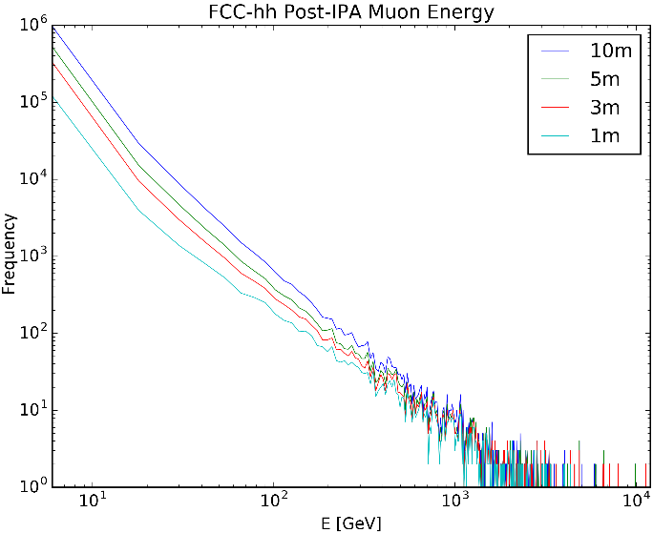
Muons
Muons can travel far in dense materials. Theoretical calculations estimate a range of ~ 3km.
Theoretical range of muons in standard rock scored at s = 10 m post IPA
Muon E at a given s post IPA
S [m]

Slide 15
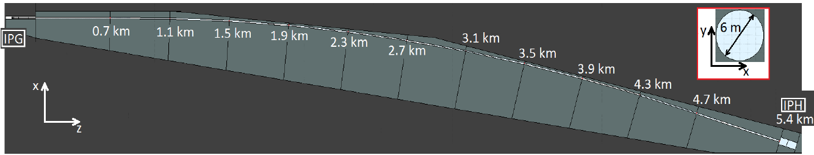
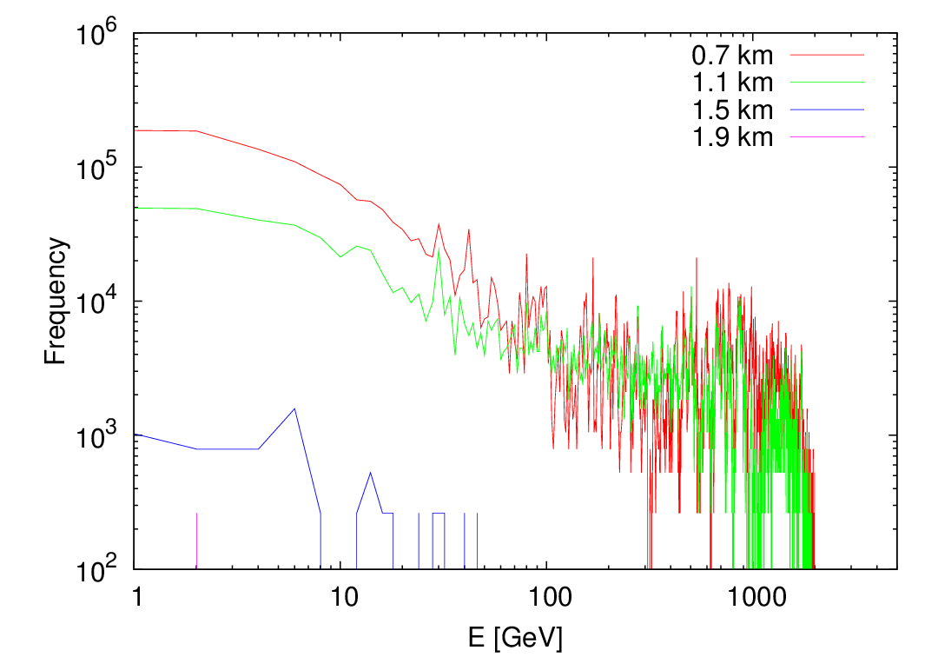
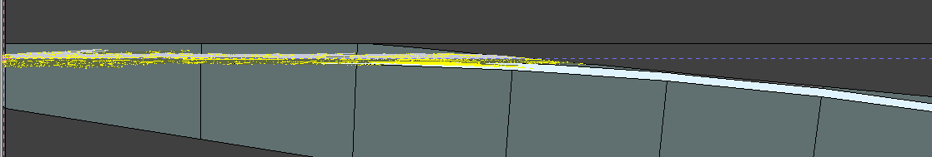
Muon tracking in FLUKA J. L. Abelleira (JAI, Oxford)
Theoretical estimate of range has been confirmed using FLUKA simulations. Muons should not reach the next IP.
10⁹ muon histories scored at given s in FLUKA
Muons generated using DPMJET-III inside FLUKA, with a full detector model, by M. I. Besana
Cross-Talk Studies between FCC-hh Experimental Interaction Regions, IPAC17’, TUPVA036
J. L. Abelleira, A. Seryi, M. I. Besana, R. Appleby, H. Rafique

