Slide 1



Low Luminosity Experimental Insertions
M. Hofer, M.I. Besana, F. Burkart, F. Cerutti, R. Martin, D. Schulte, R. Tomas

Slide 2
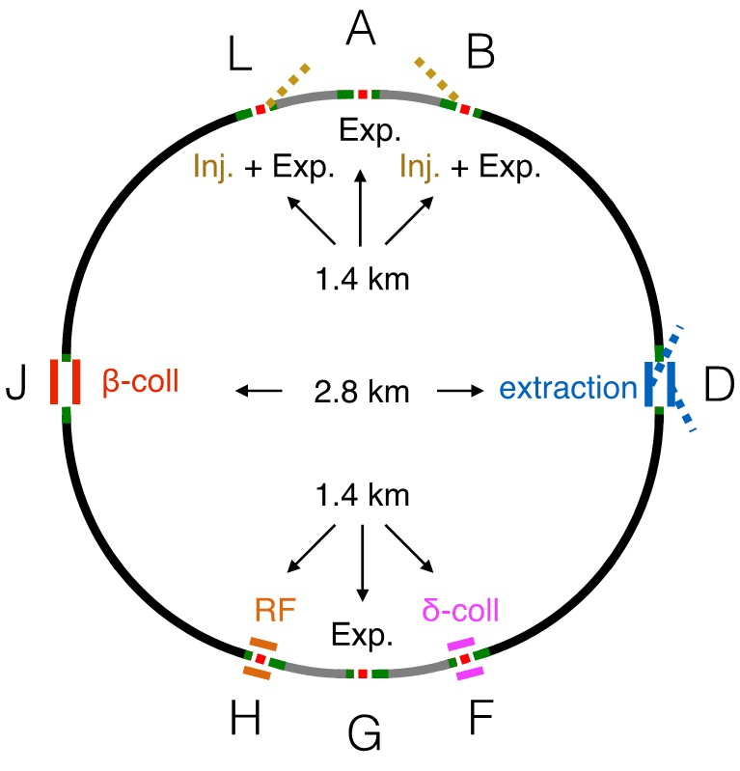
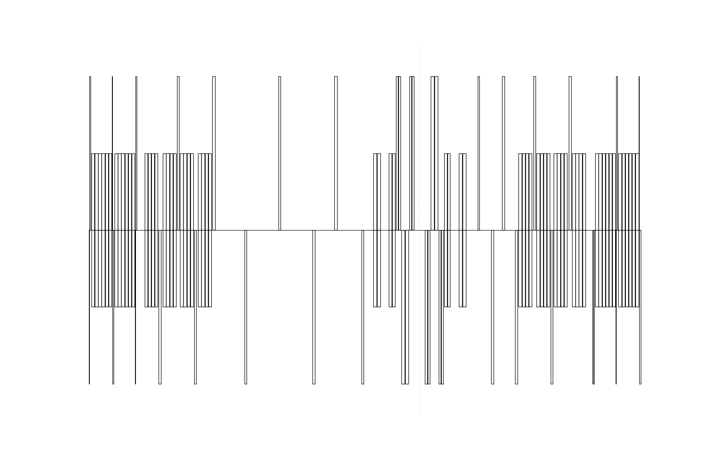
Status after FCC-Week 2017
In the current 97.75 km long baseline layout,
injection and low luminosity experiments are combined,
similar as in the LHC
Different to the LHC insertion, an asymmetric design
was chosen, as it seems more favorable
from a machine protection point of view
This way, the injection protection elements are further away
from the experiments
Injection
Experiment

Slide 3
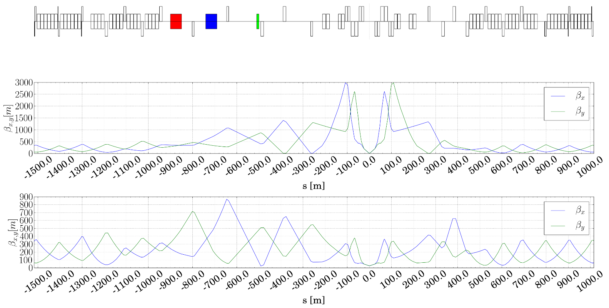
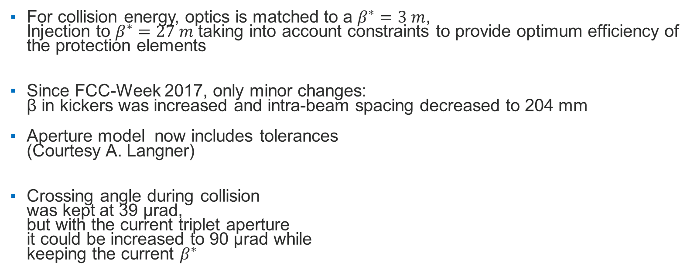
Optics
For collision energy, optics is matched to a $β^{∗}=3 m$,
Injection to $β^{∗}=27 m$ taking into account constraints to provide optimum efficiency of the protection elements
Since FCC-Week 2017, only minor changes:
β in kickers was increased and intra-beam spacing decreased to 204 mm
Aperture model now includes tolerances
(Courtesy A. Langner)
Crossing angle during collision
was kept at 39 μrad,
but with the current triplet aperture
it could be increased to 90 μrad while
keeping the current $β^{∗}$

Slide 4
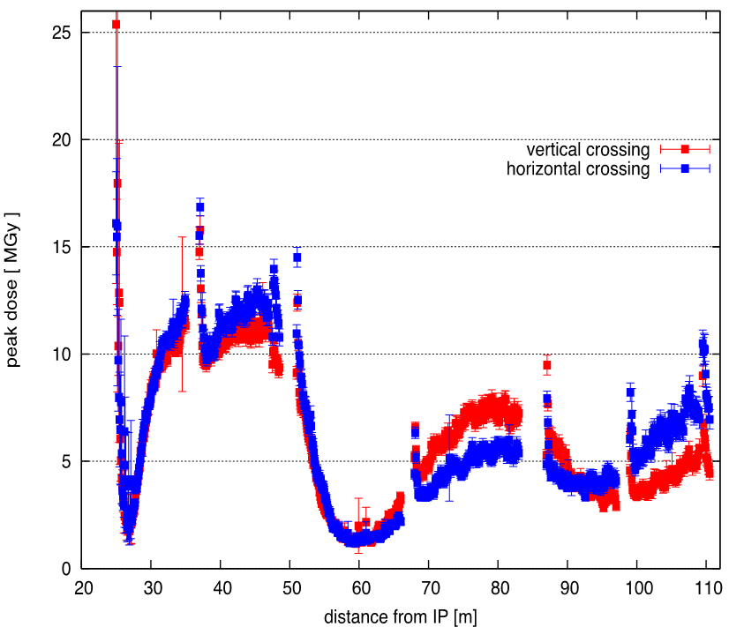


Energy deposition
All triplet quadrupoles have the same aperture and use a 10 mm thick tungsten shielding
Sufficient to bring the peak power density in the triplet below the design limit of Nb₃Sn of $5 mW{cm}^{−3}$
Concerning the integrated luminosity,
$500 {fb}^{−1}$ seem feasible
with the current baseline radiation limits
Current FCC-hh target radiation limits
Baseline | 30 MGy
Ultimate (R&D Goal) | 250 MGy
$$\text{Peak} \text{dose} \text{for} 500 {fb}^{−1}$$
Courtesy of M.I. Besana and F.Cerutti

Slide 5
Dynamic Aperture Studies
Initial Dynamic Aperture Studies with magnetic errors in the triplet and a previous lattice version (L*=45m) showed high dynamic aperture both with and without crossing angle
With crossing angle the DA was only slightly reduced
Now checking the DA with the updated lattice, which includes the latest layout of the low luminosity insertions and the L*=40m EIR and magnetic errors in the separation and recombination dipoles

Slide 6
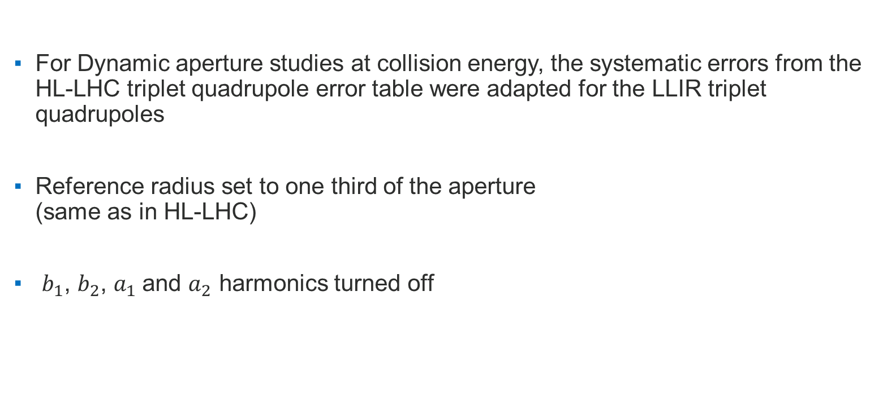
Dynamic Aperture
For Dynamic aperture studies at collision energy, the systematic errors from the HL-LHC triplet quadrupole error table were adapted for the LLIR triplet quadrupoles
Reference radius set to one third of the aperture
(same as in HL-LHC)
$b_{1}$, $b_{2}$, $a_{1}$and $a_{2}$ harmonics turned off
 | Normal |  | Skew
 | Q1a/b Q3a/b | Q2a/Q2b | Q1a/b Q3a/b | Q2a/Q2b
2 | 0 | 0 | -1.254 | -0.836
6 | -0.236 | -0.370 | 0.088 | 0.059
10 | -0.137 | -0.128 | 0.003 | 0.002
14 | -0.864 | -0.866 | -0.009 | -0.006
Systematic components at collision energy for the triplet quadrupoles

Slide 7
Dipole Field Quality
 | Normal |  | Skew
 | D1 | D2 | D1 | D2
3 | -0.900 | 3.00 | 0 | 0
4 | 0 | 2.00 | 0 | 0
5 | 0 | -1.00 | 0 | 0
7 | 0.400 | -0.200 | 0 | 0
9 | -0.590 | 0.090 | 0 | 0
11 | 0.470 | 0.030 | 0 | 0
15 | -0.040 | 0 | 0 | 0
To study the impact of magnetic errors on the DA
in the superconducting separation- and
recombination dipoles, the error tables from
HL-LHC D1 and D2 were used
Reference radius again set to
one third of the aperture
Systematic components at collision energy for the
separation and recombination dipoles

Slide 8
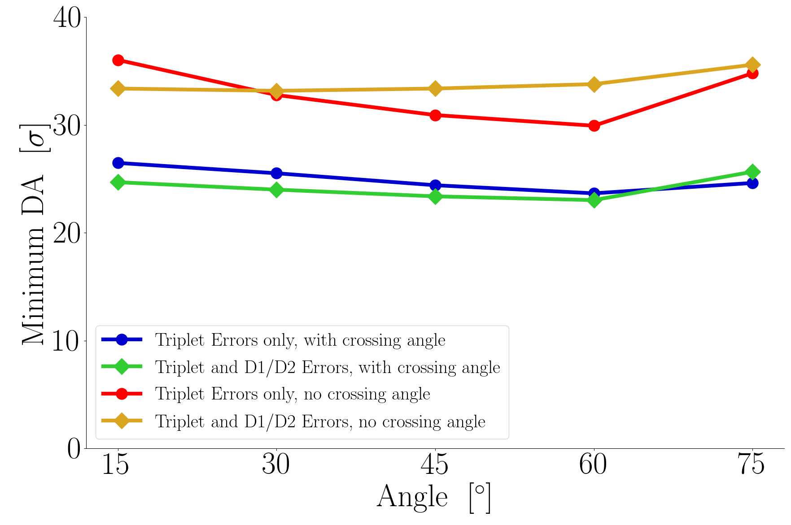
Dynamic Aperture
Sixtrack studies carried out at collision energy with
  60 seeds
  5 angles
  Amplitude step size 2 σ
  With and without crossing angle

Slide 9

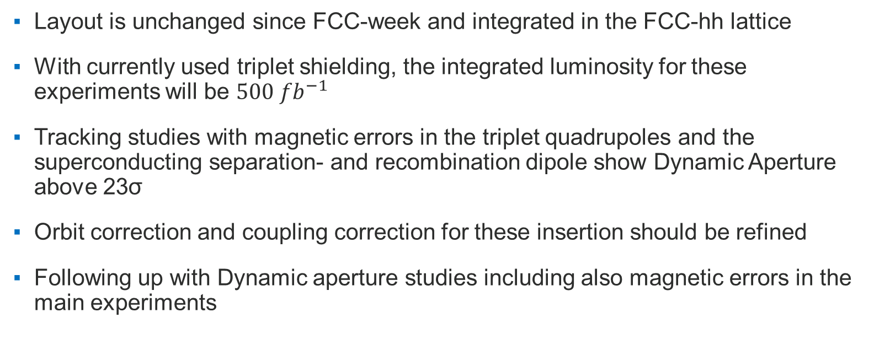
Conclusions and Outlook
Layout is unchanged since FCC-week and integrated in the FCC-hh lattice
With currently used triplet shielding, the integrated luminosity for these experiments will be $500 {fb}^{−1}$
Tracking studies with magnetic errors in the triplet quadrupoles and the superconducting separation- and recombination dipole show Dynamic Aperture above 23σ
Orbit correction and coupling correction for these insertion should be refined
Following up with Dynamic aperture studies including also magnetic errors in the main experiments

Slide 10
Thank you for your attention!

Slide 11
Triplet Field Quality in HL-LHC
CERN-ACC-2014-103

Slide 12
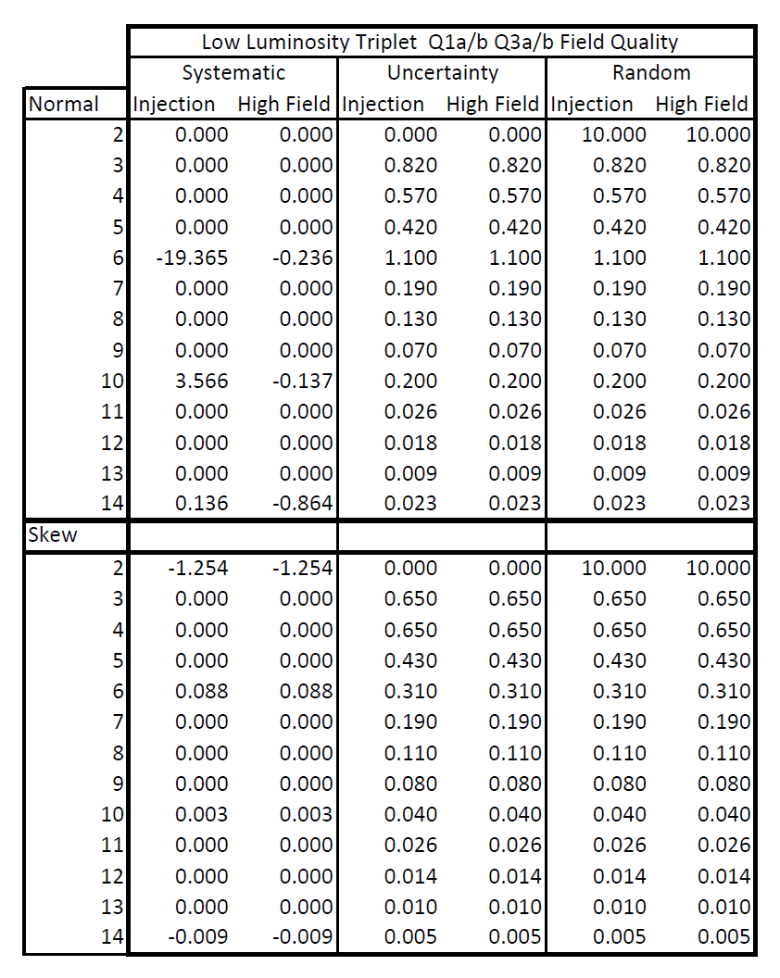
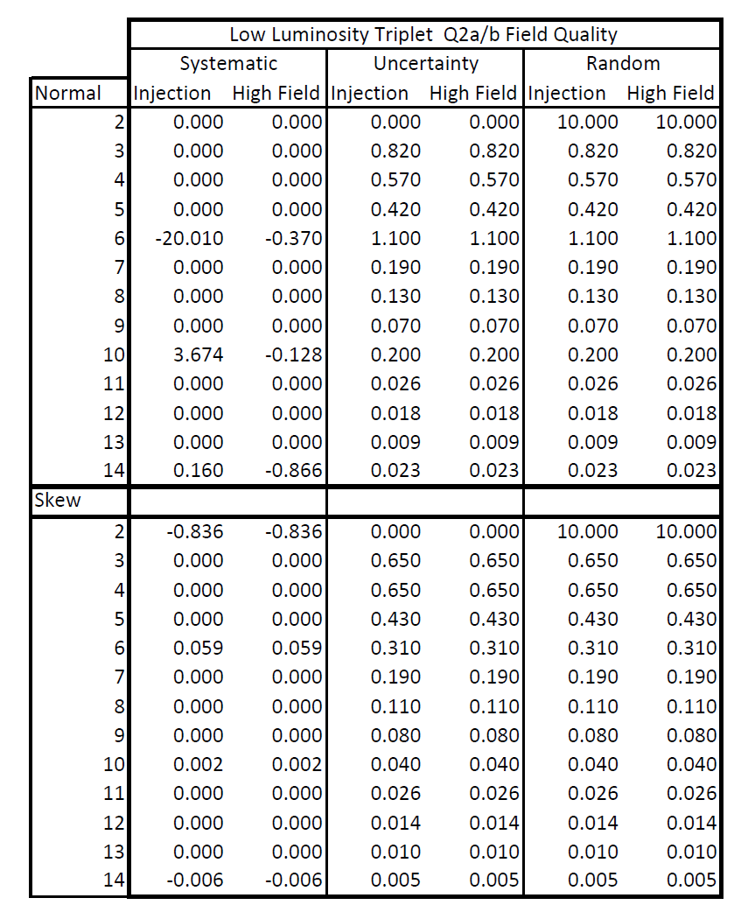
Triplet Field Quality in HL-LHC
For these error tables, the
weighted average of straights
and end parts
Magnetic lengths of the ends is
assumed to be the same as
in HL-LHC

Slide 13
Dipole Field Quality
CERN-ACC-2014-103

