Slide 1
FCC-hh Transverse Feedback Systems
Wolfgang Hofle
Acknowledgements: K. Li, J. Komppula

Slide 2
Outline
FCC-hh transverse feedback system
  recap of LHC transverse feedback system (ADT)
  design considerations for FCC-hh from injection damping and simulations
  intra-bunch feedback and simulation environment
Conclusions

Slide 3
Principle of Transverse Feedback
LHC
two pick-ups per beam and plane used (H and V)
extension to four pick-ups under way for LHC Run 2
feedback with FIR filters for phase adjustment – multiple turns of delay
gain limited by type of feedback filter used
vector sum for more robust phase adjustment possible
  T_{signal} = T_{beam} + n T_{rev}

Slide 4
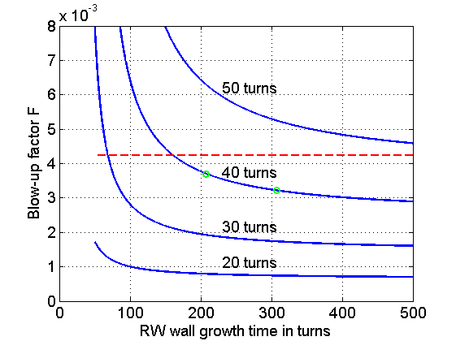
LHC ADT Design Parameters
injection |  | value
energy | E | 450 GeV
emittance (norm) | ε | 3.5 μm
injection error | a_{inj} | 4 mm @ β=185 m
increase w/o FB | a_{inj}²/(2σ²) | (5.92)
max increase of ε | (Δε/ε)_{max} | 0.025
Blow-up factor | F_{ε} | < 4.22 x10⁻³
relative emittance
increase at injection
Damping time
blow-up factor
de-coherence time
(in design report due to Q’)
Full tune spread 1.3x10⁻³
ultimate LHC
1.7e11 ppb
nominal LHC
1.0e11 ppb
EPAC’08, THPC121
LHC Design Report CERN-2004-003
LHC Run 1 (50 ns): in practice smaller emittances available from injectors (BCMS)
LHC Run 2 (25 ns): aimed for nominal, in practice BC(M)S type beams (3x48 and 8b4e)

Slide 5
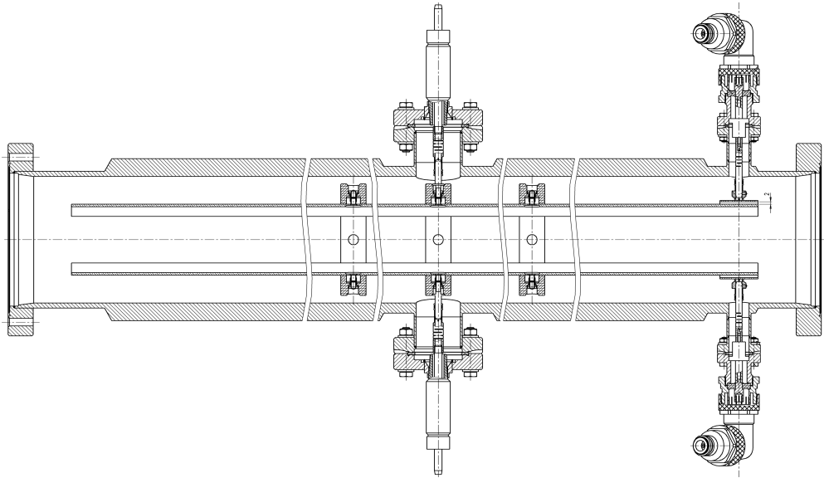
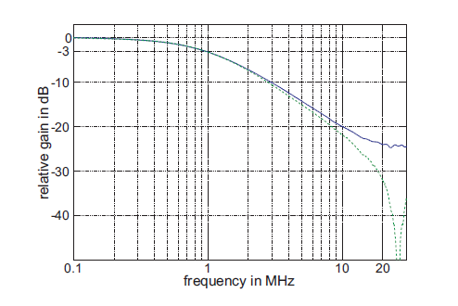
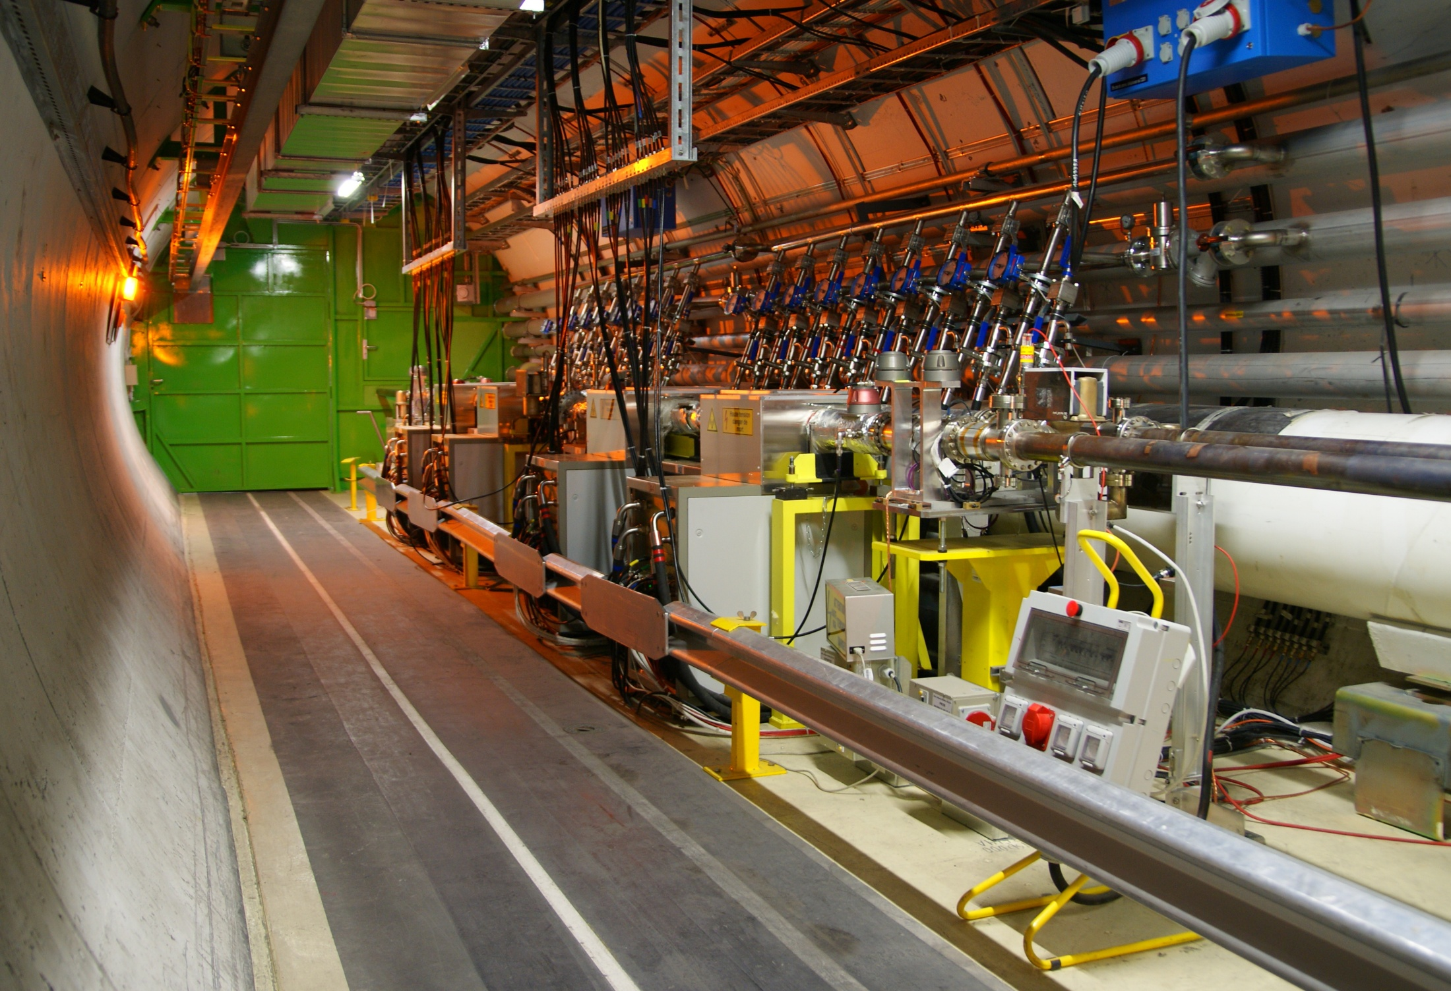
LHCADT Power and Kicker System
Power
kicker length: each kicker 1.5 m
max voltage: 10.5 kV
2 μrad kick to 450 GeV beam
gain up to beyond 20 MHz
16 kickers,
32x30 kW tetrode amplifiers
bandwidth up to 20 MHz
scaled from SPS system
observation
beam
ADT kicker. The beam is kicked by electric field
Measured ADT frequency response. Green: bare power amplifier, blue: power amp + kicker
Batch spacing (injection: 925 ns - 975 ns)
matched to 1 MHz “power bandwidth”
LHC transverse Feedback (ADT) kickers and amplifiers
in tunnel point 4 of LHC, RB44 and RB46
Kickers and Power Amplifiers → JINR, Dubna Collaboration

Slide 6
LHC TFB – Use Cases
  Initially designed for
    injection damping
    feedback during ramp (coupled bunch instabilities)
  LHC Physics Run 1 (2010-2013)
    providing stability at all times in the cycle
    (including with colliding beams !)
    diagnostics tool to record bunch-by-bunch oscillations
    abort gap and injection gap cleaning
    blow-up for loss maps and aperture studies
    tool to produce losses for quench tests
    tune measurement and online damping time measurement (from Run 2 onwards)

Slide 7
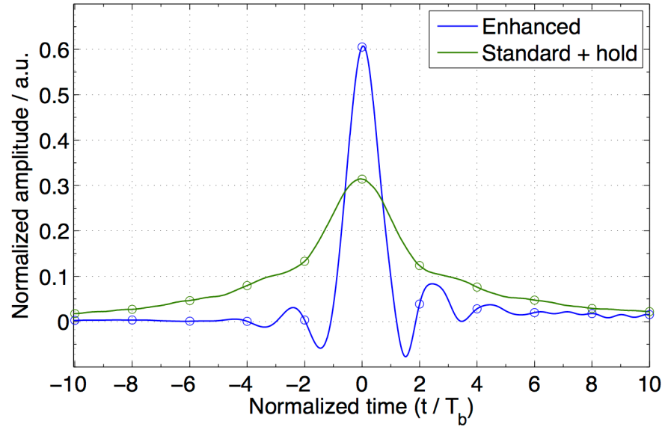
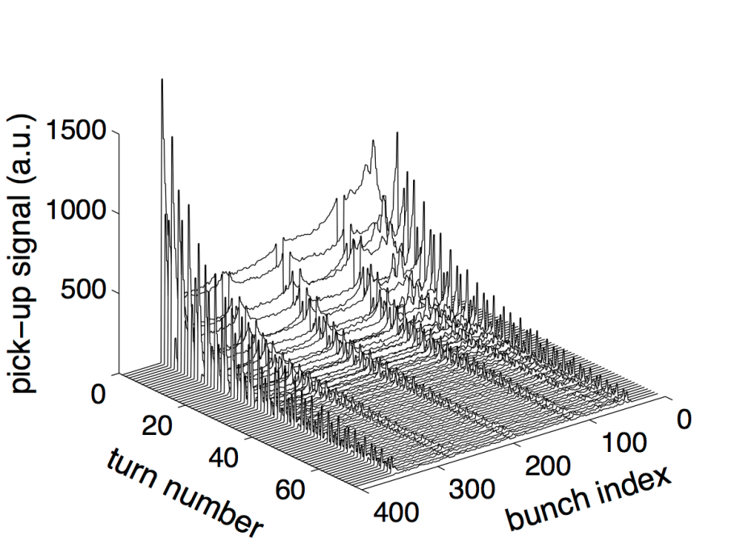
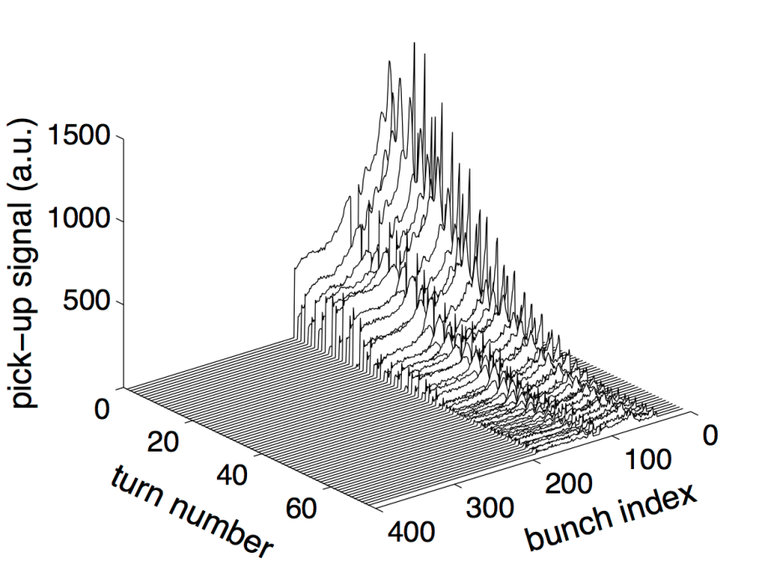
Injection oscillations – batch View
time domain ADT response
LHC
V-plane
Data from
LHC run 1 (2012)
50 ns bunch spacing
standard + hold
144 bunches (4x36)
25 ns bunch spacing
enhanced bandwidth
144 bunches (2x72)
Injection
oscillation
damping
damping at edges of batch slower
LHC rum 2: enhanced bandwidth during injection and ramp
standard bandwidth in stable beams (lower noise)
7
IPAC’13, WEPME43

Slide 8
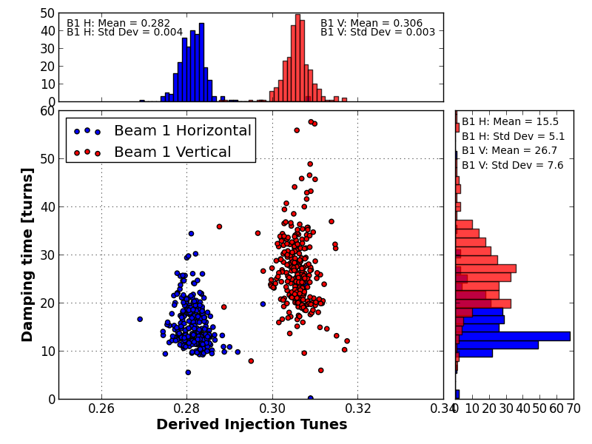
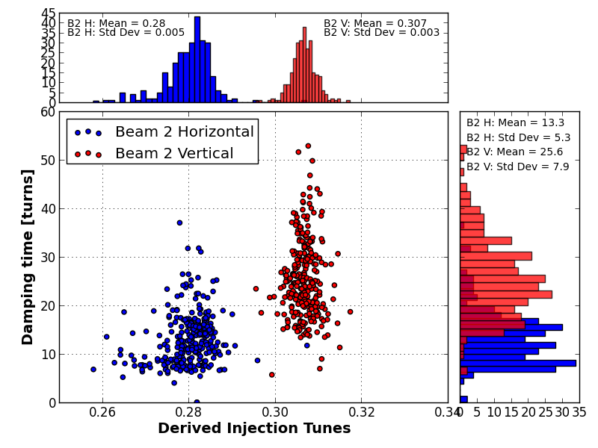
LHC 2012 Run 1 achievements
Damping times as measured on first bunch of batch
Beam 2
H: 13 turns
V: 26 turns
V
H
V
H
Beam 1
H: 16 turns
V: 27 turns
LHC, curtesy A. Macpherson
See also IPAC’13, FRXCA01
injection kicker ripple → slower V-damping

Slide 9
FCC-hh TFB: 25 ns – 97.7 km
FCC tentative parameters
injection |  | value
emittance (norm) | ε | 2.2 μm
injection error | a_{inj} | 1 mm @ β = 200 m
increase w/o FB | a_{inj}²/(2σ²) | depends on energy
max increase of ε | (Δε/ε)_{max} | 0.05
FCC versus LHC assumption:
smaller design injection error
0.5 mm + 0.5 mm ripple
de-coherence different
faster instability
FCC injection energy options
(~3x10⁻³ t.b.c.)
de-coherence time
(needs determination)
Injection energy in GeV | Coupled bunch Instability rise times in turns (O. Boine-Frankenheim et al.)
450 | 8 … 16
1500 | 22 … 47
3300 | 43 … 91
Full simulation at injection
In presence of
damping
tune spread
instabilities
desirable
fractional tunes: 0.72 or 0.32
impedance model being updated

Slide 10
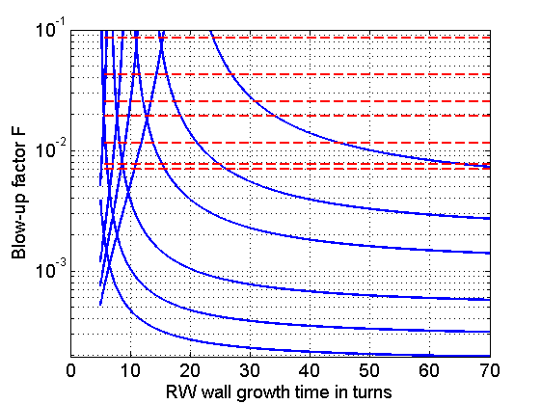
FCC injection damping (25 ns)
450 GeV case
blow-up factor limits
450 GeV
900 GeV
1.5 TeV
2 TeV
20 turns
damping
3.3 TeV (baseline)
5, 5.5 TeV
13 turns
10 turns
5% emittance
blow-up and
constant
injection
error (in mm)
6.7 turns
5 turns
4 turns

Slide 11
Parameters for injection damping
Parameter | LHC | FCC-hh (25 ns) | FCC-hh (5 ns)
energy (inj.) | 0.45 | 3.3 | 3.3 | TeV
emittance (norm) ε injected | 3.5 | 2.2 | 0.44 | μm
bunch spacing | 25 | 25 | 5 | ns
batch spacing | 925 | 300 | 300 | ns
max FB frequency | 20 | 20 | 20 (100) | MHz
Power bandwidth FB | 1 | 3 | 3 | MHz
injection errorr a_{inj} | 4 (1) | 1 | 1 | mm
max increase of ε with FB | 2.5 | 5 |  | %
res. wall instability growth | 310 | 80 (43) | 80 (43) | turns
damping time FB | 40 (13) | 20 | 20 | turns
deflection (total) | 2 | 0.5 | 0.5 | μrad
voltage per kicker (1.5 m) | 7.5 | 2.5 | 2.5 | kV
# kickers per plane/beam | 4 | 22 | 22
5 ns option requires additional (e.g. strip-line kickers) to cover 20 -100 MHz
LHC damping is as achieved in regular operation () limited by feedback stability
ref. beta for kickers / injection errors: ~200 m
100 m – 150 m needed (staggered installation)
for CDR optimization possible, propose consistent set of parameters for baseline

Slide 12
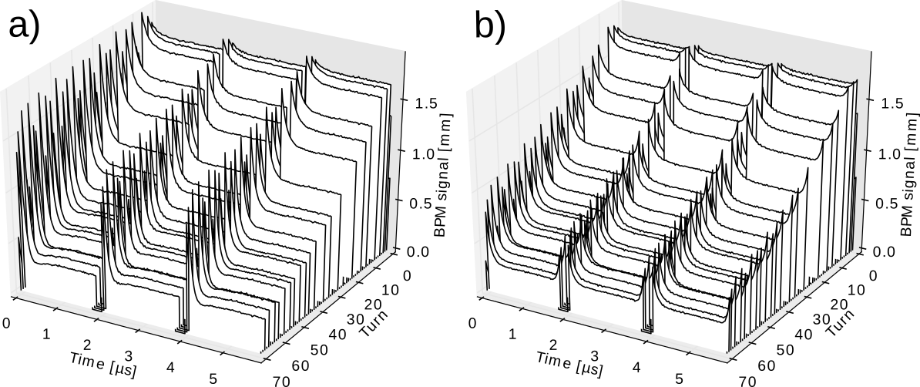
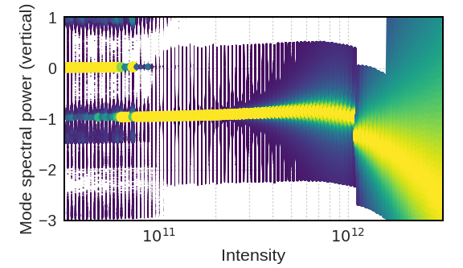
Simulation – damping-instability
simulation environment developed to cover coupled bunch and intra-bunch feedback (macro-particle code)
integrated with CERN head tail code
objective: refined quantitative results for CDR for coupled bunch and intra-bunch feedback using full impedance model, injection error, and de-coherence by non-linearities
injection damping (determine blow-up)
instability mitigation by feedback
injection damping
(different signal processing can be evaluated)
study of influence of dipolar feedback
on TMCI (64 turns damping time)
see poster J. Komppula et al. at FCC week in Berlin (2017)
also IPAC’17 TUPIK091

Slide 13
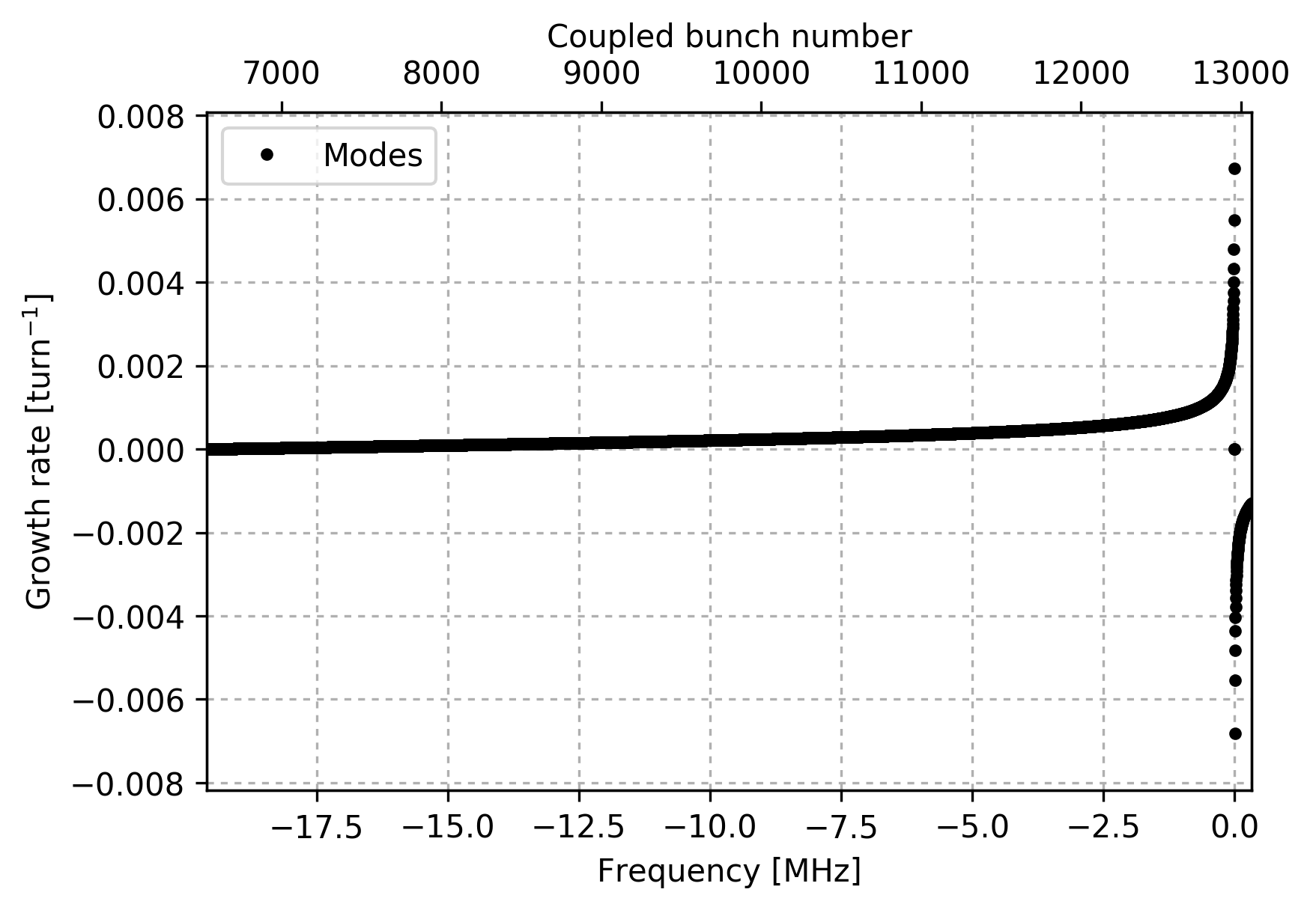
Results with Head-tail for CBI
25 ns bunch
spacing
Full number of bunches
Wakefield from impedance model
Bench marking ongoing
J. Komppula et al.

Slide 14
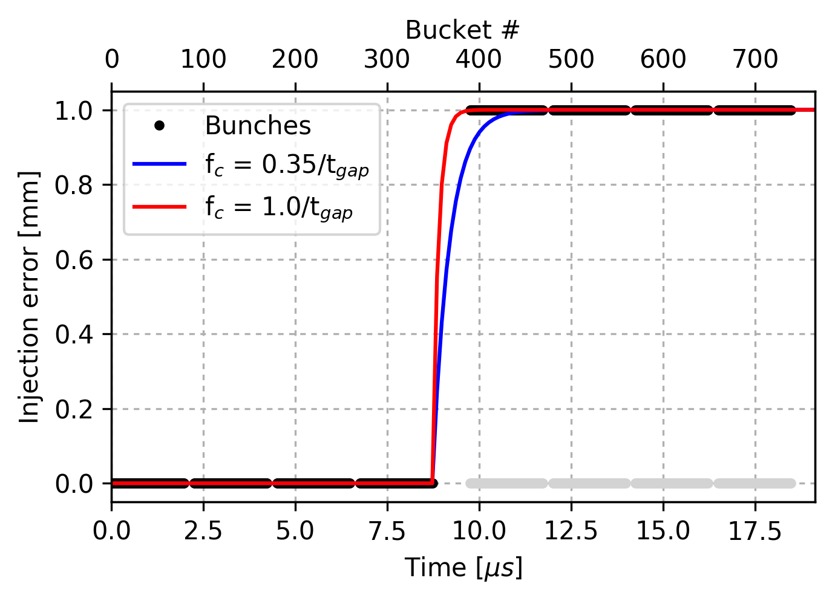
Bandwidth – step response
J. Komppula et al.
Frequency up to which full kick strength must be available given by gap length between injected batches and acceptable tolerances
Modelling with low pass (e.g. gaussian)

Slide 15
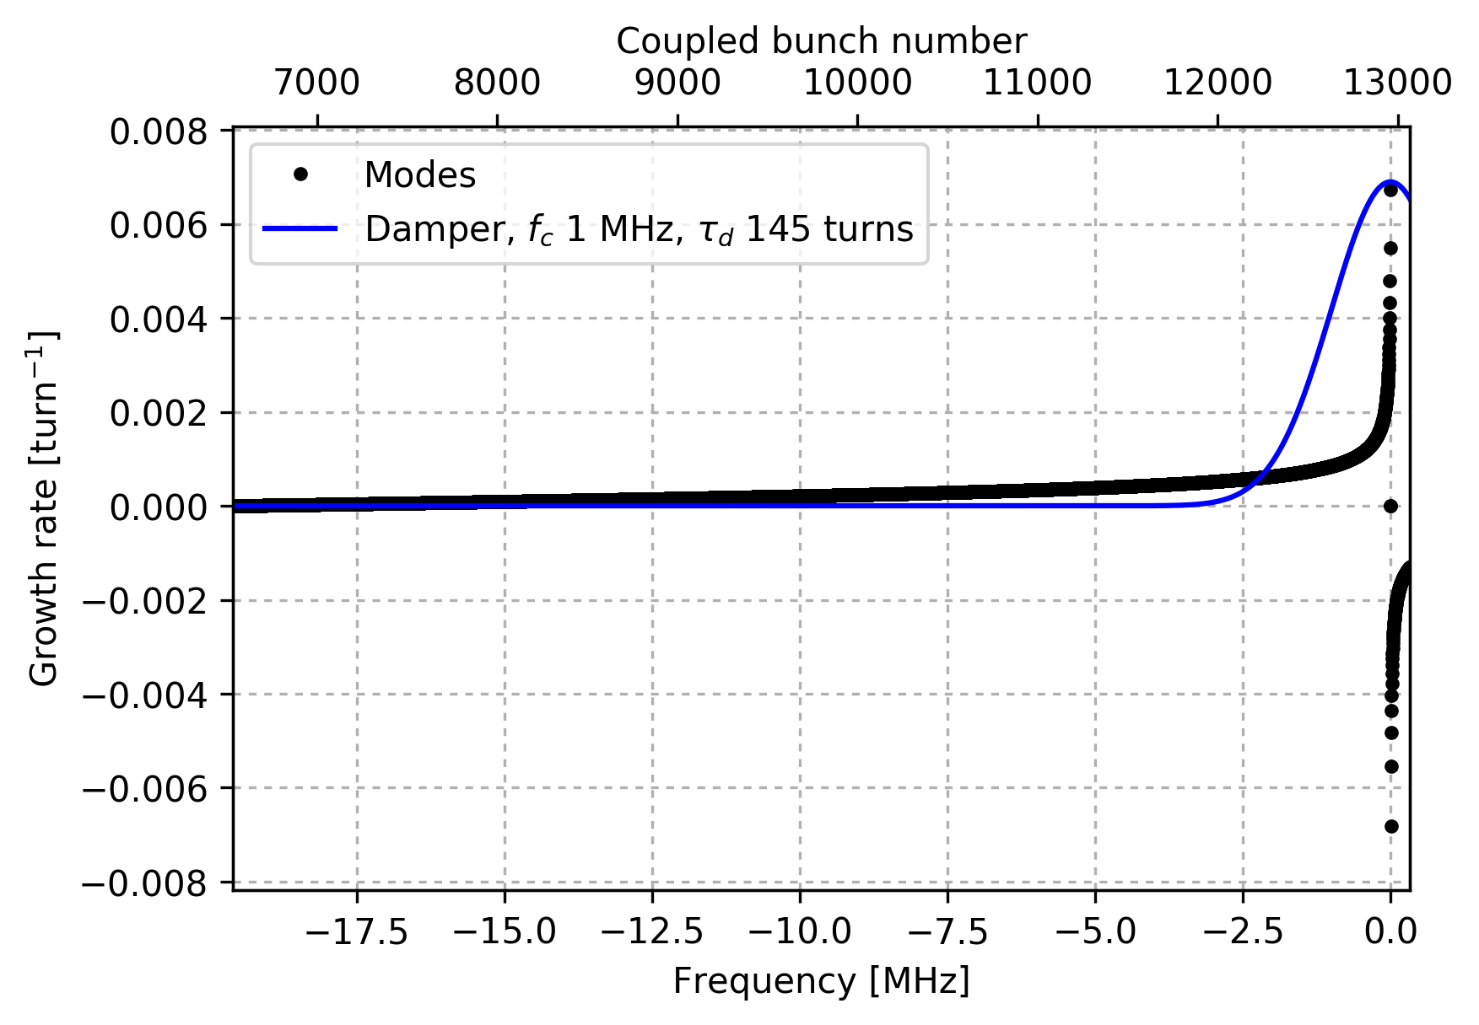
Inclusion of damper
Unstable
Stable
Inclusion of damper with its frequency response

Slide 16
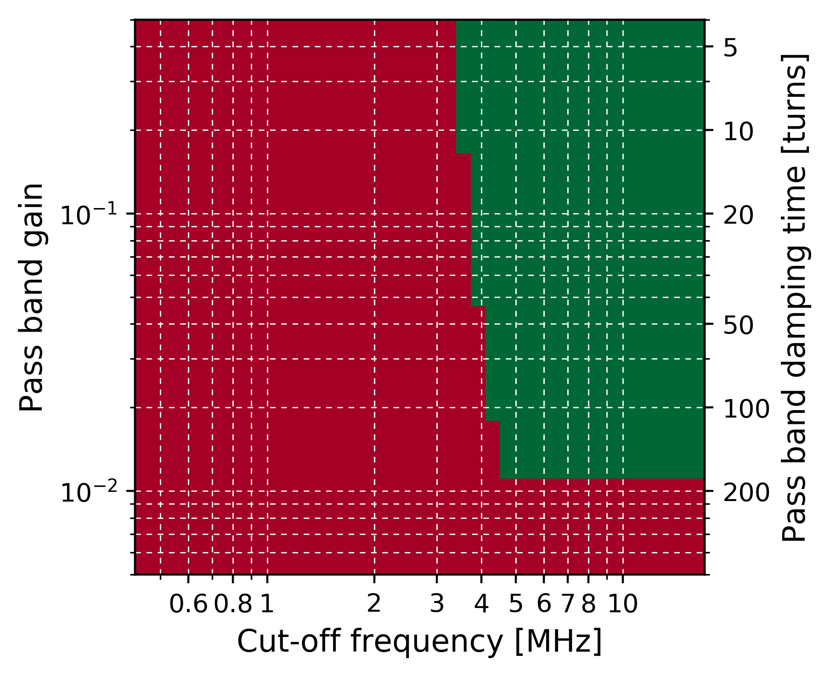
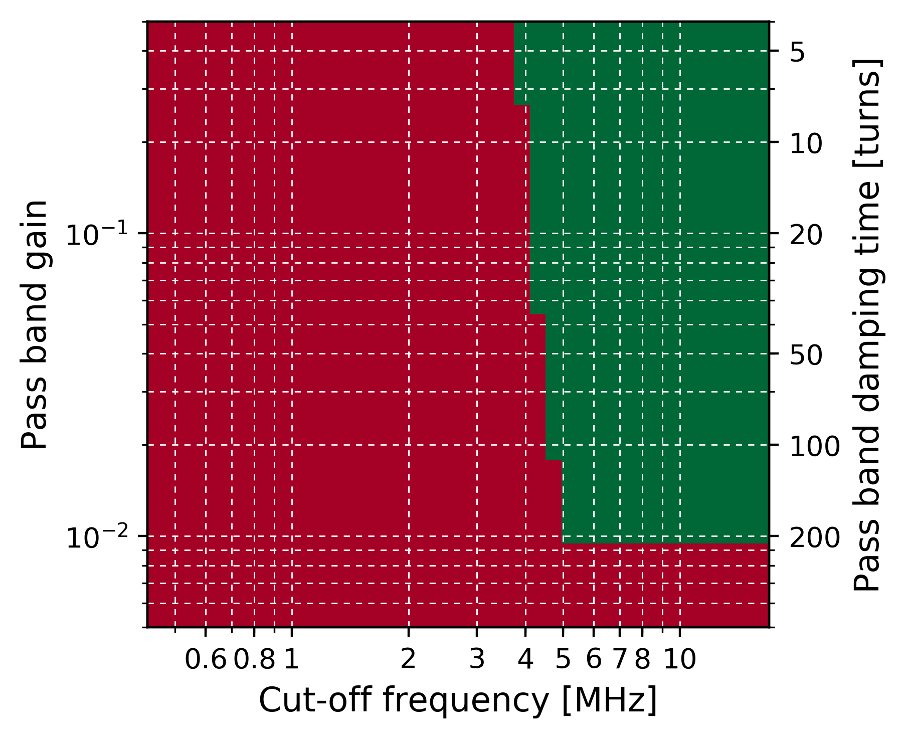
damper – numerical results
Fully filled
Filling scheme
with gaps
stable
stable
unstable
unstable
J. Komppula et al.

Slide 17
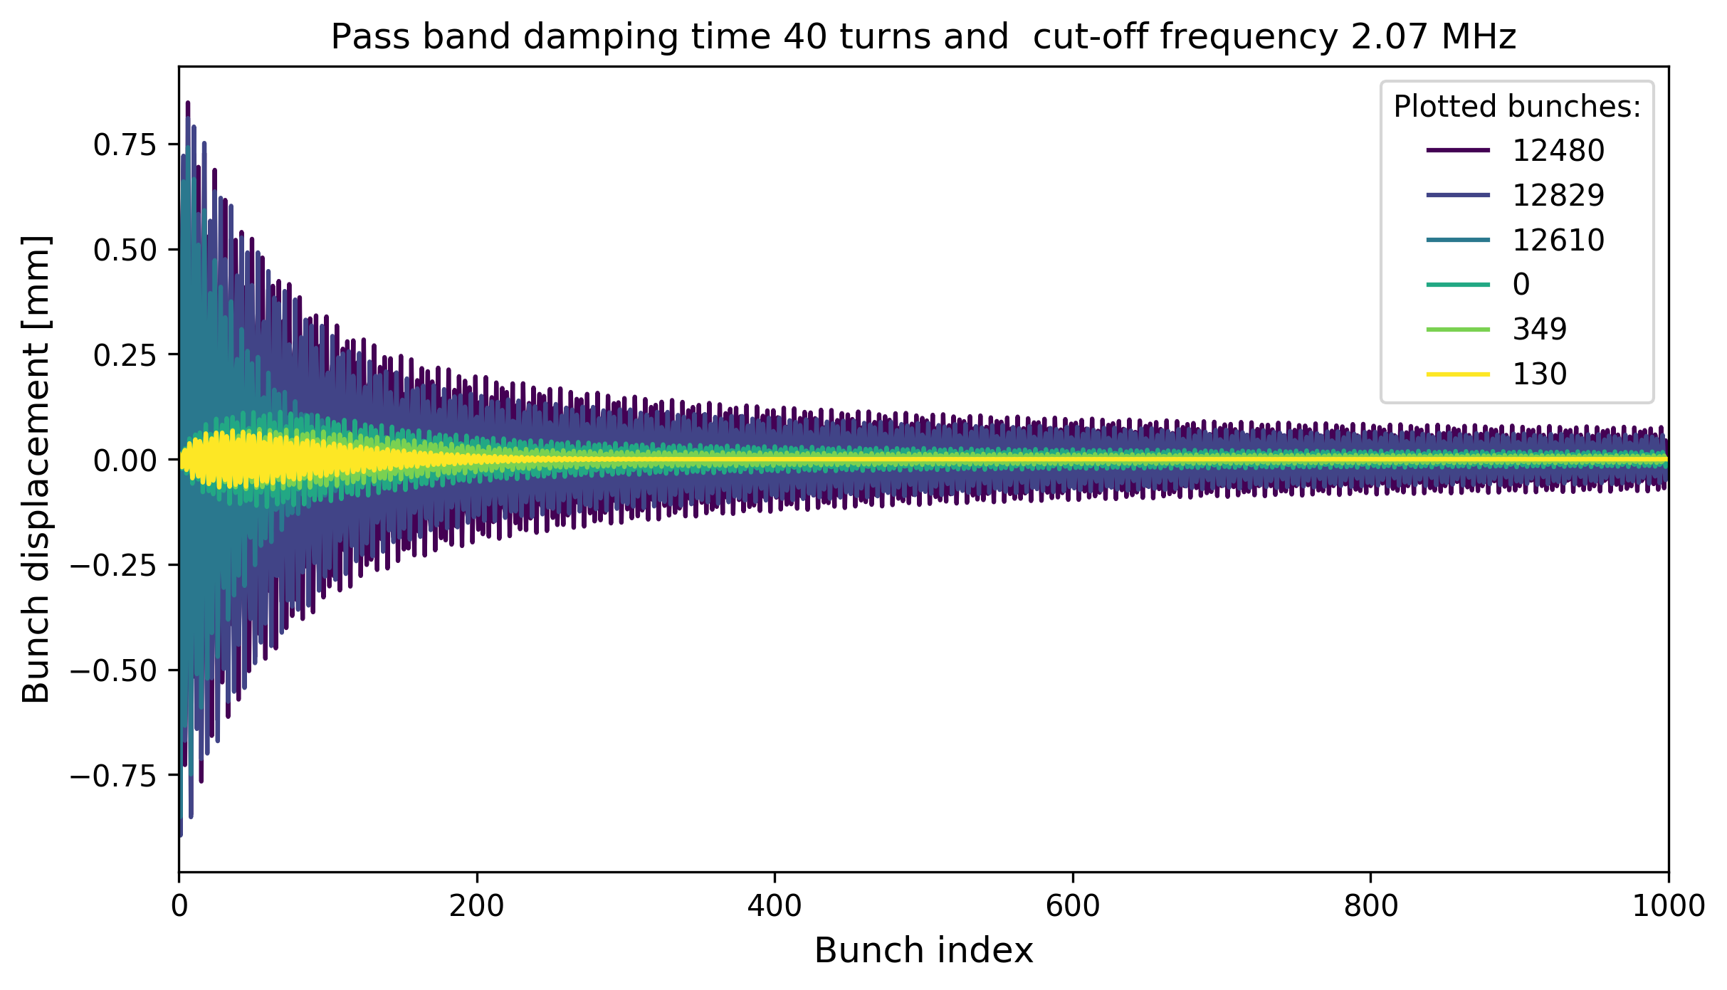
Injection damping
From the injected batch
(last injection)
From the previously
injected batch
(first injection)
Turn
  Significantly longer damping times on the edge of the injected batch (damper model sensitive)
  Wakes induce small oscillations to the previously injected bunches
Next step:
Improve model for the damper
Numbers for the emittance growth from multibunch PyHEADTAIL simulations
Taking into account chromticity, octupoles and injection kicker ripple

Slide 18
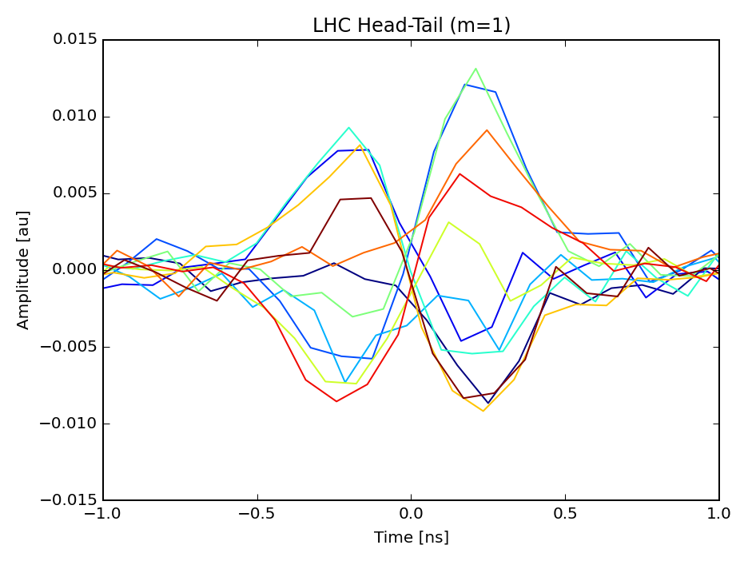
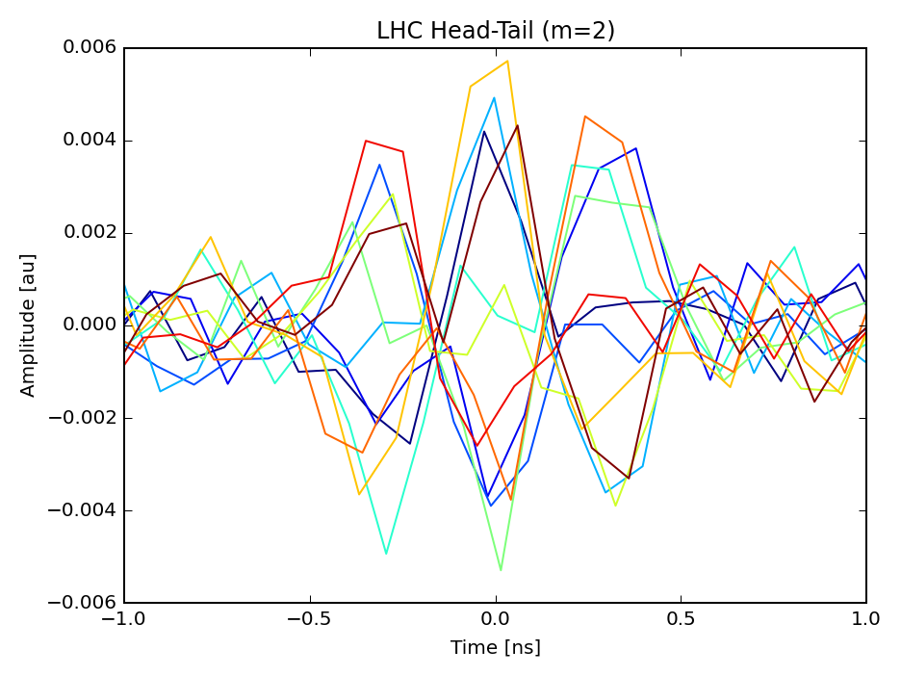
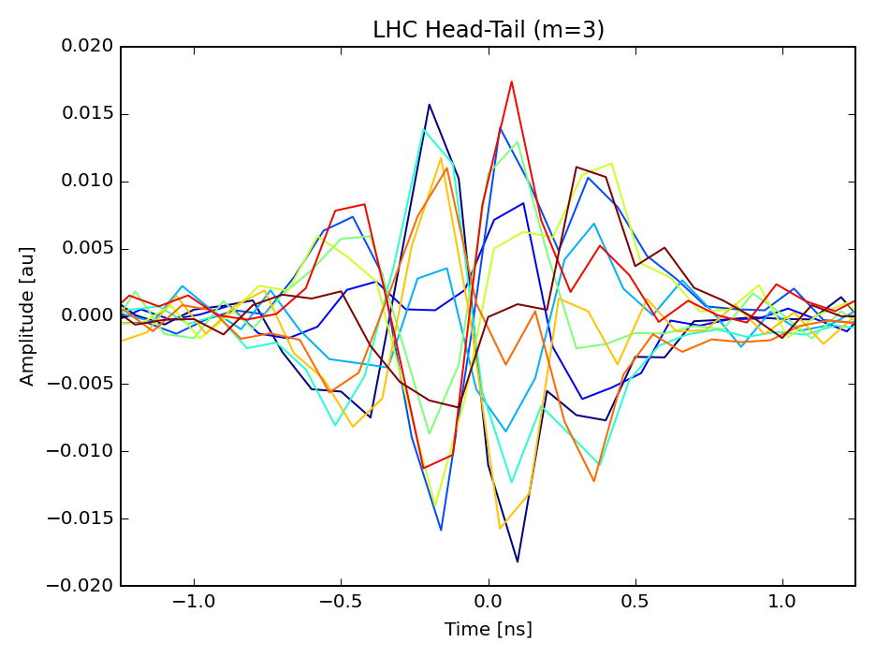
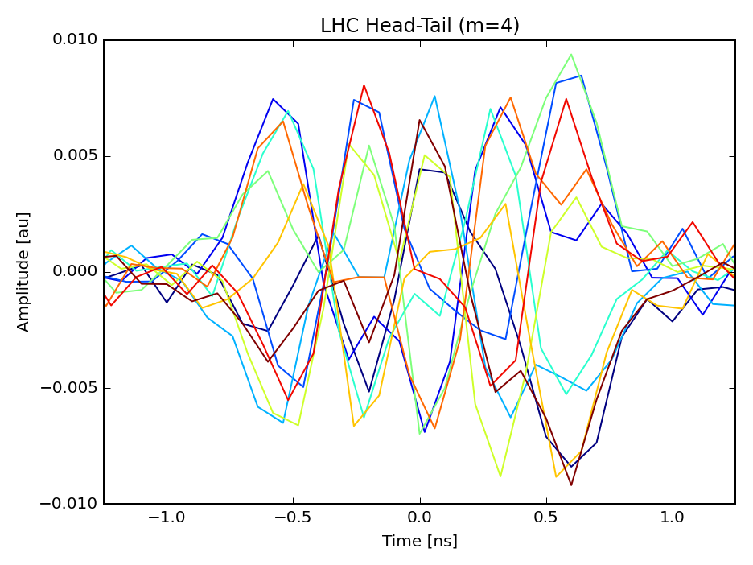
Intra-bunch motion at LHC
M=1
M=2
M=3
M=4
observed intra-bunch motion in LHC
T. Levens

Slide 19
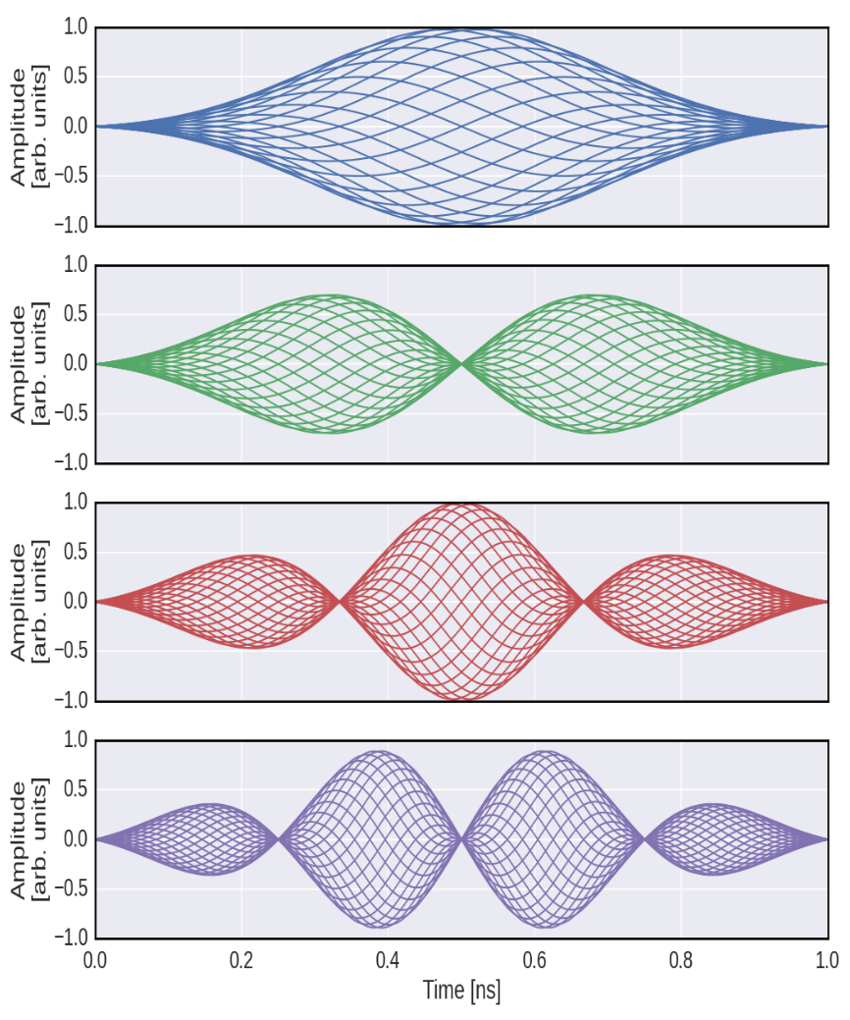
Mitigation of intra-bunch motion
  upgrade options for
  LHC Transverse Feedback
  (under study)
  options:
  Extension of current system:
  long strip-line at 40 MHz for true bunch-by-bunch damping
  Band-by-band approach:
  strip-line at 400 MHz in combination with slot-lines at 800, 1200, 1600, 2000, 2400,… MHz
0.5 GHz
0.5 GHz
1.0 GHz
1.5 GHz
2.0 GHz
under study for FCC, based on LIU SPS developments
mitigation of e-cloud and TMC instability
SPS LIU demonstrator results:
J.Fox, K. Li, e. Bjorsvik,
IPAC’17, TUPIK119

Slide 20
R&D: intra-bunch feedback (SPS)
BPM
Kicker
Beam
Active closed loop
Feedback
Analog
Front
End
ADC
Signal
Processing
DAC
Analog Back
End
Power Amp
transverse
position
pre-processed
sampled
position
“slices”
calculated
correction data
correction
signal
pre-distortion
drive signal
capacity to damp intra-bunch instabilities, 4-8 GS/s digital feedback
started as e-cloud instability feedback in SPS
also shown to damp TMCI in simulation if synchrotron tune low
closed loop experiments in SPS started
Feasibility at 450 GeV demonstrated on slingle bunch slow head-tail instability (2016)
targeted bandwidth in SPS → 1 GHz, needed BW scales with bunch length

Slide 21
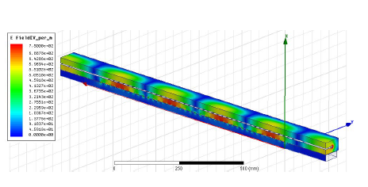
Perspectives: Kicker Design
R&D for SPS intra-bunch feedback
→ Faltin type kicker being built
(strip-line with slotted shield to beam pipe)
applicable to FCC intra-bunch feedback for up to 4 GHz
optimization of shunt impedance
caution: TeV beam energy (→ kWs power !)
30 mm
FCC
Guangyu Zhu
SPS prototyping (installation foreseen in 2017/2018 YETS):
J. Cesaratto et al. (SLAC), IPAC’2013
M. Wendt (CERN), IPAC’2017

Slide 22
Conclusions and outlook
need a coupled bunch feedback with options for 5 ns and 25 ns bunch spacing (driven by resistive wall instability → fast instability rise times at low frequency)
LHC type transverse feedback system proposed as baseline for 25 ns option, 22 kickers per plane and beam with adaptation of power bandwidth to FCC needs
5 ns option requires additional kickers to cover higher frequencies (strip-lines)
GHz feedback can be an option to mitigate slow intra-bunch instabilities, kicker designs being proposed based on SPS-LIU R&D
impact of feedback noise, suppression of emittance growth by ground motion and due to crab cavity noise needs consideration
simulation environment developed, integrated with head-tail code to refine in simulation the specifications and evaluate the performance for the CDR treating coupled bunch and intra-bunch instabilities as well as injection errors and filamentation

