Slide 1

Status of the FCC-hh impedance database*
*Database webpage:
https://impedance.web.cern.ch/impedance/fcchh/impedances.html
Sergey Arsenyev
EuroCirCol workshop, 10.10.2017

Slide 2
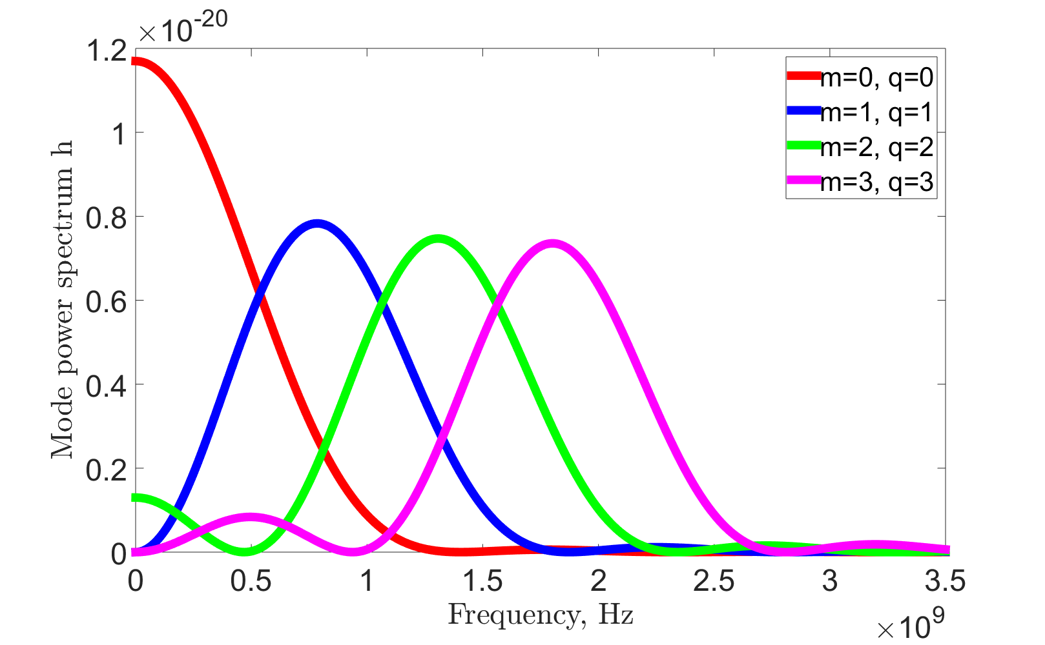

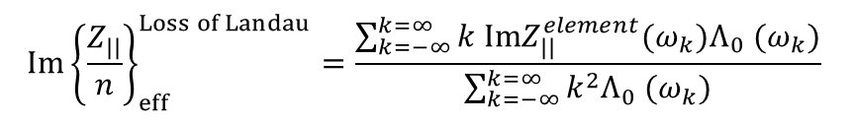

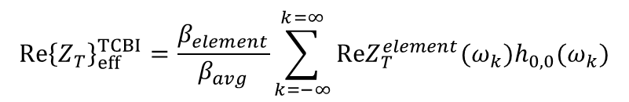

Mode 0 impedance budget
Impedance budget consists of 3 effective impedances, each one for its own instability. For each element (e.g. beamscreen, collimators, etc) we compute quantities:
$${Re\left\{Z_{T}\right\}}_{eff}^{TCBI}=\frac{β_{element}}{β_{avg}}\sum_{k=−∞}^{k=∞}{ReZ_{T}^{element}(ω_{k})h_{0,0}(ω_{k})}$$
Sum over frequency lines $ω_{k}=(frac\left[Q\right]−1+kM)Ω_{0}$
${Im\left\{Z_{T}\right\}}_{eff}^{TMCI}=\frac{β_{element}}{β_{avg}}\frac{\sum_{k=−∞}^{k=∞}{ImZ_{T}^{element}(ω_{k})h_{0,0}(ω_{k})}}{\sum_{k=−∞}^{k=∞}{h_{0,0}(ω_{k})}}$
Mode power spectra $h_{m,q}$ for a parabolic bunch
$$\text{Sum} \text{over} \text{f}\text{requency} \text{lines}\text{:} ω_{k}=(k+Q)Ω_{0}$$
$${Im\left\{\frac{Z_{||}}{n}\right\}}_{eff}^{Loss of Landau}=\frac{\sum_{k=−∞}^{k=∞}{k ImZ_{||}^{element}(ω_{k})Λ_{0} (ω_{k})}}{\sum_{k=−∞}^{k=∞}{k^{2}Λ_{0} (ω_{k})}}$$
Mode 0 effective impedances are computed for chromaticity 0 (worst case).
$$\text{Sum} \text{over} \text{f}\text{requency} \text{lines}\text{:} ω_{k}=kΩ_{0}$$

Slide 3
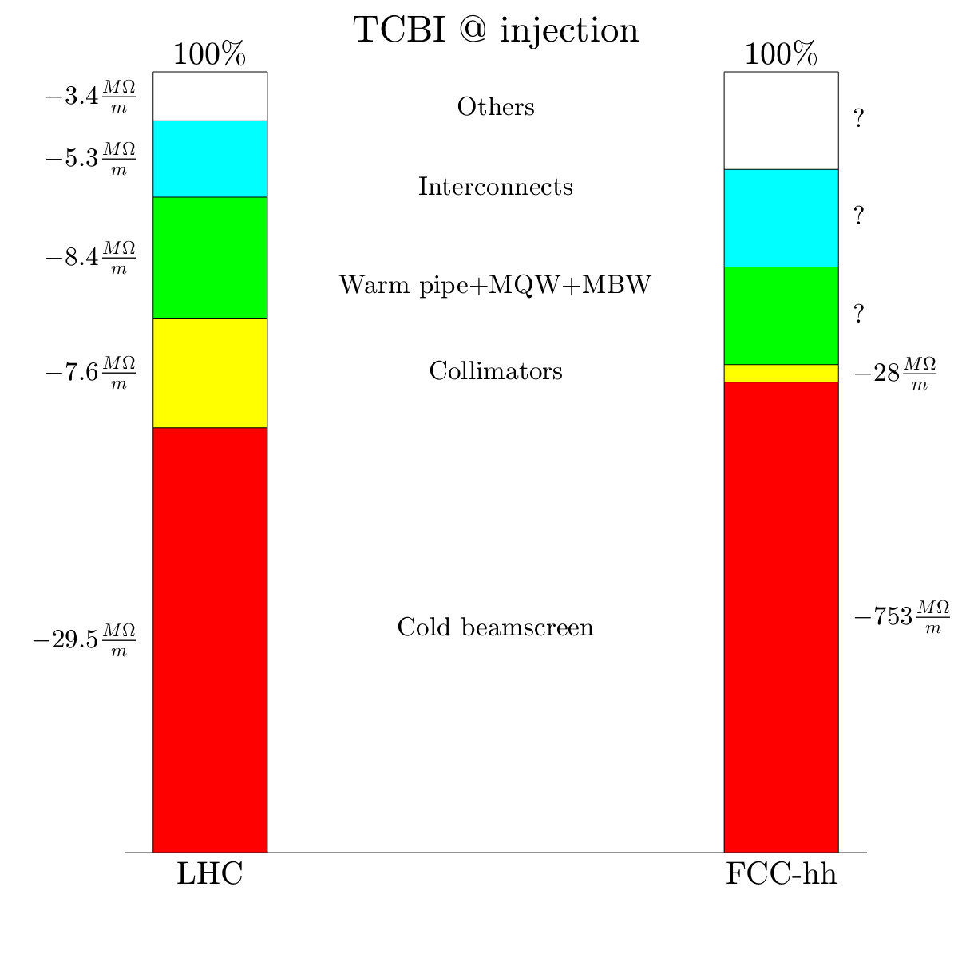


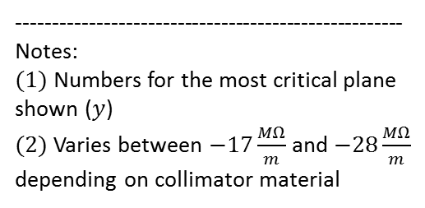
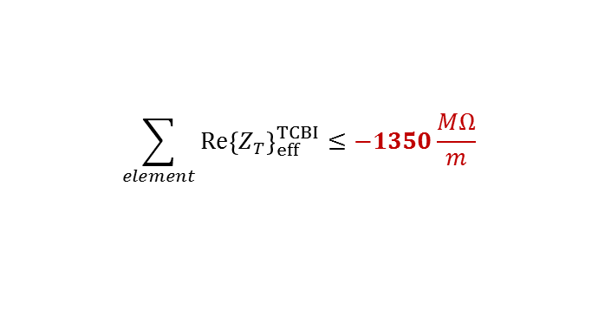
Mode 0 impedance budget: TCBI at injection
$$(1)$$
Limit:
$$\sum_{element}{{Re\left\{Z_{T}\right\}}_{eff}^{TCBI}}≤−1350\frac{MΩ}{m}$$
Assuming required feedback speed of 60 turns
$$(2)$$
20 turns for a safety factor of 3
Safe, but not far from the limit
Impedance dominated by beamscreen
-----------------------------------------------------
Notes:
$(1)$ Numbers for the most critical plane shown ($y$)
$(2)$ Varies between $−17\frac{MΩ}{m}$ and $−28\frac{MΩ}{m}$ depending on collimator material

Slide 4
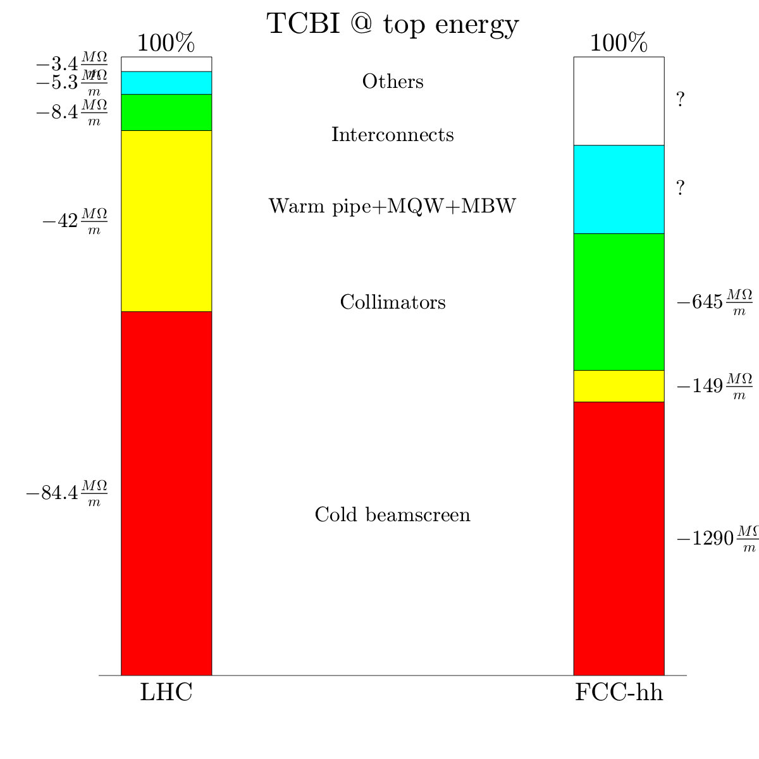


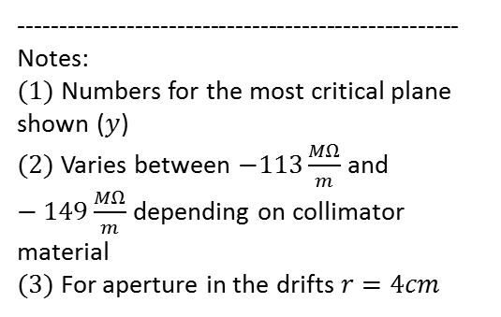
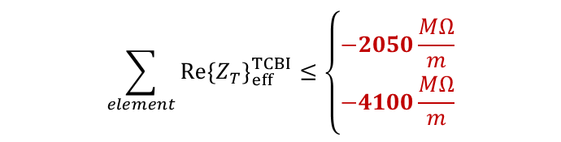
Mode 0 impedance budget: TCBI at top energy
200 turns for a safety factor of 3
$$(1)$$
Assuming required feedback speed of 600 turns
Limit:
$$\sum_{element}{{Re\left\{Z_{T}\right\}}_{eff}^{TCBI}}≤\left\{\begin{aligned}−2050\frac{MΩ}{m} \\ −4100\frac{MΩ}{m}\end{aligned}\right.$$
$$(3)$$
Assuming required feedback speed of 300 turns
Safe, but not far from the limit
Impedance dominated by beamscreen
$$(2)$$
100 turns for a safety factor of 3
-----------------------------------------------------
Notes:
$(1)$ Numbers for the most critical plane shown ($y$)
$(2)$ Varies between $−113\frac{MΩ}{m}$ and $−149\frac{MΩ}{m}$ depending on collimator material
$(3)$ For aperture in the drifts $r=4cm$

Slide 5
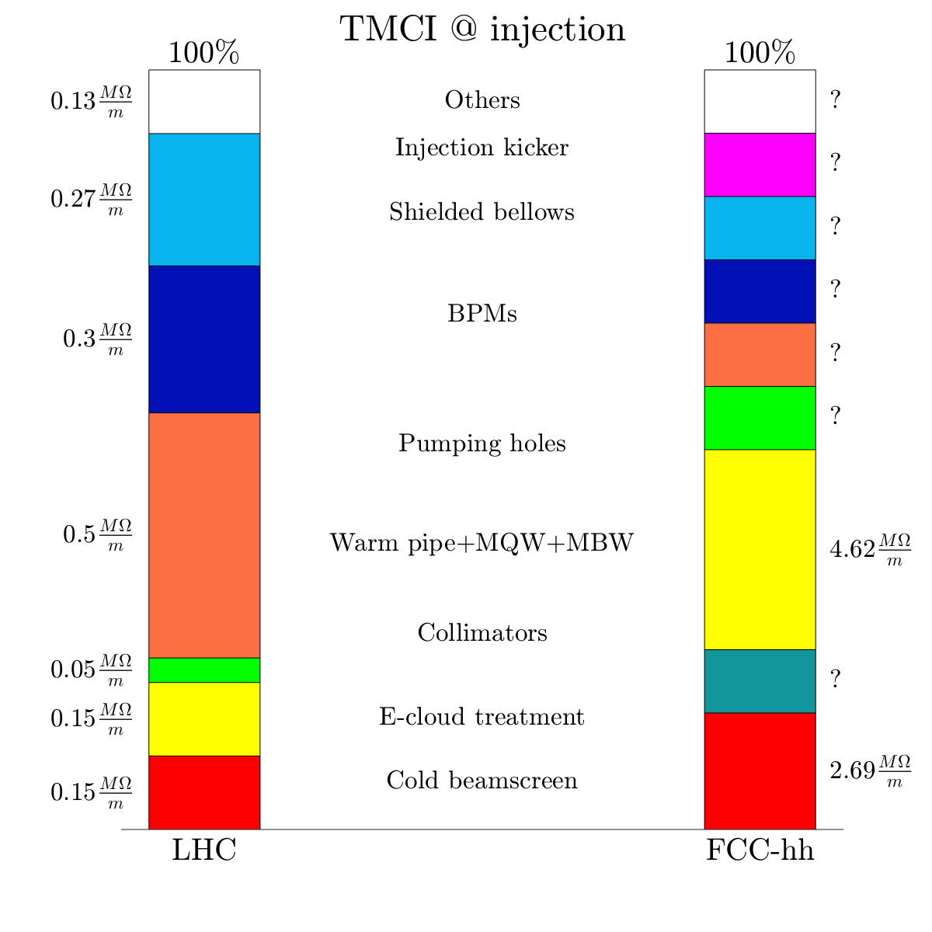
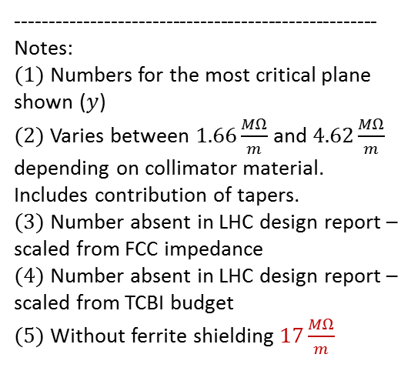

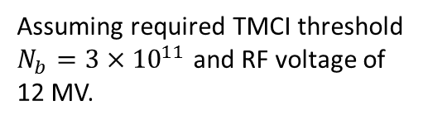

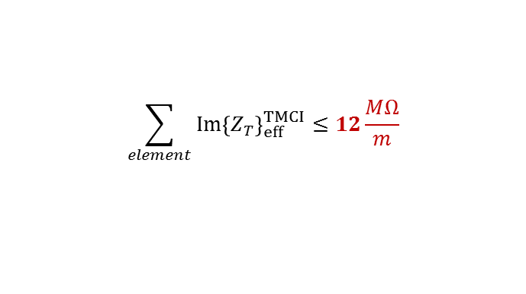

Mode 0 impedance budget: TMCI at injection
$$(1)$$
Limit:
$$\sum_{element}{{Im\left\{Z_{T}\right\}}_{eff}^{TMCI}}≤12\frac{MΩ}{m}$$
$$(5)$$
Assuming required TMCI threshold $N_{b}=3×{10}^{11}$ and RF voltage of 12 MV.
safety factor of 3
Safe, but many unknown elements
No single dominant contribution to impedance
-----------------------------------------------------
Notes:
$(1)$ Numbers for the most critical plane shown ($y$)
$(2)$ Varies between $1.66\frac{MΩ}{m}$ and $4.62\frac{MΩ}{m}$ depending on collimator material. Includes contribution of tapers.
$(3)$Number absent in LHC design report – scaled from FCC impedance
$(4)$Number absent in LHC design report – scaled from TCBI budget
$(5)$Without ferrite shielding $17\frac{MΩ}{m}$
$$(2)$$
$$(4)$$
$$(3)$$

Slide 6
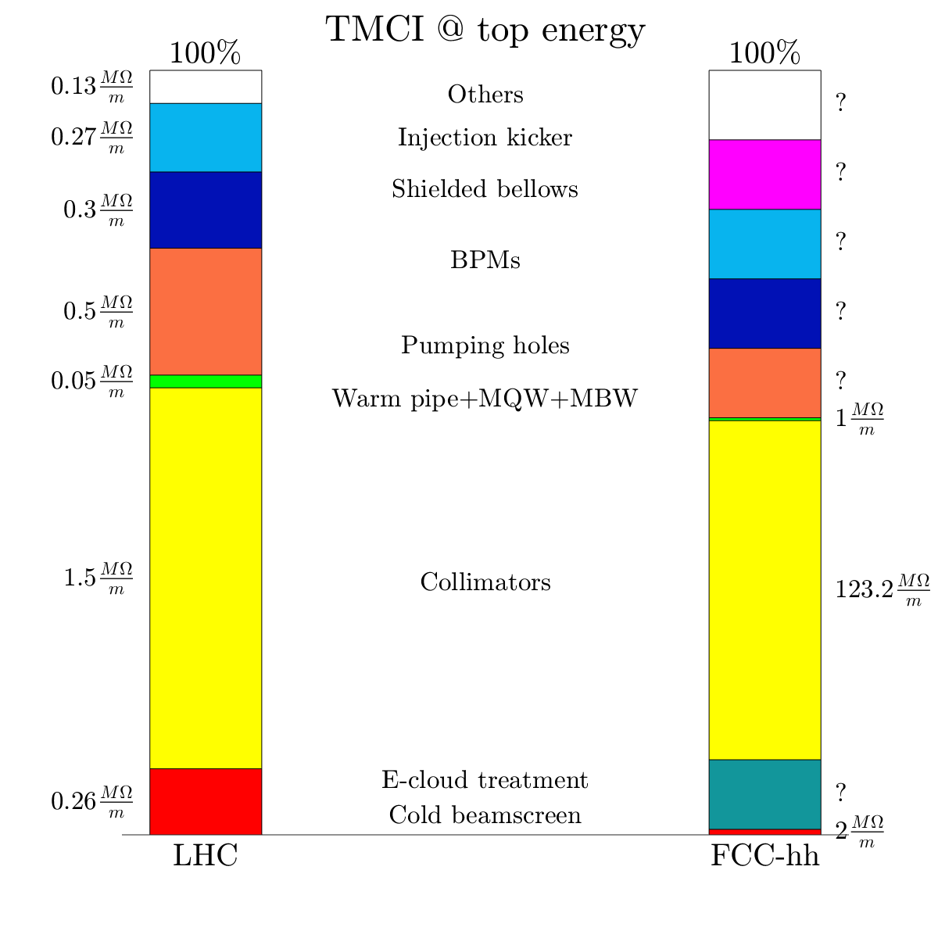
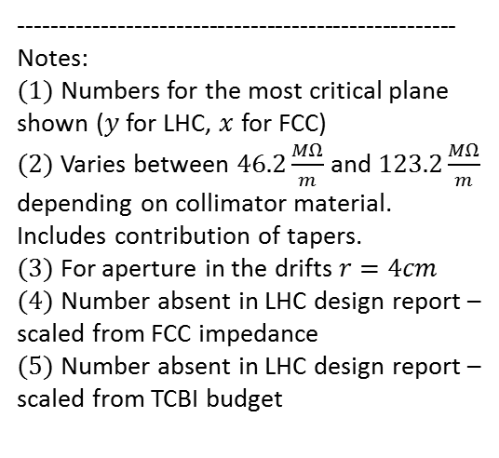


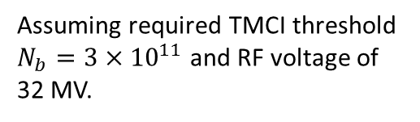
Mode 0 impedance budget: TMCI at top energy
$$(1)$$
Limit:
$$\sum_{element}{{Im\left\{Z_{T}\right\}}_{eff}^{TMCI}}≤70\frac{MΩ}{m}$$
Assuming required TMCI threshold $N_{b}=3×{10}^{11}$ and RF voltage of 32 MV.
$$(5)$$
$$(3)$$
safety factor of 3
Safe only for some scenarios
Impedance dominated by collimators
-----------------------------------------------------
Notes:
$(1)$ Numbers for the most critical plane shown ($y$ for LHC, $x$ for FCC)
$(2)$ Varies between $46.2\frac{MΩ}{m}$ and $123.2\frac{MΩ}{m}$ depending on collimator material. Includes contribution of tapers.
$(3)$ For aperture in the drifts $r=4cm$
$(4)$Number absent in LHC design report – scaled from FCC impedance
$(5)$Number absent in LHC design report – scaled from TCBI budget
$$(2)$$
$$(4)$$

Slide 7
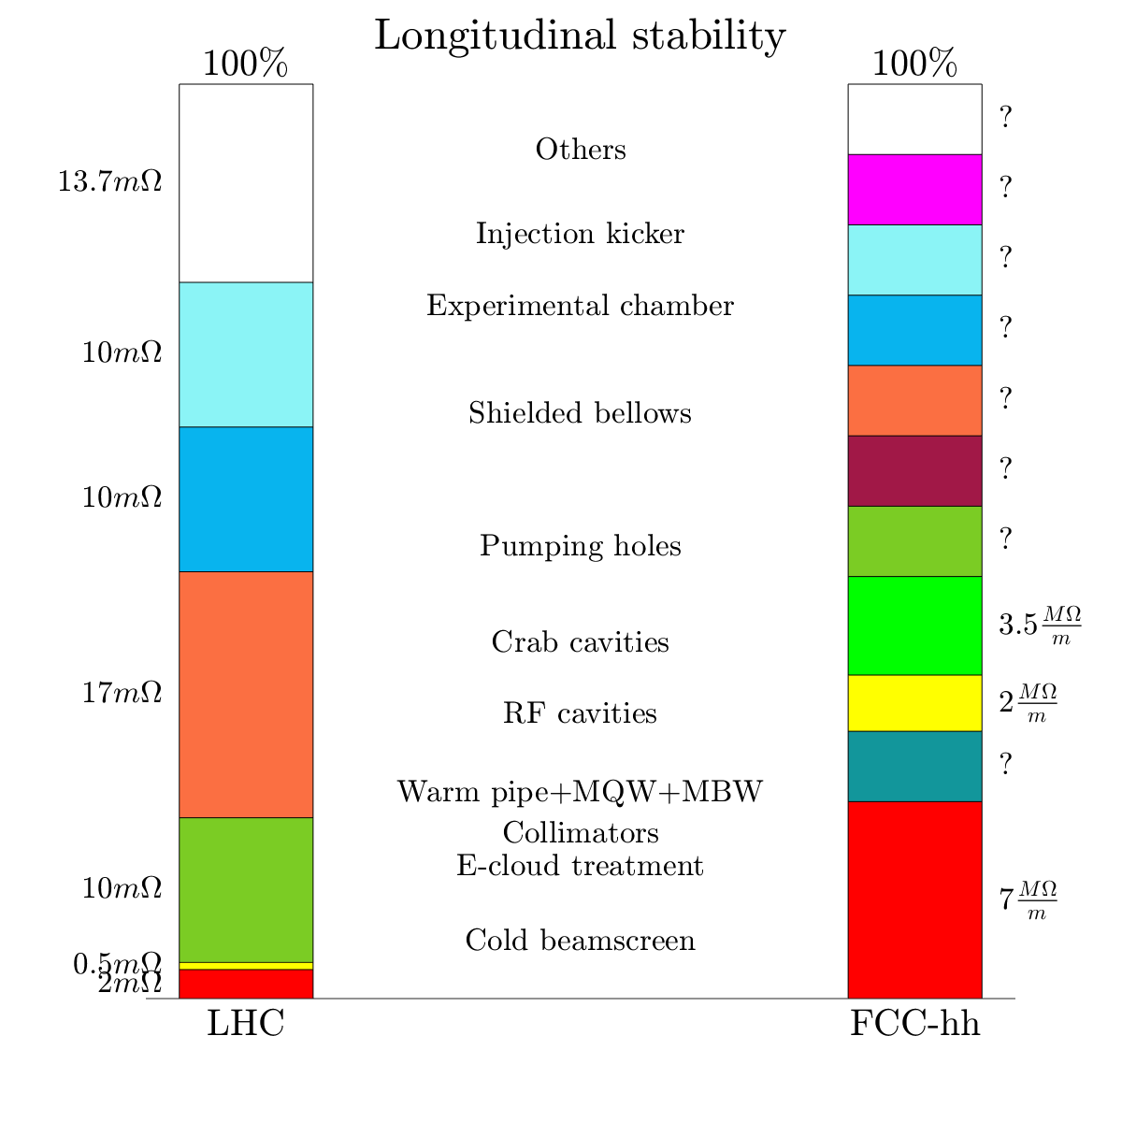

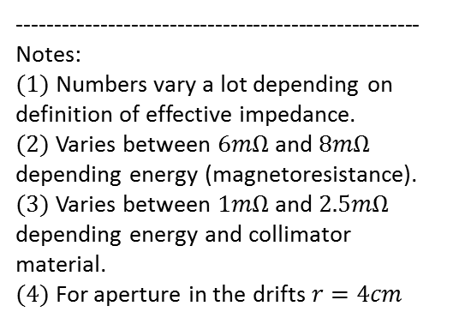
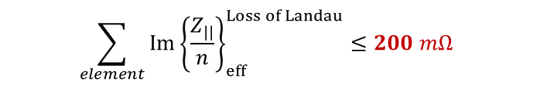
Mode 0 impedance budget: Longitudinal stability
$$(1)$$
Limit:
$$\sum_{element}{{Im\left\{\frac{Z_{||}}{n}\right\}}_{eff}^{Loss of Landau}}≤200 mΩ$$
Assuming 2 times the budget of LHC.
-----------------------------------------------------
Notes:
$(1)$ Numbers vary a lot depending on definition of effective impedance.
$(2)$ Varies between $6mΩ$ and$8mΩ$ depending energy (magnetoresistance).
$(3)$ Varies between $1mΩ$ and$2.5mΩ$ depending energy and collimator material.
$(4)$ For aperture in the drifts $r=4cm$
No conclusive answer
Many elements contribute to impedance
$$(4)$$
$$(3)$$
$$(2)$$

Slide 8
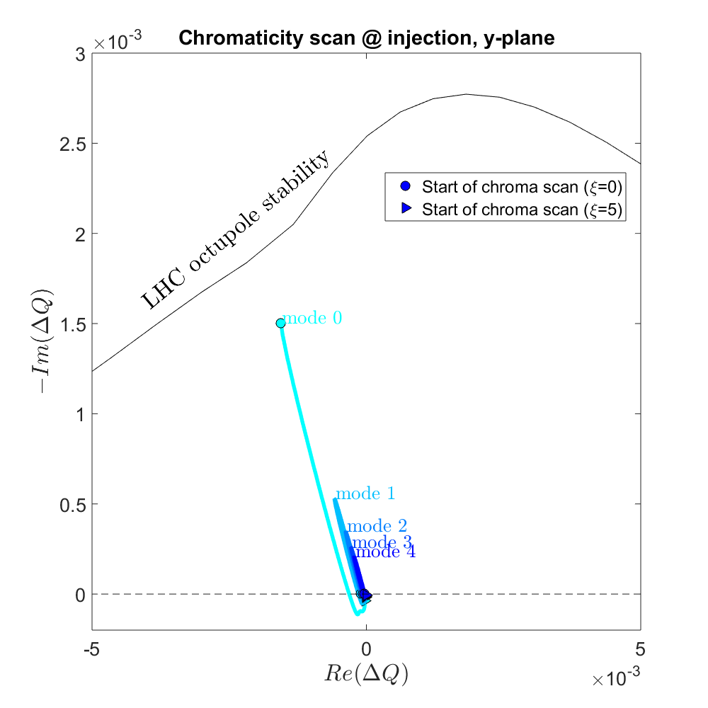
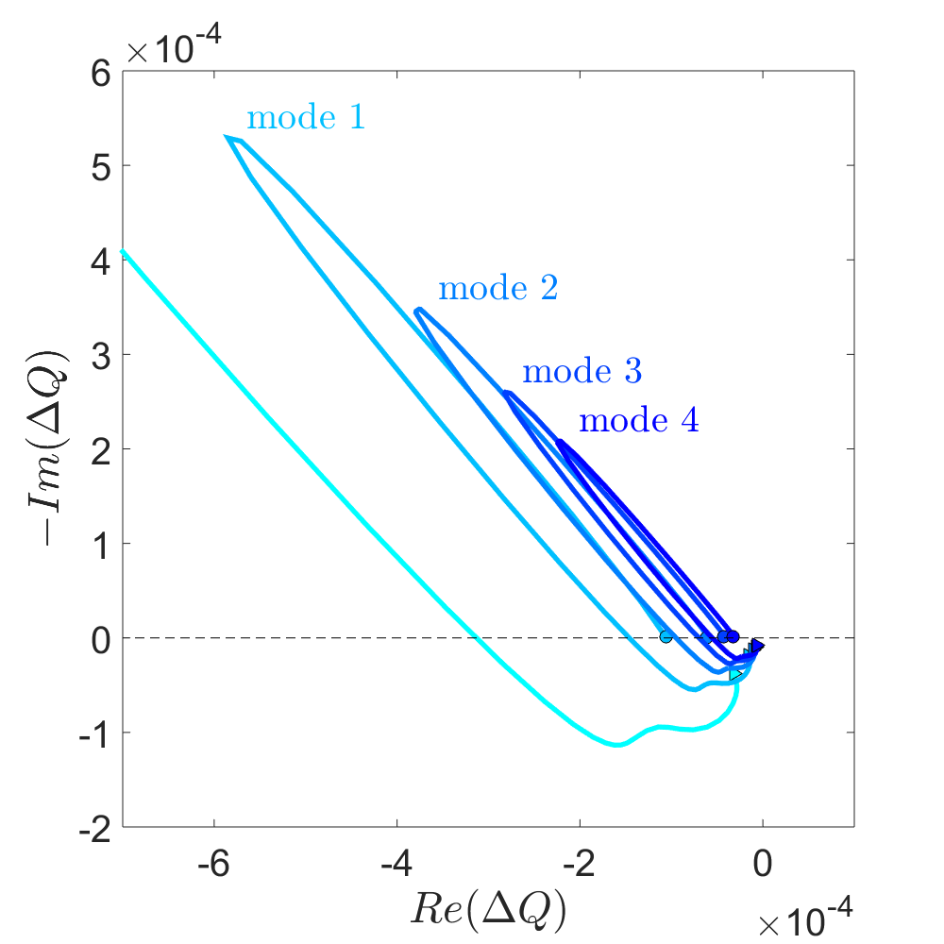

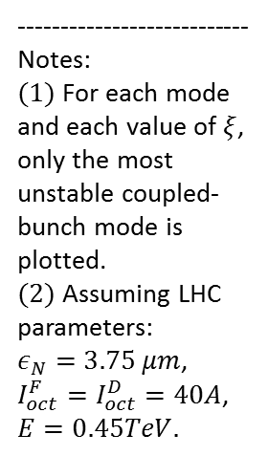




Higher modes impedance budget at injection
For higher modes $ξ=0$ is not the worst case – chromaticity scan needed
$$(2)$$
---------------------------
Notes:
$(1)$For each mode and each value of $ξ$, only the most unstable coupled-bunch mode is plotted.
$(2)$Assuming LHC parameters:
$ε_{N}=3.75 μm$, $I_{oct}^{F}=I_{oct}^{D}=40A$, $E=0.45TeV.$
$$(1)$$
$$ξ=0.58$$
$$ξ=0.28$$
$$ξ=0.38$$

Slide 9
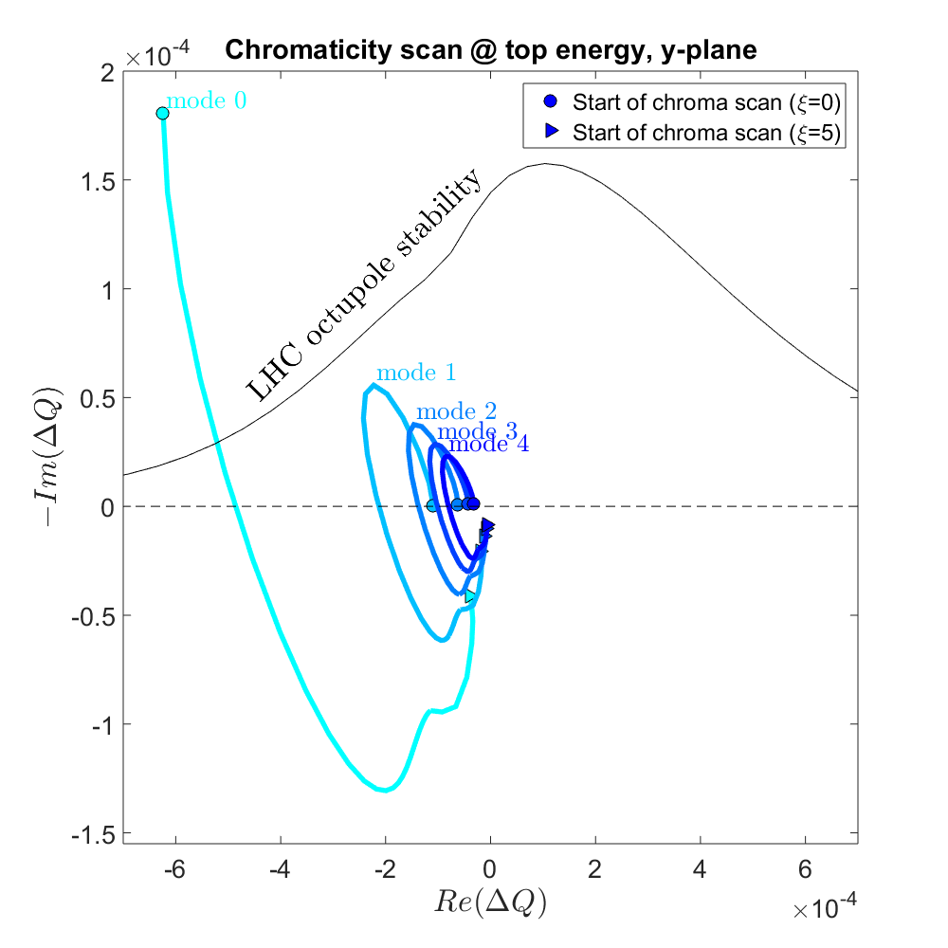


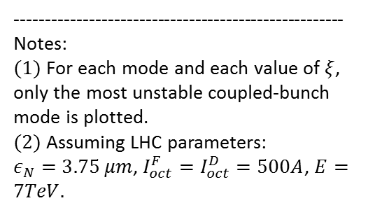


Higher modes impedance budget at top energy
$$(1)$$
For higher modes $ξ=0$ is not the worst case – chromaticity scan needed
$$(2)$$
-----------------------------------------------------
Notes:
$(1)$For each mode and each value of $ξ$, only the most unstable coupled-bunch mode is plotted.
$(2)$ Assuming LHC parameters:
$ε_{N}=3.75 μm$, $I_{oct}^{F}=I_{oct}^{D}=500A$, $E=7TeV.$
$$ξ=0.12$$
$$ξ=0.25$$
$$ξ=0.43$$

Slide 10
Conclusions
An LHC-like impedance budget is created for head-tail mode 0.
Limits on mode 0 impedance are put based on feedback speed, TCMI threshold, and longitudinal stability.
For higher modes, tuneshift is computed over a chromaticity scan.
Work to do:
Higher modes stability study with Landau damping
Better understand longitudinal stability
Still many elements to be added to the database:
  Pumping holes + stiffeners
  Interconnects
  BPMs, Y-chambers, bellows
  Injection kicker

