Slide 1


Radiation-induced effects on data integrity and -link stability of RD53A
Pixel 2018, Taipei
M. Vogt* on behalf of the rd53 collaboration
*Physikalisches Institut, Universität Bonn

Slide 2
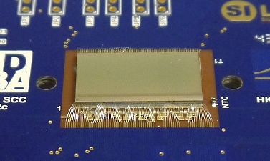
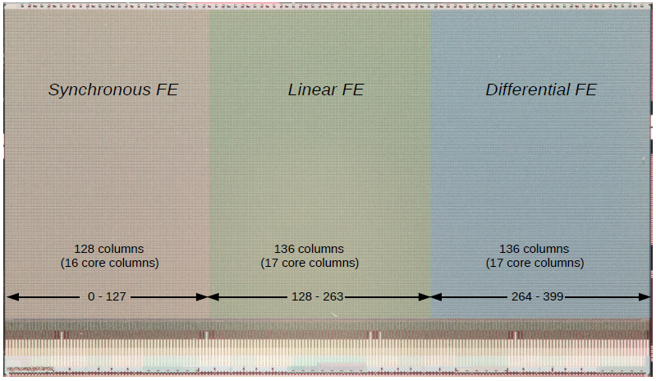
Introduction - RD53A
The RD53 collaboration is a common effort, shared between ATLAS and CMS
Goal: Development of designs and methods for a hybrid pixel detector readout chip in a 65 nm technology
RD53A is the first large (=half) scale demonstrator,
produced in 2017, available for testing since 12.2017
Features of RD53A
  Three different analog frontend designs and
  two memory architectures for comparison
  Fast data link to the readout system
    Aurora protocol
    Several configurable data rate options:
    1x 640 Mb/s … 4x 1.28 Gb/s
  Designed to withstand at least 500 Mrad

Slide 3
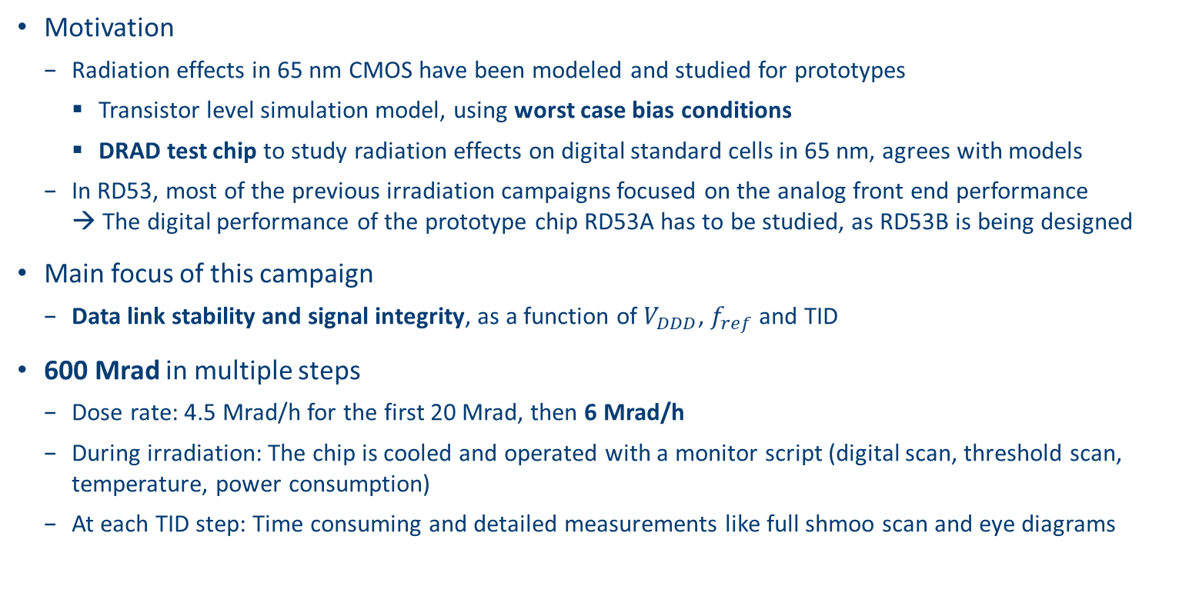
introduction
Motivation
  Radiation effects in 65 nm CMOS have been modeled and studied for prototypes
    Transistor level simulation model, using worst case bias conditions
    DRAD test chip to study radiation effects on digital standard cells in 65 nm, agrees with models
  In RD53, most of the previous irradiation campaigns focused on the analog front end performance
  → The digital performance of the prototype chip RD53A has to be studied, as RD53B is being designed
Main focus of this campaign
  Data link stability and signal integrity, as a function of $V_{DDD}$, $f_{ref}$ and TID
600 Mrad in multiple steps
  Dose rate: 4.5 Mrad/h for the first 20 Mrad, then 6 Mrad/h
  During irradiation: The chip is cooled and operated with a monitor script (digital scan, threshold scan, temperature, power consumption)
  At each TID step: Time consuming and detailed measurements like full shmoo scan and eye diagrams

Slide 4
Introduction - CDR bypass mode
Default operation mode: CDR/PLL block generates
  Command clock: Recovered from the command data stream
  Serializer: Multiplied (1,2,4,8) command clock
In order to observe only the digital logic behavior, the chip was operated in CDR-bypass mode
  Clocks have to be provided externally
  Generated by the FPGA PLL of the readout system
    CMD_CLK → 160 ± 20 MHz
    SER_CLK → 640* ± 80 MHz
    *(the chip was operated in 640 Mbit/s mode)
Fixed factor
(1, 2, 4*, 8)
SER CLK
CMD CLK
Analog chip bottom
Digital chip bottom
Pixel matrix
CDR/
PLL
CMD data
config
registers
CMD clock
CMD
decoder
CMD
SER clock
DATA
Cable driver
Serializer
Aurora
encoder
Hit data

Slide 5
Setup

Slide 6
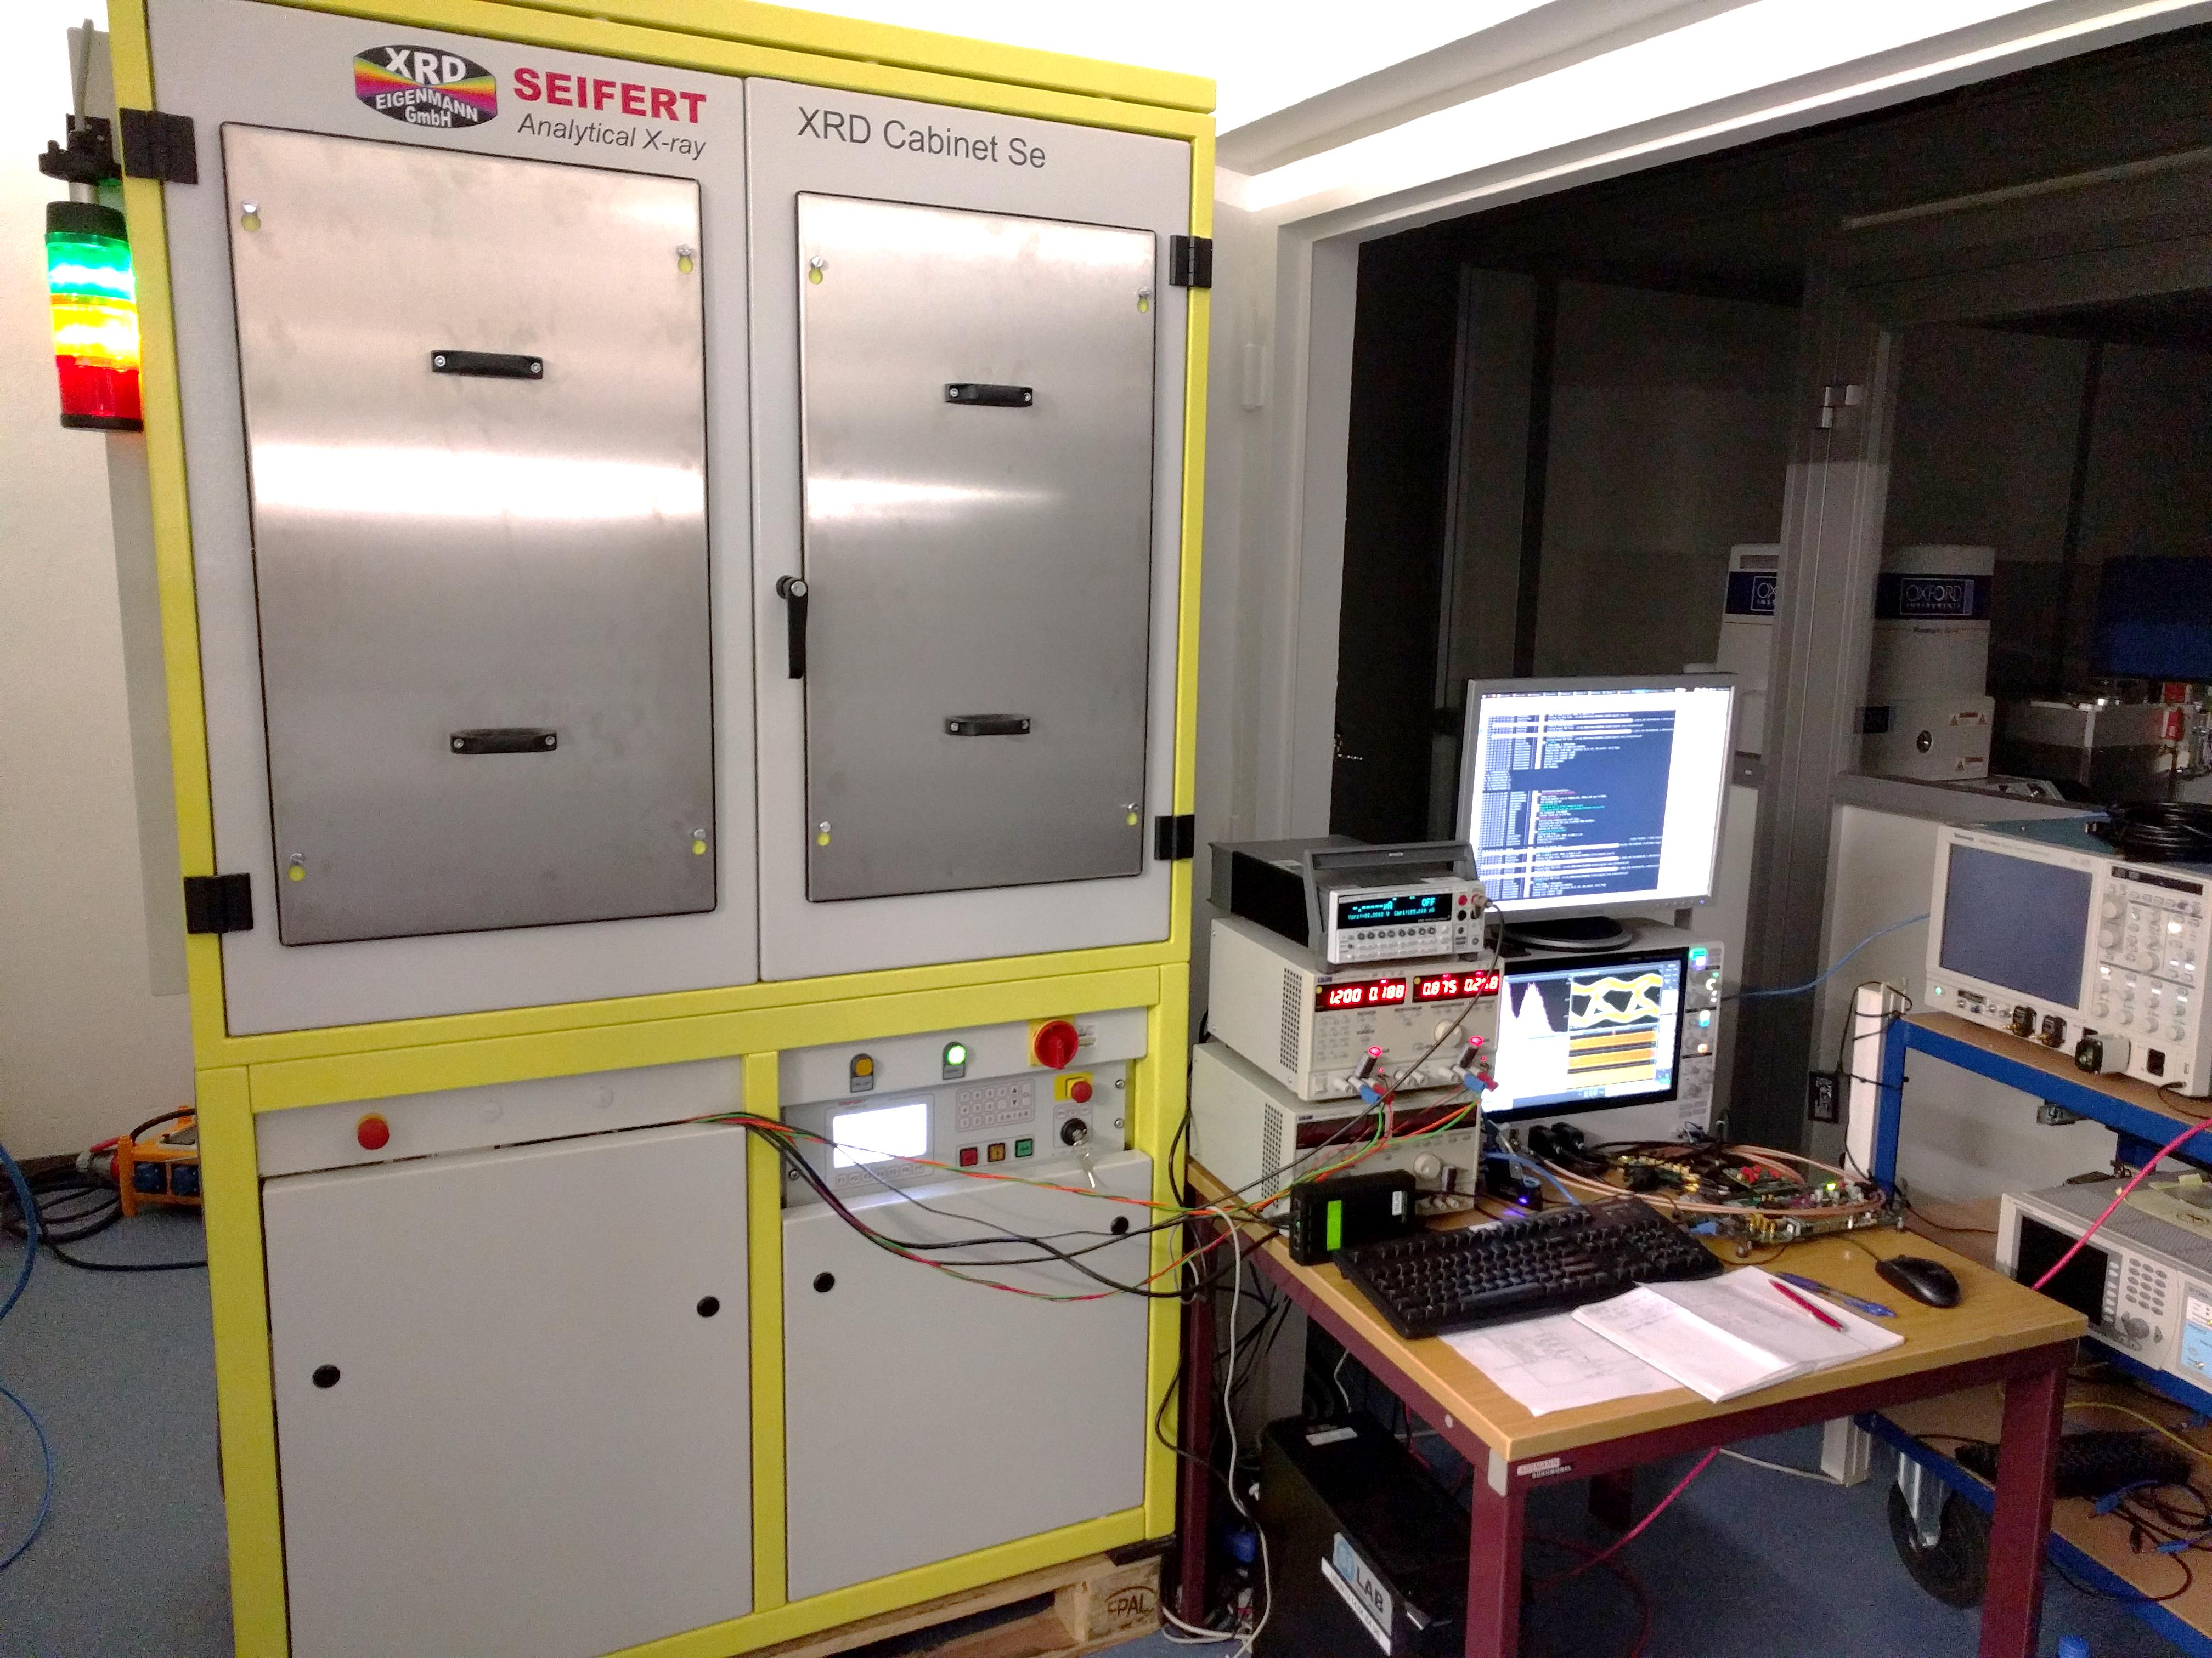
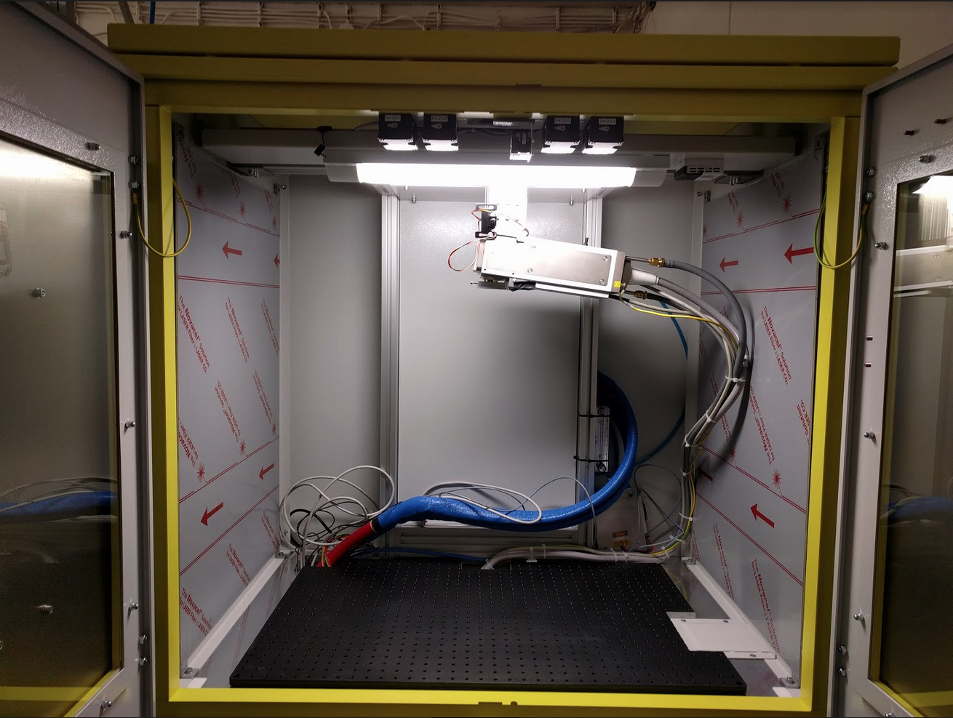
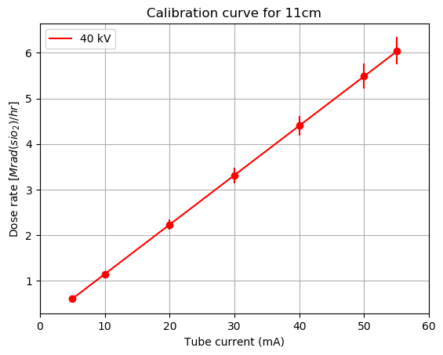
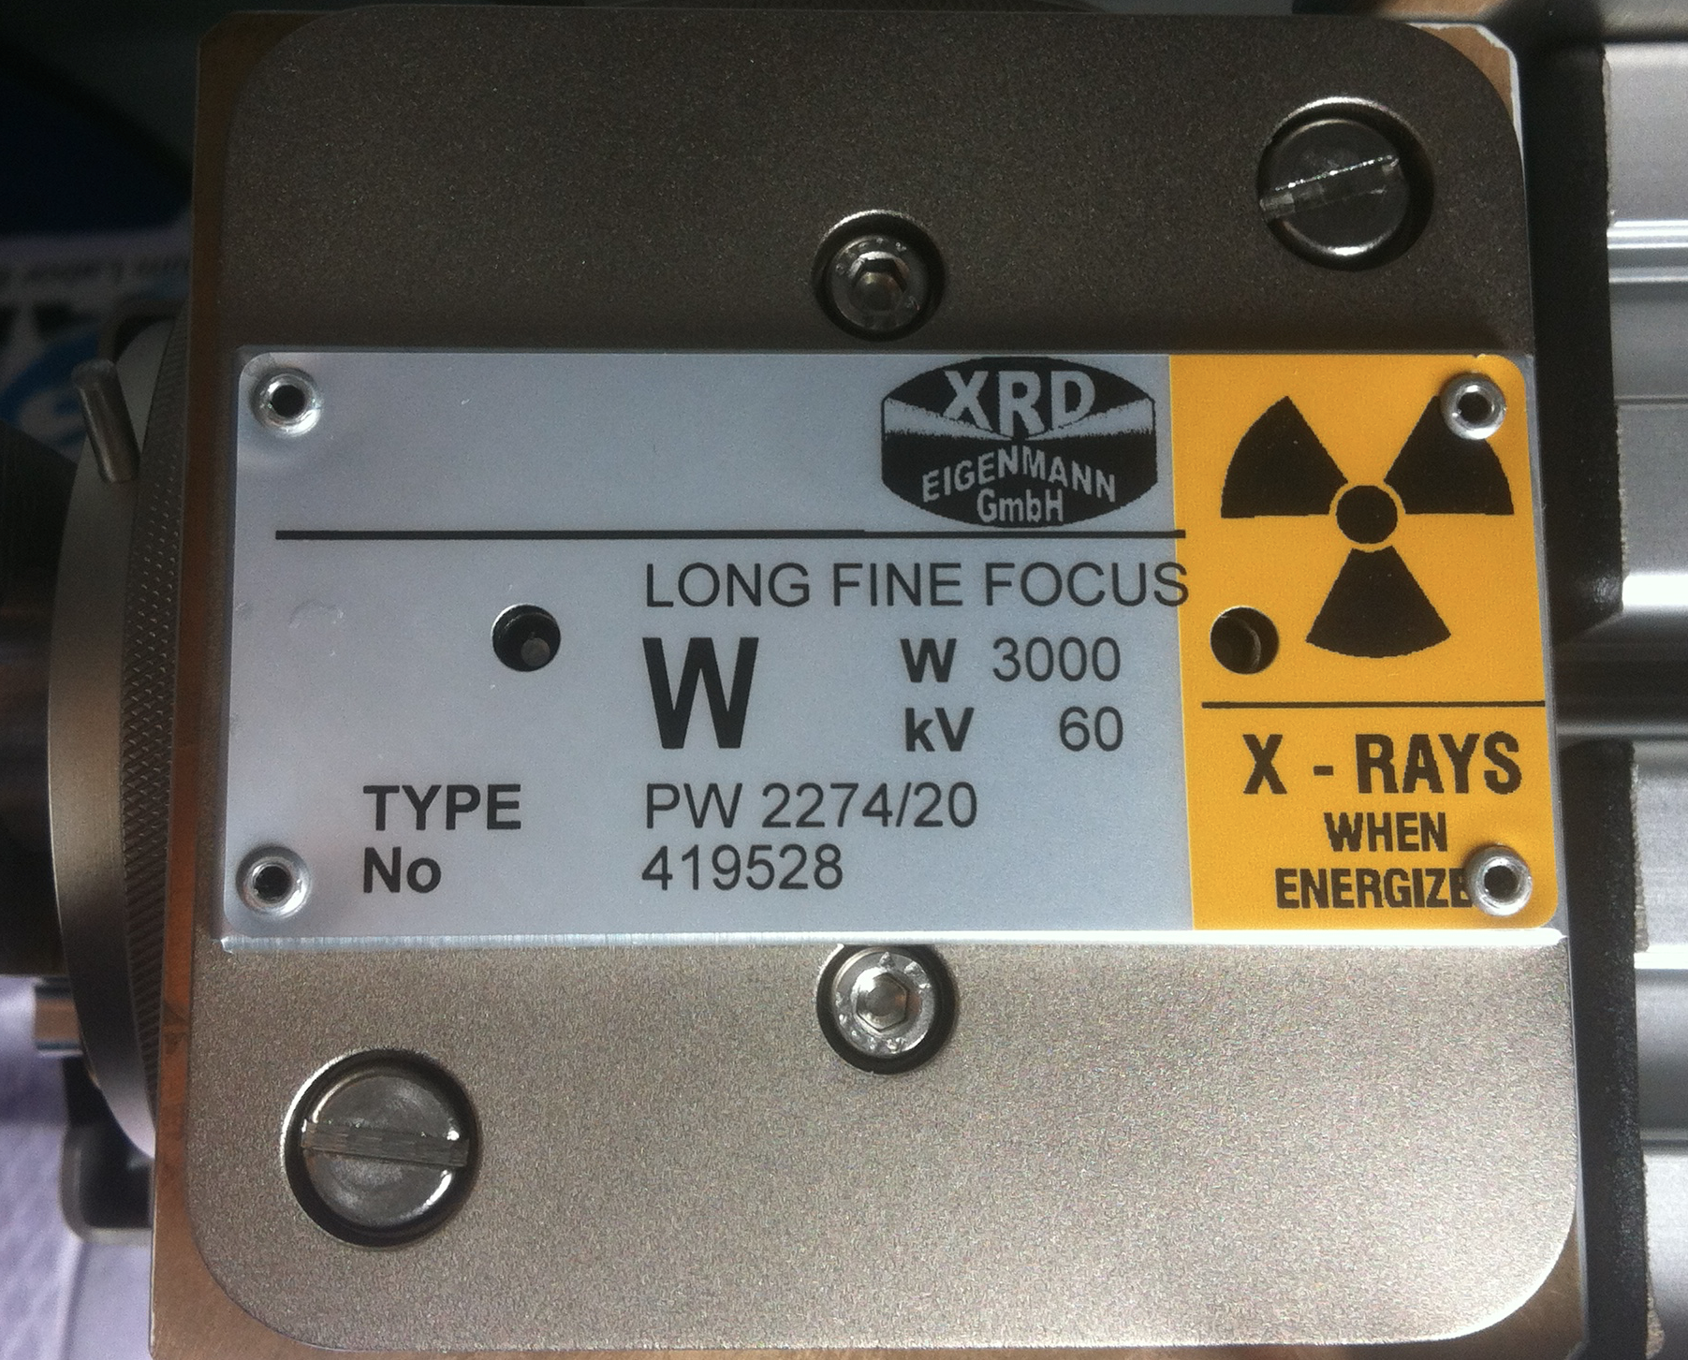
X-Ray setup
X-ray cabinet
  Tungsten target X-ray tube: 60 kV, 58 mA max
  Up to ~6 Mrad/h at a beam spot diameter,
  suitable for RD53A (3 cm)
X-ray cabinet

Slide 7
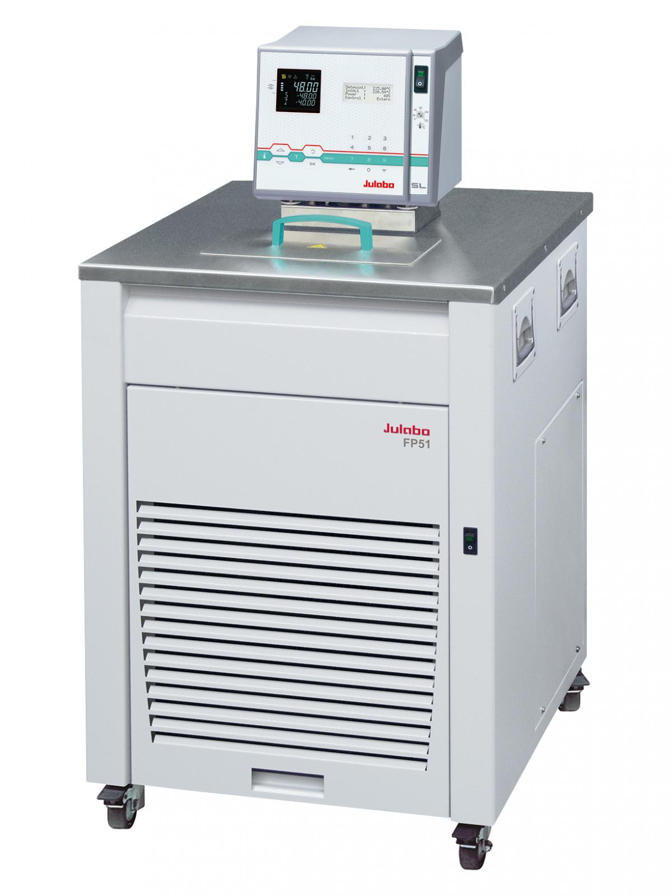
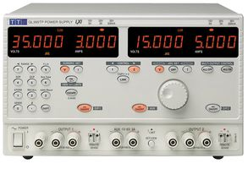
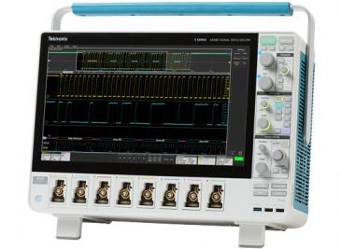
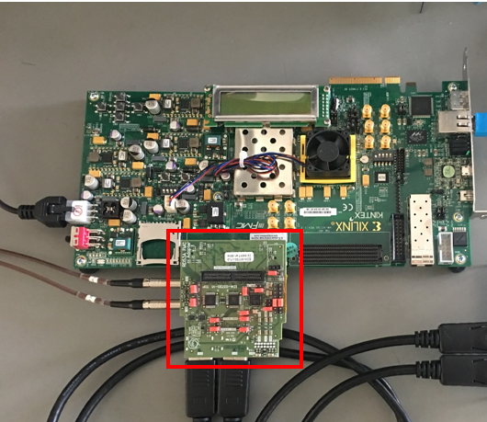
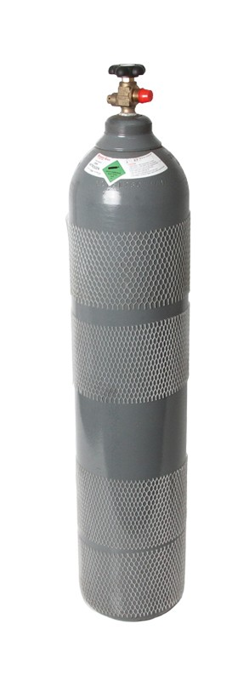
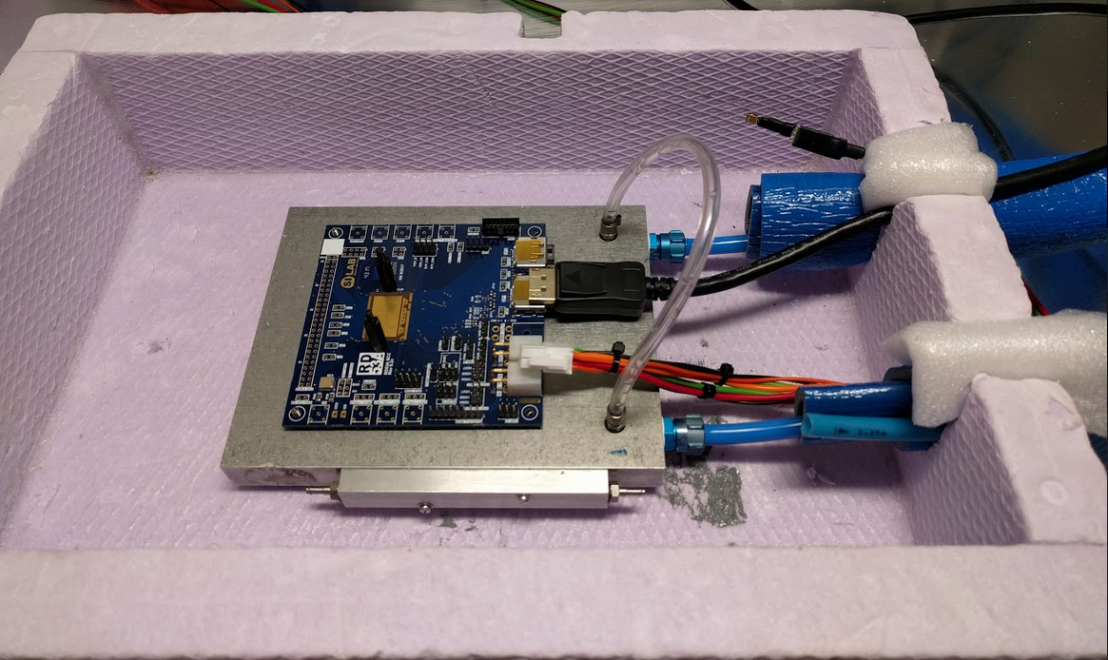
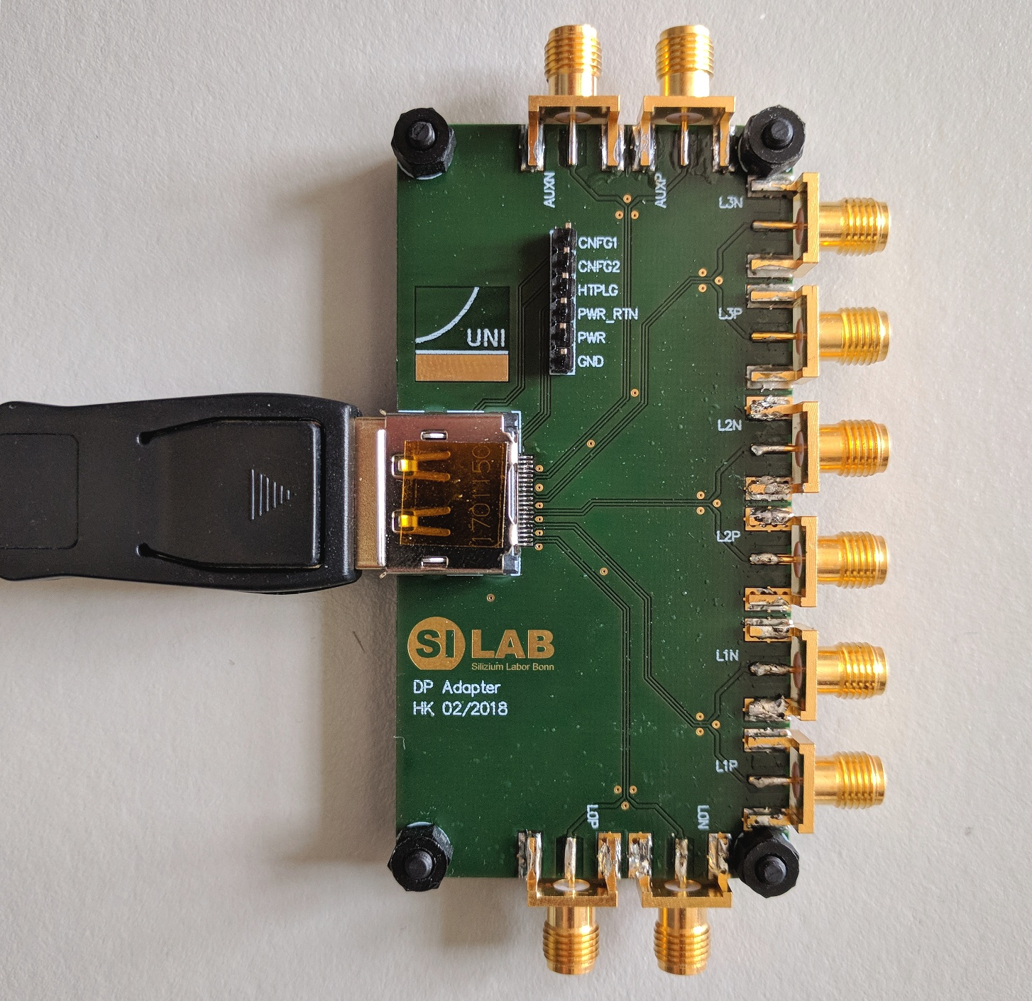
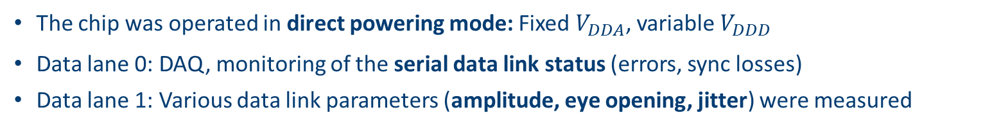
X-Ray setup
Chiller
Oscilloscope
BDAQ with FMC adapter card
Power supply
(with sensing)
Data lane 1
X-Ray cabinet
Data lane 0
CLK_CMD
CLK_SER
Nitrogen
or dry air
CMD
The chip was operated in direct powering mode: Fixed $V_{DDA}$, variable $V_{DDD}$
Data lane 0: DAQ, monitoring of the serial data link status (errors, sync losses)
Data lane 1: Various data link parameters (amplitude, eye opening, jitter) were measured

Slide 8
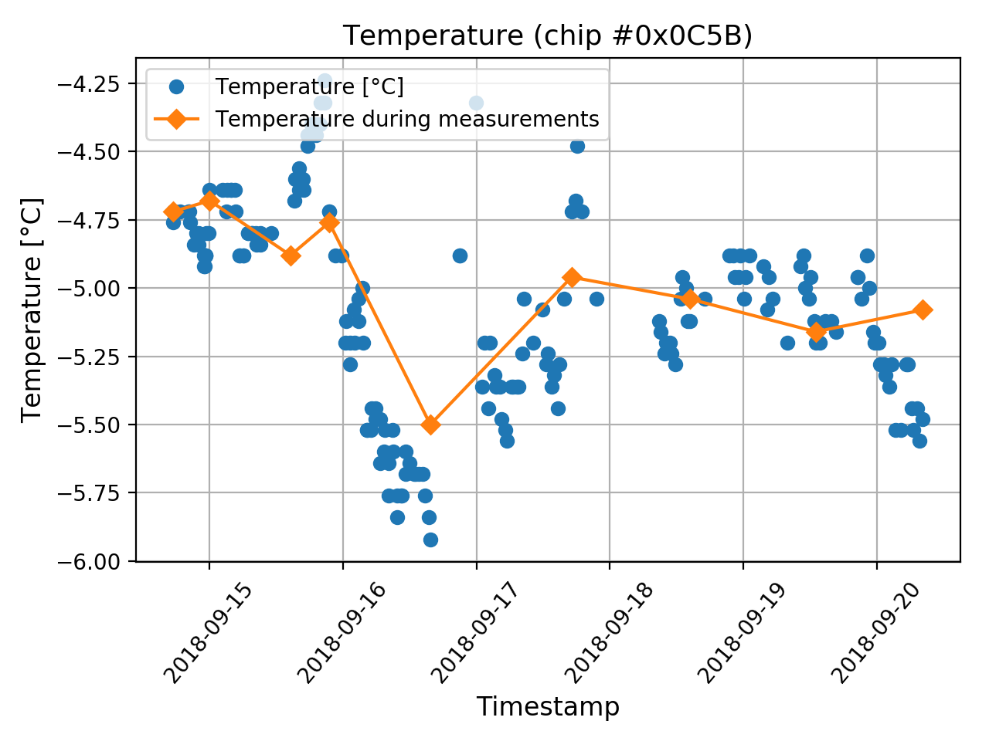

Temperature control
Temperature of the cooling plate set to $−5 °C$
Monitored close to the chip: Fluctuation of $±0.8 °C$ during the campaign
Measurements were
performed at these
temperatures

Slide 9

Results: Power and $I_{ref}$

Slide 10
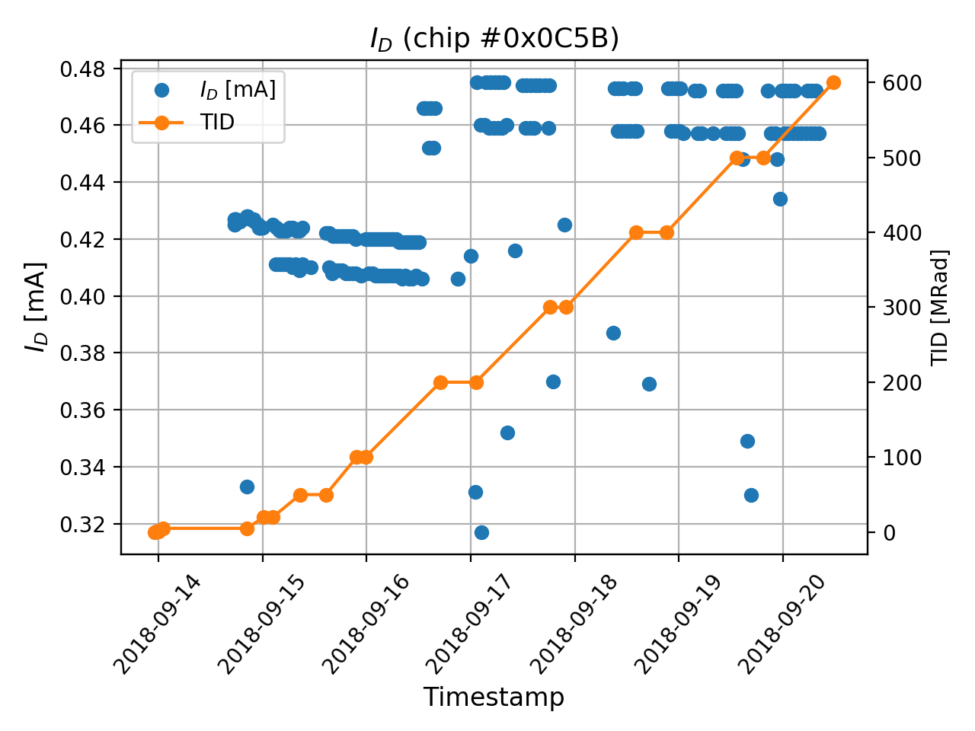
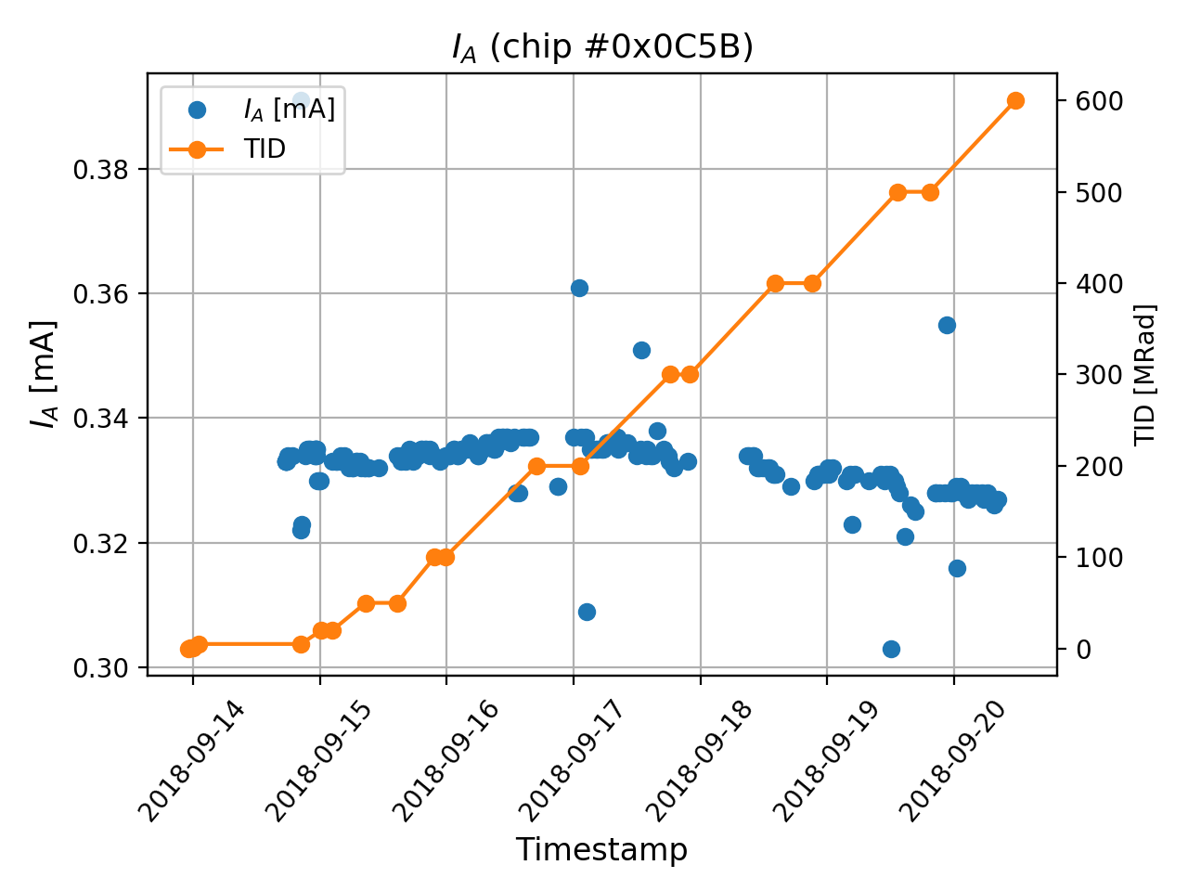
Current consumption
Starting from 200 Mrad*, we enabled the clock to the complete pixel matrix
→ Increased digital power, slope barely affected
→ Slope for analog power changed
*
Preliminary
Preliminary
Chip didn’t
lock during
a few scans

Slide 11
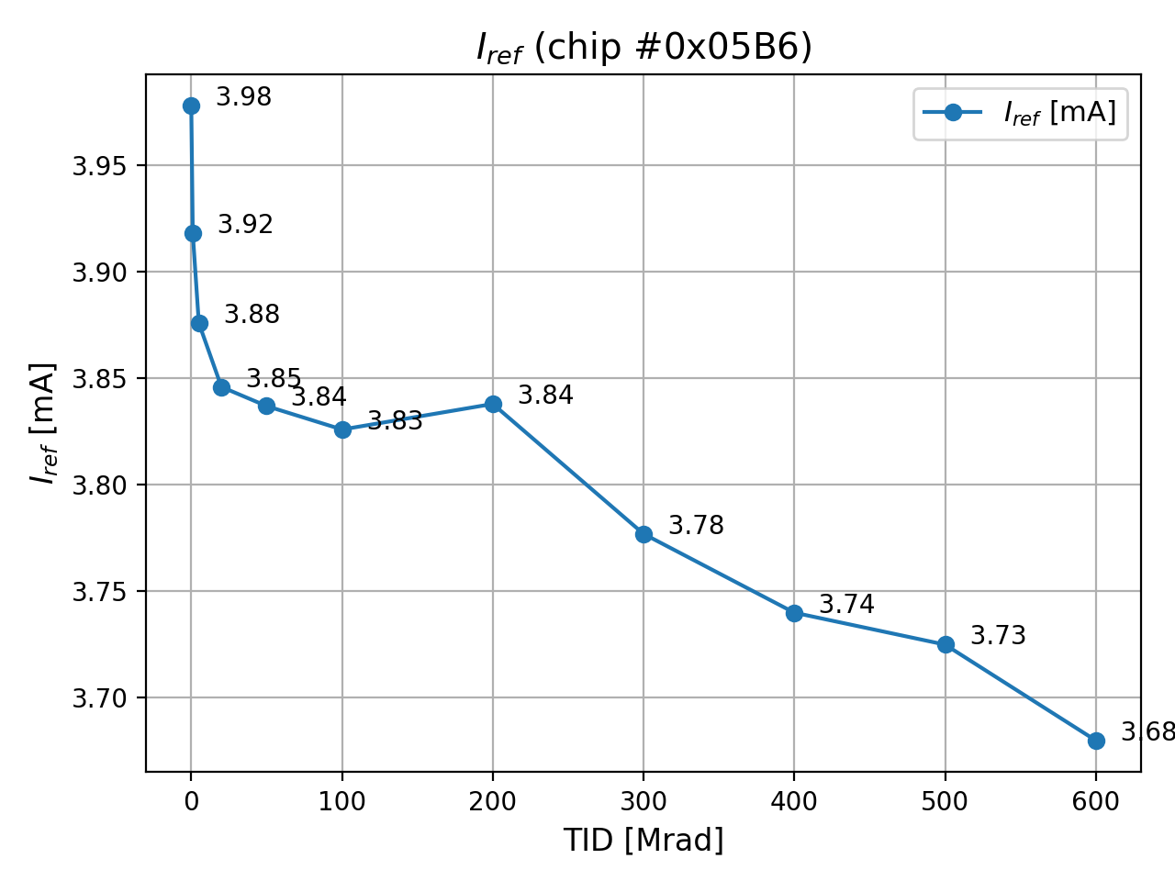

Reference current
RD53A uses a bandgap voltage reference and an internal voltage divider to generate its main reference current
  Nominal value of $I_{ref}=4 µA$ was trimmed before the irradiation
During the campaign, $I_{ref}$ decreased by ~7.5%
  Caused by the temperature-stable, but radiation sensitive divider (poly silicon + diffusion resistor)
  For RD53B, external resistors will be used instead
Preliminary

Slide 12
Results: Digital

Slide 13
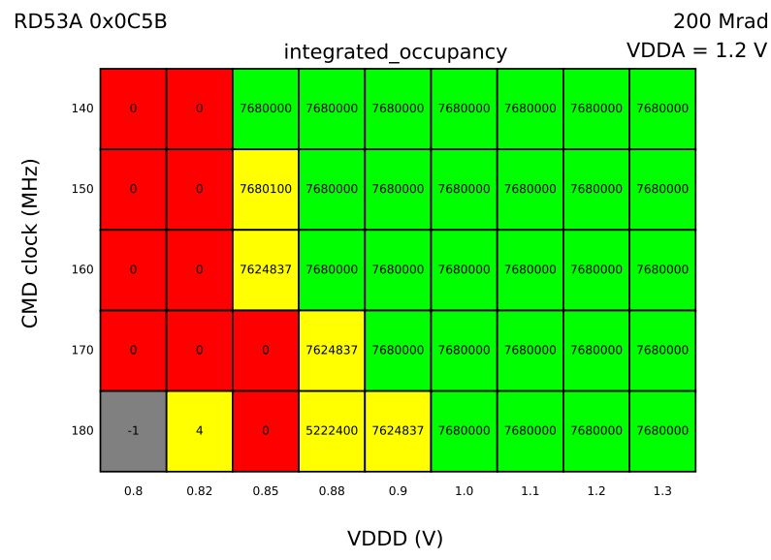

Digital scans – SHMOO plots
Question: How large are the margins in terms of digital supply voltage and reference frequency?
Method: Digital scans within a parameter space $\left(V_{DDD}:0.8−1.3 V, f:140−180 MHz\right)$
with 100 injections into every pixel → Expectation: 7.68e6 hits
No hits
How to read the shmoo plots?
Grey: No link → scan failed
Red: No hits → Link established,
but no FE response
Yellow: Only partial FE response
Green: Expected FE response
Preliminary
Nominal operation
No link
Partial FE response

Slide 14
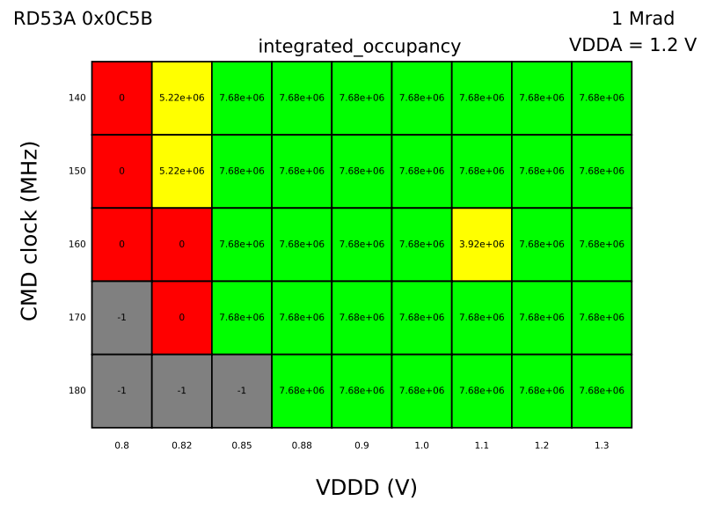
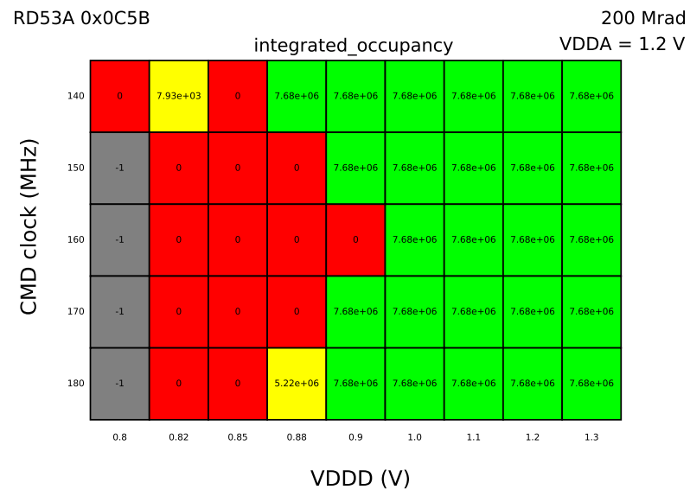
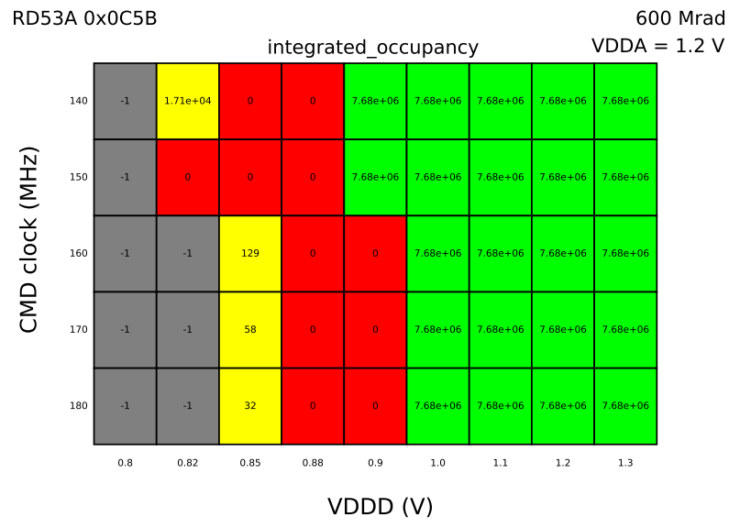
Digital scans – SHMOO plots
Partial FE response
1 Mrad
200 Mrad
600 Mrad
Preliminary
Preliminary
Preliminary
No link
No hits
Outlier
With increasing dose
  fewer combinations of operating condition are working
  the margin decreases

Slide 15
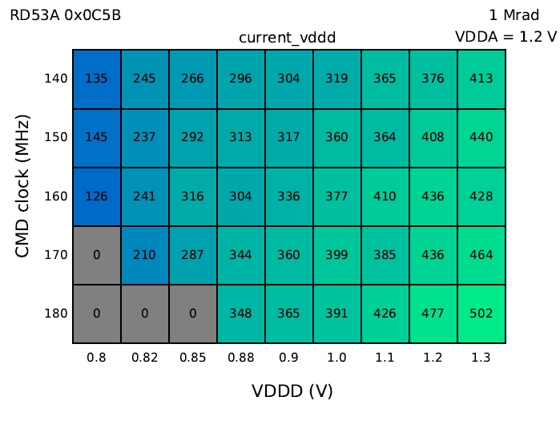
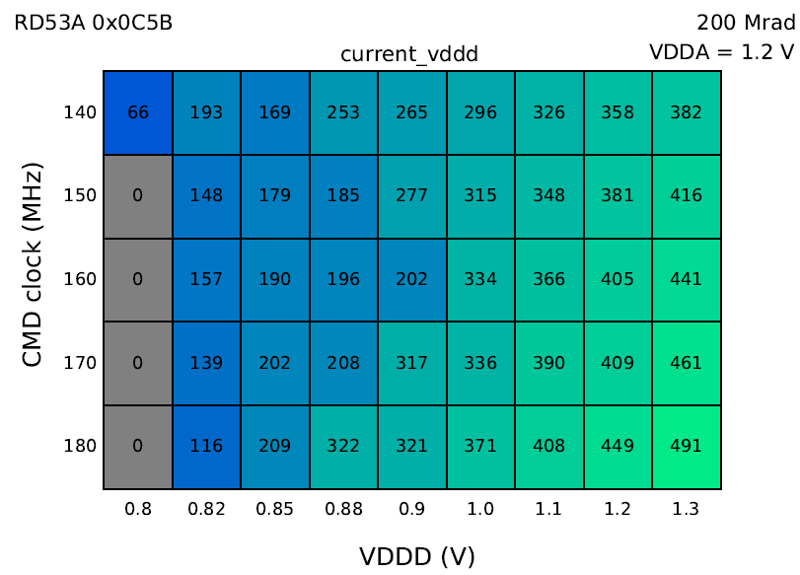
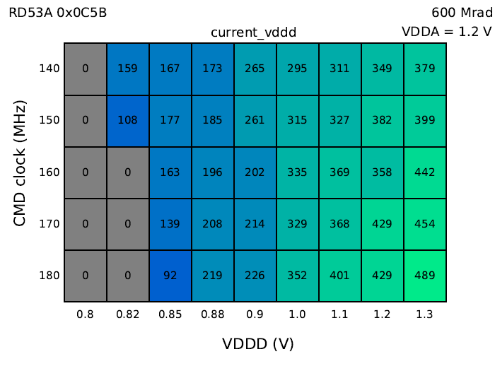
Digital scans – SHMOO plots
The digital logic is supposed to work at 0.9 V after 200 Mrad (according to simlations)
Partial FE response
1 Mrad
200 Mrad
600 Mrad
Preliminary
Preliminary
Preliminary
No link
No hits
Probably a POR issue
Preliminary
Preliminary
Preliminary
Lower digital current indicates incomplete POR/configuration

Slide 16
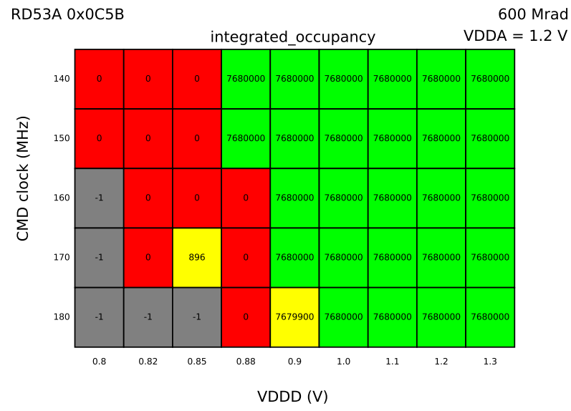

Digital scans – SHMOO plots
Partial FE response
1 Mrad
200 Mrad
600 Mrad
Preliminary
Preliminary
Preliminary
No link
No hits
Probably a POR issue
200 Mrad POR@1.2V
600 Mrad POR@1.2V
Additional scan introduced
with different reset conditions
POR is more reliable, when the chip is first powered (and reset) at 1.2 V, before lowering $V_{DDD}$
Preliminary
Preliminary

Slide 17
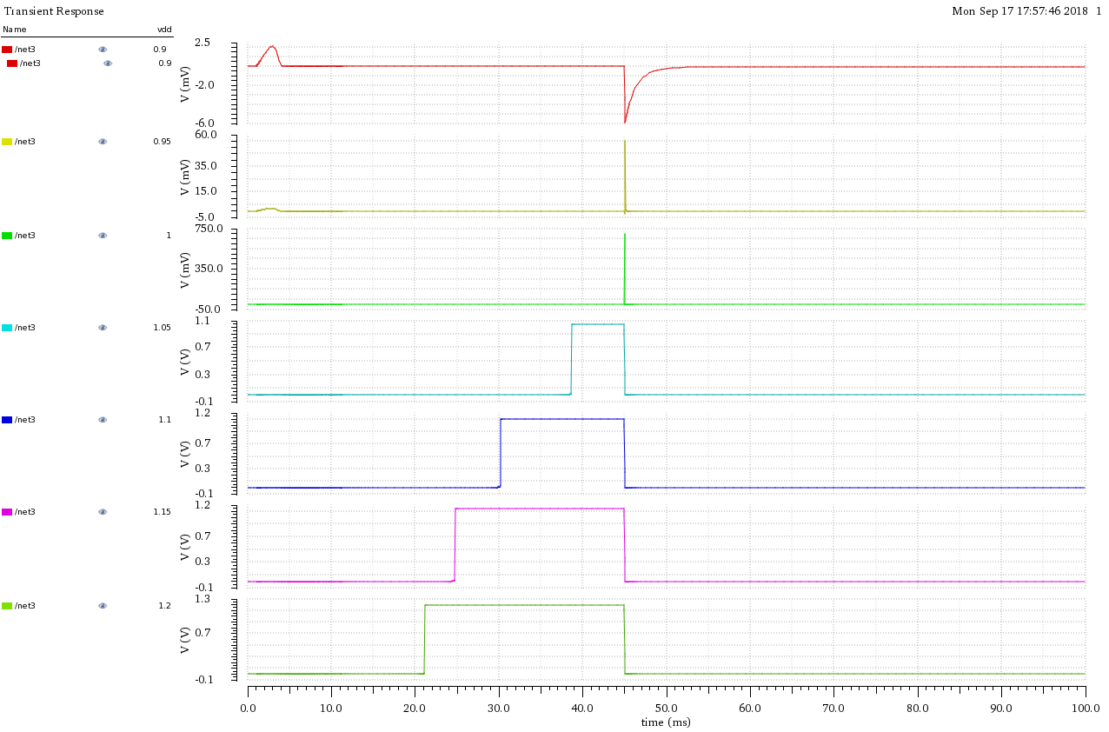










Power-on reset
The POR circuit was designed using the analog corner ($V_{min}=1.08 V$)
With $V_{DDD} ≤1 V$, the reset signal is only a short pulse, which is insufficient to reset the logic reliably
← 2.5 mV
$$0.9 V$$
60 mV →
$$0.95 V$$
0.75 V →
$$1 V$$
1.1 V →
$$1.05 V$$
1.2 V →
$$1.1 V$$
1.2 V →
$$1.15 V$$
1.2 V →
$$1.2 V$$
$$V_{DDD}$$
$$V_{RESET}$$
POR simulation

Slide 18
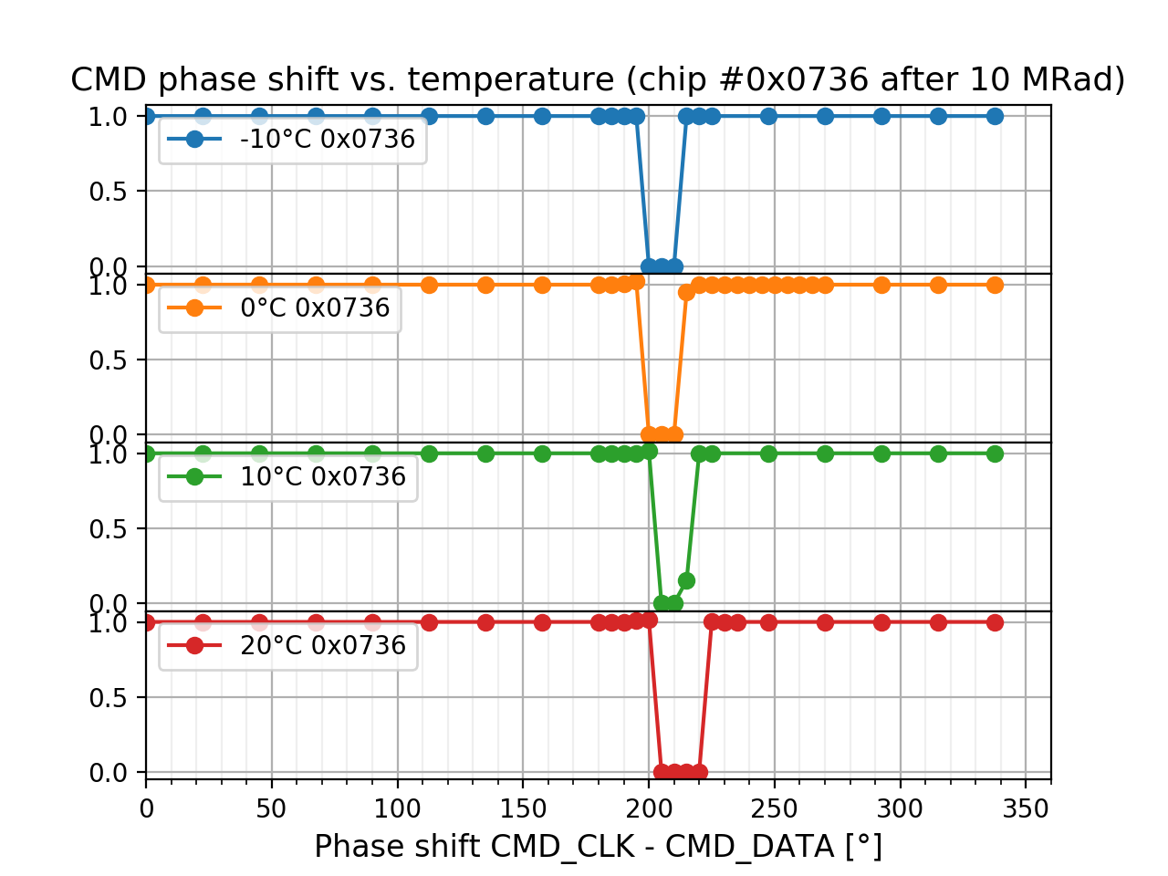
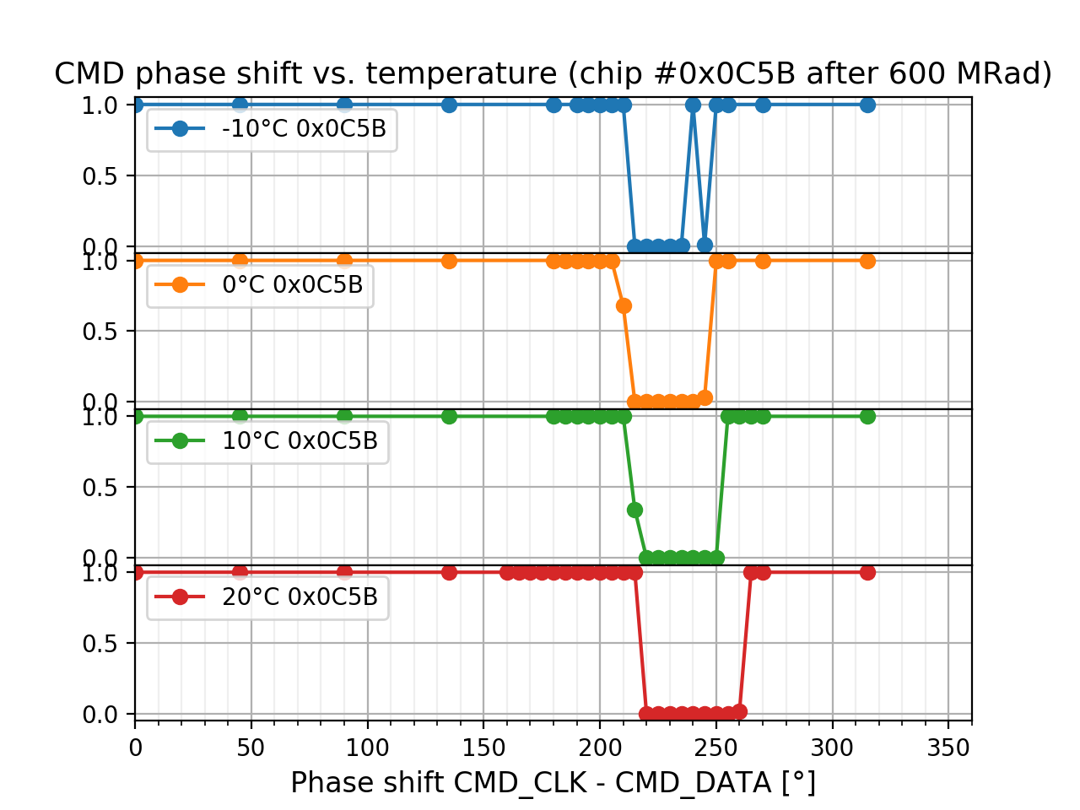

Command/data phase shift
In CDR bypass mode, the phase between command clock and data is critical
Measurement with a controllable external two channel clock generator after the campaign:
Ch1: FPGA (CMD data), Ch2: CMD clock to the chip. Phase between channels was varied
The setup- and hold timing changes with temperature and dose
  Hold time (distance between data transition and clock edge) increases by $\sim 0.5°/°C = 8.7 ps/°C$
  The critical phase region increases from ~20° at 10 Mrad to ~45° at 600 Mrad
Only in these small regions, the link failed
Absolute phase value depends on cables etc.

Slide 19
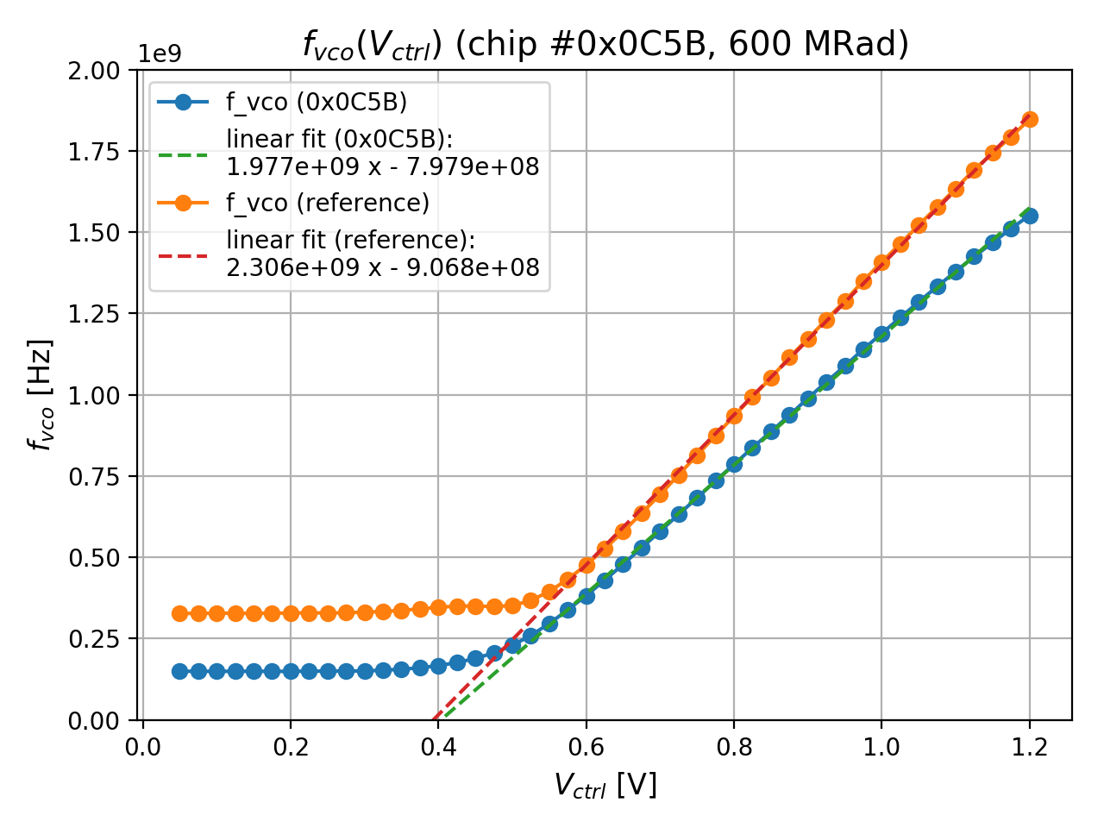

PLL: VCO tuning range
In the default operation mode of the chip, a CDR/PLL block locks to the CMD clock and provides several clocks, derived from the internal VCO
Measurement of the VCO gain curve
  $V_{ctrl}$ is scanned from 25 mV to 1.2 V, while the frequency is measured
  Compared to a non-irradiated chip, the VCO gain decreased and the frequency range shifted slightly
Nominal VCO
operating
frequency: 1.28 GHz
Preliminary

Slide 20
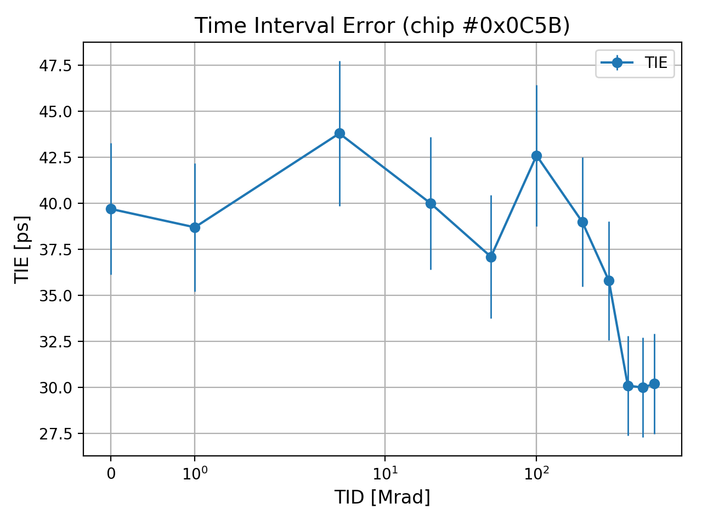
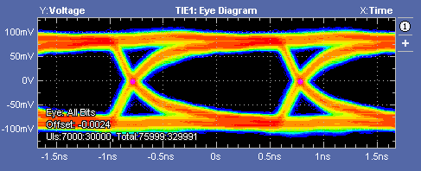
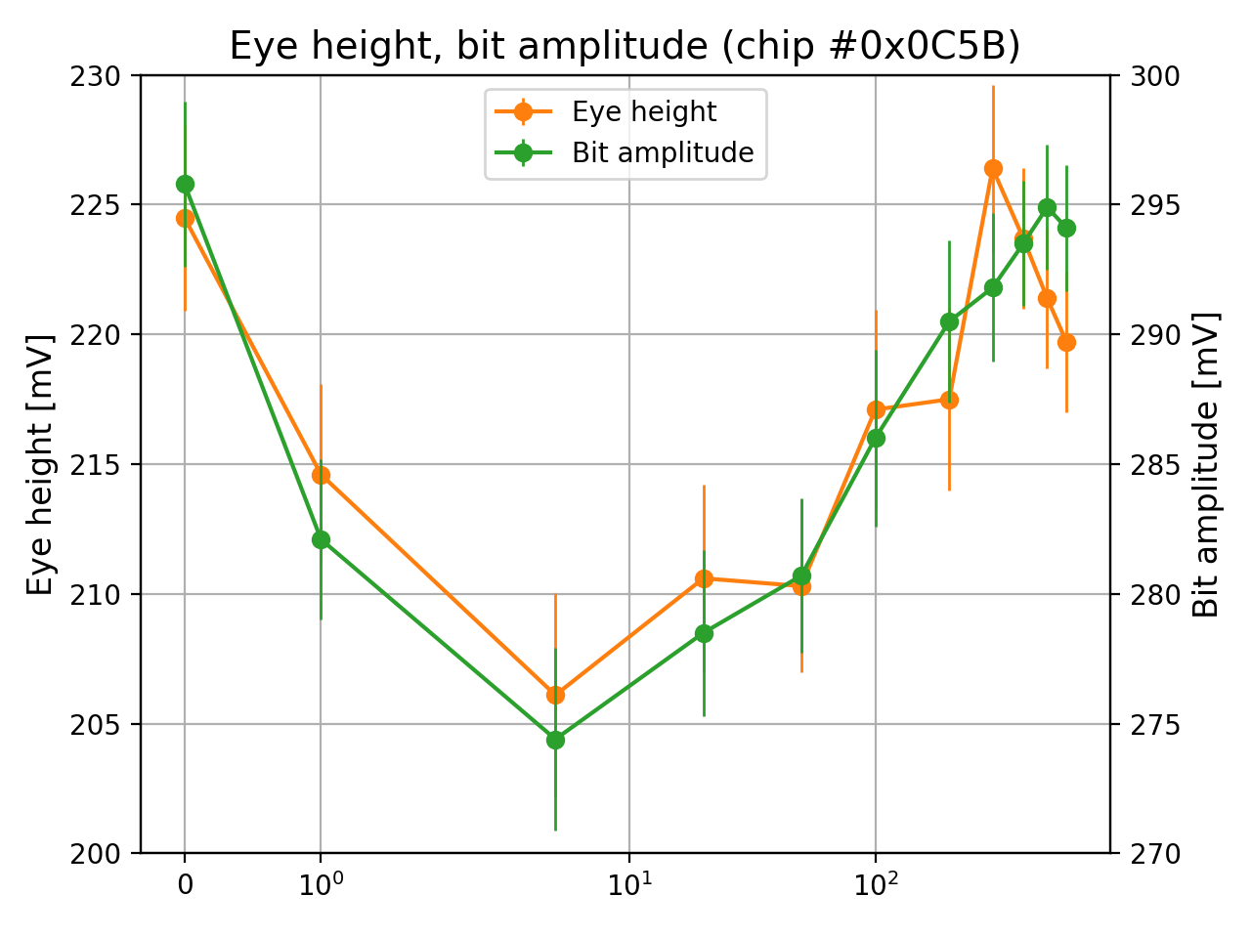
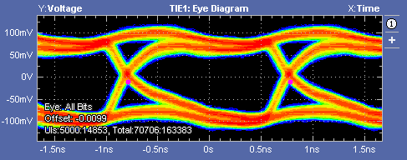

EYE diagrams
Most interesting values from the eye diagrams
  Time Interval Error: RMS of the total jitter (1)
  Eye width(2), height (3): Define the eye opening, bit amplitude(4)
Cross-coupling of SER_CLK can be seen on the data line:
$\sim 50 mV_{pp}$(4) in bypass mode – no issue for the data link
(1)
Preliminary
PLL mode
(2)
(4)
(3)
(2)
Cross talk
in bypass
mode (4)
Bypassmode
Preliminary

Slide 21
Results: Analog Front Ends

Slide 22
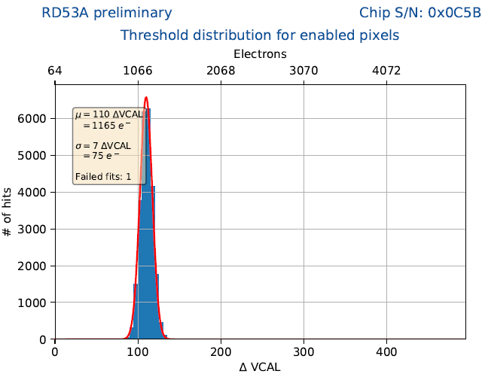
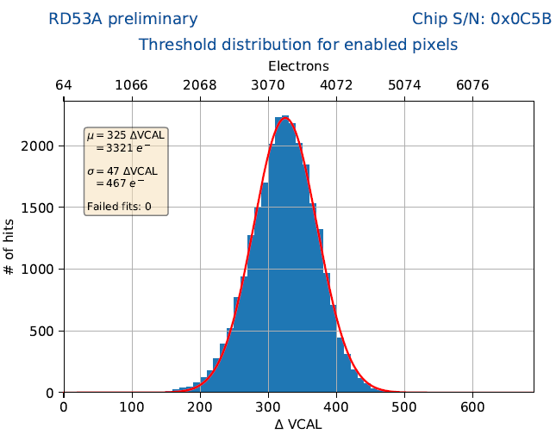
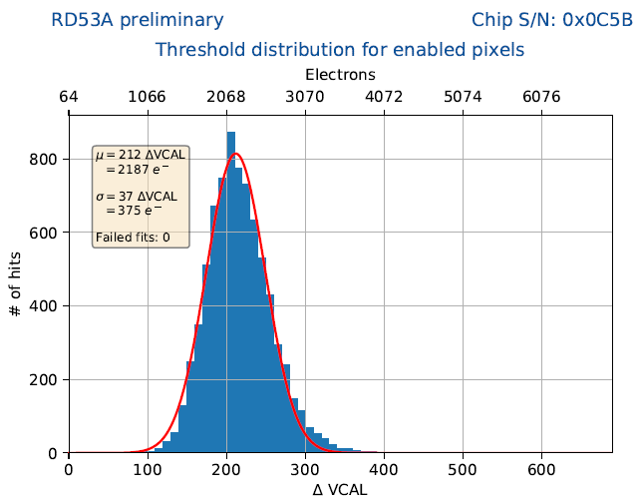
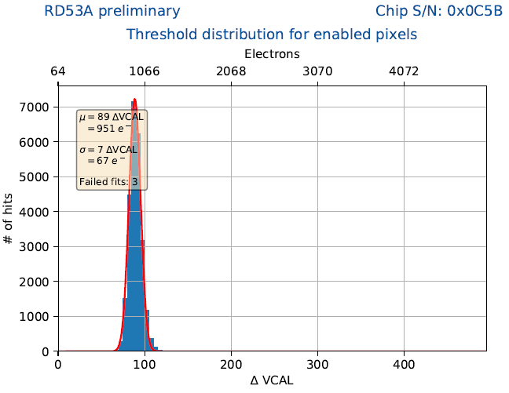
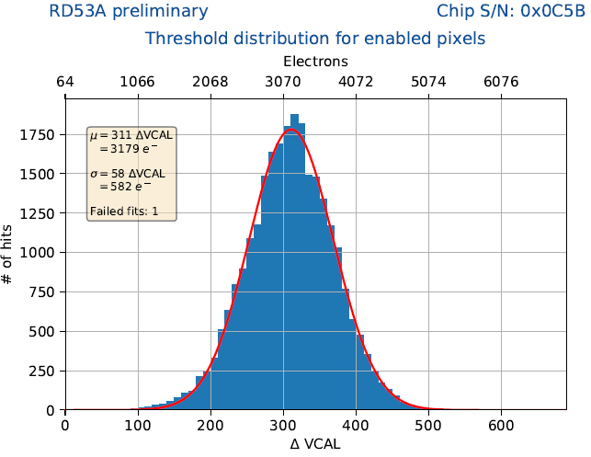
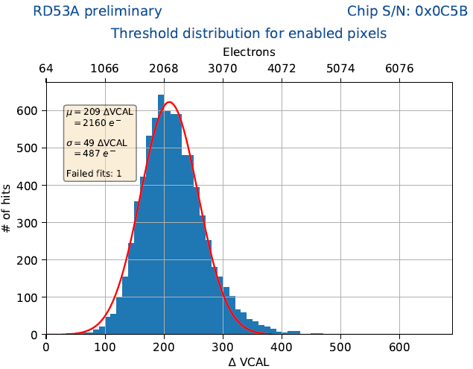






Threshold
SYNC
LIN
DIFF
0 Mrad SYNC
0 Mrad LIN
0 Mrad DIFF
Preliminary
Preliminary
Preliminary
$$μ=\text{1165} e^{−}$$
$σ=75$ $e^{−}$
$$μ=\text{3321 }e^{−}$$
$σ=467 e^{−}$
$$μ=\text{2187 }e^{−}$$
$σ=375 e^{−}$
600 Mrad SYNC
600 Mrad LIN
600 Mrad DIFF
Preliminary
Preliminary
Preliminary
$$μ=\text{951 }e^{−}$$
$σ=67 e^{−}$
$$μ=\text{3179 }e^{−}$$
$σ=582 e^{−}$
$$μ=\text{2160 }e^{−}$$
$σ=487 e^{−}$

Slide 23
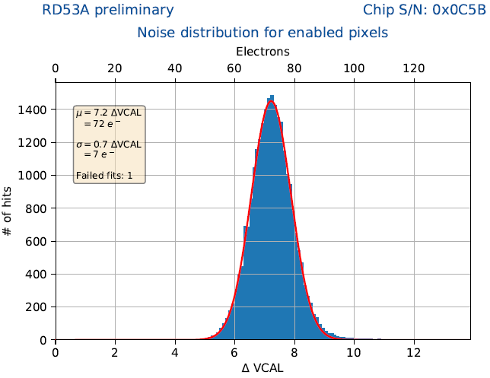











noise
SYNC
LIN
DIFF
0 Mrad SYNC
0 Mrad LIN
0 Mrad DIFF
Preliminary
Preliminary
Preliminary
$$μ=\text{72} e^{−}$$
$σ=7 e^{−}$
$$μ=\text{61} e^{−}$$
$σ=7 e^{−}$
$$μ=\text{52} e^{−}$$
$σ=9 e^{−}$
600 Mrad SYNC
600 Mrad LIN
600 Mrad DIFF
Preliminary
Preliminary
Preliminary
$$μ=\text{75 }e^{−}$$
$σ={7 e}^{−}$
$$μ={59 e}^{−}$$
$σ=9 e^{−}$
$$μ=\text{52} e^{−}$$
$σ=10 e^{−}$

Slide 24

conclusion
RD53A 0x0C5B has been irradiated to 600 Mrad
Observations:
  No significant degradation of the cable driver and the VCO tuning range
  POR is not reliable at $V_{DDD}<1 V$after 200 Mrad. Confirmed by simulation,
  to be improved in the next version.
  $I_{ref}$ decreases by ~7,5% → Mitigation by usage of external precision resistors for RD53B
  Operational temperature critical after irradiation (need to stay below ~-10 °C for stable operation)
Future plans
  Irradiation of a few samples to different TID
  Non-uniform irradiation
  SEU/SET studies

Slide 25
THANK YOU

Slide 26
Backup

Slide 27

BACKUP - readout system
Two readout systems for testing have been developed within the RD53 collaboration
  YARR: Comprehensive PCIe-based readout system with software framework written in C
  BDAQ53: Easy to use characterization and verification environment based on Python
Main purpose: Evaluation of the RD53A prototype chips:
  Electrical characterization (single chip)
  test beam performance measurements
  multi-chip (module) tests
  wafer-level tests with a probe station
BDAQ53 was used for this campaign: Ease of use
  Single board, no additional adapters
  Ethernet interface
  No specific PC needed, even works with a Laptop
  Python based software: Fast debugging
  Alternative HW platforms supported: Xilinx KC705, USBPix3
BDAQ53 setup with RD53A Single Chip Card

Slide 28
BACKUP - Bdaq53 Firmware
Several firmware modules are instantiated from the Basil firmware library (FIFO, GPIO, I²C etc.)
“Basil Bus”
  Simple 32-bit wide bus for internal control signals
  Firmware modules are addressed
  Bus master: Interface to the SiTCP Ethernet IP core (1Gbit/s)
AXI4-Stream
  Aurora IP core from Xilinx (GTX transceivers)
  Wrapper translates to the generic
  FIFO-style interface of SiTCP
Command encoder
  Programmable sequencer
  Arbitration of triggers and
  idle/sync patterns
Future plans
  10 Gbit/s Ethernet for SFP+
  DDR3 memory FIFO
DAQ system board
Xilinx Kintex 7 FPGA
Programmable reference
clock
I²C
CMD encoder
SelectIO
RD53A
PLL
Aurora
receiver
GTX
Basil bus
TLU
TLU controller
BRAM
FIFO
Computer
Ethernet
PHY
Basil bus master
SiTCP
IP core

