Slide 1
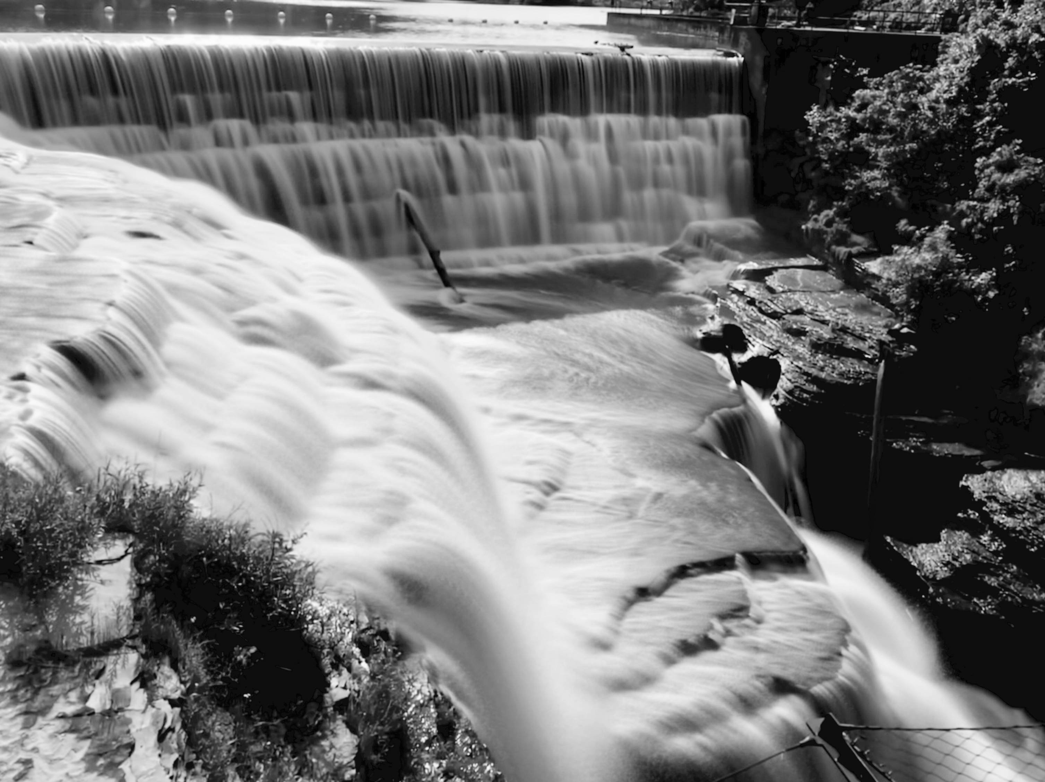
CdTe Mixed-Mode Pixel Array Detector
(CdTe MM-PAD)
Hugh Philipp, Gruner Group, Cornell University
Pixel 2018, Taiwan
Notes:
Picture nothing to do with presentation.
Water falls on Cornell Campus.
If you’re ever in that corner of world drop by.
Talk a little bit about our mixed-mode pixel array detector & coupling it to CdTe.
Show results.

Slide 2
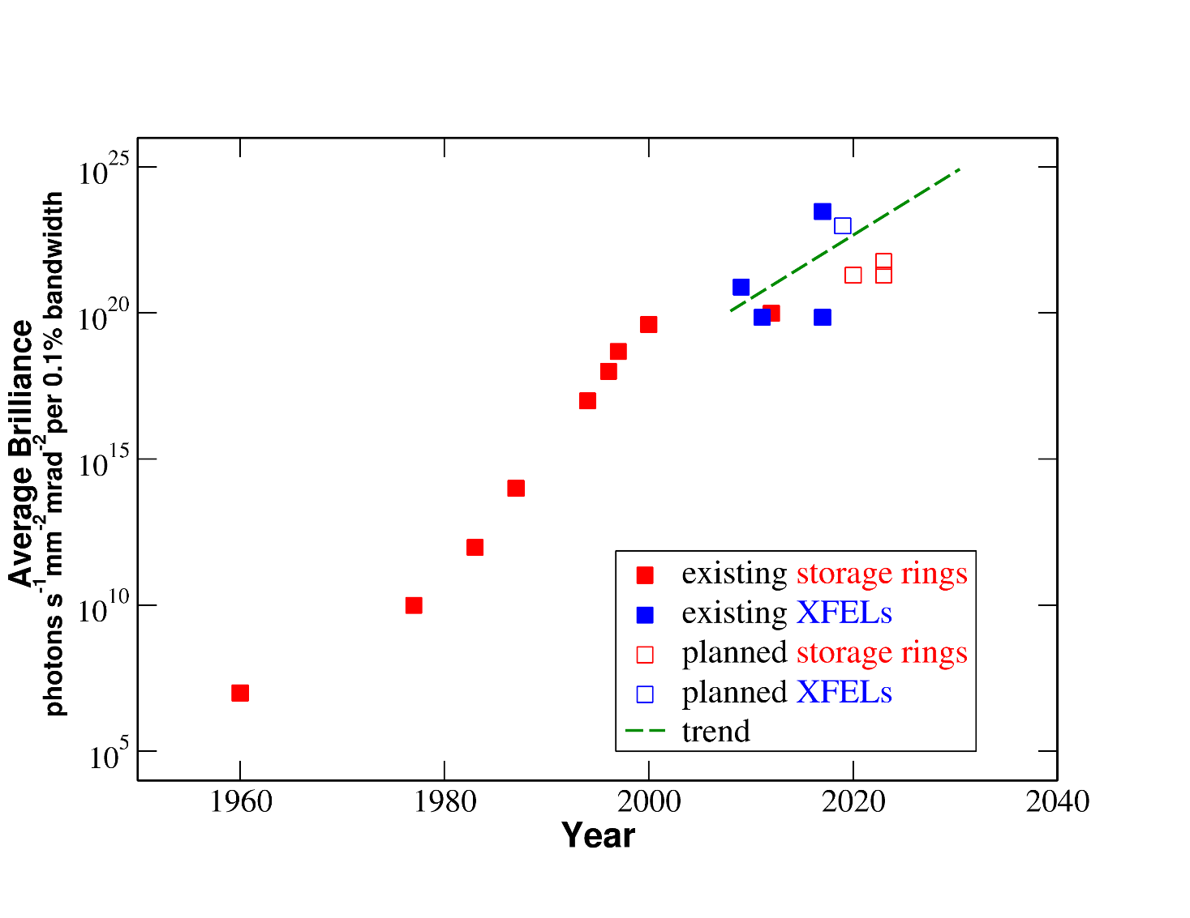
Synchrotron Light Sources creating new experimental possibilities…
Average Brilliance
Average brilliance increasing
New experimental possibilities
Detector technology development essential
Also more energetic x-rays (> 20 keV)
Yabashi & Tanaka ,Nature Photonics volume 11, pages 12–14 (2017)
Notes:
To give a context for detector development in photon science.
Source capabilities really increasing.
Different metrics – showing average brilliance for XFELs, synchrotron sources.
Logarithmic scale.
XFELs impressive – but also advances at new low emittance storage ring sources
Key: multibend achromat (MBA)
diffraction limited sources.
Important thing to Detector Development: Brilliance -> more photons probing smaller samples -> more information collected by detectors.
At the same time: a push to harder x-rays (e.g. LCLS, APS, MaRIE)
LCLS
Advanced Photon Source
Los Alamos proposed MaRIE XFEL
Thus the need for higher Z sensor materials

Slide 3
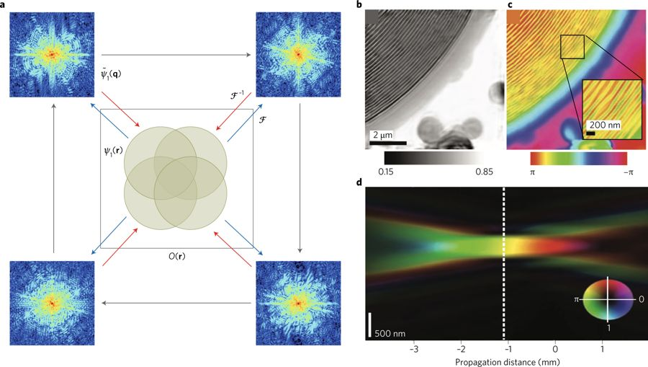
Storage ring application:
Ptychography
Scanning coherent diffraction
High dynamic range beneficial
Reconstruct high resolution images
Used with x-rays at synchrotrons
Also used in e-microscopes
Review ptychography techniques:
Jiang, Nature, volume 559, pages343–349 (2018)
Pfeiffer, Nature Photonics, volume 12, pages9–17 (2018)
Notes:
One posterchild for high brightness sources: Ptychography : scanning coherent diffraction microscopy.
Measurement of overlapping diffraction measurements to reconstruct magnitude and phase of sample.
General technique: x-rays (review of methods – Pfeiffer) and also electron microscopes.
Example application
STXM (scanning x-ray transmission microscopy) meets coherent diffraction imaging.
Key: Scans with overlapping illuminated areas provide sufficient constraints to allow recovery of high resolution amplitude and phase.
The reconstructed object is both
absorption profile
phase shift
Nature of the Data: High dynamic range:
Central peak can be quite intense.
Low-fluence information at higher angles. (important for high resolution)

Slide 4
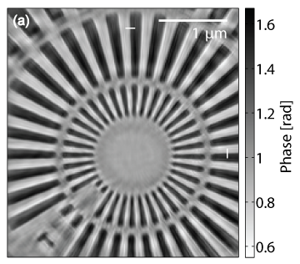
Need High Dynamic Range Pixel Array Detector
Si MM-PAD
Reconstructed object
Energy: 7.9 keV
Integration time: 100 ms/frame
Image reconstruction resolution: 25 nm horizontal, 26 nm vertical
Collaborators:
  Adrian Mancuso, Klaus Giewekemeyer, Andy Acquila (European XFEL)
No beam stop
P10 beamline
Petra III
Giewekemeyer et al., (2014). J. Synchrotron Rad. 21, 1167-1174
Notes:
We’ve used the high dynamic range pixel array detector ( Si MM-PAD) for this.
8 keV
Direct beam.
Single photons on periphery and no beamstop in center.
7.9 keV.
100 ms frame
No beamstop.
On right a sample frame.
The phase of a reconstructed object.
Petra-III

Slide 5
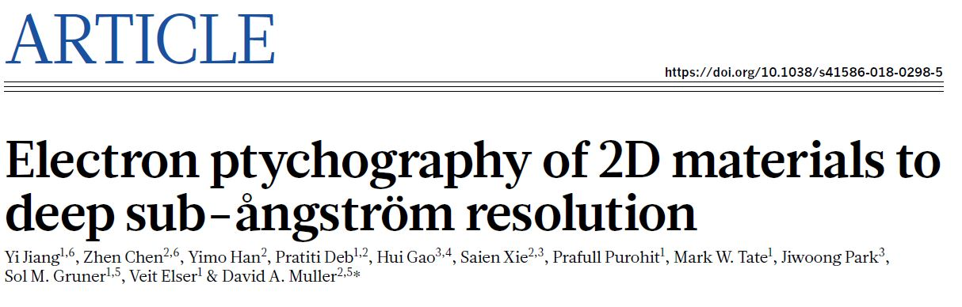
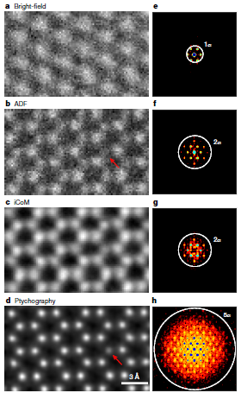
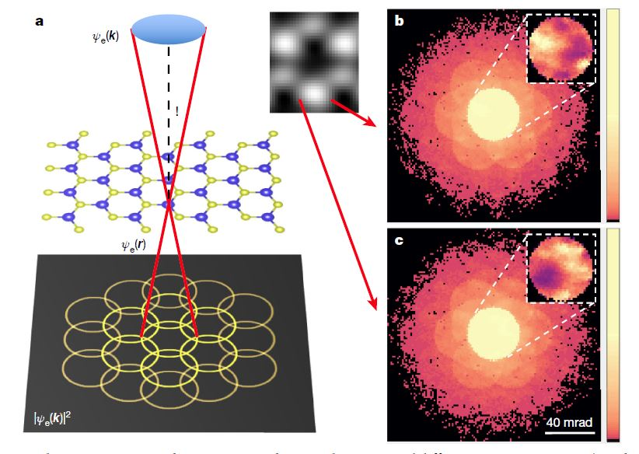
Jiang, Nature, volume 559, pages343–349 (2018)
Notes:
Can also use same chip for ptychography with electrons.
Extend techniques to electron microscopy – using the EM-PAD.
Using a divergent beam at 80 keV (electrons!)
Looking at molybdenum disulfide (MoS2) a 2D material typically having two layers of sulfur atoms.
Left – a cartoon of the setup.
In the middle some example electron diffraction patterns.
Note again: high dynamic range needed.
Comparison of data analysis techniques with ptychography at the bottom.
If you look at where the red arrow is – it’s dimmer because there’s a missing sulfur atom.
It’s not the first examination of moly disulfide defects – but it is world record breaking microscopy resolution of 0.39 Angstrom.
Kate Notes:
In STEM the most common technique for achieving atomic reolustion is high-angle annular dark field (ADF) imaging: electrons scattered through large angles form an incoherent image – this is an incoherent imaging technique. To get high resolution, it is generally necessary to go to small wavelength and large aperture. The former increases radiation damage in 2D materials, the latter introduces geometric and chromatic aberrations. But there is phase information encoded throughout a diffraction pattern formed from a localized electron beam – in the form of interference patterns between overlapping scattered beams. So we turn to a scanning technique called ptychography to extract this phase information. In principle the resolution is limited by the largest scattering angle at which meaningful information can be recorded – but as in x-ray imaging, the signal falls rapidly with scattering angle. So wide dynamic range is required.

Slide 6
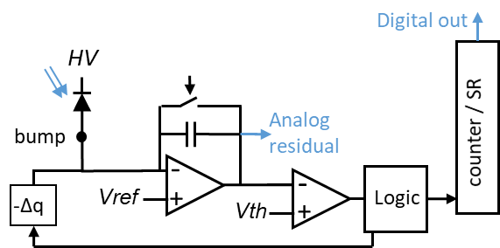
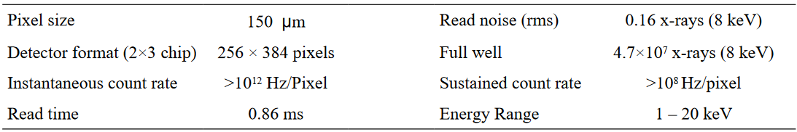
MM-PAD Pixel
Charge integrating front-end.
Re-triggerable charge removal
# of -Δq tracked with counter.
Pixel output digital and analog.
Hole collecting.
~4 x
(8 keV)
M.W. Tate, et al. ,Journal of Physics: Conference Series 425 (2013) 062004
Notes:
Pixel we’ve been using to do this – we originally developed for protein crystallography with NIH funding.
Charge integrating front-end (folded cascade), collecting holes, 50 fF feedback capacitor.
Output of the integrator is tracked.
When Vth passed, a charge dump is triggered. (switched capacitor).
~200 * 8-keV photon equivalent for single charge dump
Approximate max dump rate – 2 MHz.
Charge dumps are tracked with an in-pixel counter.
Pixel output = digital (18-bits from pseudorandom counter), 12 or 14 bits ADC analog signal. >=30 bits.
Frame rate: 1 KHz.

Slide 7
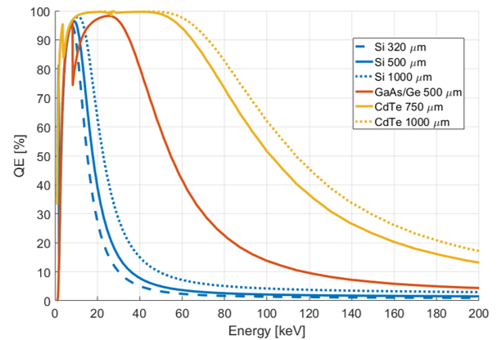
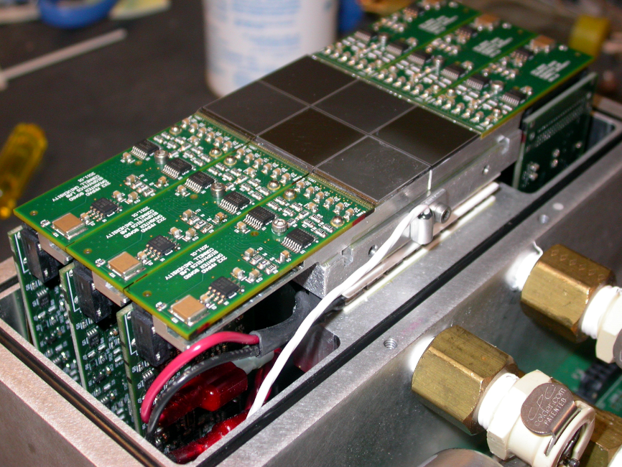
Silicon sensor inefficient at higher energies
Tiled MM-PAD array with Si sensors
High Energy X-rays useful for thick, high-Z samples
e.g. materials science of metals
25 keV
100 keV
Notes:
New experiments demanding high efficiency at higher energies.
Mating sensors to our ASICs.
Options for high-Z sensors. GaAs,Ge, CdTe.
If you want good efficiency CdTe (possibly CZT) is the best option.
Applications – we have a lot interest from materials scientists. (Show very relevant example later)

Slide 8
Material Comparison
Material | ρ [g/cm³] | Z | E_{gap} [eV] | E [eV] | µ_{e} [cm²/Vs] | µ_{h} [cm²/Vs] | τ_{e} | τ_{h}
Silicon | 2.33 | 14 | 1.12 | 3.6 | 1500 | 400 | >1ms | >1ms
Ge | 5.33 | 32 | 0.67 | 2.9 | 3900 | 1900 | >1ms | >1ms
GaAs | 5.32 | 31,33 | 1.42 | 4.3 | 4000 | 300 | ~10ns | ~ 1ns
CdTe | 5.85 | 48,52 | 1.44 | 4.4 | 1100 | 90 | ~ 3µs | ~ 2µs
Advantages:
Disadvantages:
Si: Highest quality
Ge: Higher Z than Si
uniformly high mobility
GaAs: Higher Z than Si
CdTe: Highest Z
Si: low ρ,Z
=> low QE at high E
Ge: low E_{gap}
=> needs cryo cooling
GaAs: low τ
=> energy dependence
CdTe: slow; material polarization
=> speed, complexity
Notes:
Looking at some rough numbers for high-Z materials.
Germanium looks very attractive for moderately hard x-rays.
High mobility of both electrons and holes.
Relatively long carrier lifetimes.
Bad: small bandgap – typically needs cryocooling.
Gallium arsenide:
Short lifetimes.
Not uniformly high mobility.
There are material reliability/quality issues.
Material polarization – hole trapping.
Flatfield strong function of energy.
Magnitude of materials effects strong function of temperature and bias.
CdTe:
+Highest Z.
-Polarization.
-Slow (not relevant for MM-PAD).
Complex.
Note: Compound semiconductors subject to atom swapping defects – would like to move away from them.

Slide 9
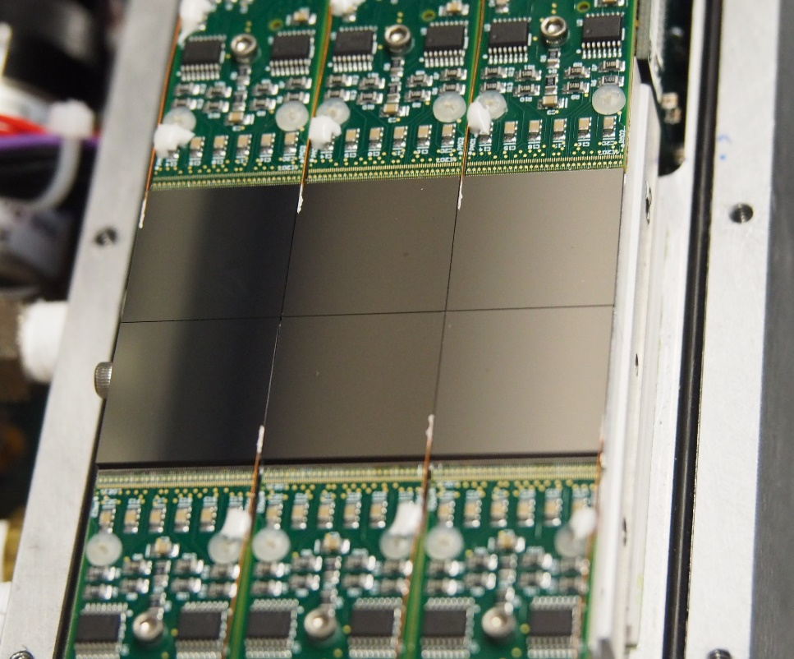
CdTe: Sensor for MMPAD
Supplied by Acrorad Ltd. (Japan)
750 μm thick CdTe
Schottky diode.
  In (front-side) /CdTe/ Pt (pixel)
  Hole collecting (compatible with MM-PAD).
  Very low leakage current
Notes:
Acquired 750 um thick CdTe from Acrorad in Japan.
We’re using it in a schottky diode configuration with Indium anode and platinum
Very low leakage current.
This our standard 3x2 tiling of sensors.
Some notes: CdTe is very soft – so you really need to take care when you’re placing it not to damage it.

Slide 10
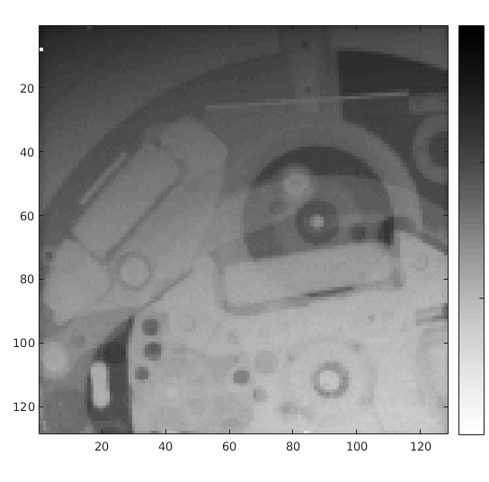
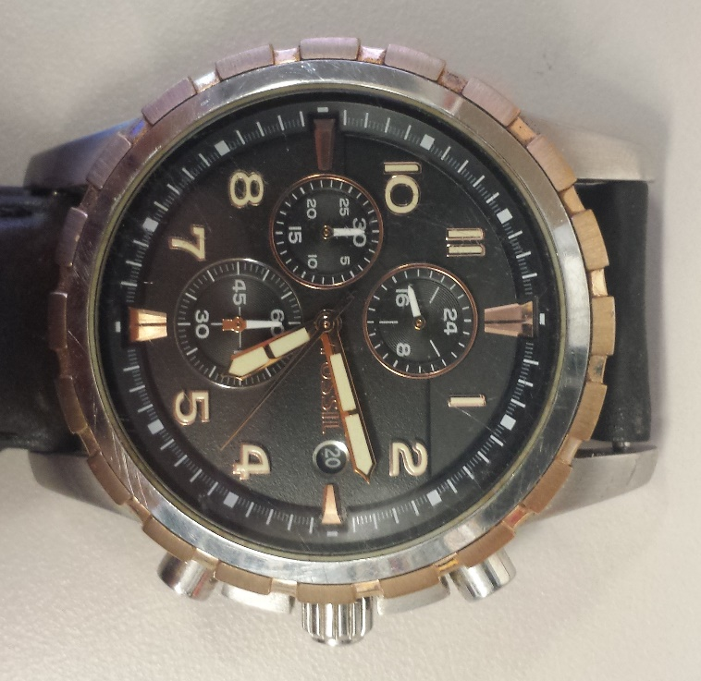
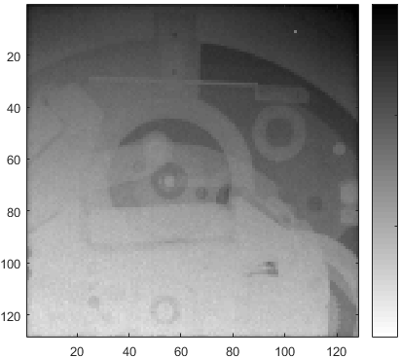
CdTe vs. Si MM-PAD
10000
1000
CdTe
1s total exposure
0.2 mA tube current
ADU
100
10
300
1 second vs. 8.5 minutes
100
Ag tube 47 kV
Average of 1000 images
No Flat Field Correction
Si
8.5min total exposure
0.9 mA tube current
ADU
30
10
Notes:
Simple radiograph of Julian’s watch reveals some immediate benefits over Si.
Source: Silver 47 keV.
Average images.
Top CdTe: total integration time is 1s.
Bottom Si: total integration time 8.5 minutes.
Never going to recover the contrast.

Slide 11
CdTe vs. Si MM-PAD
10000
1000
CdTe
1s total exposure
0.2 mA tube current
Parameter | CdTe MM-PAD | Si MM-PAD
Pixel Size | Both 150 μm x 150 μm
Format (2x3 tiling) | Both 256 x 384 pixels
Read Noise | 1.6 keV eq. | 1.3 keV eq.
Full-Well | 4.6 x 10⁸ keV | 3.8 x 10⁸ keV
Sustained “Count” Rate | 3.92 x 10⁹ keV/s | 3.2 x 10⁹ keV/s
Energy Range | 10 - 100 keV | 1-20 keV
ADU
100
10
300
100
Si
8.5min total exposure
0.9 mA tube current
ADU
30
10
Notes:
Comparing Specifications:
Same pixel size (150 um), same format 3x2 tiling of 128x128 pixels.
The read noise, the full well, and sustained “count rate” if you cast them in terms of equivalent keV all scale with the difference in the conversion factor.
So 3.6 eV /e-h pair silicon, 4.4 eV/ e-h pair for CdTe.
But the biggie is energy range. – and these are approximate.
General rule: if you’re in a range where silicon will suffice – use it.

Slide 12
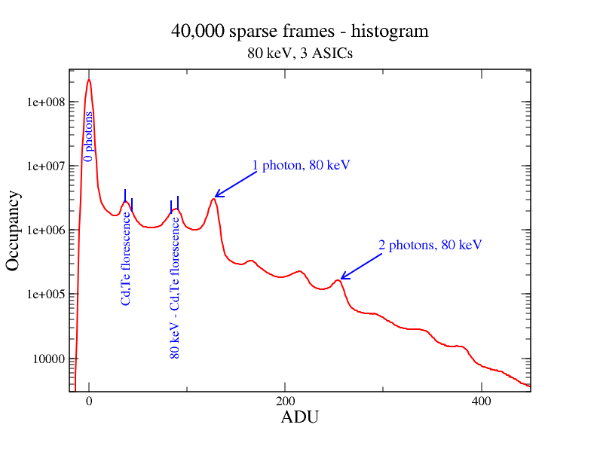
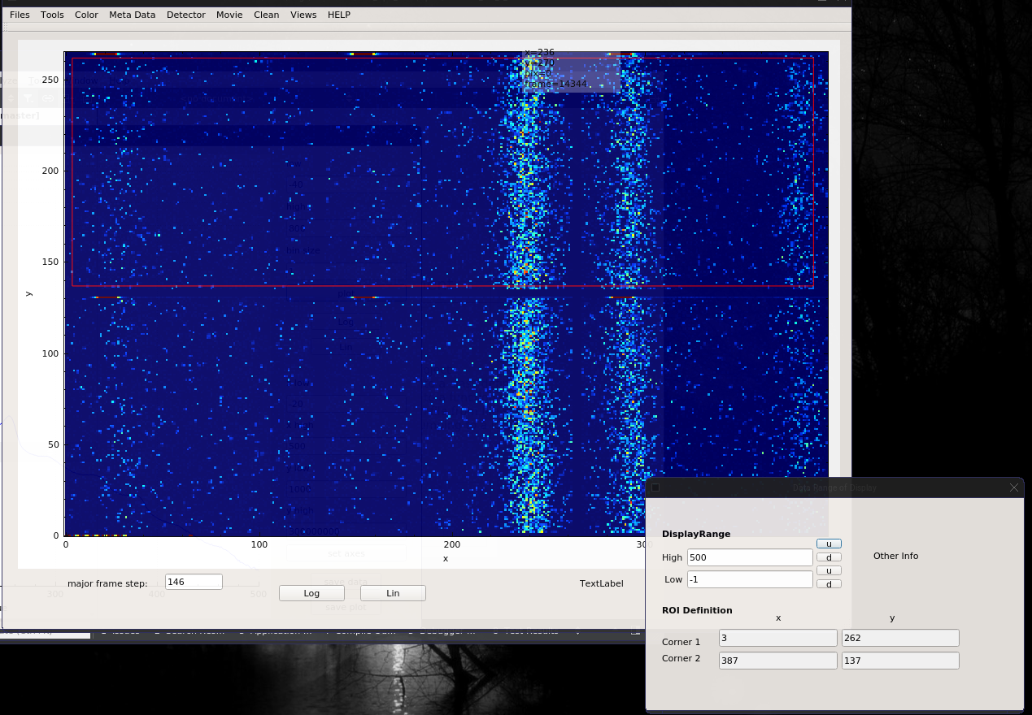
Histogram from experiment, 80 keV
Histogram
Cd Kα = 23.2 keV, Te Kα = 27.5 keV
APS Beamline 1-ID-E
Notes:
Problems with CdTe and they come in different flavors.
Florescence : both Cd & Te florescence.
Take sparse 80 keV x-ray data from 40,000 frames and histogram pixel outputs.
You can see the peaks associated with 0,1,2 photons.
You can see peaks from the florescence.
from pixels that weren’t illuminated but absorbed secondary fluorescence.
You can see the 80 keV – the florescence peak.
From pixel that absorbed 80 keV but then lost the florescence.
Non-ideal – degrades your data – need to keep it in mind.
With smaller pixels it will be even more of nuisance .
You can see higher order echoes of this between 1 and 2 photons, 2 and 3 photons.

Slide 13
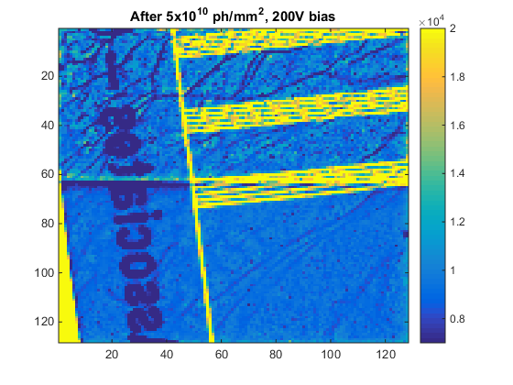
CdTe: Polarization
Image of line pair mask after
knife edge illumination
Polarization significant after X photons/pixel or long period of time.
Polarization: dose dependent accumulation of space charge.
A
Complex behavior
B
Region A : undosed
  increased variance
  same average signal
Region B : between the dosed and undosed
  lateral displacement
Region C : dosed
  reduced in signal
  less variance than A.
C
200 V bias
Becker, et. al., (2016) JINST 11: P12013
doi:10.1088/1748-0221/11/12/P12013
Polarization clear at 10¹⁰ photons/mm²
Notes:
1) The other major problem with CdTe is Polarization.
2) Trapping of charge, building of space charge.
3) Non-uniformities that look like networks.
Showing:
Sitting around for 15 hours.
Results of polarization after illumination with a knife edge.
Top region was shielded with knife edge. Bottom region was dosed. (47 keV Ag tube for 5×10^10 ph/mm2 at 600 V bias.
Effects:
A: Just sitting around gets this non-uniformity/network – but average signal the same.
C: Dosed less variance than A but reduced signal.
B: Difference in space charge causes distortion of fields lines in the detector -> displacement and ghosting of edges in subsequent frames.
Some effects more apparent on integrating PAD?

Slide 14
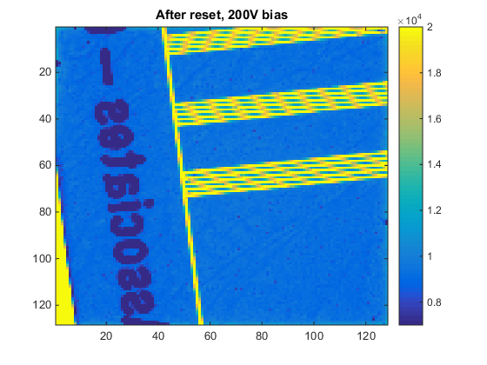

CdTe: Polarization
Reset procedure:
Apply slight forward (5V) bias.
Wait for ~ couple minutes.
Reapply High Voltage bias.
Wait ≥ 3 minutes.
Take new dark images
200 V
Relatively simple
mitigation
600 V
Becker, et. al., (2016) JINST 11: P12013
doi:10.1088/1748-0221/11/12/P12013
Notes:
You can, however, reset the material.
After some experimentation, here is what we do:
Apply a slight forward bias (~5V) for a couple minutes.
Reapply high voltage.
Wait a few minutes.
Take new backgrounds/dark images.
Returns signal to original value within 0.5%
Comments:
Acrorad warned against forward biasing.

Slide 15
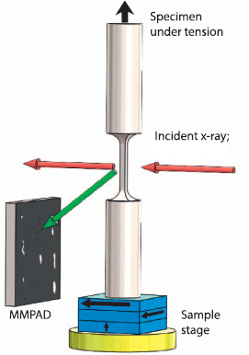
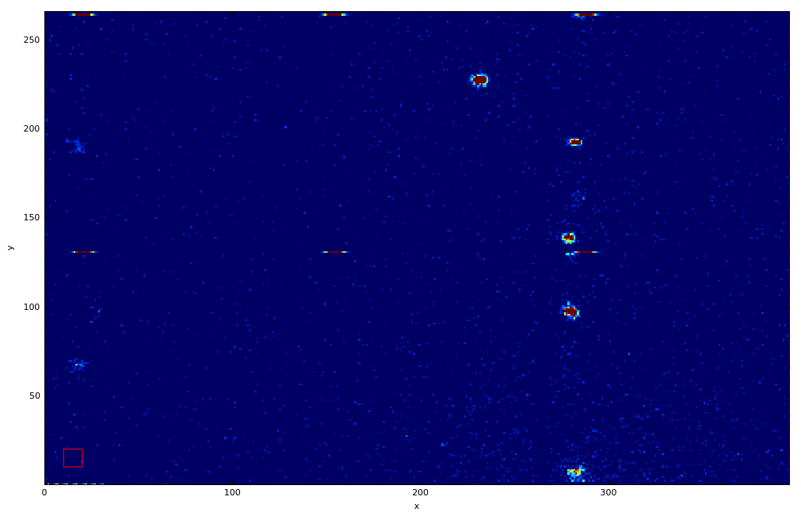
Experimental Example
Looking at Ti alloys and grain structure stress-strain response.
Relevant to airplane metal fatigue
Framing at 300 Hz
Collaborators: A. Beaudoin, K. Chatterjee, D. Pagan, P. A. Shade, P. Kenesei, J.-S. Park
  (Cornell, APS, US Air Force Research Lab, University of Illinois, Urbana-Champaign)
80 keV
Rotating +/- 2.5 degrees
While applying tension
& synchronized imaging
APS Beamline 1-ID-E
Notes:
Who is flying today?
Material scientists like to look at metals and how they fail (crack propagation, deformation of metal grains, twinning).
USAF + aerospace + structural materials shifting toward integrated computational materials engineering (ICME) that “requires validated predictive models of material performance”
Look at applying and releasing tensions on metals (her Ti alloys).
Animation – is just keeping angle fixed as we’re doing it.
Grains disappear – rotating and going out of diffraction condition/ewald sphere.
Sweep through section of recip. Space by continuous back and forth rotation.
Of cource – 80 keV (metals) and MMPAD.

Slide 16
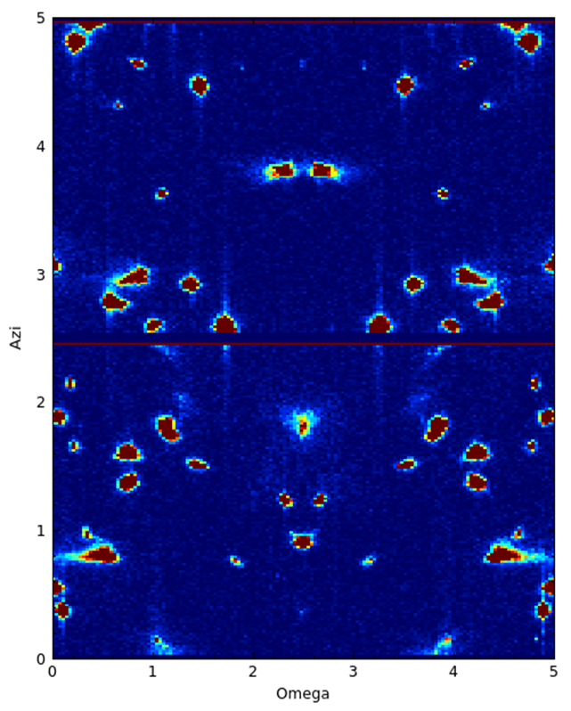
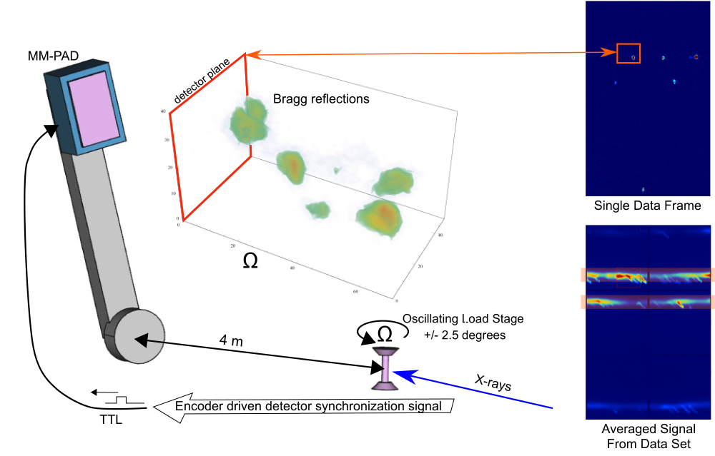
Experimental Example (continued)
Azi
r
r
K. Chatterjee, “Intermittent plasticity in individual grains - a study using high energy x-ray diffraction”
Accepted manuscript, Structural Dynamics.
APS Beamline 1-ID-E
Notes:
4 dimensional data set:
Radial (r)
Azimuthal angle.
Omega (sample rotation).
Time.
Can:
Select r range to track diffraction spots.
Sum over r.
Plot pictures of omega vs azi and make a movie.
Shows:
Really rich behavior.
See things drift out of omega range can now be tracked.
Looking for things like :
Intermittancy of material response. i.e. Continuous tension that are punctuated – like, if you will, like little tiny earthquakes on the grain level.

Slide 17
Conclusions
MM-PAD: High dynamic range PAD.
CdTe extends useable energy range beyond 100 keV
CdTe has polarization and florescence, but still very useful instrument.
Working on new upgrades to the MM-PAD that extends capabilities.
Notes:
Sydor Technologies, Inc. is commercializing the Si and CdTe MM-PAD with 512x512 pixel format.
ThermoFisher Scientific/FEI commercializing the EMPAD.

Slide 18

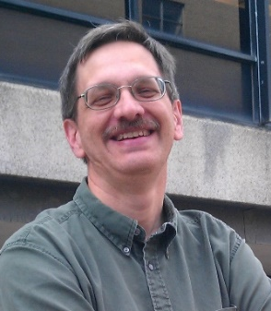

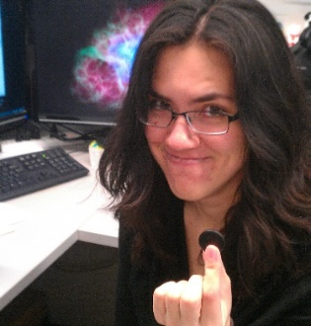
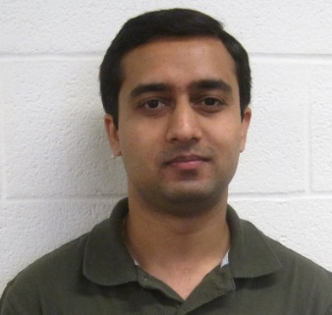
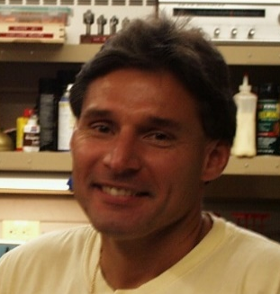

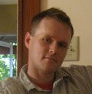

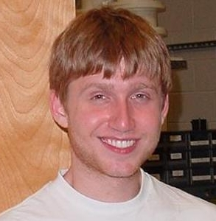


Who we are
Present members
Sol Gruner
Mark Tate
Hugh Philipp
Kate Shanks
Prafull Purohit
Marty Novak
Some past members
Lucas Koerner
(U. St. Thomas)
Dan Schuette
(MIT-LL)
Marianne Hromalik
(SUNY Oswego)
Joel Weiss
(Apple)
Julian Becker
(DESY)
Darol Chamberlain

Slide 19
Additional Slides Follow

Slide 20
MM-PAD 2.0 - High Current Testing
No sensor, external current source, HDR-PAD 1st submission
Inferred Input vs Actual Input
Max oscillator
frequency
Design goal
20
Notes:
20

Slide 21
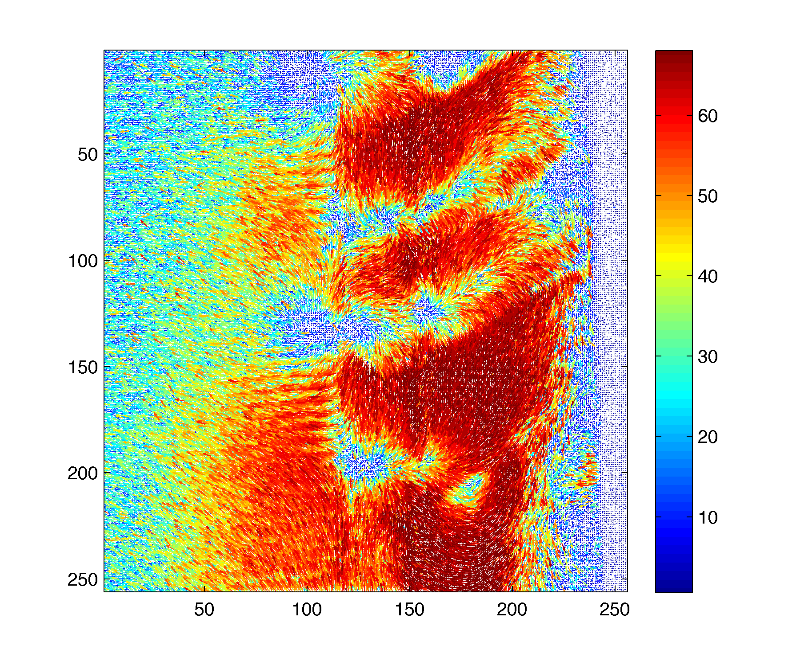
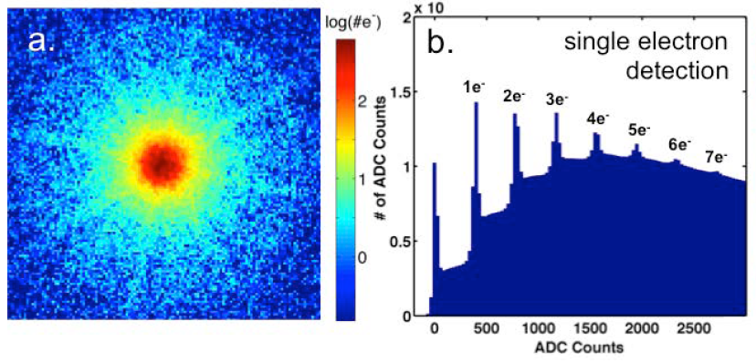
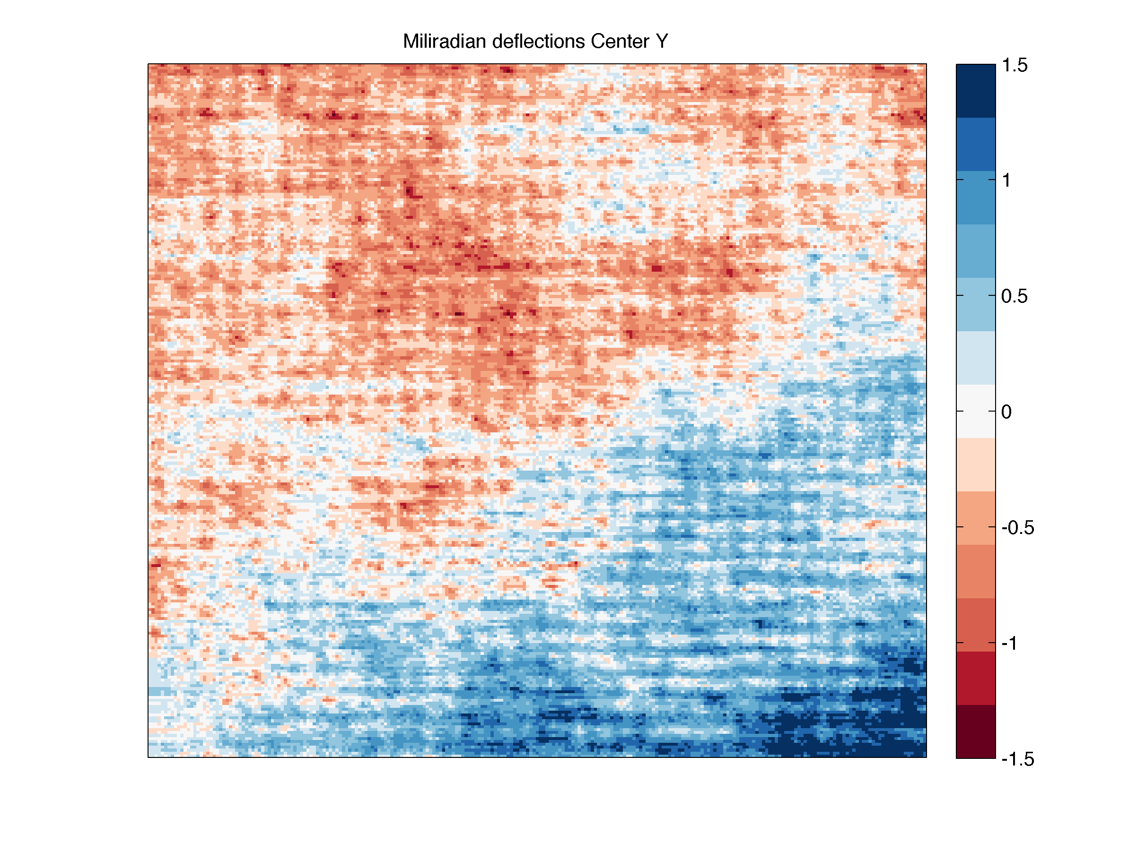
EM-PAD: Lorentz-STEM Imaging at Atomic Resolution
Electron energy: 200 keV, Tecnai F20 electron microscope
Collaborators: Mueller group (CHESS)
Goal: Lorentz-STEM imaging of electromagnetic fields in BiFeO2
Wide dynamic range with single-electron sensitivity allows for determination of crystal orientation, local atomic potentials, and electromagnetic fields at the atomic level
Nguyen et al. Microscopy and Microanalysis 21 (Suppl 3), 2015
Notes:
This slide summarizes one of the early experiments done with the EM-PAD.
This is Lorentz microscopy, a method for imaging magnetic domain structure in a material.
What you see here a vector map of bismuth iron oxide calculated from shifts in momentum of the electron beam from the diffraction pattern, as the sample is scanned through the beam.
The detector’s wide dynamic range allows one to accurately measure the high-angle scattering with single electron sensitivity, as shown at right, at the same time as we u measure the high-intensity central region. This allows to extract the magnetic and electric fields at atomic resolution.
This data was taken with 1 ms readout and 200 keV Tecnai F20 electron microscope

Slide 22
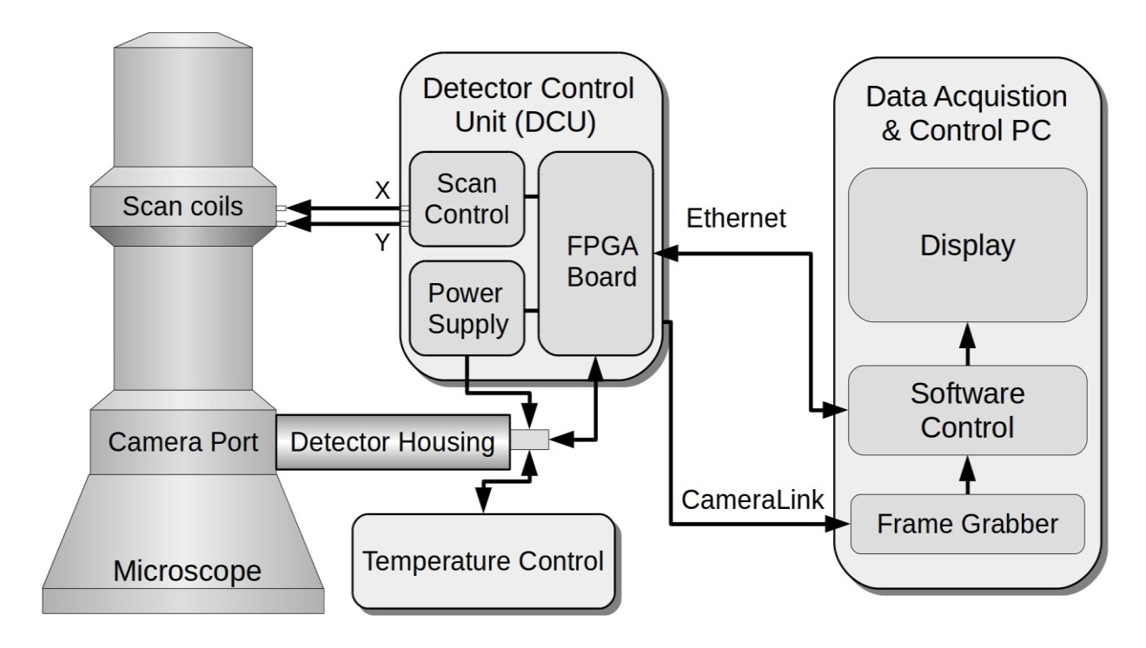
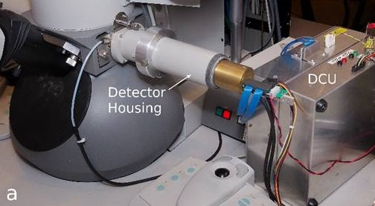
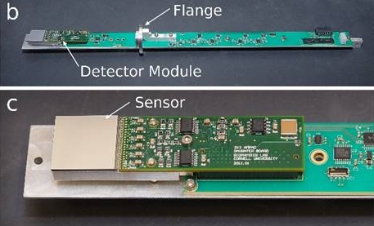
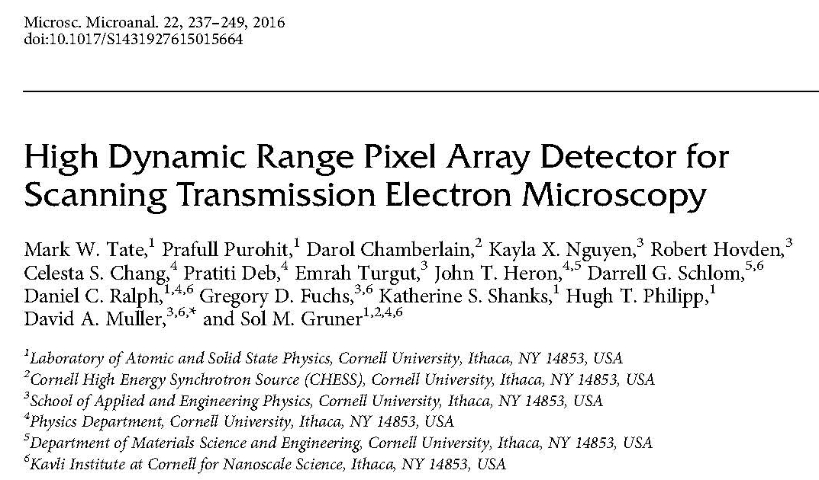
MM-PAD used in STEM (EM-PAD)
Notes:
Additionally, as I mentioned earlier, a single-chip silicon MMPAD module has proven very well suited for use in scanning transmission electron microscopy. This iteration of the detector was developed in collaboration with the Mueller group at Cornell. A block diagram of the system is shown here, with photographs of the detector housing and single-chip module at right.

Slide 23
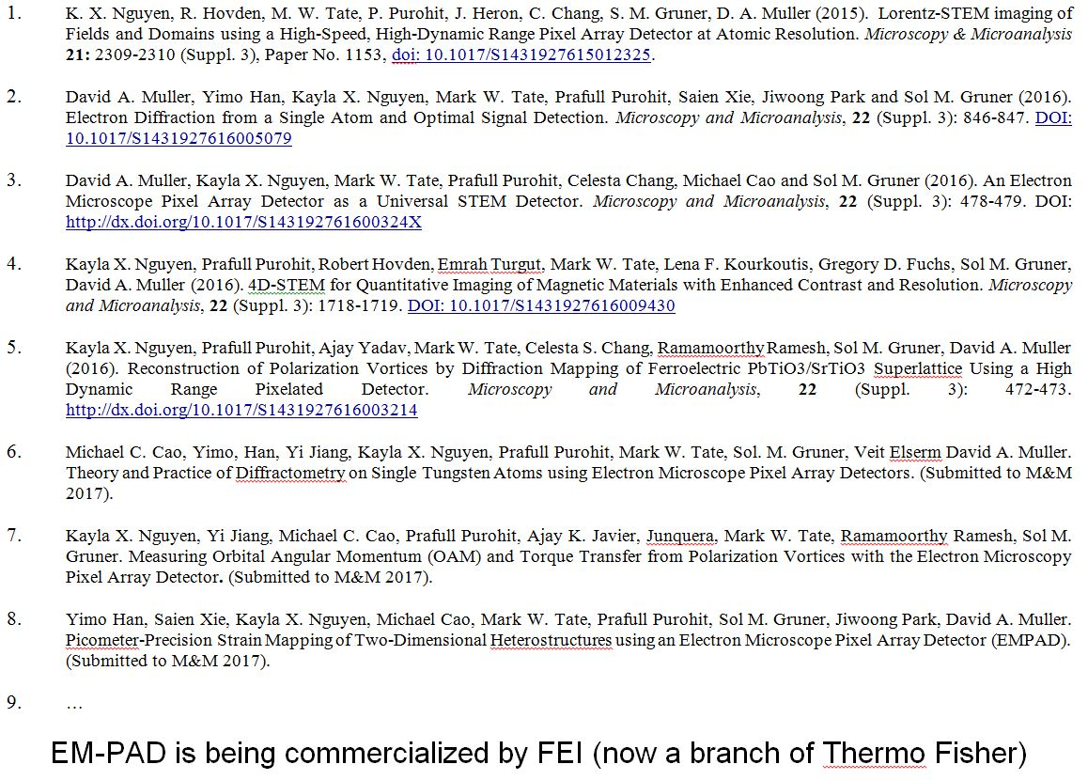
Notes:
This has lead to a proliferation of experimental results and papers, of which this is only a partial list. This iteration of the detector, which we refer to as the EM-PAD, is being commercialized by FEI.

Slide 24
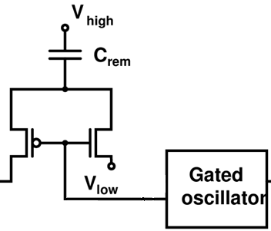
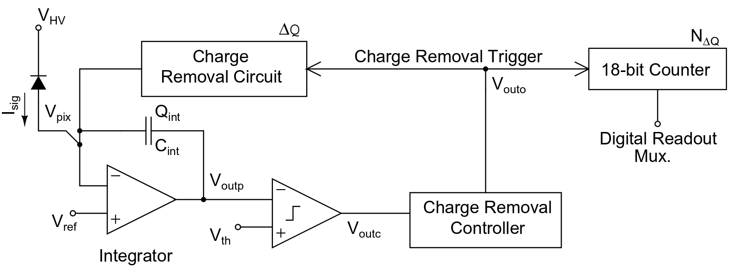
Present MM-PAD: Limitations
Charge removal circuitry runs at 2 Mhz max
  4x10⁸ 8 keV x-rays/pix/s max sustained rate
Readout limited to ~0% duty cycle at max frame rate of 1.1 kHz
C_{CR}
Sensor
C_{F}
24

Slide 25
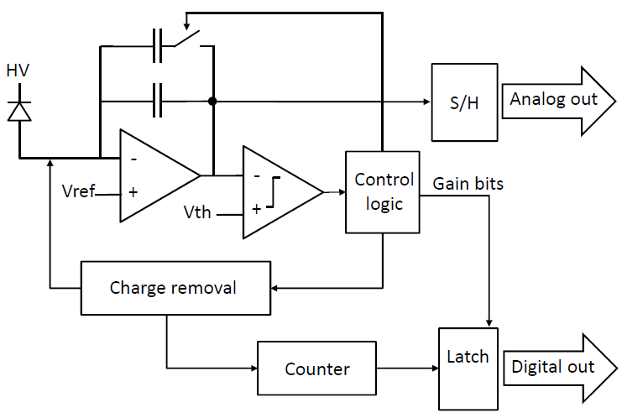
HDR-PAD option 1: MM-PAD 2.0
improvements to MM-PAD pixel
Adaptive gain
At start :
Use 40 fF for high S/N
After first fill:
Use larger cap to handle large pulses
(tried 460 - 2600 fF)
Charge removal now at 100 MHz max operation
CF_{LG}
CF_{HG}
Class AB amplifier higher slew rate
25
Notes:
Similar to MM-PAD, comp monitors output voltage,
But some key differences
25

