Slide 1
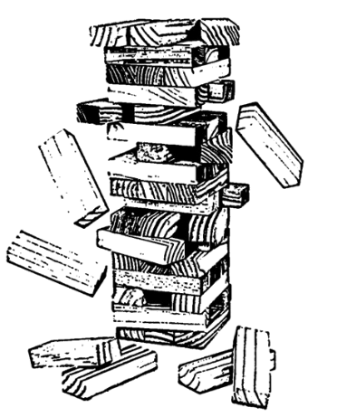
PATATRACK
Accelerated Pixel Tracks at the HLT starting from Run 3
D. Bacciu¹, A. Bocci², E. Brondolin⁸, C. Calabria³, A. Carta¹, S. Roy Chowdhury⁴, E. Corni⁵,
A. Di Florio³, S. Di Guida⁶, S. Dubey⁷, S. Dugad⁷, S. Dutta⁴, R. Fruhwirth⁸, V. Innocente², V. Khristenko²,
M. Kortelainen², P. Mal⁴, D. Menasce⁶, F. Pantaleo², M. Pierini², M. Rovere², S. Sarkar⁴, V. Volkl²
University of Pisa¹, CERN², INFN Bari³, SINP⁴, INFN CNAF⁵,
INFN Milano Bicocca⁶, TIFR⁷ , Austrian Academy of Sciences⁸
felice@cern.ch

Slide 2
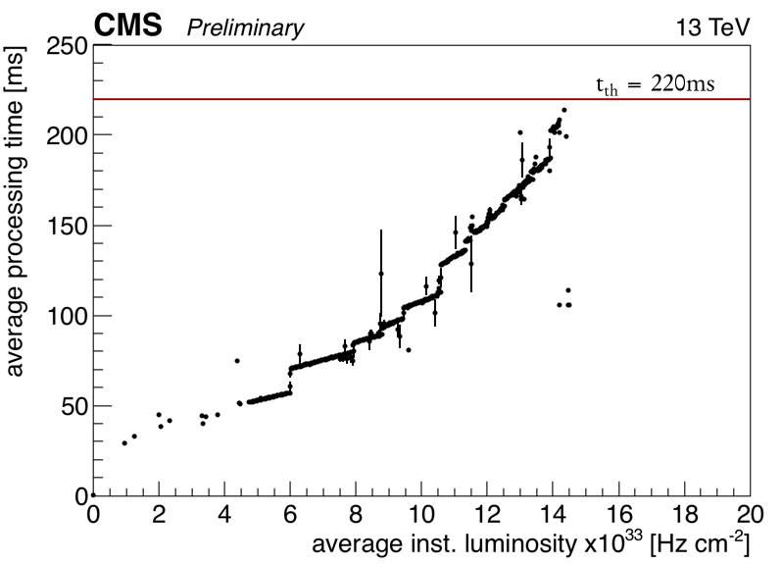
CMS High-Level Trigger in Run 2 (1/2)
Today the CMS online farm consists of ~26k Intel Xeon cores
  The current approach: one event per logical core
Pixel Tracks are not reconstructed for all the events at the HLT
This will be even more difficult at higher pile-up
  More memory/event

Slide 3
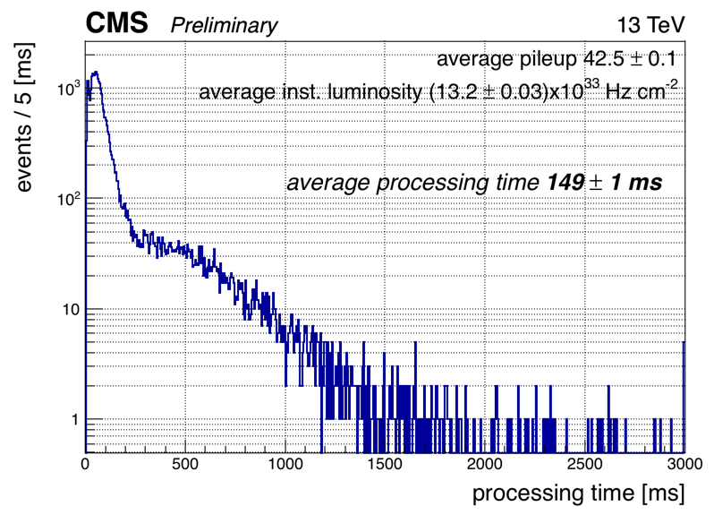
CMS High-Level Trigger in Run 2 (2/2)
Today the CMS online farm consists of ~22k Intel Xeon cores
  The current approach: one event per logical core
Pixel Tracks are not reconstructed for all the events at the HLT
This will be even more difficult at higher pile-up
  More memory/event
full track reconstruction and particle flow e.g. jets, tau

Slide 4
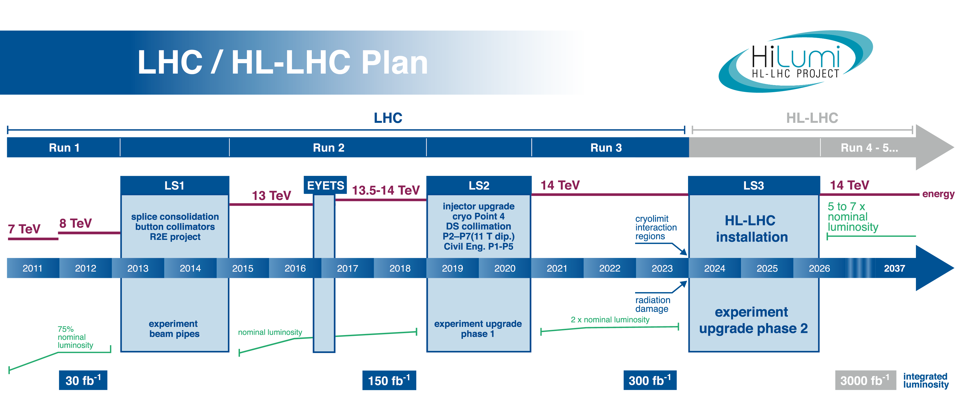
CMS and LHC Upgrade Schedule
CMS
pixel detector upgrade

Slide 5
Pixel Tracks
Evaluation of Pixel Tracks combinatorial complexity could easily be dominated by track density and become one of the bottlenecks of the High-Level Trigger and offline reconstruction execution times.
The CMS HLT farm and its offline computing infrastructure cannot rely on an exponential growth of frequency guaranteed by the manufacturers.
Hardware and algorithmic solutions have been studied

Slide 6
Pixel Tracks on GPUs during Run-3

Slide 7

PATATRACK
Curiosity-driven project started in 2016 by a very small group of passionate people, right after I gave a GPU programming course…
CMS-specific project
Started with no funding, no EPRs: people joined because it’s fun and
interesting to work at the forefront of technology
Soon grown:
  CERN: F. Pantaleo, V. Innocente, M. Rovere, A. Bocci, M. Kortelainen,
  M. Pierini, V. Volkl (SFT), V. Khristenko (IT, openlab)
  Austrian Academy of Sciences: E. Brondolin, R. Fruhwirth
  INFN Bari: A. Di Florio, C. Calabria
  INFN MiB: D. Menasce, S. Di Guida
  INFN CNAF: E. Corni
  SAHA: S. Sarkar, S. Dutta, S. Roy Chowdhury, P. Mal
  TIFR: S. Dugad, S. Dubey
  University of Pisa (Computer Science dep.): D. Bacciu, A. Carta
  Thanks also to the contributions of many short term students (Bachelor, Master, GSoC): Alessandro, Ann-Christine, Antonio, Dominik, Jean-Loup, Konstantinos, Kunal, Luca, Panos, Roberto, Romina, Simone, Somesh
Interests: algorithms, HPC, heterogeneous computing, machine learning, software eng., FPGAs…
Lay the foundations of the online/offline reconstruction starting from 2020s (tracking, HGCal)
Website under construction: PATATRACK , contact: patatrack-rd@cern.ch
Meetings: https://indico.cern.ch/category/7804/

Slide 8
From RAW to Tracks during run 3
Profit from the end-of-year upgrade of the Pixel to redesign the seeding code from scratch
  Exploiting the information coming from the 4th layer would improve efficiency, b-tag, IP resolution
Trigger avg latency should stay within max average time
Reproducibility of the results (equivalence CPU-GPU)
Integration in the CMS software framework
Targeting a complete demonstrator by 2018 H2
E-group: gpu-cms-pixel-phase1
Ingredients:
  Massive parallelism within the event
  Independence from thread ordering in algorithms
  Avoid useless data transfers and transformations
  Simple data formats optimized for parallel memory access
Result:
  A GPU based application that takes RAW data and gives Tracks as result

Slide 9
Tracking at HLT
Pixel hits are used for pixel tracks, vertices, seeding
HLT Iterative tracking:
Iteration name | Phase0 Seeds | Phase1 Seeds | Target Tracks
Pixel Tracks | triplets | quadruplets
Iter0 | Pixel Tracks | Pixel Tracks | Prompt, high p_{T}
Iter1 | triplets | quadruplets | Prompt, low p_{T}
Iter2 | doublets | triplets | High p_{T}, recovery

Slide 10
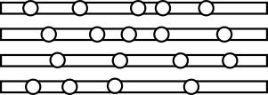

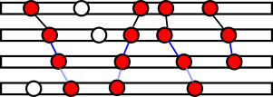
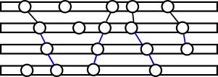
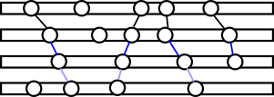
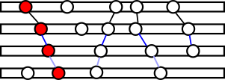
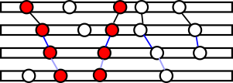
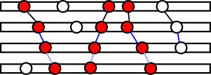
Algorithm Stack
Input, size linear with PU
Raw to Digi
Hits - Pixel Clusterizer
Hit Pairs + DNN Filter
CA-based Hit Chain Maker
Riemann Fit
Output, size ~linear with PU + dependence on fake rate

Slide 11
Overall status
RAW to DIGI
  Complete
Clustering
  Complete
CPE
  Almost complete
Doublet generation
  Ongoing
Cellular Automaton
  Complete, aligned to CMSSW
Riemann Fit
  CPU version implemented using Eigen (see talk by Roberto ~1month ago), GPU version missing
Overall integration in CMSSW
  In preparation

Slide 12
Massive parallelization?

Slide 13
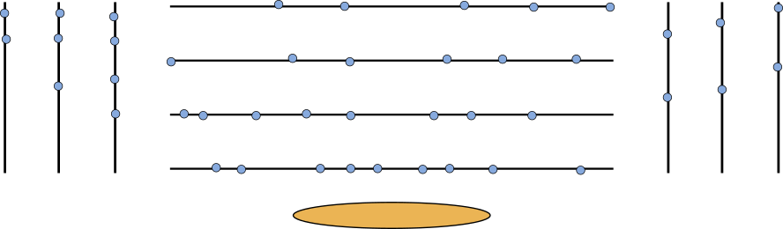
Our typical algorithms
First create doublets from hits of pairs
Take a third layer and propagate only the generated doublets
Consider a fourth layer and propagate triplets
Store found quadruplets and start from another pair of layers

Slide 14
Our typical algorithms
First create doublets from hits of pairs
Take a third layer and propagate only the generated doublets
Consider a fourth layer and propagate triplets
Store found quadruplets and start from another pair of layers
Repeat until happy…
Does this fit the idea of massively parallel computation? I don’t really think so…

Slide 15
Cellular Automaton (CA)
The CA is a track seeding algorithm designed for parallel architectures
It requires a list of layers and their pairings
  A graph of all the possible connections between layers is created
  Doublets aka Cells are created for each pair of layers (compatible with a region hypothesis)
  Fast computation of the compatibility between two connected cells
  No knowledge of the world outside adjacent neighboring cells required, making it easy to parallelize
However this is not a static problem, not at all…

Slide 16
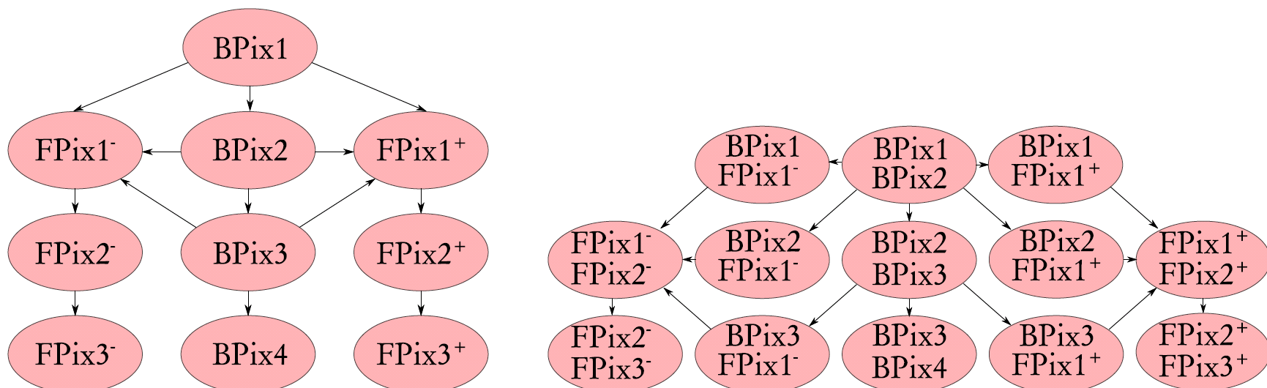
CAGraph of seeding layers
Seeding layers interconnections
Hit doublets for each layer pair can be computed independently by sets of threads

Slide 17
Integration studies

Slide 18


Integration in the Cloud and/or HLT Farm
Different possible ideas depending on :
  the fraction of the events running tracking
  other parts of the reconstruction requiring a GPU
Filter Units
Today
Builder Units
or disk servers
CMS FE, Read-out Units

Slide 19

Integration in the Cloud/Farm
Every FU is equipped with GPUs
  tracking for every event
GPU Filter Units
Option 1
Builder Units
or disk servers
Rigid design
  + easy to implement
  - Requires common acquisition, dimensioning etc

Slide 20
Integration in the Cloud/Farm
A part of the farm is dedicated to a high density GPU cluster
Tracks (or other physics objects like jets) are reconstructed on demand
Filter Units
Option 2
DL Inference Accelerators
Builder Units
or disk servers
GPU Pixel Trackers
FPGA Calo Reco
Flexible design
  + Expandible, easier to balance
  - Requires more communication and software development (e.g. HPX, MPI)

Slide 21
Integration in the HLT Farm
Builder units are equipped with GPUs:
  events with already reconstructed tracks are fed to FUs with GPUDirect
  Use the GPU DRAM in place of ramdisks for building events.
Filter Units
Option 3
GPU Builder Units
CMS FE, Read-out Units
Very specific design
  + fast, independent of FU developments, integrated in readout
  - Requires specific DAQ software development: GPU “seen” as a detector element

Slide 22
Tests

Slide 23
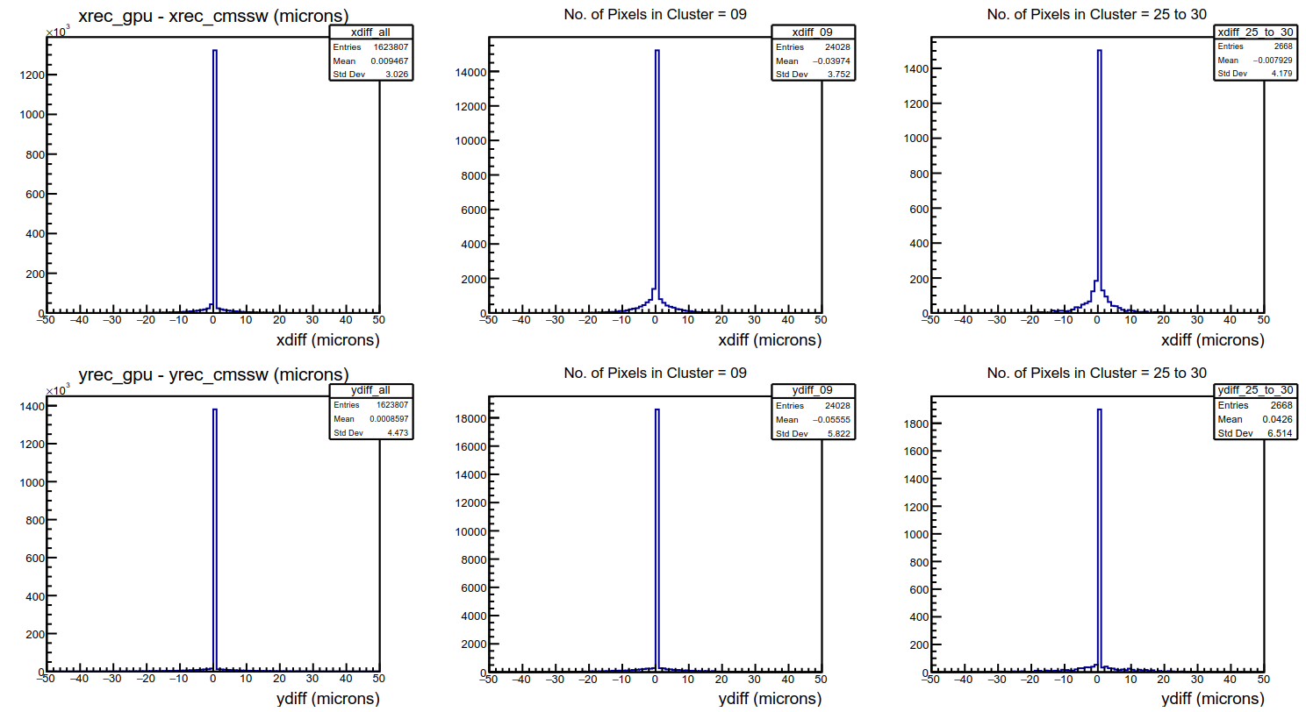
GPU Pixel Clusterizer
New Clusterizer algorithm
Excellent agreement with CMSSW

Slide 24
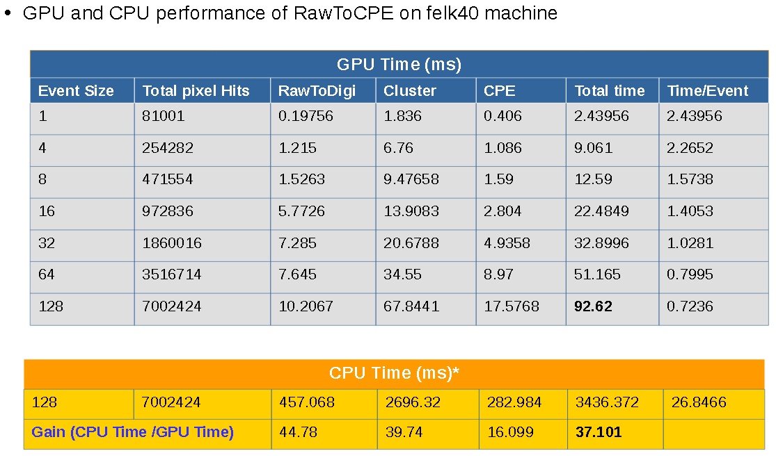
Raw To CPE

Slide 25
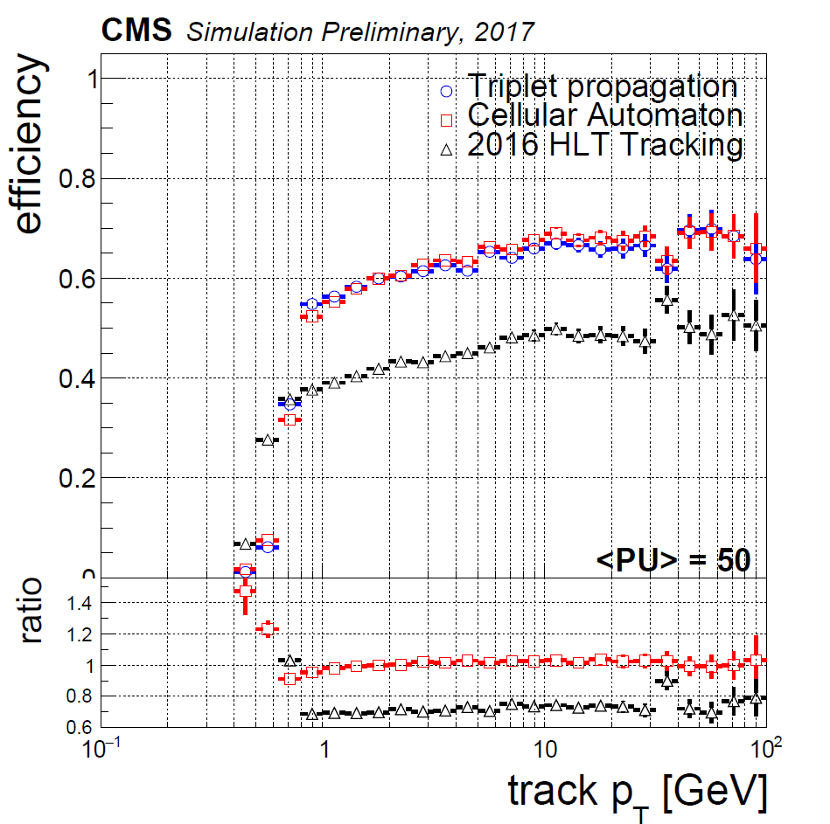
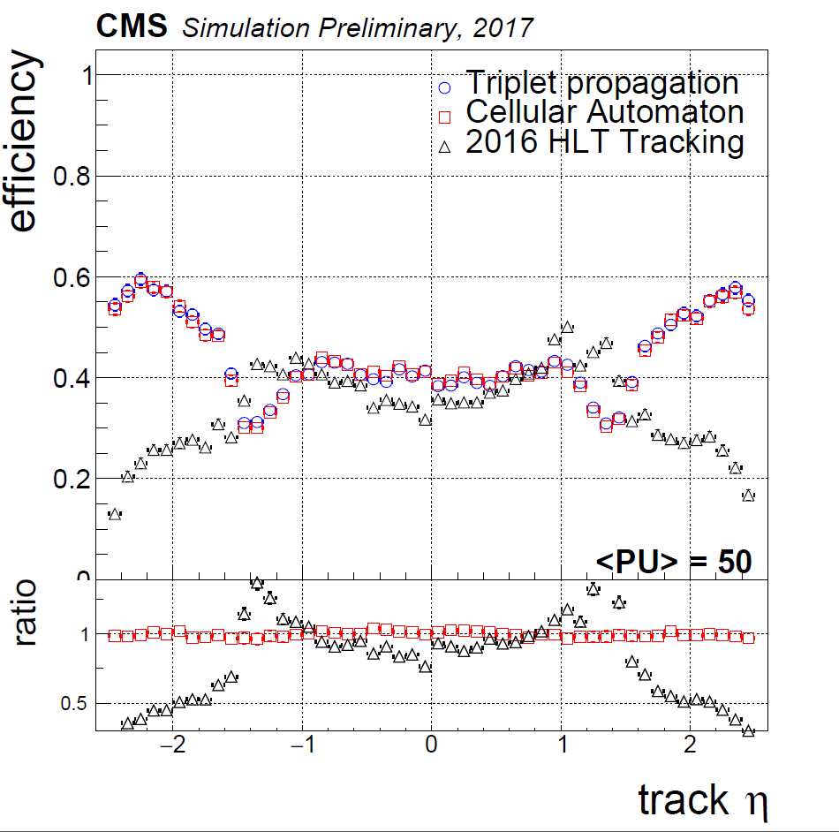
CA - Simulated Physics Performance PixelTracks
CA tuned to have same efficiency as Triplet Propagation
Efficiency significantly larger than 2016, especially in the forward region (|η|>1.5).

Slide 26
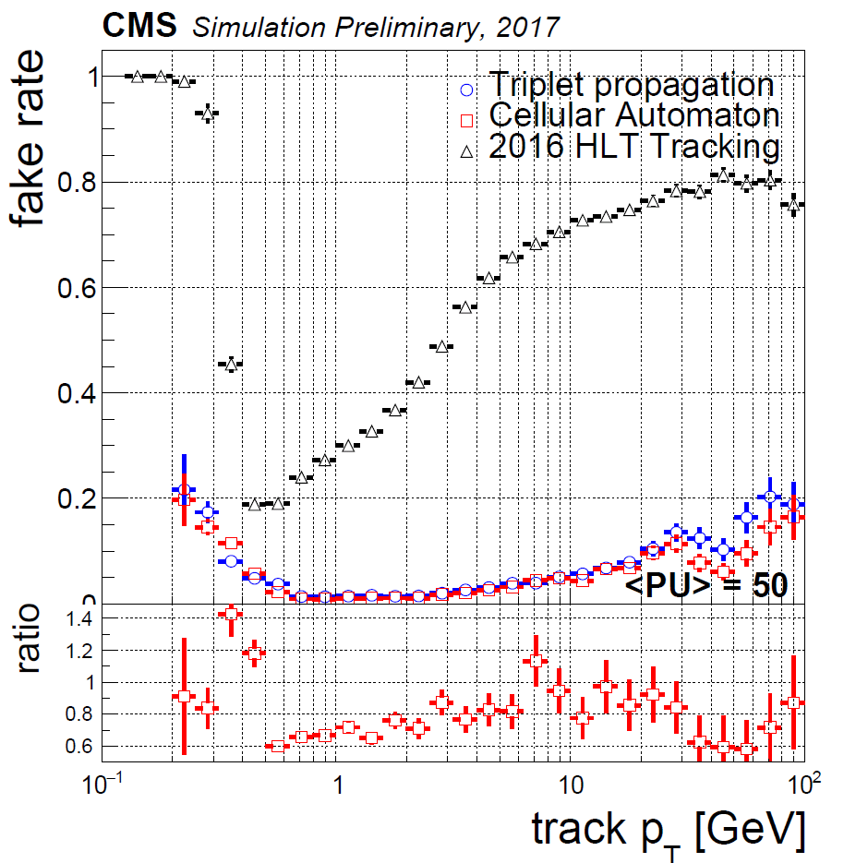
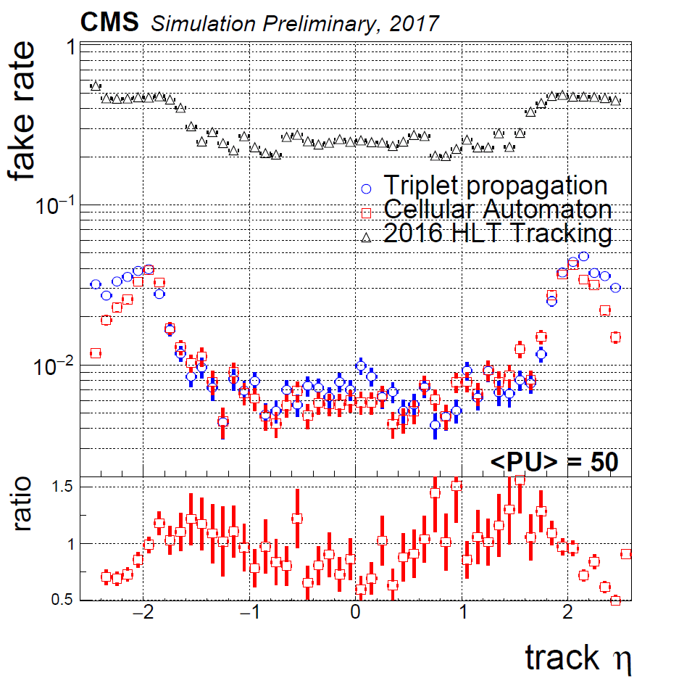
CA - Simulated Physics Performance PixelTracks
Fake rate up to 40% lower than Triplet Propagation
Two orders of magnitudes lower than 2016 tracking thanks to higher purity of quadruplets wrt to triplets

Slide 27

Hardware on the bench
We acquired a small machine for development and testing:
  2 sockets x Intel(R) Xeon(R) CPU E5-2650 v4 @ 2.20GHz (12 physical cores)
  256GB system memory
  8x GPUs NVIDIA GTX 1080Ti
  Total cost: 5x

Slide 28
Rate test
The rate test consists in:
  preloading in host memory few hundreds events
  Assigning a host thread to a host core
  Assigning a host thread to a GPU
  Preallocating memory for each GPU for each of 8 cuda streams
  Filling a concurrent queue with event indices
  During the test, when a thread is idle it tries to pop from the queue a new event index:
    Data for that event are copied to the GPU (if the thread is associated to a GPU)
    processes the event (exactly same code executing on GPUs and CPUs)
    Copy back the result
  The test ran for approximately one hour
  At the end of the test the number of processed events per thread is measured, and the total rate can be estimated

Slide 29
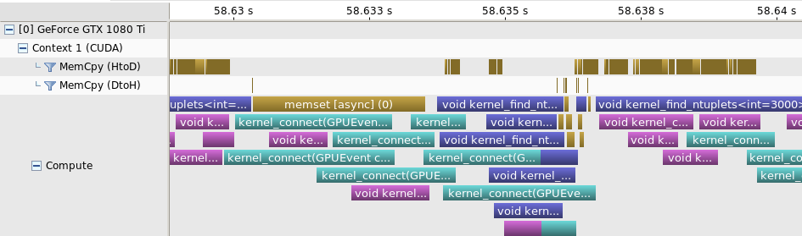
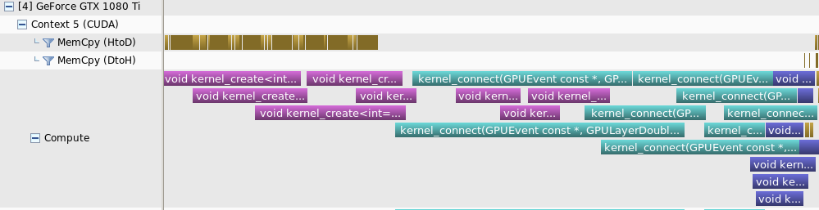
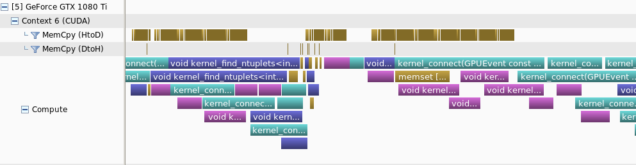
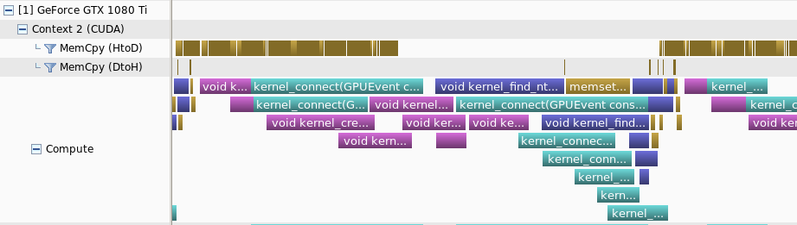
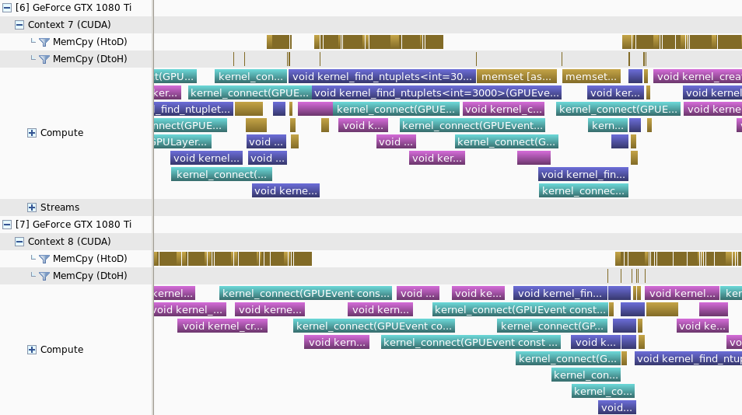
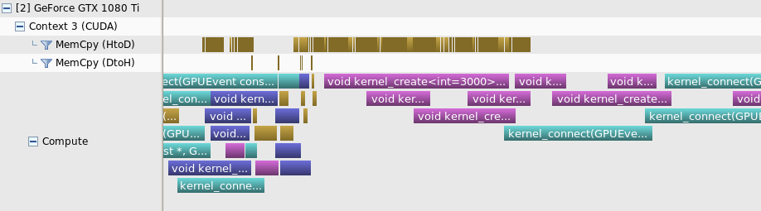
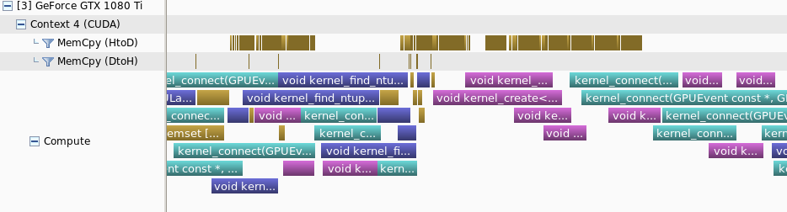
What happens in 10ms

Slide 30
Rate test

Slide 31
Rate test
Total rate measured:
  8xGPU: 6527 Hz
  24xCPUs: 613 Hz
Number of nodes to reach 100kHz: ~14
Total Price: 70x
When running with only 24xCPUs
  Rate with 24xCPUs: 777 Hz
Number of nodes to reach 100kHz: ~128
Total Price: 320x
  Assuming an initial cost of 2.5 per node

Slide 32
Energy efficiency
During the rate test power dissipated by CPUs and GPUs was measured every second
  Nvidia-smi for GPUs
  Turbostat for CPUs
8 GPUs: 1037W
  6.29 Events per Joule
  0.78 Events per Joule per GPU
24 CPUs in hybrid mode: 191W
  3.2 Events per Joule
  0.13 Events per Joule per core
24 CPUs in CPU-only test: 191W
  4.05 Events per Joule
  0.17 Events per Joule per core
That is 1/3 more s in the energy bill when processing 100kHz input

Slide 33
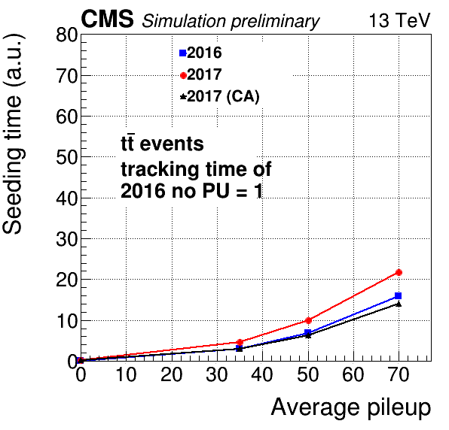
Algorithmic Innovation benefits offline reco
CA track seeding at same level of the 2016 seeding
More robust, smaller complexity vs PU than 2016 track seeding despite the increased number of layer combinations involved in the seeding phase with respect to the 2016 seeding
~25% faster track reconstruction wrt to 2016 tracking at avg PU70
Replacing the CMS Phase2 offline track seeding with sequential CA
  Overall tracking 2x faster at PU200
  T(PU=200 – Phase2 detector) = 4xT(PU50 – 2017 detector)
    Detector and algorithms defeated combinatorial complexity
Innovation at algorithmic level often underestimated
  We believe algorithmic modernization should be more encouraged and promoted by CMS

Slide 34
Conclusion
Pixel Track seeding algorithms have been redesigned with high-throughput parallel architectures in mind
Improvements in performance may come even when running sequentially
  Factors at the HLT, tens of % in the offline, depending on the fraction of the code that use new algos
Graph-based algorithm are very powerful
  By adding more Graph Theory sugar, steal some work from the track building and become more flexible
The GPU and CPU algorithms run in CMSSW and produce the same bit-by-bit result
  Transition to GPUs@HLT during Run3 smoother
Running Pixel Tracking at the CMS HLT for every event would become cheap @PU ~ 50 – 70
  Integration in the CMS High-Level Trigger farm under study
DNNs under development for early-rejection of doublets based on their cluster shape and track classification

Slide 35
Questions?

Slide 36
Back up

Slide 37
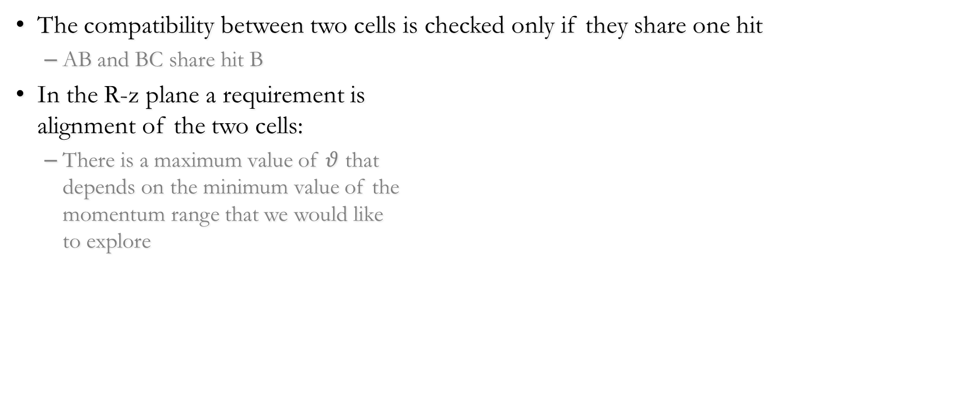
CA: R-z plane compatibility
The compatibility between two cells is checked only if they share one hit
  AB and BC share hit B
In the R-z plane a requirement is
alignment of the two cells:
  There is a maximum value of $θ$ that
  depends on the minimum value of the
  momentum range that we would like
  to explore

Slide 38
CA: x-y plane compatibility
In the transverse plane, the intersection between the circle passing through the hits forming the two cells and
the beamspot is checked:
  They intersect if the distance
  between the centers d(C,C’)
  satisfies:
  r’-r < d(C,C’) < r’+r
  Since it is a Out – In propagation,
  a tolerance is added to
  the beamspot radius (in red)
One could also ask for a minimum
value of transverse momentum
and reject low values of r’

Slide 39
RMS HEP Algorithm
Hits on different layers
Need to match them and create quadruplets
Create a modular pattern and reapply it iteratively

Slide 40
RMS HEP Algorithm
First create doublets from hits of pairs

Slide 41
RMS HEP Algorithm
First create doublets from hits of pairs
Take a third layer and propagate only the generated doublets

Slide 42
RMS HEP Algorithm
This kind of algorithm is not very suitable for GPUs:
Absence of massive parallelism
Poor data locality
Synchronizations due to iterative process
Very Sparse and dynamic problem (that’s the hardest part, still unsolved)
Parallelization does not mean making a sequential algorithm run in parallel
  It requires a deep understanding of the problem, renovation at algorithmic level, understanding of the computation and dependencies
The algorithm was redesigned from scratch getting inspiration from Conway’s Game of Life
Traditional Cellular Automata excluded because 2x slower
  quadruplets by triplets sharing a doublet

Slide 43
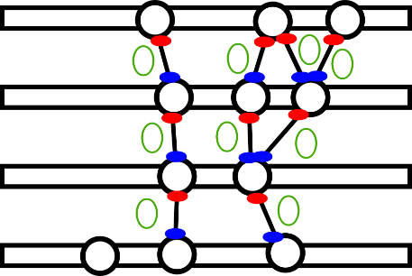
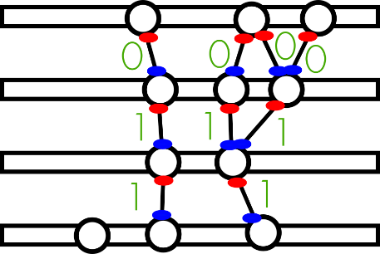
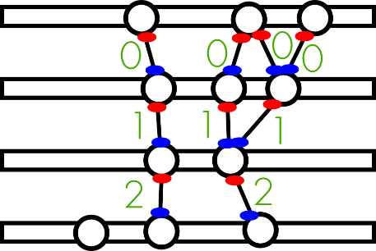
T=1
T=2
T=0
43

Slide 44

Cells Connection
blockIdx.x and threadIdx.x = Cell id in a LayerPair
Each cell asks its innermost hits for cells to check compatibility with.
blockIdx.y = LayerPairIndex [0,13)

Slide 45
Quadruplets finding
blockIdx.x and threadIdx.x = Cell id in a Root LayerPair
Each cell on a root layer pair will perform a parallel DFS of depth = 4 following outer neighbors.
blockIdx.y = LayerPairIndex in RootLayerPairs

Slide 46
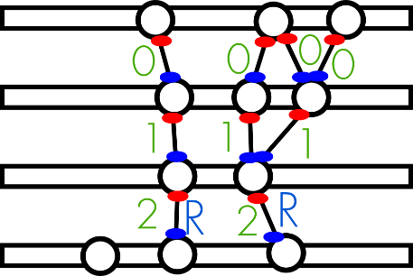
Evolution
If two cells satisfy all the compatibility requirements they are said to be neighbors and their state is set to 0
In the evolution stage, their state increases in discrete generations if there is an outer neighbor with the same state
At the end of the evolution stage
the state of the cells will contain the
information about the length
If one is interested in quadruplets,
there will be surely one starting from
a state 2 cell, pentuplets state 3, etc.

