Slide 2

CERN Pension Fund
Preparing for retirement
Emilie Clerc
Benefits Service
5 December 2017

Slide 3
Retirement Pension
REMINDER:
 | Member before 01.01.12 | Member on or after 01.01.12
Official retirement age | 65 | 67
Amount of retirement pension | 2% last reference salary | 1.85% average of the last 36 months of reference salary
Minimum years of membership | 5 | 5
Maximum years of membership | 35 | 37 years and 10 months
CERN Pension Fund - Benefits Service

Slide 4
Anticipated Retirement Pension
(Art. II 2.05)
CERN Pension Fund - Benefits Service

Slide 5
Deferred Retirement Pension
end of contract before the applicable retirement age
retirement pension deferred to 65/67 years of age
anticipated retirement pension from the age of 50/52 onwards
CERN Pension Fund - Benefits Service

Slide 6
Benefits / Contributions
Benefits that may be added to the basic pension (if applicable):
+ family allowance
+ child allowance
Contributions deducted from the basic pension (optional):
health insurance (main premium + complementary for spouse)
life insurance
Reminder:
Educational fees are not reimbursed to beneficiaries
CERN Pension Fund - Benefits Service

Slide 7
Child allowance
To ensure continued entitlement to a dependent child allowance you are required to:
a) complete the «declaration of intent» (sent in June/July)
b) send the relevant proof of enrollment
In case of failure to return this form/certificate, payment of child allowance will be suspended
CERN Pension Fund - Benefits Service

Slide 8
Pensions payment
pensions are paid in CHF in Switzerland
between the 6th and the 8th of each month
payment dates can be found on our website and in the CERN Bulletin in December
CERN Pension Fund - Benefits Service

Slide 9

Departure formalities
CERN Pension Fund - Benefits Service

Slide 10
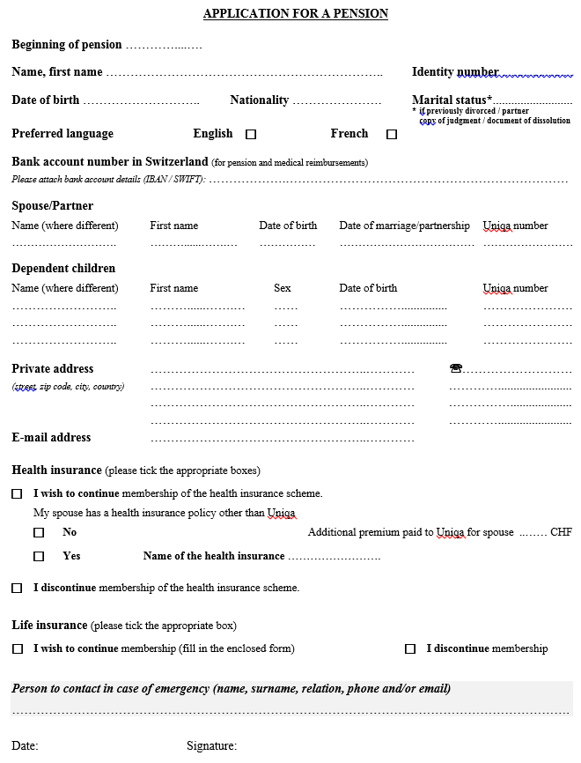
Application for a pension
(example)
CERN Pension Fund - Benefits Service
Notes:
Plus de fiche de salaire mensuelle, virement automatique sur le compte. Donc en janvier, la caisse envoie une révision de vos prestations mensuelles.

Slide 11
Health insurance coverage:
Confidential Declaration of Family Situation (CDFS)
CERN Pension Fund - Benefits Service
Notes:
Plus de fiche de salaire mensuelle, virement automatique sur le compte. Donc en janvier, la caisse envoie une révision de vos prestations mensuelles.

Slide 12
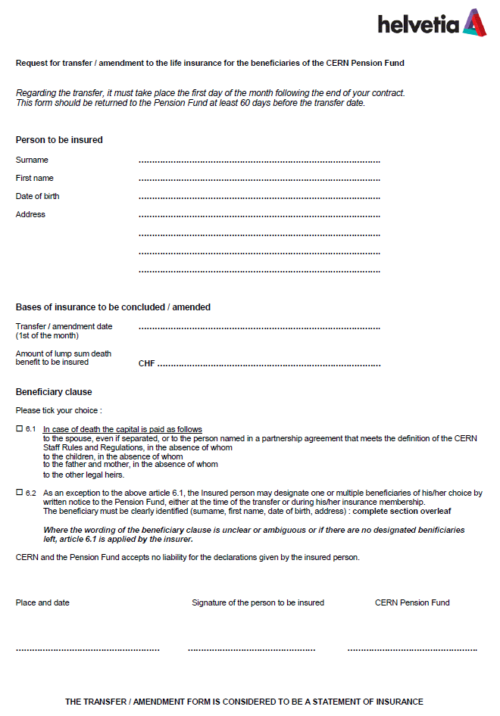
Life insurance application form
CERN Pension Fund - Benefits Service
Notes:
Plus de fiche de salaire mensuelle, virement automatique sur le compte. Donc en janvier, la caisse envoie une révision de vos prestations mensuelles.

Slide 13
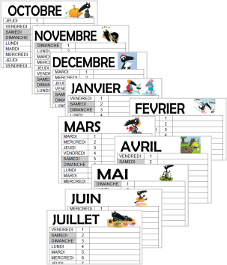
Annual documentation
CERN Pension Fund - Benefits Service

Slide 14
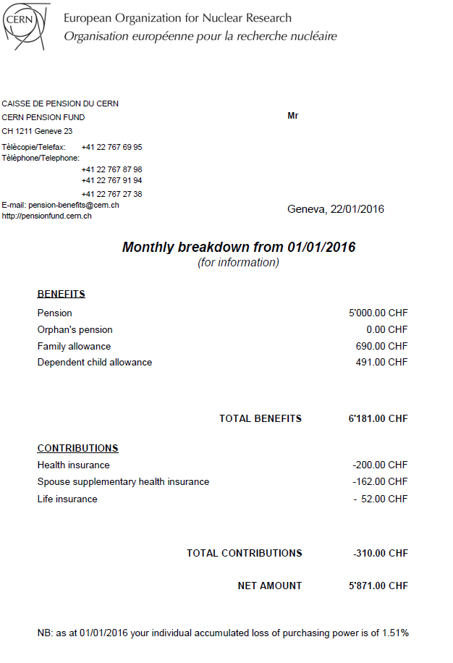

Monthly breakdown (January)
CERN Pension Fund - Benefits Service
Notes:
Plus de fiche de salaire mensuelle, virement automatique sur le compte. Donc en janvier, la caisse envoie une révision de vos prestations mensuelles.

Slide 15
Statement for declaration of income (February)
CERN Pension Fund - Benefits Service

Slide 16
"Life certificate " (December)
This questionnaire is sent each year in December just before CERN end-of-year closure.
It has to be returned by 31 January at the latest.
In case of failure to return this form, payments will be suspended.
IMPORTANT :
If absent during this period, please contact us before you go away.
CERN Pension Fund - Benefits Service

Slide 17
Duty to provide information
IMPORTANT:
Beneficiaries have to inform the Benefits Service, within 30 calendar days, of any change in their personal data (marital status, address, bank account,…)
CERN Pension Fund - Benefits Service

Slide 18
In case of death
the Benefits Service of the Pension Fund to be contacted as soon as possible
IMPORTANT :
Surviving spouse’s and/or orphan’s benefits are paid in CHF into his/her personal bank account in Switzerland or into a joint account
CERN Pension Fund - Benefits Service

Slide 19
Pension for Surviving Spouse
Entitlement to pension for surviving spouse:
the spouse/partner of a beneficiary whose marriage/partnership dates from at least 5 years prior to the decease and was married prior to retirement
Amount:
55% of the pension of the deceased beneficiary + a fixed sum of 564 CHF (on the basis of the maximum years of membership).
NB: in the case of marriage/partnership to a beneficiary, the spouse/partner has no entitlement to a surviving spouse’s pension (Art. II 5.08); however, the beneficiary can buy the right (Art. II 5.09).
Family allowance is not covered by the purchase of this right, nor can it be bought.
CERN Pension Fund - Benefits Service
Notes:
Dire que la pension est versée si le mariage durait depuis au moins un an (MP) ou 5 ans (benef)

Slide 20
Divorced former spouse(s)
Entitled to pension if:
the marriage had lasted 10 years or more
AND
the ex-spouse was receiving an alimony
AND
he/she is 45 years of age or more at the time of the death of the former spouse. This age limit shall not apply if the survivor has at least one dependent child at the time of decease.
The amount of the pension for surviving spouse cannot exceed the amount of the alimony
CERN Pension Fund - Benefits Service

Slide 21
Orphan’s Pension
Due to a "dependent child" recognised by CERN before the end of contract
It is paid up to the age of 20 to children who are unmarried and not holders of a full-time employment.
It will be paid to children over 20 and under 25 years of age who are attending an educational establishment full time or are in vocational training
equal to:
  24%* for 1 orphan
  34%* for 2 orphans...
    *of the last reference salary
NB: Not applicable to children born after the 1st day of retirement (Art. II 6.09)
CERN Pension Fund - Benefits Service

Slide 22
Other information
pension-benefits@cern.ch
Building 5, 5th floor
Web site: http://pensionfund.cern.ch
- Rules and Regulations of the CERN Pension Fund
- Annual report and Financial statements
Annual information meeting (October)
CERN Pension Fund - Benefits Service

