Slide 1

WP5 1 year activity report
Niko Neufeld CERN/PH

Slide 2
WP5 (people)
6 ESRs working in ALICE, ATLAS, CMS and LHCb
  Adriana Telesca
  Luca Magnoni, Dan Octavian Savu
  Sebastian Bukowiec, Yi Ling Hwong
  Jean-Christophe Garnier
2 ERs to work in ATLAS and CMS (still to be hired)
6 supervisors, 1 coordinator
1 visiting scientist

Slide 3



WP5 – Associated Partners
Force10 networks
Laboratori Nazionali di Legnaro (LNL)

Slide 4
WP5: Work
All researchers are deeply involved in core projects in their respective Online system.
In broad terms of fields we have
  storage (2)
  experiment control (3)
  collaborative tools (1)
  network (2)

Slide 5
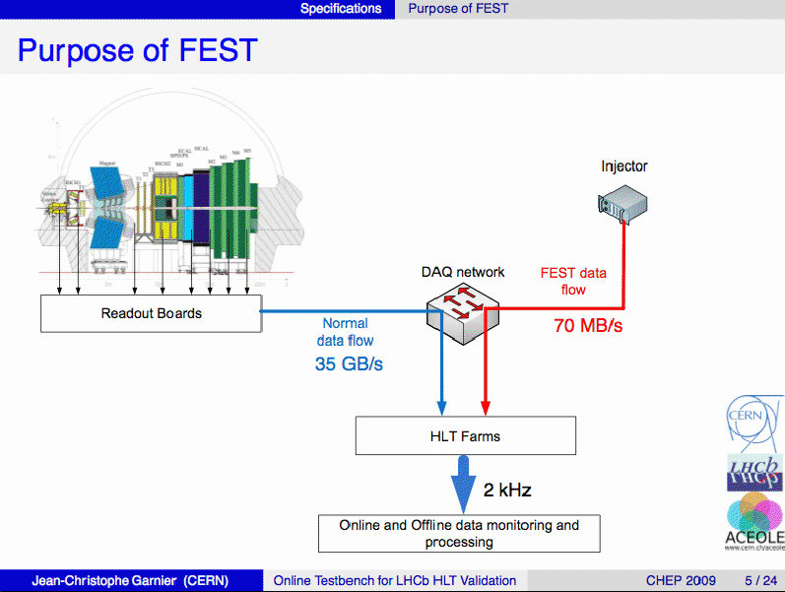

Slide 6
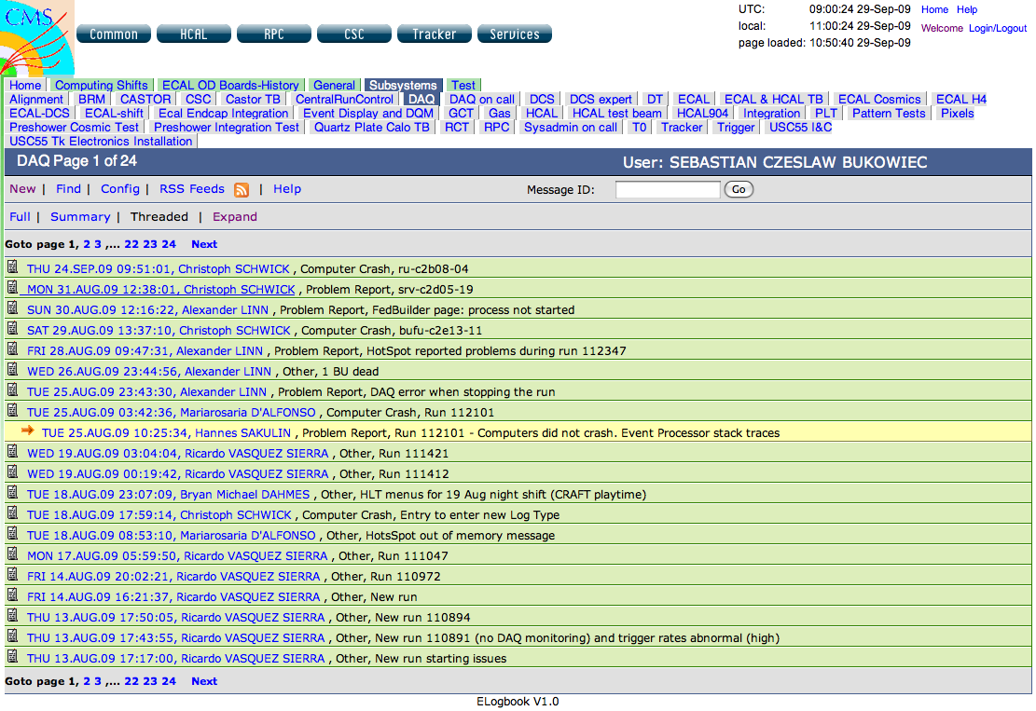

Slide 7
Training
WP5 students have followed a lot of training courses (many of them outside CERN)
  languages: from German to Java
  data-bases
  storage technologies
  Ethernet networking (router configuration)
  control systems & SCADA
but arguably the most valuable training is what they learn and learned at CERN from their supervisors on-the-job!

Slide 8
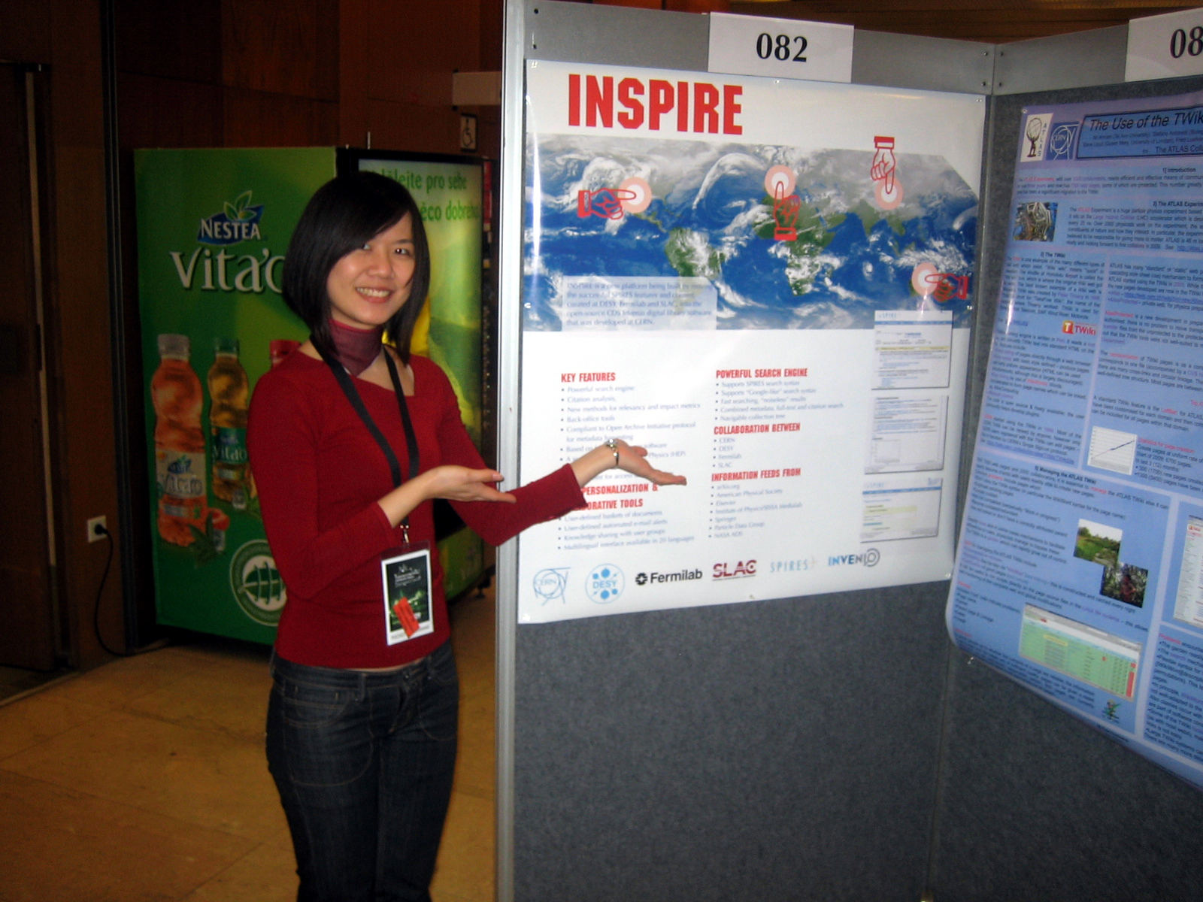

Slide 9
Papers, presentations
ACEOLE students are very active participants in conferences such as CHEP, TWEPP, IEEE RealTime (and very soon) ICALEPCS
6 conference contributions, 4 oral presentations, 2 posters, two papers to appear in peer-reviewed journals
And this is just the beginning… (most students do not even have a full year yet!)

Slide 10
WP5 in year 2
Secondments
  easy for networking guys (Force10)
  not so easy for some other fields (no direct associated partner)
Visiting scientist
ER hiring
LHC startup!!!

Slide 11
Summary & Status
WP5 ESRs well integrated in the LHC experiments with exciting projects
Lots of good results already! (Deliverable D51!)
After the LHC startup we are sure to see (more) R&D results on SLHC (Deliverable D52)
Lots of training in and outside CERN, conference papers & presentations

Slide 12
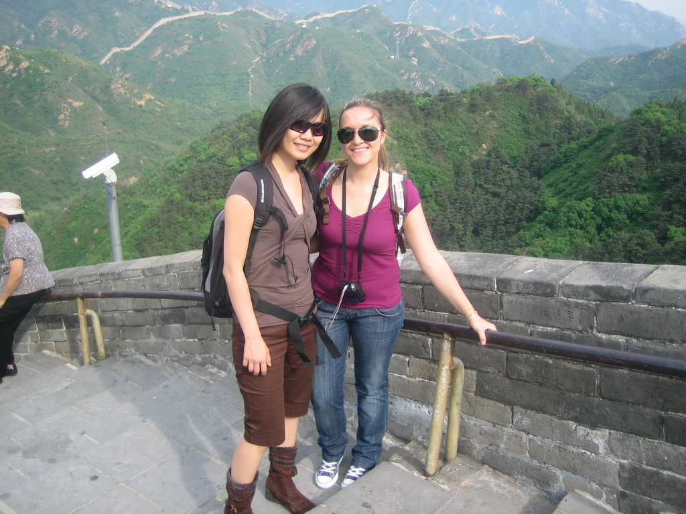
WP5 is fun!

