Slide 1

Magnetic and Quadrupole moments of Cu isotopes
With collinear laser spectroscopy
Pieter Vingerhoets
18/11/2009

Slide 2
Motivation: The region of the nuclear chart
28
40
50
Zn
57
Zn
58
Zn
59
Zn
60
Zn
61
Zn
62
Zn
63
Zn
64
Zn
65
Zn
66
Zn
67
Zn
68
Zn
69
Zn
70
Zn
71
Zn
72
Zn
73
Zn
74
Zn
75
Zn
76
Zn
77
Zn
78
Zn
79
Zn
80
30
Cu
55
Cu
56
Cu
57
Cu
58
Cu
59
Cu
60
Cu
61
Cu
62
Cu
63
Cu
63
Cu
64
Cu
65
Cu
59
Cu
65
Cu
66
Cu
67
Cu
68
Cu
69
Cu
70
Cu
71
Cu
72
Cu
73
Cu
74
Cu
75
Cu
76
Cu
77
Cu
78
Cu
79
29
Cu
64
Cu
66
Cu
67
Cu
68
Cu
69
Cu
70
Cu
78
Ni
53
Ni
54
Ni
55
Ni
56
Ni
57
Ni
58
Ni
59
Ni
60
Ni
61
Ni
62
Ni
63
Ni
64
Ni
65
Ni
66
Ni
67
Ni
68
Ni
69
Ni
70
Ni
71
Ni
72
Ni
73
Ni
74
Ni
75
Ni
76
Ni
77
Ni
78
28
ν2p_{3/2} 1f_{5/2} 2p_{1/2}
ν1g_{9/2} gets filled
1g_{9/2}
⁷⁵Cu
2p_{1/2}
40
E(keV)
28
40
1f_{5/2}
5/2⁻
1/2⁻
2p_{3/2}
1000
1g_{9/2}
?
40
3/2⁻
2p_{1/2}
57
59
61
63
65
67
69
71
73
75
1f_{5/2}
Franchoo et al. Phys.Rev.C. 2001, Stefanescu et al, Phys.Rev.Lett. 2008
2p_{3/2}

Slide 3
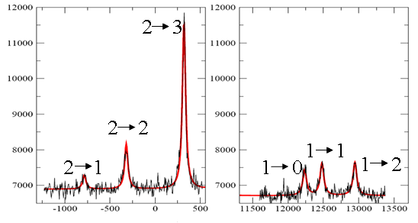
Laser spectroscopy: experimental technique
F
3
2
3²P_{3/2}
1
0
I(⁶⁷Cu)=3/2
F=I+J
2
3²S_{1/2}
1
counts
Relative frequency (MHz)

Slide 4
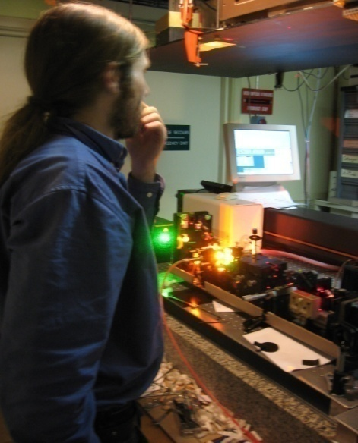
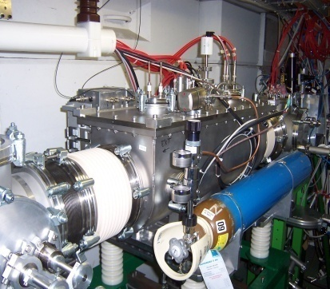
Laser spectroscopy: experimental setup
Mark
Dye laser
Wavelength 648nm,
Doubled to 324nm
mirror
Post-acceleration voltage
+
+
+
+
+
+
charge exchange
Cell (200ºC)
+
+
+
electrostatic
deflectors
Photomultiplier tubes
Ion beam
+
+
+
+
+
+
+
Varying post-acceleration
voltage to scan frequency:
From HRS
RFQ beam cooler/buncher

Slide 5
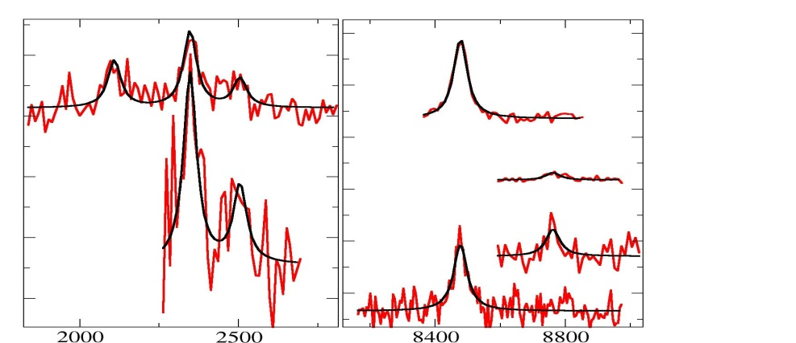
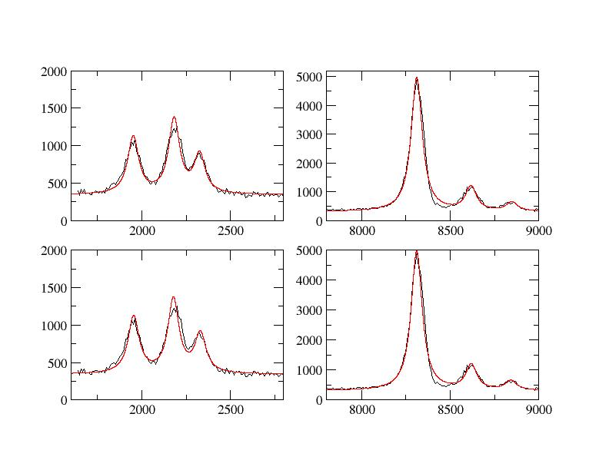
⁷²Cu: spin confirmation of 2, a challenge for nuclear shell model
2007, without ISCOOL buncher
K. Flanagan
counts
Relative frequency (MHz)
>40 hours measured, 5 out of 6 peaks resolved
2008, with ISCOOL buncher
counts
Relative frequency (MHz)
2.5 hours measured, 6 out of 6 peaks resolved

Slide 6
⁷²Cu: spin confirmation of 2, a challenge for nuclear shell model
72Cu
1g_{9/2}
(πp_{3/2} νg_{9/2}³) → (3,4,5,6)⁻
40
40
2p_{1/2}
(πf_{5/2} νg_{9/2}³) → (2,…,7)⁻
1f_{5/2}
(πp_{3/2} νp_{1/2}⁻¹g_{9/2}⁴) → (1,2)⁺
2p_{3/2}
E(keV)
E(keV)
(1+)
376
2+
431
What would we expect?
empirical magnetic moments
1+
418
(6-)
t_{1/2}=1.76μs
270
2-
387
(4-)
219
5-
235
μ(πf_{5/2} νg_{9/2}³; 2⁻) :
μ_{emp} (2⁻) = -1.94 μ_{N}
(3-)
137
4-
140
μ(πp_{3/2} νp_{1/2}⁻¹g_{9/2}⁴; 2⁺):
μ_{emp} (2⁺) = +1.44 μ_{N}
6-
16
2-
(2)
0
3-
0
Realistic interaction
μ_{exp}(72Cu)= -1.3460(5) μ_{N}
Experiment
J.C. Thomas, Phys.Rev.C 2006

Slide 7
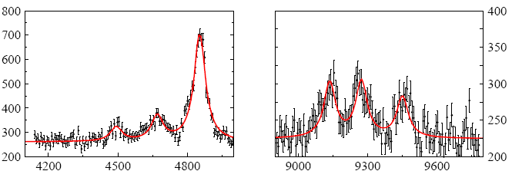
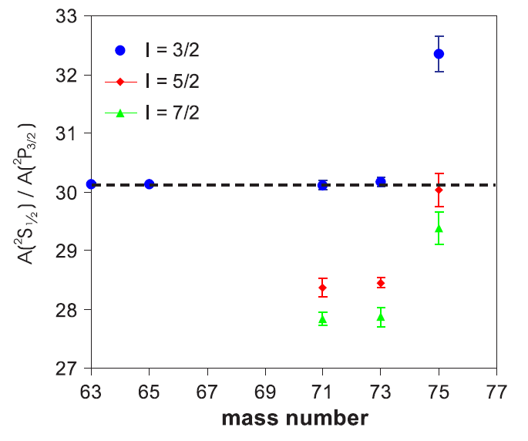
⁷⁵Cu: Spin assignment
Flanagan et al., PRL103, 142501 (2009)
⁷⁵Cu, I=5/2
counts
Relative frequency (MHz)
- Yield ~ 5 10⁴ ions/μC
- Accumulation time 100ms
- Background reduction of 10³
A (²S_{1/2}) = +1592(1) MHz
B(²P_{3/2}) = -34(2) MHz
SPIN OF 75Cu IS 5/2

Slide 8
Comparison odd magnetic moments with theory
Flanagan et al., PRL103, 142501 (2009)
N=40
N=50
1g_{9/2}
µ_{eff} (πp_{3/2})
40
2p_{1/2}
g_{s,eff}=0.7*g_{s,free}
1f_{5/2}
2p_{3/2}
µ_{eff} (πf_{5/2})
1g_{9/2}
40
2p_{1/2}
1f_{5/2}
2p_{3/2}
Model space: 1f_{5/2,} 2p_{3/2}, 2p_{1/2}, 1g_{9/2} for both proton and neutron orbits, 56Ni core
Interaction: jj4b, by Brown and Lisetskiy(private communication),
g_{s,eff}=0.7*g_{s,free}

Slide 9
Comparison with theoretical calculations
N=28
N=40
N=50
µ_{eff}(πp_{3/2})
g_{s,eff}=0.7*g_{s,free}
3/2⁻
Cocolios et al., PRL 2009
Flanagan et al., PRL 2009
GXPF1
g_{s,eff}=0.9*g_{s,free}
⁶⁹Cu
jj4b
g_{s,eff}=0.7*g_{s,free}
⁶⁹Cu
1g_{9/2}
1g_{9/2}
40
40
40
40
2p_{1/2}
2p_{1/2}
1f_{5/2}
1f_{5/2}
2p_{3/2}
2p_{3/2}
28
28
28
28
1f_{7/2}
1f_{7/2}
Honma et al., private comm.
A. Brown, A. Listetskiy, private comm.

Slide 10
Comparison with theoretical calculations
N=40
3/2⁻
Jj4b: ep=2, en=1
GXPF1: ep=1.15, en =0.8
Du Rietz et al., PRL 2004
- Jj4b is doing a fair job in reproducing the trend
Again N=40 behaves more or less like a magic shell closure
No sign of increased deformation after N=40

Slide 11
Conclusions and Outlook
Conclusions
The copper isotopes ⁶¹Cu - ⁷⁵Cu have been measured at COLLAPS, ISOLDE. During the 2008 experiment 11 different isotopes were measured.
Background reduction of 10³ and more due to the RFQ beam cooler/buncher
allows measurements on more exotic isotopes.
The spin of 72Cu presents a challenge for shell model calculations
N=40 exhibits magic properties for the magnetic and quadrupole moments thanks to parity considerations
Quadrupole moments reveal no sign of increased deformation after N=40
Outlook
9 shifts of beamtime on neutron-deficient Cu isotopes

Slide 12
The Collaboration
P. Vingerhoets¹, K.T. Flanagan^{1,2}, M.Avgoulea¹, J. Billowes³, M.L.Bissell¹, K.Blaum^{4,5}, P.Campbell³,B.Cheal³, M. De Rydt¹, D.Forrest⁶, C. Geppert⁷, P.Lievens⁸,
M.Kowalska⁹, J. Krämer⁴, A.Krieger⁴, E.Mane³, R. Neugart⁴, G. Neyens¹, W.Nörtershäuser¹⁰,
G.Ory¹, A. Smolkowska¹, G.Tungate⁶, M. Schug⁴, H. Stroke¹¹, D.Yordanov⁴
THANK YOU !
¹Instituut voor kern-en stralingsfysica, K.U. Leuven, Belgium
²IPN Orsay Cedex, France.
³Schuster Laboratory, The University of Manchester, UK.
⁴Institut fur Physik, Universität Mainz,Germany
⁵Max-Planck-Institut für Kernphysik,Heidelberg, Germany
⁶School of Physics and Astronomy, The University of Birmingham, UK
⁷GSI, Darmstadt, Germany
⁸VSM, K.U. Leuven, Belgium
⁹ISOLDE, CERN, Geneva, Switzerland
¹⁰ Institut für Kernchemie, Universität Mainz, Germany
¹¹Department of Physics, New York University, USA

Slide 13
Evolution of the 1+ magnetic moments
N=40
1+
1g_{9/2}
⁶⁸Cu
2p_{1/2}
40
magnetic moment (µ_{N})
μ_{emp}(πp_{3/2}νp_{1/2})
1f_{5/2}
2p_{3/2}
μ_{exp}
1g_{9/2}
40
μ_{emp}(πp_{3/2}νf_{5/2})
2p_{1/2}
1f_{5/2}
2p_{3/2}
For ⁶⁸Cu: µ_{p}=µ(⁶⁹Cu)
µ_{n}=µ(⁶⁷Ni)
Assume weak proton-neutron coupling:

Slide 14
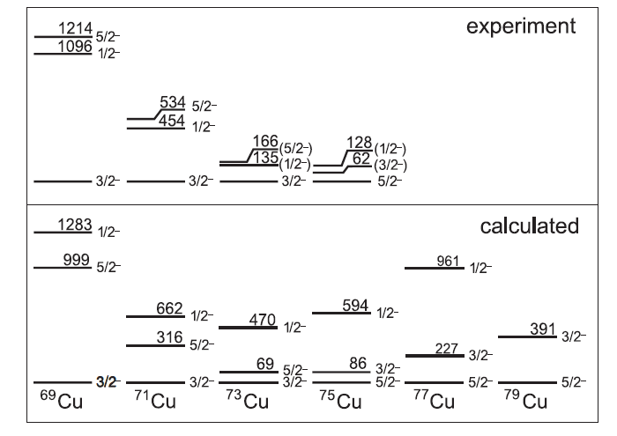
S. Franchoo et al., Phys.Rev. C 64,054308 (2001)
I. Stefanescu et al., Phys.Rev.Lett. 100, 112502 (2008)
I. Stefanescu et al., Phys.Rev. C 79, 044325 (2009)
B.A. Brown and A.F. Lisetskiy, private comm.

Slide 15
μ(πf_{5/2} νg_{9/2}³; 2⁻) → write as a function of μ(πf_{5/2}) and μ(νg_{9/2}³; 9/2⁺) using additivity
μ₁
μ₂
μ₁
μ₂
j₁(j₁+1)
-
j₂(j₂+1)
μ (I) = I ½( + ) + ½( - )
j₁
j₂
j₁
j₂
I(I+1)
Schmidt value exp. value (ADNDT, Stone)
μ(πf_{5/2}) = μ₁ +0.86 +1.58(16) ⁶⁹As, Z=33, 5/2⁻
+1.674(2) ⁷¹As
+1.63(10) ⁷³As
μ(νg_{9/2}³; 9/2⁺)= μ(νg_{9/2}) = μ₂ -1.91 (-) 1.097(9) ⁶⁷Zn, N=37, 9/2⁺
(-) 1.157(2) ⁶⁹Zn, N=39
(-) 1.052(6) ⁷¹Zn, N=41
μ_{free}(2⁻) = 2 [ 0.5 (0.86/2.5 –1.91/4.5) + 0.5 (0.86/2.5 +1.91/4.5)(35/4-99/4)/6 ]
= 2 [ 0.5 (-0.08) + 0.5 (0.77)(-16)/6 ]
= 2 [ -0.04 – 1.027]
μ_{free}(2⁻) = -2.13 μ_{N}
μ_{emp} (2⁻) = 2 [ 0.5 (1.63/2.5 –1.05/4.5) + 0.5 (1.63/2.5 +1.05/4.5)(35/4-99/4)/6 ]
= 2 [ 0.5 (+0.42) + 0.5 (0.885)(-16)/6 ]
= 2 [ 0.21 – 1.18]
μ_{emp} (2⁻) = -1.94 μ_{N}

Slide 16
μ(πp_{3/2} νp_{1/2}⁻¹g_{9/2}⁴; 2⁺) → write as function of μ(πp_{3/2}) and μ(πp_{1/2}⁻¹)
Schmidt value exp. value (ADNDT, Stone)
μ(πp_{3/2}) = μ₁ 3.79 +2.5135(8) ⁶⁷Cu, Z=29, 3/2⁻
+2.8372(9) ⁶⁹Cu
+2.28(3) ⁷¹Cu
μ(νp_{1/2}⁻¹) = μ₂ 0.64 0.601(5) ⁶⁷Ni, N=39, ½-
μ_{free}(2⁺) = 2 [ 0.5 (3.79/1.5 + 0.64/0.5) + 0.5 (3.79/1.5 - 0.64/0.5) (15/4-3/4)/6 ]
= 2 [ 0.5 (3.81) + 0.5 (1.25) 3/6 ]
= 2 [ 1.91 + 0.31]
μ_{free}(2⁺) = +4.44 μ_{N}
μ_{emp} (2⁺) = 2 [ 0.5 (2.28/1.5 + 0.6/0.5) + 0.5 (2.28/1.5 - 0.6/0.5) (15/4-3/4)/6 ]
= 2 [ 0.5 (2.72) + 0.5 (0.32) 3/6 ]
= 2 [ 1.36+0.08]
μ_{emp} (2⁺) = +1.44 μ_{N}

Slide 18
Quadrupole moments vs B(E2) values
Normalized Q-moment
and B(E2) values
Mass number
Stefanescu et al, Phys.Rev.Lett. 2008

