Slide 1
Stability diagram with a Gaussian electron lens in HL-LHC
S. Antipov, N. Biancacci, E. Metral
Many thanks to A. Kolehmainen, D. Perini, and
M. Fitterer, G. Stancari, and A. Valishev (FNAL)

Slide 2
Why E-Lens
Octupoles are inefficient for Landau damping are high energies: ~ 1/γ²
E-lens tune shift scales as 1/γ
High 4x10⁻³ – 10⁻² tune shifts have been observed with e-lenses
  Tevatron, 980 GeV: FERMILAB-THESIS-2005-105 (2005)
  RHIC, 100 GeV: X. Gu, et al., Phys. Rev. Accel. Beams 20, 023501 (2017)
E-lens can act on individual bunches
Can optimize e-beam distribution for maximum tune spread and Landau damping
  V. Shiltsev, et al., Phys. Rev. Lett. 119, 134802 (2017)

Slide 3
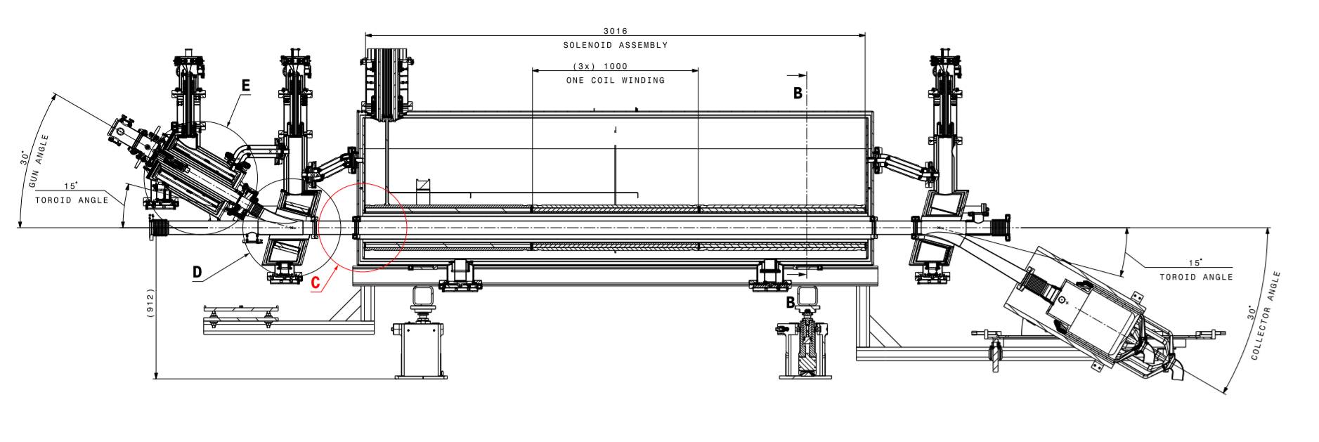
HL-LHC hollow electron lens layout
A. Kolehmainen

Slide 4
HL-LHC hollow e-lenses can be reconfigured to give the right shape with a new e-gun
Parameter (Constraint) | Value | Comment
Current density | < 2-10 A/cm² | Present technology limit
Electron current | < 5 A | Current E-Lens design
Electron beam length | 3 m
Electron energy | 10 kV
Max field ratio | B_{m}/B_{g} < 4.0 T/0.2 T = 20
Electron beam size | 0.4 – 2.0 mm
Beta-function | 240 m | 40 m downstream IP 4
Proton beam energy | 7 TeV
Proton beam size | 0.25 mm | 2.0 um norm emittance
Transverse distribution | Gaussian

Slide 5
Theory
Maximum tune shift
I_{a} = 17 kA – Alfven current
Tune spread
Electron beam is suppressed adiabatically:
Higher field ratios (main solenoid/gun) preferable
  Stability diagram

Slide 6
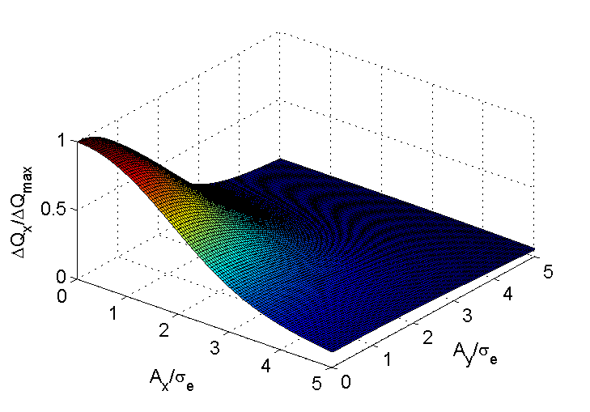
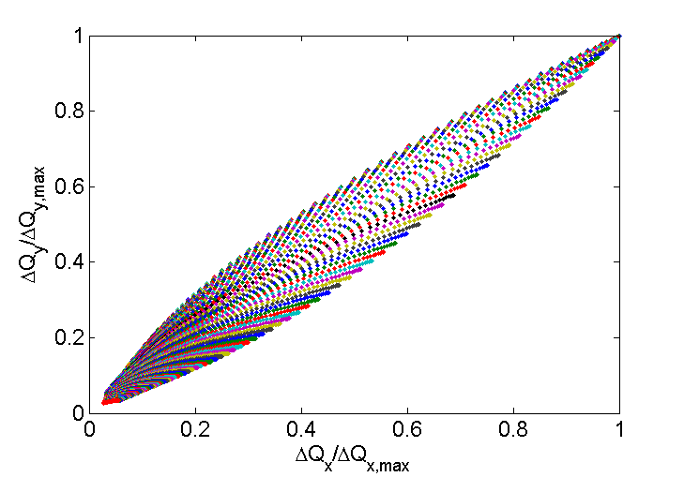
The tune spread is created by the core of the bunch
Up to 0.01 in Tune
Normalized spread for a Gaussian bunch profile

Slide 7
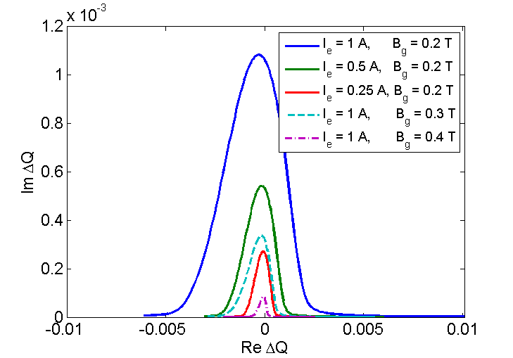
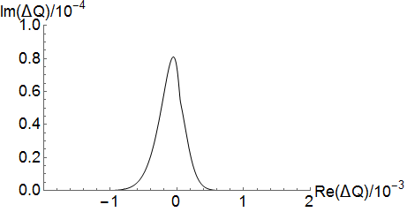
Electron lens can produce up to 10 times higher stability diagram compared to octupoles
Octupoles at max current of -550 A
Electron lens
ε_{n} = 2.0 μm

Slide 8
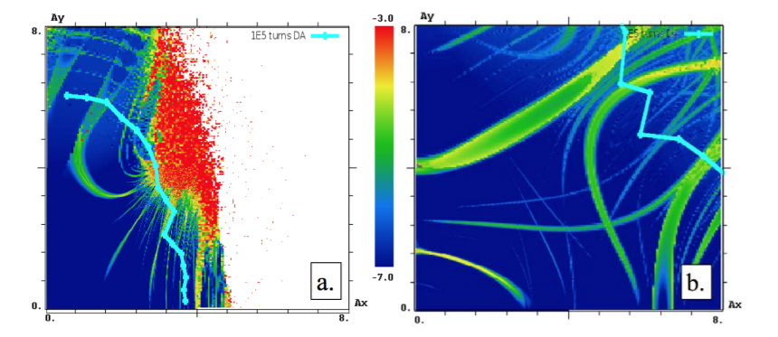
Electron lens also offers at least twice the dynamic aperture for the same tune spread
Study for HL-LHC optics lattice, DA computed from 10⁵ turns of tracking
Octupoles
Electron lens
A. Valishev
V. Shiltsev, et. al, Landau Damping of Beam Instabilities by Electron Lenses

Slide 9
Conclusion
Electron lens offers an efficient way to produce tune spread for Landau damping at high energies
Beam stability does not suffer from cutting the tails of the distribution
  Because the spread is produced by the core of the beam
In HL-LHC with one electron lens we can increase the stability diagram by a factor of 10 compared to octupoles
  Assuming the current parameters for the Hollow Lens
  Would require a new gun

Slide 10
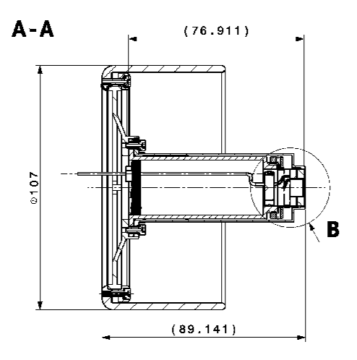
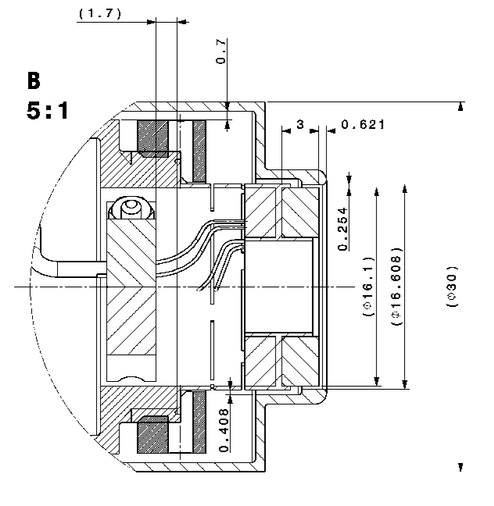
Hollow electron lens cathode assembly
We are assuming a similar size of the cathode for the Gaussian lens
All dimensions in mm
Courtesy A. Kolehmainen

