Slide 1
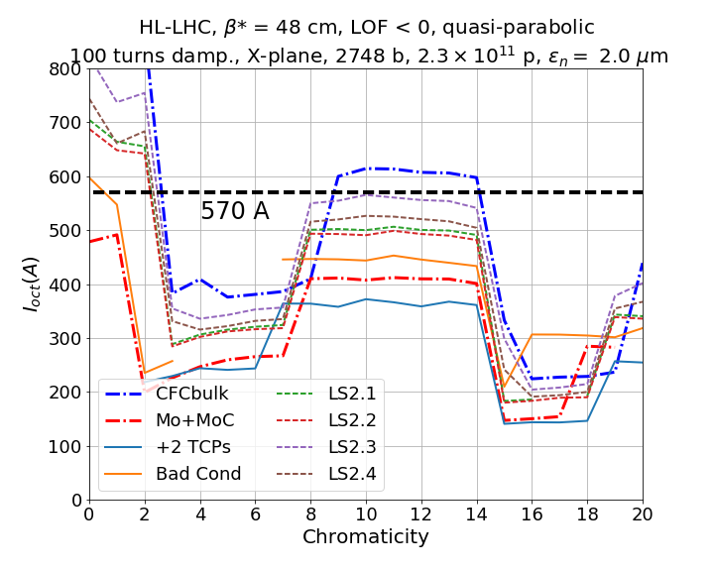
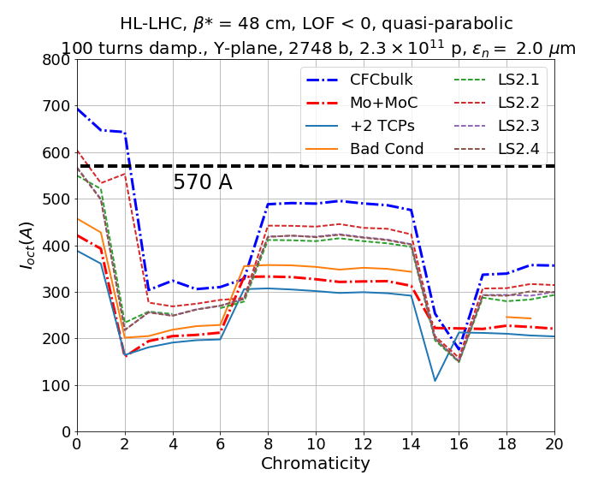
HL-LHC Ultimate Scenario
Tight collimator settings (TCSGs at 1.5 σ)

Slide 2
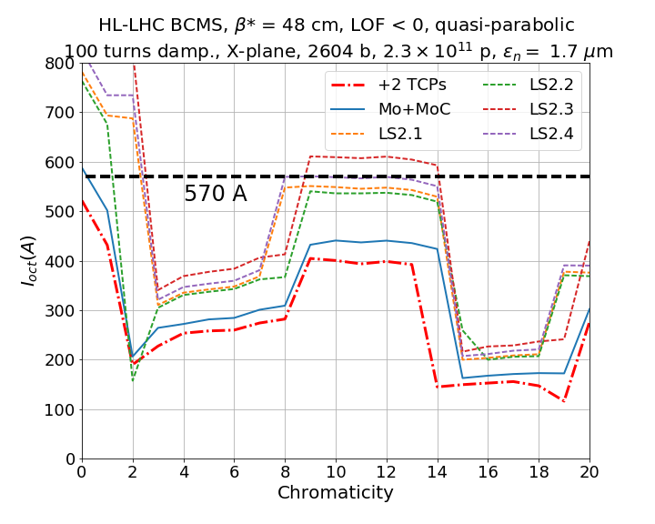
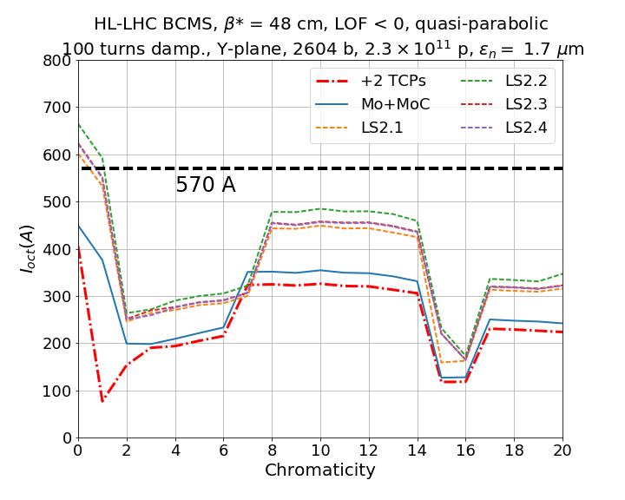
HL-LHC BCMS
Tight collimator settings (TCSGs at 1.5 σ)

