Slide 1
Simulations of UAr dark matter detectors shielded by LAr vetoes
E. Nowak, P. Sala

Slide 2
Simulation activity
Based on FLUKA (www.fluka.org) , P.S. one of the authors
Long experience on LAr (ICARUS, Dune)
ProtoDUNE cryostat geometry ready
NEW pointwise correlated treatment of low energy neutron interactions in Argon (low energy means < 20 MeV ). Implemented..last week
  Pointwise==exact cross section from databases, without group-wise averaging
  Correlated== energy conservation at each interaction, with “self-consistent” emission of the reaction products, for instance detailed gamma-deexcitation cascade between experimental excited levels.
  Nuclear recoil included, but: how much of the recoil energy produces light?

Slide 3
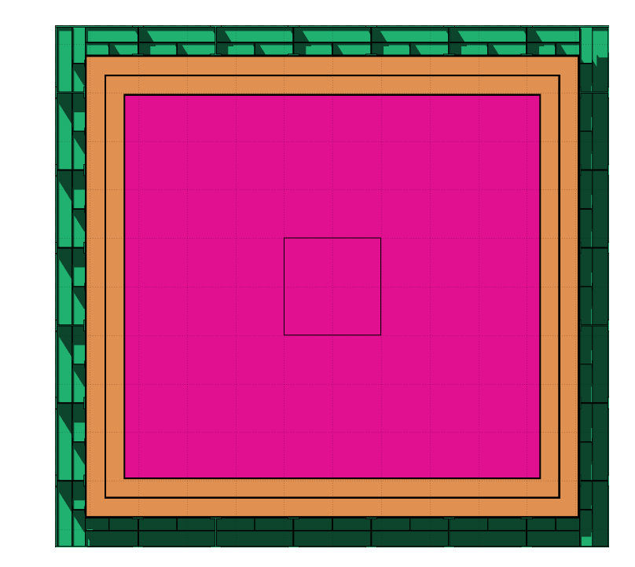
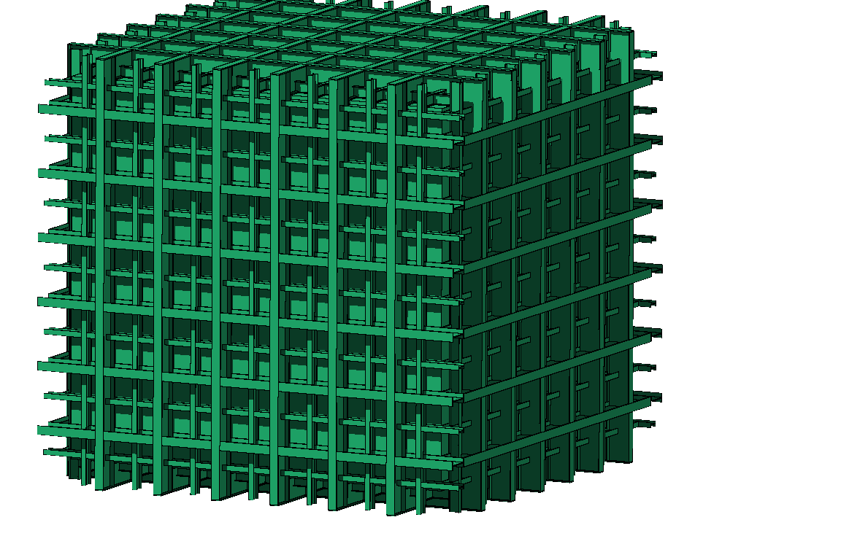
PROTODUNE geometry in FLUKA

Slide 4
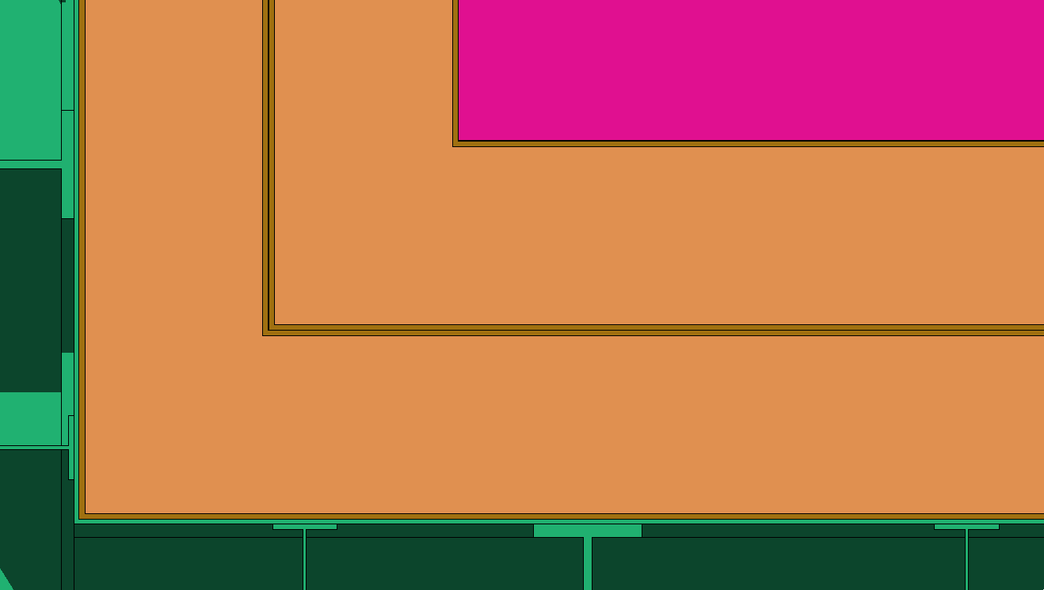
Detail of the insulation
80cm
LAr
Internal SS (1.2mm)
Plywood (1.2cm)
Polyurethane foam (37.6cm)
Plywood (2x1.2cm) + SS (1mm)
Polyurethane foam (37.6cm)
Plywood (1.2cm)
External SS membrane (1cm)

Slide 5
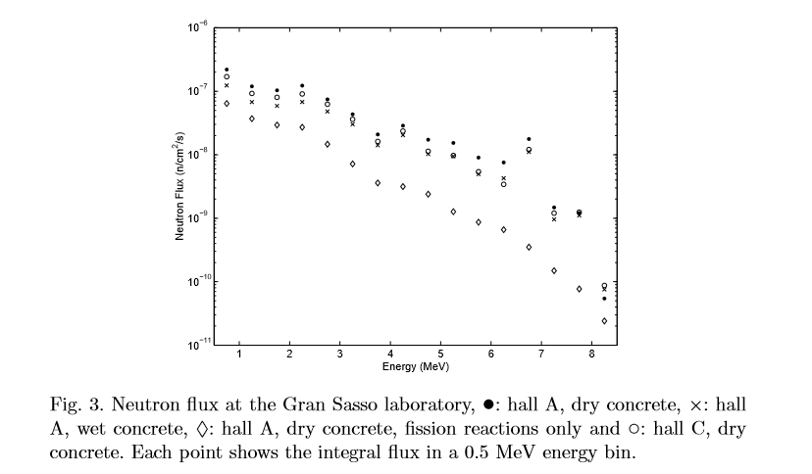
Neutron backgrounds –I
Neutrons from fission and (α,n) reactions in the rock
At LNGS:
H. Wulandari et al, Astropart.Phys.22:313,2004
Also, previous measurement by ICARUS, Il Nuovo Cim. 112A (1999) 819 and others
Order of 10⁻⁷ n/cm²/s (E>1MeV)
Shape already implemented in the simulation

Slide 6
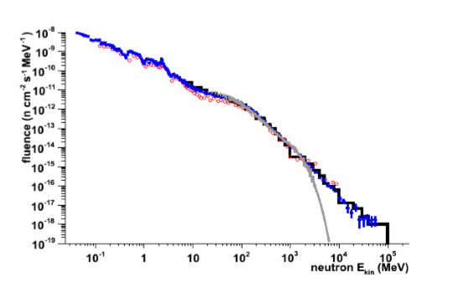
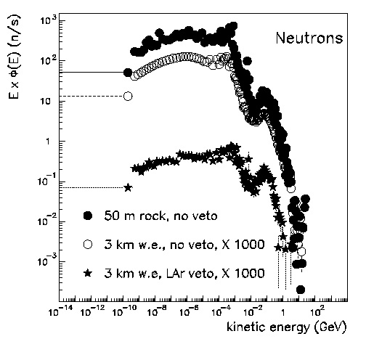
Neutron backgrounds –II
Neutrons from cosmic muons: high energy
At LNGS:
A. Empl et al. , arXiv:1210.2708
Simulated with FLUKA
Old studies for proton decay in giant LAr, done with FLUKA (by me….)
Published in A. Bueno et al., JHEP 0704:041,2007
Kaon0 and Λ0 also present

Slide 7
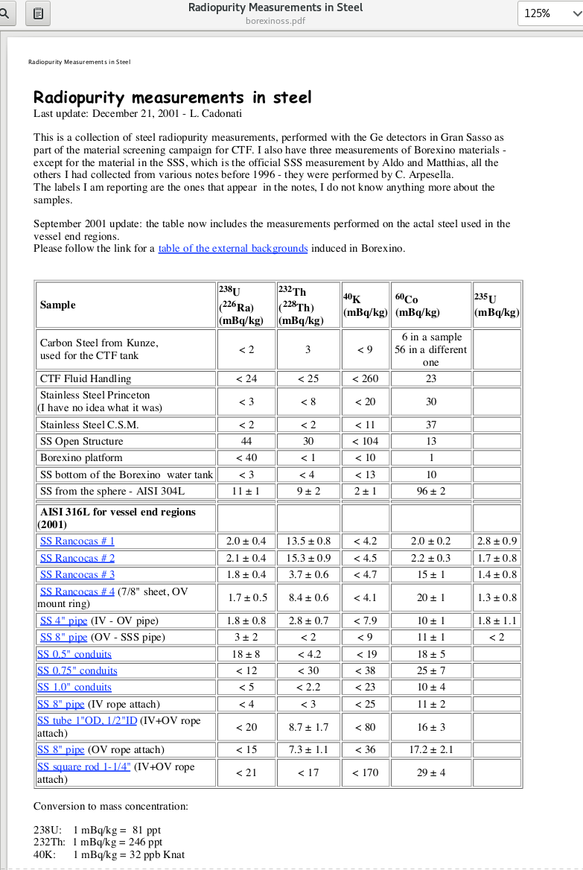
Neutron backgrounds –II
From radioactive isotopes in cryostat and other materials
Very dependent on the material/production process/ contamination (compilations from LNGS and others, for instance
  Astropart. Phys 35,43 (2011)
  NEXT-100 TDR http://www-eng.lbl.gov/~shuman/NEXT/MATERIALS&COMPONENTS/Background_measurement/radiopurity_jan2012-3.pdf
Order of magnitude for steel >1mBq/kg
ProtoDune has ~200 tons of iron in the vessel
In FLUKA, we can simulate radioactive decays as source particles
Will have to consider also photon background, from all sources

Slide 8
First simulations
First look at background from rock radioactivity
Full cryo geometry
Inner box of LAr 2m side
Source: hall C spectrum, generated on a sphere surrounding the detector, with angular distribution such as to give a uniform isotropic flux within the sphere
Detailed vertex / hits analysys in progress
First look at global quantities and
raw “hits” == energy deposited in 20x20x20 cm cells

Slide 9
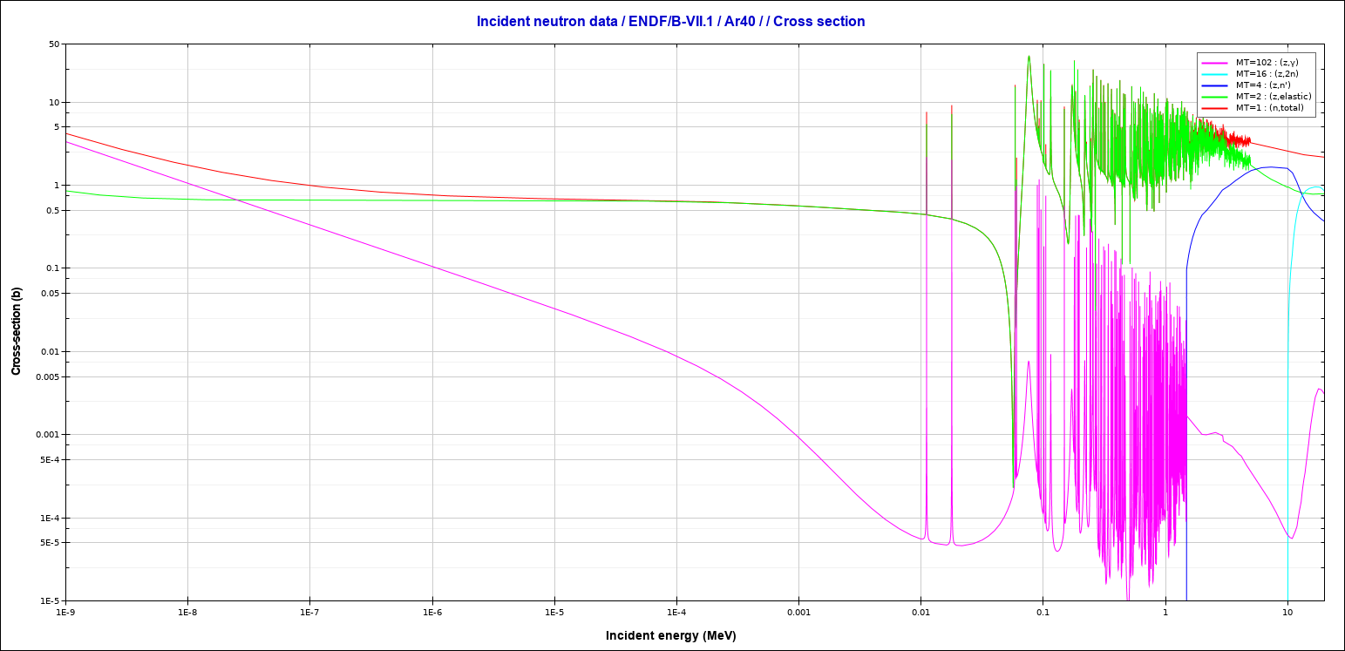
Neutron cross sections (low energy)
( at high energy, the neutron interaction length in argon is around 80~cm)
n, total
n, elastic
n, n’
1. b ~ 50 cm path
n, γ
Elastic : ΔE≈0.1E
Capture: Q≈6MeV
Inelastic: ΔE>1.4 MeV
1 keV
10 keV
1.4 MeV: Ar 1st excited state

Slide 10
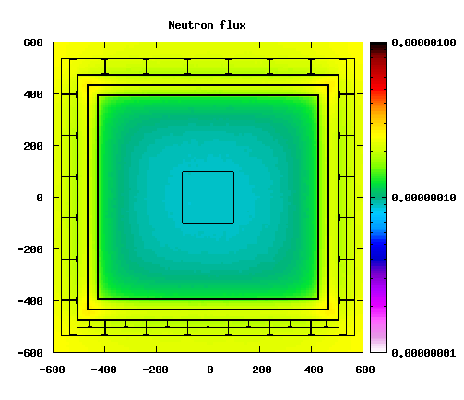
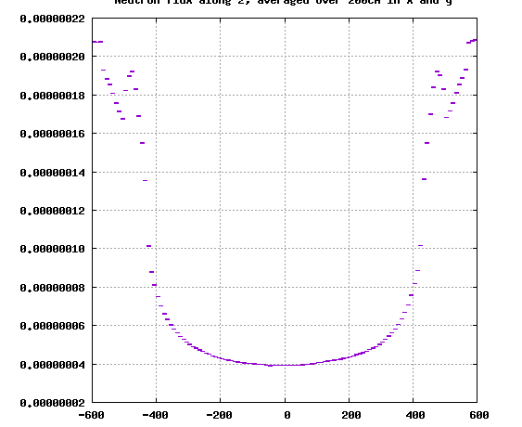
Neutron flux (a.u.), overall view

Slide 11
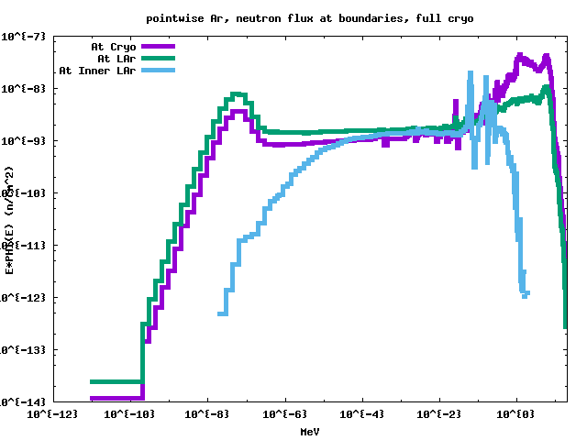

Neutron spectra
About 3m of Ar, means> 6 scattering lengths for neutrons above 1.4 MeV
Below this, only elastic, with a dip in the cross section in between 10 and 100 keV
At even lower energies, neutron capture kills again.
10 keV
1 MeV
20 MeV

Slide 12
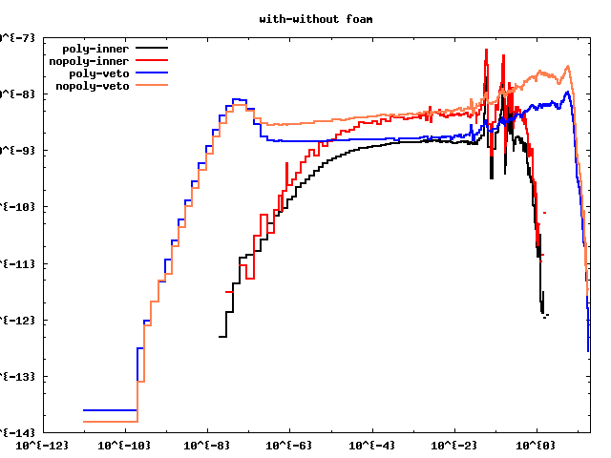
Effect of foam
Lethargy spectra, n/cm^2
Blue, black : with foam
Red, orange: without foam
At Lar entrance and
at inner box surface
Effect: factor of 3
Can be improved by adding foam in the spaces between I-beams
20 MeV

Slide 13
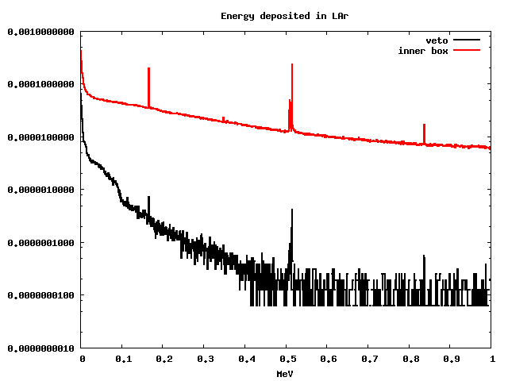
Deposited energy, global
Spectra of deposited energy in the veto region(red) and in the inner box(black)
(integrated event-by-event in the whole volume)
Arbitrary normalization
Note log y scale

Slide 14
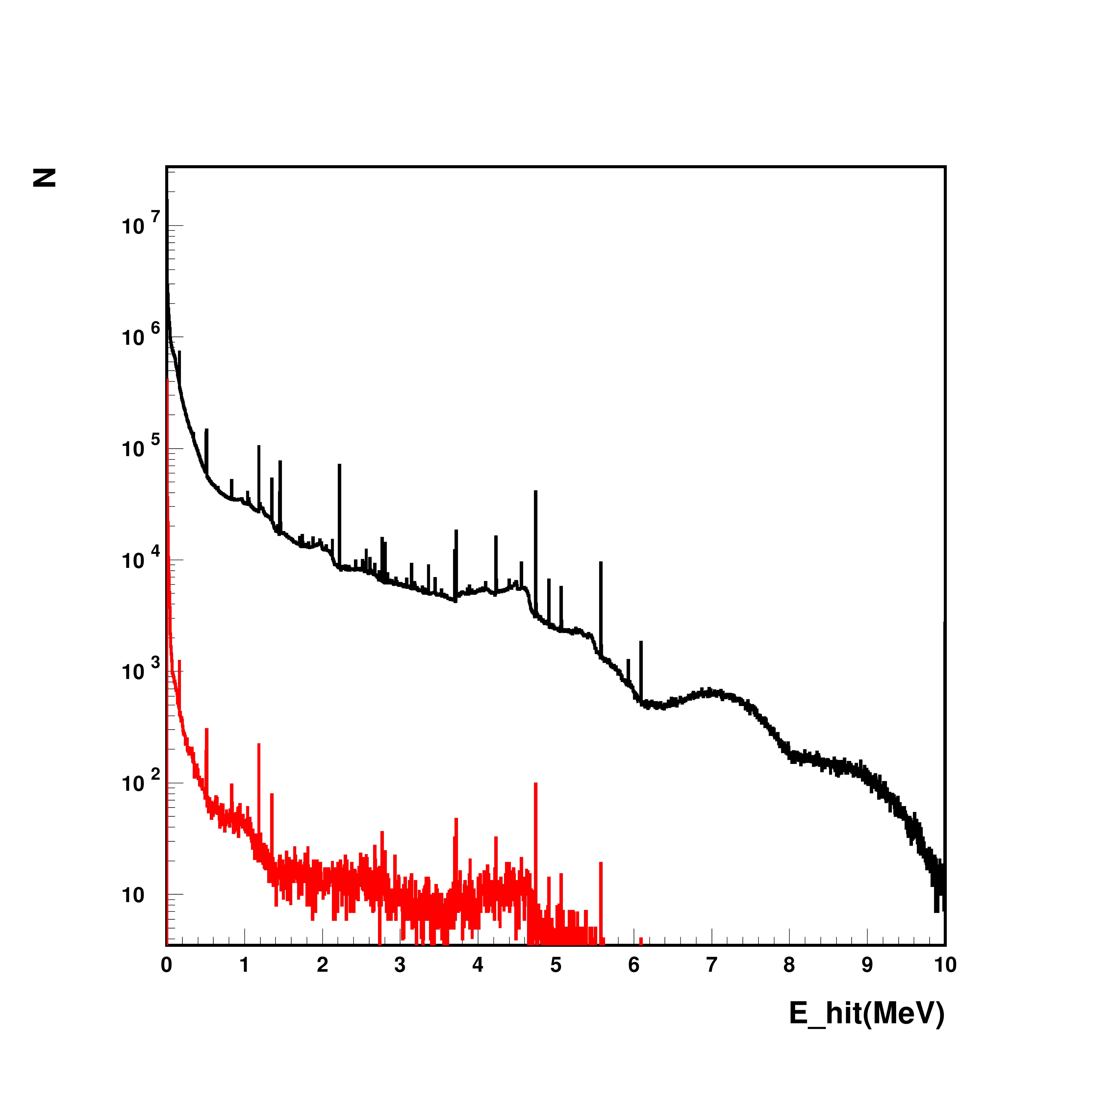
Deposited energy , “hits”
Spectra of energy depositions in subcells (20cm side)
In the veto (black)
And signal (red) regions

Slide 15
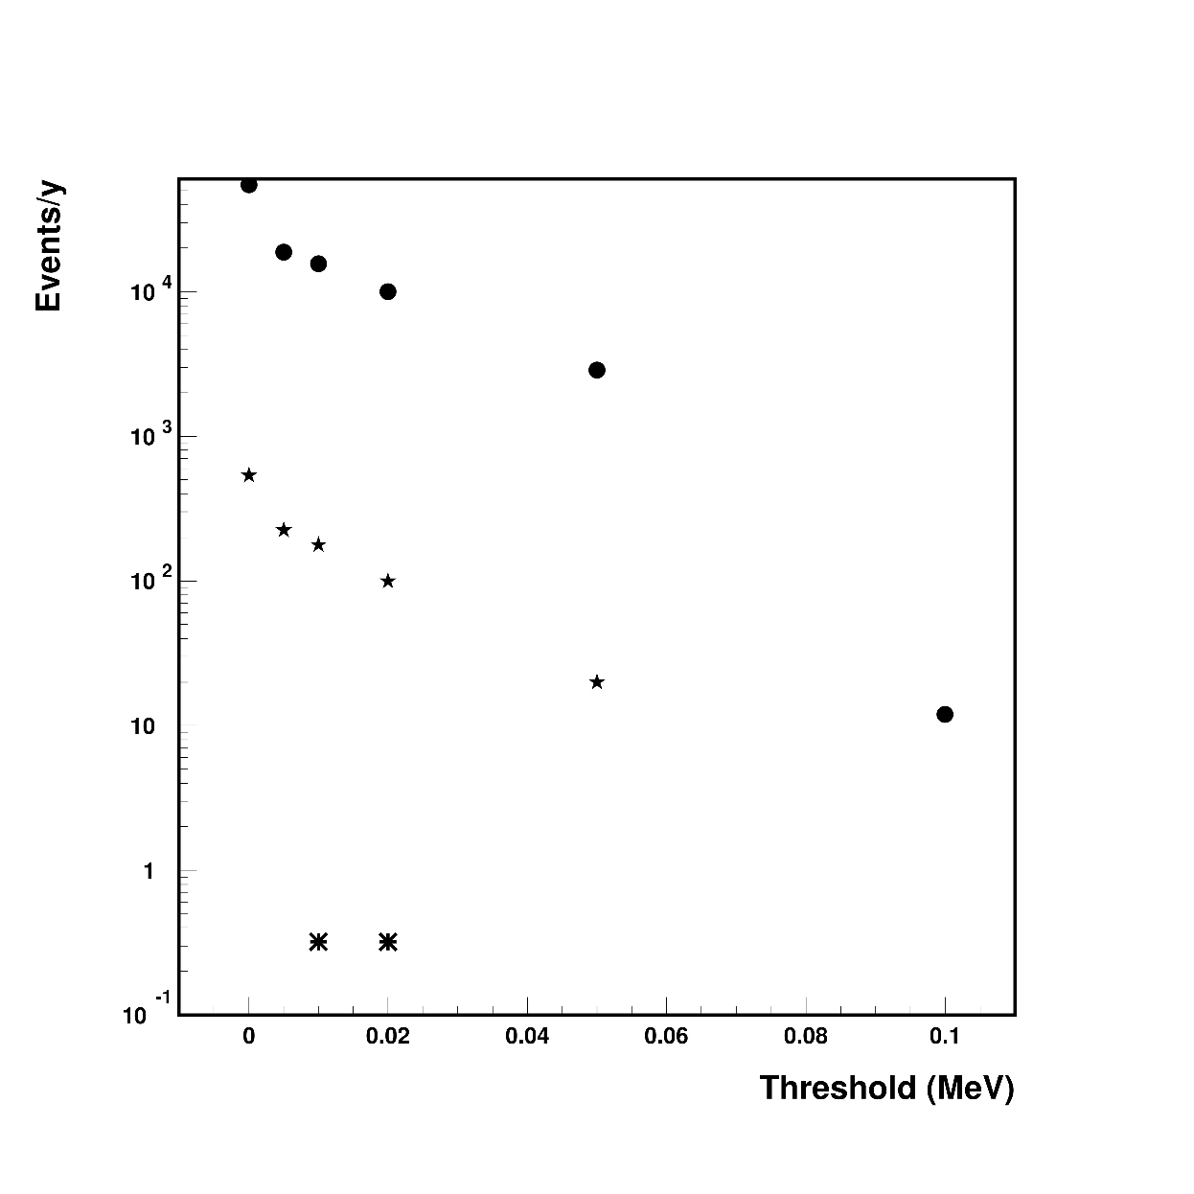
Veto? Some exercises
Assuming Hall C neutron bkg.
Number of events in the “Signal” box with at least one hit above threshold, vs threshold, per year
Dots: no veto
Stars: with at least 100 keV in veto volume
Asterisks: with same threshold on signal and veto
….waiting for input/discussion on reasonable values

Slide 16
Conclusion
Just started..
Geometry is there, simulation tools and simulation experience too
Still very much to learn from experts..
Inner foam has a beneficial effect, will investigate additional moderators around the cryo
The 3m Ar veto is very efficient in reducing the flux except in the”sub-MeV range, where however more LAr will be almost useless, the cross section becomes small.
Should try to get as a low threshold as possible for event identification in the “veto”region
Next
Full analysis of all verteces/depositions
Will have a look at other background sources, for instance cosmic-generated neutrons will propagate differently
Will also consider radioactivity in the materials

Slide 17
Backup

Slide 18
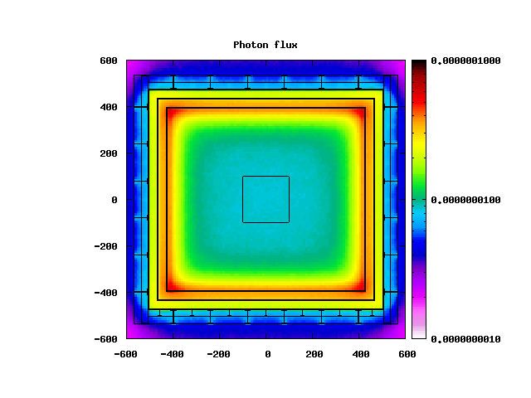
photons

Slide 19
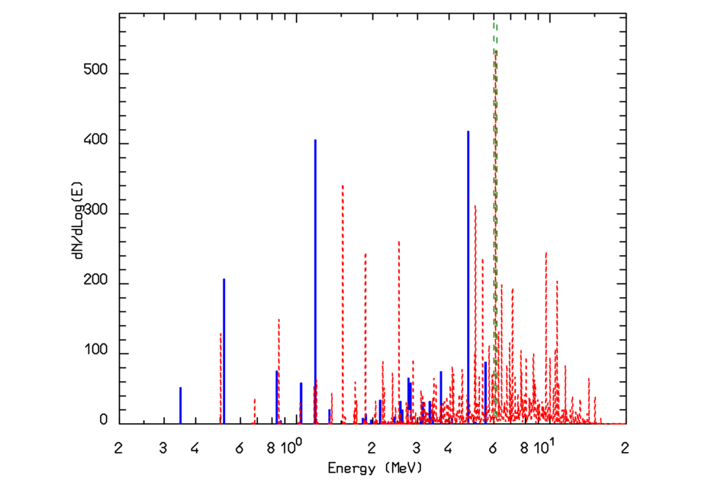
(Un)correlated capture γ cascades: ⁴⁰Ar(n,γ)⁴¹Ar
Liquid Argon experiment are popular for neutrino physics.
Icarus @LNGS was supposed to measure also solar ν’s and the main background was neutron capture by ⁴⁰Ar
⁴⁰Ar(n,γ)⁴¹Ar:
Capture γ spectrum
Q for corr. cascades (6.10 MeV)
Q distribution for uncorr. cascades

Slide 20
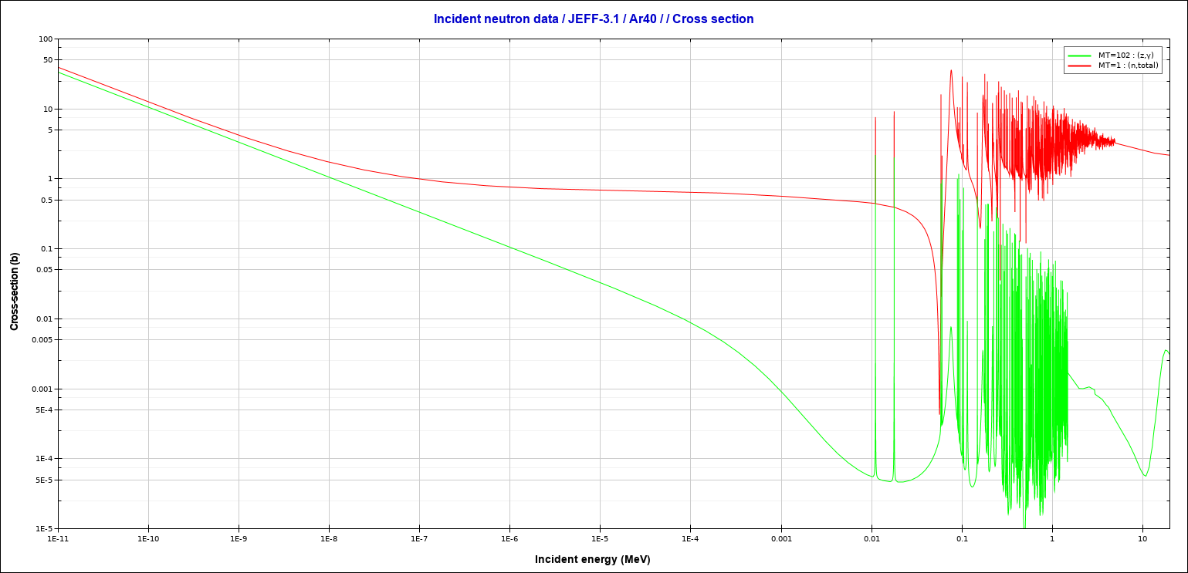
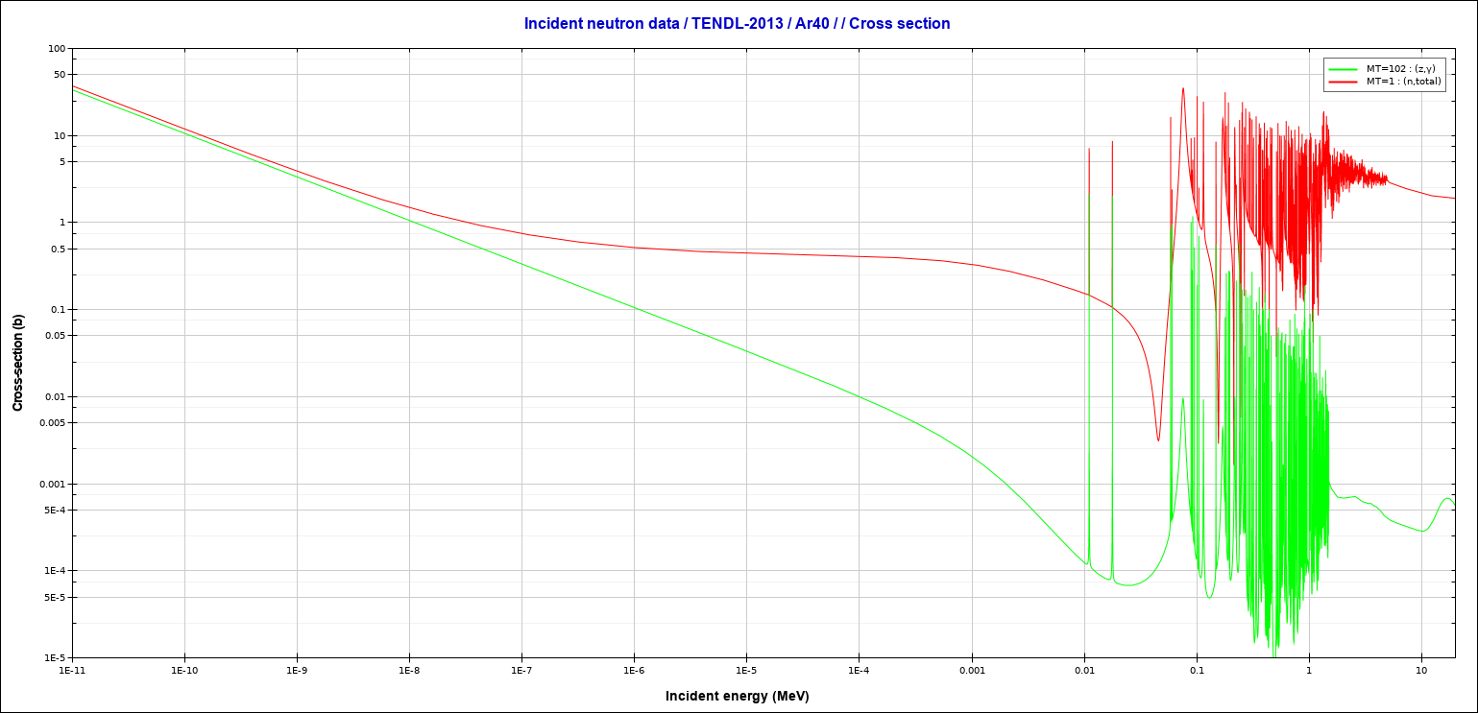
Neutron data sets differ

