Slide 1


LAr purification from Rn
Grzegorz Zuzel
Jagiellonian University, Cracow, Poland
DS-20k CERN meeting, 26-27.10.2017, CERN, Switzerland

Slide 2
Outline
Sources of Rn in the DS detectors
Cryo-adsorption of Rn
Removal of Rn from (L)Ar
Summary

Slide 3
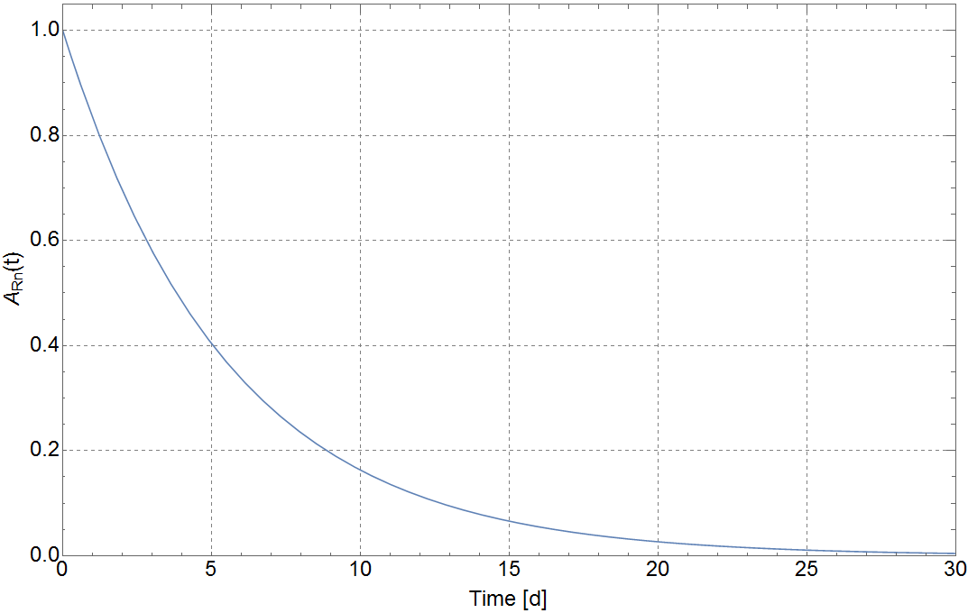
Sources of Rn in the DS detectors
²²²Rn in DAr
T_{1/2} = 3.8 days
²²²Rn sources
²²²Rn cryo-adsorption
²²²Rn removal from (L)Ar
Summary

Slide 4
Sources of Rn in the DS detectors
²²²Rn in DAr
²²²Rn sources
²²²Rn cryo-adsorption
²²²Rn removal from (L)Ar
Summary

Slide 5
Sources of Rn in the DS detectors
²²²Rn in DAr: 1 mBq/m³ (0.6 mBq/kg)
A_{tot} (30 tons) = 18 Bq
²²²Rn sources
²²²Rn cryo-adsorption
²²²Rn removal from (L)Ar
Summary

Slide 6
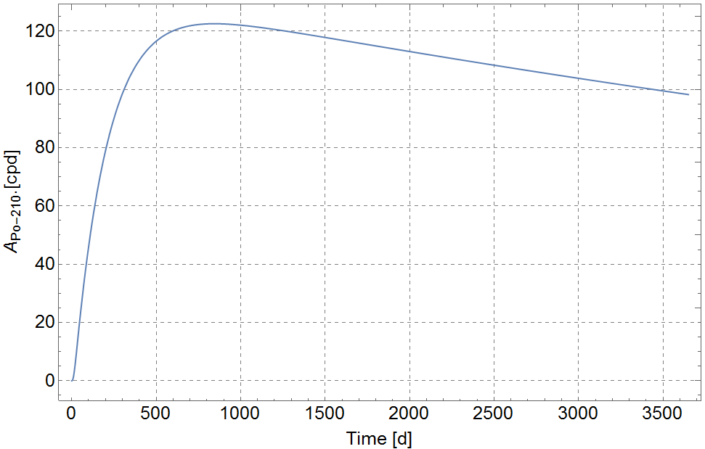
Sources of Rn in the DS detectors
²²²Rn in DAr: 1 mBq/m³ (0.6 mBq/kg)
A_{tot} (30 tons) = 18 Bq
²²²Rn sources
²²²Rn cryo-adsorption
²²²Rn removal from (L)Ar
Summary

Slide 7


Sources of Rn in the DS detectors
²²²Rn emanation
Internal: emanation from parts
inside the detector, Rn
enters directly LAr
External: emanation from
auxiliaries,
(purification loop)
²²²Rn sources
²²²Rn cryo-adsorption
²²²Rn removal from (L)Ar
Summary
TPC
Getter
Pump

Slide 8
Sources of Rn in the DS detectors
²²²Rn emanation
Internal: emanation from parts
inside the detector, Rn
enters directly LAr
External: emanation from
auxiliaries,
(purification loop)
²²²Rn sources
²²²Rn cryo-adsorption
Rn removal
system
²²²Rn removal from (L)Ar
Summary
TPC
Getter
Pump

Slide 9
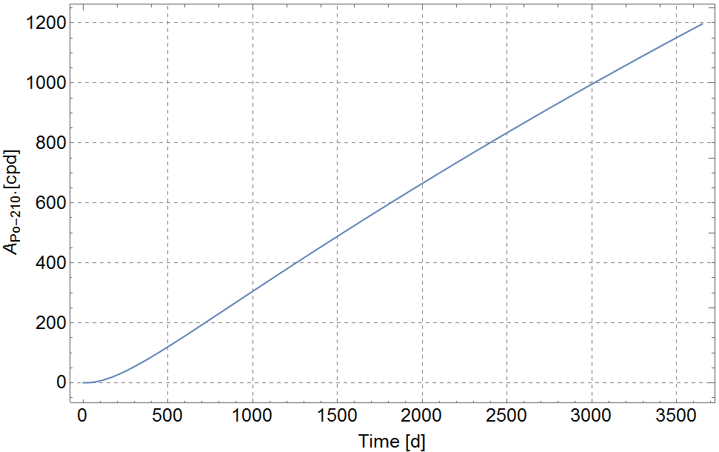
Sources of Rn in the DS detectors
²²²Rn in DS-50: 2 μBq/kg (constant in time)
DS-20k: A_{tot} (30 tons) = 60 mBq
²²²Rn sources
²²²Rn cryo-adsorption
²²²Rn removal from (L)Ar
Summary

Slide 10
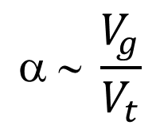
Cryo-adsorption of Rn
$$ ∼ \frac{V_{g}}{V_{t}}$$
C₀
C_{N}
V_{t}
²²²Rn sources
²²²Rn cryo-adsorption
²²²Rn removal from (L)Ar
Summary

Slide 11
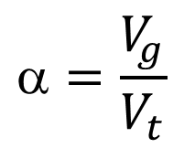
Cryo-adsorption of Rn
$$=\frac{V_{g}}{V_{t}}$$
C₀
C_{N}
V_{t}
²²²Rn sources
²²²Rn cryo-adsorption
²²²Rn removal from (L)Ar
1
Summary
C_{N}/C₀
0.5
R – Rn reduction factor
R
0
V_{g} V

Slide 12
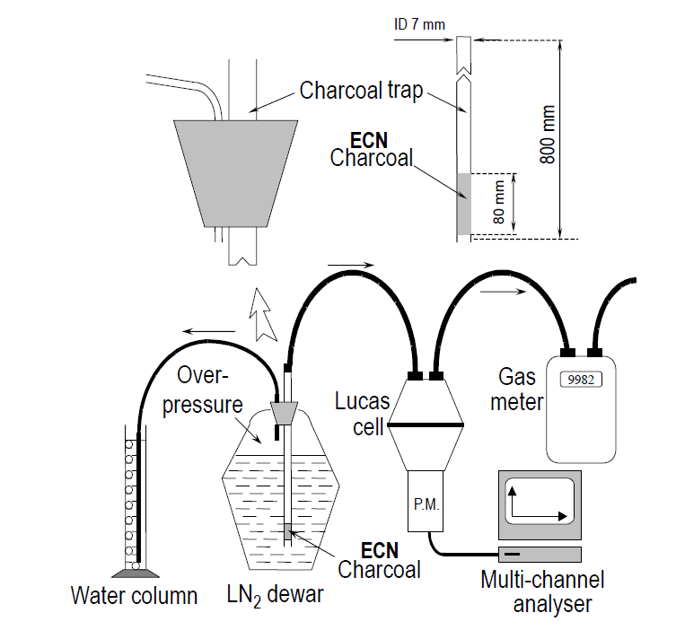
Cryo-adsorption of Rn
²²²Rn sources
²²²Rn cryo-adsorption
²²²Rn removal from (L)Ar
Summary

Slide 13
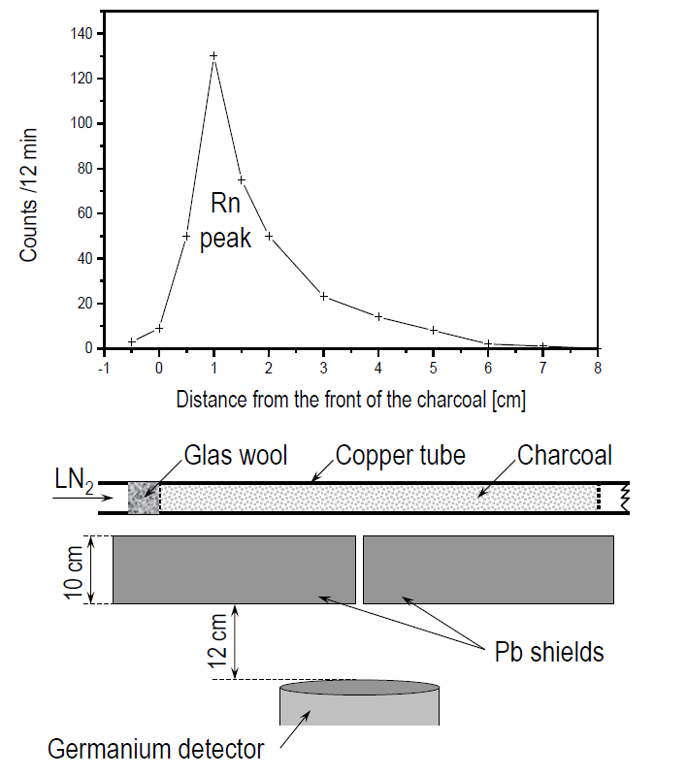
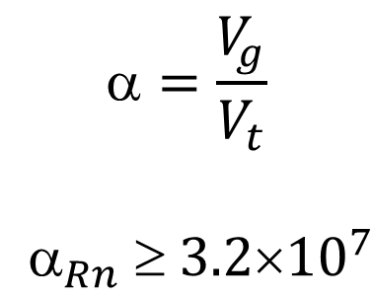
Cryo-adsorption of Rn
$$=\frac{V_{g}}{V_{t}}$$
$$_{Rn}  3.2{10}^{7}$$
²²²Rn sources
²²²Rn cryo-adsorption
²²²Rn removal from (L)Ar
Summary

Slide 14
Cryo-adsorption of Rn
$$=\frac{V_{g}}{V_{t}}$$
$$_{Rn}  3.2{10}^{7}$$
²²²Rn sources
²²²Rn cryo-adsorption
²²²Rn removal from (L)Ar
Summary
1 L of CarboAct
>32 000 m³ of Ar
(>53 tons)

Slide 15
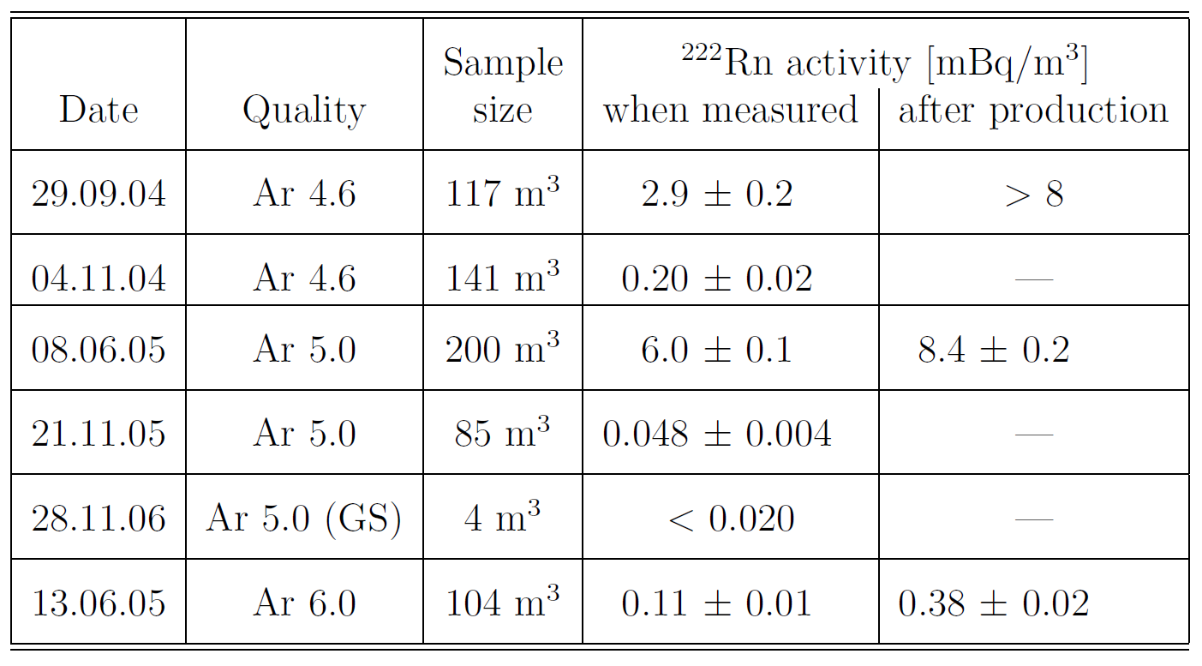
²²²Rn content in LAr
²²²Rn sources
²²²Rn cryo-adsorption
²²²Rn removal from (L)Ar
Summary
²²²Rn content in Ar 100-1000 higher compared to N₂

Slide 16
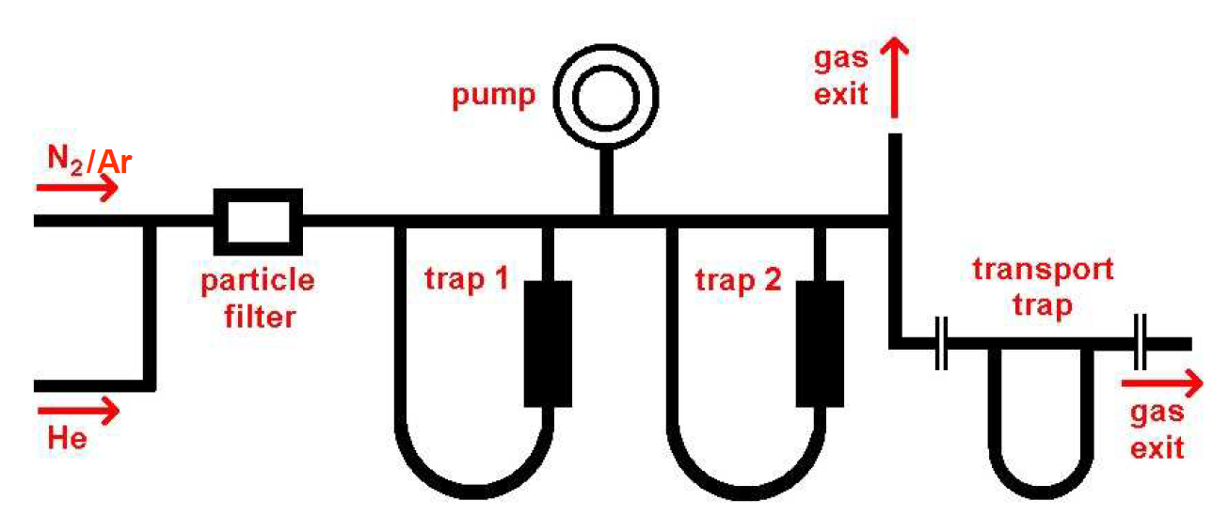
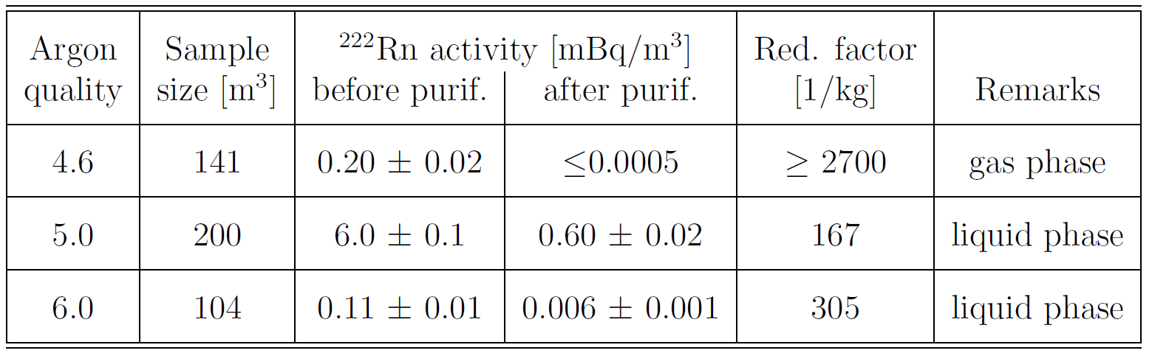
²²²Rn removal from (L)Ar
MoREx (MPI-K HD)
²²²Rn sources
²²²Rn cryo-adsorption
²²²Rn removal from (L)Ar
Summary
H. Simgen, G. Zuzel, Appl. Radiat. Isot. 67 (2009) 922

Slide 17
Summary
Rn removal from (L)Ar by low-temperature adsorption is very effective
Purification in the liquid and in the gas phase has been already demonstrated, specific activities down to μBq/kg (or lower) achievable
Gas-phase purification preferred
Purification system for DarkSide may be based on a kg-scale column containing CarboAct (very pure in terms of ²²⁶Rn content)
Operational conditions to be defined (temperature, gas flow, Rn emanation from components, …)
²²²Rn sources
²²²Rn cryo-adsorption
²²²Rn removal from (L)Ar
Summary

