Slide 1
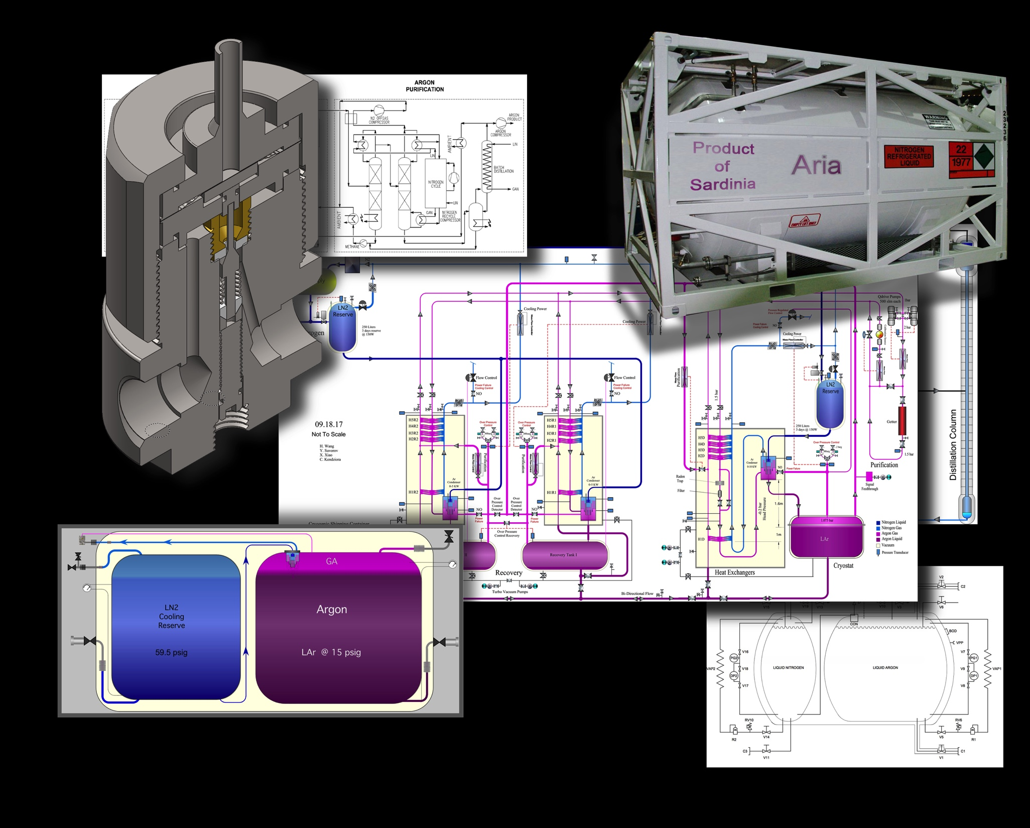
Low-Radioactivity Argon Transportation and Storage
Neutrino Platform Meeting CERN 2017
Cary Kendziora

Slide 2
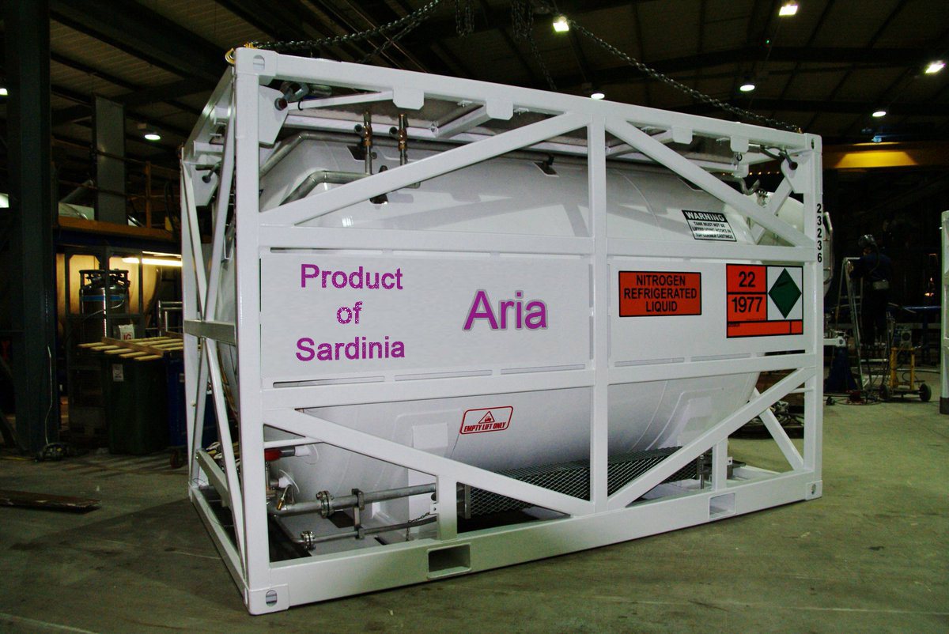
Wessington Cryogenic ISO Shipping Container
8000 Liters of Argon
Cost $125,000.00 ea
Neutrino Platform Meeting CERN 2017
Cary Kendziora

Slide 3
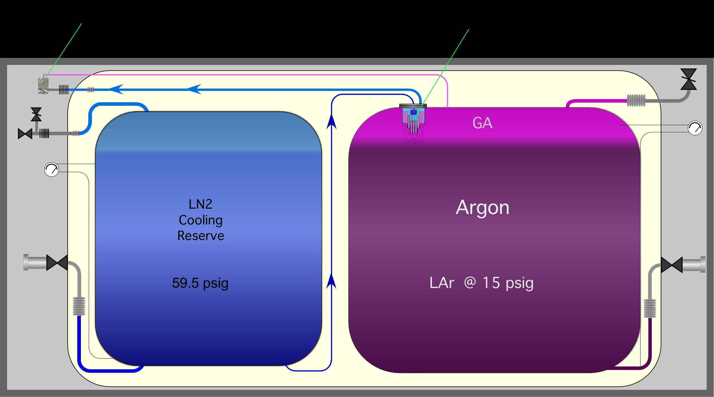
Custom Cryogenic Shipping Container
No Electronic Dependent Devices
Cooling Power Control Valve
Condenser
Neutrino Platform Meeting CERN 2017
Cary Kendziora

Slide 4
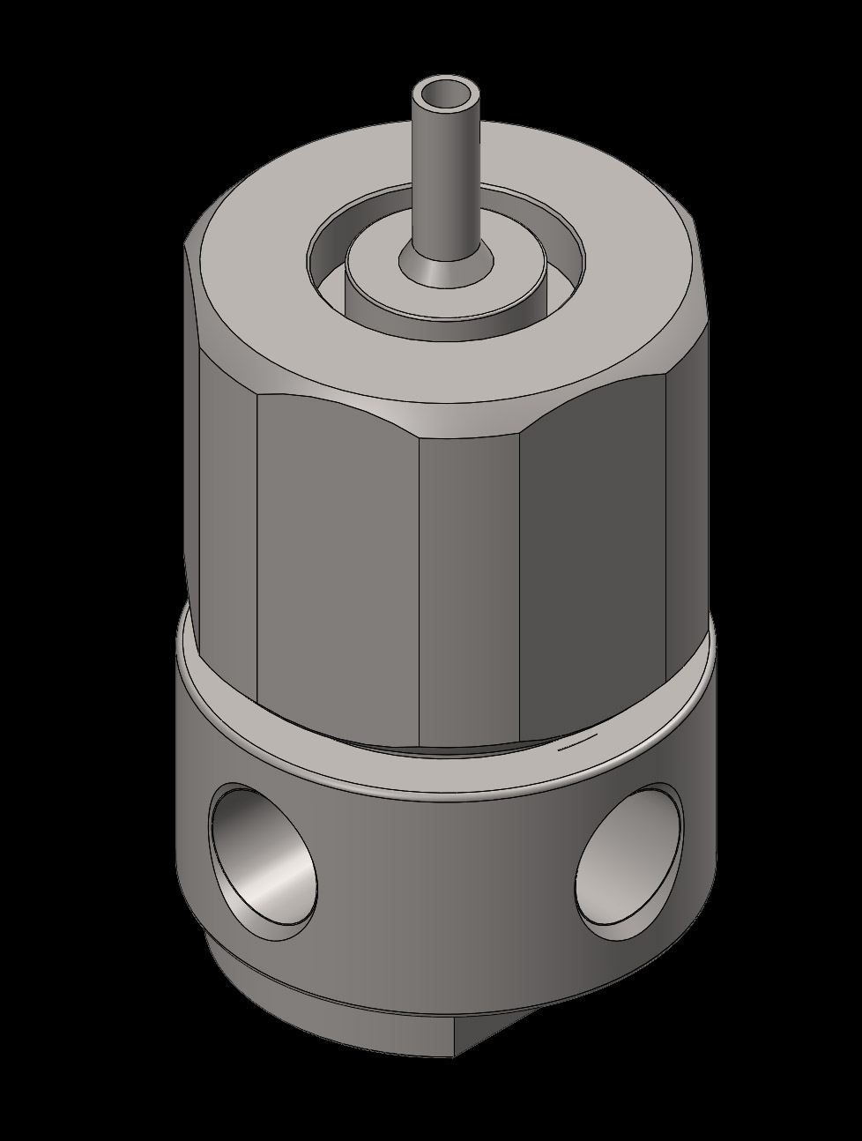
Custom Cryogenic Cooling Control Valve
Neutrino Platform Meeting CERN 2017
Cary Kendziora

Slide 5
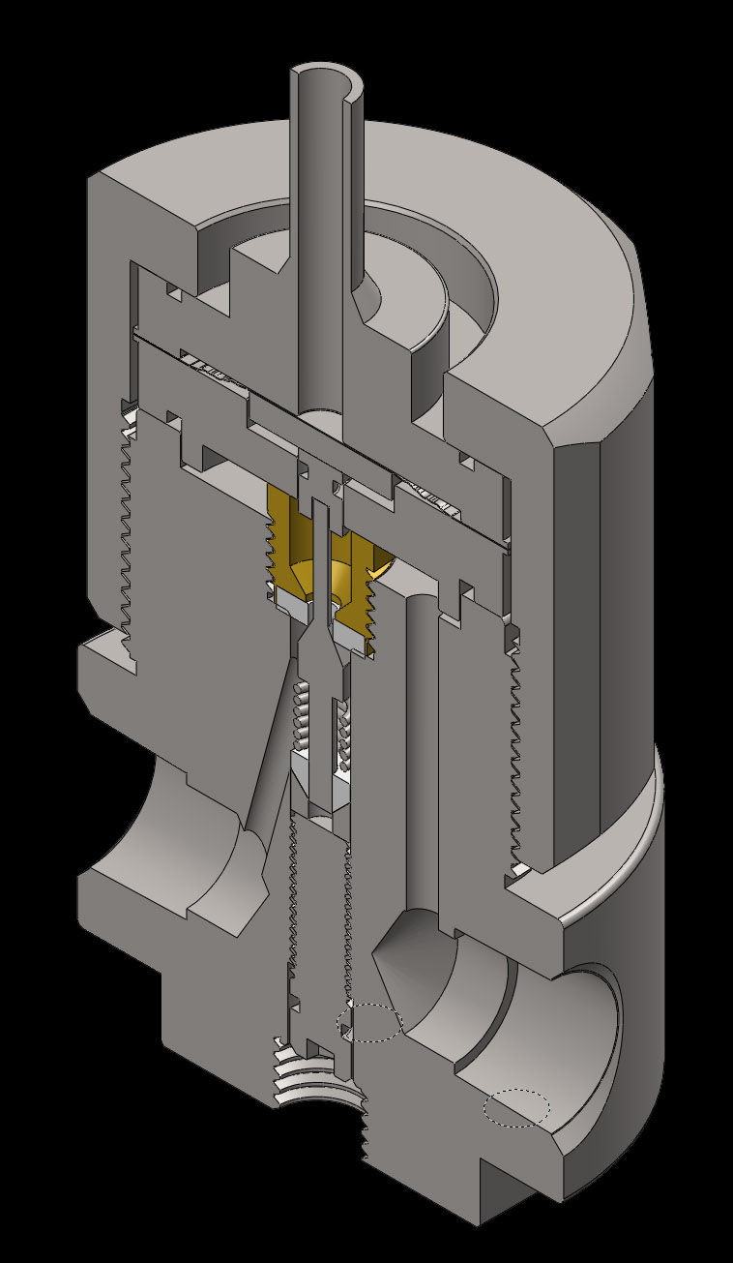
Simple Design
Neutrino Platform Meeting CERN 2017
Cary Kendziora

Slide 6
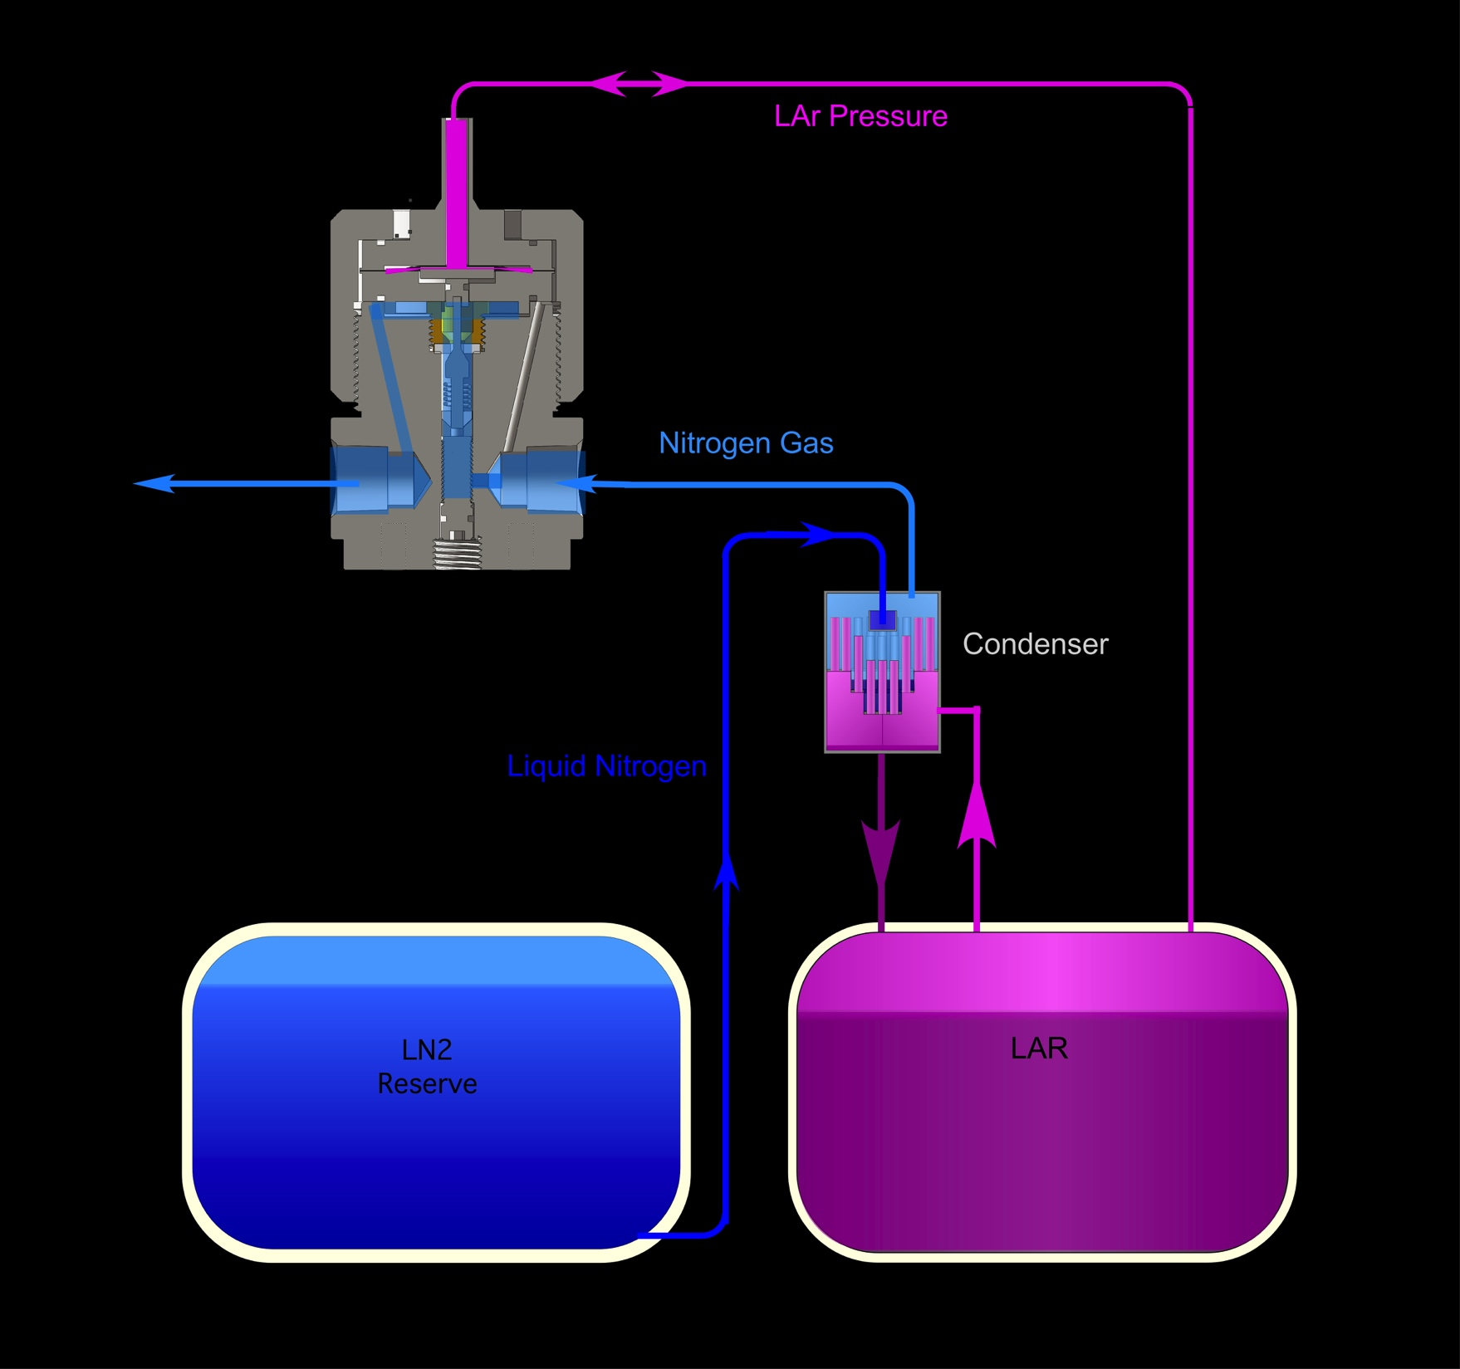
Custom Cryogenic Shipping Container
Control Valve Operation
Neutrino Platform Meeting CERN 2017
Cary Kendziora

Slide 7
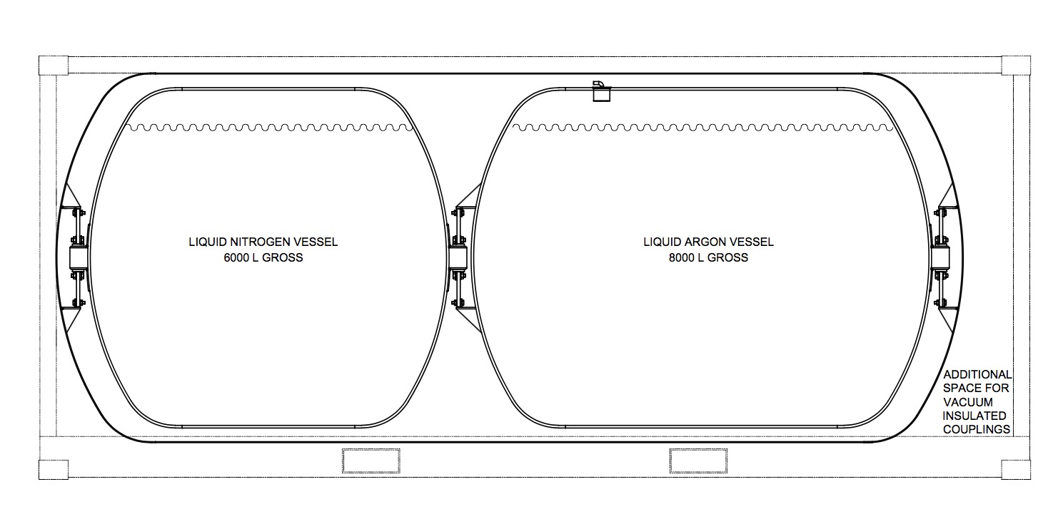
Cryogenic Shipping Container Volume
Neutrino Platform Meeting CERN 2017
Cary Kendziora

Slide 8
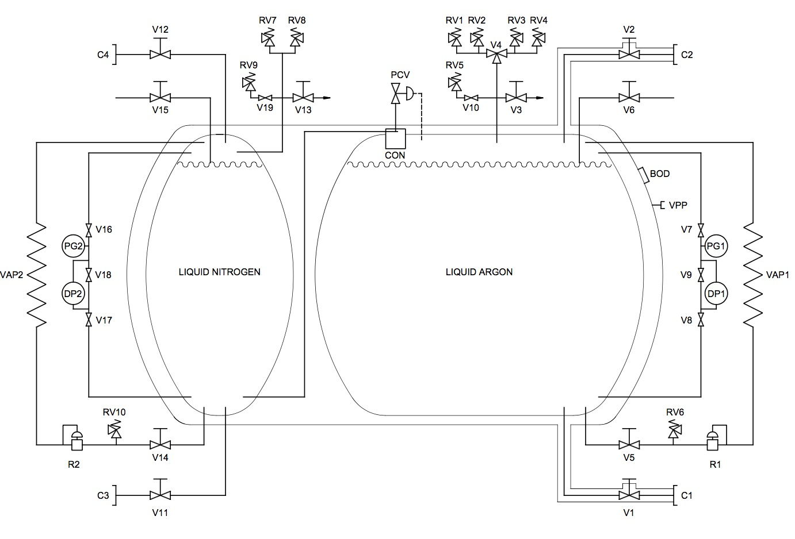
Shipping Container P&ID
Neutrino Platform Meeting CERN 2017
Cary Kendziora

Slide 9
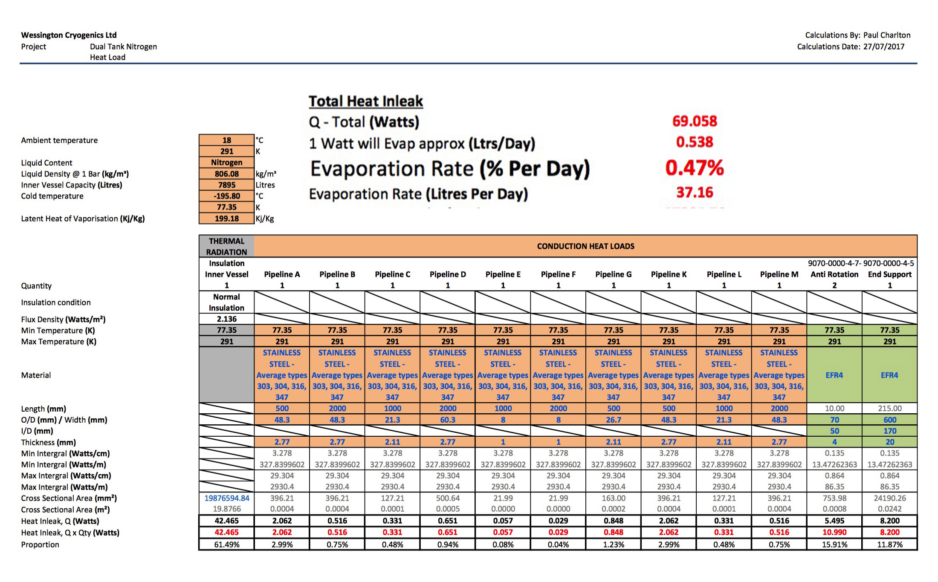
ISO Container Efficiency Nitrogen
Neutrino Platform Meeting CERN 2017
Cary Kendziora

Slide 10
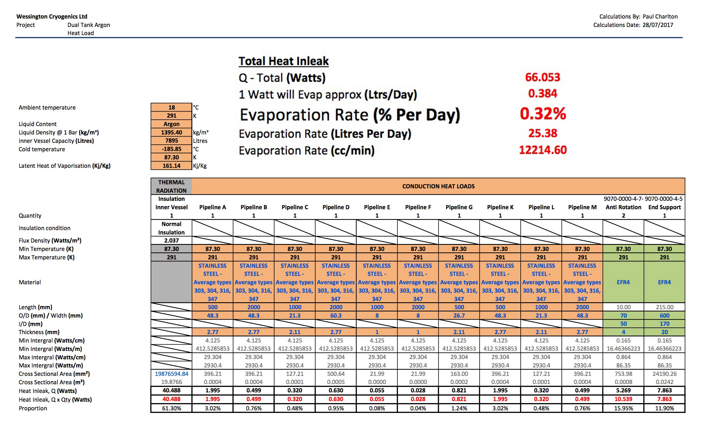
ISO Container Efficiency Argon
Neutrino Platform Meeting CERN 2017
Cary Kendziora

Slide 11
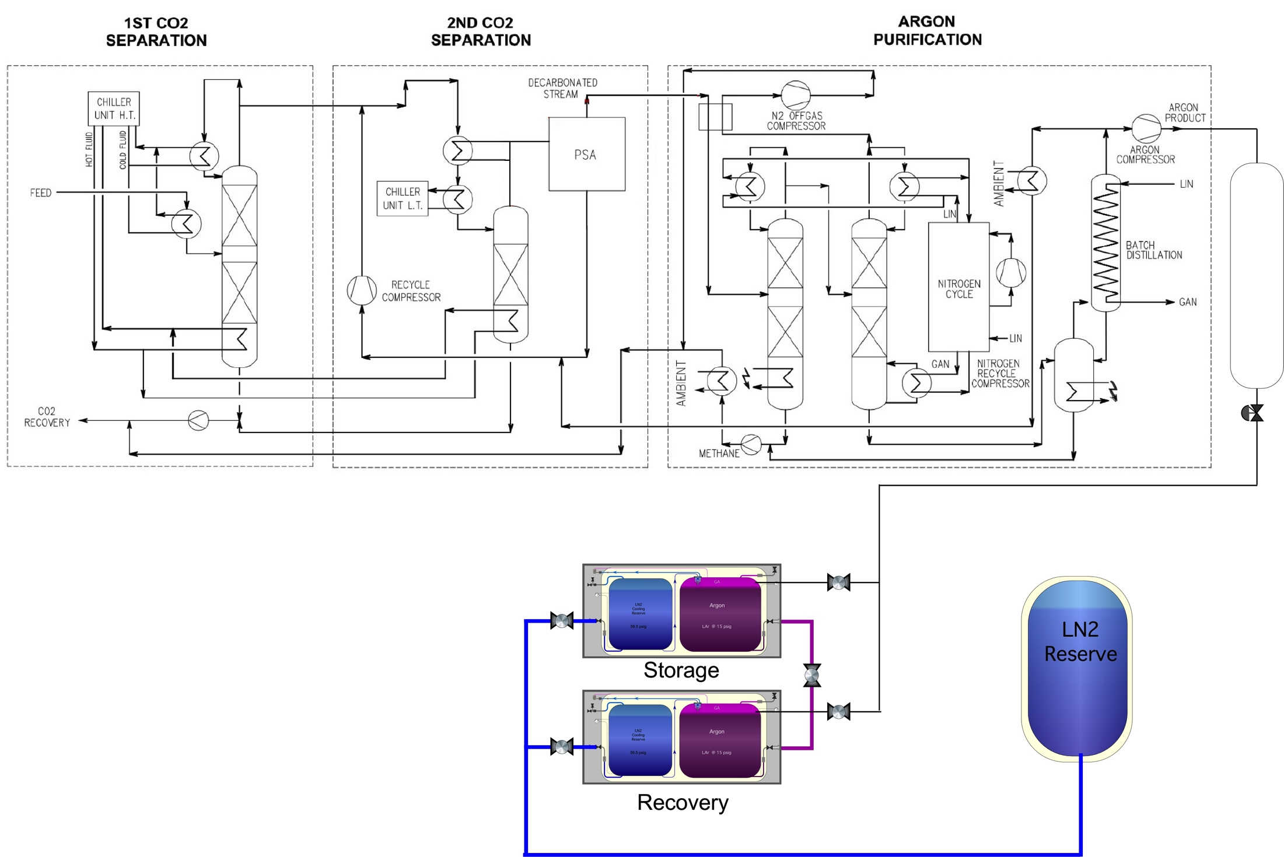
Urania Storage and Recovery
Production Rate:
100kg/day at 99.9% purity
10 tonnes = 100 days
Neutrino Platform Meeting CERN 2017
Cary Kendziora

Slide 12
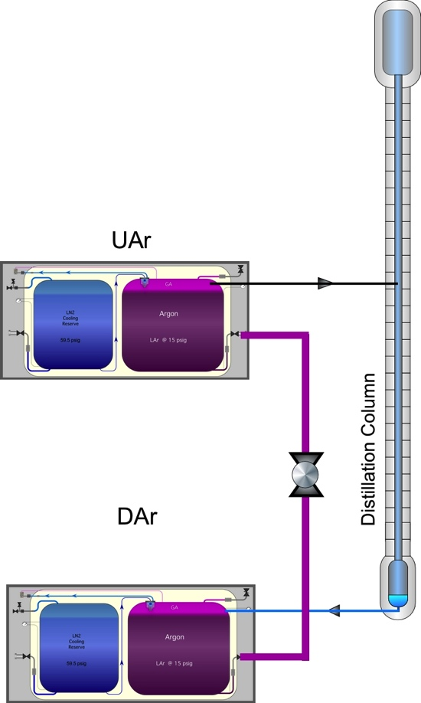
Aria Storage and Recovery
Production Rate of Aria:
Isotopic Separation Rate 10 kg/day
Neutrino Platform Meeting CERN 2017
Cary Kendziora

Slide 13
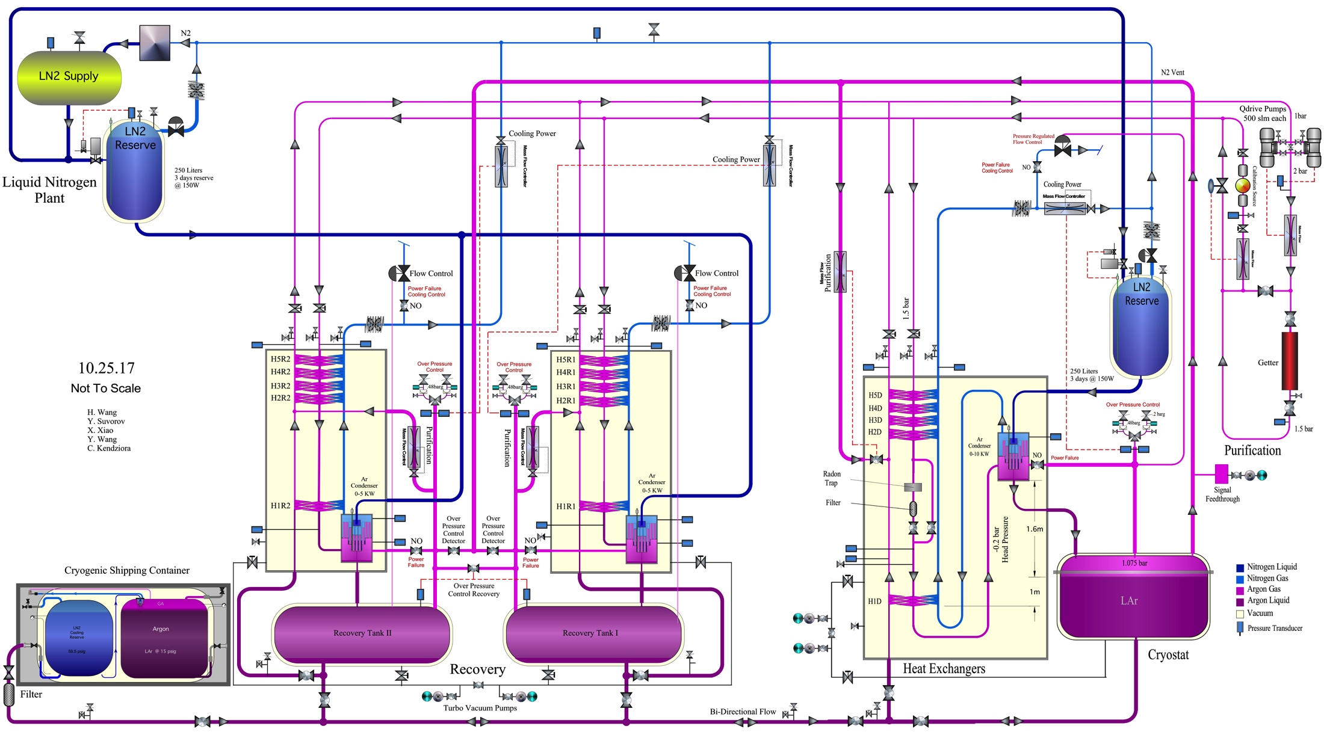
DarkSide 20K Cryogenics
Neutrino Platform Meeting CERN 2017
Cary Kendziora

Slide 14
Thank You

