Slide 1
Integrated DAQ+DCS framework for LHC and Neutrino Platform
Giovanna Lehmann Miotto

Slide 2
Introduction
A bit of history
Proposing a more integrated approach for DAQ/DCS
  SW layer
  HW layer
Examples:
  ATLAS LHC Phase II
  ProtoDUNE and maybe DUNE
High performance architecture for low bandwidth experiments?

Slide 3
A bit of History
Traditionally DAQ and DCS (Detector Control System) have been designed and implemented separately
  DAQ: custom high performance electronics, high speed buses and networks, custom software for data transport and event selection
  DCS: reliable electronics, low speed industrial field buses, HMI/SCADA systems for supervision
The main system requirements, i.e. high reliability vs. high speed/throughput were considered incompatible

Slide 4
The LHC Era
All experiments agreed to join forces and have a single framework for the DCS
  Joint COntrols Project (JCOP) started end of the 90’s
  A commercial SCADA system was chosen and enhanced with additional framework components (hw support, extra features such as archiving, finite state machine, …)
At the time of the design the DAQ systems were still too challenging to agree on a common solution
  Nevertheless, one of the experiments decided to combine DCS and DAQ at the level of the control/monitoring aspects and adopted the JCOP framework
    The concept of joint DAQ+DCS was born

Slide 5
Evolution
With time the technologies used in these two domains have come closer together
  DAQ:
  the need for very special electronics has been confined to the on/near detector area
  DCS:
  the amount of data to monitor and the amount of devices to control has increased, thus requiring to move to higher speed interconnects
  Software:
  Both systems have embraced the evolution of software, with interoperability and platform independence, encapsulation of the low level functions, abstraction of the system logic, increased emphasis on usability, visualization, automation, and monitoring

Slide 6
Integrated approach for DAQ/DCS
Why:
  Concentrate the effort of developing custom boards and system specific firmware to the on(near)-detector electronics.
  Maximize use of high level programming languages in conventional environment (PCs)
Software (supervisory) layer:
  Continue investing in the “JCOP” approach
  Cross-fertilization of domains: many required tools and techniques are similar, some have advanced more in DAQ and others in DCS
Hardware layer:
  Unify the physical links to the detector front-ends (control, data, timing, trigger & fast control distribution (TTC) )
  Choose protocols/systems that join high availability and high performance

Slide 7
Sketched Architecture
Detector
FE
FE
FE
…
FE
Point-to-point links
Clever router
Clever router
TTC
Switched Network
DCS
event building, online selection, storage,…

Slide 8
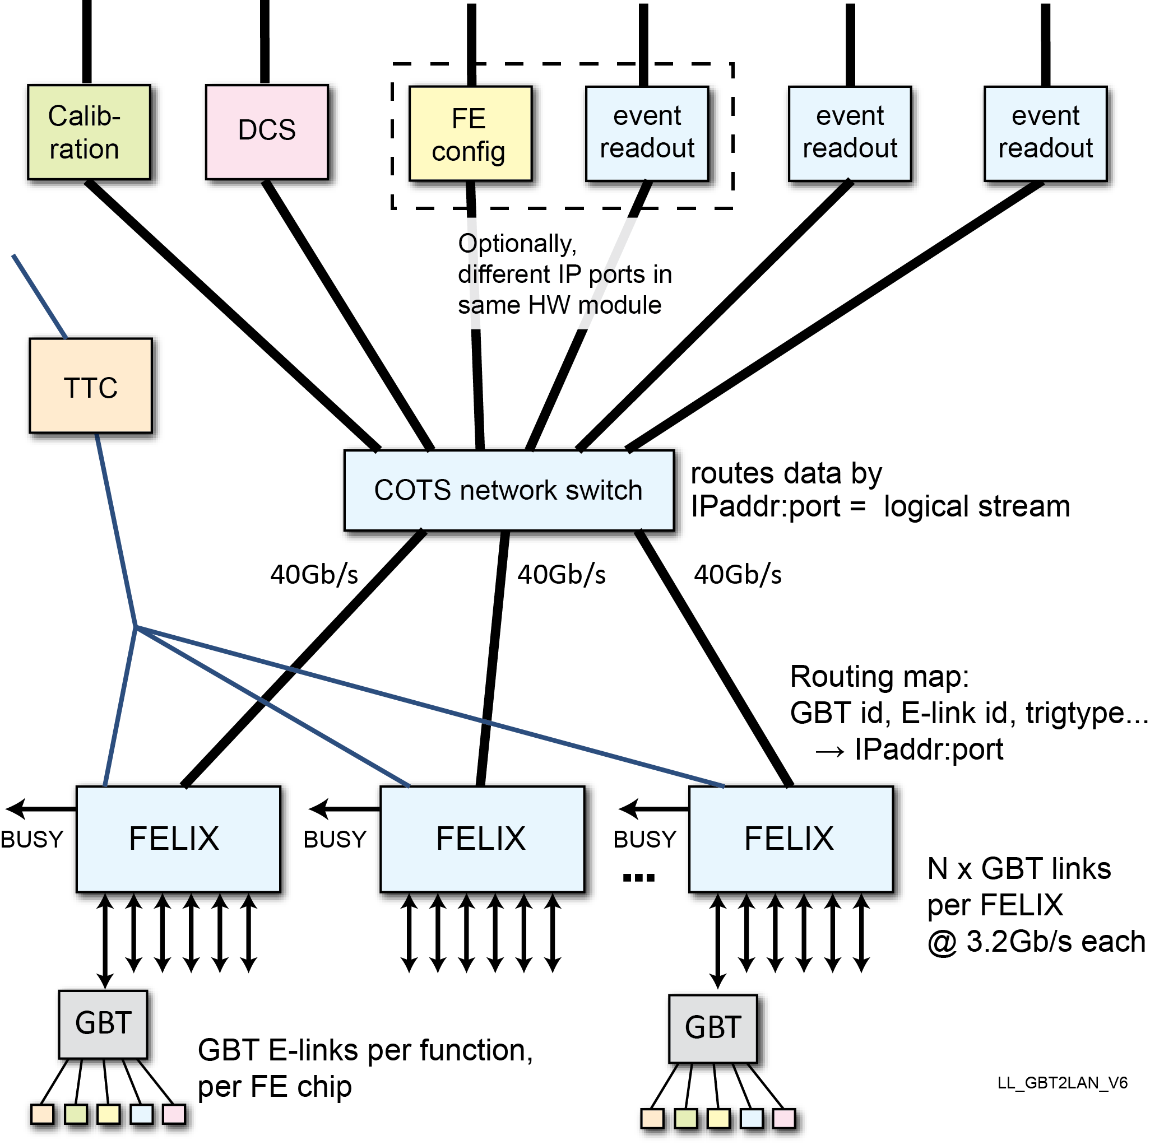
FrontEnd LInk eXchange (FELIX)
Routing of multiple traffic types: physics events, detector control, configuration, calibration, monitor
SW based data processors and handlers; less custom electronics, more COTS components; flexibly upgradable (PCs, FPGAs, NICs)
Integrated Timing Trigger and Control (TTC), and LHC clock distribution
Scalable bidirectional architecture: off-detector end-points freed from one-to-one geographical mapping of FE GBTs
*
* E-link: variable-width logical link on top of the GBT protocol. Can be used to logically separate different streams on a single physical link.

Slide 9
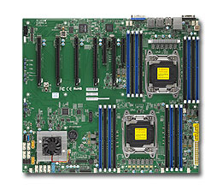
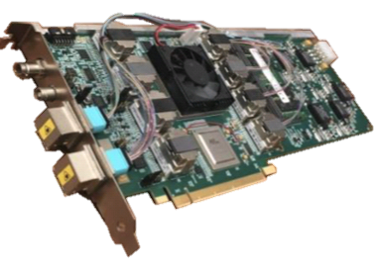
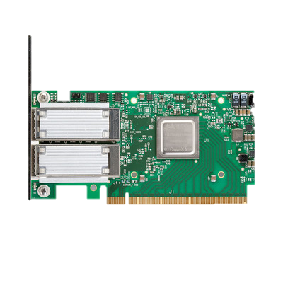
FELIX: Present Implementation
FELIX PC
CPU
Memory
DMA
MSI-X
FELIX
Application
Custom
Device
Driver
FELIX Card (FLX)
TTC*
128 Gb/s
PCIe Gen-3
Wupper
PCIe Engine
Control/Monitor
Large Buffers per group of E-links
GBT Wrapper
Central Router
Housekeeping
128 Gb/s
2 x
100 Gb/s
ports
PCIe Gen-3
NIC
Optical Links
Data Links
* “TTC” is the Timing, Trigger and Control System

Slide 10








The FELIX Project
The FELIX project is a joint collaboration among several institutions, started within the ATLAS experiment
  It has crossed the experiment’s boarders thanks to its success and applicability to very different environments (irradiation facilities, medical applications, large neutrino experiments,… )
It is much more than a hardware platform and comes with
  Firmware supporting several protocols
  Complete software suite for: low level debugging, routing logics, high performance networking (ethernet, omnipath, infiniband)
  An open spirit fostering collaboration and mutual support

Slide 11
Design for the ATLAS upgrades
> 20 thousand links; 6 TB/s

Slide 12
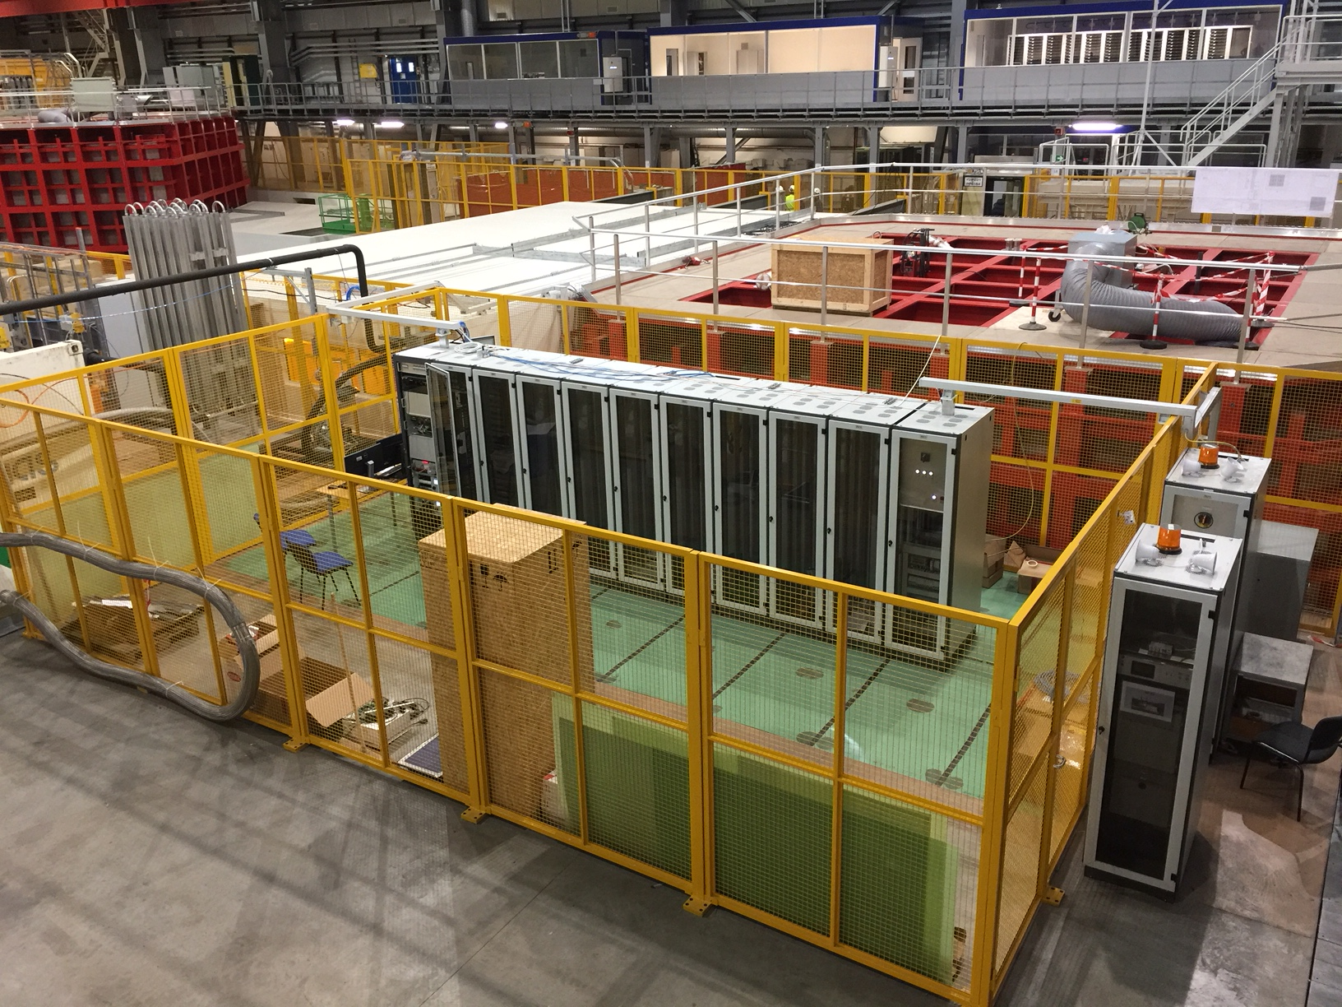
Neutrino Platform

Slide 13

Proof of concept in NP04
Detector Front-End
~100 links; 54 GB/s
Detector Front-End
Detector Front-End
Timing/Trigger
Baseline Readout
FELIX
DCS
Baseline Readout
DAQ Data Handler
Switched Network
DAQ Data Handler
Online Processing
DAQ Data Handler
DAQ Board Reader
DAQ Event Builder
DAQ Storage System

Slide 14
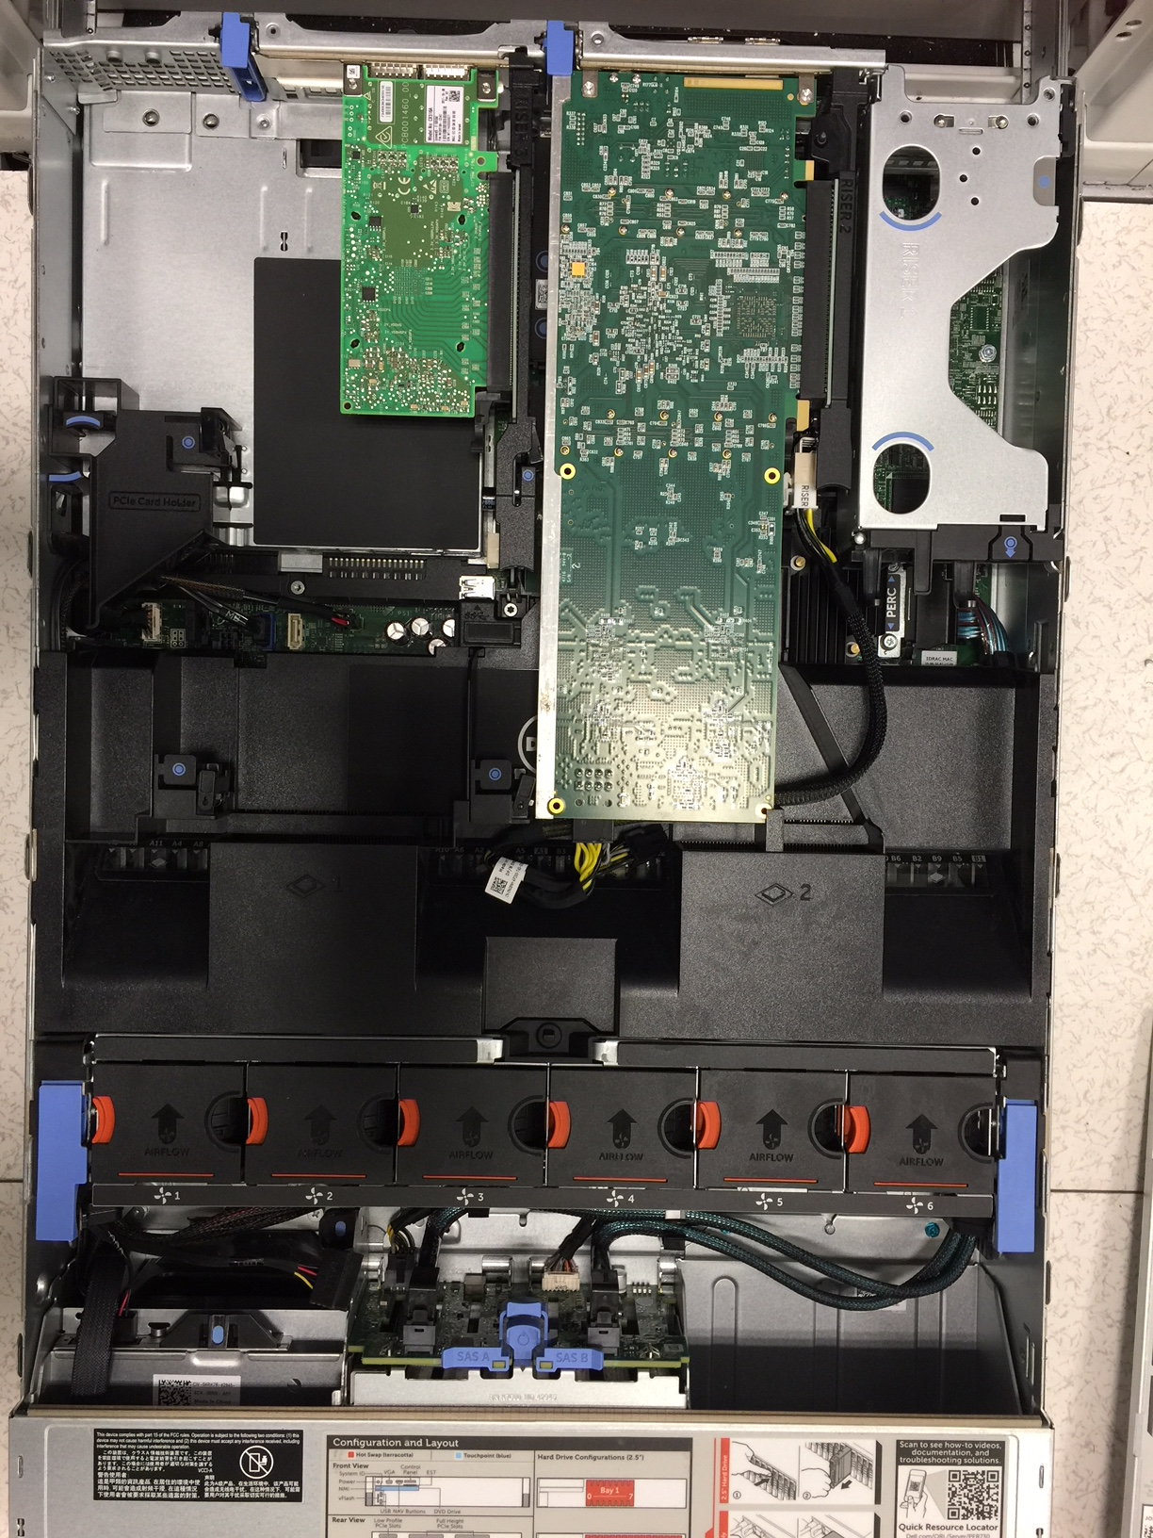
FELIX in NP04

Slide 15
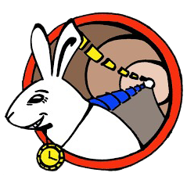
Candidate Design for DUNE
Detector
FE
FE
FE
…
FE
~1500 links; 1.5 TB/s (per super module)
4 super modules in DUNE
FELIX
Large distributed temporary store
DCS
Event selection farm (e.g. +GPUs)
Data selected for permanent storage
To permanent storage

Slide 16
How can all this apply to dark matter experiments?
Dark matter experiments have typically very low data rates.
The FELIX implementation may seem an over-kill
  But FELIX is only a building block of a wider architecture
The concepts remain valid:
  Reduction of custom electronics
  Better integration of detector control and data acquisition
  Unified framework for DAQ, detector and cryostats control system
    E.g. Seamlessly supporting PLCs, cRIO technologies as well as any OPC-UA compatible devices
  Modularity allowing for partial upgrades when needed
    Essential for long lifetime experiments
We may collaborate and explore how to best develop an integrated DAQ/DCS system for a dark matter experiment.

