Slide 2
  ProtoDUNE cryogenics
  technical data, detailed performance and assembly time
26 October 2017

Slide 3
Content
Experience at CERN with cryogenic systems for noble liquids
NP04 cryogenic system:
Requirements
Design Principles
Design / Fabrication
Status

Slide 4
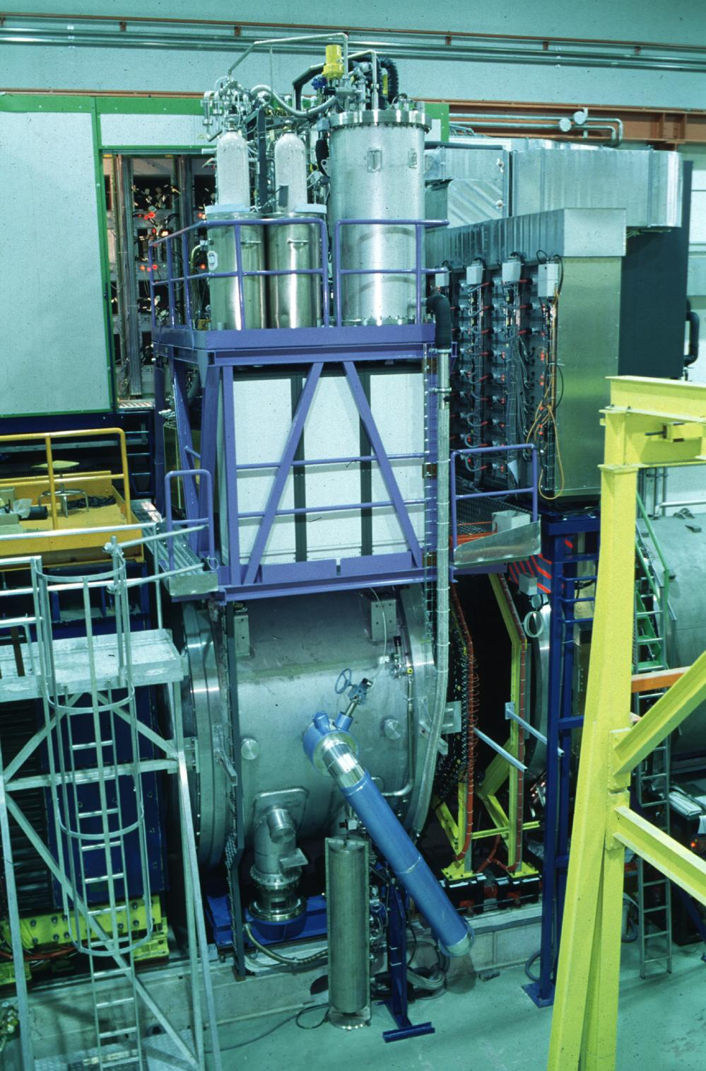
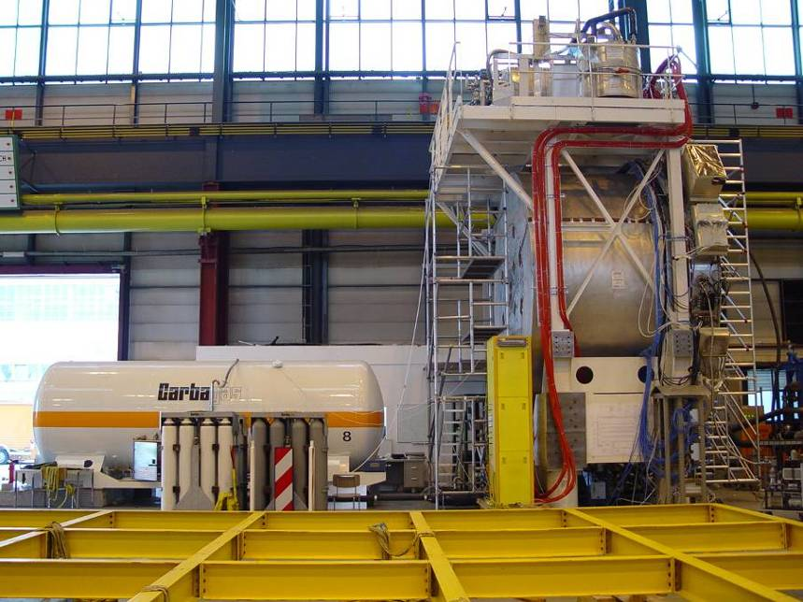
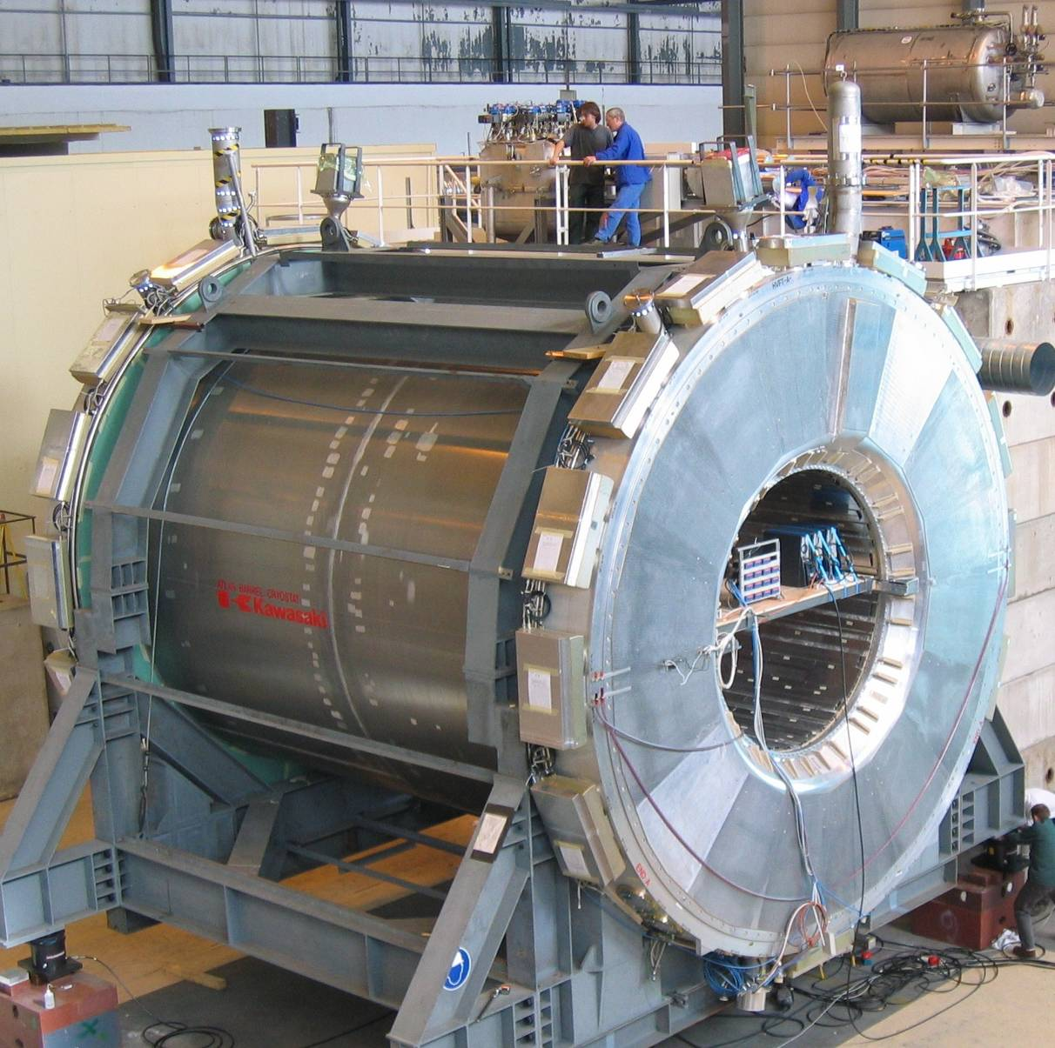
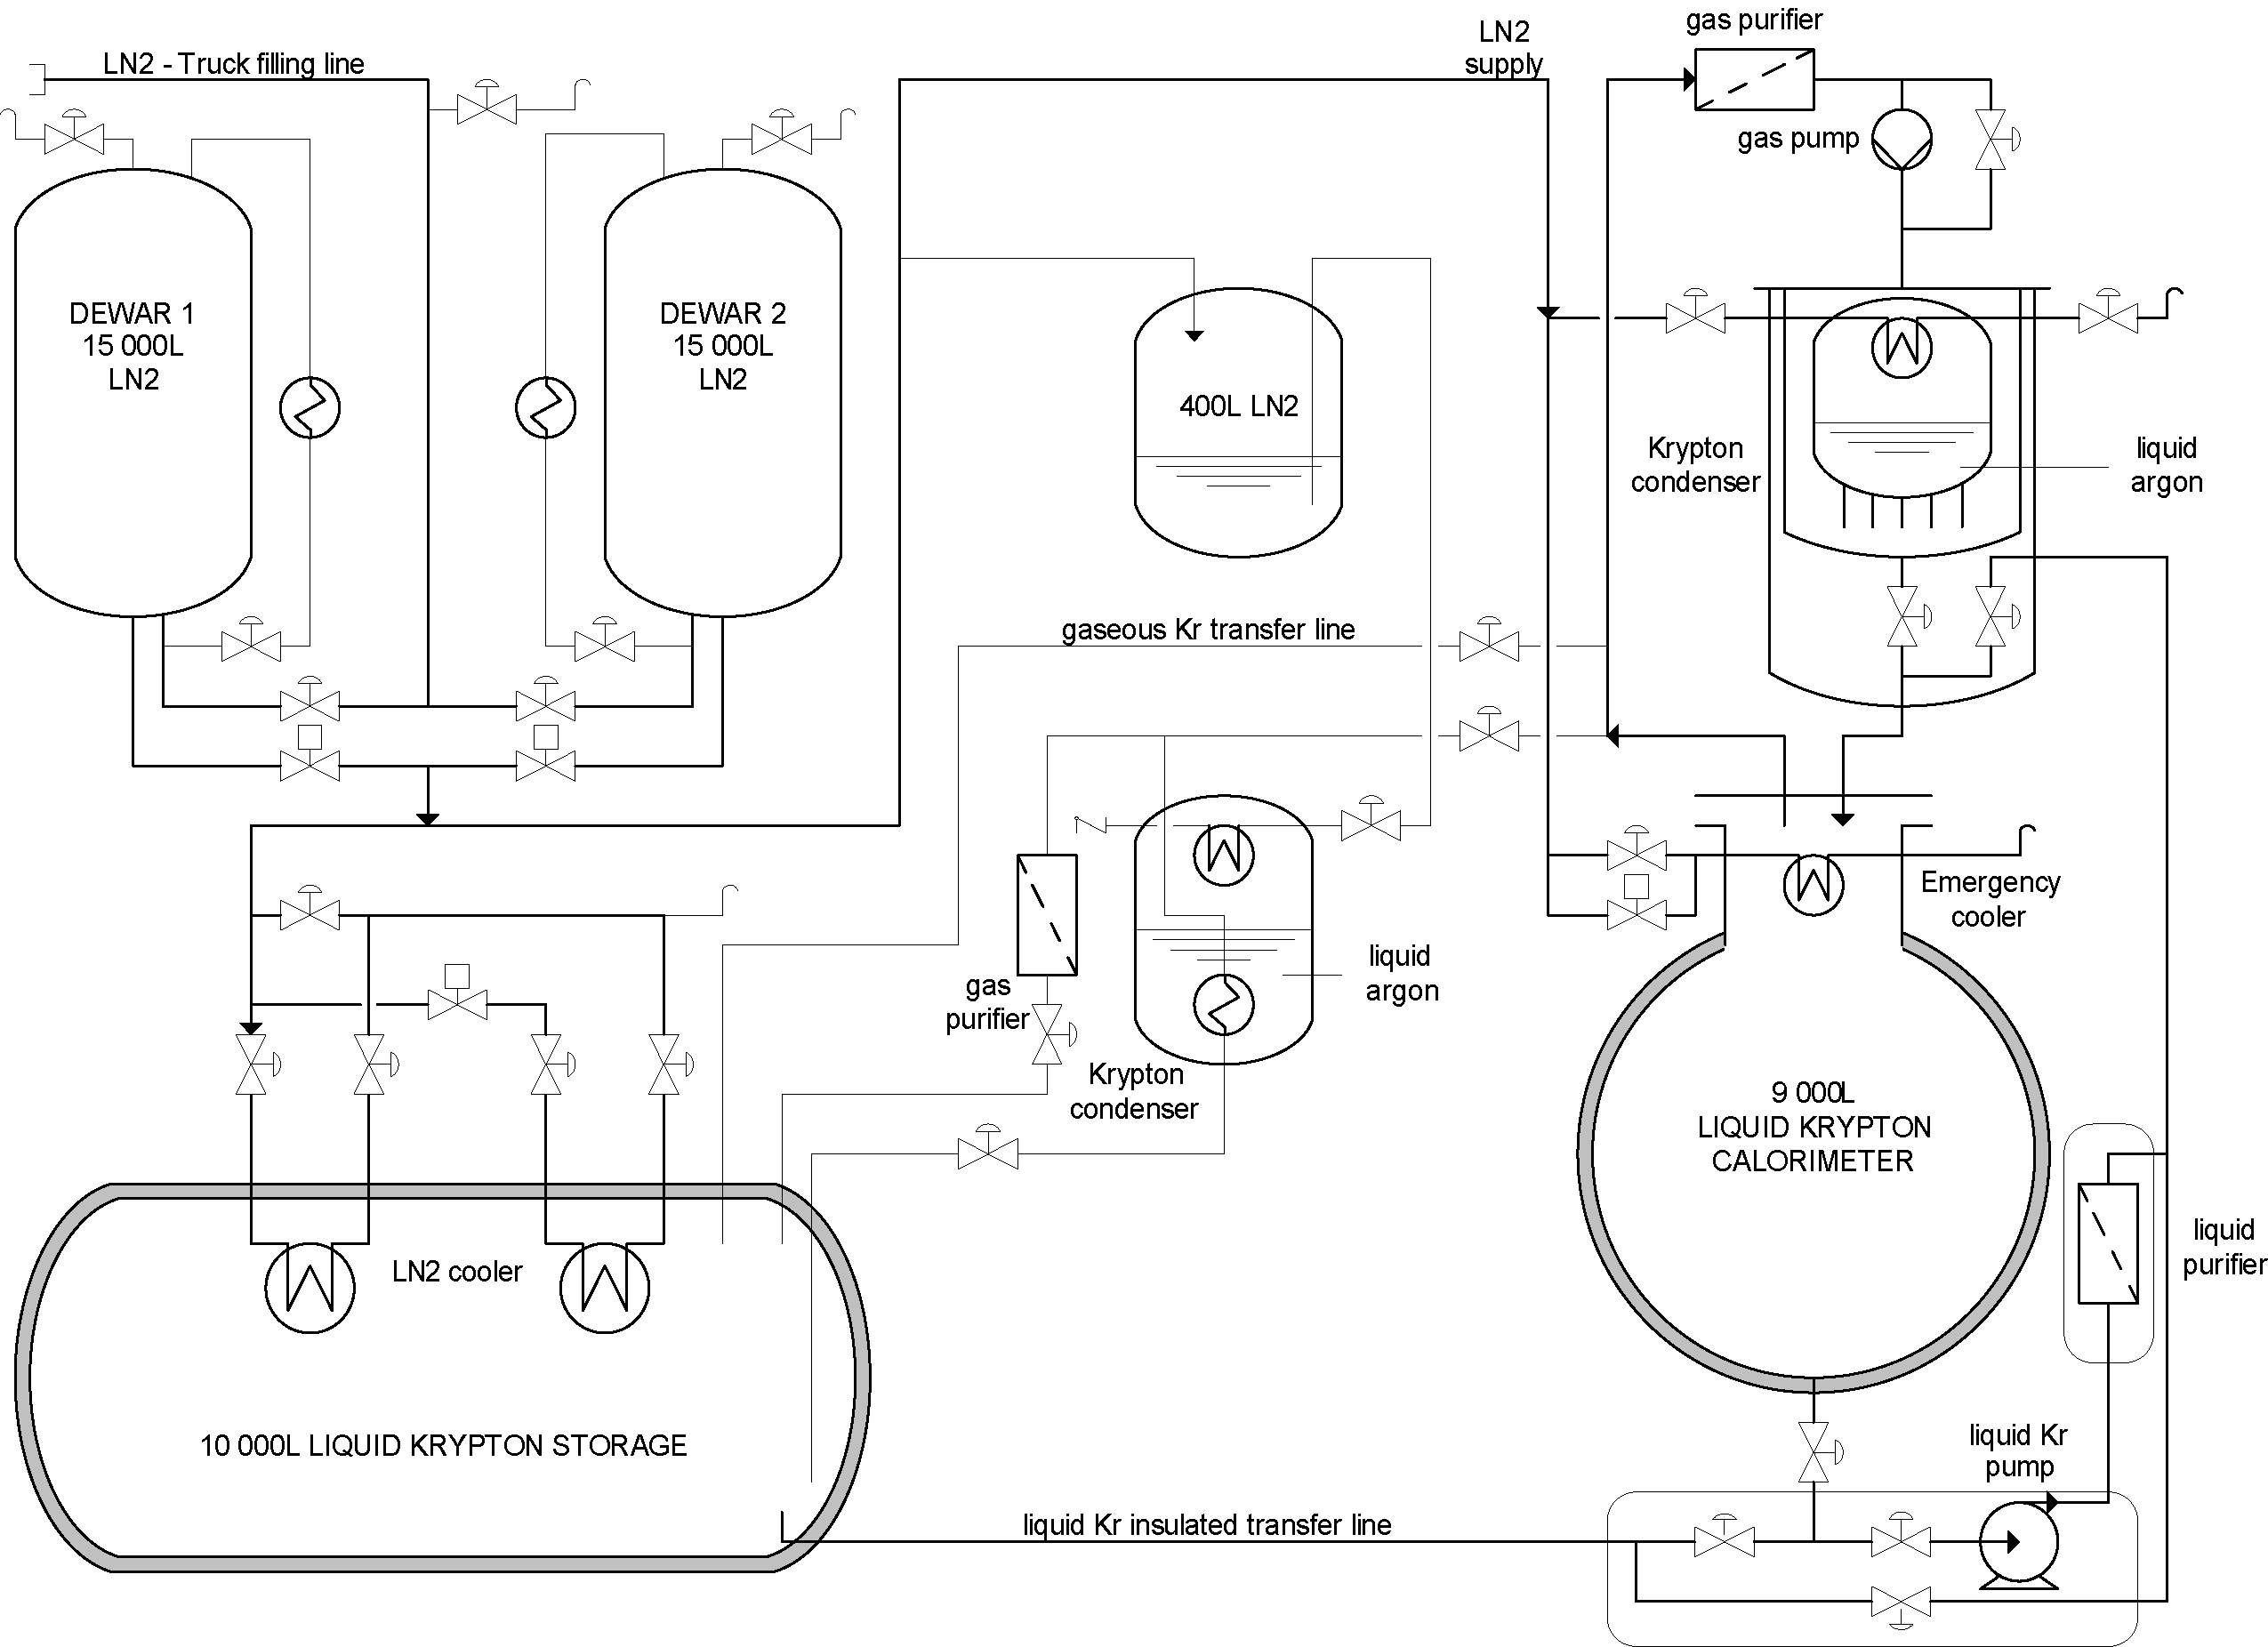
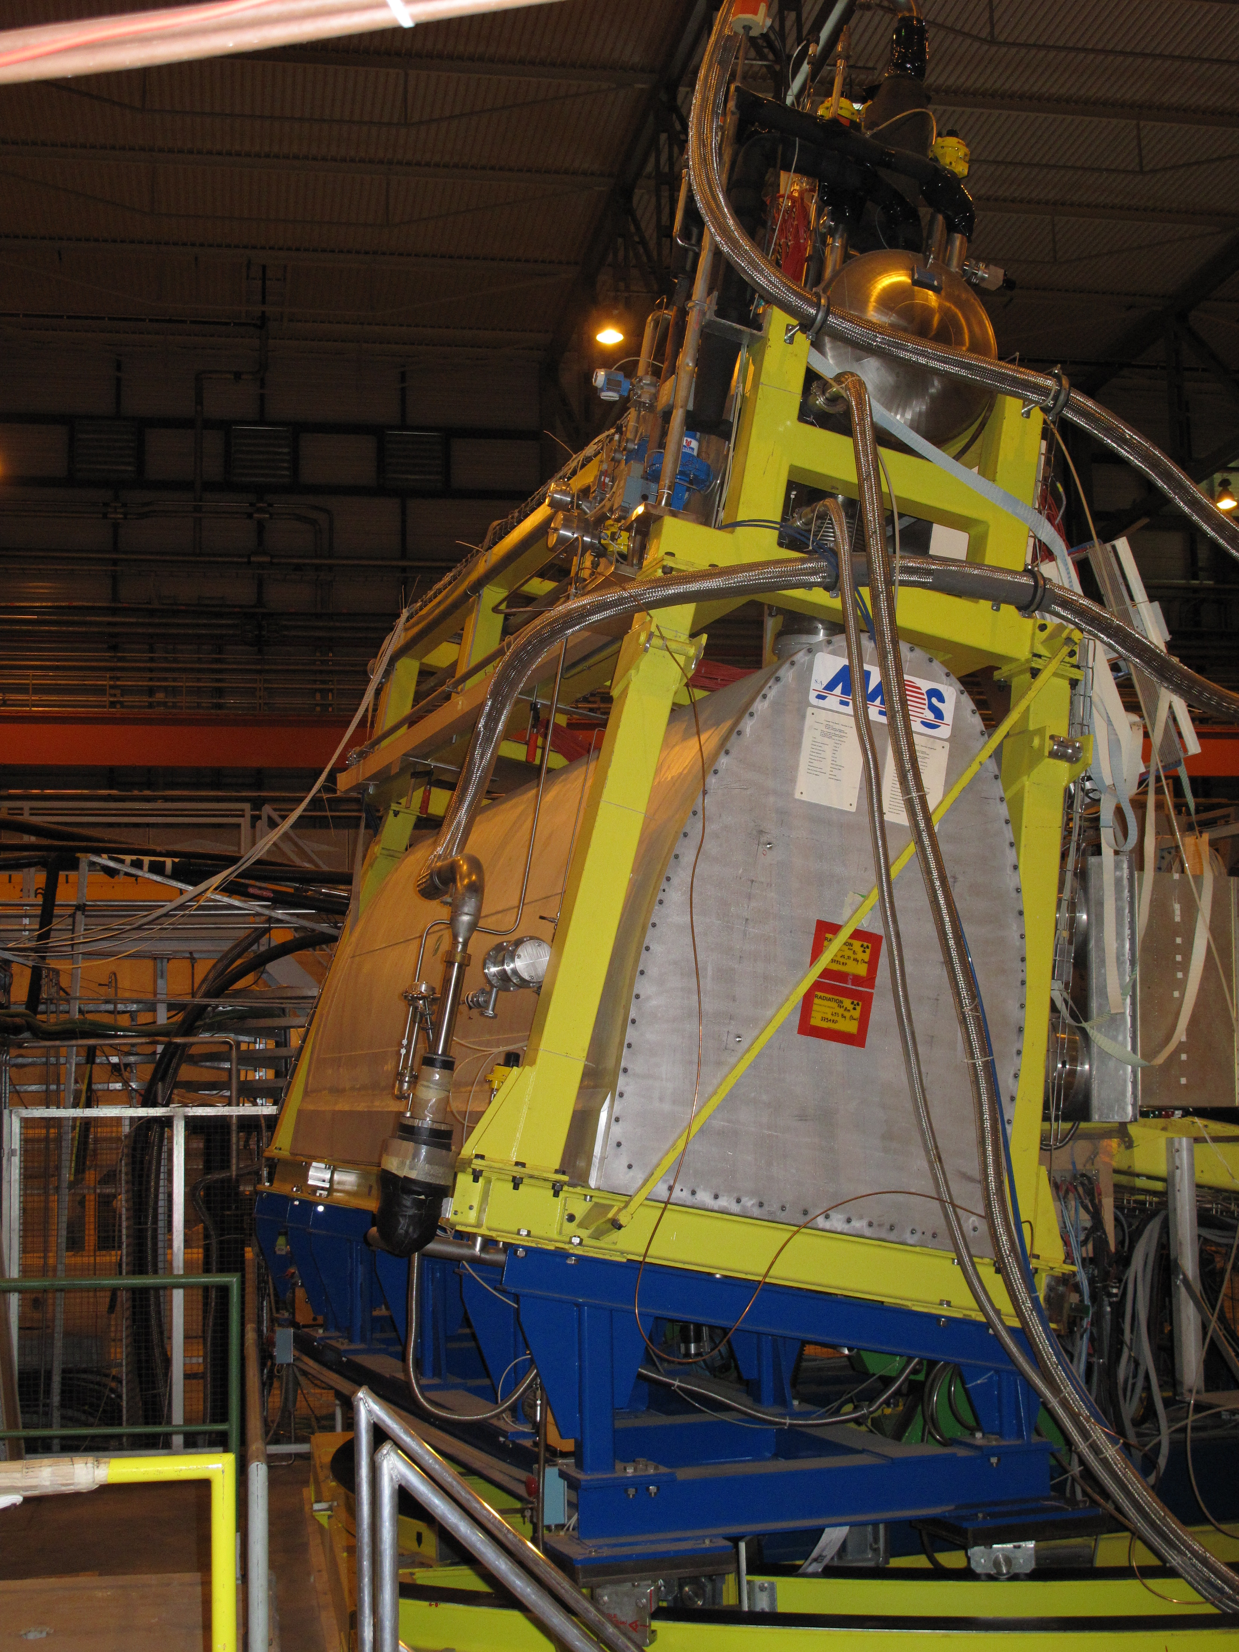
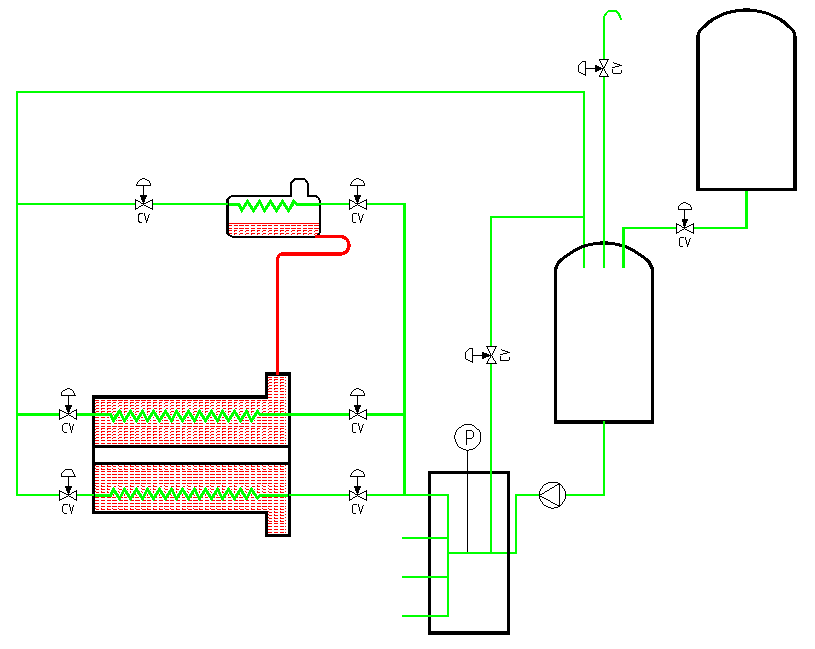
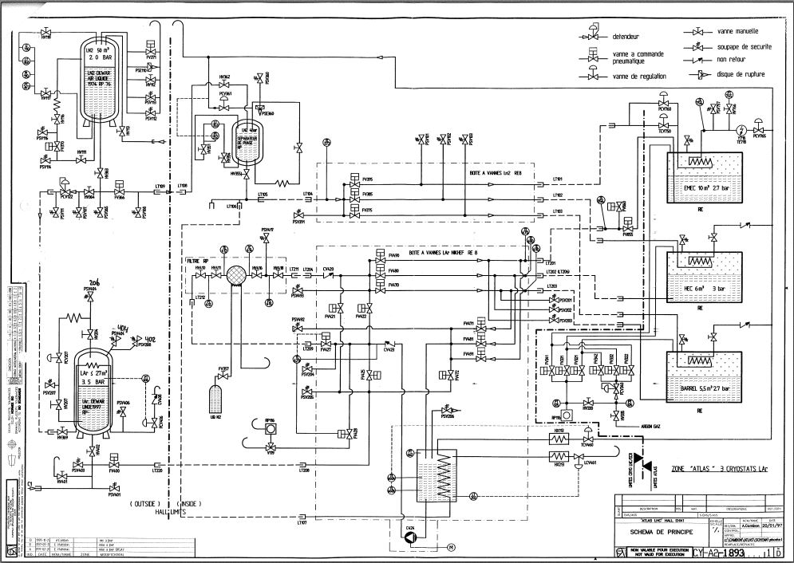
Experience at CERN with cryogenic systems for noble liquids (1/2)
NA48/NA62: 10 m³ of liquid krypton, continuously operating since 1996. Cryogenic system house-build.
50 m³
25 m³
ATLAS full detector tests: prototype tests station 2003 till 2005. Cryogenic system by external supplier and collaboration.
ATLAS test area for detectors: three cryostats operated in parallel from 1997 till 2004. Cryogenic system by in house and external supplier.
LN₂
Expansion vessel
End-cap
LN₂ phase separator
End-Caps
LN₂ pump
Barrel
LAr Tanks

Slide 5
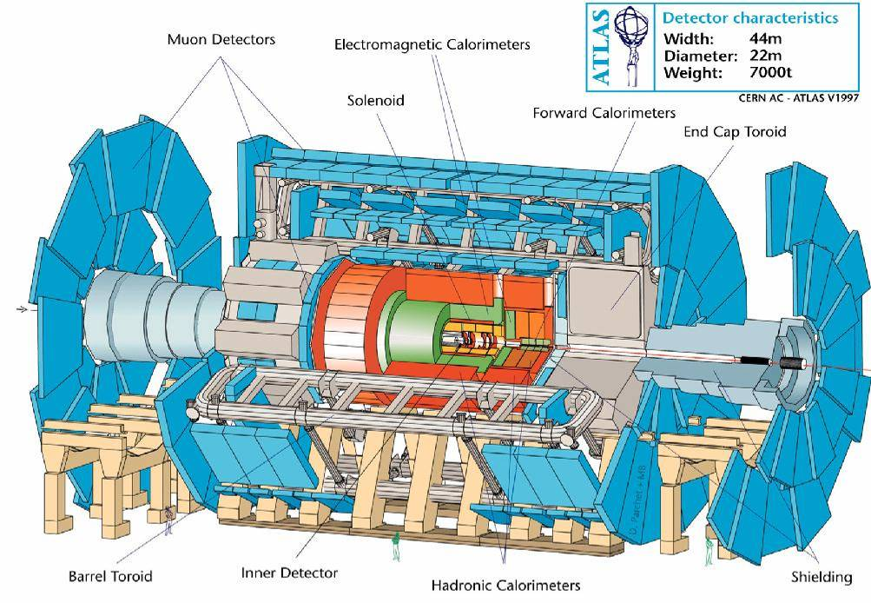
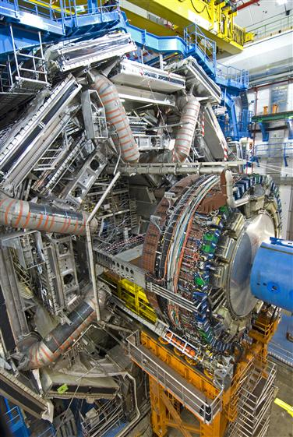
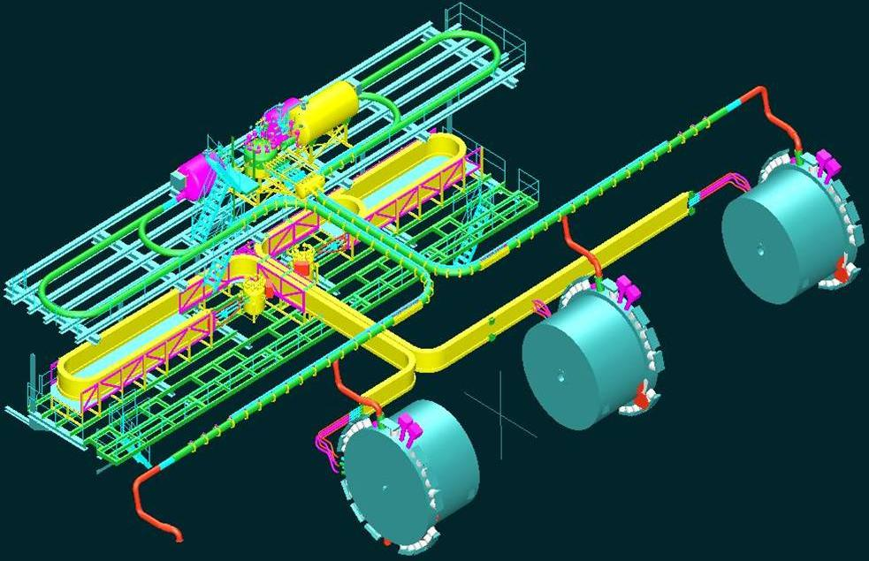
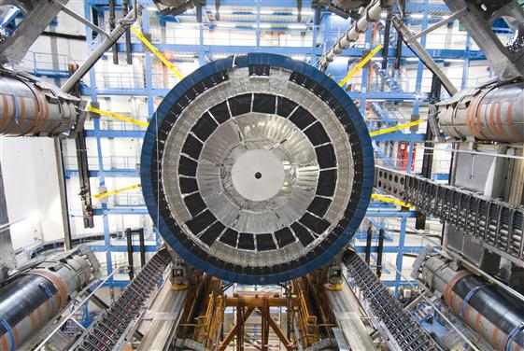
Experience at CERN with cryogenic systems for noble liquids (2/2)
Liquid argon calorimeter in the ATLAS experiment:
100 m³ of liquid argon;
Operating in; underground area;
Continues in operation since 2006;
expansion vessels
12 m displacement
Total heat load about 12 kW;
Sub-cooled liquid argon bath;
Temperature uniformity over detector volume: < 70 mK rms;
Cooling source: evaporating LN2;
Argon purity in the ppm O₂ level;
Cryogenic system by collaboration, constructed / installed by supplier.
LN₂
Expansion vessel
End-cap
LN₂ phase separator
End-Caps
LN₂ pump
Barrel
LAr Tanks

Slide 6
NP04 /
ProtoDUNE

Slide 7
Design / Fabrication
CERN based cryogenics team working on the cryogenic systems of the NP01, NP02, NP03 and NP04 projects, in close collaboration with Neutrino Platform;
CERN team: 2.5 engineer; 1 technician; 2 fellow; 1 technical student;1 designer;
Contract for design, construction and installation of cryogenic system and for design and construction of cryogenic circulators are tendered via CERN;
Electrical distribution and control systems for cryogenic system are designed, produced and installed by CERN cryo-group (operational reasons)
Liquid argon contract in tendering phase
Infrastructure: Neutrino Platform

Slide 8
Requirements for NP04 cryogenic system
Parameter | Value
LAr purity in the cryostat | 10 ms electron lifetime (100 ppt O₂ equivalent)
GAr piston purge rate of rise | 1.2 m/hr
TPC cool-down rate | < 40 K/h, but vertical gradient <10 K/m
Nominal LAr purification flow rate | 5.5 days / volume change (4m³/hr)
All surfaces in the ullage during operation | < 100 K
GN₂ purge within insulation | 1 volume change/day
Cooling power | 2.4 kW static cryostat 2.6 kW cryo system and electronics

Slide 9
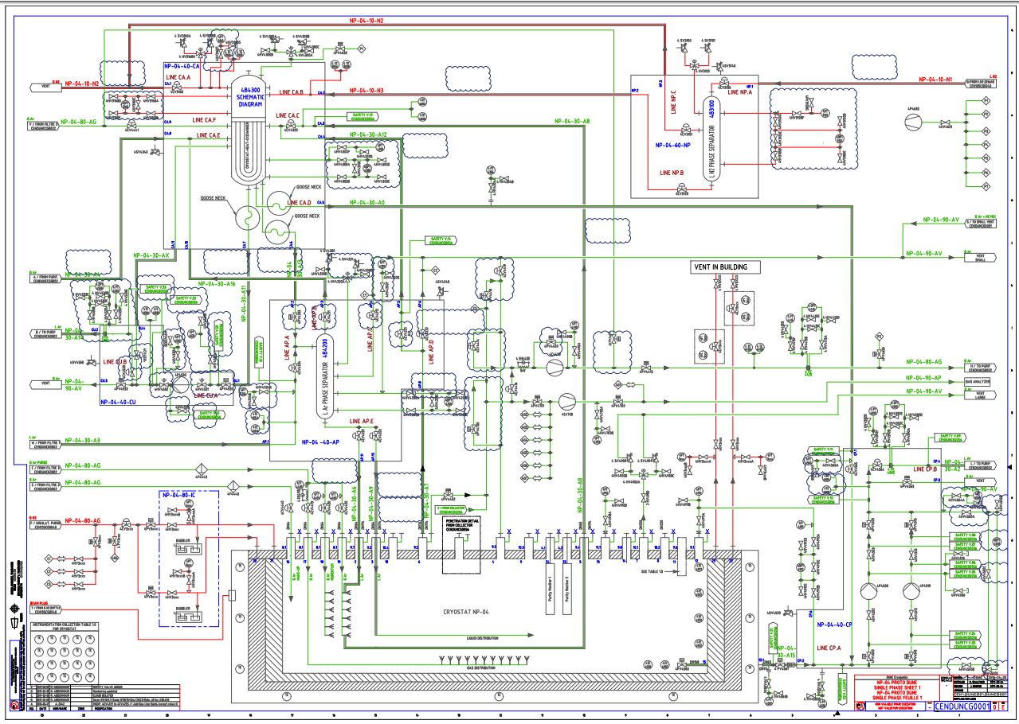
Design Principles
System also partially based on ICARUS experience.
1: Gas piston purge system before cool-down;
2: Cool-down system, creating mixture liquid and gaseous argon, dispersed by second gas flow
3: Gaseous argon from feed through towers is constantly circulated through purifier and re-liquefied
4: Liquid argon is taken by pump and circulated through liquid purifier, condenser, phase separator
720 ton LAr
2
1

Slide 10
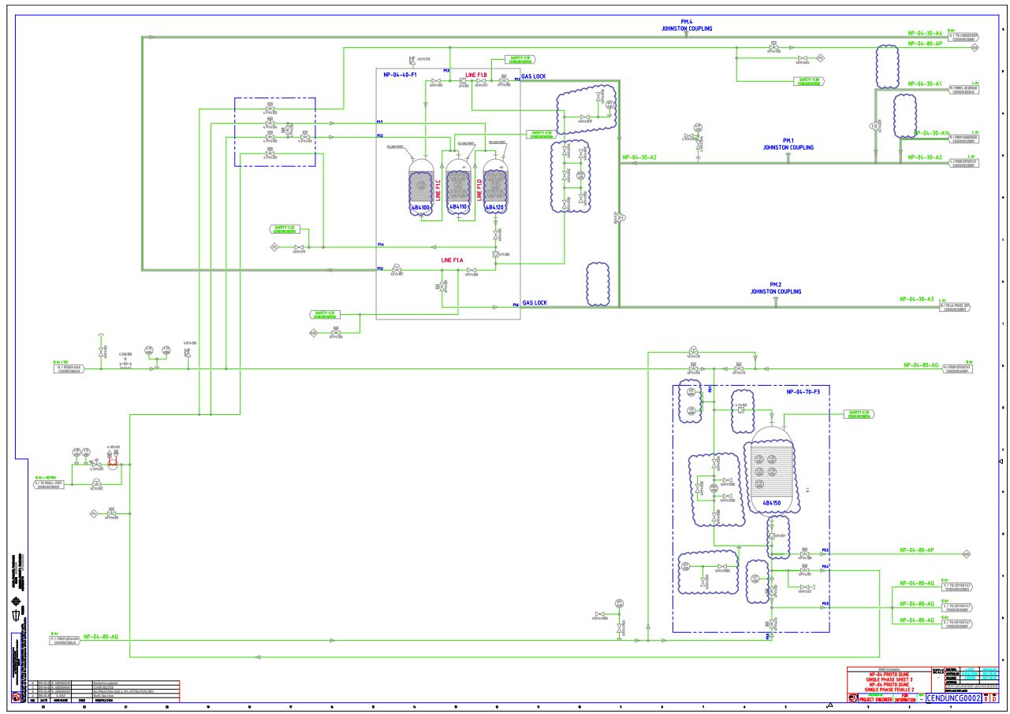
Design Principles
Active Cu based purification system
1: Circulation through liquid purifier during liquid filling
2: Circulation through liquid purifier during normal operation
3: Circulation through gaseous purifier during gaseous purges
4: Circulation through gaseous purifier during normal operation
Experience WA105: O₂ equivalent impurities after 7 liquid volume passages: < 30 ppt

Slide 11
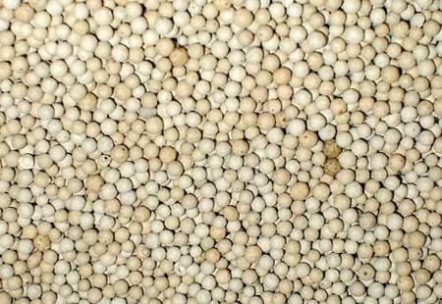
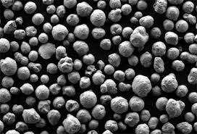


Purification principle
Molecular Sieve
Cu-226 ( Cu coated Al₂O₃ )
Moisture adsorption
Oxidation – 87K
$$Cu^{2+}+{\frac{1}{2}O}_{2}→CuO$$
Regeneration – 420K
$$CuO+H_{2}→H_{2}O+Cu^{2+}$$
Activation
“Controlled reduction of atmosphere exposed Cu-226”
“very” exothermal, 0.5 % hydrogen
Regeneration
“Controlled reduction of Cu-226 oxidised in purity conditions”
exothermal, 2.5% hydrogen

Slide 12
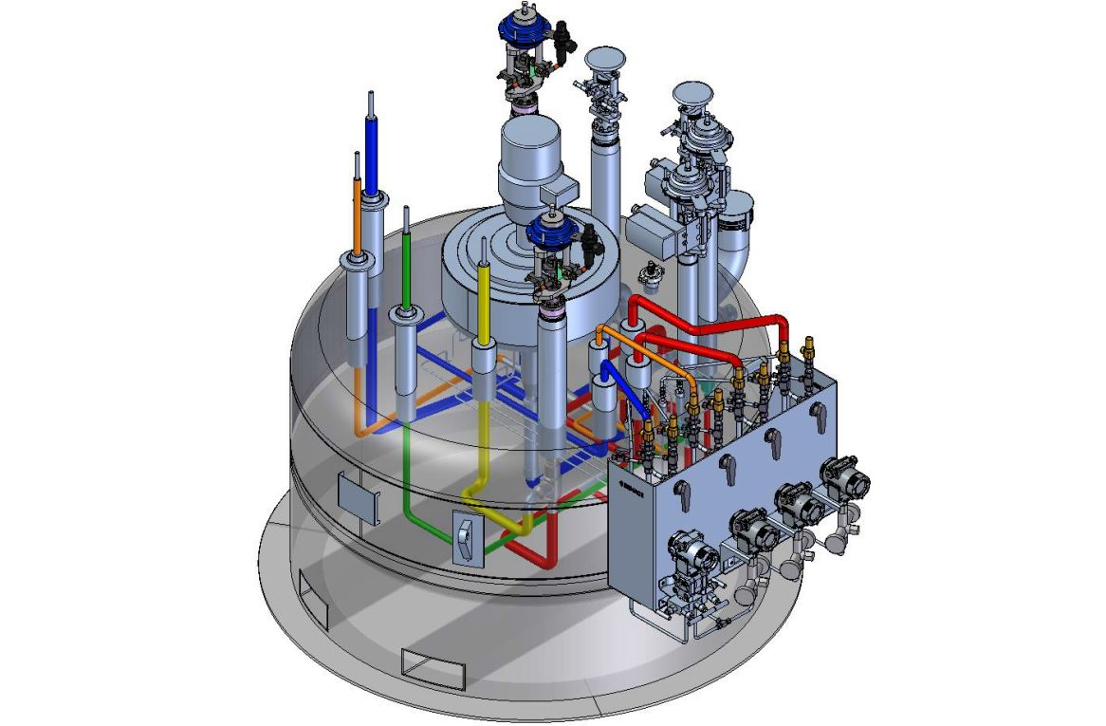
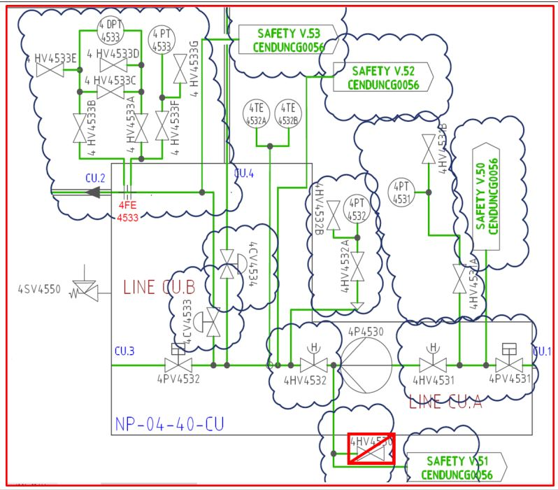
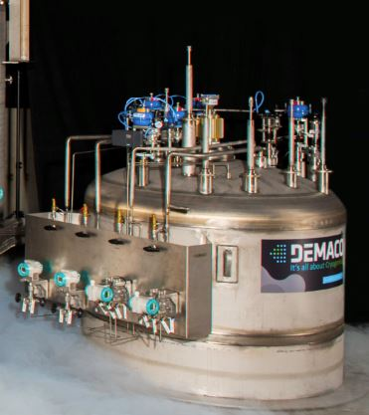
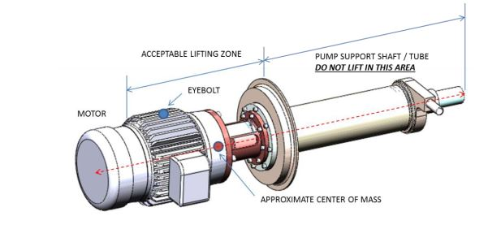
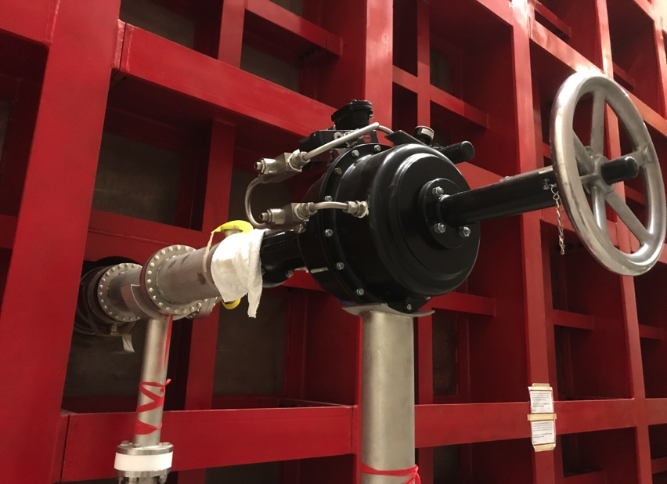
Time line
Contract supplier
(4 months)
Order long lead items
(3 months)
Conceptual design (CERN): 3 months*
Engineering by supplier
3 months
Fabrication
3 months
Order very long lead items (CERN):
9 months
Installation 6 weeks
Little over one year
* After approval of functional proposal

Slide 13
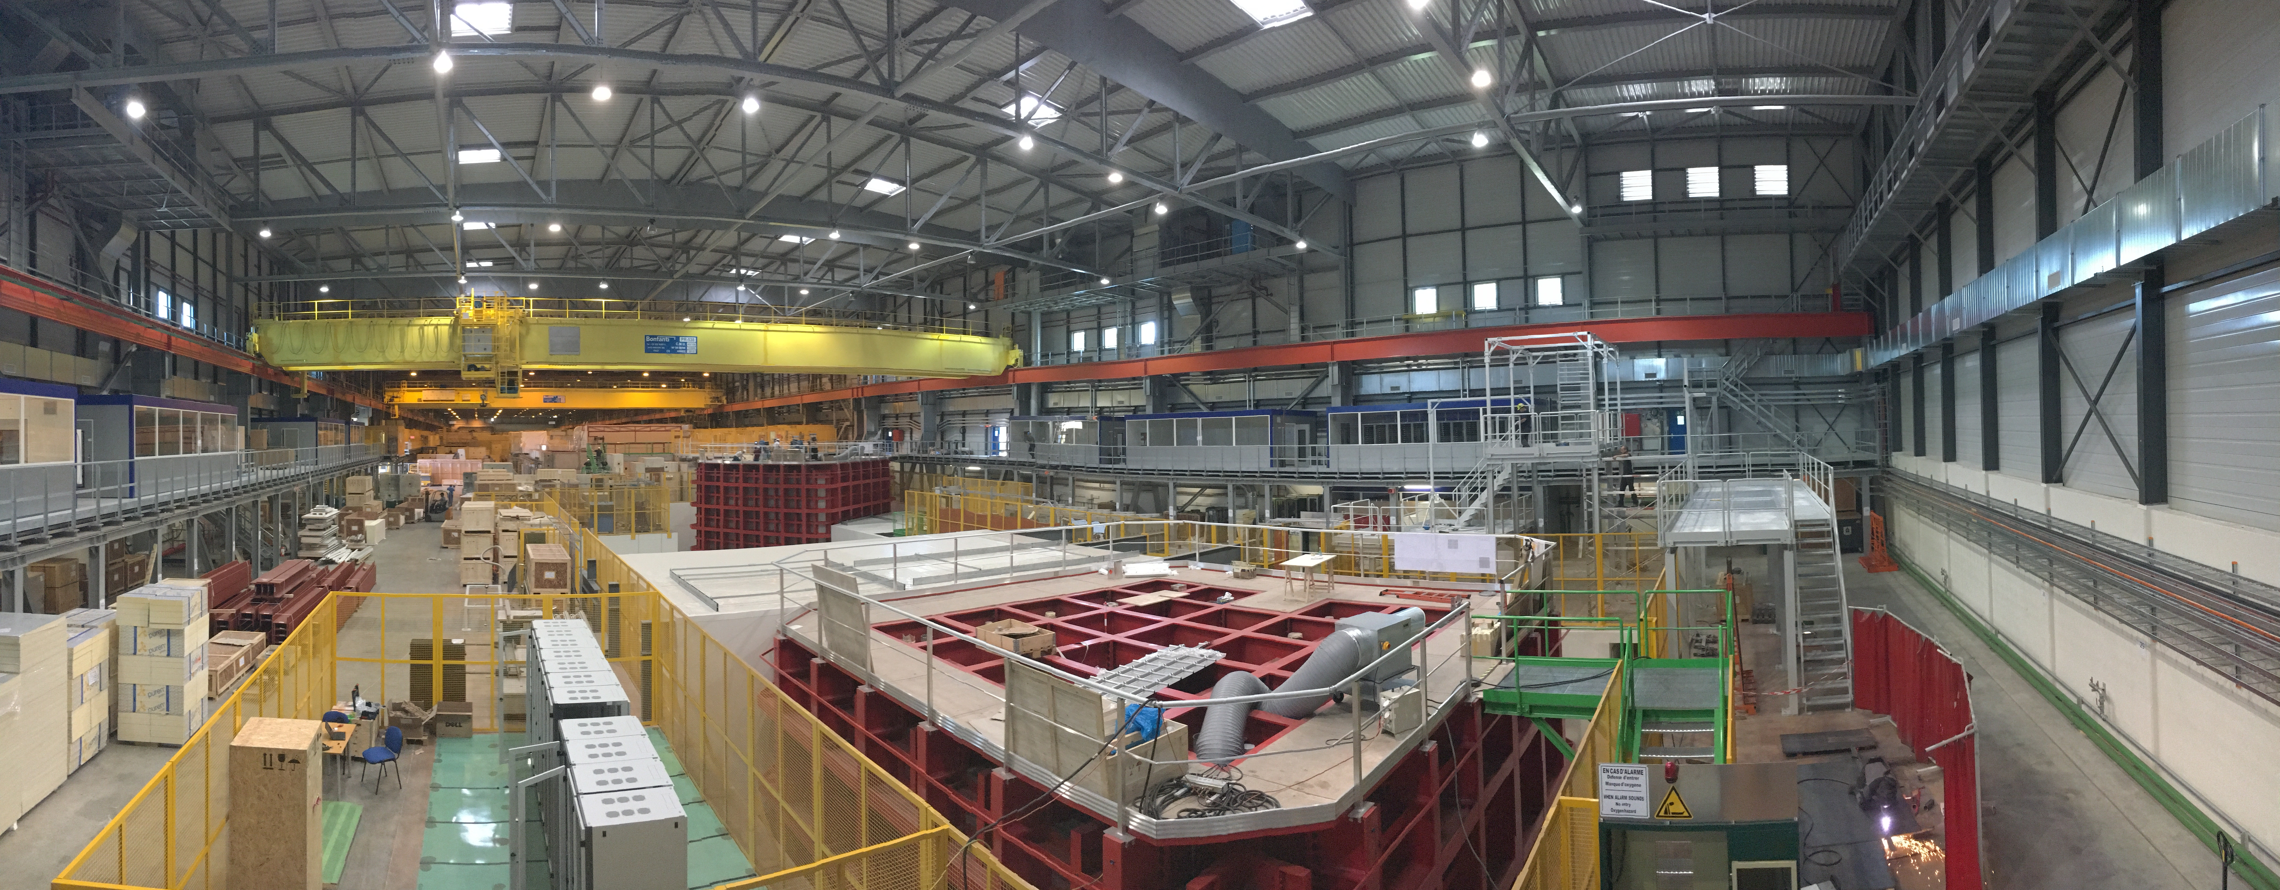
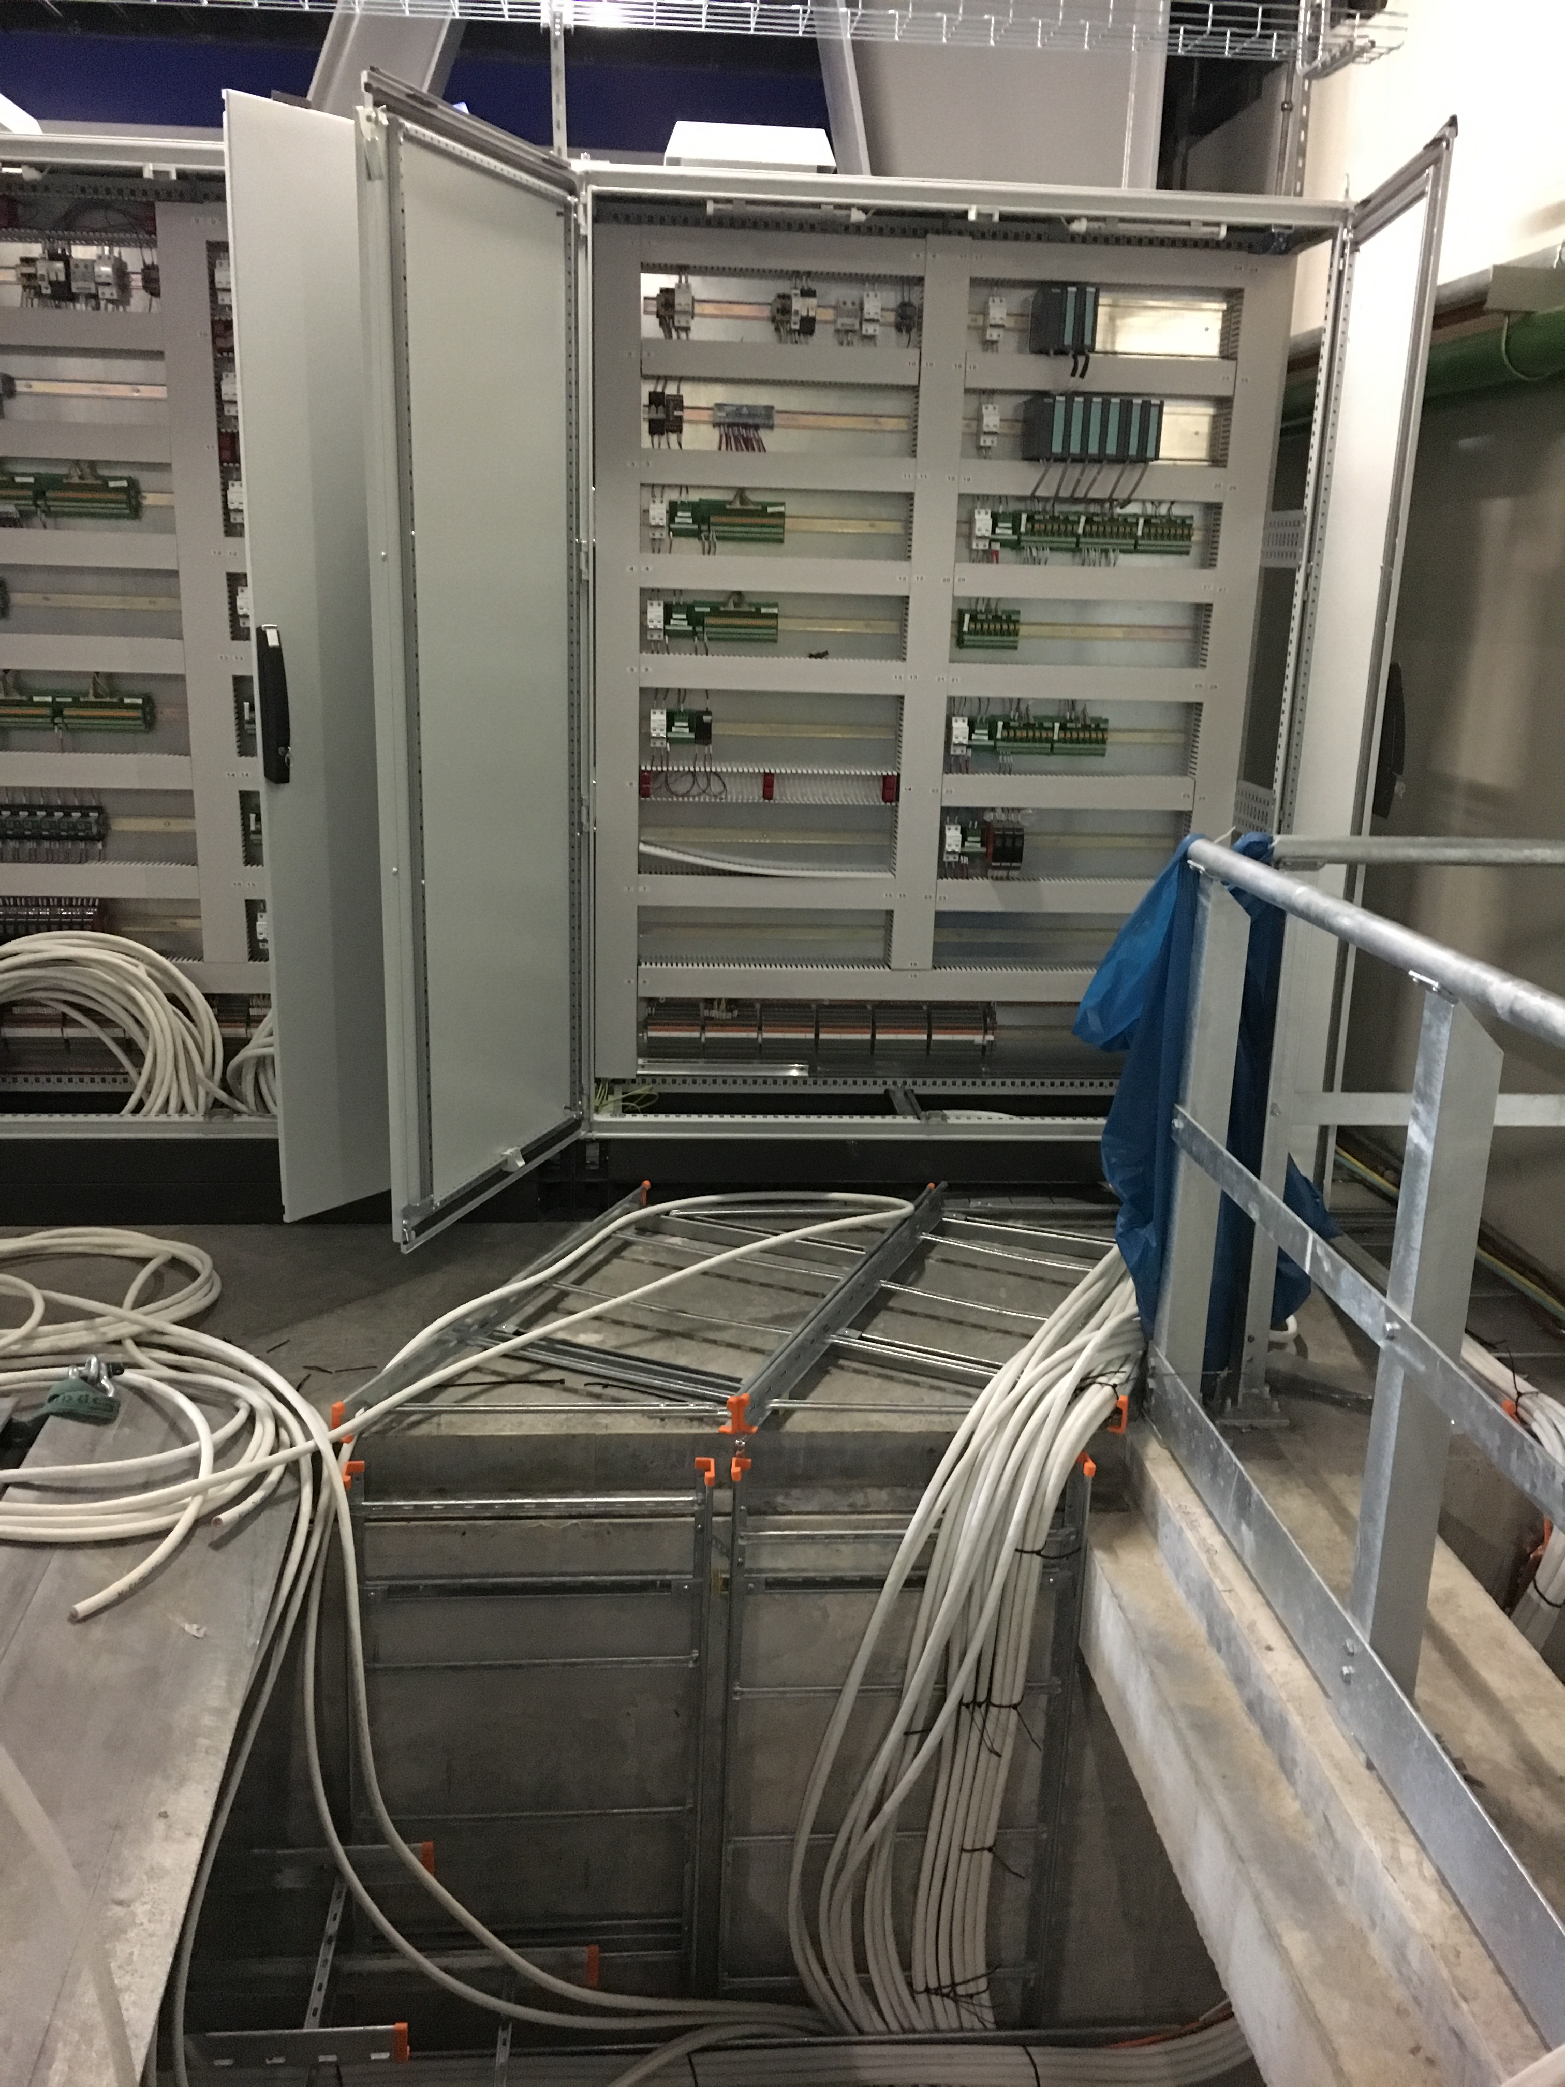
Present status
Cryo control racks
Cryogenic platforms ProtoDUNE

Slide 14
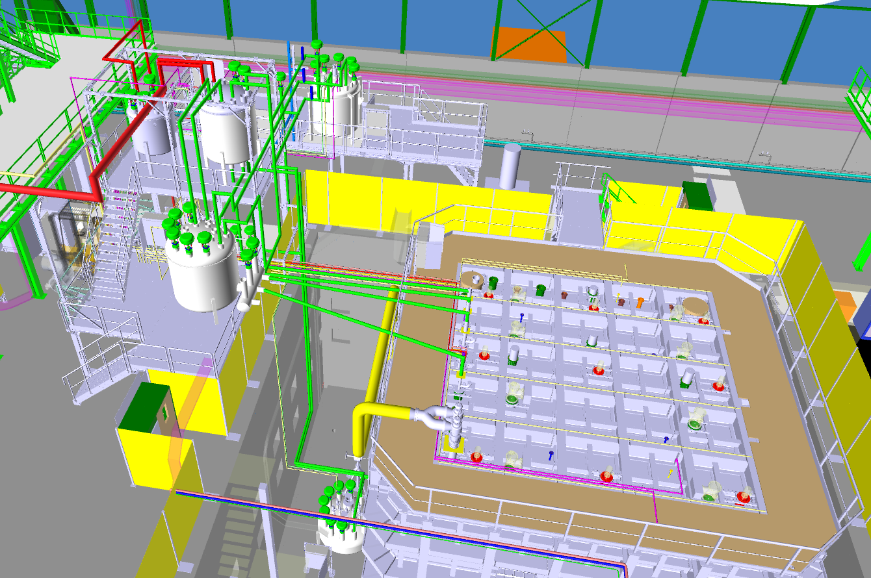
Cryogenic system in near future inside
Delivery cryogenic hardware from beginning of 02/2018

Slide 15
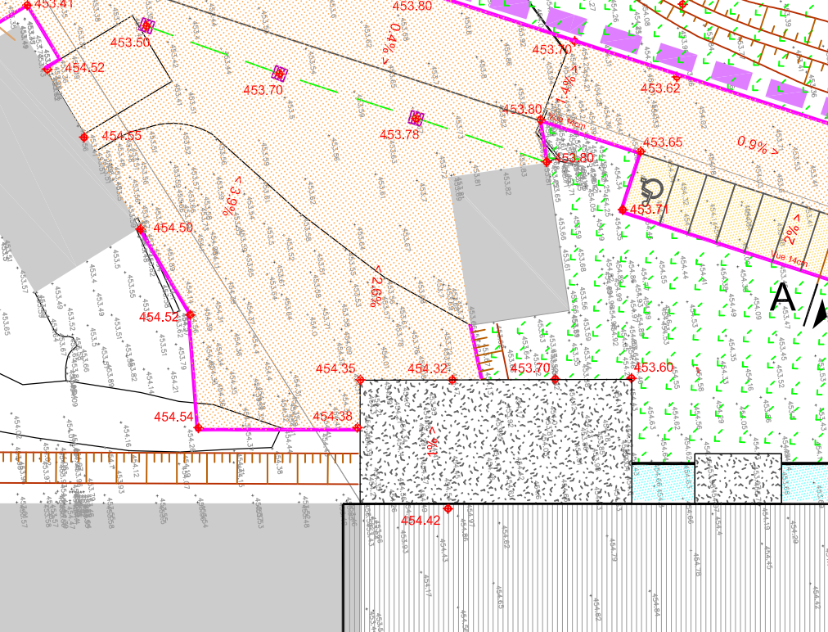
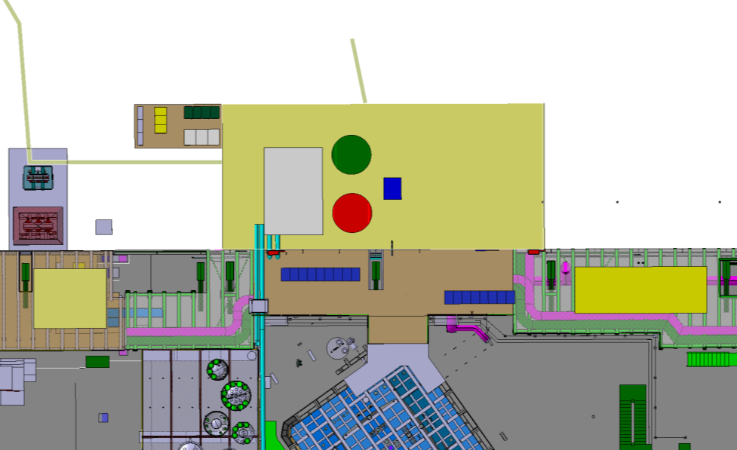
Cryogenic system in near future inside
EHN1 EXTERNAL CRYOGENICS
ELEMENTS
Purifier regeneration station
Cryo Tank 50[m3]
Cryo Tank 11[m3]
9.5m
Warm Panel
WALKWAY
Ar Vaporizer
LN2
LAr
LAr
H₂ Bottle Rack
7m
Mech Filter Cryo
Mixer
Field Boxes
emergency door
LAr cryolines
LN2 cryolines
Warm lines

