Slide 2
Assembly and Test Activities for the Cryogenic System of DarkSide-20k at CERN
CERN Cryolab Infrastructure
T. Koettig, L. Mapelli, J. Bremer

Slide 3
Content
Requirements for the cryogenic system
Upgraded supply systems
LN₂ transfer line to building 159

Slide 4
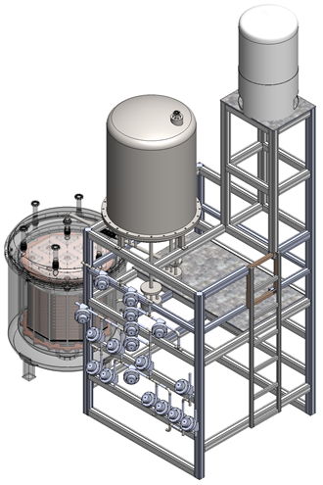
Requirements
Assembly and test activities for the cryogenic system of DarkSide-20k at CERN Cryolab.
Table 1 Consumables for the commissioning and tests
Fluids | Quantities
LN₂ during cool down | 100 l/hr or 80 kg/hr
LN₂ during normal operation | 20 l/hr or 16 kg/hr
LAr (max level of impurity will be apecified) | 2 t
Compressed air | Small consumption operating valves
4 m
Electrical power | 20 kW
Crane Fork Lift | 250 kg 1 ton
5 m
4 m

Slide 5
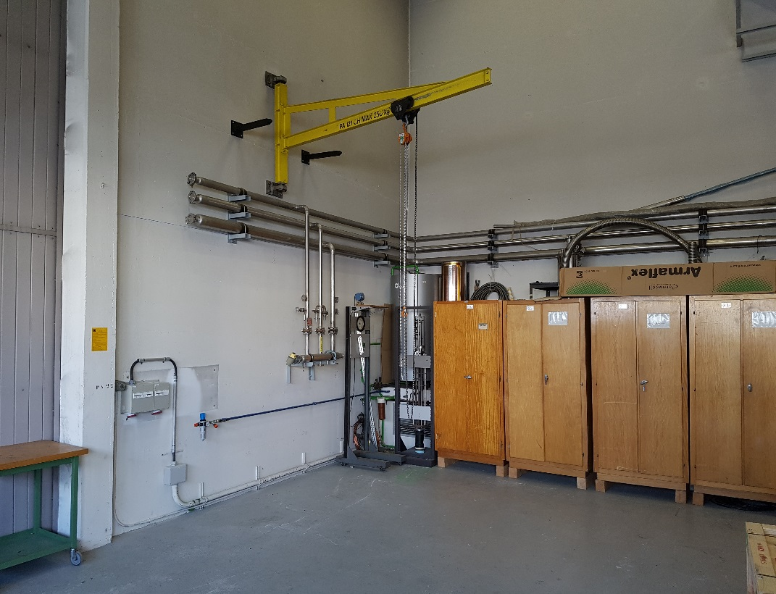
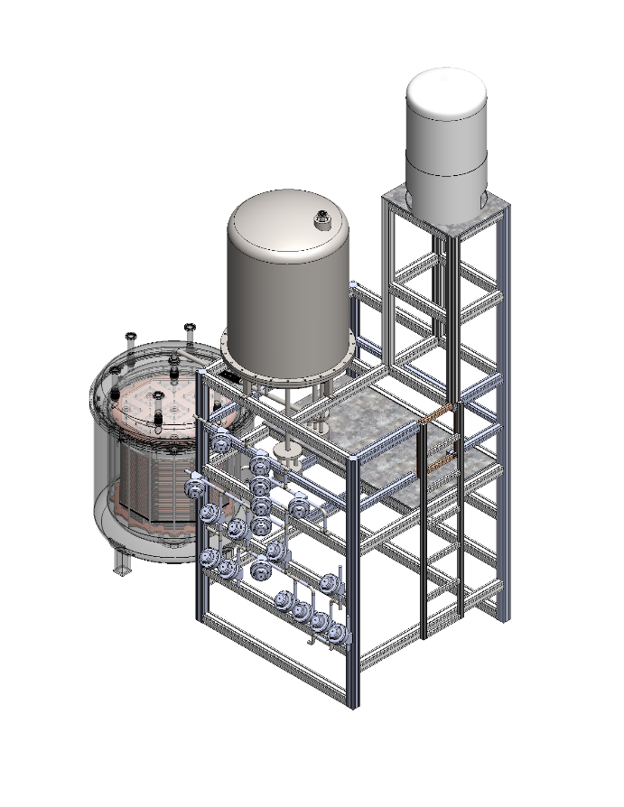
Infrastructure already upgraded or in place
Experimental space of 4 x 5 m² with 4 m height
Upgrade of the electrical supply and pressurized air 6 barg
Network and wifi connection
Crane capabilities in the area 250 kg (maybe need an increase in height 3.5 m => 4.5 m)

Slide 6
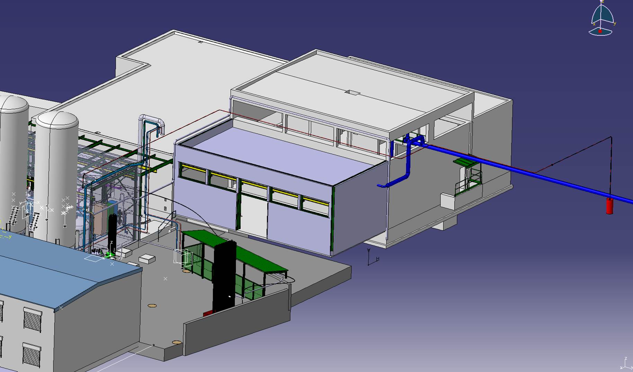
Routing of the new to be installed LN₂ transfer line
Cryolab 165
Phase
separator
Buffer
600 l

Slide 7
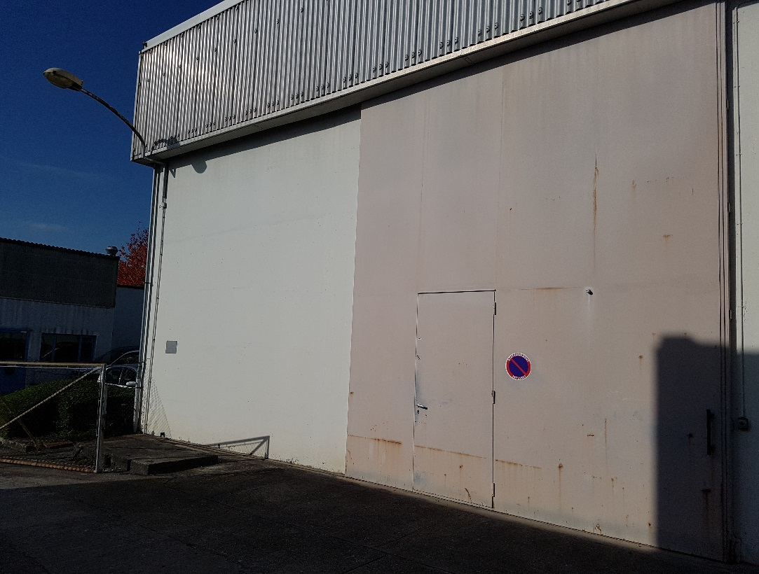
Routing of the new to be installed LN₂ transfer line
LN₂ tank
DS 20k experimental space
in Bldg. 159
Cryolab 165
VB
Buffer
500 l
Phase
separator
Buffer
500 l

Slide 8
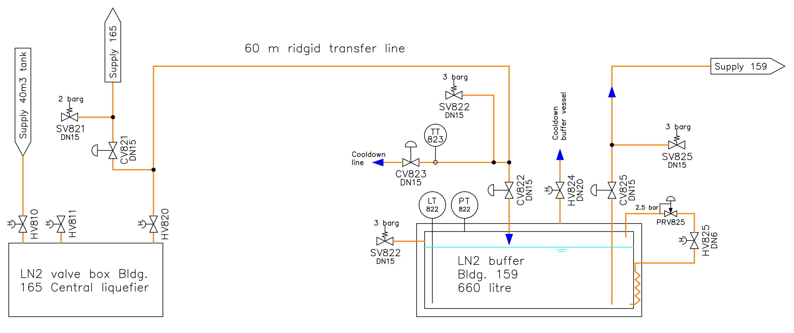
PID of the new to be installed LN₂ transfer line

Slide 9
Conclusions
Experimental space is ready
Supply of electricity, pressurized air ready
LAr can be purchased via CERN gas group
LN₂ transfer line is under study, price inquiry started
Thank you for your attention

