Slide 1
DarkSide-20k Cryogenics
Assembly and test activities at CERN
Livio Mapelli – Torsten Koettig

Slide 2
Preamble - DarkSide-Proto
Complete DS-Proto Program in 3 phases:
Assembly, test validation of cryo system of DS-20k
Characterization of reduced-size cryostat (1 ton)
Test of TPCwith photodetectors equipped with SiPMs
Becomes the facility to test, characterize and validate components of DAQ and R/O.

Slide 3
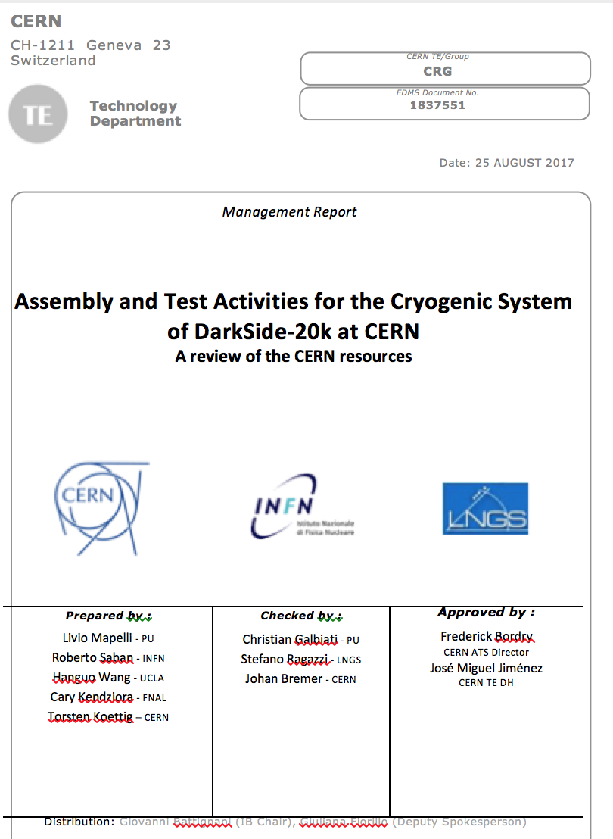
An Agreement CERN-TE / DarkSide
CERN support phase 1, i.e. validation of cryogenic system.
Support includes participation to
reviews
assembly,
verification, commissioning
tests

Slide 4
Cryogenic test at CERN
The test at CERN will consist of
Assembly and commissioning of the cryogenics plant
Acceptance test to validate the plant for operation with DarkSide-20k
Measurements of performance
This will take place during one year starting Q2 2018

Slide 5
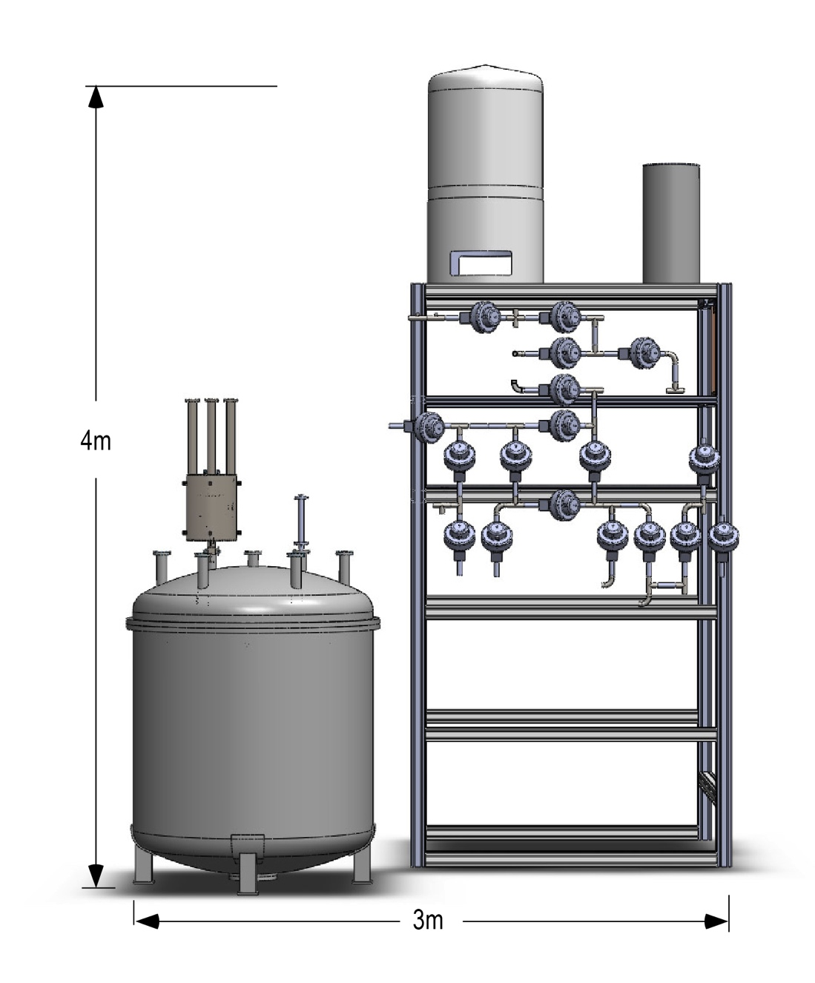
1. Assembly
Compenent from US delivered to site + integrated - Q2 2018
New upgraded argon condenser
Heat exchanger
Heat recovery system
Functionality and stability of controls
System safety during power failure
500 std L/min gas pump & flow rate

Slide 6
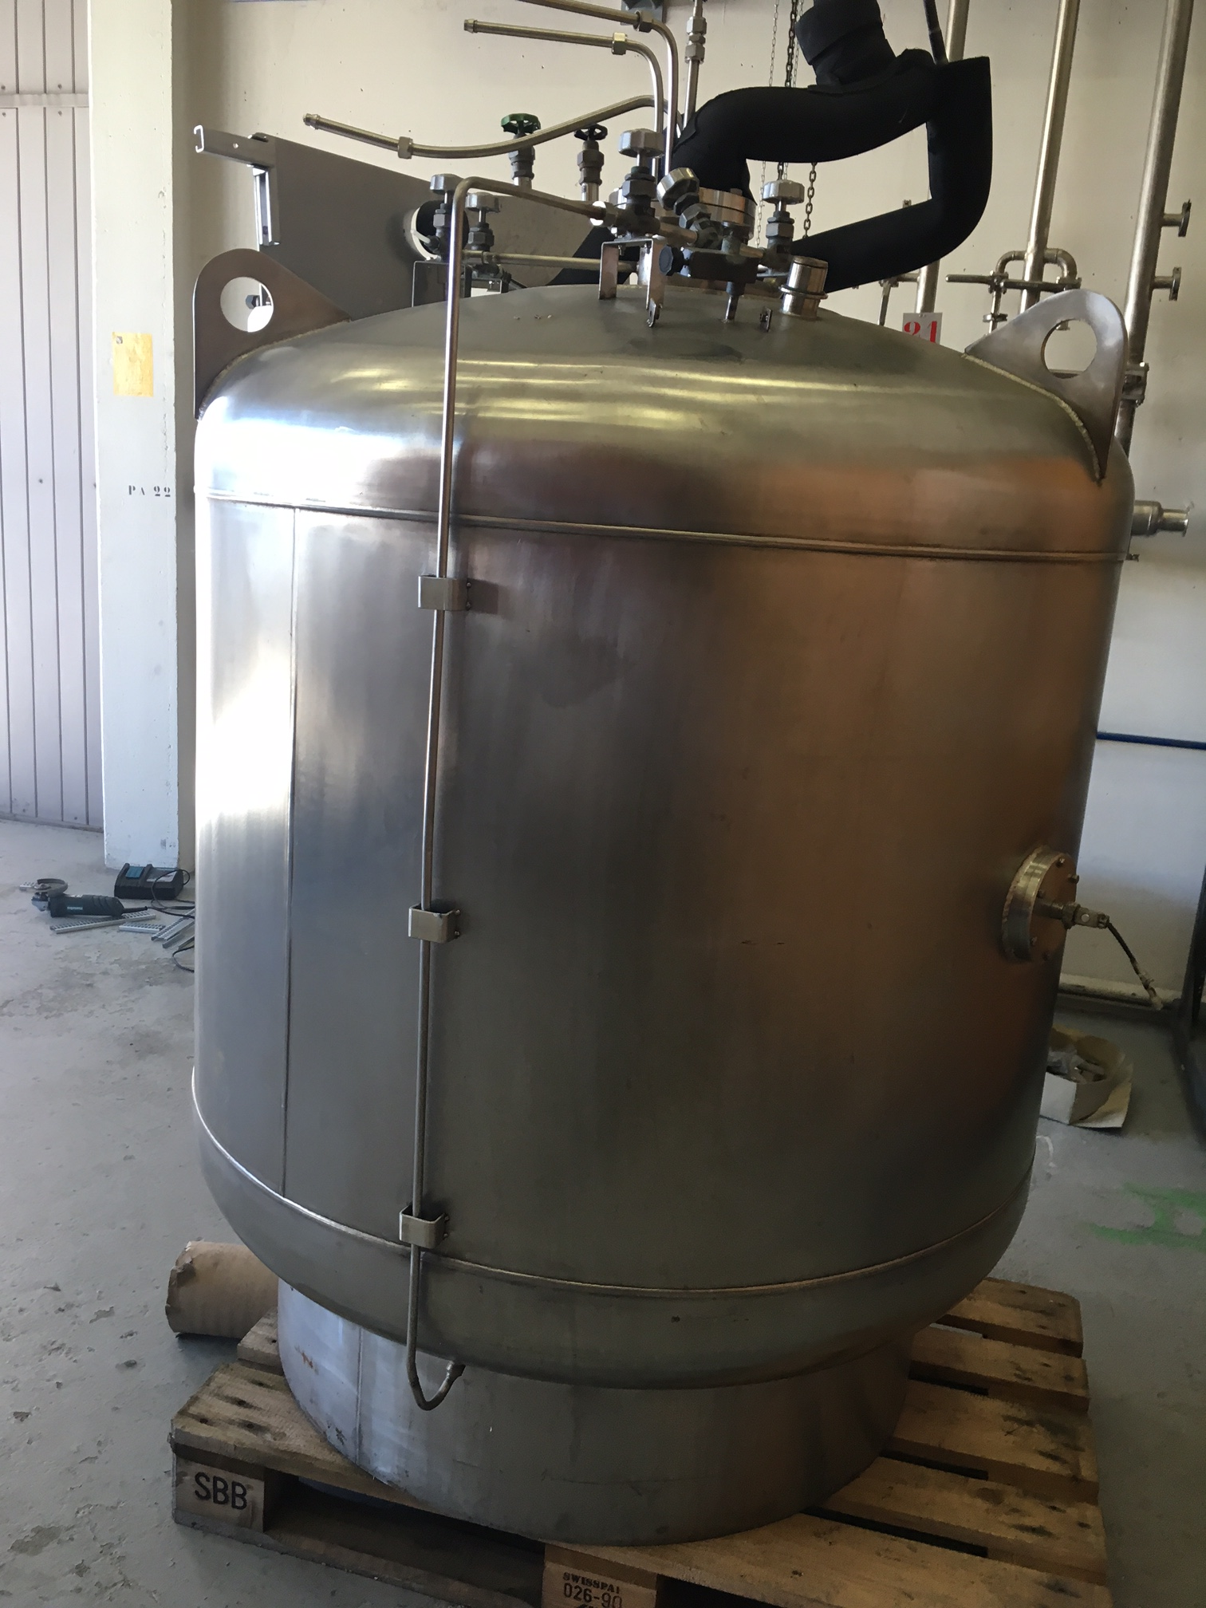
2. Acceptance tests
Validation of the plant with a dummy load - Q3 2018
Pressure test
Leak test
Maximum liquefaction speed (cooling power)
Maximum circulation speed
Long-term stability test at normal circulation speed (200 slm)
Pressure and temperature stability during maximum and normal operation mode
Safety test: system should be safe during total power shutdown.
dummy
cryostat

Slide 7
2. Acceptance tests - plan B
1-ton cryostat prototype - Q3 2018
Pressure test
Leak test
Maximum liquefaction speed (cooling power)
Maximum circulation speed
Long-term stability test at normal circulation speed (200 slm)
Pressure and temperature stability during maximum and normal operation mode
Safety test: system should be safe during total power shutdown.

Slide 8
3. Performance measurements
1-ton cryostat ready - Q4 18 / Q1 19
Key performance required is the stability of the pressure in the detector gas phase
i.e. pressure stability must be within 0.1 psi during a range of operating conditions
Heat exchanger system overall efficiency
should be better than 90%
Circulation speed dependence and optimization with operating pressure in detector gas phase.

Slide 9
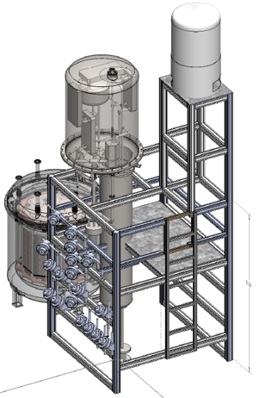
Following steps
TPC prototype - Q1 - Q2 2019
...
The installation, validation and characterization of the DarkSide20k cryo system will also serve as the first step of the DarkSide 1-ton Prototype project.
It will include the 1-ton Proto-cryostat
Should the Proto-TPC become ready, it could be fitted, with previous agreement of TE DH and compatibly with overall project schedule.

