Slide 1
Geneva, 27 October 2017
DarkSide-50
Distributed Control System
Towards DarkSide-20k
Paolo Cavalcante

Slide 2
Introduction
DARKSIDE-50 DISTRIBUTED CONTROL SYSTEM (DCS):
System that provides a real-time monitoring and controlling for different hardware and system:
Photomultipliers
  Time Projection Chamber
  Muon Veto and Neutron Veto
High High Voltage for electric field (Extraction field, Drift field)
Scalers (dark noise monitoring)
Cryogenic System
Radon Abatement System
Other auxiliaries facilities
DCS also provides:
Event and Data logging into a DataBase
Notification System

Slide 3
DCS Hardware
DarkSide50- DCS is based on NATIONAL INSTRUMENTS (NI) hardware and NI LABVIEW as programming language
1 Controller cRIO-9082
    Best performance from NI when purchased
  Controller CompactRIO Virtex-5 LX150 FPGA a 8 slot, 1.33 GHz CPU dual-core, 2 GB DRAM, 32 GB memory
3 Expansions chassis 9148
  To increase the numbers of channels
  Chassis CompactRIO Ethernet , 8-Slot, Spartan-3 FPGA

Slide 4
DCS Considerations
Ability to support different equipment , interface and protocols
  Supports RS232,RS485, 4-20mA current loop,
analog, digital input/output (I/O) etc.
  Supports potocols such as modbus, fieldbus, profibus, GBIB, OPC etc..
Easy of expansion over the network
  Daisy chain
Prompt real time/deterministic control
  To monitor and control
  For safety management
Easy to integrate with heterogeneity of software
  Allow to communicate with other appliccations such as local SQL database,DAQ etc..

Slide 5
SCS Architecture
Multi-layered distributed architecture: this allows to integrate many services communicating with different devices and hardware:
Presentation layer
  shifters tools (labVIEW Human-Machine Interface -HMI)
Logic Layer
  Compact-RIO Controller services
  Services deployed on network node
Persistency Layer (Data Logging)
  Postgres Data Base

Slide 6
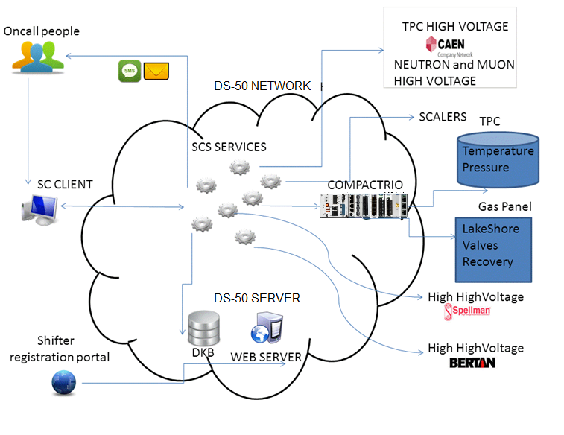
Darkside-50 DCS topology

Slide 7
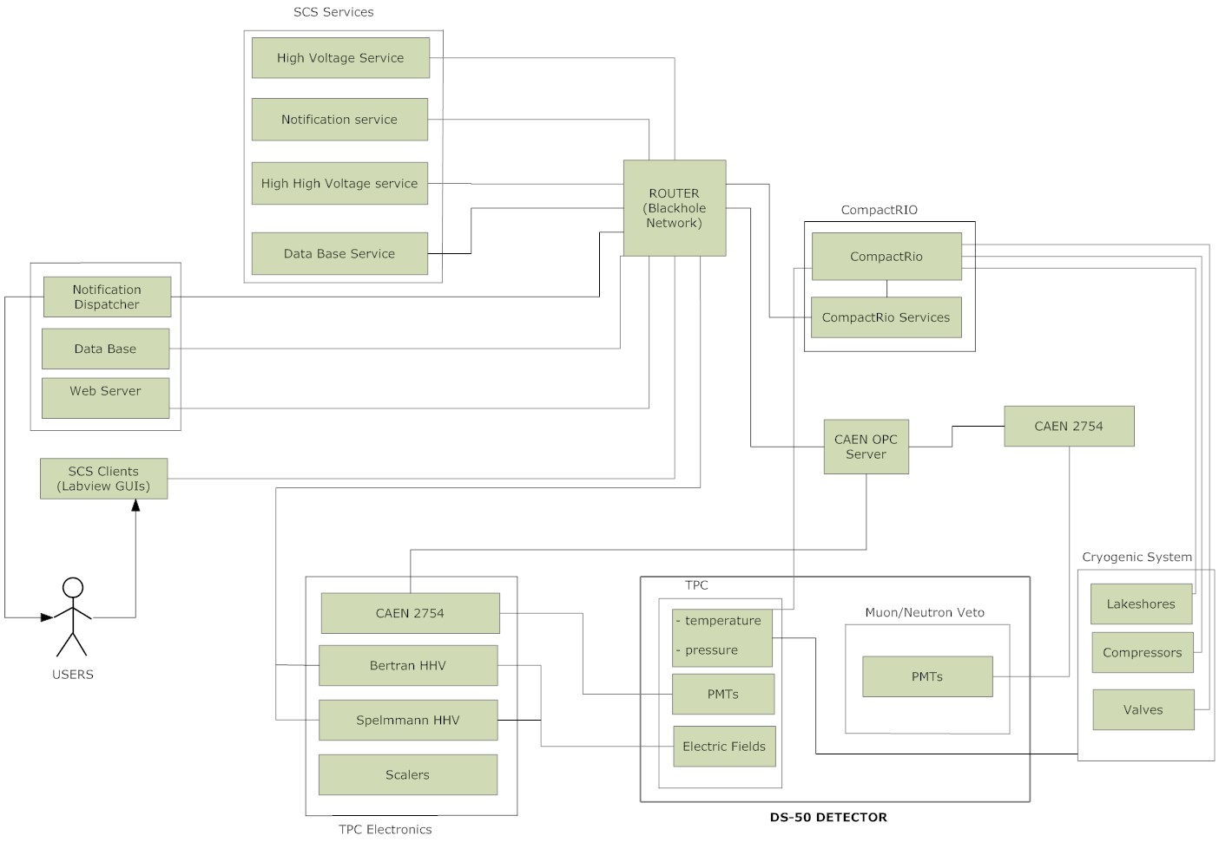
DS-50 SCC Communication

Slide 8
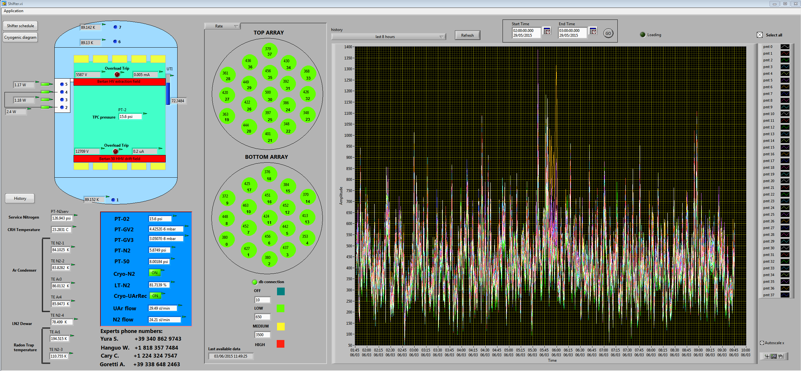
Shifters tools
Graphical User Interface for the monitoring of the most important process parameters

Slide 9
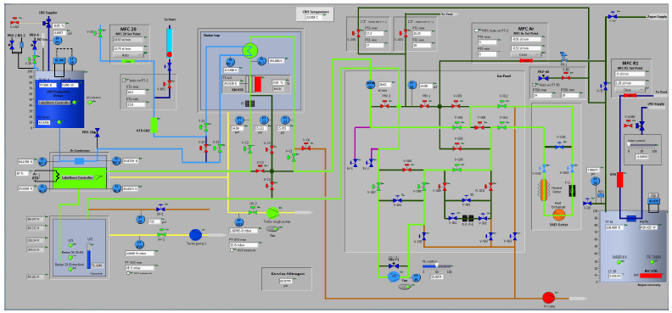
Shifters tools
Cryogenic System process monitor

Slide 10
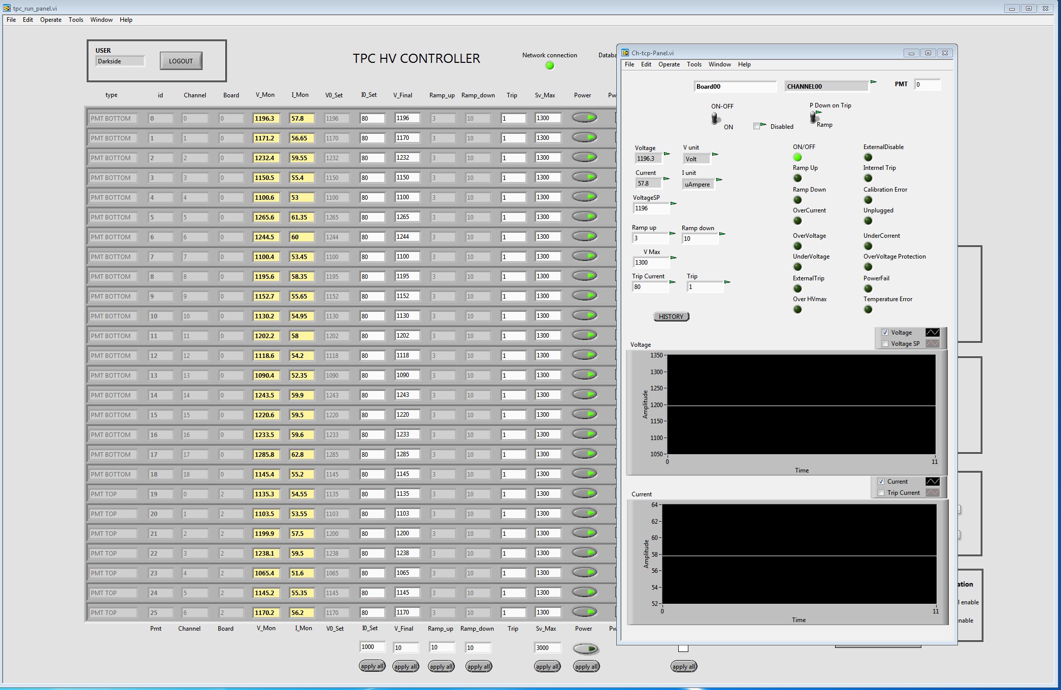
Shifters tools
TPC High Voltage monitor

Slide 11
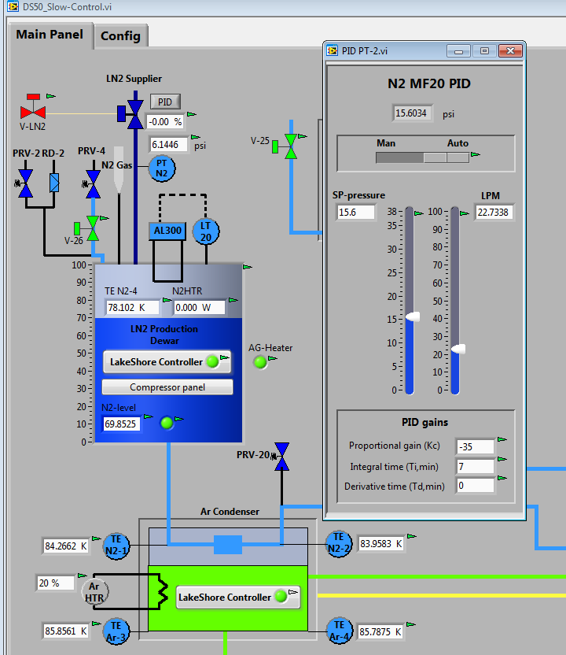
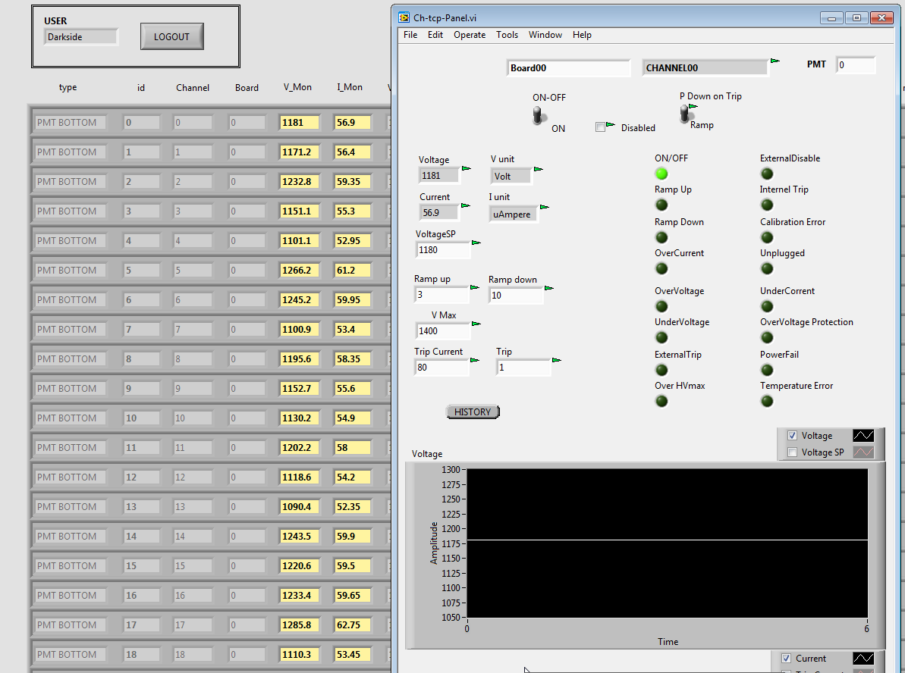
Advanced tools for Controlling
Cascade control, PID, ramp, set-point, etc.

Slide 12
From DS-50 Toward DS-20k
DS-20k Architecture similar to DS-50
Multi-layered distributed architecture
Adoption of the general structure of DS-50
  NI CompactRIO as real time controller
  NI Labview as development language
Many tools already implemented can be adapted to the new project.
Reuse the DS-50 system infrastructure
  Deeply tested since 2014
  Proven Technology
  Efficient measurament
  Easy to integrate with external software

Slide 13
From DarkSide-50 SCS to DarkSide-20k SCS
Distributed Control System for around 300 channels
Instrumentation list is under developing (from last P&D)
Most of the hardware components have been defined
Controller cRIO-9039 Controller CompactRIO
  1.91 GHz Quad-Core, 8-Slot, Kintex-7 325T FPGA
  Order ongoing in INFN Rome
  It will be used for the Proto Cryogenics tests at CERN
  Problably reused for the final System
n.3 expansion chassis NI-9148
n.2 GPIB-ENET/1000
n.32 modules (analog IO, digital IO, relay, 4-20 mA, RTD, thermocouple, RS485, RS232 etc.)

Slide 14
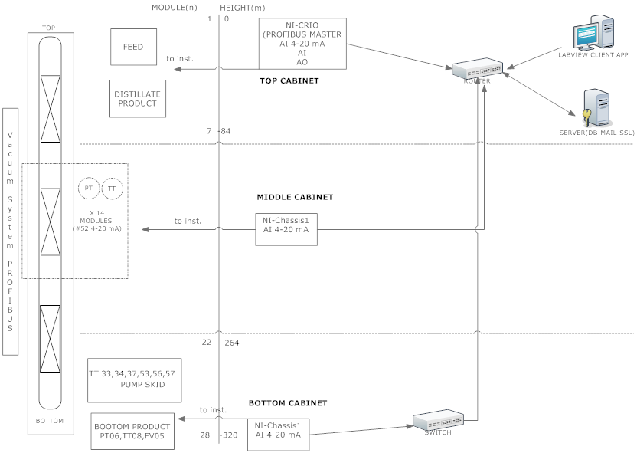
Aria Slow Control topology

Slide 15
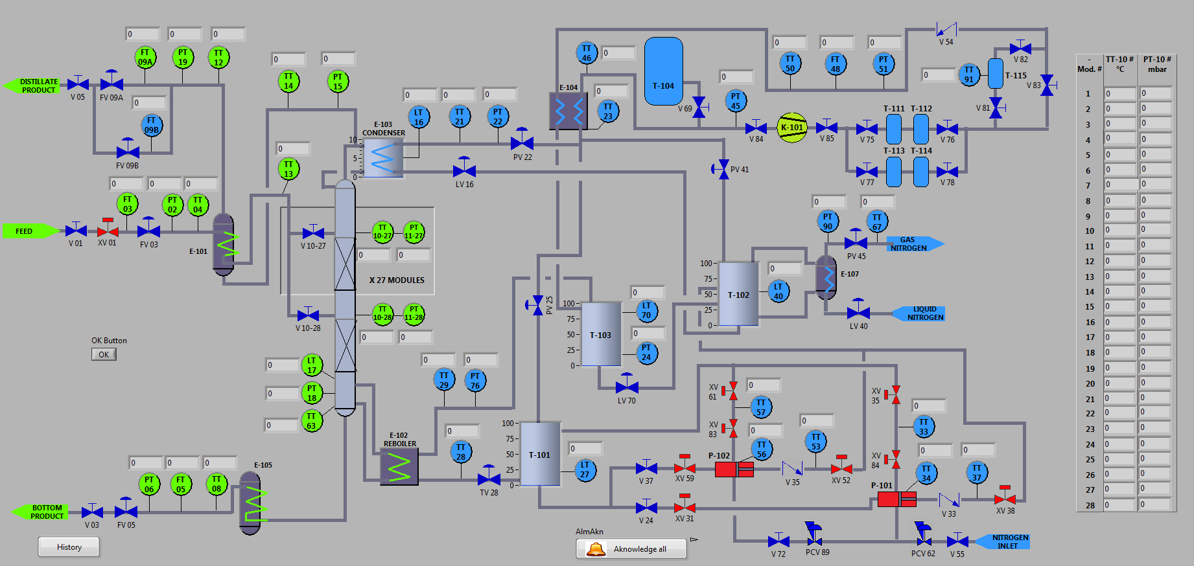
Aria Slow Control v0

Slide 16
Geneva, 27 October 2017
DarkSide-50
Distributed Control System
Towards DarkSide-20k
Paolo Cavalcante

