Slide 1
TISD activities in 2017/18
Sebastian ROTHE
EN-STI-RBS

Slide 2
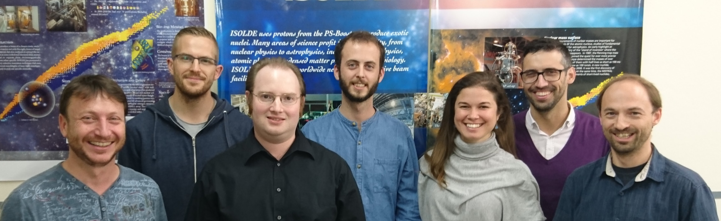
The Target and ion Source Development (TISD) team
T. Stora
D. Leimbach
J. Ballof
F. Boix Pamies
Y.Martinez
J.P.Ramos
S.Rothe
Providing a large choice of intense and pure radioactive beams
Constant development is required to keep ISOLDE at the forefront of RIB facilities

Slide 3
RILIS Team

Slide 4



ISBM working group
EN/STI
LP
EN/STI
RBS
Scheme
development
Target
development
Laser
development
R&D for
Ion Source &
Beam
Manipulation
(ISBM)
Target
construction
RILIS
operation
Target operation
Technical
coordination
of ISOLDE
Laser
spectroscopy
Ongoing development projects
LIST
Development of refractory metal beams
Ion source selectivity
FEBIAD optimization
VADLIS
Optical pumping in ISCOOL
ToFLIS
Negative ion beams
ISCOOL upgrades
Ion beam multiplexing
HRS upgrade
Fast beam gating

Slide 5
Target and ion Source Development (TISD) mandate
Providing a large choice of intense and pure radioactive beams
Constant development is required to keep ISOLDE at the forefront of RIB facilities
target and ion source units
target materials
beam interactions (p2n converter)
ion source design / mode of operation shared with ISBM group
yield & release study
ion source efficiency measurements
prototype tests
Sharing same resources as the ISOLDE physics program
WORKSHOP: target unit production
OFFLINE: target quality control
ISOLDE: beamtime

Slide 6
Expected TISD @ ISOLDE (presented to GUI February 2017)
Sc: Ti foils (CF4, RILIS)
Te: yields with RILIS
M(CO)x formation @ MEDICIS irradiation point
ThO felt + Negative ion source
LIEBE @ GPS-online
STAGISO beam test
Si from UCx
TiC-CNT (pending safety clearance)

Slide 7
Expected TISD @ ISOLDE (presented February 2017)
Sc: Ti foils (CF4, RILIS)
Te: yields with RILIS
M(CO)x formation @ MEDICIS irradiation point
ThO felt + Negative ion source
LIEBE @ GPS-online
STAGISO beam test
Si from UCx
TiC-CNT (pending safety clearance)
DONE
DONE
ongoing
ongoing
ongoing
DONE
ongoing
pending

Slide 8
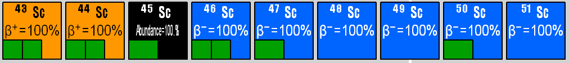
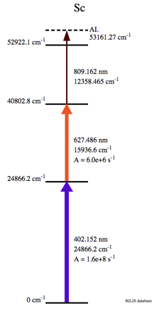
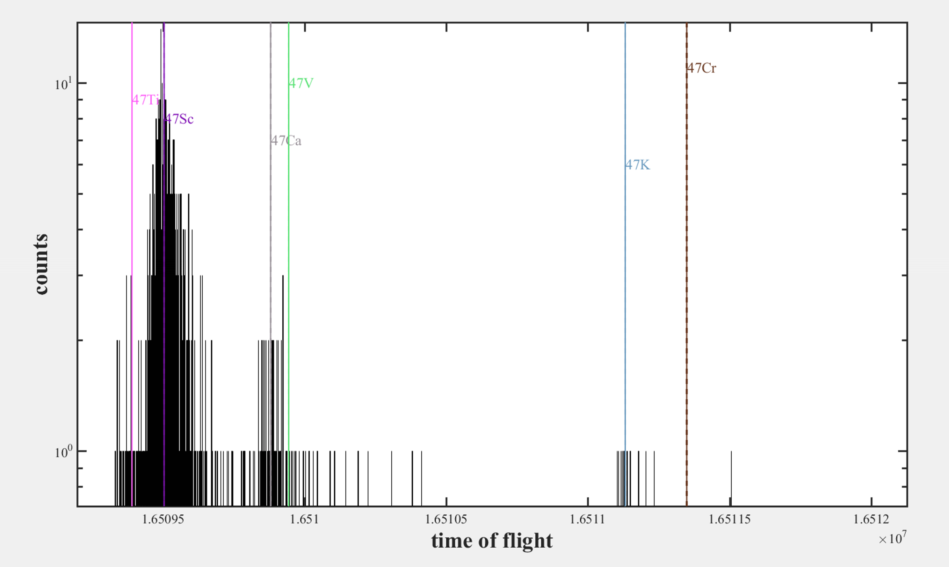
Scandium beams
Target: #565 Ta Ta
 | 43 | 44 | 45 | 46 | 47 | 48 | 49 | 50 | 51
FC |  |  |  | 1.5E+07 | 1.2E+07 | 8.1E+06 | 7.3E+05
betas |  |  |  |  |  |  | 7.6E+05 | 1.8E+04
MR-TOF |  |  |  | 2.3E+06 | 1.6E+06 | 1.2E+06 | 7.4E+05 | 1.3E+04
Extrap. | 3.6E+05 | 1.2E+06 |  |  |  |  |  |  | 1E+02
ISOLTRAP
MT-ToF spectrum
Mass scan (FC.558)

Slide 9
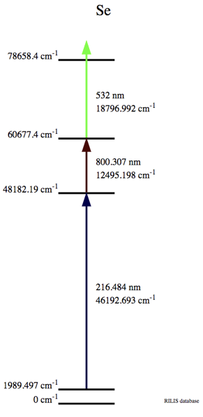
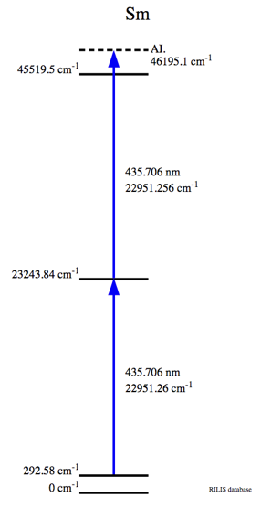
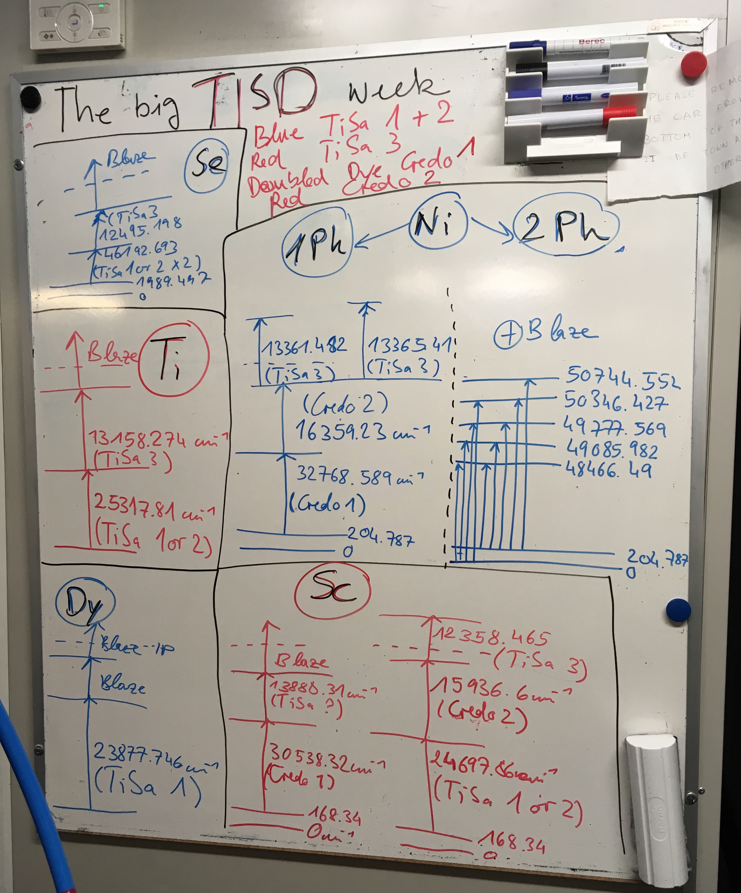
5 RILIS elements in one week: new record!
Titanium
Selenium
Tested
on-line
But further beam development
needed
Scandium
Dysprosium
Scandium
Selenium
Samarium
Convenient
efficient
one-laser
2-step scheme
Dysprosium
Nickel
B.Marsh

Slide 10
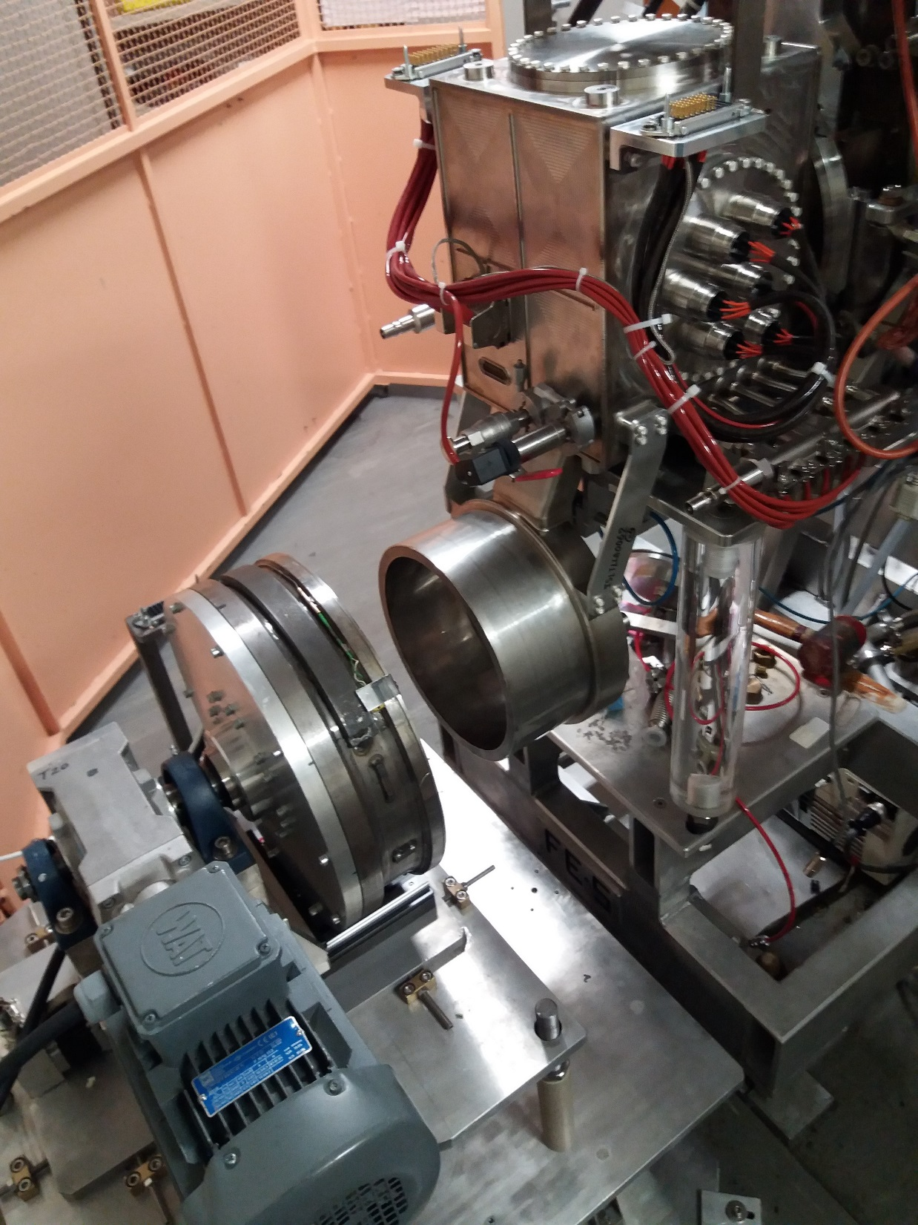


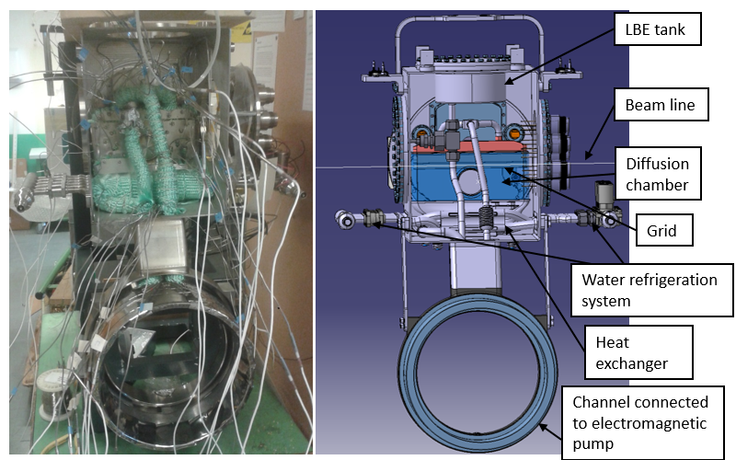
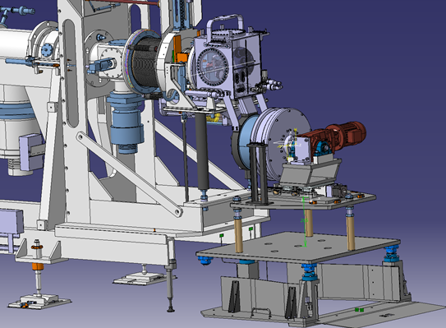
The LIEBE target – Assembled
LIEBE fully assembled and coupled to offline 1
LIEBE loop before enclosement.
F. Boix Pamies

Slide 11
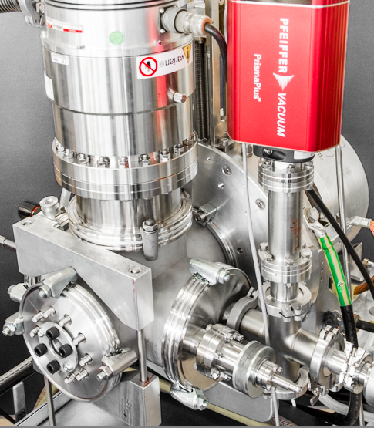
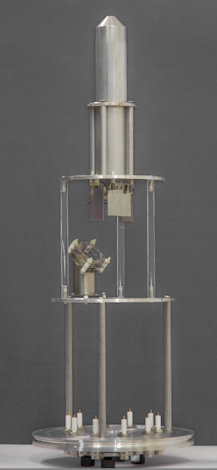
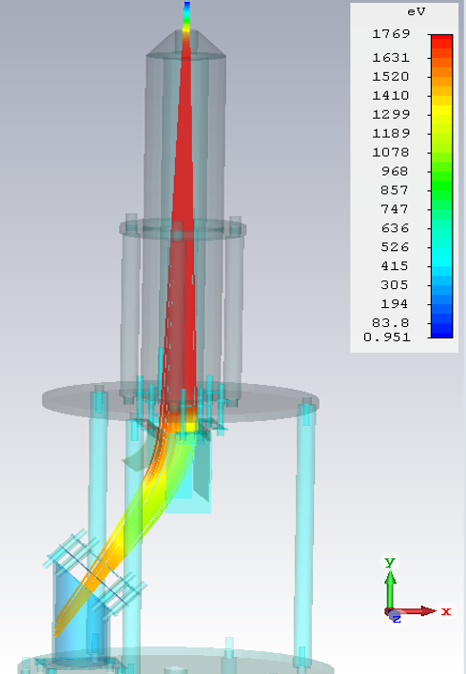
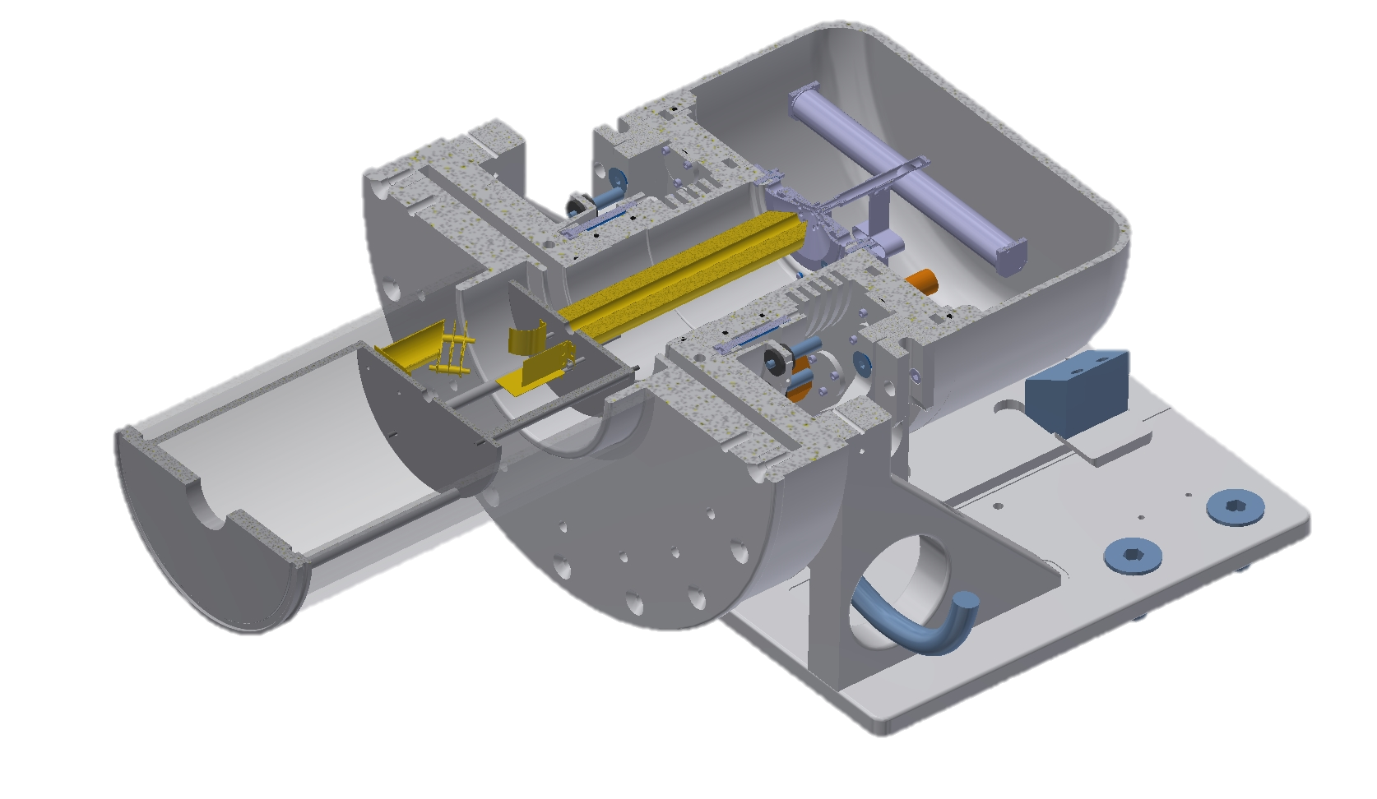
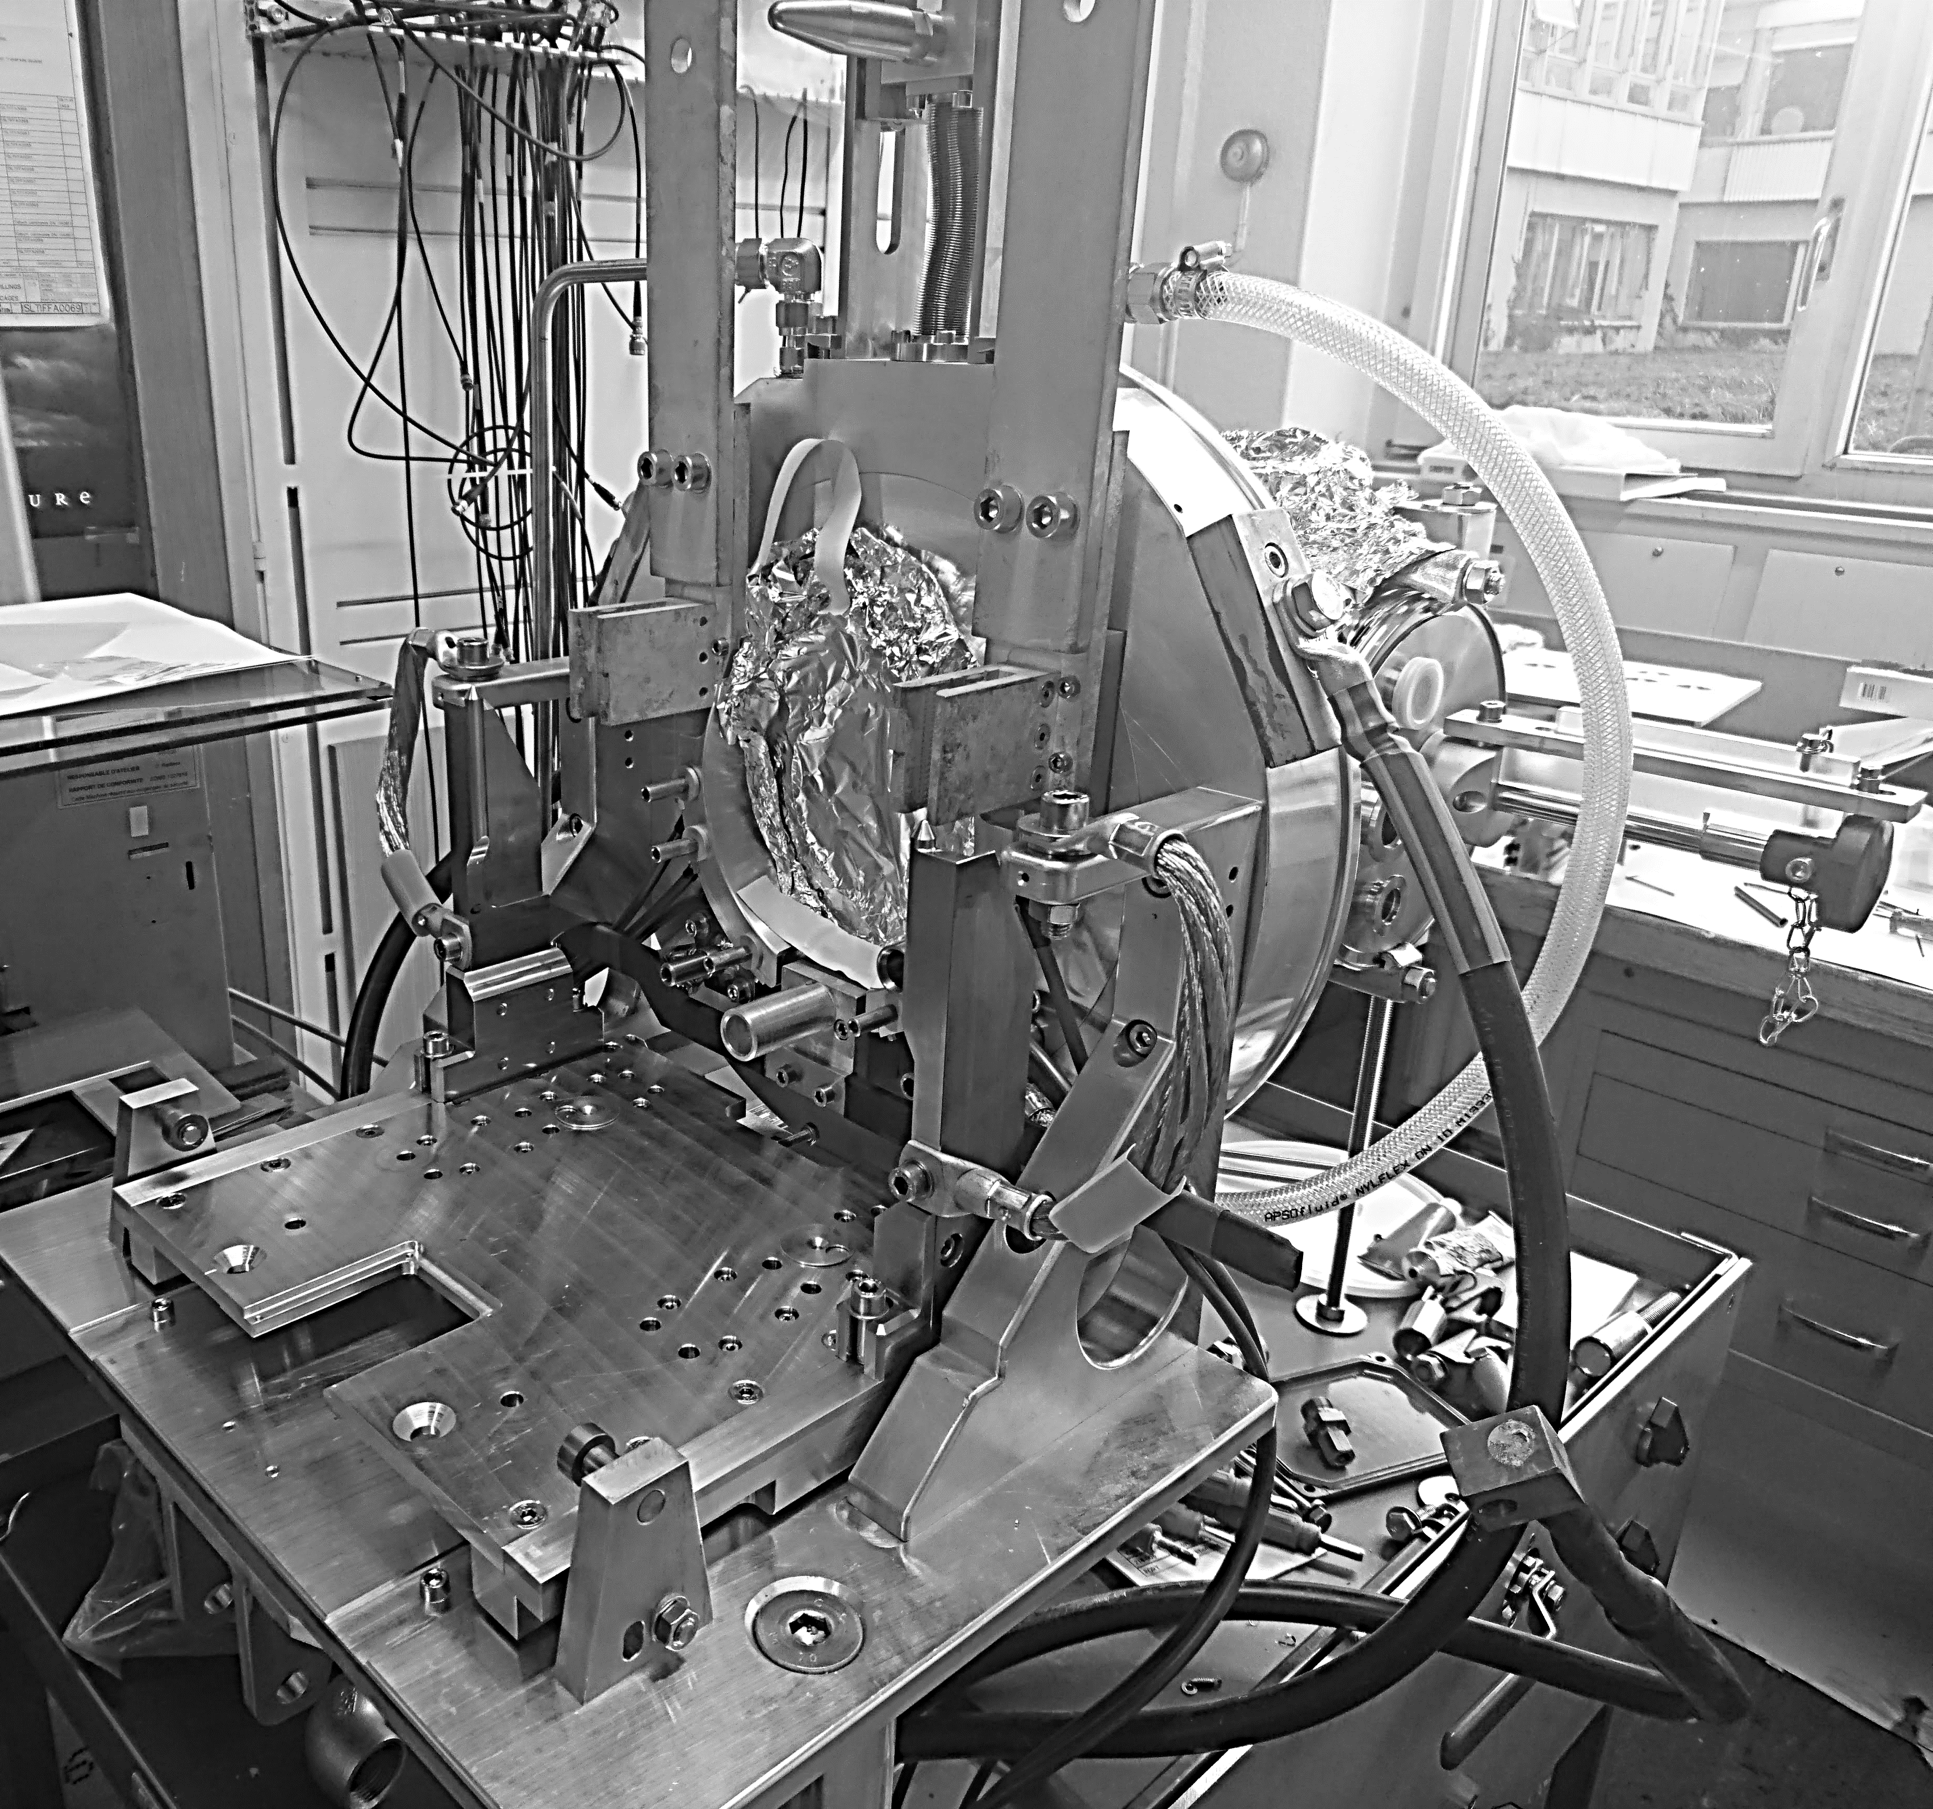
Dedicated test stand for ion source development
Main features:
ion beam extraction and detection
residual gas analyzer (RGA)
automated control and data recording (LabVIEW)
First application:
negative ion source development
investigation of source poisoning and regeneration
Future plans:
long-term performance studies
thermal stress tests
destructive tests
  operational limits
  failure mode analysis
ISOLDE calibration stand
D.Leimbach
integration

Slide 12
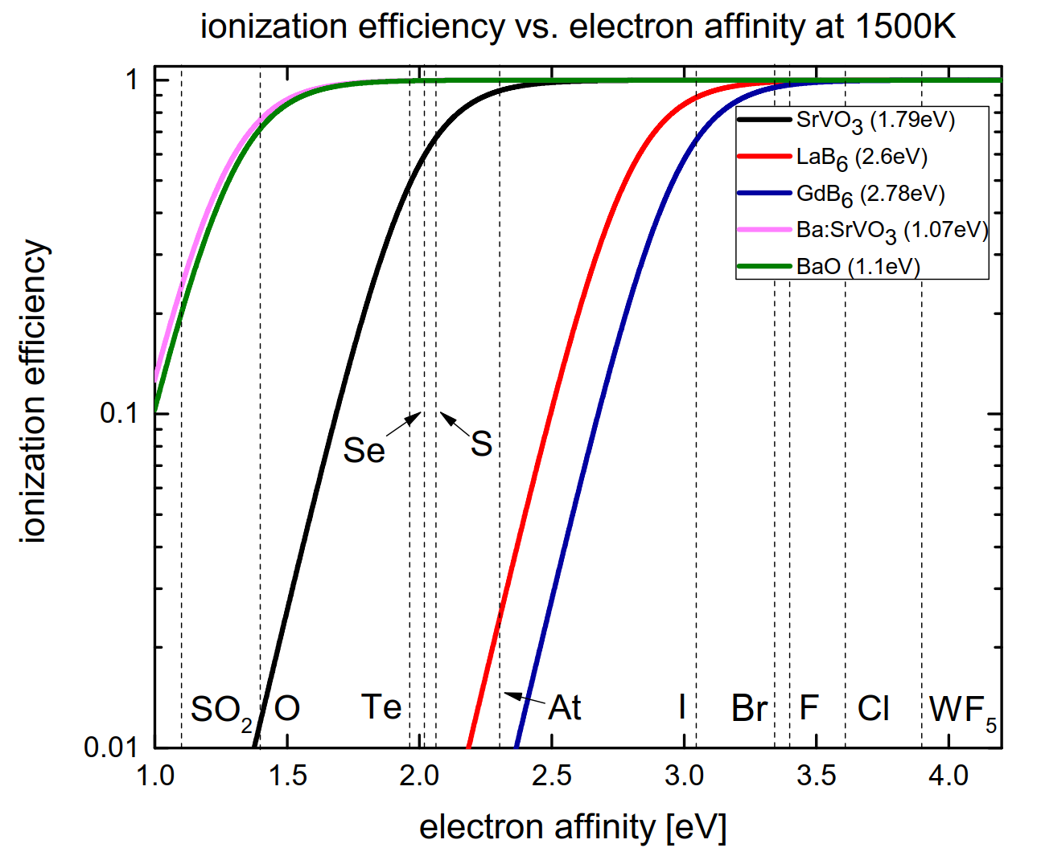
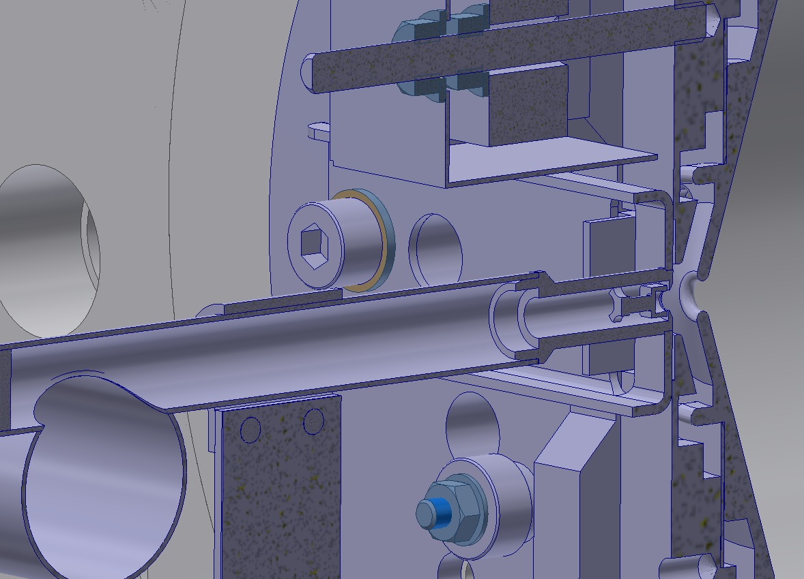
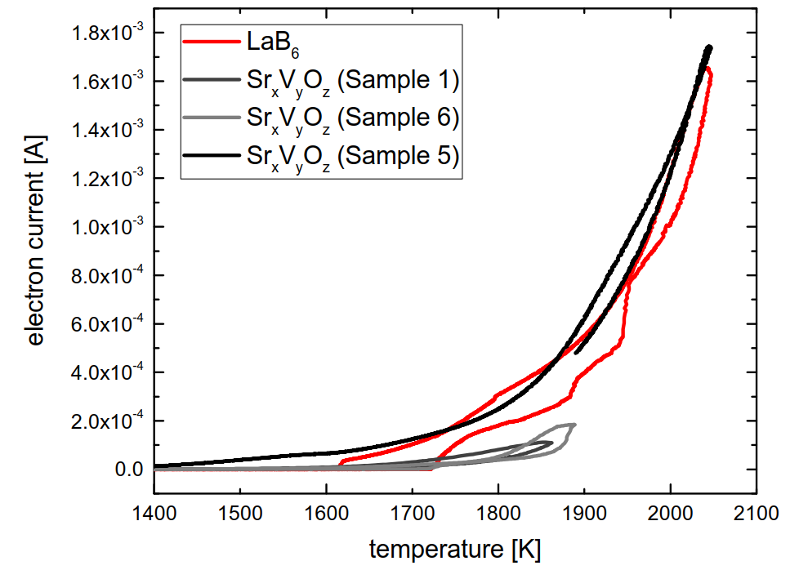
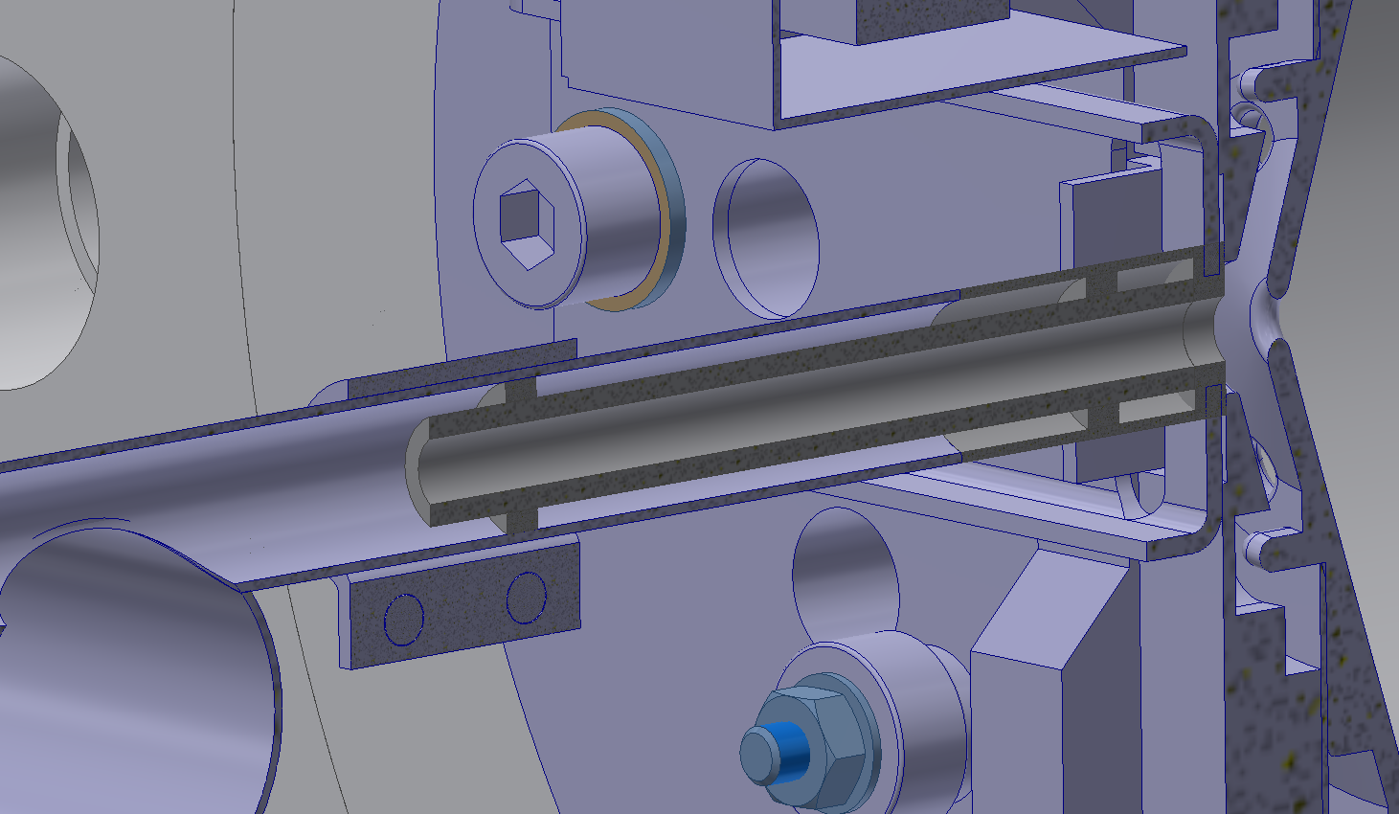
Low work function materials for negative ion production
MK4 – Pellet source
Improvement of ionization efficiency:
Elements with low affinities are not efficiently ionized by LaB₆
New compounds needed:
  SrVO₃ with expected work function <2eV
First steps:
Production of suitable candidates
Electron emission tests with LaB₆ as benchmark
Performance studies
Next steps:
Compare geometries offline
Tubular low workfunction cavity
D.Leimbach

Slide 13
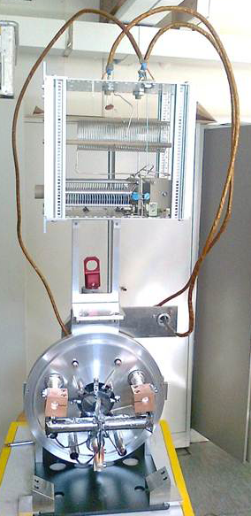
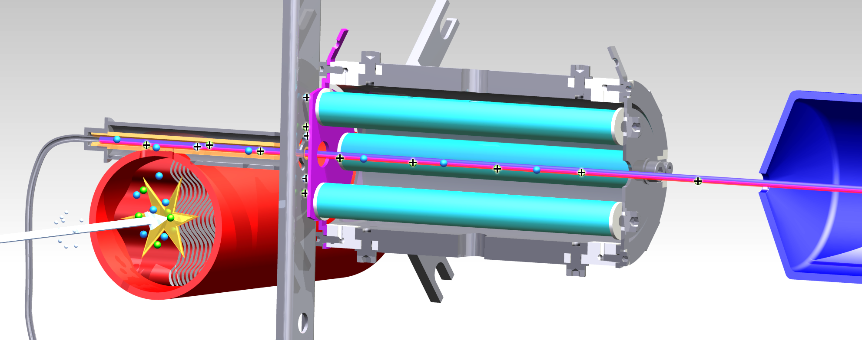



LIST
HFS studies of polonium / supression of francium (IS456, September 2012)
90 mm
Isobaric suppression > 1000, efficiency loss ≈ 50
Proton
beam
On-line implementation and first operation of the Laser Ion Source and Trap at ISOLDE/CERN, D. Fink et al., NIMB 344, 83-95 (2015)
In-Source Laser Spectroscopy with the Laser Ion Source and Trap: First Direct Study of the Ground-State Properties ^{217,219}Po, D. Fink et al., PRX 5, 011018 (2015)
R.Heinke

Slide 14
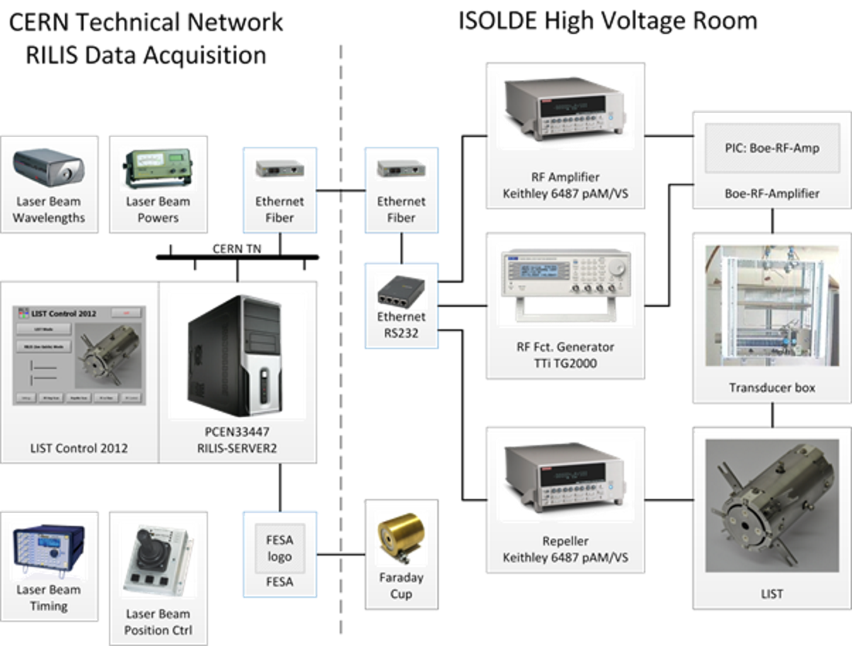
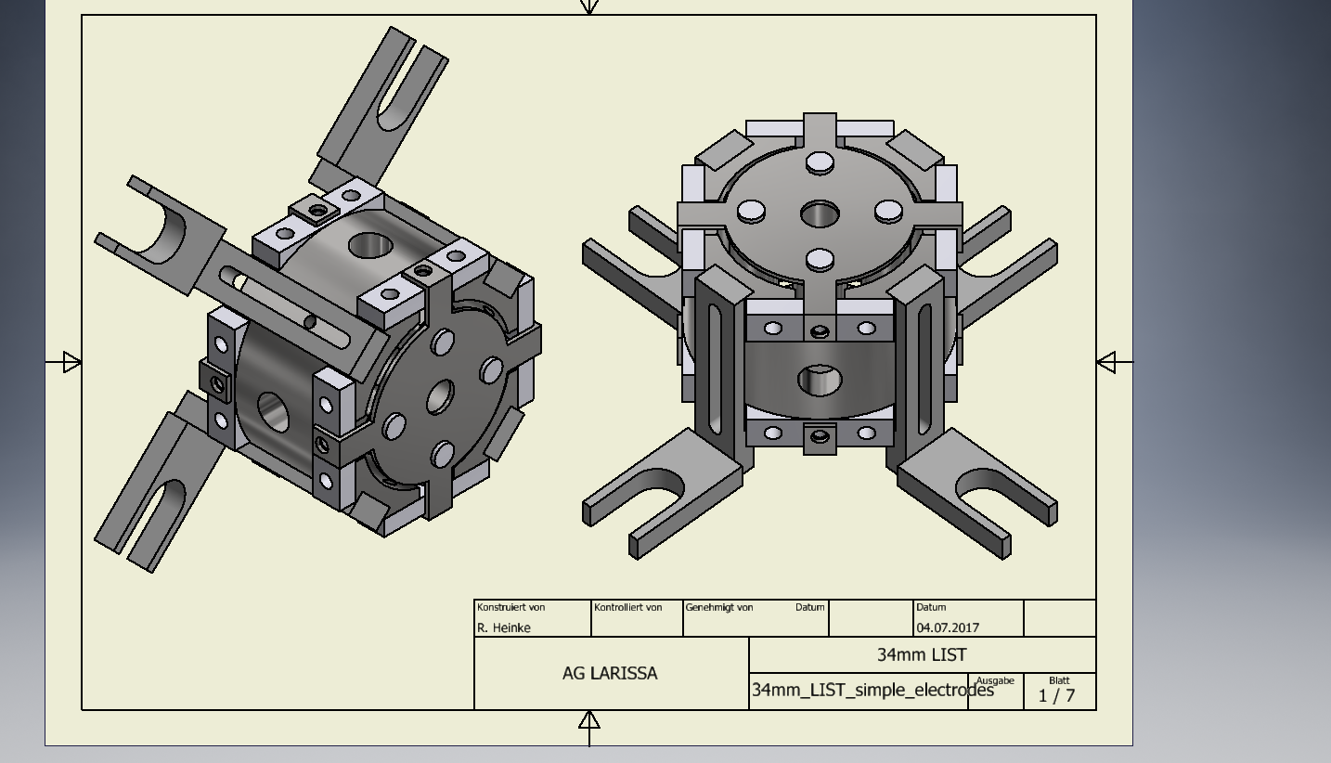
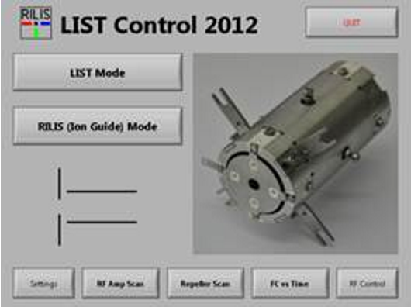
LIST 2018
Obtained technical drawings from Larissa Group Mainz
LIST 2.0 assembly will be provided from Mainz
To be verified: status of RF cable at GPS
LIST control system: replicate 2012 setup
https://edms.cern.ch/document/1400724/1
R.Heinke

Slide 15
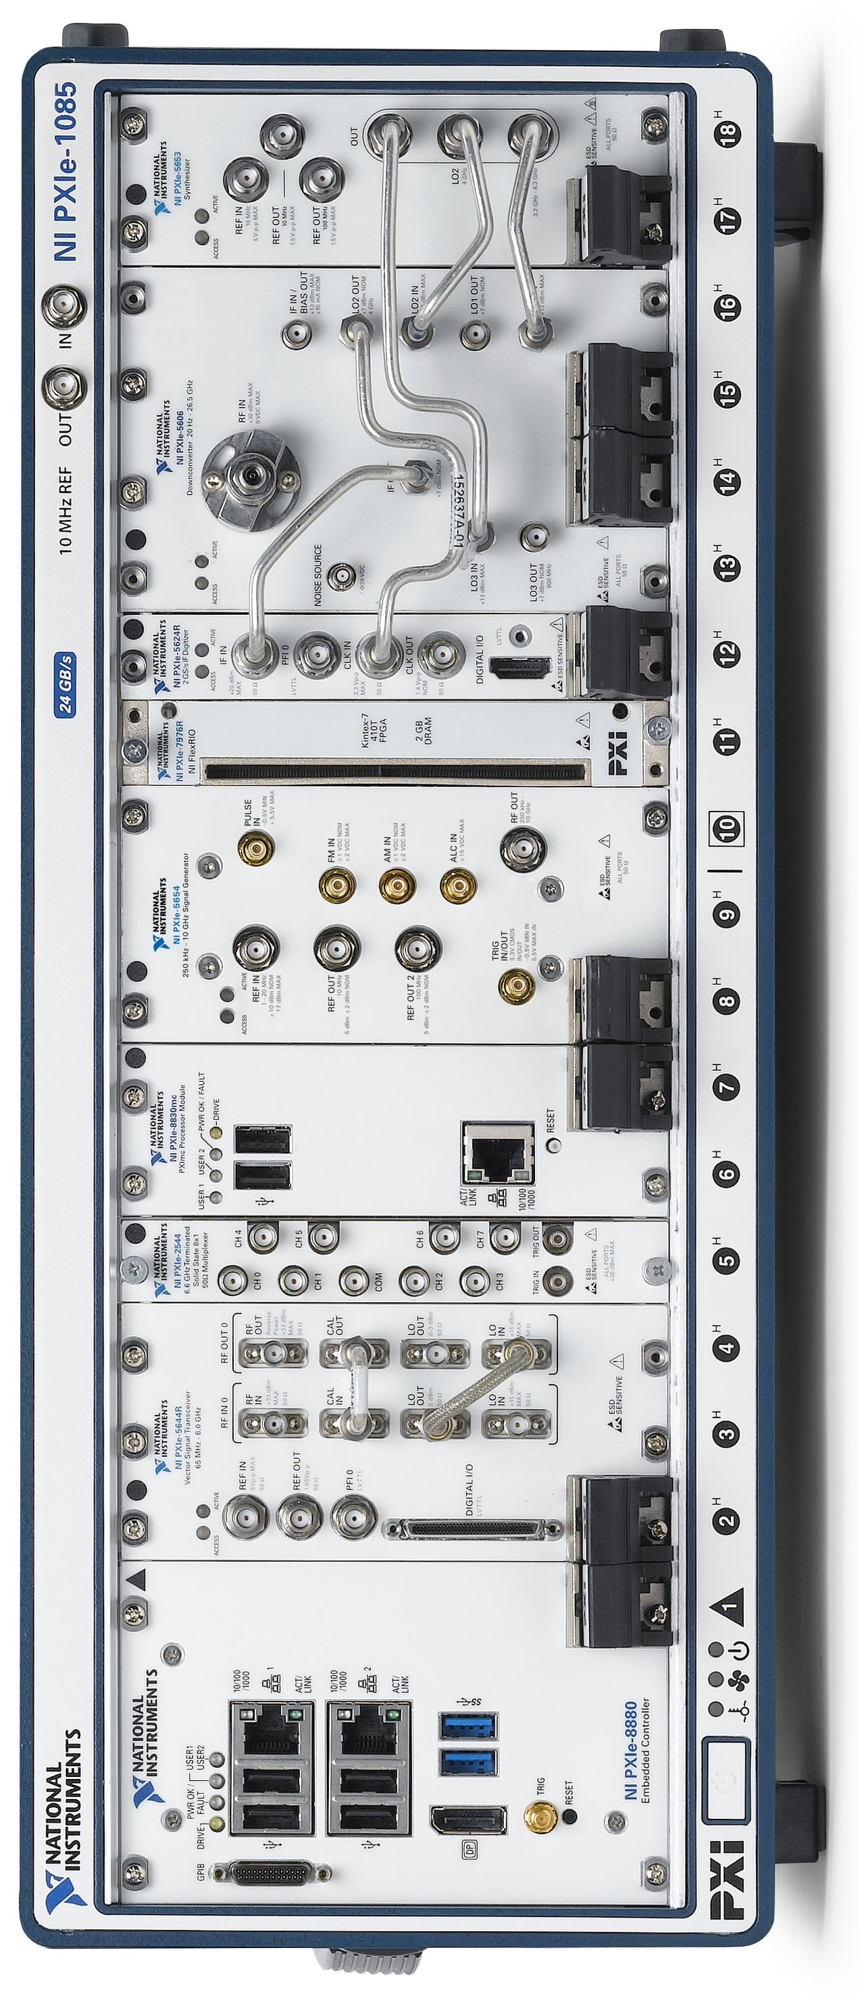
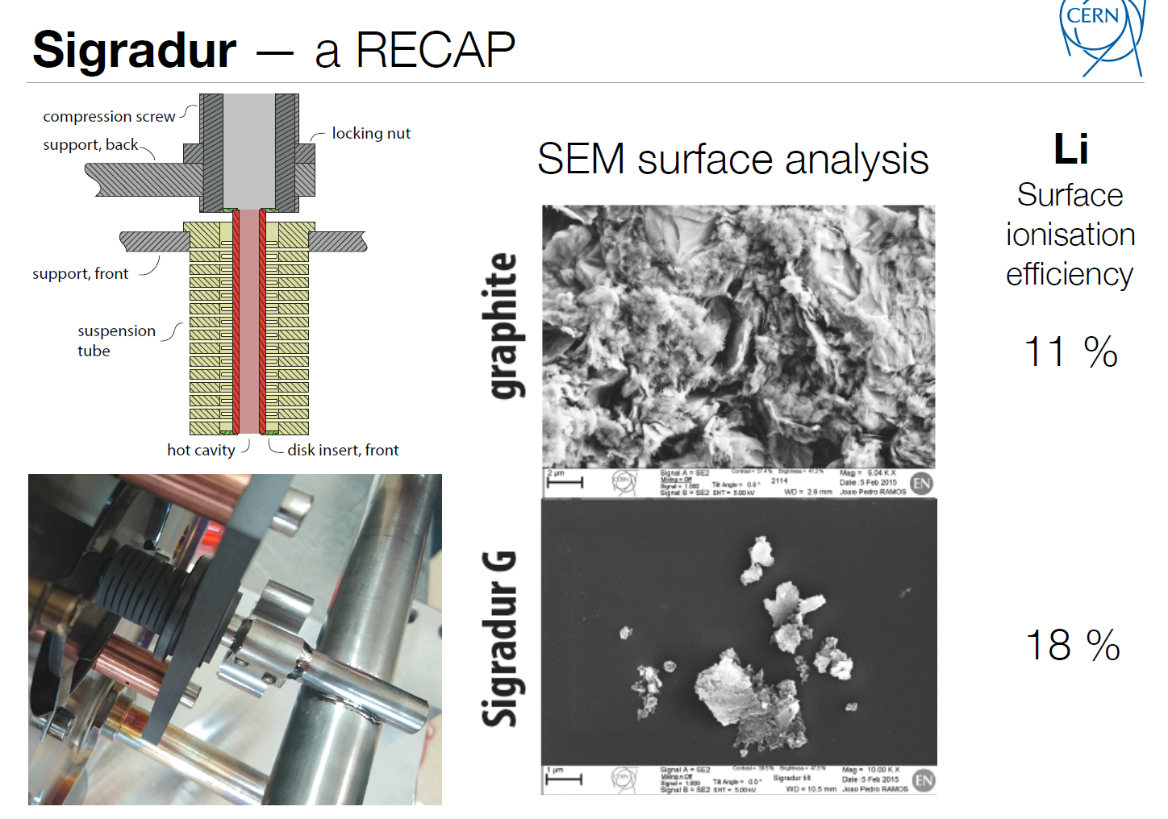
LIST Development (LS2)
Full integration to ISOLDE infrastructure
Fast line heating inversion
Connection to quartz transfer line
Connection to ToFLIS project

Slide 16
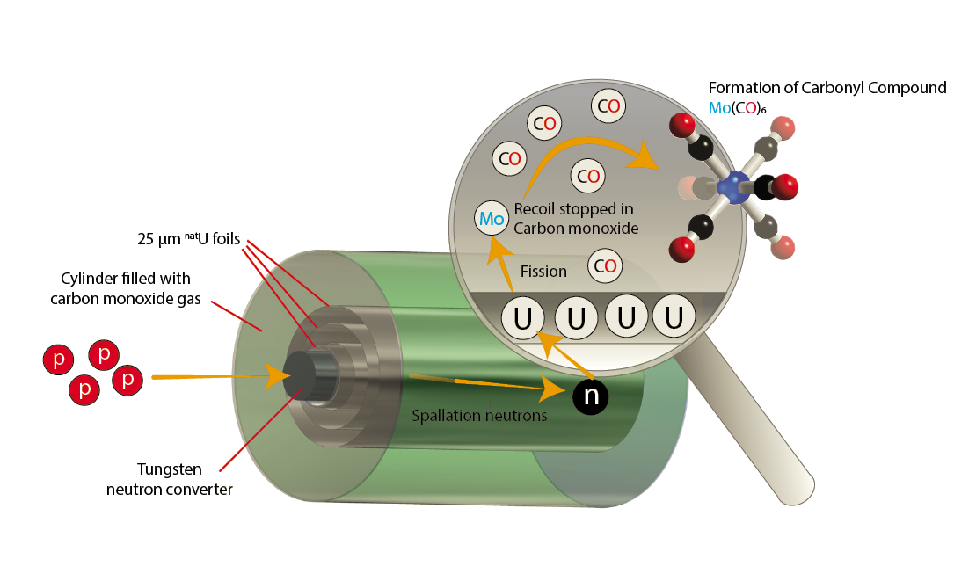
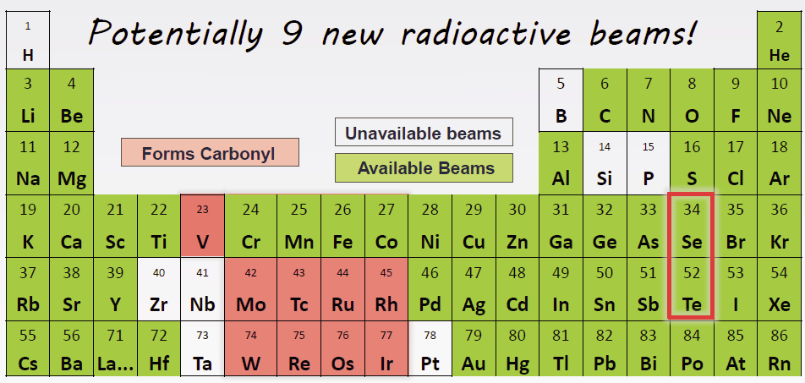
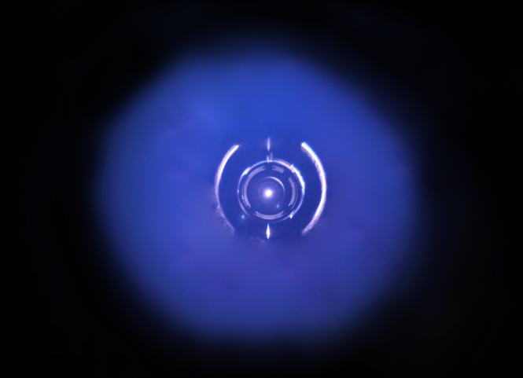
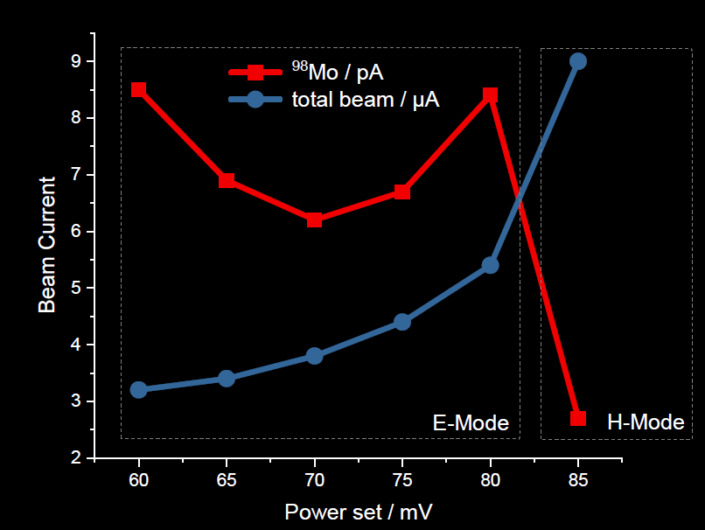
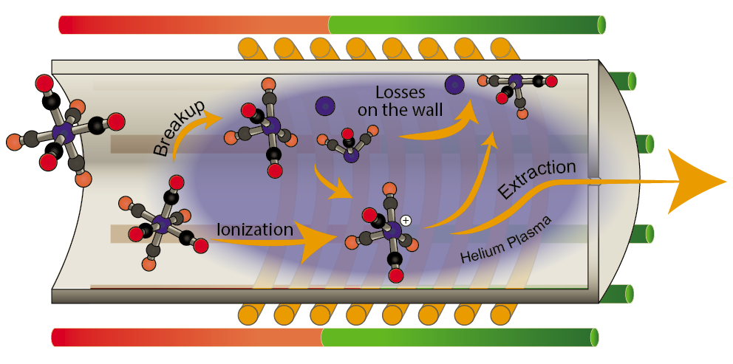
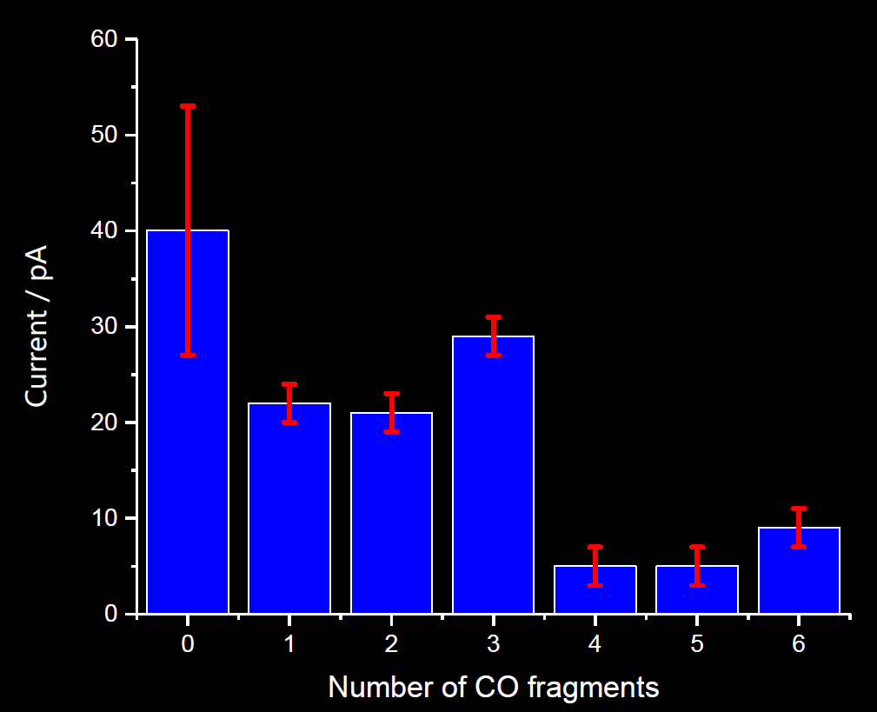
Motivation
Production
Ionization
J.Ballof

Slide 17
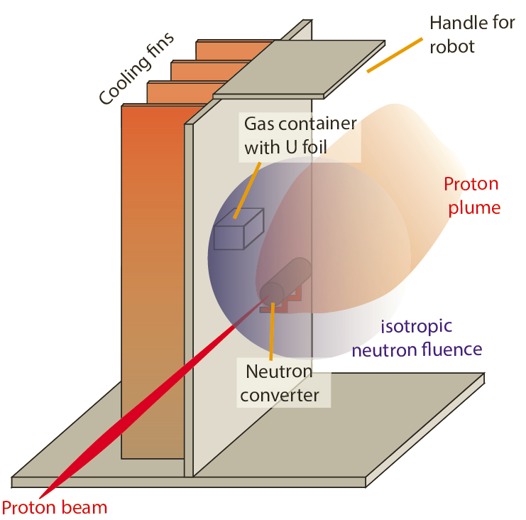
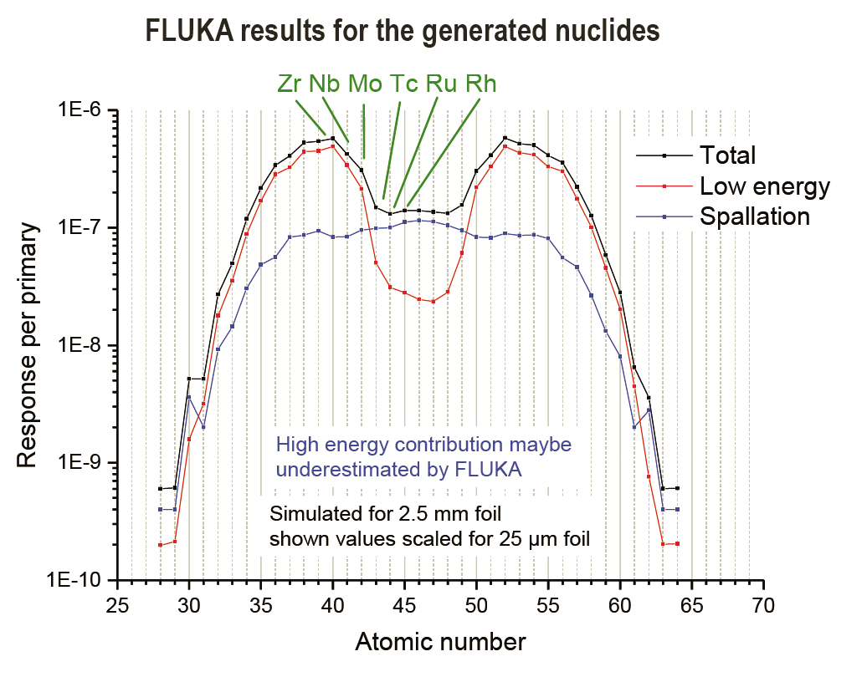
Up next
Irradiations at MEDICIS
carbonyl formation and
Stability at ISOLDE
J.Ballof

Slide 18

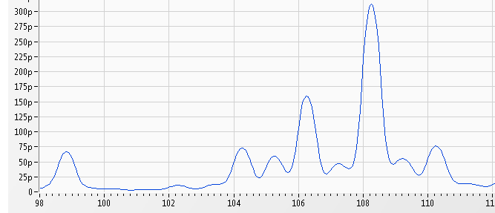

Neutron deficient SeCO beams
Target #605 and #612
Zirconia fibers, stabilized with ca. 10% Yttria
Principle:
Se + CO → SeCO
Shifting the mass to get pure beams
Why does SeCO disappear,
even if we inject CO₂?
Beam available since many years.
but….
Injecting ¹³CO₂….
⁷¹Se
…extracting Se¹²CO
CF₄
injection
⁷¹SeCO
Injected CO₂ gas does not
promote SeCO formation!
What’s the source of carbon?
Carbon from the ion source?
-> Placed graphite grid, but still depleting
Carbon from the target material?
-> EDS (preliminary) shows no carbon in ZrO fibers
SeCO gone after a few days
Atomic Se still released after days
Indications, that CF₄ gas might serve as carbon source. Work in progress.
J.Ballof

Slide 19


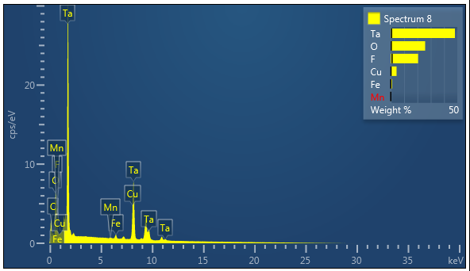
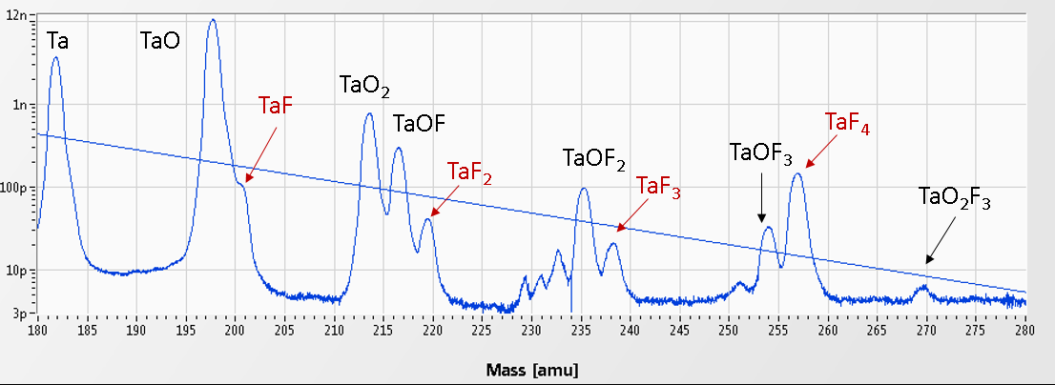
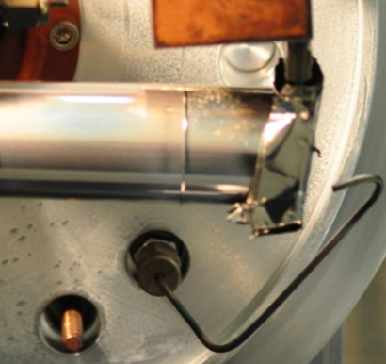
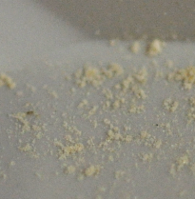
Boron fluoride beams
Principle:
B + 3 F → BF₃
Volatilization of refractory boron by injection of SF₆ gas
First prototype #499
Small gas leak (3.7e-5 mbar L / s)
Absence of TaF_{x} and SF_{x} in mass spectra
Second prototype #513
Increased leak (1.84e-4 mbar L/s)
Strong TaF_{x} and SF_{x} peaks
No TaO peaks
Unit did not produce BFx beams
no fluorine saturation
Stable and intense 8BFx beams
First production unit #606
Despite high injection,
low fluorination, and presence of oxygen. H₂O or air leak?
Gas line rupture
Not clear, if the unit
would produce BF_{x} beams.
TaO_{x}F_{y} deposits in target

Slide 20
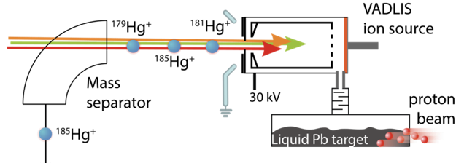
Clean ²⁰⁶Hg beams with VADLIS
3rd on-line application of VADLIS ion source for an experiment
  (full Hg chain for in source laser spectroscopy; Mg + Ne for ISOLTRAP, 206Hg for Miniball)
RILIS–mode achieves similar efficiency to VADIS-mode
Note: RILIS-mode efficiency is expected to improve by at least 2 x if the adjustable-extractor VADIS is used.
B.Marsh

Slide 21
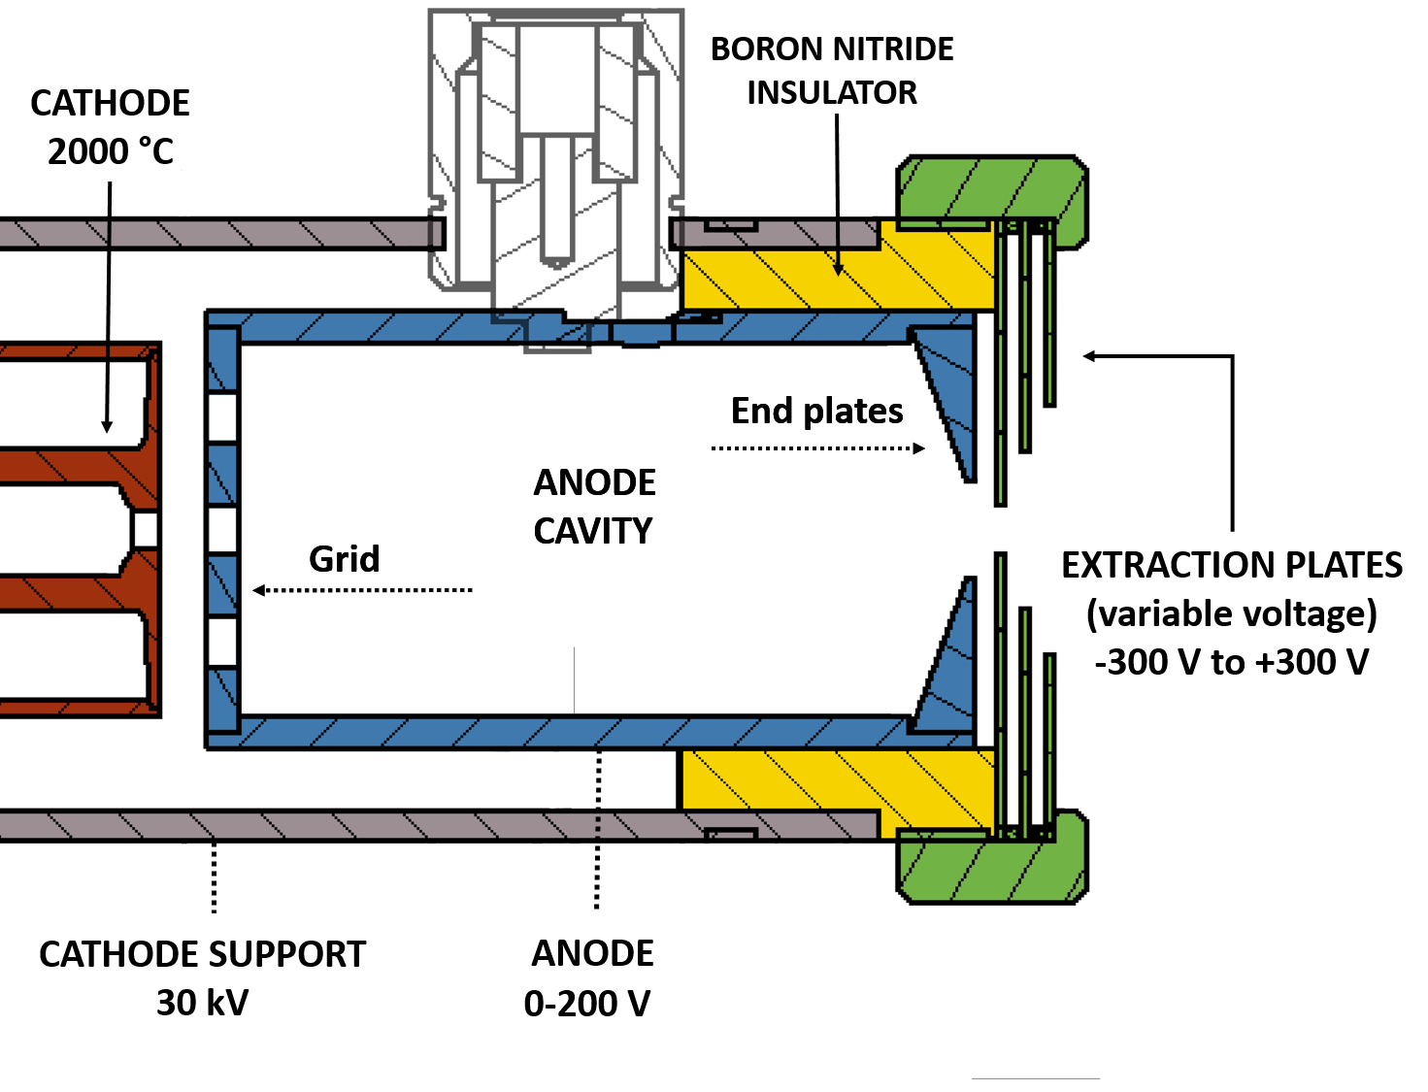
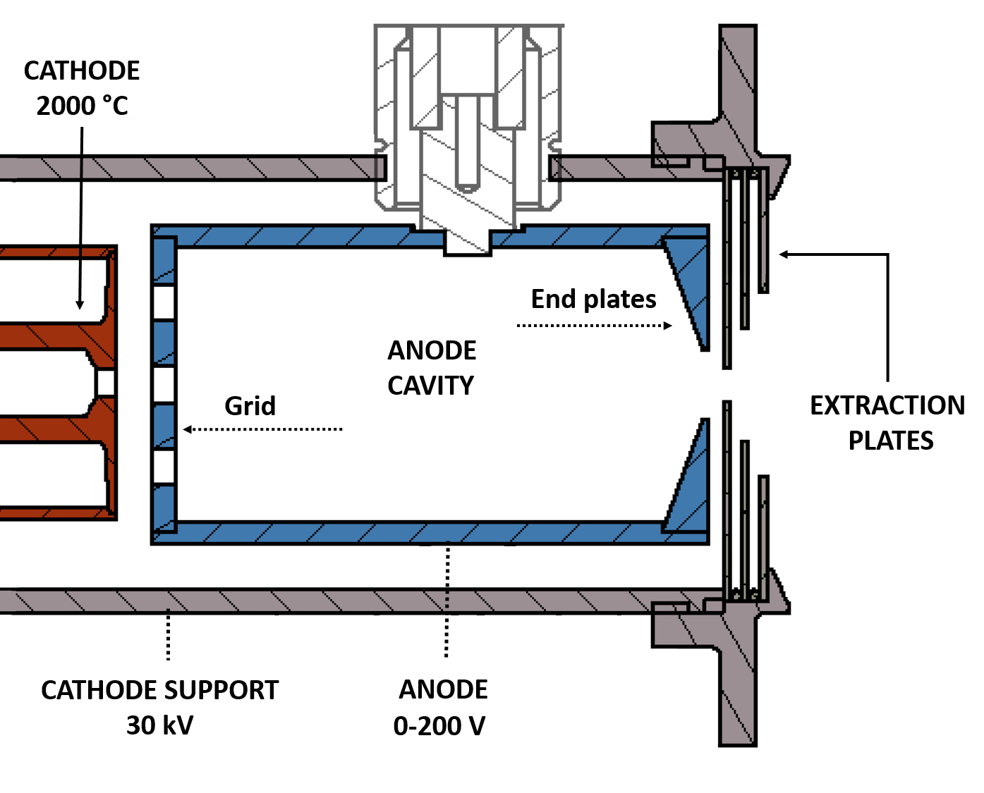
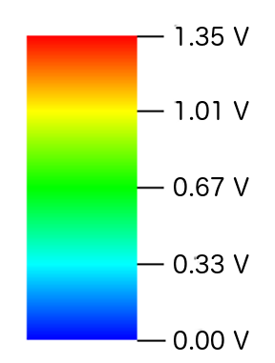
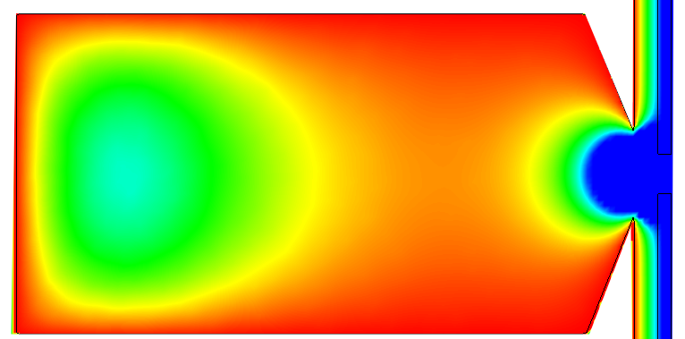
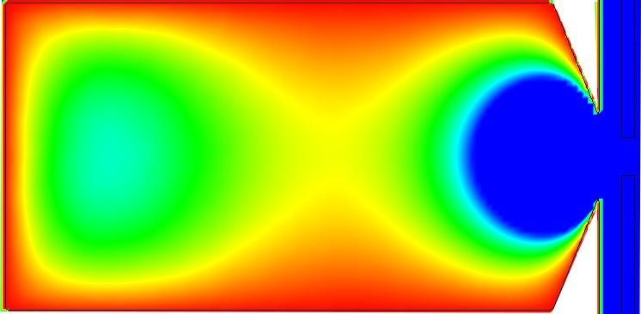

VADIS / VADLIS developments
Standard VADIS
VADIS Dev. [1]
Extraction plates 0 V
Extraction plates -100 V
[1] Y. Martinez et al. In preparation
Y.Martinez

Slide 22
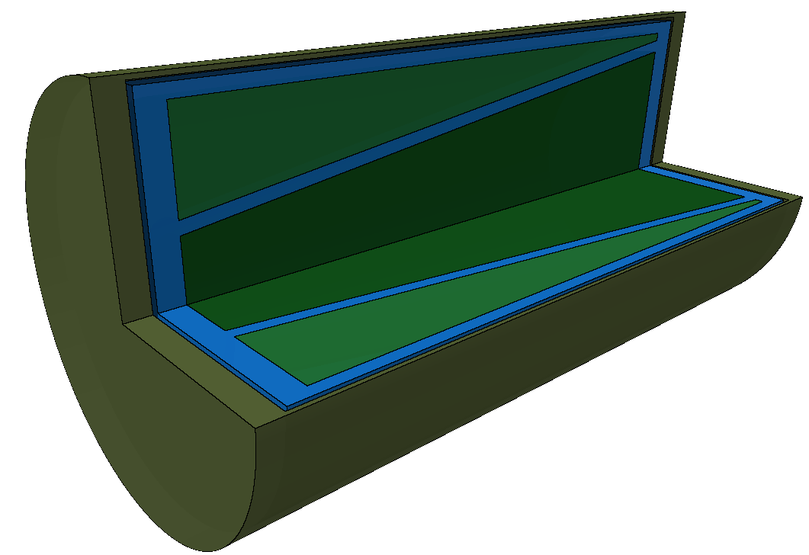
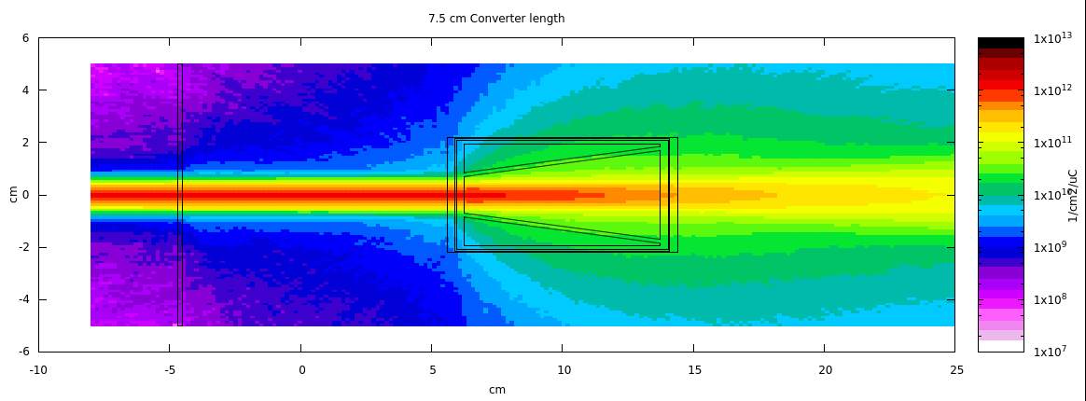
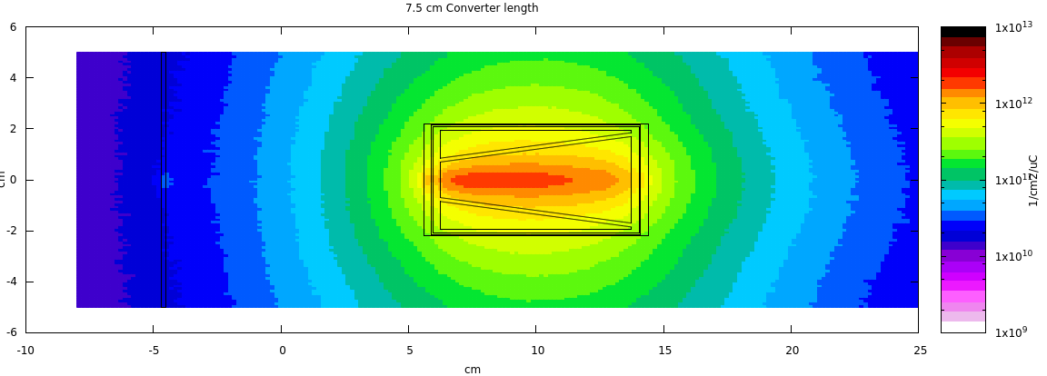
ISOLDE neutron converter design
 | New | Old
n-ind fissions (/s) | 2.79E11 | 4.55E10
p-ind fission ratio | 10.8% | 16.1%
Deposited Power | 690 W | 553 W
UCx Volume | 60 cc | 30 cc
Done:
Systematic FLUKA simulations for geometry optimizations
At the moment:
Thermomechanical simulations of the larger oven
Procurement of materials
mechanical design of prototype
Proton fluences
Neutron Fluences
Main challenges: Large oven to heat up and electrical insulate tungsten from oven current
J.P.Ramos

Slide 23
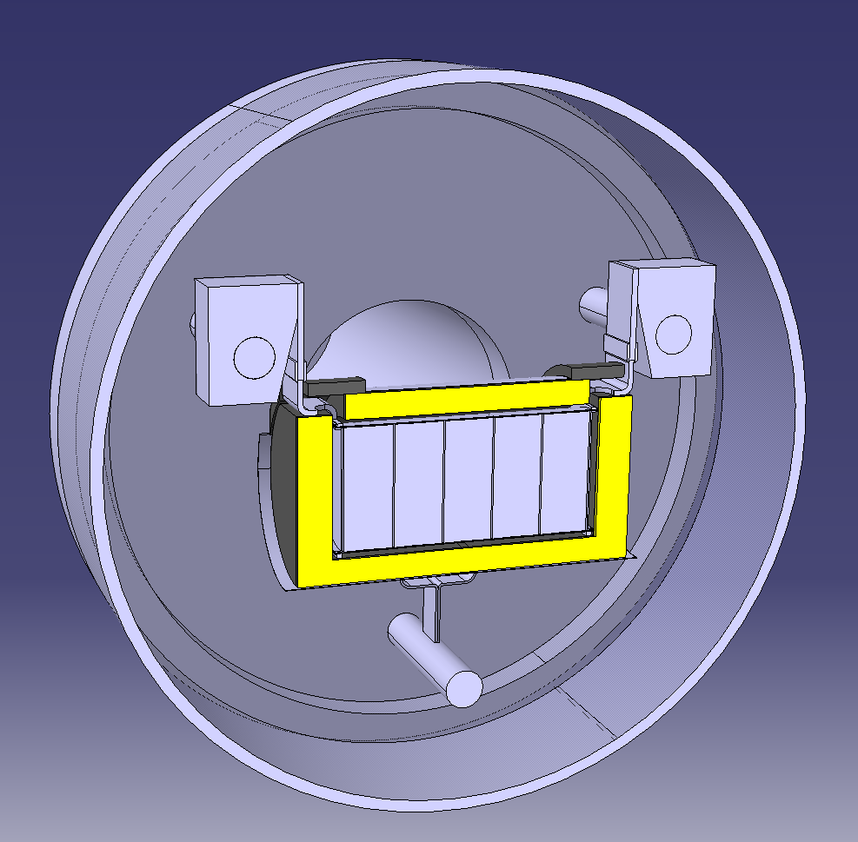
FEM model p2n Target: container temperature (1000 A)
Container outer diameter: 51 mm
Container thickness: 0.25 mm
SGL® SIGRATHERM thermal screen: 10 mm
  https://edms.cern.ch/document/1128002/1
Mo thermal screen: 0.2 mm
To be used for MEDICIS target and potentially for p2n target at TRIUMF
M. Ballan, INFN
S. Marzari

Slide 24
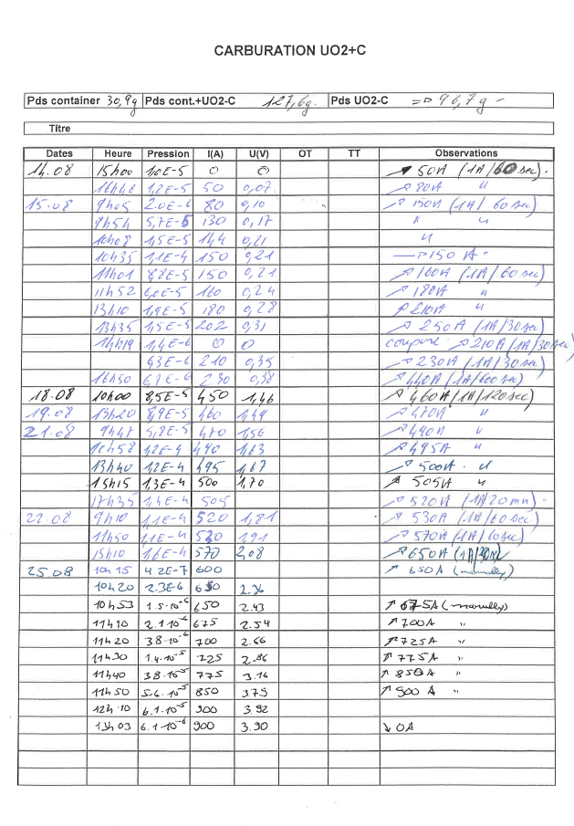




Ucx production: Previous process
2UO (s) + 3 C (s)-> 2 UC (s) + CO2 (g)
Setting ramp
Monitor pressure via webcam
Write down values manually
Detect end of carburization
by pressure drop
May result in inconsistent carburization.
Time consuming (~10 days).

Slide 25



Automatic UCx Production
Setting a ramp
Set thresholds
Start carburization
Heating is regulated automatically
Successfully used for UC611 and UC618
Finished in 4 days without human intervention

Slide 26







ISOLDE Yield Database YYDB(https://isoyields2.web.cern.ch)
Features
CERN SSO
New Database design
In target production (ABRABLA)
Release curves available
More target details visible
Issue tracking
Philosophy
All measurements (TISD, USERS) get entered into YYDB
Manually change attribute (measured -> validated -> published)
Attribute determines visibility (after login, no login required)
Future
Web based interface allows entering of yields to registered users
Add FLUKA results for in-target production
Add yield prediction
Establish link to CRIBE database
J.Ballof

Slide 27
Potential TISD @ ISOLDE, 2018
LIEBE @ GPS-online (2017)
LIST 2.0
M(CO)x formation @ MEDICIS irradiation point
P2n converter prototype test
Negative ion source
Si beam development
VADLIS prototype online

Slide 28
Thanks to the TISD and RILIS teams

Slide 29


MWCNT Target production for #606
CERN has forbidden any handling of nanomaterial
Nanomaterials are requested at ISOLDE for physics (in this case MWCNT)
Powder technology laboratory in EPFL, has a class “nano 2”
Accordingly to EPFL specifications “nano 3” is needed to handle MWCNT (need to have the nanomaterial sealed in glovebox)
Glove’s bag was bought from Sigma Aldrich and used instead of Glove’s box.
Possible solution to lift the prohibition of handling nanomaterials
Successful press of full batch of MWCNT for ISOLDE target #606
J.P. Ramos, B. Crepieux, T. Stora, et al.

Slide 30


Nanolab
Option 1
Option 2
Funding secured
Construction to be finished 2018
Connection of ventilation foreseen in 2019

Slide 31







p2n-converter development (as Presented in previous GUI)
Within CERN-TRIUMF MoU
+ SCK-CEN
50 kW , 500 MeV beam
Project Started in December
Weekly meetings with CERN/TRIUMF/SCK
Beam
ANSYS
FLUKA
UCx
Converter
Preliminary time line:
Apr-2017
Sep-2017
Jan->May-2018
?-2018
Aug->Dec-2018
Concept
Design + Offline Tests
Prototype ready
ISOLDE test
TRIUMF tests
J.P.Ramos

Slide 32


Dedicated oven for CaO production
Target unit building
Glove’s box for material transfer into unit (very sensitive to CO2 and H2O)
Calibration Target + Ion Source
Offline tests
ISOLDE
Material production
CaCO₃ → CaO + CO₂
About a week to produce material in pump stand
Current issues:
Thermocouple positioning difficult (can’t trust readout)
  Use pyrometer but readout is difficult in the 700 – 800 °C range
Thermal gradient in the container makes process much longer than should
CaO production unit difficult to handle in gloves box
Precise control of temperature
Temperature uniformity
Higher quality CaO
Quartz tube easy to handle in glovesbox
Production will be reduced to half-day.
J.P. Ramos, et al.

Slide 33
STAGISO vs NORMISO Study
J.P. Ramos
230 ns in NORM
Release measured on:
GPS and HRS
Target and Converter
26Na and 142Cs
2.3 μs in NORM
16 μs in STAG
Booster pulse pictures from PhD Thesis, R. Wilfinger
No difference between STAGISO vs NORM
Results to be published soon.

Slide 34


Tellurium beams
Target #601 UC n
A (Te) | t1/2 | Te Yield | Cs yield | t1/2 | A (Cs)
132 | 76.3 | 5.40E+08 |  | 6.47 d | 132
133 | 12.5 m | 7.50E+07 |  | stable | 133
133m | 55.4 m | 1.50E+08 |  | stable | 133
134 | 41.8 m | 1.90E+08 | 1.10E+09 | 2.90 h | 134m
135 | 18.6 s | 5.40E+06 | 5.50E+08 | 53 m | 135m
136 | 17.5 s | 5.40E+06 | 5.30E+08 | 19 s | 136m
137 | 2.5 s | 1.20E+05 |  | 30.17 y | 137
Total efficiency = Ionization efficiency x release efficiency
J.P. Ramos, S. Rothe, et al.

Slide 35



The LIEBE target – Offline tests
Offline tests:
  Leak tests
  Vibration tests
  Heat exchanger calibration
  Ion source test
1
2
5
4
3
3D model of the heat exchanger, 5 water channels to cope with 5 different temperatures.
Offline tests 6th-10th November
Operational review 3rd week of November
Target to be installed at GPS end of November
Ansys CFX simulations of heat exchanged for every water channel.
F. Boix Pamies

