Slide 1

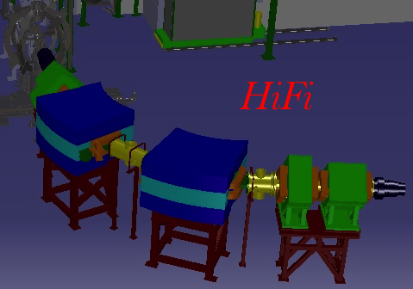
HiFi
Hie Isolde Fragment Identifier
Olof Tengblad
ISCC 7th November 2017

Slide 2

Zero-degree spectrometer @ Hie-Isolde
16 approved proposals
would profit from a Spectrometer
Transfer reactions with light targets
Energy: 5.5 - 10 MeV/u
Intensities: > 10⁵/s
Small scattering angles around 0°
Event-by-event PID
- Identification of heavy transfer product
- Reactions of beam contaminants
- Fusion-evaration reactions with target / carrier
(CH₂, CD₂, Ti+³H, ^{9,10}Be, X+³He, X+⁴He, X+¹⁶O, …)
- Beam composition for normalisation
- Integral measurement sufficient
Coulomb excitation
Energy: about 4 - 5.5 MeV/u
Intensities: > 10²/s … 10⁸/s
Large range of scattering angles
… event-by-event identification not possible
3 LoIs mention A and Z determination for scattered particles
è large area Bragg detector
Spectrometer/separator used to determine
- Beam composition for normalisation
- Integral measurement sufficient
Crucial for transfer reactions on light targets
Device capable to be operated at 0° required
Full support from the Miniball community

Slide 3
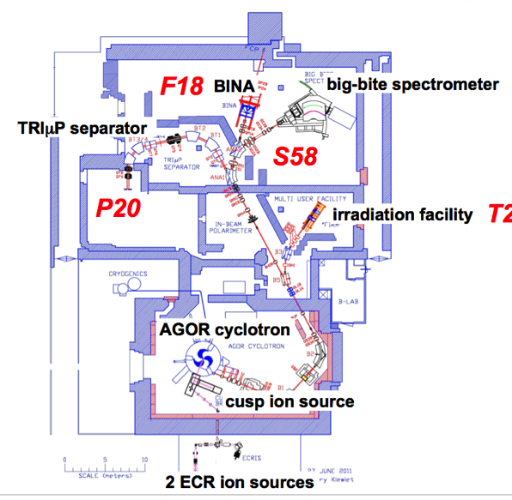
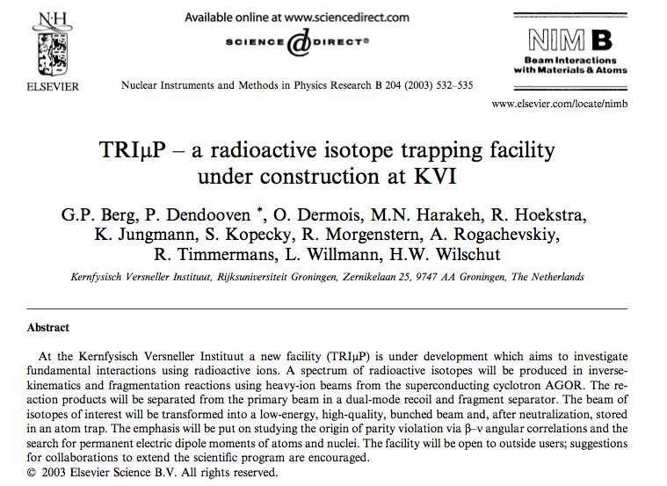

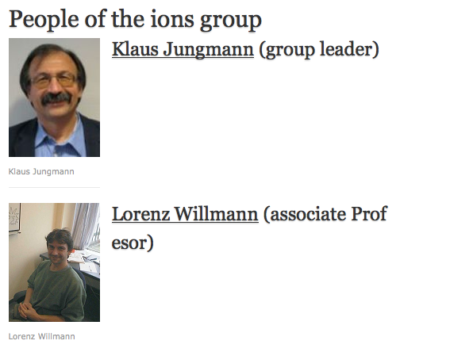
Van Swinderen Institute for
Particle Physics and Gravity
Researchgroup Ions:
TRIμP @ KVI-CAR Built 1994, commissioned 2004, in use until 2013
owner of TRIμP
VSI interest @ ISOLDE:
Radium isotopes for ATOMIC
Fundamental Symmetries Studies
+ 4 PhD students

Slide 4
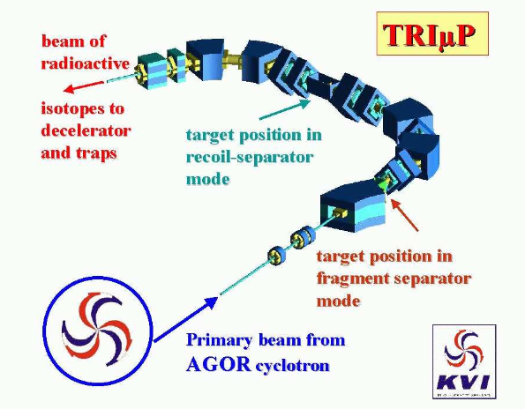
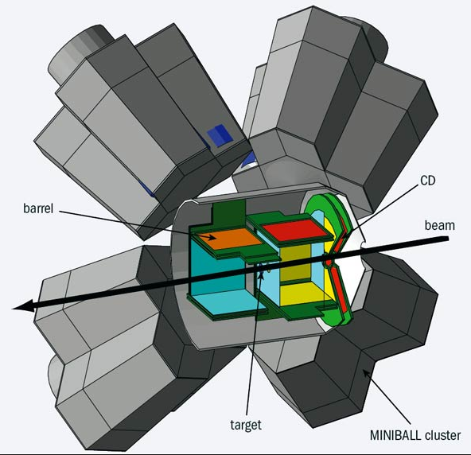
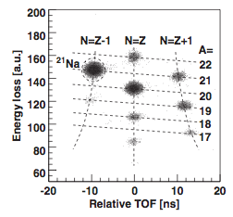
TRIμP as 0-degree spectrometer
Time of flight vs. Energy loss in a 100 μm silicon detector shows various nuclides at the intermediate plane.
Hie Isolde Fragment Identifier
References:
Emil Traykov: Production of radioactive beams for atomic trapping, PhD thesis 27.10.2006, Rijksuniversiteit Groningen
G.P. Berg et.al. NIM B204 (2003) 532
H. W. Wilschut & Klaus Jungmann, Nuclear Physics News Vol. 17, No. 1, 2007,

Slide 5

INITIATIVE: agreement to move TRIμP to ISOLDE
Meeting at RUG/VSI 15.04.2016 1:st agreement was taken,
and plans for the move were initiated
Present: RUG/VSI -- Klaus Jungmann, Lorenz Willmann, Hans Wilschut,
HiFi Collaboration -- María José García Borge, Joakim Cederkall, Olof Tengblad
Move and installation of TRIμP at ISOLDE
2016-17:
Power-supplies: donation from LUND University and already delivered to CERN
Dismount at KVI-CAR and transported to CERN 2017
The equipment will first be mounted at CERN in building B180.
2018 B180 CERN:
where all the tests of vacuum, power supplies etc. will be performed.
The detection system to be implemented and tested, will consist in a row of Double sided Si strip detectors, to be tested with alpha source and if possible to mount an external ion-source.

Slide 6
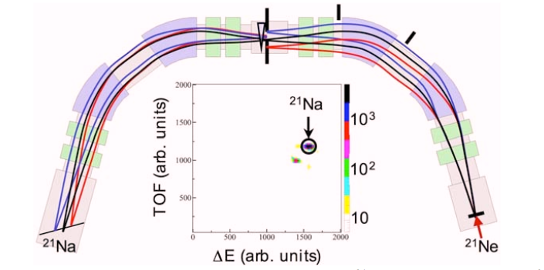
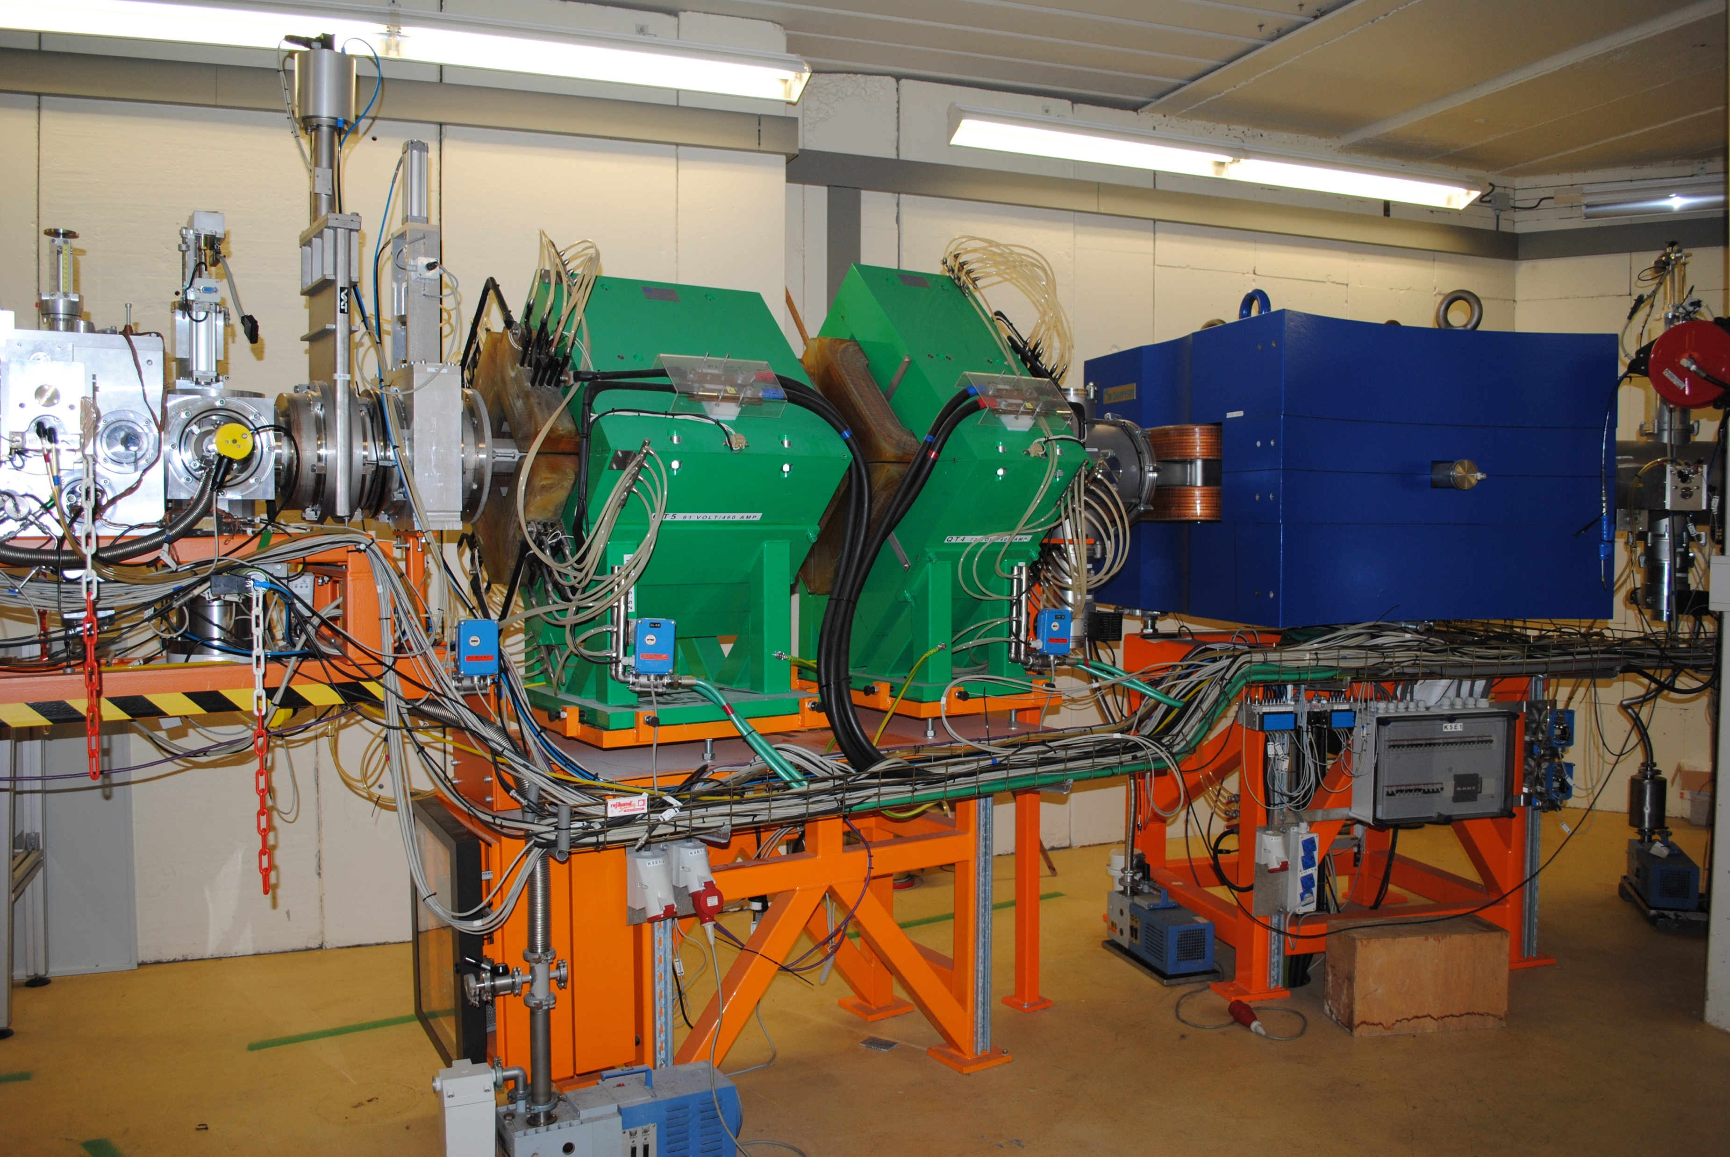
Summary of the main components of TRΙμP
Dipole BT1
weight: 13 000 kg
size: 1.5 m x 2 m x 0.6 m
Dipole BT2
weight: 13 000 kg
size: 1.5 m x 2 m x 0.6 m
Dipole BT3
weight: 12 000 kg
size: 1.5 m x 2 m x 0.6 m
Dipole BT4
weight: 12 000 kg
size: 1.5 m x 2 m x 0.6 m
Quadrupole doublets QT1-2 and QT4-5
weight 8 500 kg
size: 1.5 m x 2 m x 0.6 m
Quadrupole doublets QT6-7 and QT8-9
weight 8 500 kg
size: 1.0 m x 2 m x 0.6 m
Supports: 8 pcs, 500 kg each, 1.5 m x 2m x 1.4 m
Installation downstream Miniball
The idea is to couple half of the spectrometer downstream the Miniball setup. Footprint 5x5 m²
Pick the best components to obtain the optimum separator and use the rest as replacement units.

Slide 7
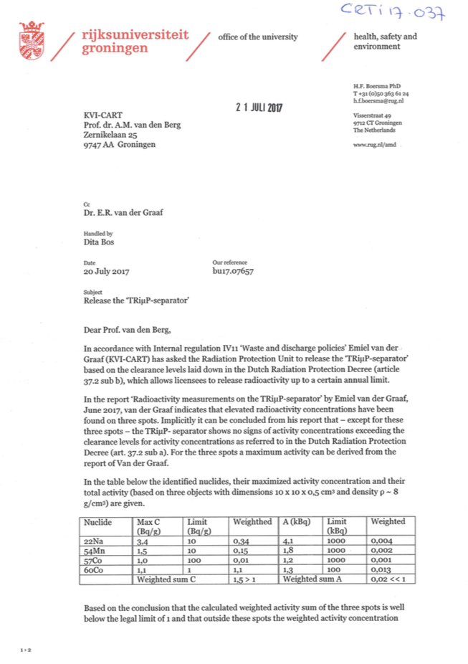
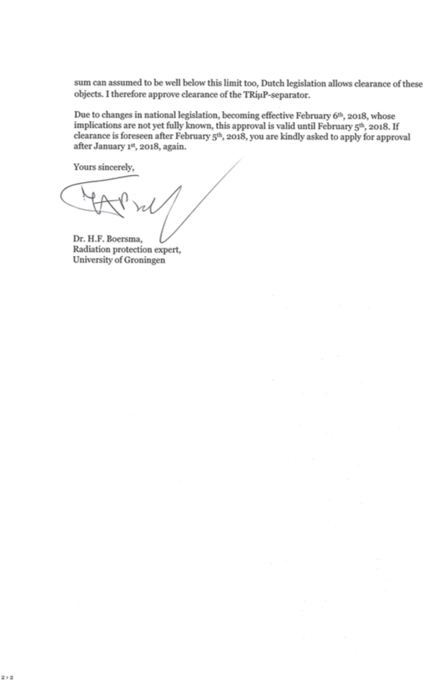
ACTION 1: SURVEY OF RADIOACTIVITY
Survey of Radioactivity at KVI-CAR
before possible transport of the TRIμP separator
20 July 2017: Declared non-radioactive
OK for transport

Slide 8
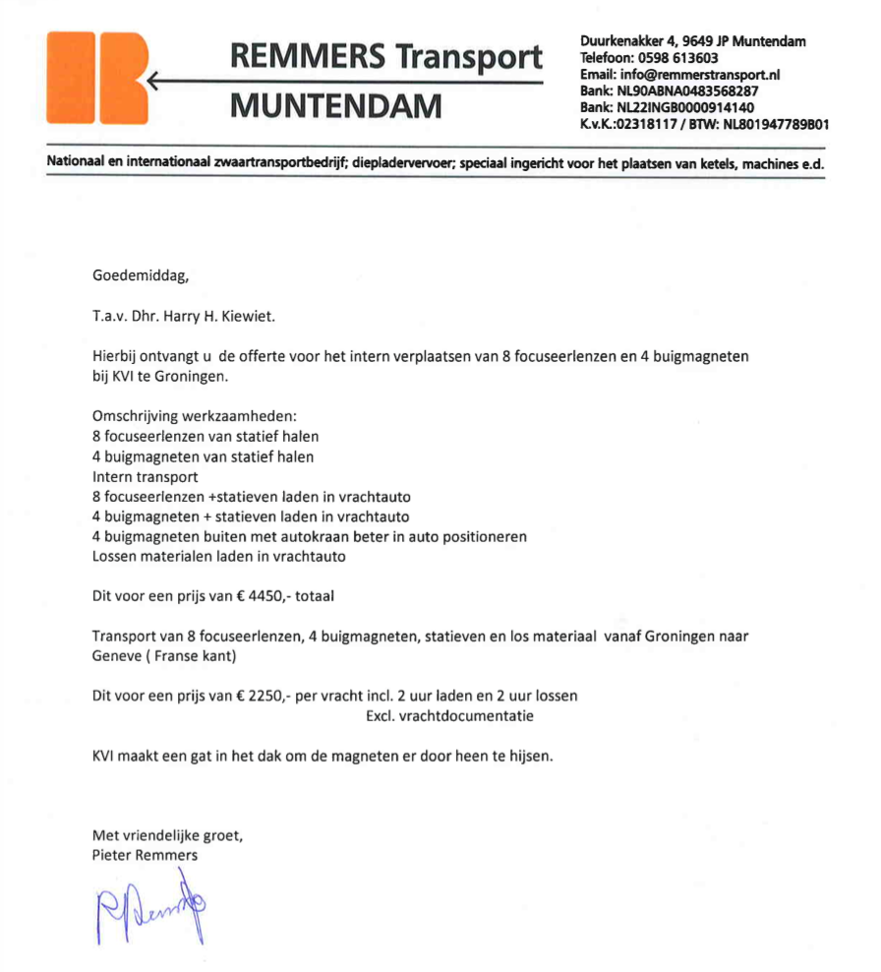
Quotation Transport
ACTION 2: Quotation for Transport
Packing at KVI: 4450 €
Transport to CERN: 2250 €
======================
Total: 6.700 €

Slide 9
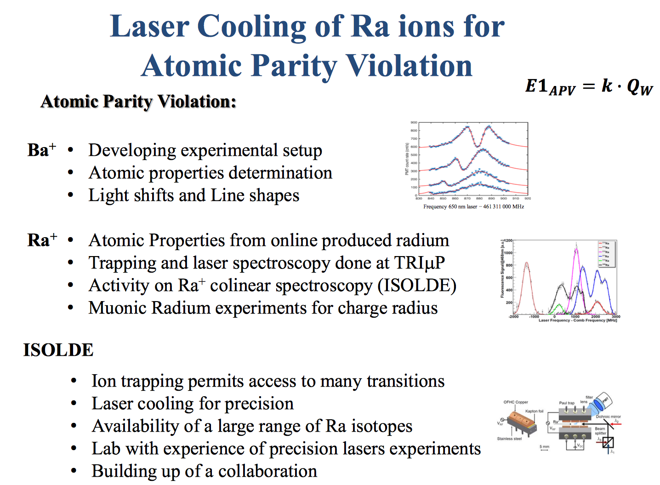
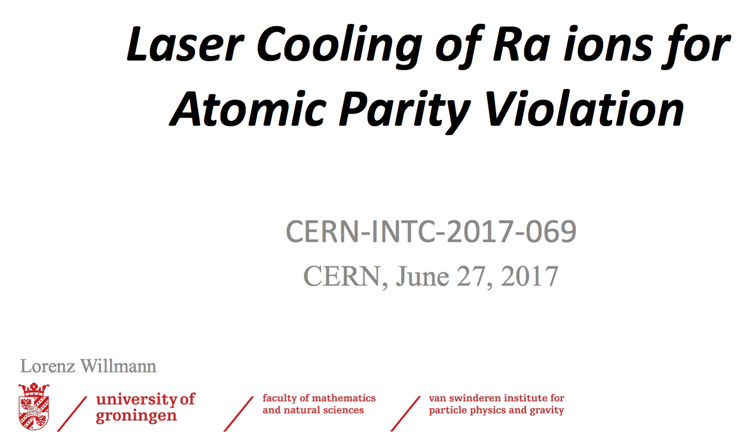
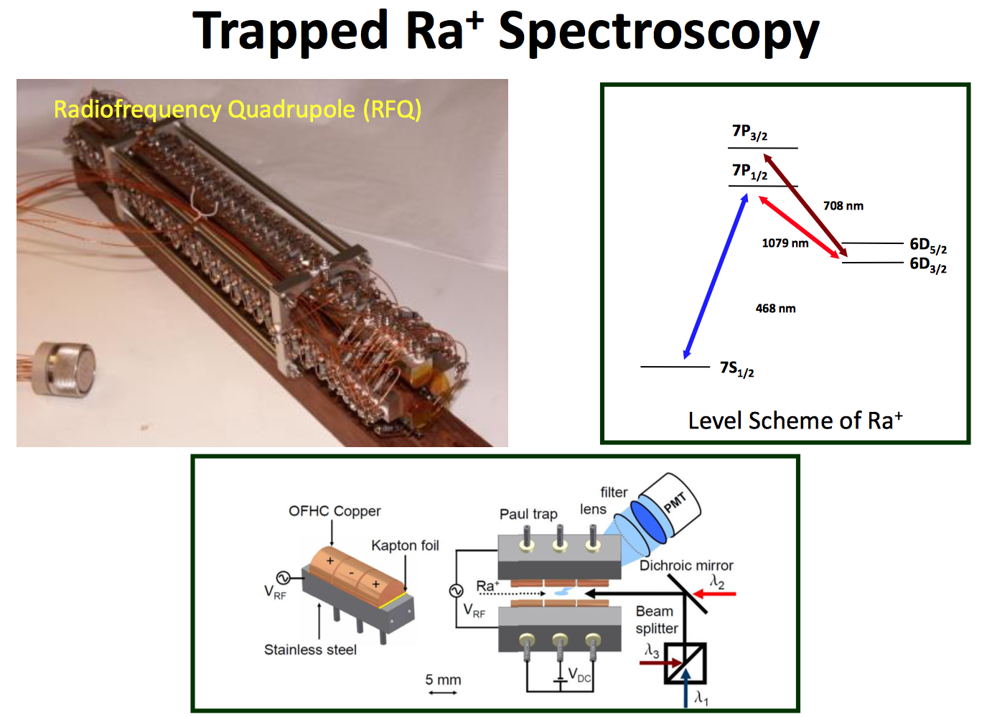
Lorenz Willmann
ACTION 3: Counter performance HiFi vs RUG/VIS; initiate collaboration at ISOLDE
Presentation at ISCC
MINUTES 79th ISCC: The Netherlands is not yet a member of the ISOLDE collaboration. Discussions have been ongoing in conjunction with the TRImP separator, which is due to come to ISOLDE and will be placed after Miniball. This could constitute a first step towards the Netherlands becoming a member of the ISOLDE collaboration. The committee welcomes the arrival of the TRImP separator and the new area of physics which the Paul trap would make available at ISOLDE. It is clear that the Dutch group consider membership of the collaboration to be important for the continuation of this project and that the leadership of the project will come via the Dutch groups; the collaborators from existing ISOLDE members would not be expected to be the spokesperson of this experiment.
The committee welcomes the physics which is being proposed. There are many uncertainties regarding space and final integration at ISOLDE along with a detailed timeline. If the submitted letter of intent is endorsed, the group would be encouraged to submit a more detailed full proposal
T

Slide 10
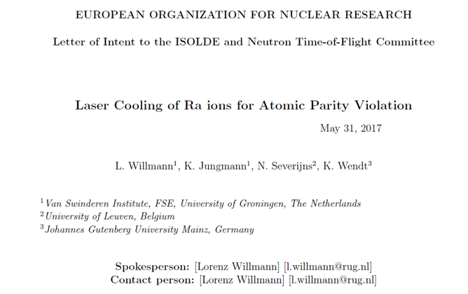
CERN-INTC-2017-069
ACTION 4: VSI interest @ISOLDE, Endorsed by the INTC
INTC-I-196 Laser Cooling of Ra ions for Atomic Parity Violation
The authors propose to perform laser cooling of Ra ions. Radium is one of the favorable systems for the investigation of atomic parity violation (APV). This provides a way to investigate the contribution of weak interactions at low momentum. Some preparatory studies have already been made by some of the proponents. The INTC recognizes the importance of APV studies and finds the science case attractive. However, it has to be considered that this activity is a long-term endeavour. It requires not only a commitment from the ISOLDE collaboration, but also installation of adequate infrastructure will be needed. The setup should be permanently placed in the ISOLDE hall and the details of this should be discussed with the ISOLDE physics and technical coordinators. The INTC recommends proceeding in this way and eventually to prepare a full proposal.
The INTC recommends 0 shifts for approval by the research board but endorses the physics motivation and supports the allocation of resources to develop this technique at ISOLDE.

Slide 11
Summary
Actions for the HiFi Separator Project
Phase A 2017
L. Willman presented the VSI interests at ISOLDE to the ISCC and submitted a LOI to the INTC. DONE – Physics case endorsed by the INTC
Identifying radioactive and non-radioactive components of the TRIMUP separator. DONE - declared non-radioactive signed by Univ. Groningen
Preparation for and transport of non-radioactive components to CERN and installation in test area B180. Quotation for transport obtained, Test area B180 assigned @ CERN
CERN– fellow for the preparations, simulations and installation: Andree Welker
Phase B 2018 Workshop at ISOLDE to form the collaboration.
Testing hardware for the HiFi separator, including cooling and power, in test area B180 at CERN. Installation of new detector systems and tests of these.
J. Cederkäll: DANFYSIK Power supplies for Dipoles and Quadropoles
MJ Borge: Project application for the Vacuum system and a 2nd student
K.Riisager: Project application for the detection system
Phase C 2019
Installation in ISOLDE experimental area and in situ testing

Slide 12
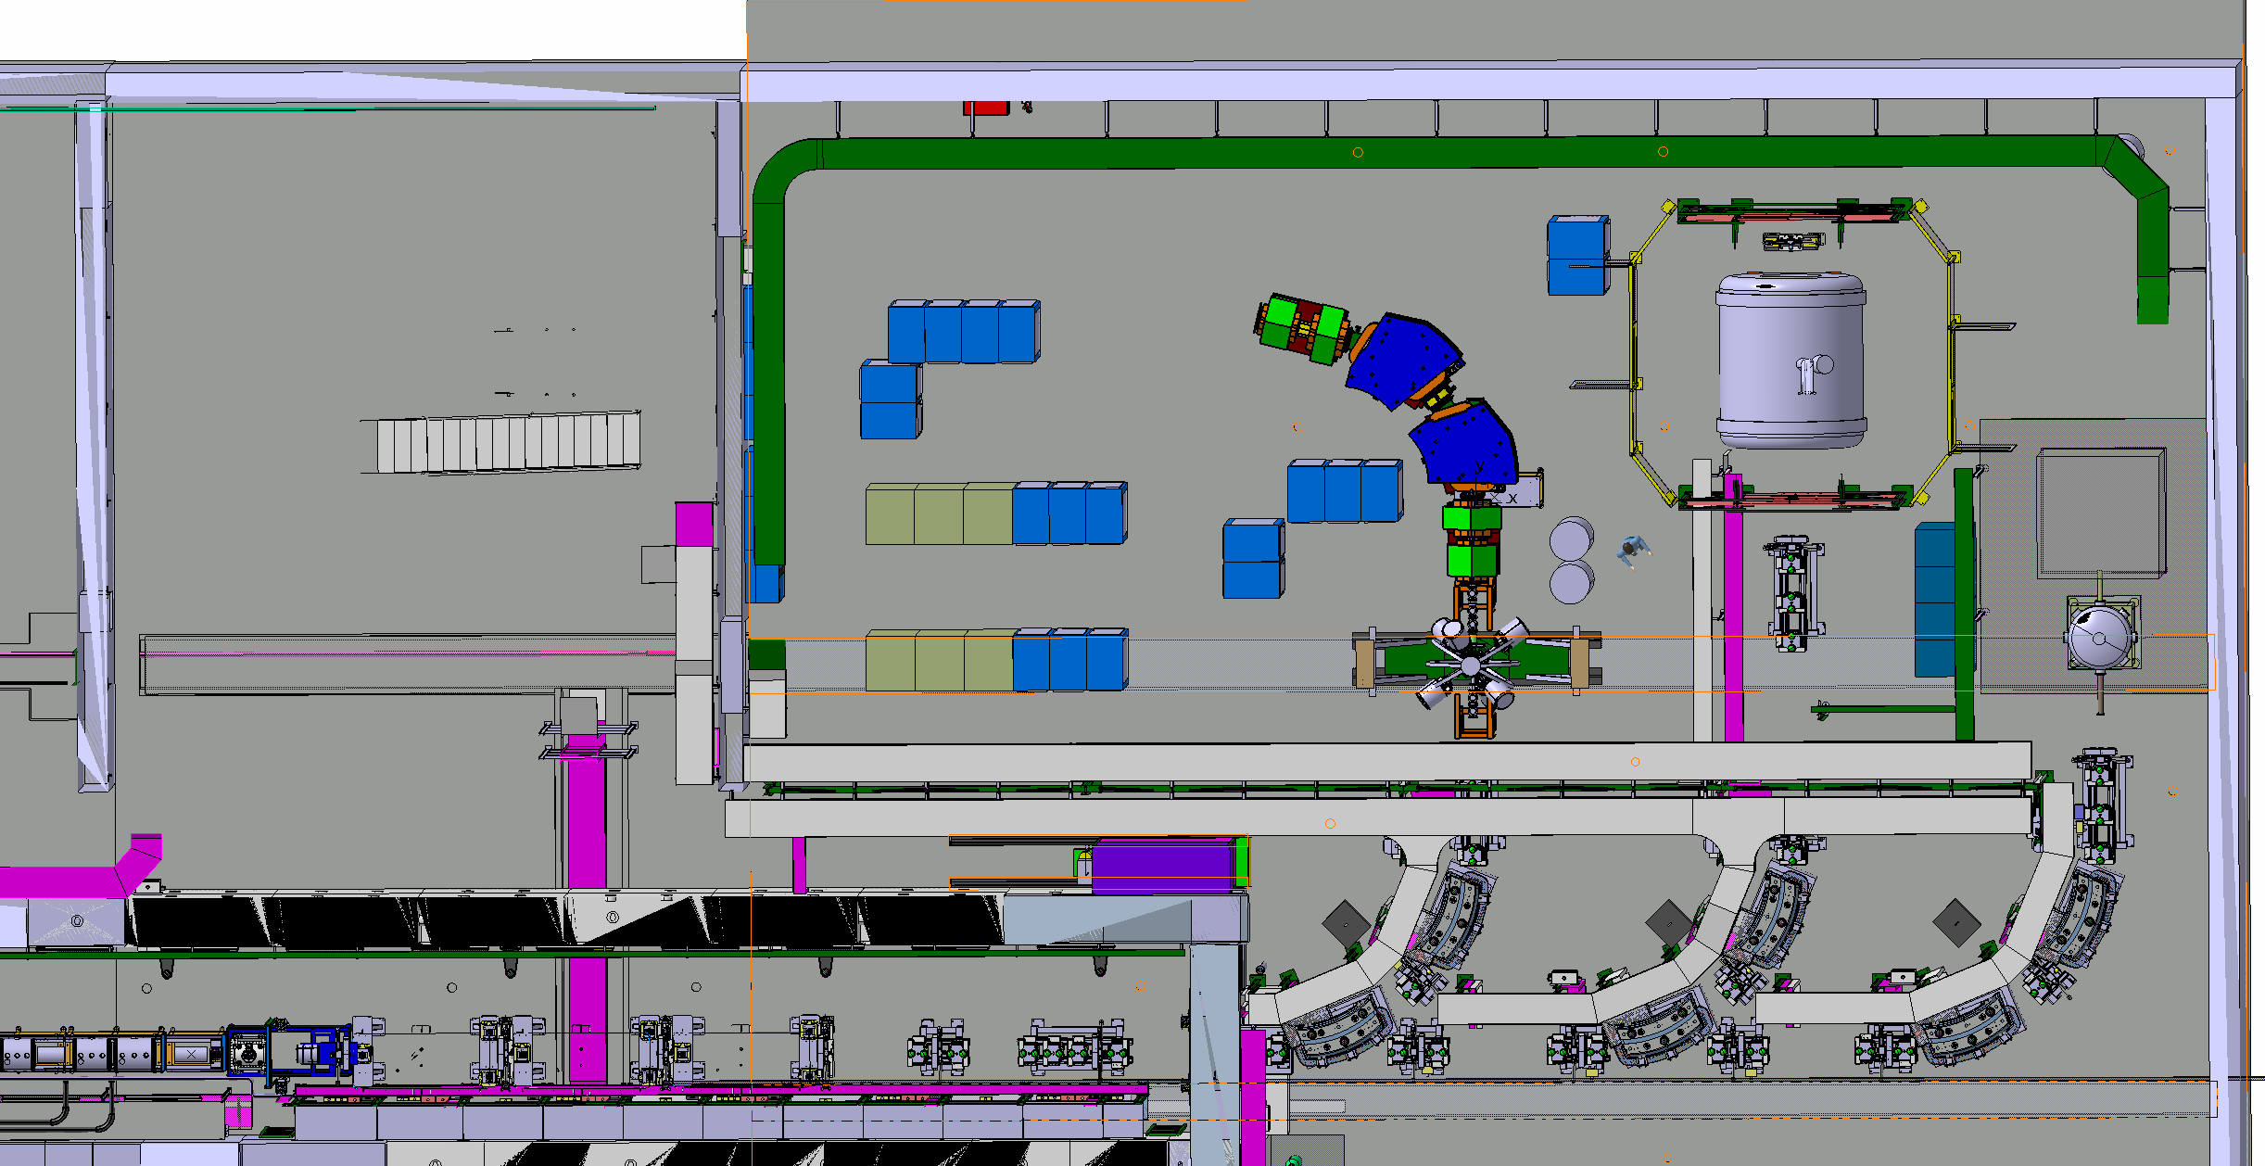
HiFi with MiniBall @ XT01
3.2 m
Power supplies
Ionization chamber
Beam diagnostics
Detector
MINIBALL
HIE ISOLDE LINAC

Slide 13
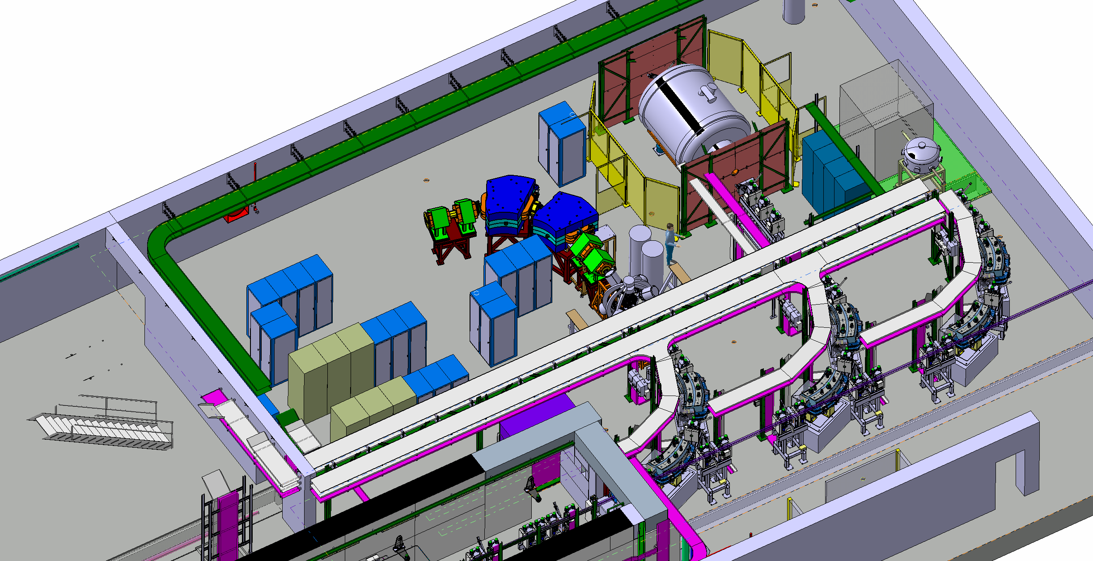

Slide 14
The HiFi-collaboration Request to ISCC:
Endorse the installation of the TRIμP separator downstream Minball at XT01 beamline of HIE-ISOLDE DONE!
Pay the transport from KVI to CERN of the separator AGREED!
The HiFi-collaboration Request to CERN:
Space in building B180, access to power and cooling water. AGREED!
Next to do 2018:
Initiate the transport
  Sign the memorandum of agreement with Univ. Groningen to transport and receive the TRIμP at CERN. HiFi collaboration MJG Borge
Transport the equipment
  Dismount at KVI and package Transport company with help of VSI, HiFi supervise
  Receive and unpack at CERN HiFI collaboration (Lund and Madrid)
Prepare for installation at HIE-isolde
  Catia drawings for the installation at XT01. A. Welker
  Simulation of the system for real physics cases. A. Welker
B180
  Coupled the Power supplies to the equipment and perform 1st test Lund
  Change the vacuum system to dry pumps Madrid
  Install and test focal plane detection system Aarhus

Slide 15
Memorandum of Agreement
Memorandum of Agreement
between
University of Groningen PO Box 72 9700 AB Groningen
and
The HiFi Collaboration at CERN/ISOLDE CH-1211 Geneva Switzerland
Concerning: Transfer of TRIμP Separator to CERN/ISOLDE
Purpose of agreement
Transfer of the TRIμP separator from the Fundamental Interaction and Symmetries Group at the Van Swinderen Institute for Particle Physics and Gravity, University of Groningen to ISOLDE at CERN. The separator was built within the framework of the TRIμP programme funded by the University of Groningen and the Dutch funding agency FOM and was commissioned in 2004. It has been used until 2013 for the separation of isotopes produced in fusion-evaporation and fission reactions. Stable beams, mainly lead beams (^{206,208}Pb) on carbon targets (¹²C) of up to 100 W (until 2011) and neon beams on hydrogen/deuterium targets of up to 300W, were used.
The equipment, referred to as the TRIμP-separator in the following, consists of four dipoles, four quadrupole-doublet magnets and one hexapole magnet, including the vacuum chamber and the slit systems. The equipment is transferred to ISOLDE as a complete device but only including the components listed by the radioprotection officer in the list in appendix B. A full list of the components of the TRIμP-separator is given in Appendix A.
The ISOLDE Collaboration is very pleased with the donation of the TRIuP spectrometer and by the interest shown by the Fundamental Interactions and Symmetry Group in performing experiments at ISOLDE. The group at the Van Swinderen Institute is interested in exploiting the beams at ISOLDE for measurements related to atomic parity violation. The Collaboration invites the group to present the case in its meeting the 27th of June 2017. If the physics case is endorsed by the INTC the ISOLDE Collaboration will facilitate the access service at the Facility at the same level enjoyed by ISOLDE members for setting up a new experiment.
Cost:
All costs associated with the transport of the TRIμP-separator from Groningen, NL, to CERN, CH, will be covered by ISOLDE. Such costs include packaging, freight, insurance, import duties and local taxes.

Slide 16
Memorandum of Agreement
Warranty:
The University of Groningen gives no warranty of the regular function of the TRIμP-separator. In case of loss or damage before or during delivery to the transportation company from the location in Groningen to CERN, ISOLDE is not entitled claim any indemnification.
Liability:
The University of Groningen shall not be liable towards ISOLDE for any damages including indirect and/or consequential damages. ISOLDE shall indemnify, defend and hold harmless the University of Groningen, its employees from any and all claims, liabilities, losses, damages and expenses arising out, or in, connection with the donated equipment.
Additional:
This contract is valid subject to the necessary official permissions and licenses (e.g. export license, import license) to be obtained and paid by ISOLDE. A declaration by the responsible radiation protection officer at the University of Groningen concerning the levels of residual radioactivity of the TRIμP-separator, as listed in Appendix A, is attached to this agreement as Appendix B.
Appendix A: The TRIμP separator.
The figures below are to help to identify the various components in term of beam optics and vacuum. The equipment includes the magnets and the vacuum chambers.
Appendix B: Declaration from radioprotection officer at the University of Groningen

