Slide 1
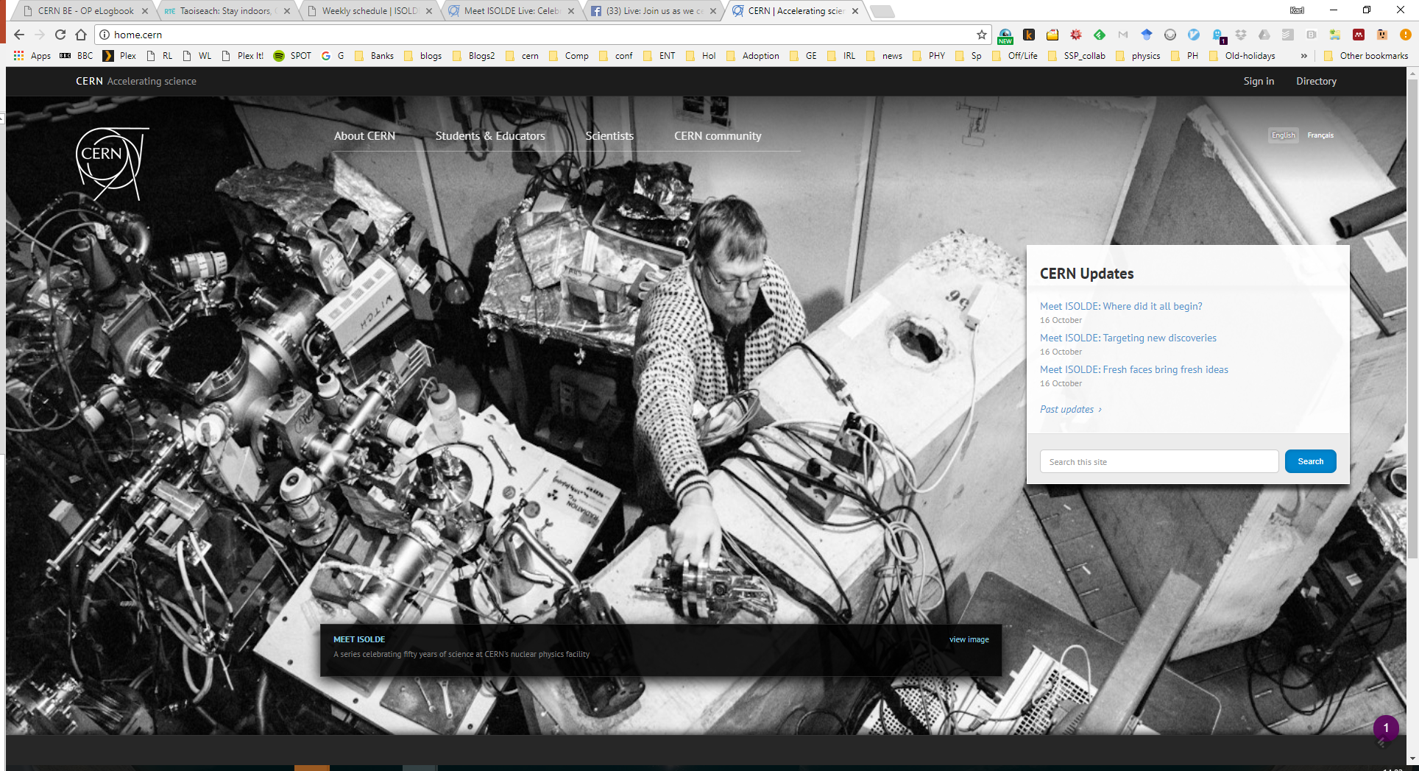
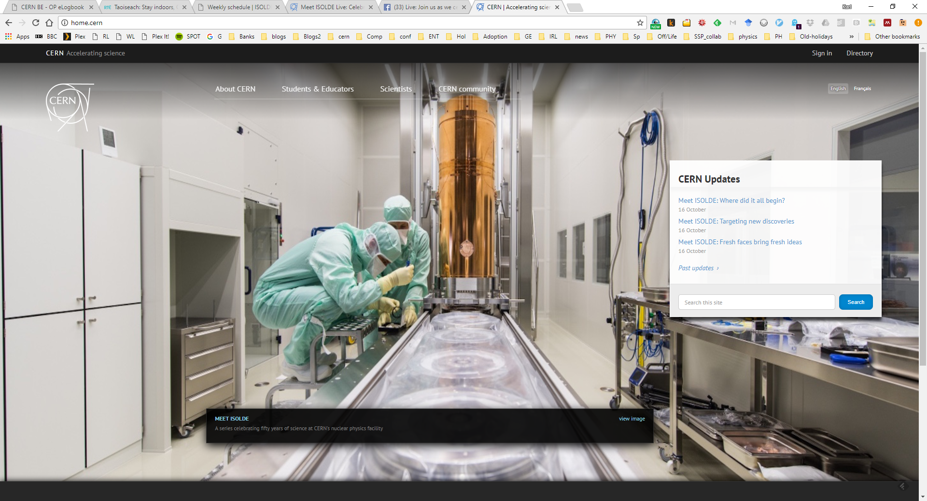
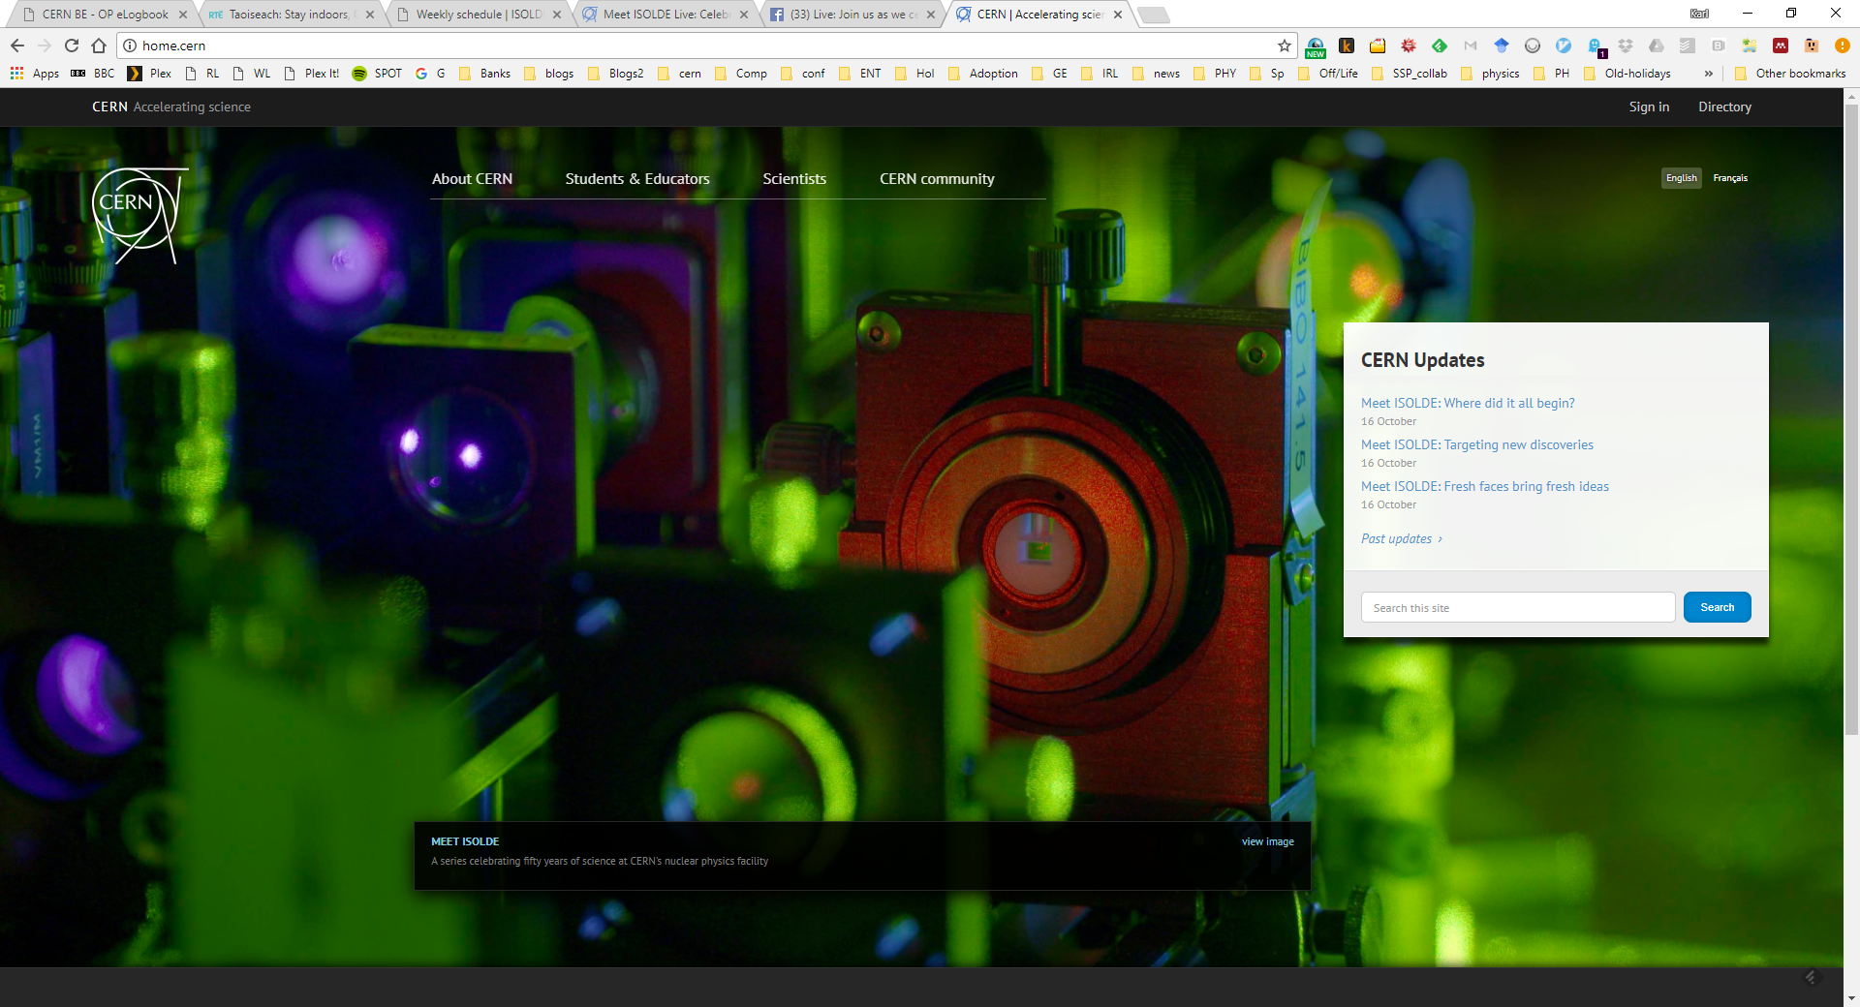
News from the 2017 ISOLDE running period
Karl Johnston

Slide 2
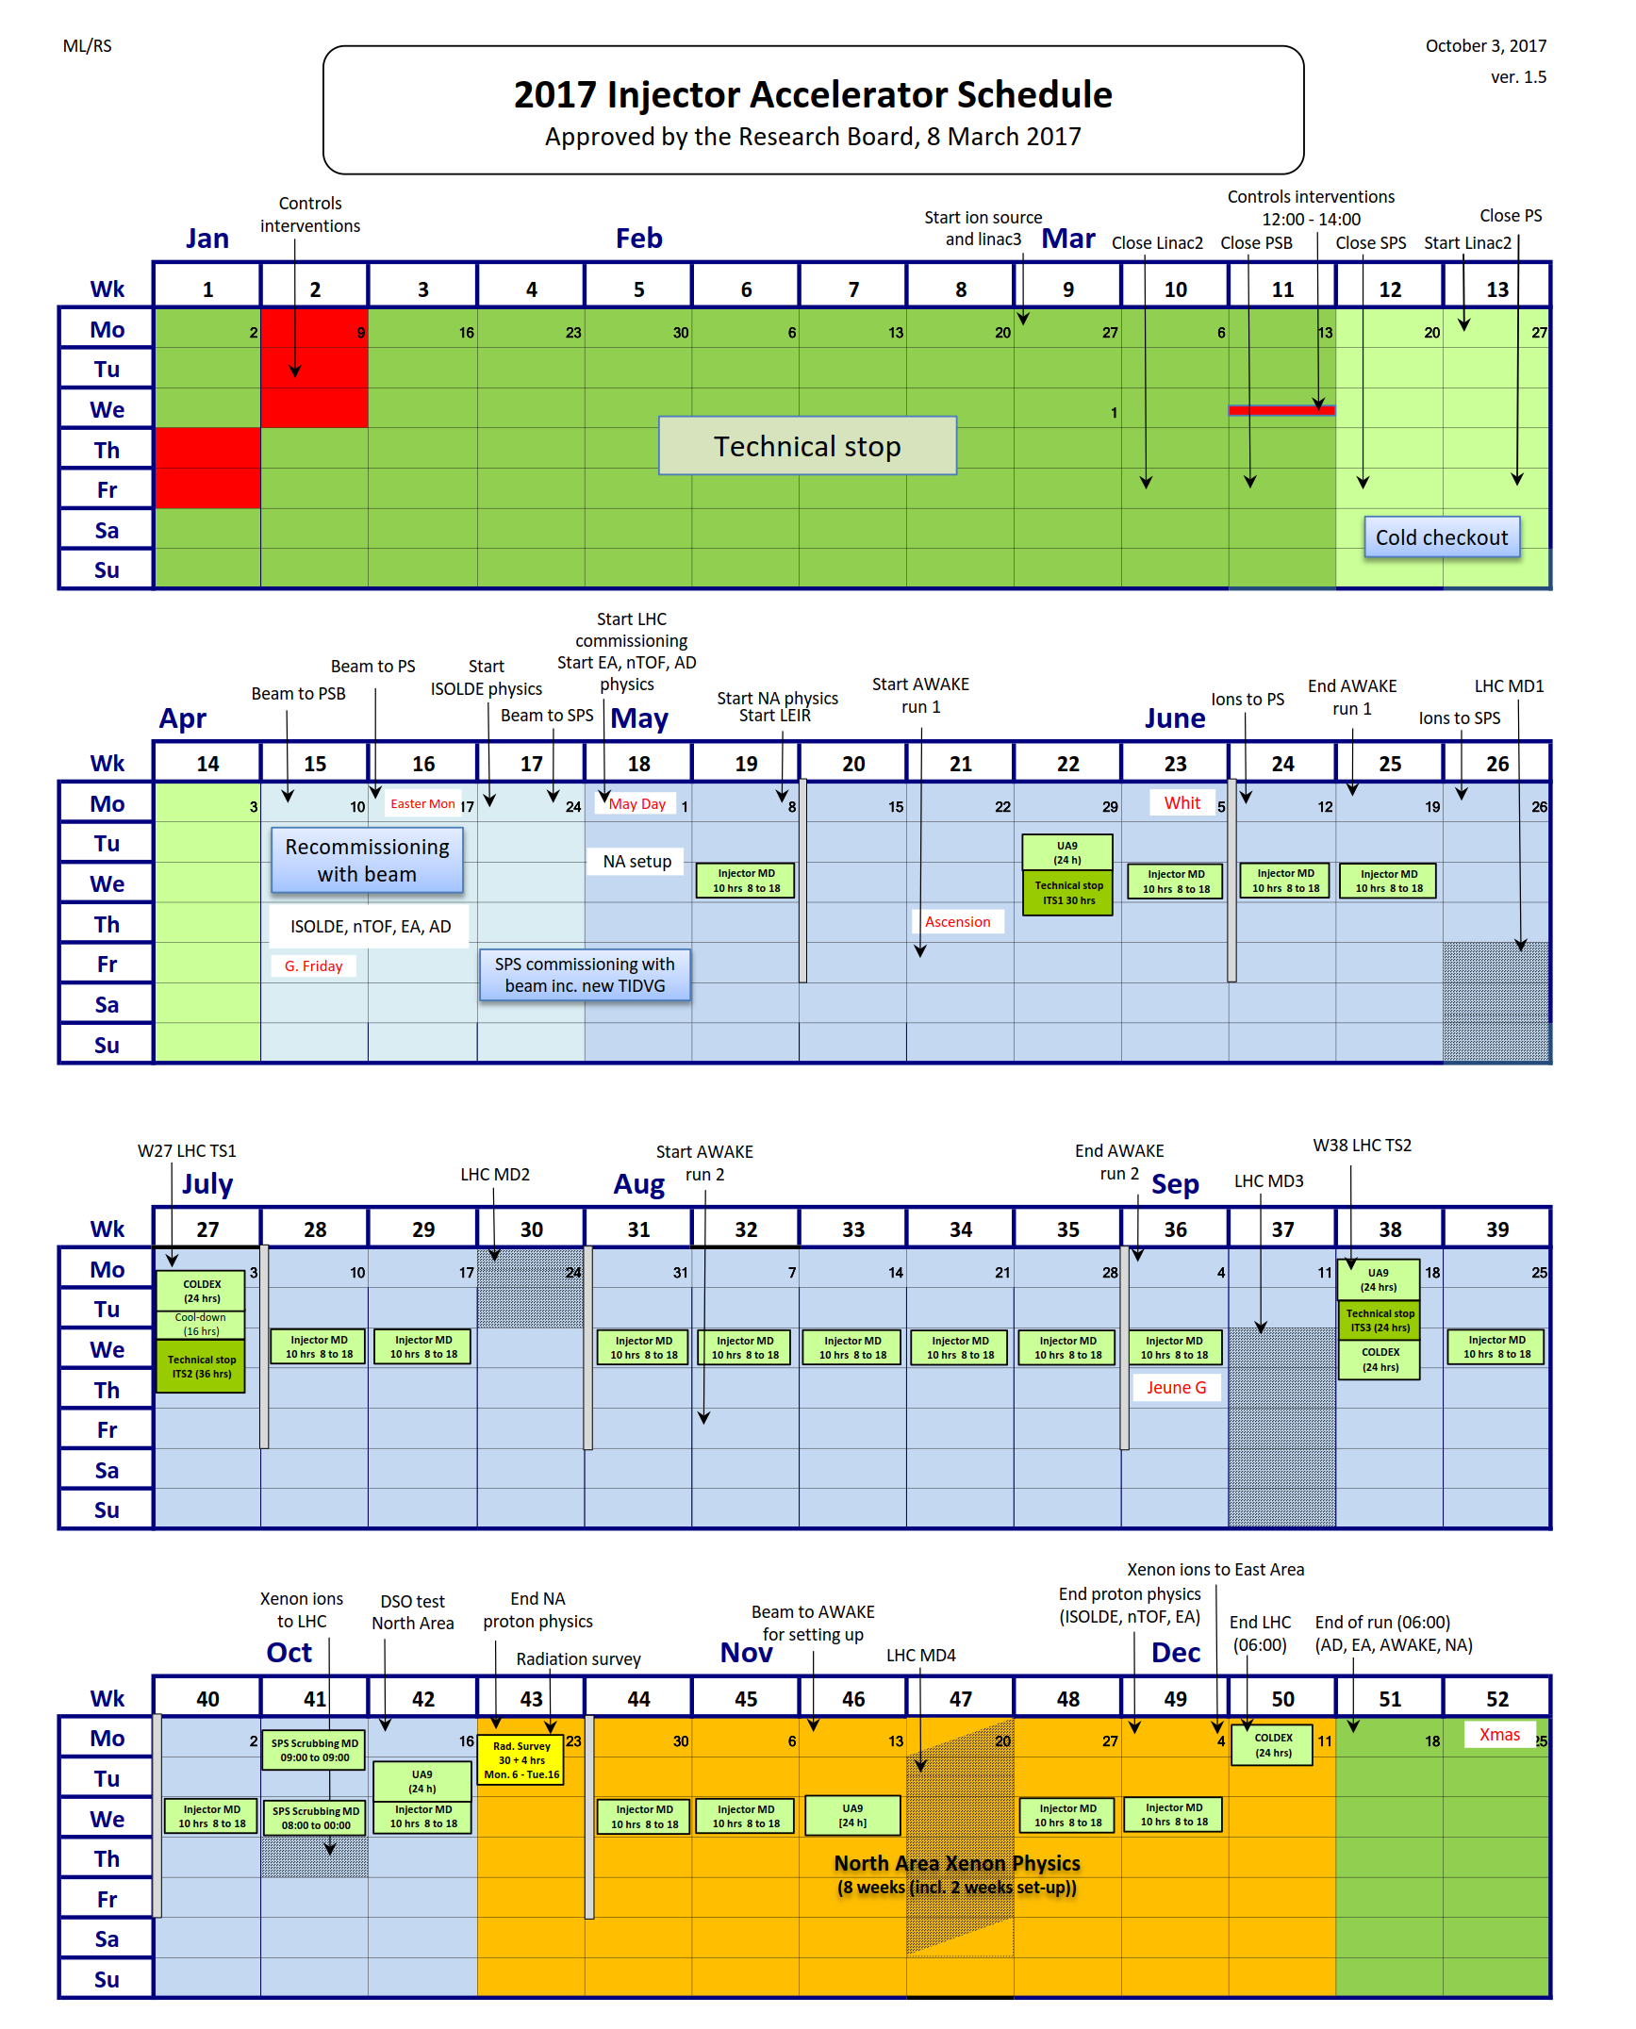
Protons to ISOLDE for physics since week 17
Original end of protons was week 47 (Nov 20th)
Negotiated extension of two extra weeks
224 days of physics: currently on day 197

Slide 3
900 HIE-shifts!

Slide 4
Row Labels | Sum of Requested shifts (summary)
Biophysics | 8
COLLAPS | 25
Collection | 7
CRIS | 50.5
GANDALPH | 9
HIE | 583
IDS | 49.001
ISOLTRAP | 41
LA1 | 22
Medical | 10.5
NICOLE | 8
SSP | 88
TISD | 17
VITO | 18
Windmill | 16
(blank) | 41
Grand Total | 993.001
49 HIE-ISOLDE Experiments; 27 requested beam in 2017

Slide 5






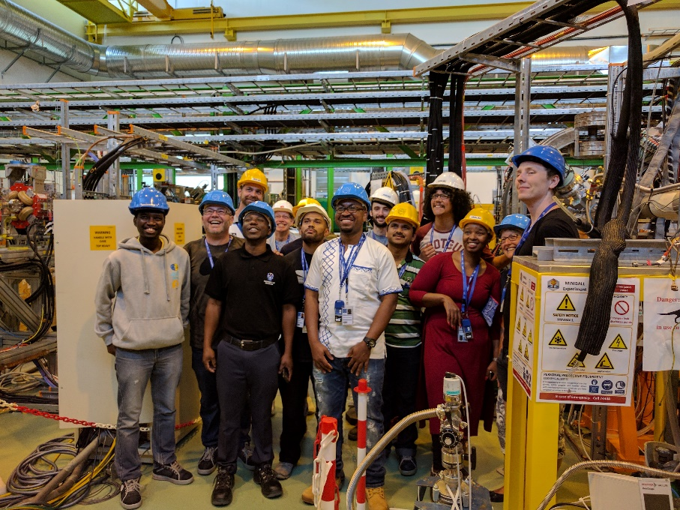








ISOLDE Schedule 2017: weeks 16 - 48
XT03
XT03
(Windmill)
Re-used target: leaking
Se beams…
Ge beams…
Had to re-use#513…
TISD/Dy week
Incorrect ion source proton stop difficult setup: machine+experiment
We are here…
VADIS + VADLIS mode
Low/no yields; HRS problems
Target change
CERN holiday
Setting up/proton scan/yield
Physics GPS
Physics HRS
KJ: 06.10.17

Slide 6
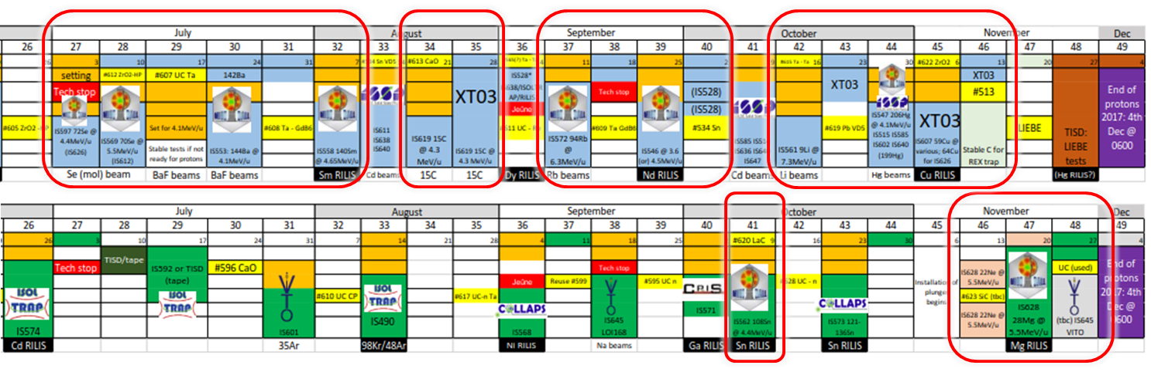
12 HIE ISOLDE experiments
9 at Miniball : 8 Coulomb excitation; 1 multi-nucleon transfer; 3 at XT03
→ Still to come: 59Cu (this week) and 28Mg (plunger)
Coulomb excitation
108Sn
IS562
140Nd; 142Sm
IS546
140Sm
IS558
144Ba; 142Ba
IS553
206Hg
IS547
70Se
IS569
72Se
IS597
94Rb
IS572
Experiment # | IS597 | IS659 | IS553 | IS558 | IS619 | IS572 | IS546 | IS562 | IS561 | IS547 | IS607 | IS628
Isotopes | 72Se19+ | 66Ge16+, 70Se17+ | 142Ba33+, 144Ba33+ | 140Sm34+ | 15C5+ | 94Rb23+ | 140Nd33+, 142Sm33+ | 108Sn26+ | 9Li3+ | 206Hg46+ | 59Cu20+ | 28Mg9+
Energies [MeV/u] | 4.4 | 4.4 | 3.4, 4.2 | 4.65 | 4.35 | 6.21 | 4.62 | 4.5 | 8.04 | 4.19 | 3.6, 4.0, 4.3, 4.7, 5.0, 5.3 | 5.5
Target | GPS | GPS | GPS | GPS | GPS | GPS | GPS | HRS | GPS | GPS | GPS | HRS
HEBT | XT01 | XT01 | XT01 | XT01 | XT03 | XT01 | XT01 | XT01 | XT03 | XT01 | XT03 | XT01
Target installation | Fri - AM | Wed - AM | Tue - PM | Mon - AM (-1) | Mon - AM | Mon - AM | Fri - AM | Tue - AM | Mon - AM | Fri - AM | Mon - PM
Ionization | Molecular | Molecular | Molecular | RILIS | Molecular | Surface | RILIS | RILIS | RILIS Tried | RILIS | RILIS | RILIS
RIB ready |  |  |  |  | Thu - 14:30 |  |  |  | Thu - 23:50
RIB first delivery | Fri - 23:00 | Thu - 19:45 | Thu - 18:40 | Tue - 18:00 | Sat - 17:00 | Wed - 17:30 | Wed - 17:15 | Thu - 20:00 | Sat - 00:45 | Thu - 21:40
 | 2017/07/07 | 2017/07/13 | 2017/07/20 | 2017/08/08 | 2017/08/26 | 2017/09/13 | 2017/09/27 | 2017/10/12 | 2017/10/21 | 2017/11/02
Scattering Chamber
15C beams to XT03
IS619
9Li
IS561
(Thanks for Jose Alberto Rodriguez)

Slide 7

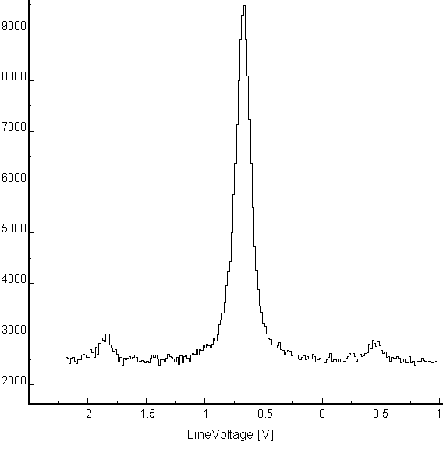
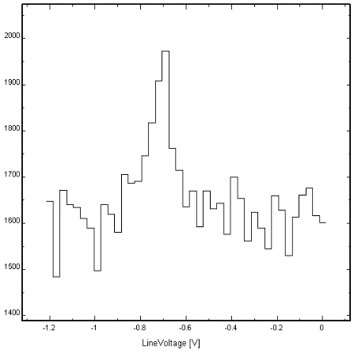
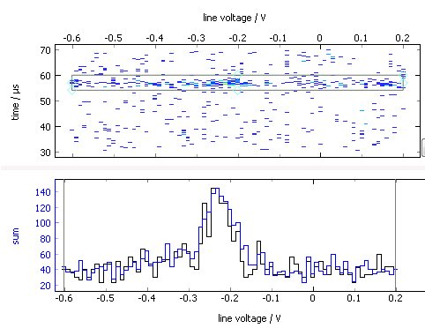
The year 2017 for
Laser spectroscopy of Sn across N = 82
Atomic transition complementary to the one used in 2016:
  Combining both gives firm μ, Q, radii
  Resolve weakly produced isomers
> 20 isotopes in 3 days!
  N = 57 up to N = 84
N = 82
^{128m+g}Sn
¹³⁴Sn
1h30
*
*
1h30
New data acquisition
Photon timing
wrt bunch extraction
Problems ☹
Unexpectedly low Al and Ni yields: key cases out of reach
Long ISOLDE set-up times despite (much appreciated!) efforts of technical teams
⁶⁸Ni
Projection
Line voltage (freq)

Slide 8

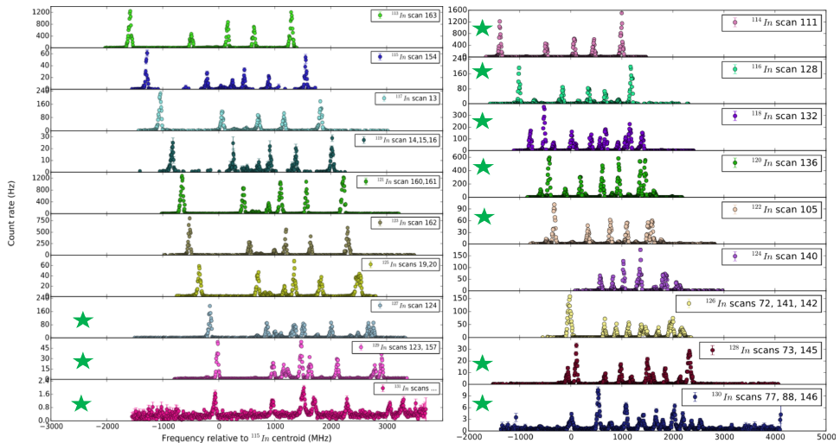
RESULTS CRIS Experiments on neutron-rich In
From ¹¹³In up to ¹³¹In
( New results )

Slide 9
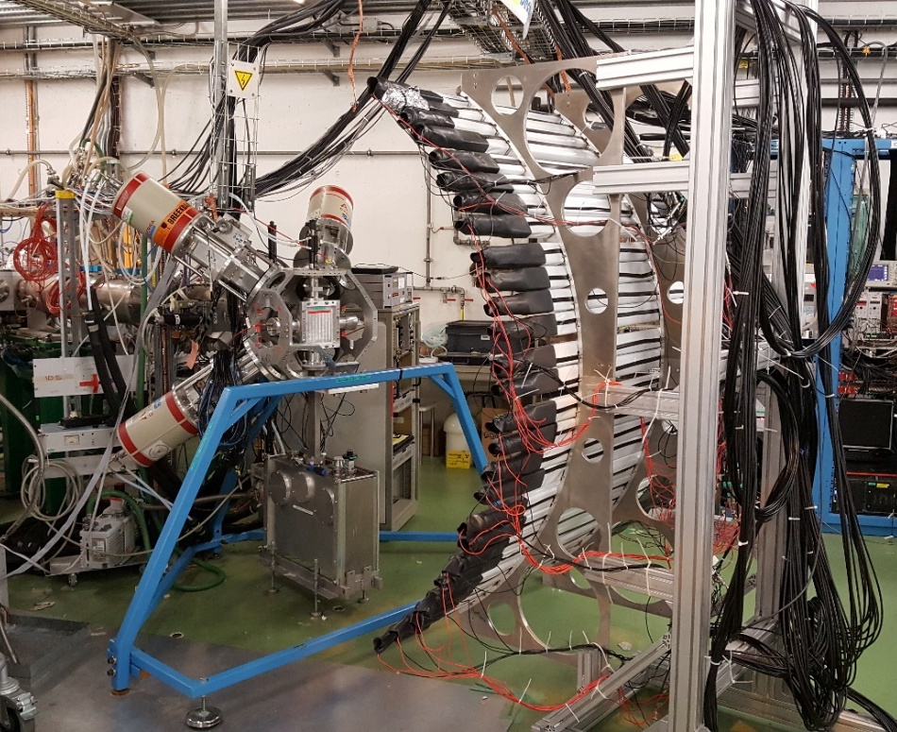
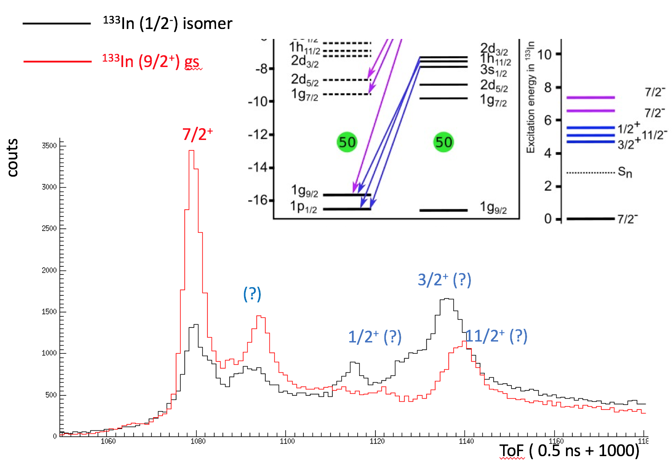
IS632 at IDS: Neutron unbound single particle states in ¹³³Sn from the beta decay of ¹³³In
The IDS Neutron Detector and HPGe Clovers were used
ToF calibrations with ¹⁷N from the HRS CaO target.
Production of ¹³³In ~ 900 ions/uC (~70% transmission from GPS)
Using RILIS, both isomer and gs in ¹³³In were selectively ionized
Clear resonances were observed, to be clarified in the offline analysis using neutron-gamma coincidences

Slide 10
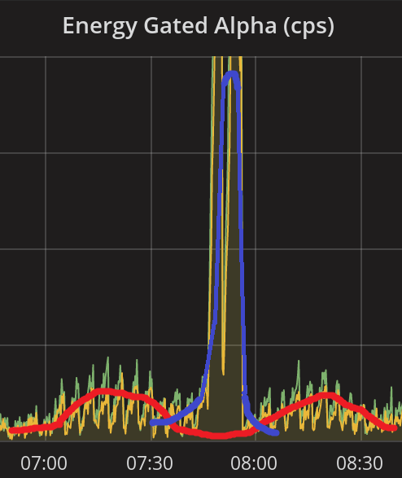
IS608-II, Laser spectroscopy of Bi isotopes a GPS (21-26 June 2017)
Windmill-IDS-RILIS Collaboration
First collaboration between Windmill and IDS teams
Demonstrated unique power of IDS for HFS studies
188m1,193,193m,195,195m,197,197m,200m2,203m,214,214m,215,215mBi were measured (many new results!)
Issue 1: the target could not deliver ²¹⁶⁻²¹⁸Bi (which were ‘easily’ produced in IS608 in 2016)
Issue 2: Mass-contaminating tails at many masses of interest due to abundantly-produced Fr’s, need to preferentially use HRS for this region
Decay pattern and T_{1/2} for IS measured for the 1st time, identifies new band in ²¹⁴Po
^{214m}Bi
(8⁺)
^{214g}Bi
(0,1)
Q(β)=3270 keV
β⁻
8⁺
An example: Direct identification and spectroscopy
of high-spin isomer in ²¹⁴Bi (including HFS/isomer shift measurements, spin…)
First identification of high spin states)
6⁺
Many low spin states(0,1,2)
4⁺
²¹⁴Bi^{g} hfs (new)
2⁺
0⁺
α
²¹⁴Po
²¹⁴Bi^{m} hfs (new)
Overall, a successful run, due to very strong sensitivity of IDS to long-lived, β-decaying isotopes

Slide 11
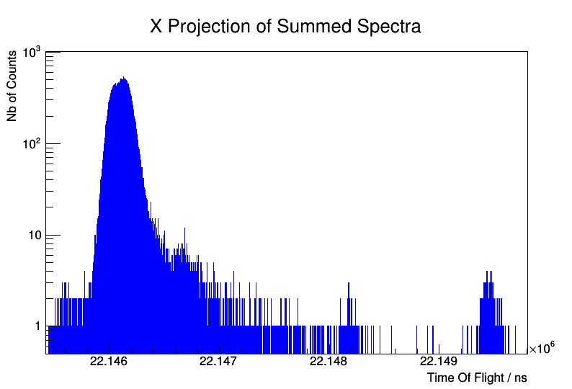
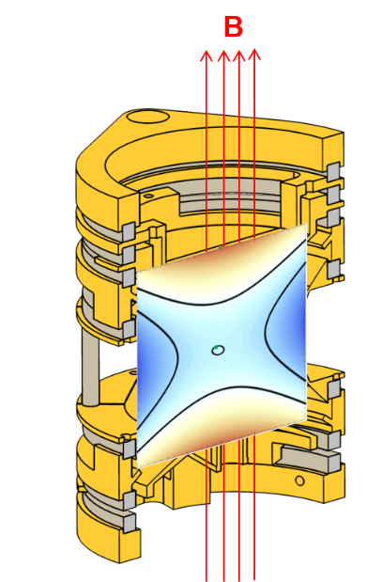
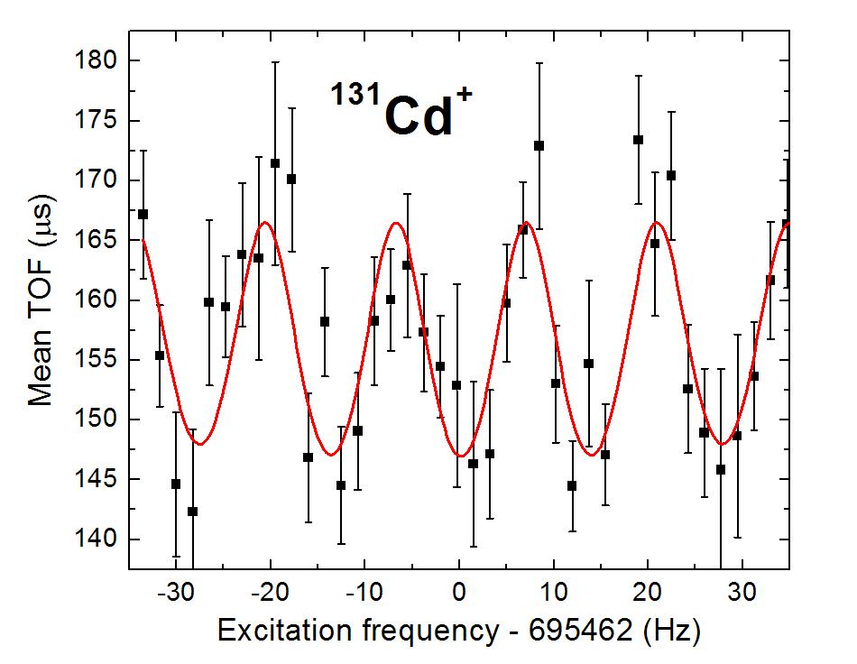
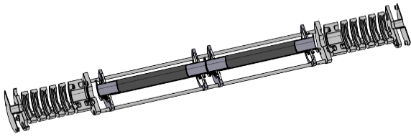
Precision mass spectrometry of ^{131,132}Cd
June 2017 – UC_{x}-converter + quartz + RILIS: high-quality cadmium beams.
¹³²Ba^{+/132}Cs⁺
¹³²Cd⁺
MR-TOF MS
Precision
Penning trap
c
Penning trap confirms and improves the MR-TOF mass of ¹³¹Cd from 2014.
MR-TOF MS allows first mass measurement of ¹³²Cd.

Slide 12
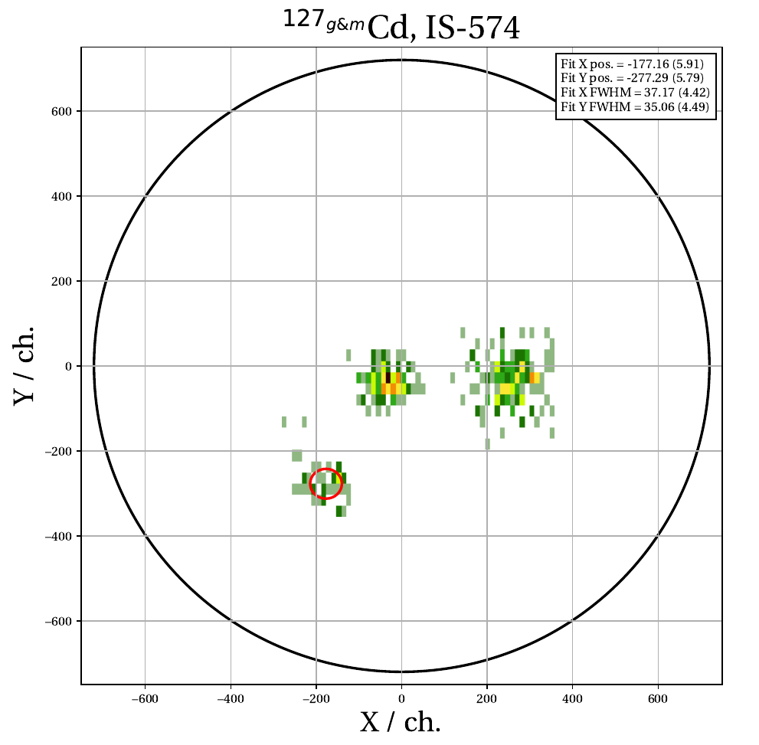
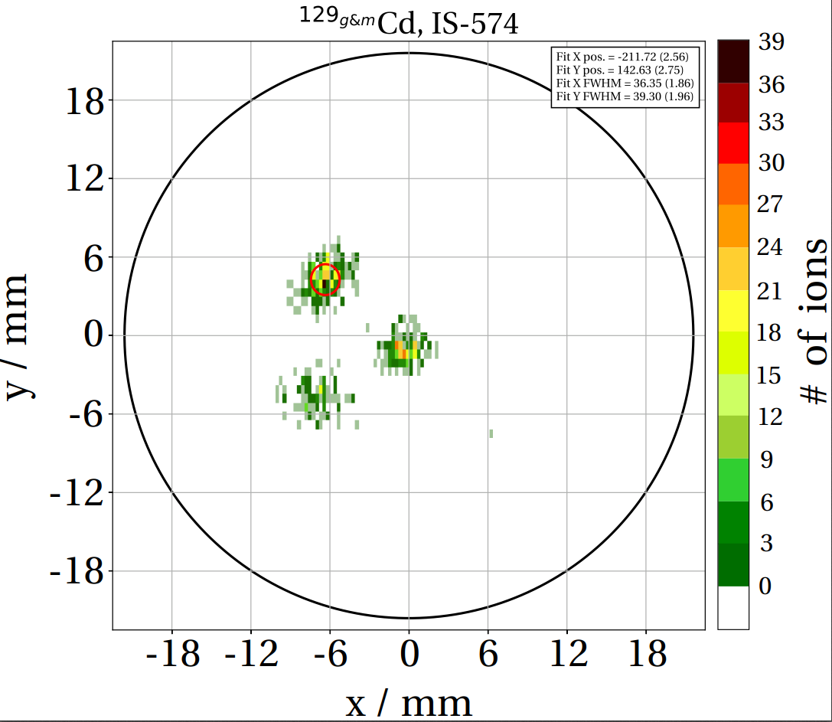
Isomer separation in ^{127,129}Cd with PI-ICR
The PI-ICR technique allowed fast and optimal separation of the isomeric states in the odd-A cadmium isotopes.
¹²⁷Cd⁺
¹²⁹Cd⁺
Trap center
High spin
Trap center
Low spin
Measurement time
209 ms
Measurement time
106 ms
J. Karthein, master thesis 2017.

Slide 13
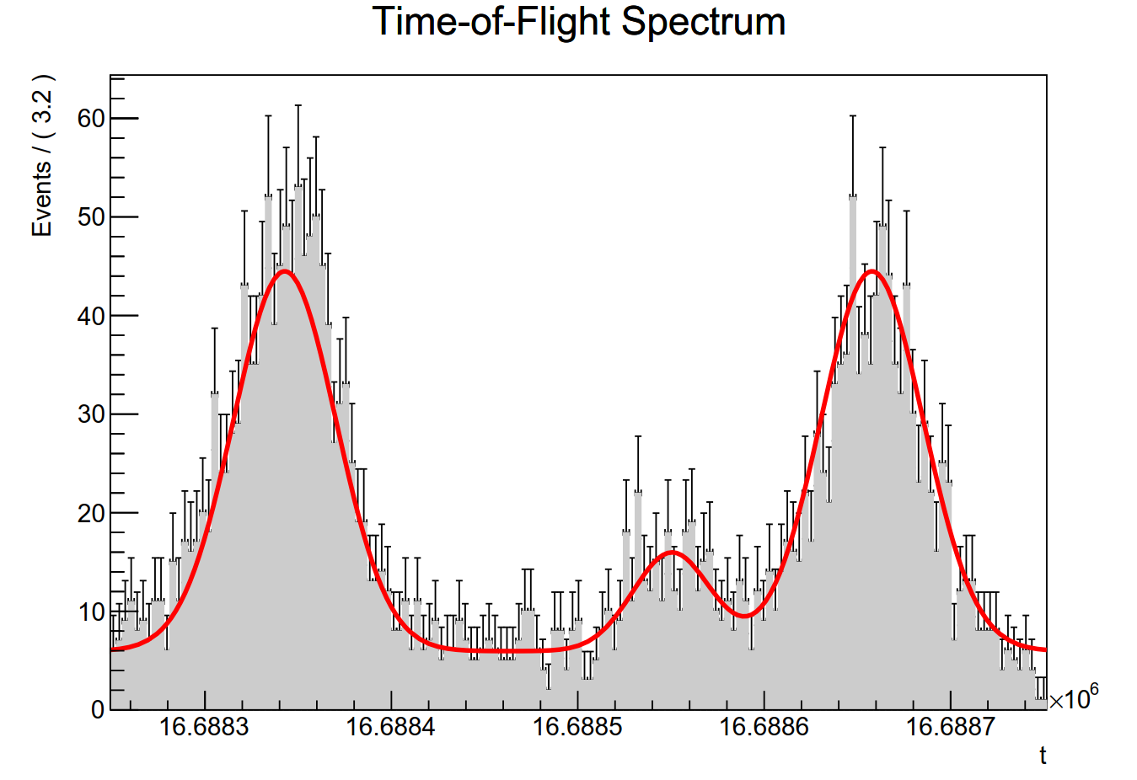
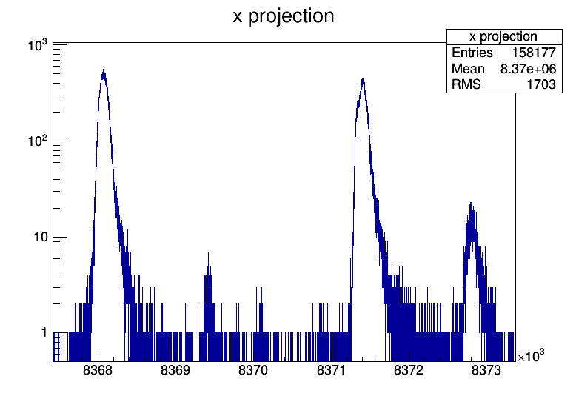
MR-TOF mass measurements of ⁴⁸Ar and ⁹⁸Kr
August 2017 – UC_{x} with cold plasma: a challenge for the MR-TOF MS sensitivity
MR-TOF MS
c
⁴⁸Ar⁺
⁹⁸Mo⁺
¹⁹⁶Hg²⁺
Strength of the N = 28 shell closure
⁹⁸Kr⁺
Onset of deformation in the A≈100 region

Slide 14
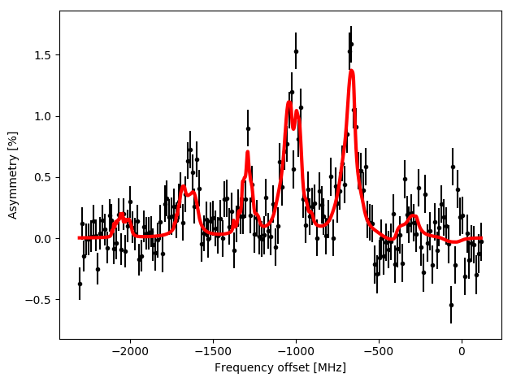
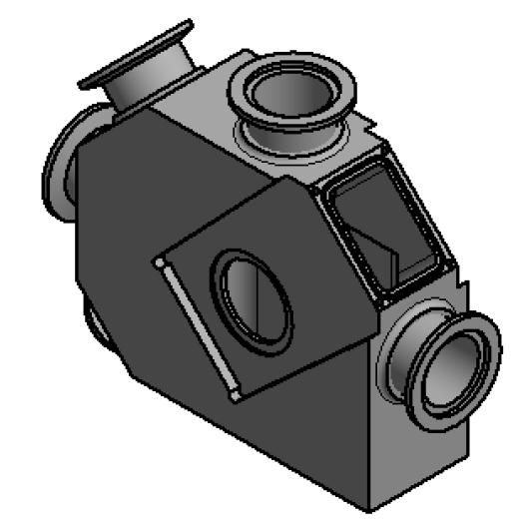
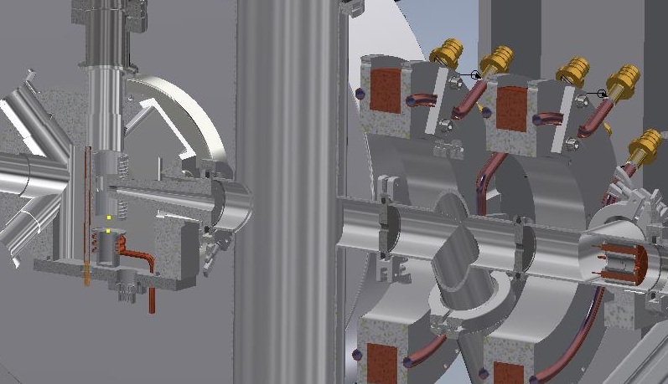
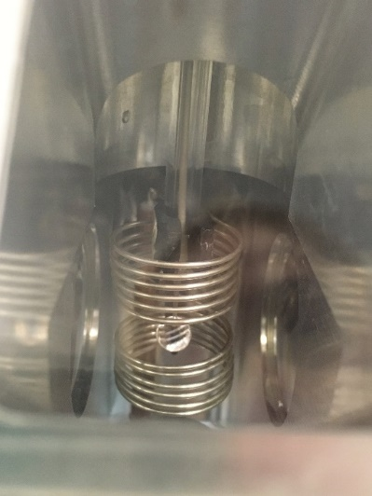
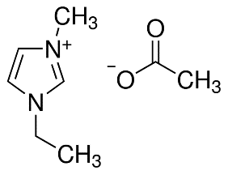
VITO
IS601
Since last meeting:
2 beamtimes with 35Ar – looking for implantation host for β-asymmetry studies:
1st use of multiple laser pumping
1 beamtime on liquid β-NMR (2nd in December):
Compact β-detectors with Si PMTs (U Tennessee)
New liquid b-NMR chamber, differential pumping and transitional field system
Liquid handling system
1st NMR signal at VITO!
IS645
Thanks to Magda Kowalska

Slide 15

IS634: Fluence dependence of interstitial ²⁷Mg in GaN
Complex balance of interstitial vs substitutional Mg as function of temperature, doping type and implanted fluence
reason: amphoteric character of Mg and its interaction with Ga vacancies
Mg_{i} + V_{Ga} → Mg_{Ga}
Impact: prospects for more efficient p-type doping of GaN
(high-power electronics, optoelectronics…)
Also extremely successful Mn beamtime..follow-up proposal at tomorrow’s INTC
Continuing our work initiated in
Phys. Rev. Lett. 118, 095501(2017)

Slide 16
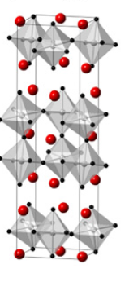
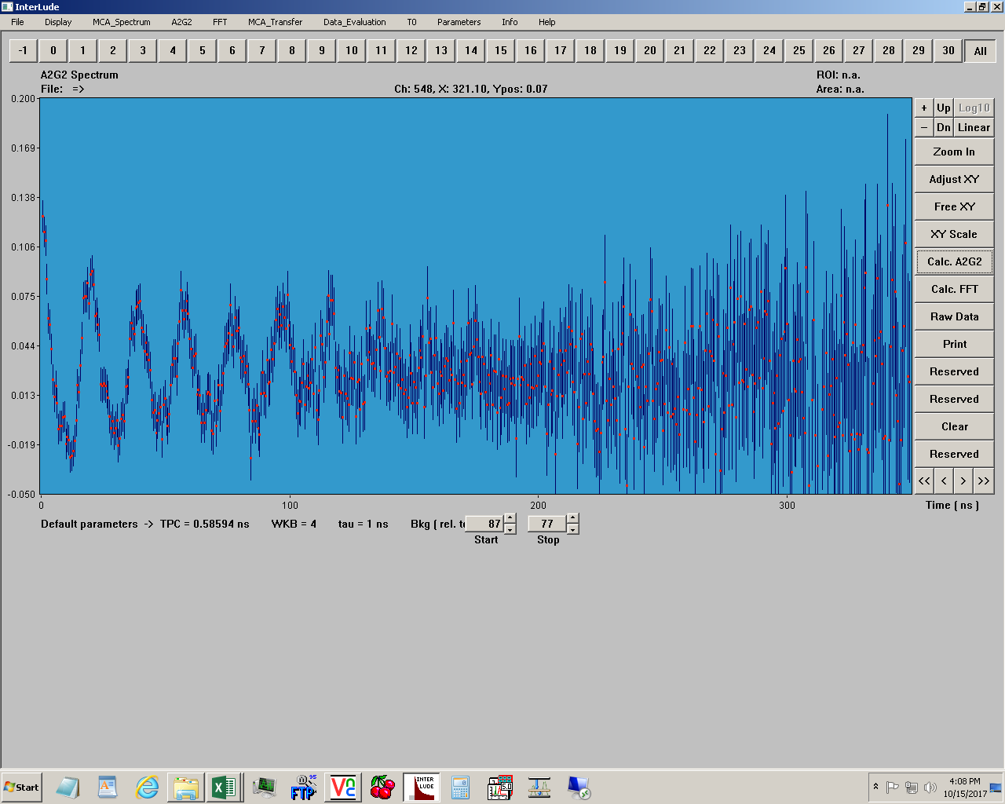
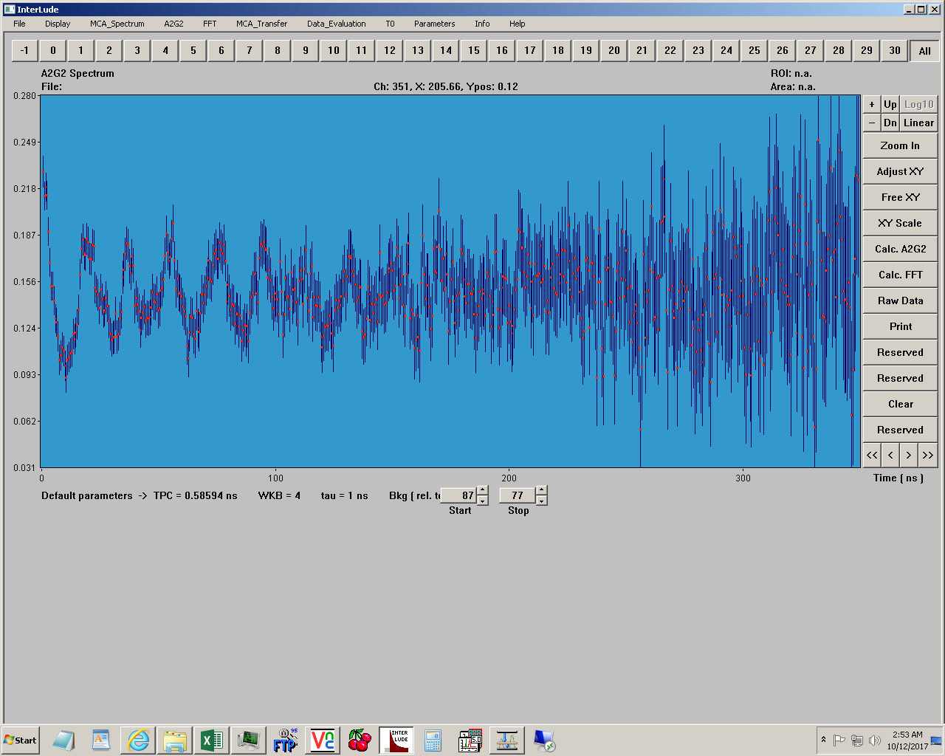
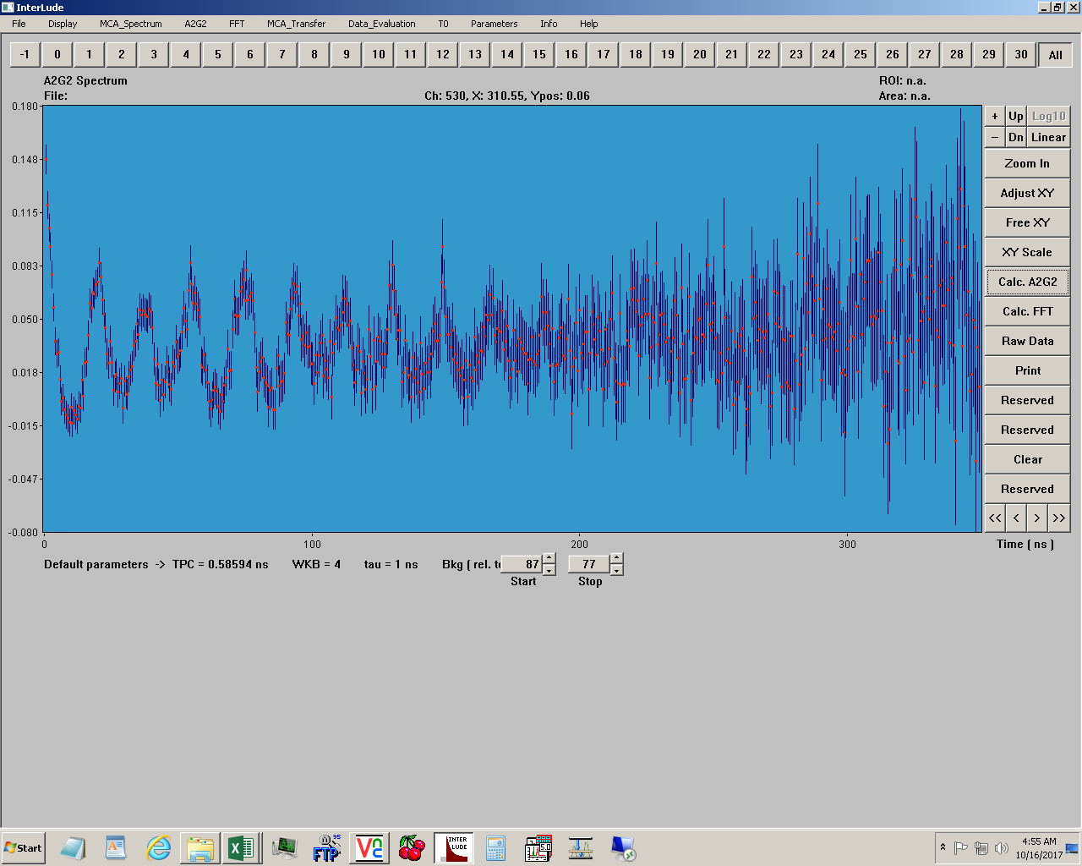
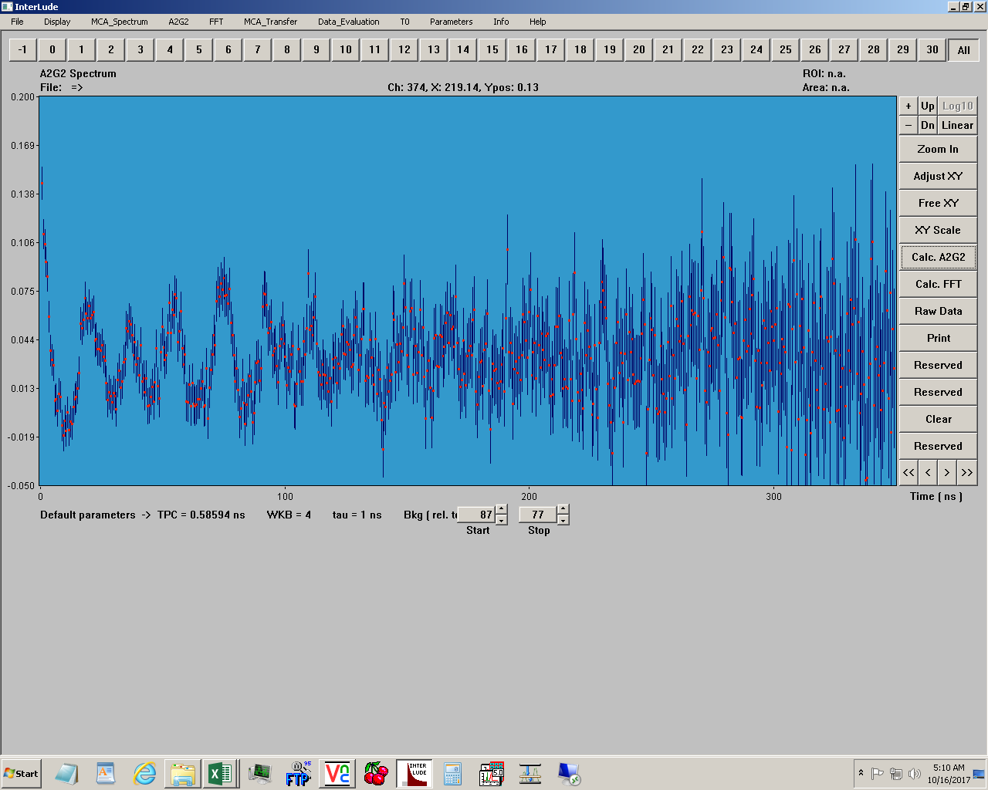
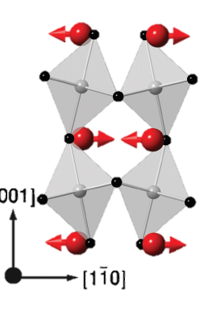
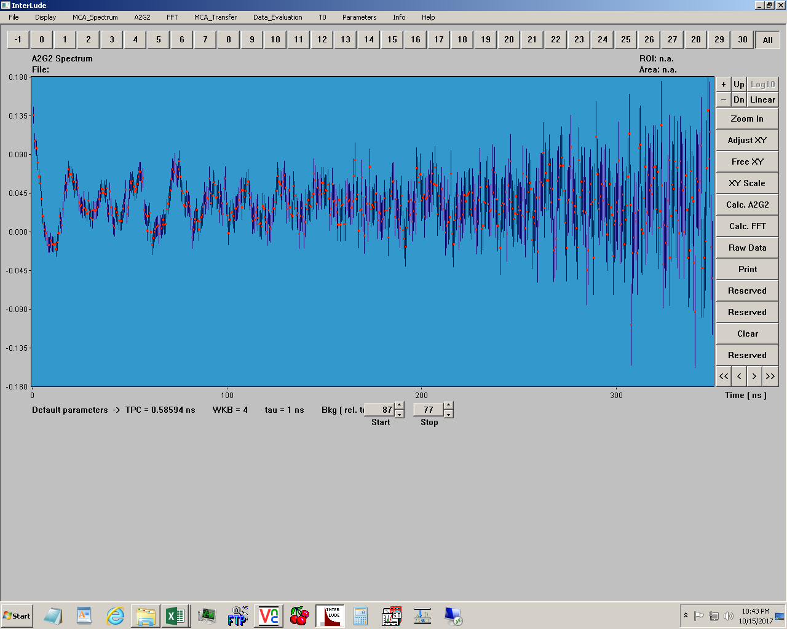
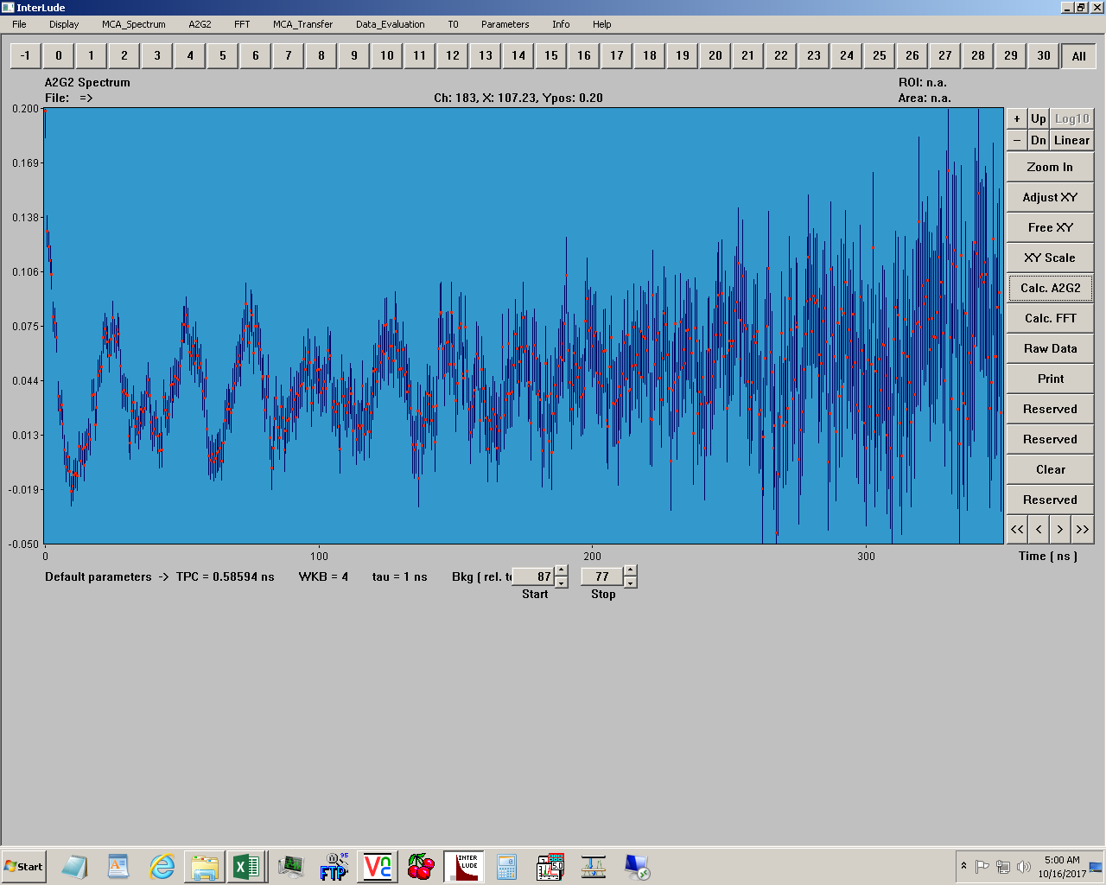
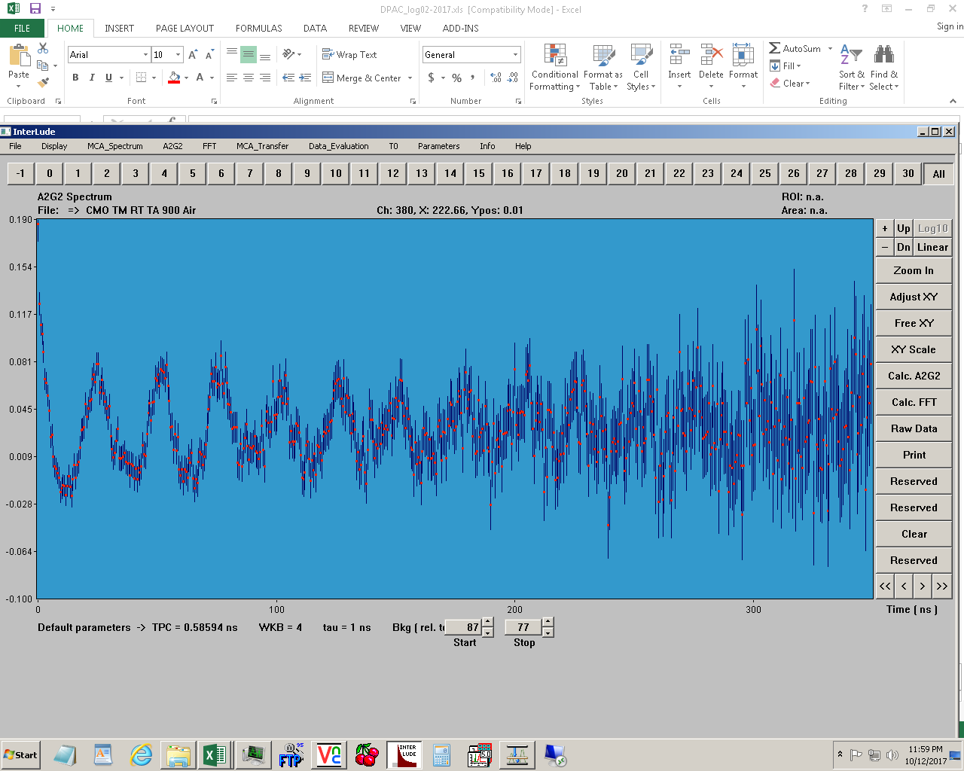
Perturbed Angular Correlation measurements
PAC measurements were performed successfully for the Ca₃Mn₂O₇ in CERN-ISOLDE by beam implantation of ^{111m}Cd run 10/2017.
111Cd beam
424 K
Orthorhombic
Cmca – non polar
400 K
freeezing of the MnO₆ octahedral tilting and
Ca²⁺ displacement phonon modes
380 K
PAC allows us to probe the local atomic environment behind Hybrid Improper Ferroelectricity
- the coupling of the
MnO₆ octahedral rotation
and the
polar displacement of the Ca²⁺ ion’s
368 K
358 K
330 K
300 K
Orthorhombic
Cmc2₁ ₋ polar

Slide 17
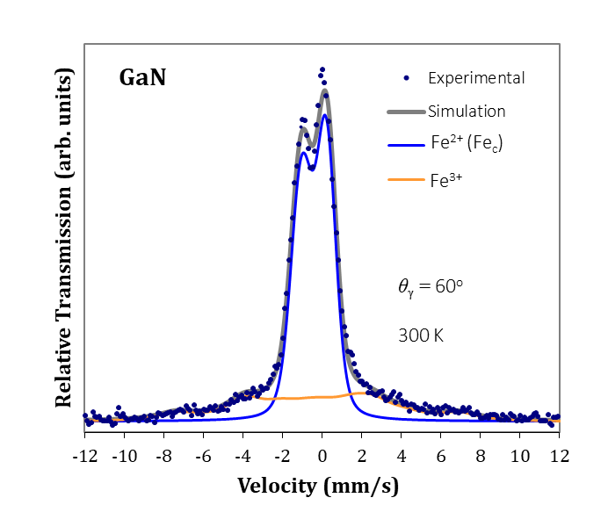
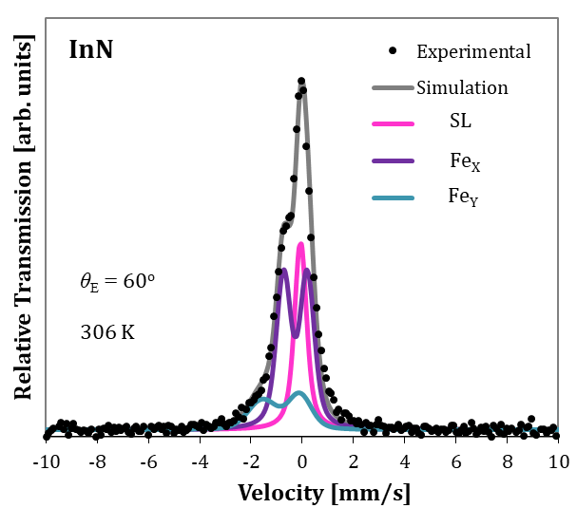

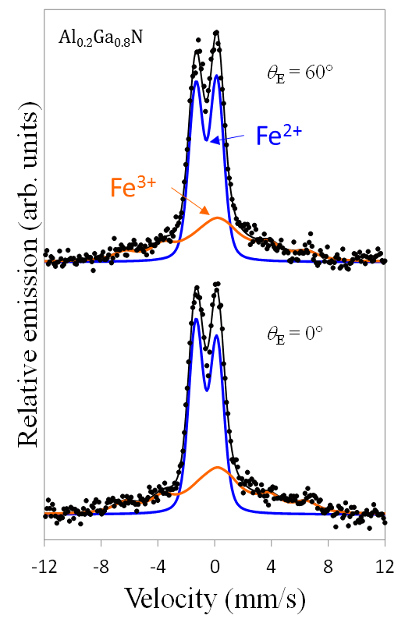
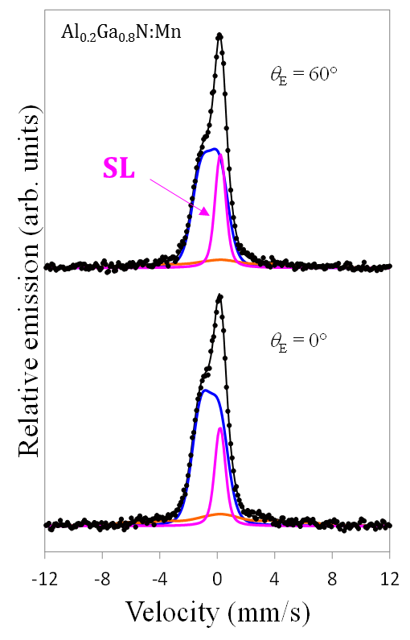
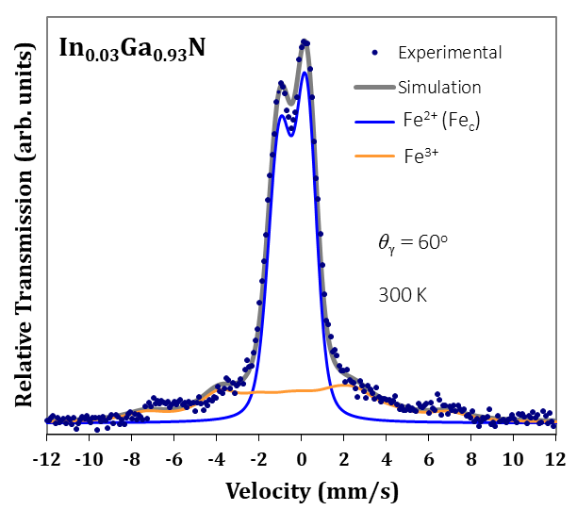
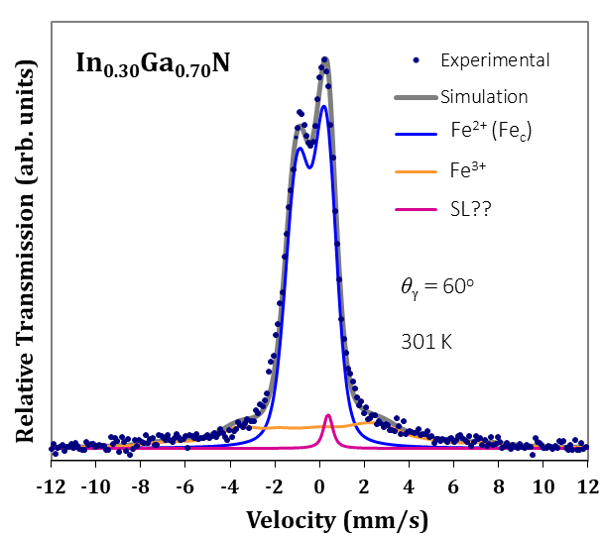

....but single line (SL)…
→ Fe⁴⁺ as in Mn doped Al_{x}Ga_{1-x}N
p-type doping without Mn incorporation?
InN and GaN → In_{x}Ga_{1-x}N
No magnetic feature, no Fe³⁺
...development SL as a function of x
When doped with Mn
eMS June 2017 – preliminary analysis [IS630]
SL
..doping with Mn results in acceptors that make the Fe⁴⁺ state stable
→p-type
Decrease in Fe³⁺ with increasing x
Development of a SL?? – possibility of p-type doping without Mn
…data analysis of temperature series underway
InN
- Fe_{X}
- Fe_{Y}
Concentration of Fe³⁺ decreases, New Single Line?? δ_{RT} ~ -0.25 mm/s
…further measurement on higher In concentration planned for 2018

Slide 18
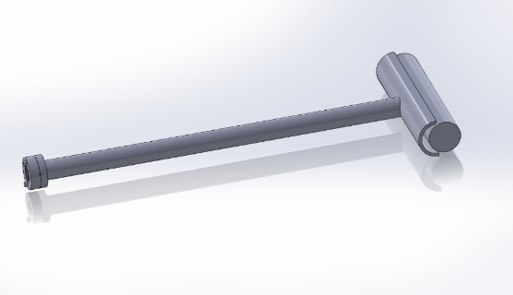
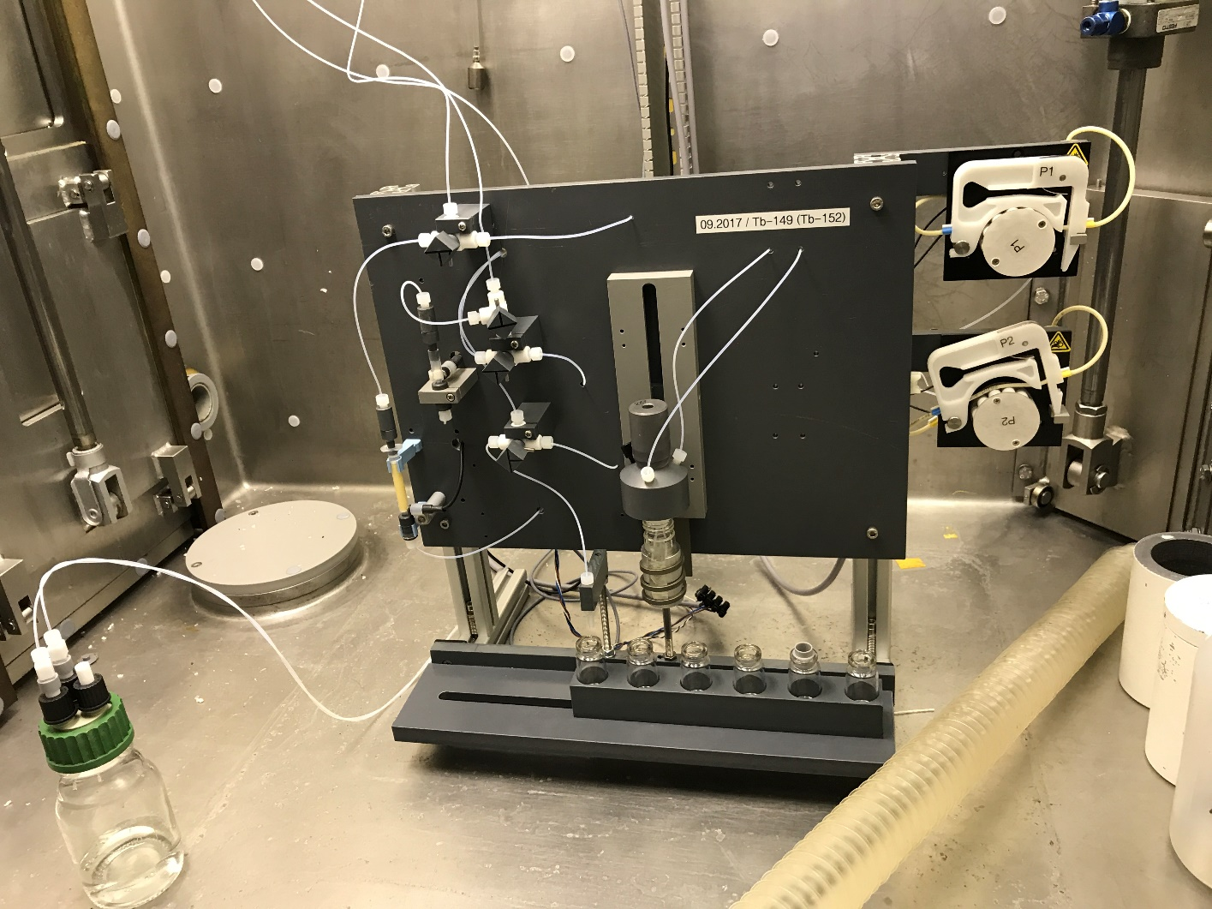
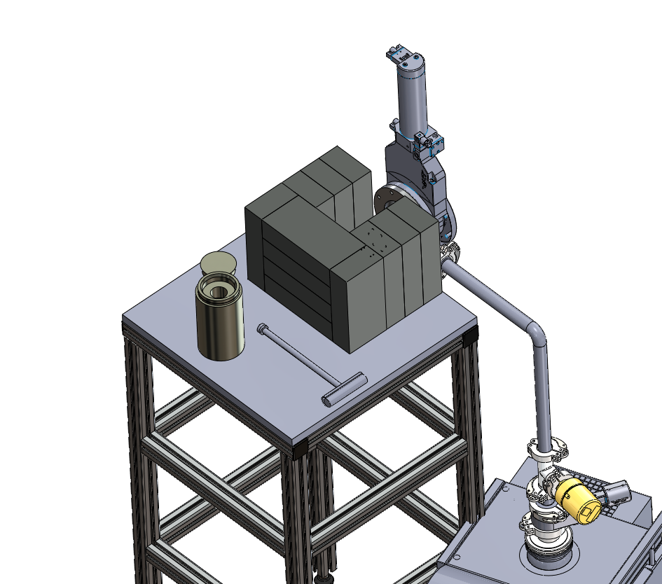
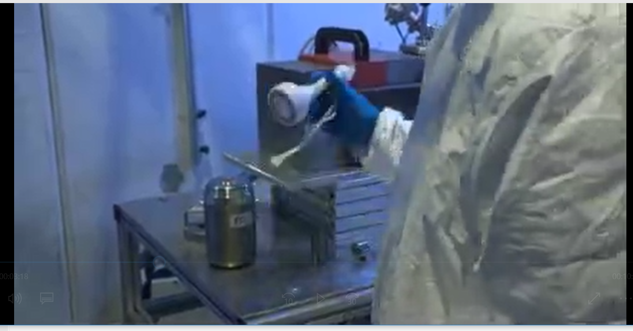
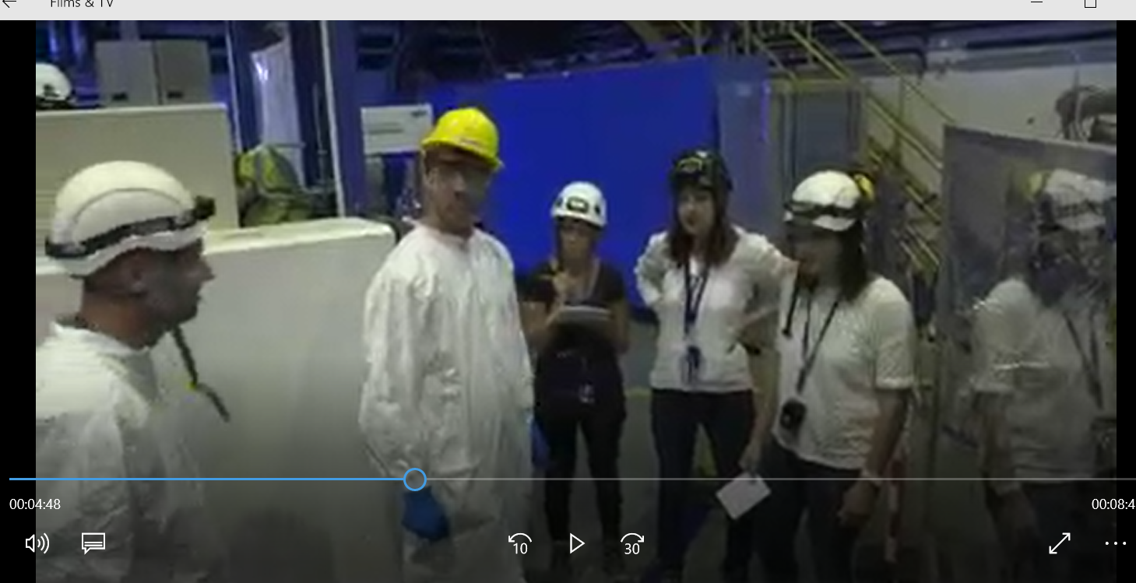
IS528: new collection chamber and separation system

Slide 19
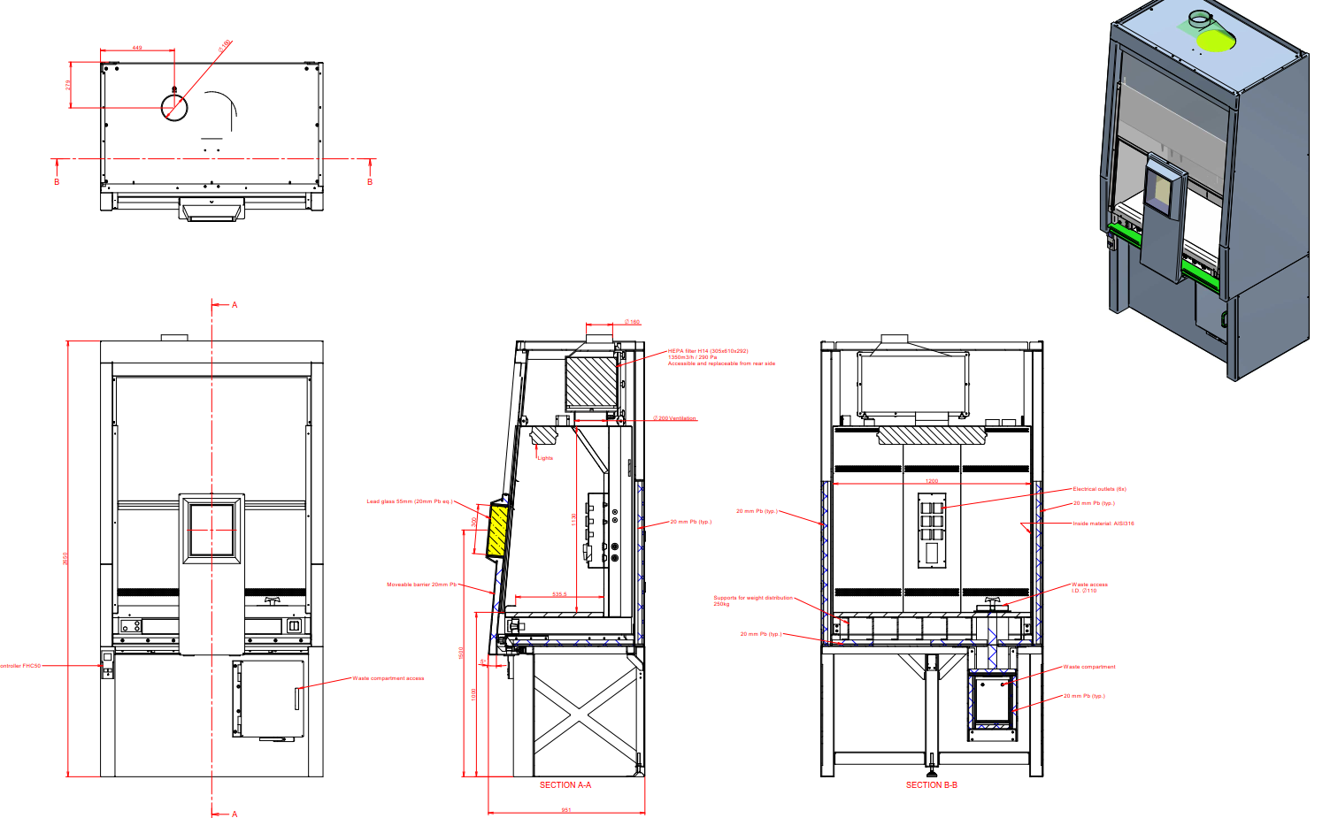
Ergonomy around GLM/GHM area
New working group to optimise the space. New shielded fume cupboard ordered (paid by EP)

Slide 20
⁷²Se Coulomb Excitation (IS597)
¹⁹⁶Pt
“Quasi-online” spectrum
⁷²Se + ⁶⁸Ge
¹⁹⁶Pt
⁷²Se
³⁸Ar, ¹⁹F
⁶⁸Ge
~5% of requested ⁷²Se delivered to Miniball but some evidence that we observe the critical transition from the excited 0⁺ state.
1st information about coexisting shapes
Analysis still preliminary
Notes:
- About 5% of the expected yield of 72Se delivered to Miniball. Physics goals (obviously) not met BUT there is some evidence that we populate the key excited 0+ state which, when analysed, will reveal the first direct information about competing shapes in this nucleus. Theoretical calculations disagree about the nature of this state. However, this needs to be confirmed as the energy of this transition is low so tricky to untangle from the background.
The data are presently being investigated by Adam Kennington (Ph.D student at University of Surrey).
Used a VADIS ion source (molybdenum) rather than a FEBIAD (carbon) one.
One night shift + a few hours of stable running (but with much reduced beam intensity). After this no beam delivered.
Unexpected 68Ge contamination
Long half life of 72Se means that we do not have beta decay data from Miniball but we could estimate the beam intensity at Miniball from the Coulomb-excitation cross sections.

Slide 21
Beam and Target
1
Prior to us taking beam
First ~1 hour of running
End of the run (Tues 8am)
Beam intensity [pps]
2
3
Molecular extraction of ⁷²SeCO
Used a VADIS ion source (molybdenum) rather than a FEBIAD (carbon) one.

Slide 22
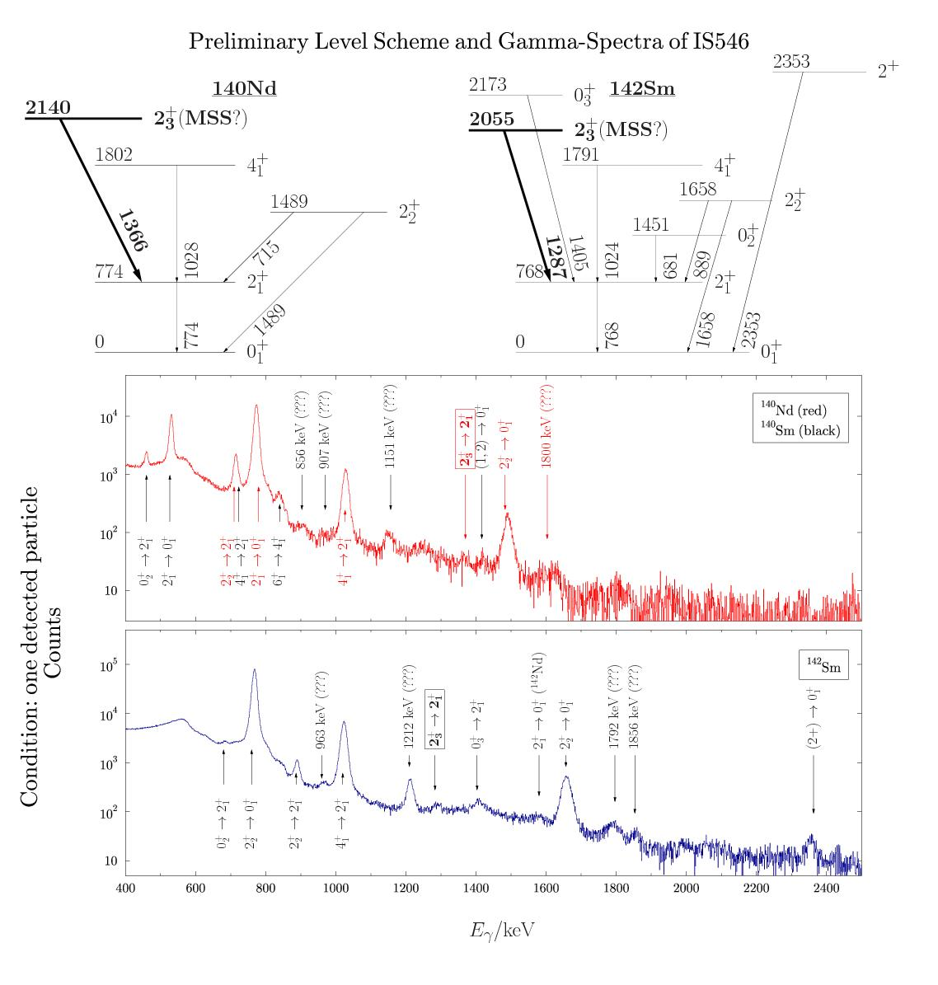
IS546
What is the predictive power?
QPM: single 2⁺ MSS of ¹⁴⁰Nd
SM: fragmented 2⁺ MSS of ¹⁴⁰Nd
Need to identify and quantitatively study MSSs of ¹⁴⁰Nd and ¹⁴²Sm

Slide 23
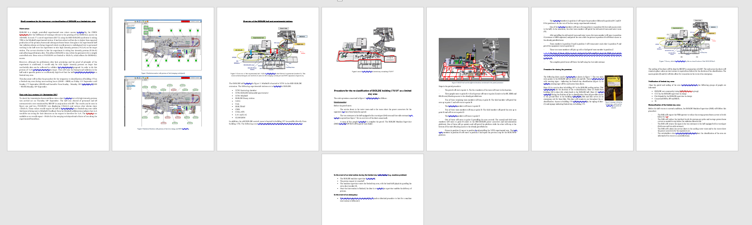
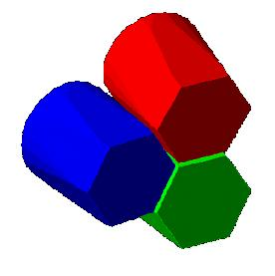


IS572 – Multi Nucleon Transfer Experiment @ MINIBALL
First MNT experiment with RIB.
Beam Intensity required 1.5 10⁷pps
First Exp. @ HIEISOLDE with:
  All cavities used (6.15 MeV/u)
  The RF pulse length of 1.6 ms.
Problems during the run:
Low beam intensity (> factor 10).
Some technical problems after the TechStop.
High instantaneous beam intensity.
Radiation problems in ISOHALL. We couldn’t run with high proton beam intensity. Some actions were carried out without any success.
Patrol procedure to be defined at upcoming CSAP
Targets used:
1 mg/cm² for cross-section normalization.
13 mg/cm² for statistic collection.
Since we will beusing high intensity and high cross-section. γ-γ, γ-p, γ-γ-γ, γ-γ-p, etc have been implemented in the DAQ.
⁹⁴Rb
6.15 MeV/u
Target ²⁰⁸Pb

Slide 24




IS572 – Multi Nucleon Transfer Experiment @ MINIBALL
Rb
Gate in 799 keV (²¹⁰Pb :2⁺ → 0⁺)
Rb-like
298 keV (²¹⁰Pb :4⁺ → 2⁺)
Pb
94Rb Coulex
²¹⁰Pb lines
94Sr Coulex
(contamination)
?
?

Slide 25




Slide 26





ISS: tests in week 49
Also, successful re-energising of the WISARD magnet to 9T… stable beams in 2018

Slide 28
HRS “underused”?
Little downtime compared to 2016: benefits of interleaving H/L ISOLDE
Few days without physics on either GPS or HRS

Slide 29


Slide 30
Safety and training etc
Required training for ISOHALL
Online:
Safety at CERN
RP supervised (changed since last year)
Basic electrical awareness
Hands-on:
Electrical awareness
RP hands-on → going to be linked in December
Every Tuesday @ 1300 – 1700), training centre Prevessin.
External trainer: Recent cancellations have been a problem. Meeting soon to discuss this.
2018
Beam requests sent out just after Christmas
Protons from ~ Easter/end of March
HIE ISOLDE from ~ end of June
4 cryomodules: transfer reactions
Continue with interleaving low and high…

Slide 31







Oct 16th 2017: 50 years of beams at ISOLDE
1975
"
H. Haas
„First results are described in the HMI-AR/1976. First conference contribution: HFI-IV in Madison (1977): ⁷⁹Kr/Zn,Cd,Sb.

Slide 32



Slide 33


